Slide 1
Analytics Training Guide
https://slcny.libguides.com/training-analytics

Slide 2

Advanced Search or Analytics?
Shared Library Services Platform Project
Jennifer Koerber

Slide 3

Agenda
What is Alma Analytics?
  About Alma Analytics
  Uses of Analytics Reports
“Do I Need Analytics?”
  Alma vs. Analytics
  Alma Menu Links
  Using Search

Slide 4
What is Alma Analytcs?

Slide 5
About Alma Analytics
Alma’s built-in data analysis & reporting tool
Accessed directly via Alma for both Alma and Primo VE
  Alma Analytics and Primo Analytics are two instances of the same platform
  Your personal folders (“My Folders”) are visible in both instances
Built on Oracle’s Business Intelligence (Enterprise Edition) platform
Use to compose analyses, run reports, and create dashboards for staff

Slide 6
Uses of Analytics
Individual work
  Data cleanup projects
  Collection management data
  Monitor trends in Discovery search
Create sets for jobs and tracking purposes
Share data with Alma users and non-Alma users
  As-needed reports
  Subscribed reports
  Dashboards
  Alma home page widgets
Export for offline reporting

Slide 7
Analytics Vocabulary
Analysis = the criteria and query used to run a report
Report = the output of an analysis
  Run-on-Demand Reports = available to run at any time
  Scheduled Reports = subscribe to receive them via email
Dashboard = a collection of reports

Slide 8
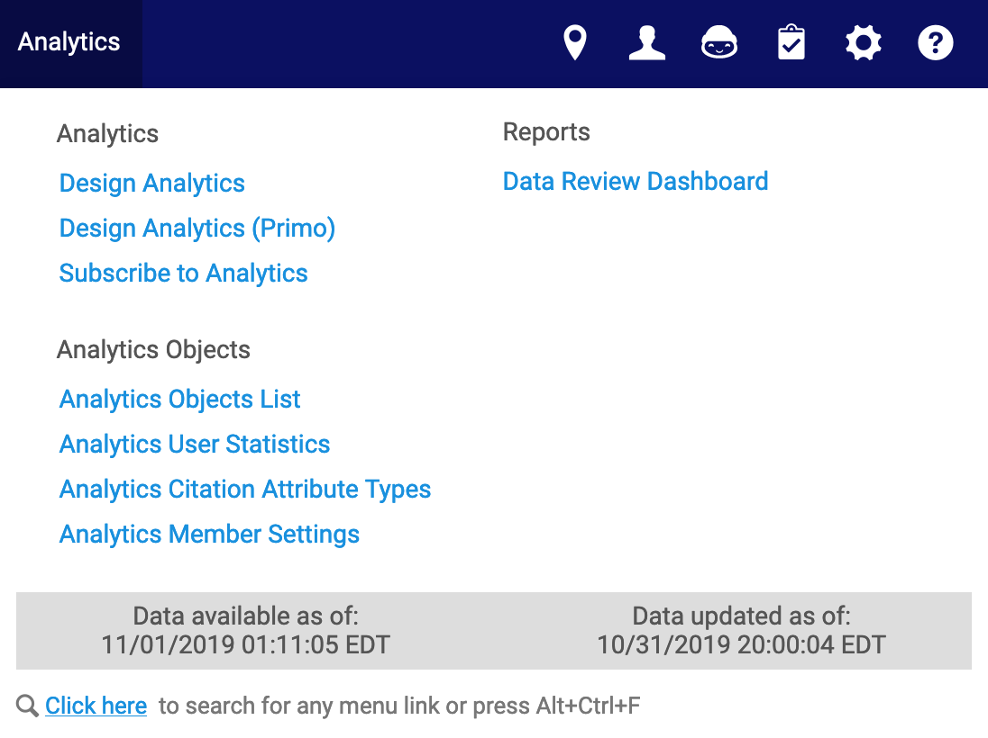
Navigating Alma Analytics
SUNY Polytechninc
Notes:
Let’s start by looking at the Analytics menu. Under this menu, you can:
Access Design Analytics to create analyses
Subscribe to Analytics that have been made available for subscription
Run any of the reports listed under the Reports menu as needed
At the bottom of the menu, you can view the status of the Alma data:
Data updated as of shows when data was last pulled from Alma
Data available as of is the time at which that data was made available in Analytics

Slide 9
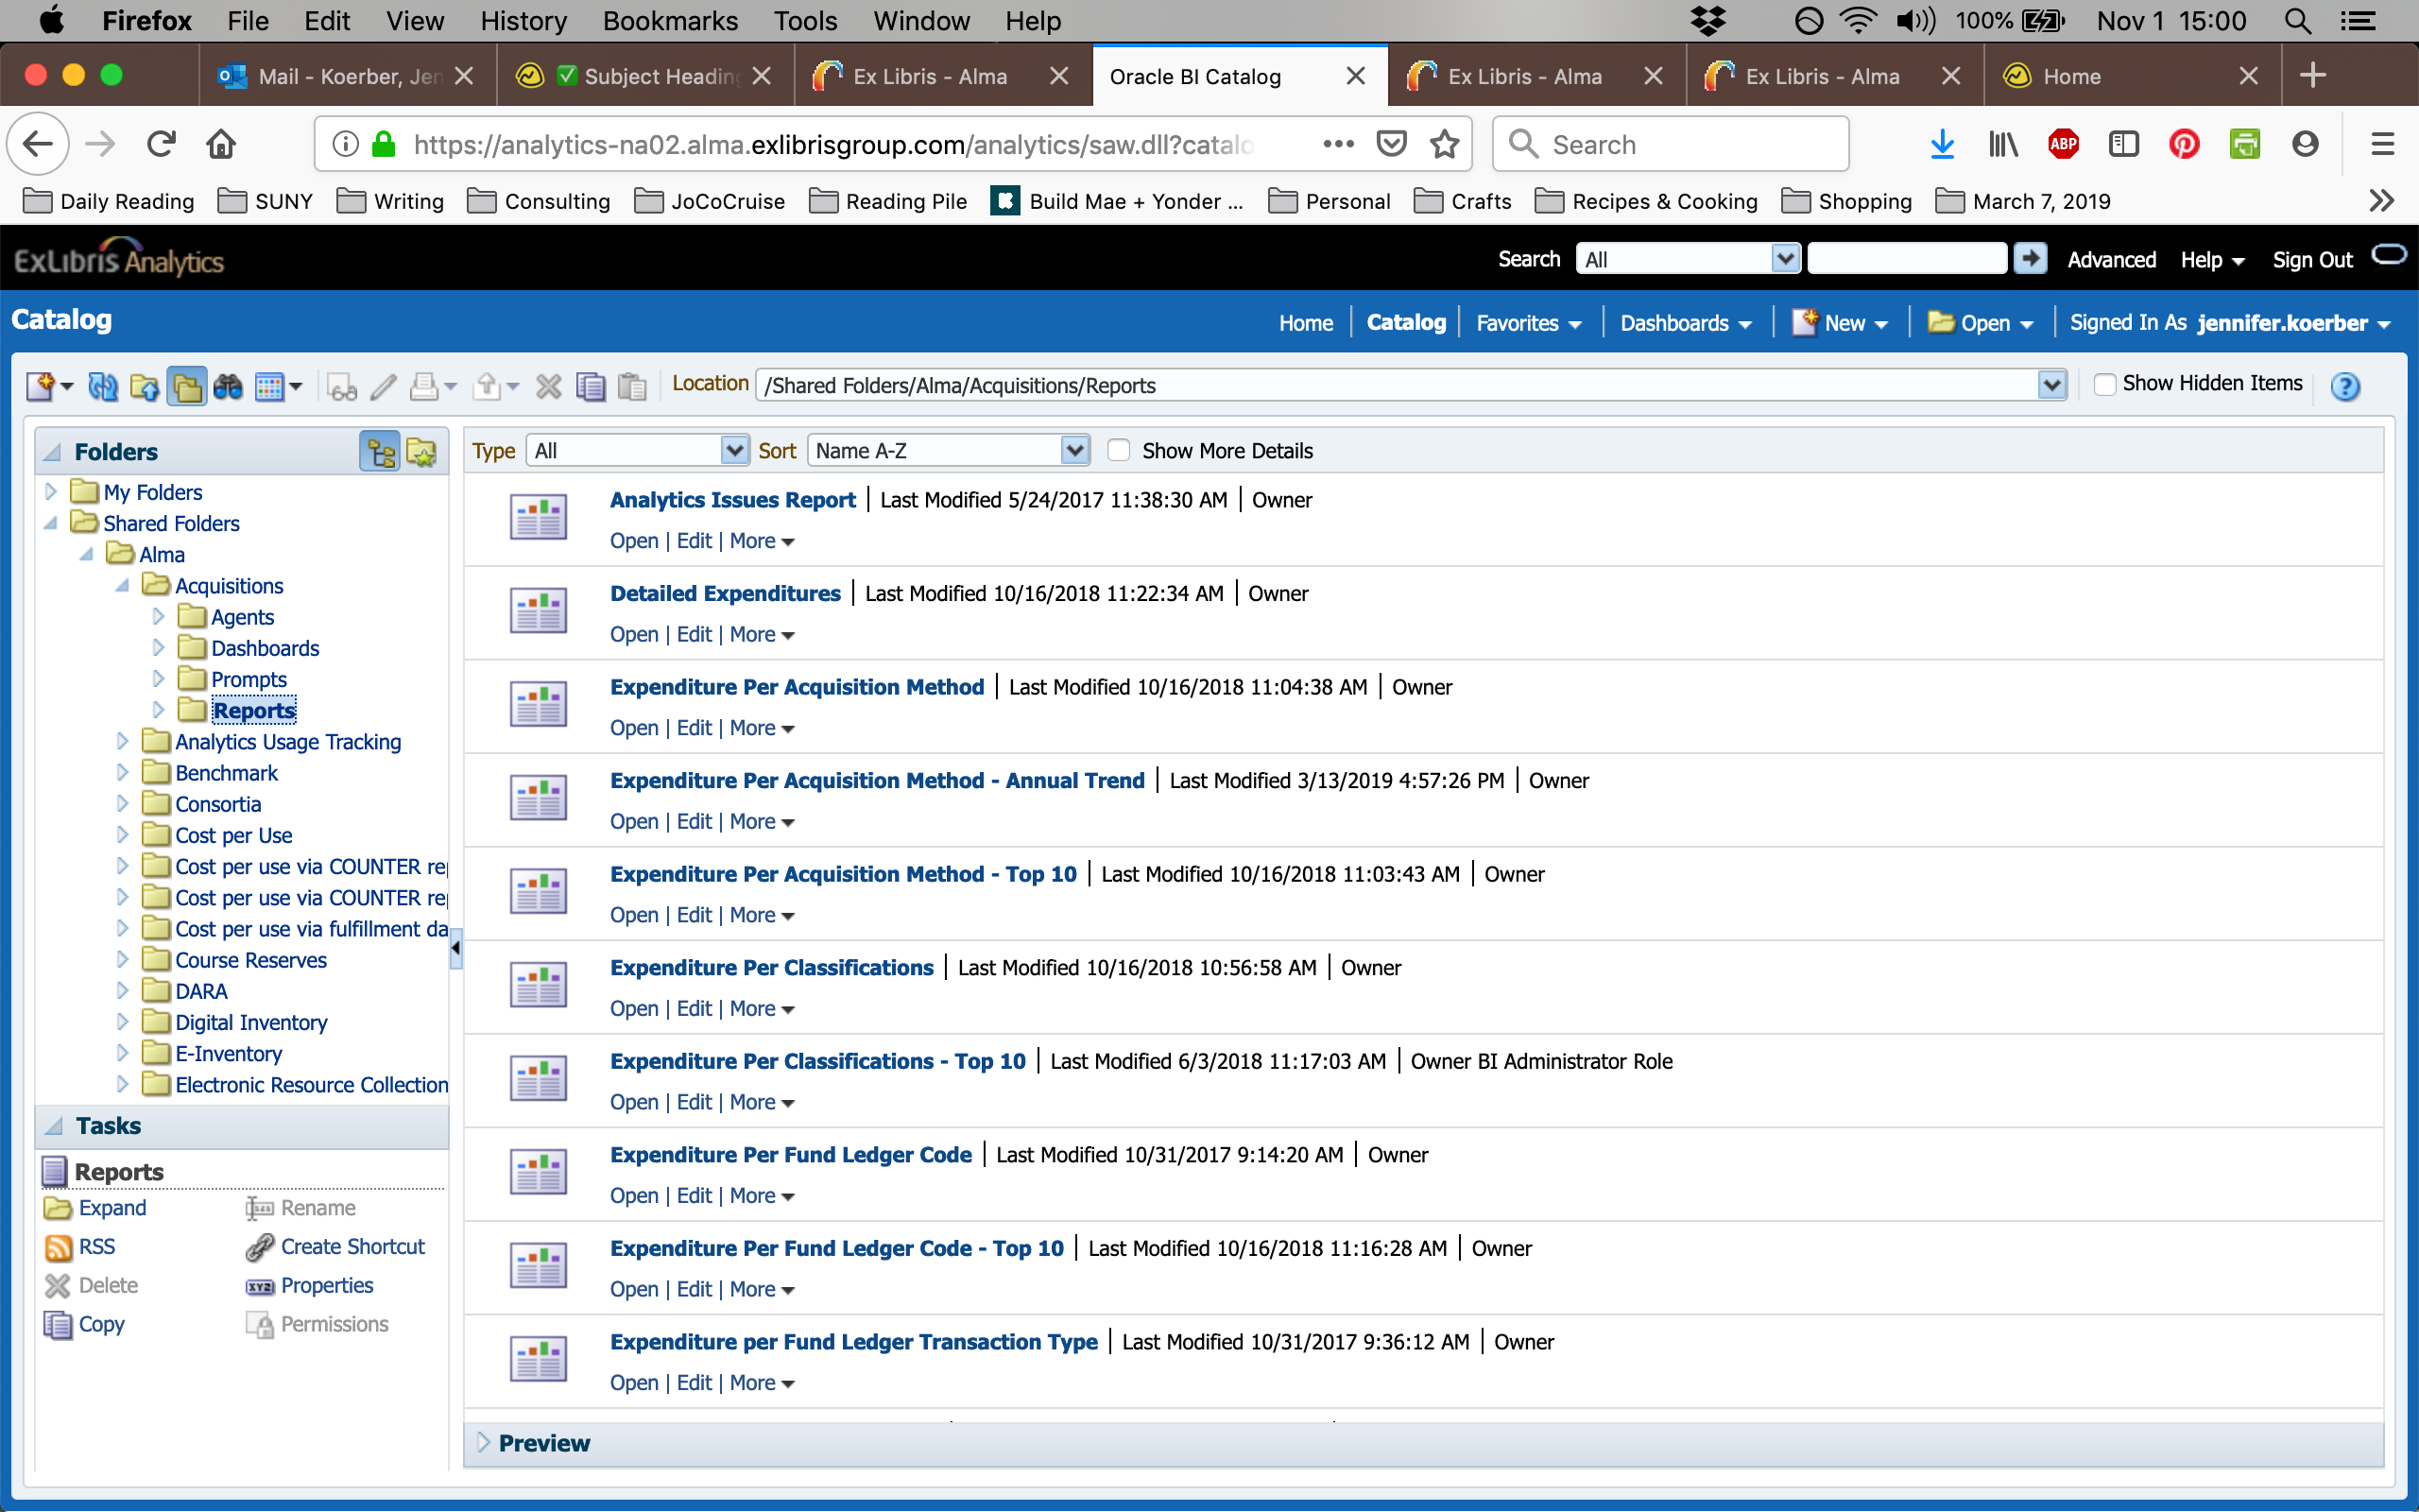

Slide 10
“Do I need Analytics?”

Slide 11
Do You?
Alma
Alma Analytics
Single-focus questions (by record type)
Point-and-click criteria options
Visible information in records
(to staff in Alma)
Current information
Limited ”saveability” – Sets or Menu Link
Export results to Excel only
No extra permissions or training needed
Complex & comparative questions
Robust query capabilities
Under-the-hood data (i.e, item lifecycles, including deleted records)
Data updated once every 24 hours
Save and share any analysis or report in multiple ways
Export results to Excel, CSV, and more
Needs Design Analytics user role and additional training for OBIEE interface
Notes:
In Alma, you can only look at information in one record type at a time. In Analytics, you can see related information from different record types at the same time.

Slide 12
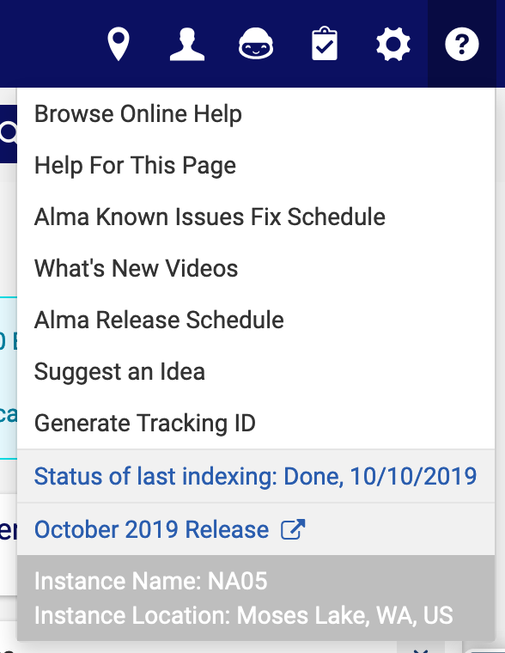
Explore the Alma Menu Links
Click on the link
Read the screen
Click on Help for this Page
(under the Help icon)
Read the Ex Libris Documentation
Evaluate what it can do for you

Slide 13
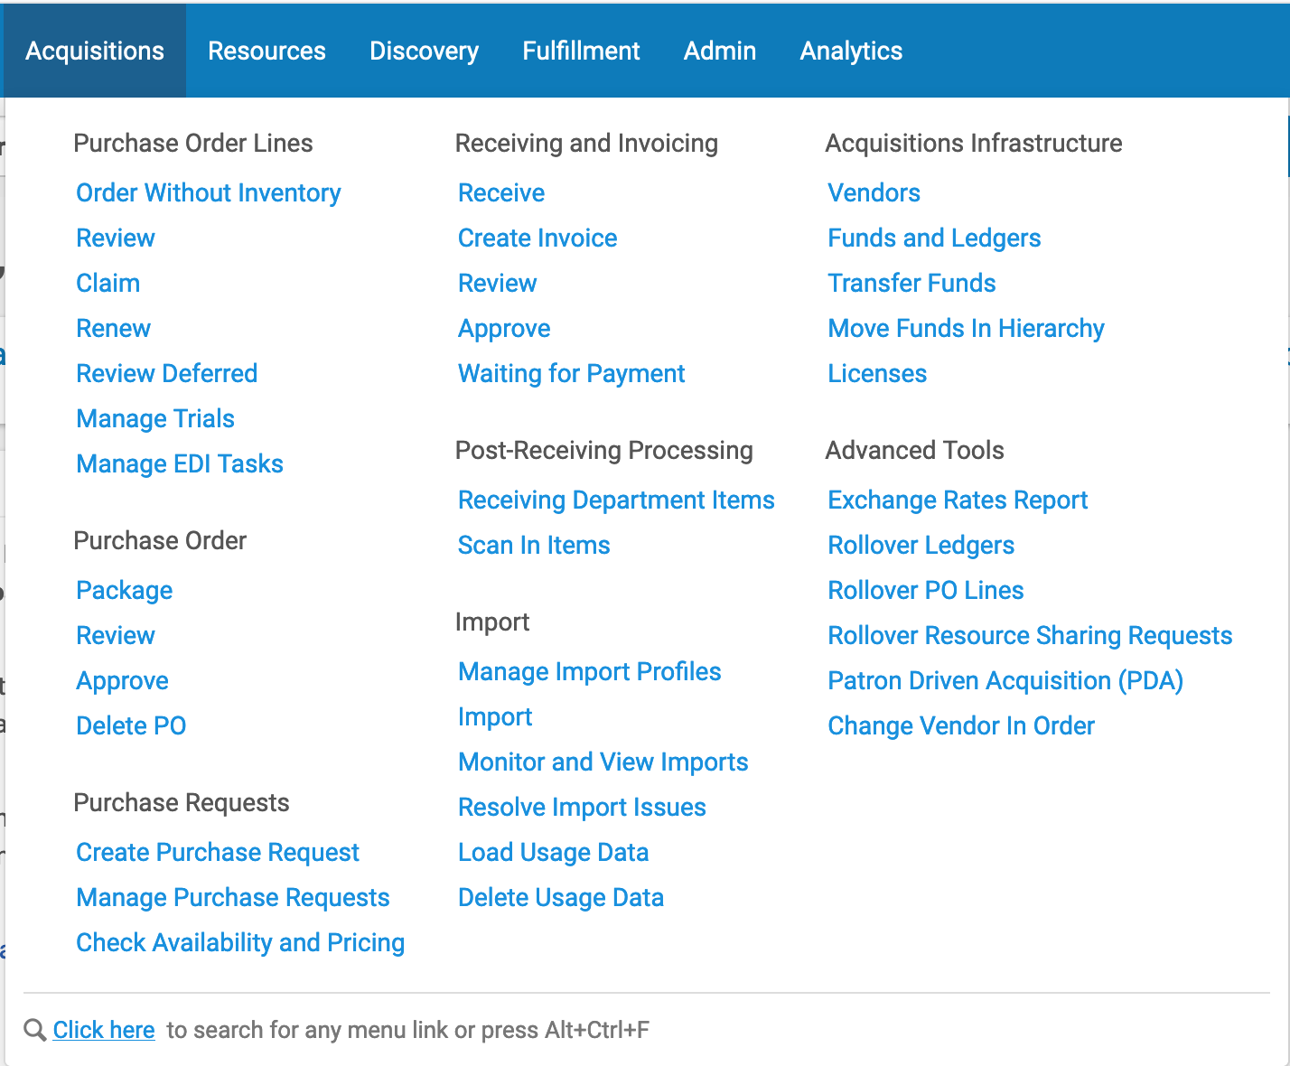

Slide 14
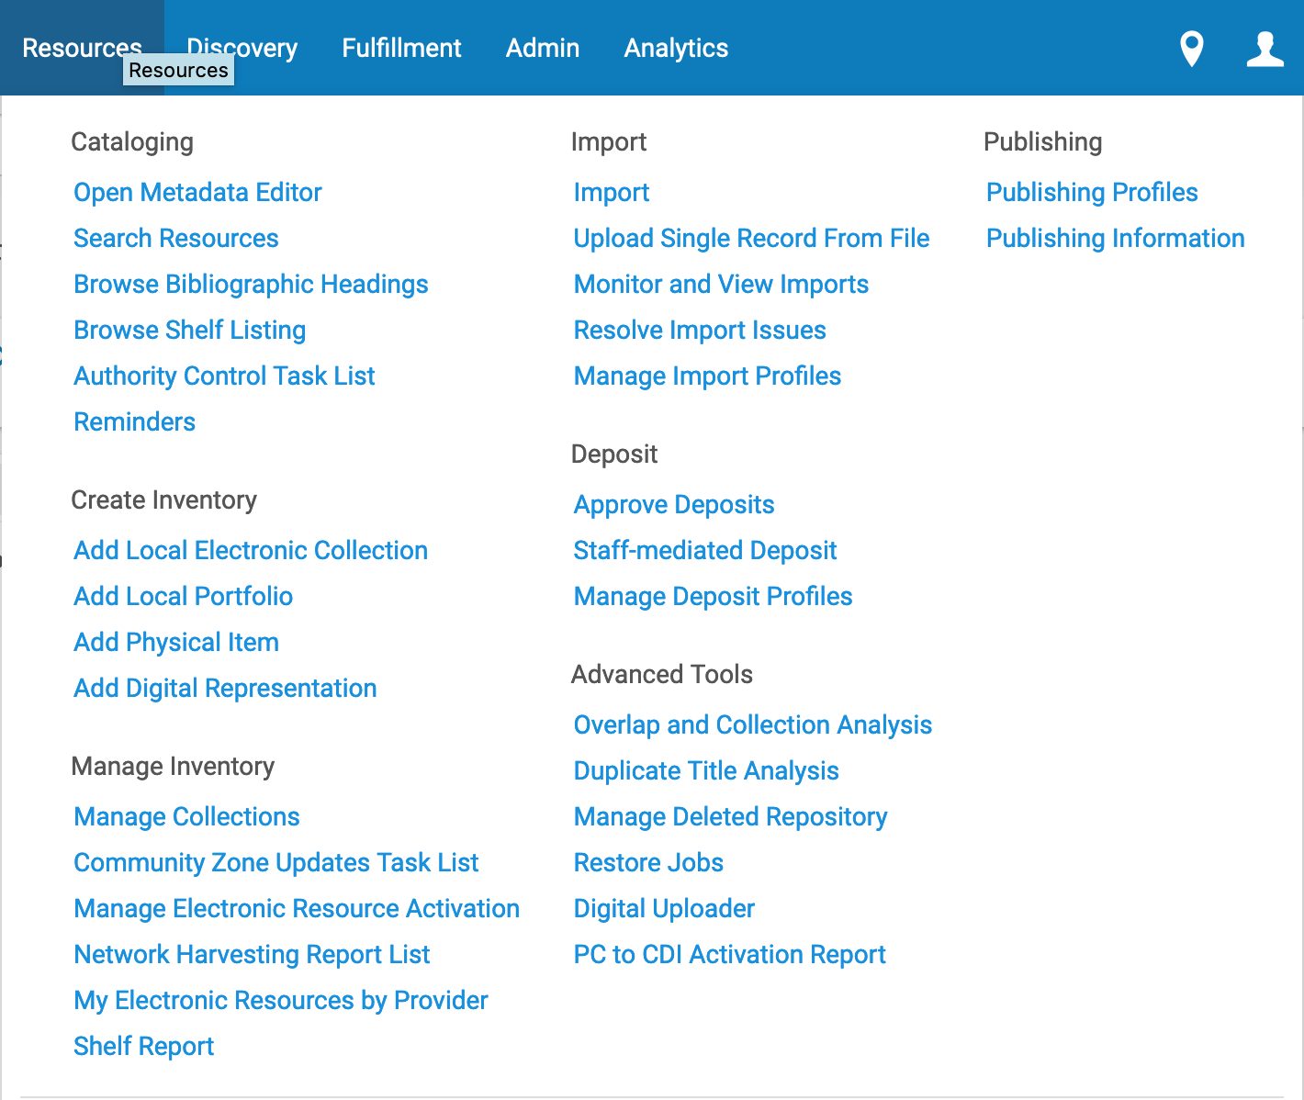
Notes:
Overlap & Collection Analysis = eResources only
Duplicate Title Analysis & Manage Deleted Repository = Repository Manager

Slide 15
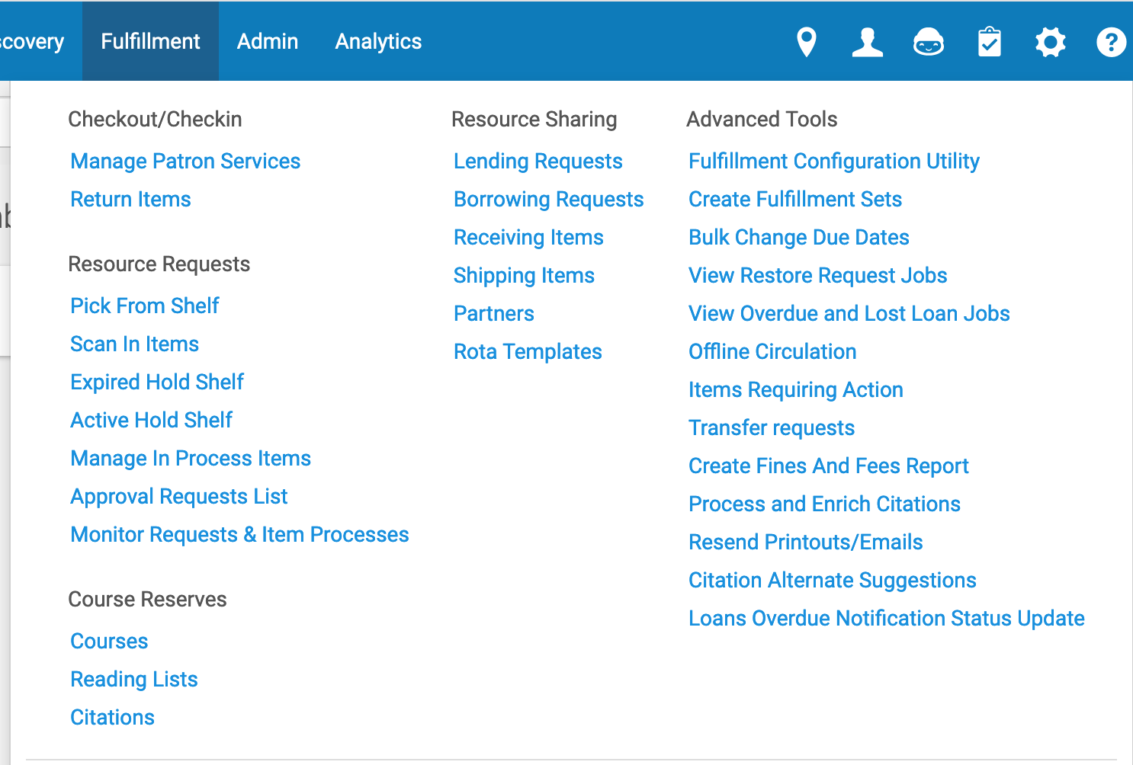
Notes:
Create Fulfillment Sets = Request Operator, Fulfillment Administrator, System Administrator
Citation Alternate Suggestions = Suggests alternate editions/formats for course reserves lists. Fulfillment Services Operator/Manager, Fulfillment Admin, System Admin

Slide 16
Using Search - Basic
Some Search Types allow for a blank search field to see all records
  Vendor
  Funds & Ledgers
  Licenses (eResources)
Use Alma for what it’s good at – having lots of information in one system!
  Current data snapshots – what’s the situation Right Now?
  Go from Title to Item to Ordering a new book
  Go from a eResources subject search to a title list to the collection/service information to the license

Slide 17
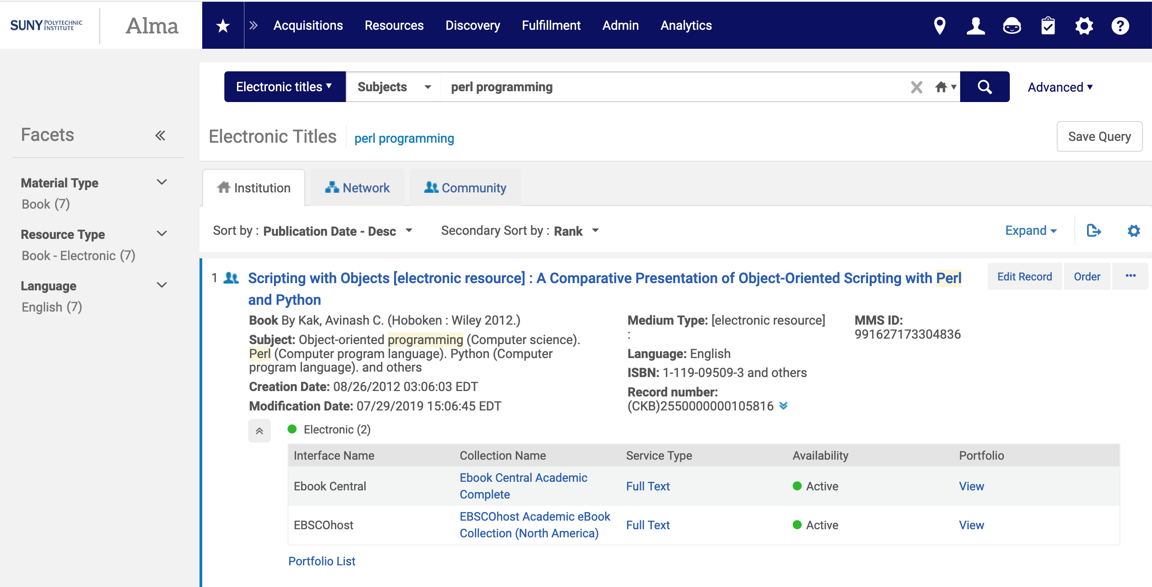
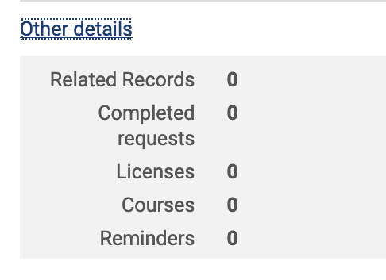

Slide 18
Using Search - Advanced
Advanced Search is powerful:
  For Physical materials, mix criteria from Title, Holdings, and Item records to search
  For Electronic materials, mix criteria from Title, Collection, and Portfolio records
  For other record types, more extensive lists of criteria than in Basic search
Search for records with empty fields (e.g., Items with no barcode, Titles with no LC/Dewey number or standard numbers, Portfolios with no Access Rights listed, and much more)
Save Query to re-run as needed
Export as Excel for data manipulation and/or sharing
Notes:
Searching for Items https://knowledge.exlibrisgroup.com/Alma/Product_Documentation/010Alma_Online_Help_(English)/010Getting_Started/050Alma_User_Interface_%E2%80%93_General_Information/Searching_in_Alma#Searching_for_Items_Without_Specific_Information

Slide 19
Using Search - Advanced
Basic + Advanced Search
Basic Search Only
Titles – All, Physical, Electronic
Physical Items
Electronic Collections & Portfolios
Order Lines (POLs)
Licenses
Reading Lists
Authorities
Citations
Users
Requests
Funds
Vendors
Invoices
Notes:
Searching for Items https://knowledge.exlibrisgroup.com/Alma/Product_Documentation/010Alma_Online_Help_(English)/010Getting_Started/050Alma_User_Interface_%E2%80%93_General_Information/Searching_in_Alma#Searching_for_Items_Without_Specific_Information

Slide 20
Search Demos

Slide 21
Using Sets (an extension of Search)
Logical sets = dynamic/current answers to a query
  What are current holdings for this subject? (help faculty create course lists)
  When was the last time these items circulated?
  What Rush orders haven’t been acted on yet?
Itemized sets = static group of records you choose individually
  All the materials paid for by a grant or bequest
  Items needed for an annual display
  Barcodes for items to be withdrawn
More on Sets at https://slcny.libguides.com/training-sets-jobs, including a link to the Sets & Jobs training video

Slide 22
Viewing Existing Reports

Slide 23
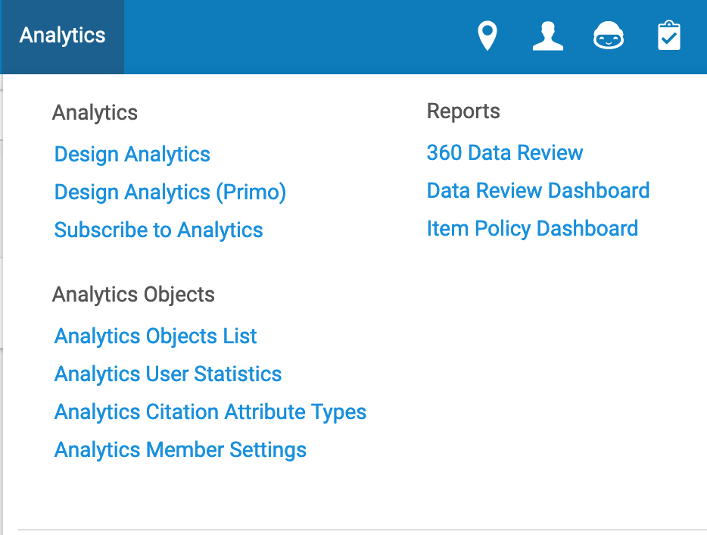
Running Reports
Go to the Analytics menu
Click on the title of the report
Report opens in new tab or window, either directly to the results or to a page of prompts
Choose options from the prompts, then click OK to see results
SUNY Geneseo - Sandbox

Slide 24
Report Options
Print - print the report without exporting or saving it
Export will allow you to export and save the report as:
  PDF
  Excel 2007+
  Powerpoint 2007+
  Web Archive (.mht)
  Data (CSV, tab delimited, XML)
Row limits on exports:
  To Excel = 65,000 rows
  To CSV = 500,000 rows
Refresh updates results, remember that Analytics data is only updated every 24 hours

Slide 25
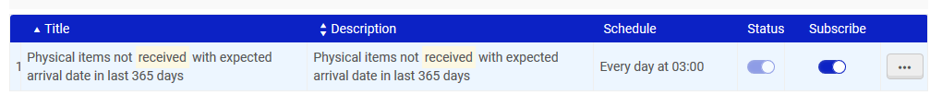
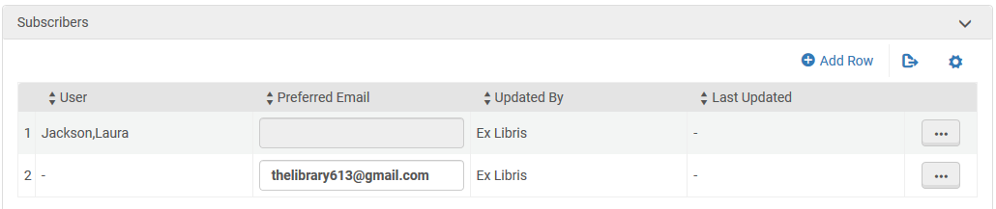
Subscribing to Reports
Analytics Menu >> Subscribe to Analytics >> Choose from the list
It shows up in the subscriber’s email on the schedule set by the creator
Notes:
The top image is what an Alma user sees. The bottom is how you can manage subscribers to any report you create, including adding non-Alma users by email address.

Slide 26
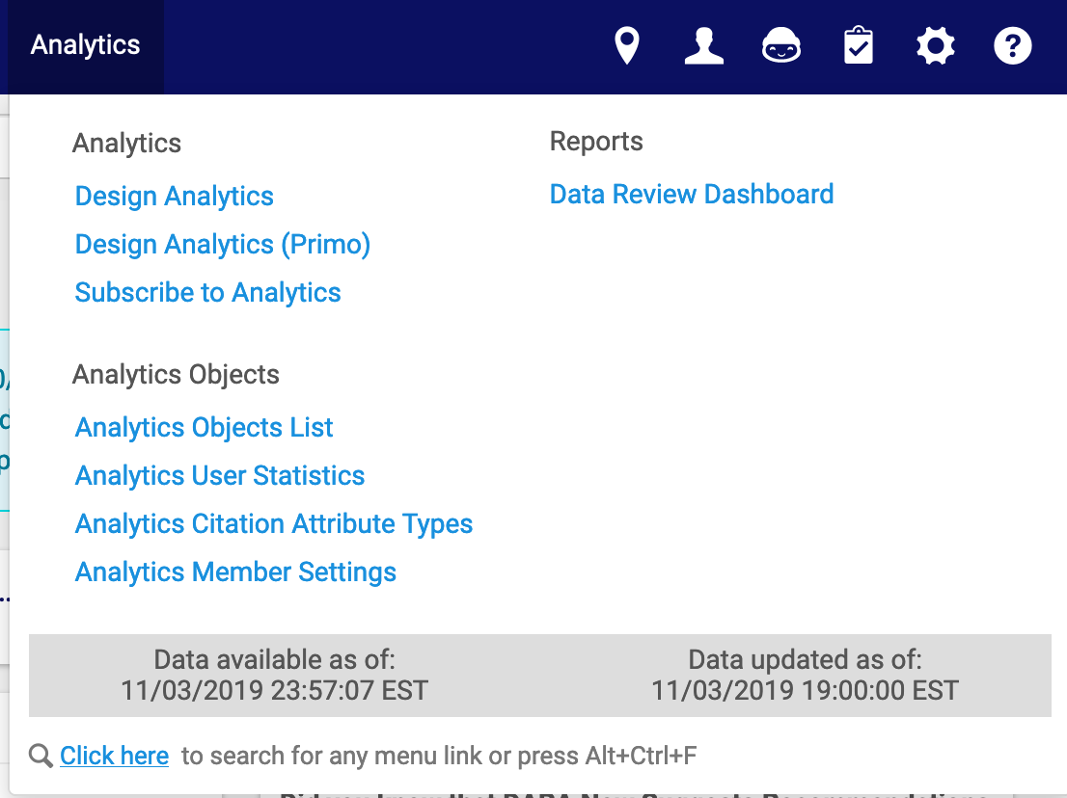
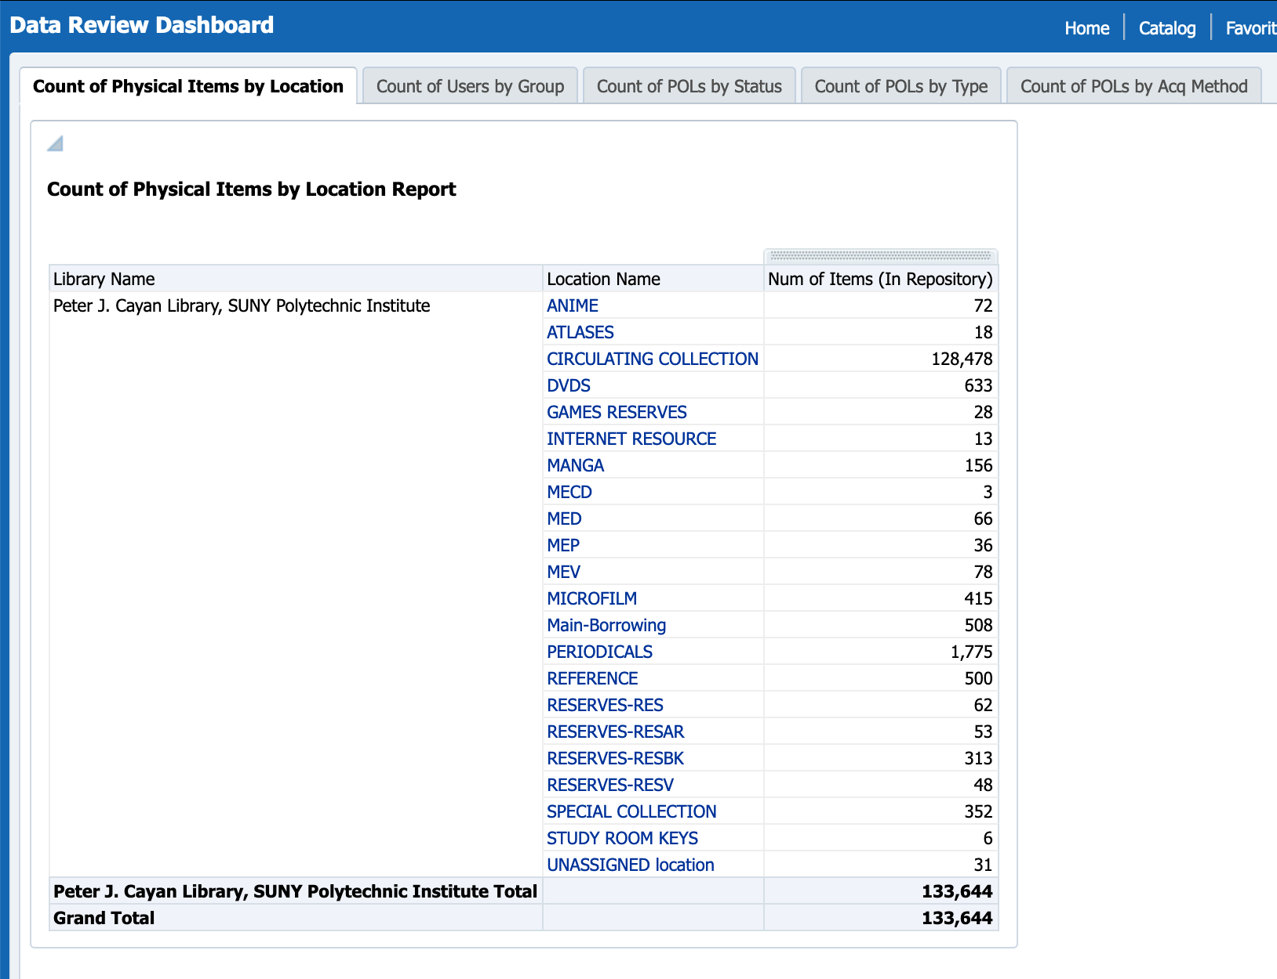
Dashboards
Notes:
SUNY Poly – You can click on each Collection/Location name to see a list of the item records in that location.
SUNY Poly created a Data Overview Dashboard – snapshot/overview on the first page, then click through for detailed information
Count of Physical Items by Location (Collection)
Count of Users by Group
Count of POLs by Status
Count of POLs by Type
Count of POLs by Acquisitions Method

Slide 27
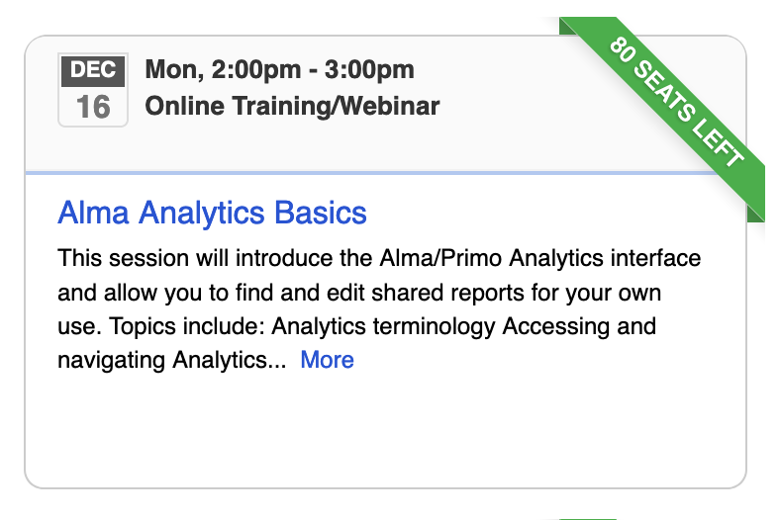
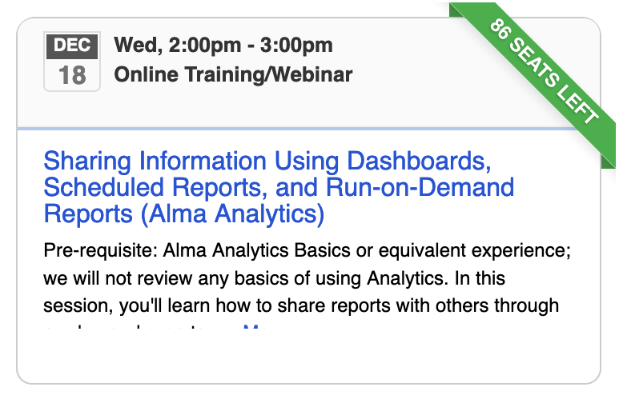
Upcoming Analytics Trainings
https://slcny.libcal.com/calendar/training

