Slide 1
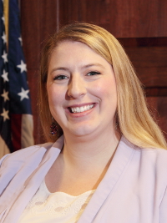
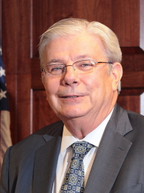
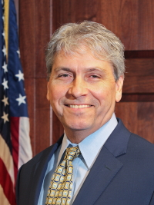
Intro to PURA
Chairman Marissa P. Gillett | Vice Chairman John W. “Jack” Betkoski III | Commissioner Michael Caron

Slide 2
PURA’s Equitable Modern Grid
Objectives
Enable
Economy-Wide Decarbonization
More Resilient, Reliable, and Secure Commodity
Advance Energy Affordability
Support Growth of Green Economy
On October 2, 2019
PURA released its
Framework for an Equitable Modern Grid
(Docket No. 17-12-03)
Connecticut Public Utilities Regulatory Authority

Slide 3
Docket No. 17-12-03RE04
Objective: Enable Connecticut's commitment to the ten state ZEV MOU (125,000 – 150,000 EVs by 2025)
RFPD Solicits Proposals Across Six ZEV Program Areas (May 6, 2020):
Residential Level II Charging (Single-Family)
Residential Level II Charging (Multi-Unit Dwellings)
Publicly Accessible Direct Current Fast Charging
Publicly Accessible Level II "Destination" Charging
Workplace Level II Charging (including light-duty fleets)
Low-to-Moderate Income (LMI) Customer Electrified Mobility Study
Connecticut Public Utilities Regulatory Authority

Slide 4
Request for Program Design Proposals
Stakeholder responses to the RFPD (July 31, 2020)
Eversource
United Illuminating
Chargepoint
Enel X
EVSE LLC
Greenlots
DEEP
CT EV Coalition
CT Green Bank
LMI customer electrified mobility
study
EVNoire
Rocky Mountain Institute
Power Advisory LLC
Eversource
Connecticut Public Utilities Regulatory Authority

Slide 5
Publicly Accessible Charging
Request for Program Design to Address Direct Current Fast Charging (DCFC) & Destination Charging included:
Ownership models and proposed incentive structures
Site selection parameters (particularly for DCFC)
Measures to ensure consistent EV charging experience across locations
Rate design proposals to address demand charges
Co-location of EV charging infrastructure with distributed energy resources
Connecticut Public Utilities Regulatory Authority

Slide 6
How to engage with PURA
PURA online calendar
Sign up for email alerts
Interested in receiving email updates for the above dockets, or other PURA proceedings? Sign up through PURA's email notification system. If you’re having difficulties updating an existing account, use the Internet Explorer browser and follow these troubleshooting tips.

Slide 7
How to engage, Con’t
Provide comment during a public hearing
Submit written comments into the record by email: PURA.ExecutiveSecretary@ct.gov
Intervene in a docketed matter
Contact Info for PURA’s Consumer Affairs Unit
You may
file a complaint via our website, or by email at
pura.information@ct.gov
Telephone Numbers
Toll Free Number: 1-800-382-4586
Outside Connecticut: 1-860-827-2622 Fax Number: (860) 827-2885 TDD Telecommunications for the Deaf:
(860) 827-2837
(to be used only if you have a TDD machine)

