Slide 1
Unit 9
The Work Group / Programme/ Community report
LLME Toolkit
(Revised May 2023)

Slide 2
From Unit 6: what and why are we evaluating?
What are trying to find out?
(What was the actual reach of the Work Group/ Programme/ Community?)
Which outcomes were achieved? How do we know? (impact evaluation)
Which aspects of the Work Group design and delivery were effective? (process evaluation)
Why do we need to know?
(Accountability regarding time, money and effort)
Understanding what success looks like
Learning lessons to ensure continuous improvement
This information needs to be captured through the Work Group/ Programme/ Community Report (same document as the plan)

Slide 3
What is reported on?
Work Group | With the primary aim of supporting school – or department-wide development in their own setting, participant teachers will develop their own expertise as classroom practitioners.
Programme | Teachers participating in a programme join a cohort of colleagues from other schools on a series of sessions – more akin to a training course – where the central objectives are individual professional learning and practice development.
Community | Professional learning communities are looser in structure, with fewer fixed meeting times, but more frequent, informal communications among members in their own time. There’s also an expectation that participants will continue to work and learn together beyond one academic year.

Slide 4
Key features of the report
Actual reach and school profiles
Actual outcomes (and evidence)
Actual activity completion
Summary statements of overall impact and effectiveness
Recommendations for the future

Slide 5
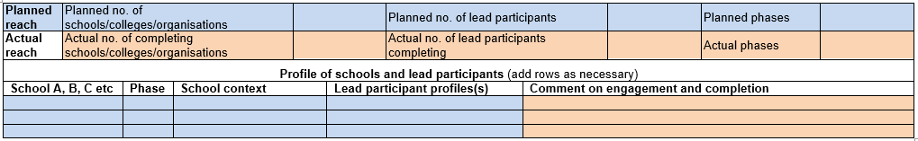
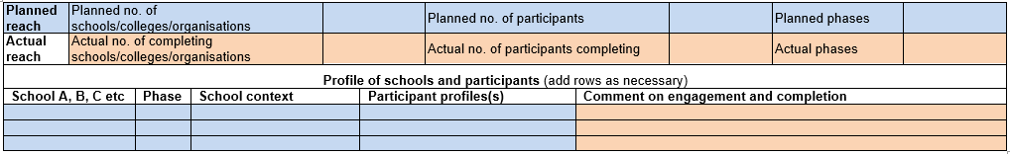
Reach and school profiles
Work Group
Programme
Community

Slide 6
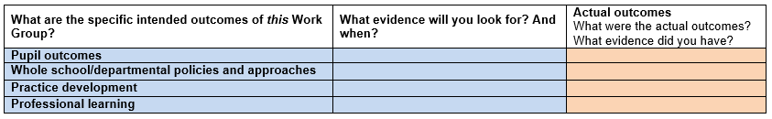
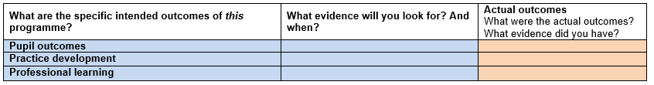

Outcomes (and evidence)
Work Group
Programme
Community

Slide 7
Actual Work Group activity completion

Slide 8
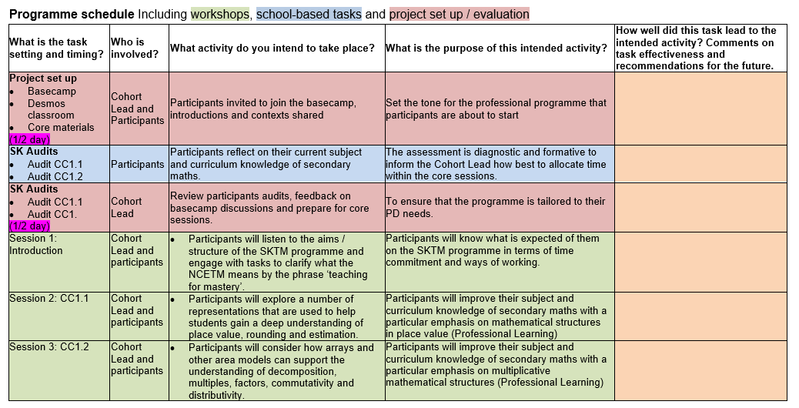
NCP22-30 Programme plan example
80% participants joined automatically, another 10% did so when prompted.
The final few were invited to join during session 1. For next year, expect all to say virtual ‘hello?’
All completed (some needed chasing)
Asymmetric information gathered from participants reluctant to contribute to B/C – use @ to tag in quieter participants?
Participants engaged quickly – their comments helped us assess any TfM misconceptions
Useful diagnostic for maths anxiety! Consider how to reassure nervous participants that this is a ‘safe space’ for mistakes?
See above. All participants surprised by precision in mathematical language

Slide 9
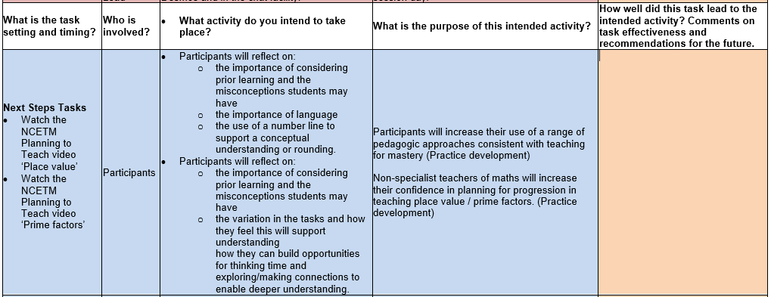
NCP22-30 Programme plan example
Impossible to get evaluative evidence from ‘watching’ video (other than number of views!)
Did not explicitly follow this task up.
Choice: Expect participants to comment (eg on a Padlet) after watching, or elicit feedback during next workshop

Slide 10
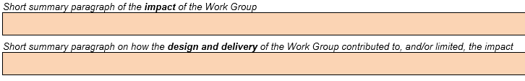
Summary statements of overall impact and effectiveness
Work Group
Programme
Community

Slide 11
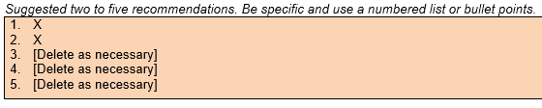
Recommendations for the future

Slide 12
Advice, feedback and agreement
Exemplar reports
Guidance from project team, community members and evaluation strand
LLME community colleagues
MHLM team link – key point of agreement
2022-23 submission date: Tuesday 11th July

Slide 13
Taking it further
Suggestions for reading, watching, listening
Read the Work Group/ Programme/ Community Plan and Report Template 2022/23
Suggestions for discussion with others
What evidence did you collect during your set PD tasks?
How did you use the evidence to assess the impact of the PD you led?
Which aspects of the tasks and activity contributed most to the impact? How do you know?
How will your report help the project in future?

