Slide 1

Wolf Trap District
Program Launch
August 08, 2024

Slide 2

Pledge

Slide 3
Welcome
New to Roundtable?
Please introduce yourself!

Slide 4
Agenda
Welcome and Pledge
Award(s)
Questions about Read-ahead
Join Scouting Night Information/Council Announcements
General Announcements
Program
Breakout Sessions
Cracker Barrel/Networking (Optional; NLT 9pm)
Next Meeting: Sept 12, 2024 - at Thoreau MS, Vienna, VA

Slide 5
District and other Award(s)

Slide 6
Questions/Clarification about Read-ahead?

Slide 7
Join Scouting Night/Event Prep
Goal: Provide information and resources that can assist your Unit for upcoming recruitment events. This includes:
Online Tools
Resources Available from Council
Planning Timelines
Best Practices – Please share your successes!

Slide 8
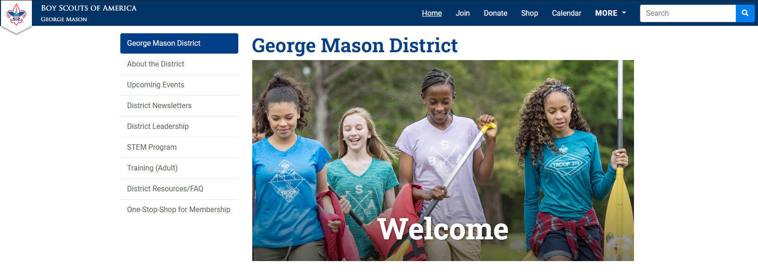
One-Stop Shop for Membership https://ncacbsa.org/george-mason/

Slide 9
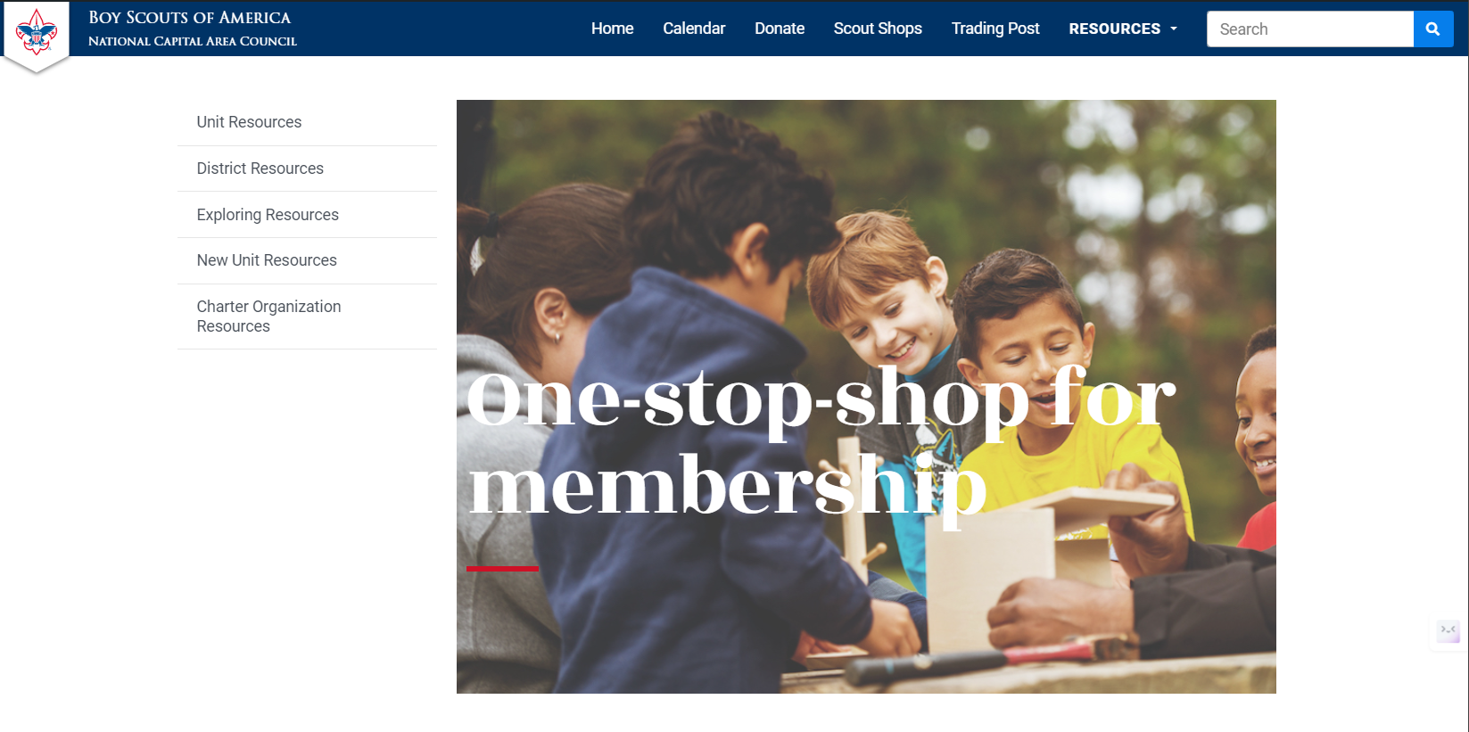
One-Stop Shop for Membership https://ncacbsa.org/membership-resources/

Slide 10
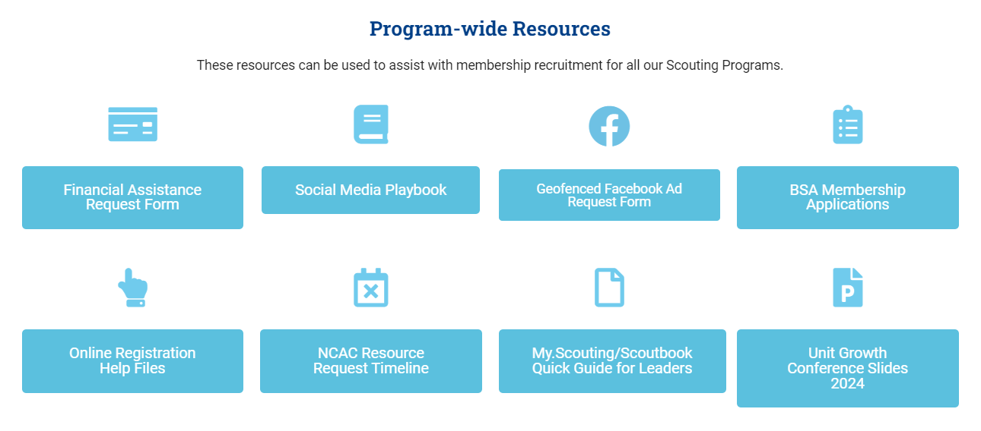
One-Stop Shop for Membership https://ncacbsa.org/unit-resources/

Slide 11
Geofence Request Form
Information Needed:
Email
District
Unit Number
Unit Type (Pack, Troop)
Name of Chartering Organization
Is the event In-Person or On-line
  Address of In-Person Event
  URL (if virtual event) w/ login instructions
Event Date/Time and description of activity
Unit Facebook Page info (if applicable)
Flyer (if available)

Slide 12
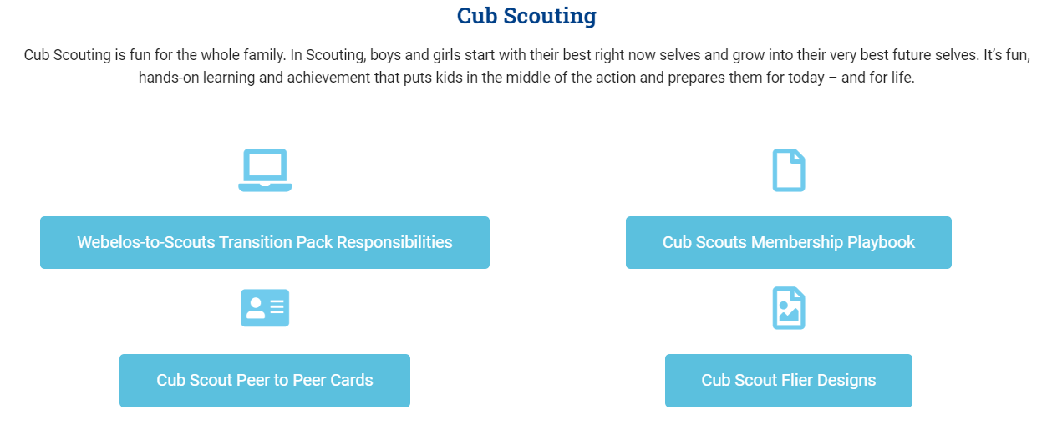
On-Stop Shop for Membership https://ncacbsa.org/unit-resources/

Slide 13
JSN Resources
Scout Talks – Videos
JSN Logistics – Resources for various stations – Activities, Advancement, Ideals of Scouting, Calendar, Application, etc.
New Leader Welcome Packet
Program Information
Unit Guides

Slide 14

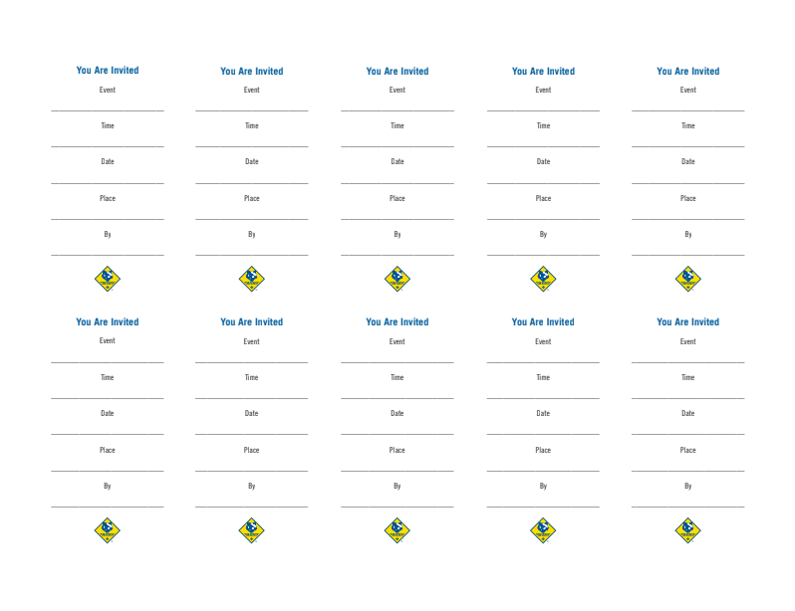
Peer-to-Peer Cards

Slide 15
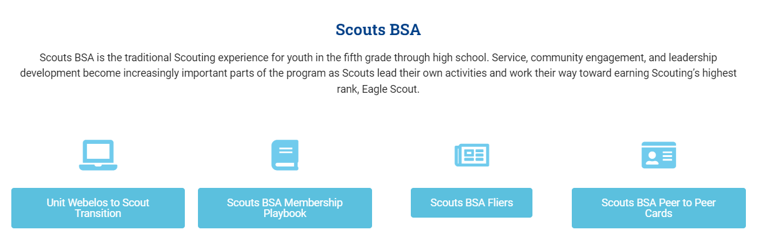
On-Stop Shop for Membership https://ncacbsa.org/unit-resources/

Slide 16
NCAC Resources Available
Items to request/keep on-hand:
Flyers – Please give Liz 2-3 week’s notice
Yard Signs
Parent’s Guides
Paper Applications
Items to borrow and return:
Roll-out recruitment banners
Pup-up Tents

Slide 17
Planning Timelines (Suggested)
Three Weeks Prior:
Request Facebook Geofenced Advertising (date, location, time, & contact info)
Request PeachJar Advertisements (Flyer, Schools, additional info)
Two Weeks Prior:
Submit Physical Flyer Requests (Color: 10 cents per page)
Submit Peer-to-Peer Cards Requests
Request Council Recruitment Banners (While resources are available)
Request Council Projectors (While resources are available)
Request Council Pop-Up Tents (While resources are available)
One Week Prior:
Request Yard Signs
Request Parents’ Guides
Request Paper Applications
Request Printed “How-To” Social Media templates
Prepare materials needed (e.g., Pens/Pencils, forms, one-pager, method to register online)

Slide 18
Best Practices Some Units Use
(Please share your successes/ideas!)
Have information they need – ideally one page
  Meeting location, day of week/month and time
  Background about the unit (size, history, typical events)
  Contact information
  Costs – BSA, NCAC insurance, Unit fees, how you raise funds
  Other needed items – uniform, equipment, books, etc.
Have a way to sign up immediately
  Tablet / Computer for adults to register their youth
  Paper forms and pens
  A way to collect fees (Square, check, etc.)
Have a way for Parents to volunteer/be informed of unit needs
  Emphasize that your unit is a volunteer organization
  Have a list of possible jobs they can volunteer to do
  Emphasize the need for YPT when recruiting Adults

Slide 19
Council Announcements
Web Site Updates – NCAC is making changes – some downtime
District Changes in my.scouting.org – still being worked
July – Dec – Renewal notices, via email, to registered Adults/Youth
  Bills individual youth/adults both National and NCAC Fees
  Units can choose to pay but will pay every 30-60 days
  Still working on Scholarship processes
Key 3 replacement error – my.scouting.org (60 days)
Powder Horn (8/15/24 – 8/18/24), Camp St. Charles, Newburg, MD
  Adult and Youth (13 years/8th grade or 14 years)
  (Breaking News) Program is NOT being phased out in NCAC.

Slide 20
General Announcements

Slide 21

Current 2024 Wolf Trap Calendar
Sep 28, 2024 – Life to Eagle Seminar(In Person), St James Catholic Church, Falls Church, VA
Oct 18-20, 2024 – Fall Camporee, Camp Rock Enon, Gore, VA
Nov 02, 2024 – Scouting for Food (Tags)
Nov 09, 2024 – Scouting for Food (Pick-up)
Nov 10, 2024 – Flags In (Veterans Day), NMP, Falls Church, VA
Feb 22, 2025 – University of Scouting, Alexandria, VA
Mar 08, 2025 – WTD MB Day, Fairfax Presbyterian Church

Slide 22
STEM
09/07/24 – Scouts BSA STEM MB and NOVA Workshop, Fredricksburg, MD
NCAC STEM contact is Bruce Donlin (bruce.donlin@scouting.org; 240-395-0601)
Ancient Earth: Birth of the Sky (on PBS) - link
Anytime – DC STEM Trek- Showcases 24 government agencies, private organizations and monuments related to the tenets upon which STEM is based. Two hikes - 10.57 miles, or 4.75 miles
Ancient Earth: Birth of the Sky (on PBS) - link
Anytime – DC STEM Trek- Showcases 24 government agencies, private organizations and monuments related to the tenets upon which STEM is based. Two hikes - 10.57 miles, or 4.75 miles

Slide 23

Fall Camporee

Slide 24
Breakout Sessions

Slide 25
Time for Cracker Barrel
Minutes and slides available on the WTD web site (District Resources, Roundtable). Password is “GMDRT”
Next meeting – Sept 12, 2024, at Thoreau Middle School

Slide 26
Backup Slides

Slide 27
Scouts Deserve a Trained Leader
Wolf Trap Training site: https://www.ncacbsa.org/george-mason/training/
2024
CM/ACM/Cub Scout Den Leader Specific (C42)
Available on-line (125 min)
09/21/24 – Herndon, VA
09/28/24 – Stafford, VA
Basic Adult Leader Outdoor Orientation (BALOO; C32) -
10/05/24 – 10/05/24 – Camp Snyder, Haymarket, VA
Spring: 03/01/25 & 4/26-27/25
Fall: 09/20/25 & 10/18-19/25
Scoutmaster Position Specific Training(S24)
Available on-line (192 min)
09/21/24 – Herndon, VA
Introduction to Outdoor Leadership Skills (IOLS; S11)
10/04/24 – 10/05/24 – Huntingtown, MD
Back Country Outdoor Leadership Skills (BCOLS)
09/21/24 (Alexandria) & 10/19/24-10/20/24 (Camp Big Mac)
Climbing Level 1 Instructor
Sept 7-8 at Great Falls Park, 7:30 AM to 5:00 PM. Logistics memo
Sept 21-22 at Sugarloaf Mountain, 8:15 AM to 5:00 PM. Logistics memo
Mental Health First Aid
https://www.fairfaxcounty.gov/hscode/ereg/Registration.aspx?groupID=47
NYLT https://www.ncacbsa.org/national-youth-leadership-training/
Outdoor Ethics Orientation Courses (Scouts and Cubs) - 09/30/24 & 10/5/24, Germantown, MD
Powder Horn – 08/15/24 – 08/18/24, Newburg, MD
Scouterhorn Operations Training
10/19/24 – Camp Snyder, Haymarket, VA
11/16/24 – Camp Snyder, Haymarket, VA
Wood Badge (A90) https://www.ncacbsa.org/wood-badge/
09/13/24 – 09/15/24
2025
BCOLS:
Spring: 03/01/25 & 4/26-27/25
Fall: 09/20/25 & 10/18-19/25
Trainers Edge: 08/09/25 & 12/06/25
University of Scouting: 02/22/25
Wood Badge:
Spring: 4/4-6/25 & 5/3-4/25
Fall: 09/12-14/25 & 10/4-5/25

Slide 28
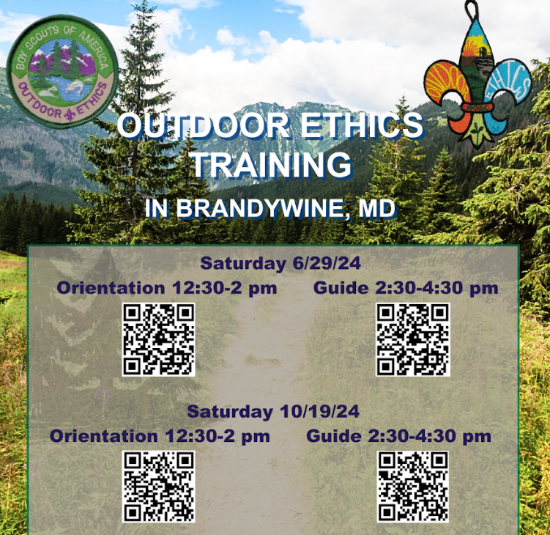
Outdoor Ethics

Slide 29
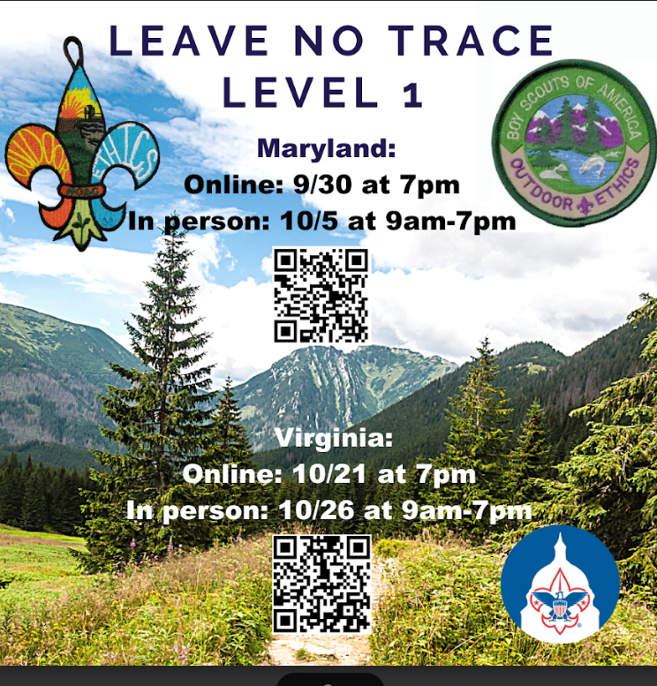
Leave No Trace

Slide 30
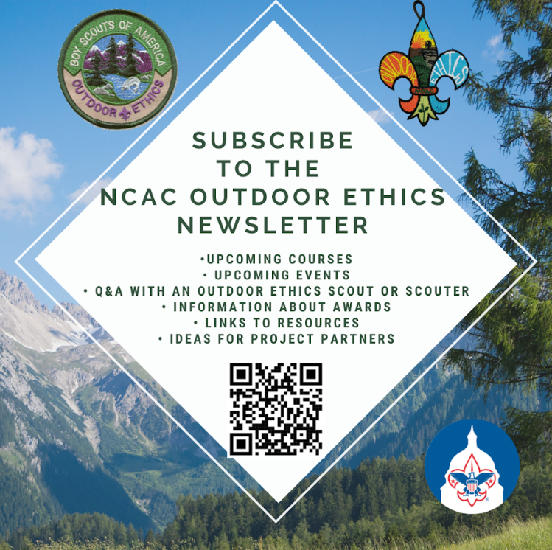
Outdoor Ethics
Newsletter

Slide 31


Merit Badges
The online Merit Badge Counselor registration.
New Merit Badge Counselors must complete online merit badge counselor training, in addition to YPT. Be sure the counselor uses his/her legal name – no nicknames.
Merit Badge Counselors, or the unit Dean/Leader, also need to scan and send Margee the Merit Badge application form listing the badges the counselor is applying to teach and providing a justification of his/her qualifications.
Youth Protection Training is the essential first step. Don’t hit “send” on the application without it!
Contact Margee if you have questions at GM.MB.Dean@hotmail.com.
Did you know:
The National Council does not limit the number of merit badges a youth may earn from one counselor, though a unit leader is permitted to do so, as long as the same limit applies to all Scouts in the unit. Ideally, Scouts should work with a variety of adults. (GTA 7.0.0.3)
Partial Merit Badges have no expiration except the Scout’s 18th birthday. (GTA 7.0.3.3)
Due to the BSA policies related to Youth Protection and two-deep leadership, a merit badge counselor must have another adult present during all merit badge counseling sessions. However, the parent or legal guardian of the Scout may serve as the second adult. This parent or legal guardian does not have to be a registered leader.
If the requirements for a merit badge differ between the merit badge pamphlet and the current edition of Scouts BSA Requirements, the requirements in the Scouts BSA Requirements book supersede all others.

Slide 32

GM High
Adventure
Members of the High Adventure Committee are available to assist units in planning and training for their upcoming high adventure trips – Contact Brian Heath for more information
Important notes for this month
  Registration for BSA’s high adventure bases - https://www.scouting.org/outdooradventures/open4adventure/
    2025 treks – Registration for all high adventure bases are now open
    2026 treks – Registration for Philmont treks will open this fall
2024 NCAC-Organized High Adventure Trips
  11-12 year old Scout High Adventure Experience - Sept 28-29 - Prince William Forest
  Joshua Tree with Climbing Committee - Winter Break 2024/25 (Gathering interest)
2025 NCAC-Organized High Adventure Trips
  Sawtooth Mountain, ID Trip - 06/21 to 06/29/2025 - $1,385 per person – Ask for details
High Adventure Preparation Training
  Back Country Outdoor Leadership Skills - Virginia session
    Fall 2024: 9/21/2024 (classroom), 10/19-20 (overnight) - Registration Link
Other Training
  Paddle Craft Safety Training: Aug 24-25, Sept 7-8
National High Adventure Base Quick Links
  Philmont: https://www.philmontscoutranch.org/register/
  Northern Tier: https://www.ntier.org/provisional-scout-connections/
  Sea Base: https://www.bsaseabase.org/scouts/scout-connections/
  Summit: https://www.summitbsa.org/registration/scoutconnections/
Other High Adventure Bases
  Adirondack High Adventure Area: https://public.3.basecamp.com/p/hLgsVbk7Suju6cuDzQQJaEn4
  Maine High Adventure Area: https://www.mainehighadventure.org/
  Montana Outdoor High Adventure Base: https://montanabsa.org/camps/high-adventure/
Other useful links for high adventure information and opportunities
  NCAC High Adventure website - https://www.ncacbsa.org/high-adventure/
  List of units with available slots in their upcoming high adventure trips - https://public.3.basecamp.com/p/xWpkdrKHKAA9pCzwmHMNdbWb
August 2024
Notes:
Sea Base Trip on Jul 29-Aug 3, 2024 - FULL

Slide 33
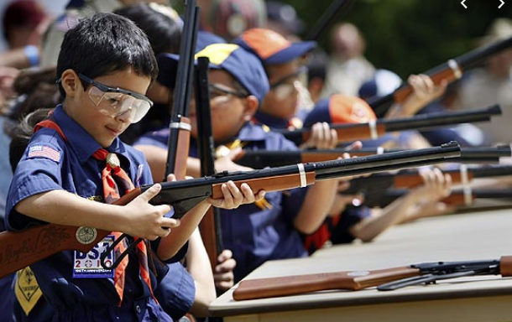
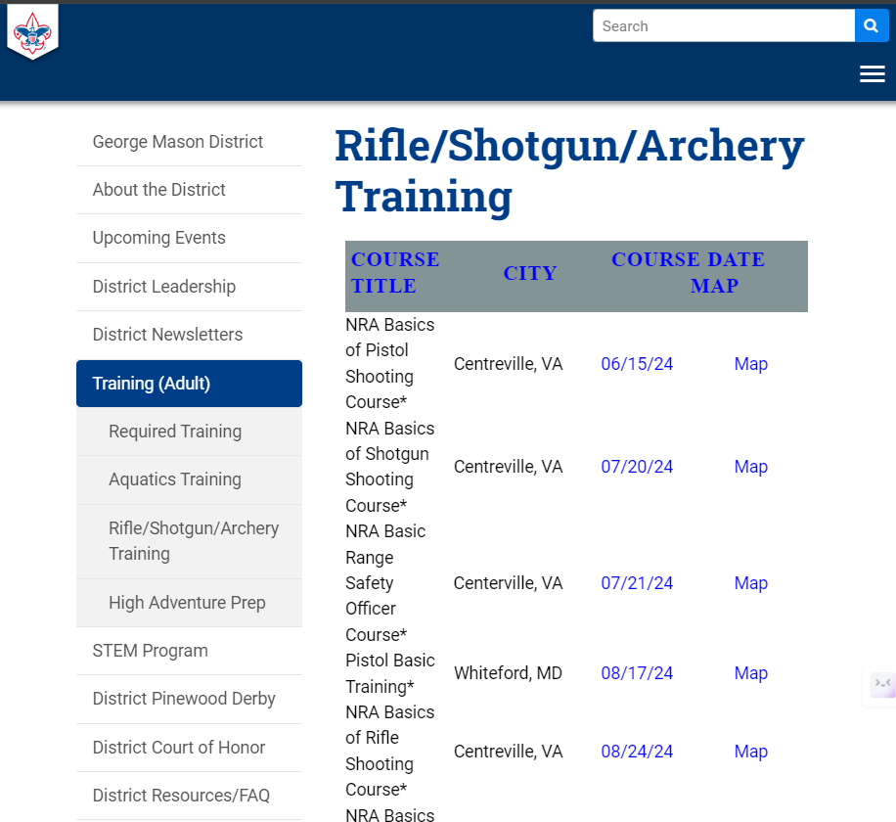
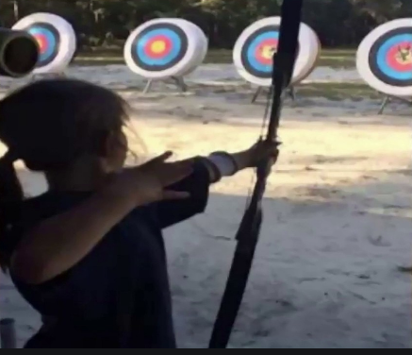
Range and Target Activities
Requests for Shooting Events – Lead Time!
  50+ scouts - 6mos
  Less than 50 scouts - 3mos
Shooting on private land:
  Requirements
  Permissions/protocols
R&TA web page
R&TA Instructor Classes:
  Rifle/Shotgun - 08/24/24

Slide 34
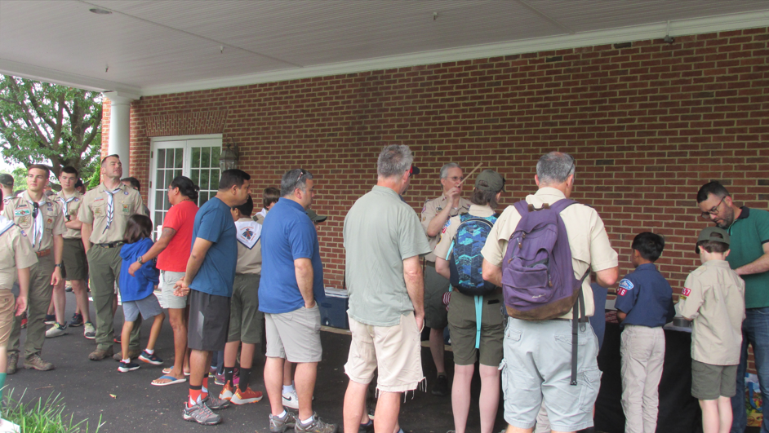
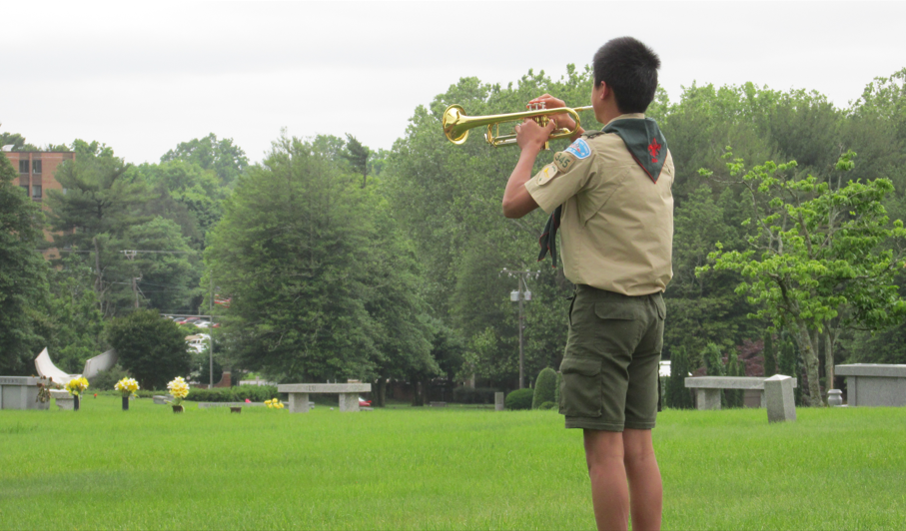
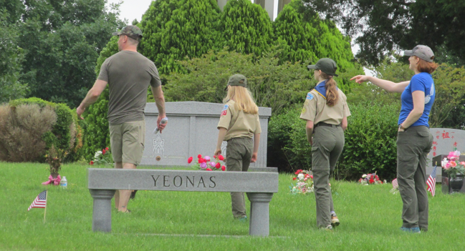
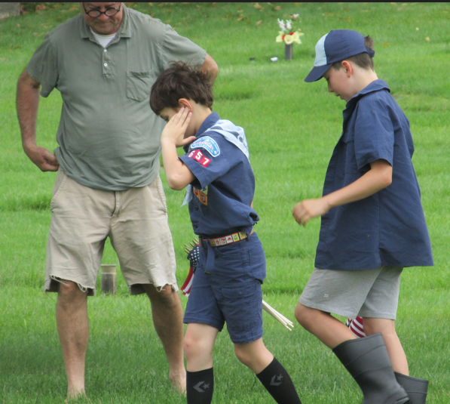
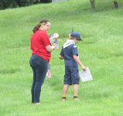
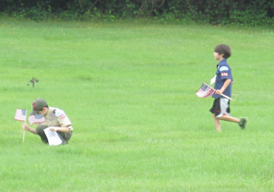
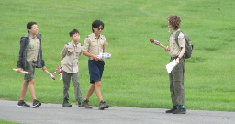
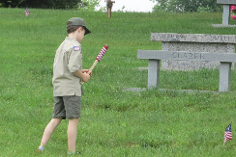
Flags In
Honoring veterans by placing flags on graves at the National memorial Park in Falls Church, VA
Veterans Day – 11/10/24 at 10am

Slide 35
Order of the Arrow
  Brian Fleck is Chapter Advisor.
  2024 Dues can be paid online: https://wipit470.org/dues.html
  Registrations open online https://wipit470.org/index.html under “Events”

