Slide 1
Unit 2 Understanding the outcomes
Work Group Lead Toolkit 2020/21

Slide 2
What are we trying to achieve?

Slide 3
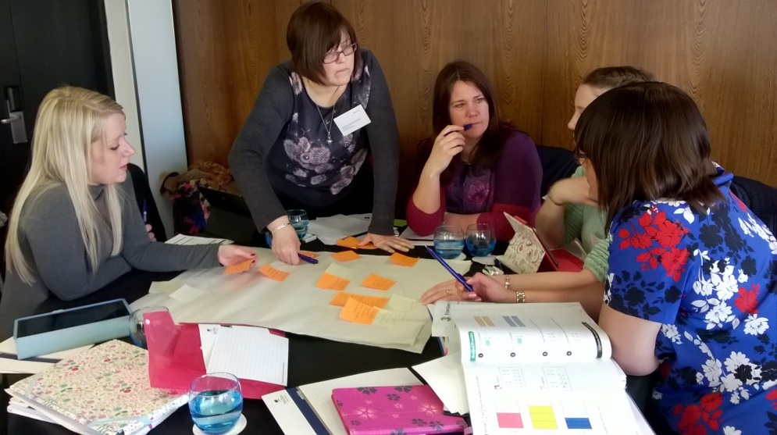
The four-fold outcomes

Slide 4
Outcomes 1 – in the classroom
Professional learning
mathematical knowledge
mathematical pedagogy
attitudes, disposition, beliefs
Pupil outcomes
mathematical experience
attitude to subject and learning
knowledge, skills, understanding
Practice development
planning
teaching
assessing
(inc. materials)

Slide 5
Outcomes 2 – In the staff room or department office
School policy and approaches (outcome 3)
Vision, culture and expectations for mathematics
Mathematics curriculum and pedagogy policy
Culture and practices that support mathematics professional and school development

Slide 6
The four-fold outcomes
Professional learning
Practice development
School policy and approaches
Pupil outcomes

Slide 7
Questioning the outcomes
Can we really plan the outcomes? (intended versus unintended)
When are the outcomes achieved? (during versus after)
Do we need all the types of outcome? (1, 2 or 3 versus 4)
Is there a sequence in the outcomes? (linear versus complex)

Slide 8
Taking it further
Suggestions for reading, watching, listening
Listen to the NCETM podcast: “What is it like to be in a Maths Hub Work Group”
Suggestions for discussion with others
How do you go about clarifying the outcomes for the Work Group in ways that help participants appreciate the intended four-fold impact?

