Slide 1

Alma’s Booking Requests Feature
July 22, 2020
www.suny.edu

Slide 2
Agenda
What is a booking request?
Booking request configuration
Submitting booking requests
Processing booking requests
www.suny.edu

Slide 3
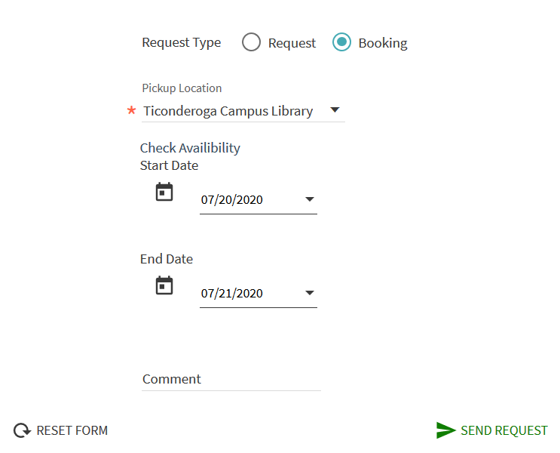
What is a Booking Request?
A booking request reserves an item for a user for a specific period of time
Submitted via Primo using the same request link and form as hold requests
  Users must define both start date/time and end date/time for booking requests
  Items cannot be checked out to other users for set amount of time before Start Date
Staff can also create Booking requests in Alma
Requested items appear in the Pick From Shelf list like holds or resource sharing requests
Possible Uses:
  Managing library space reservations (study rooms, etc).
  Reserving media for classroom use by faculty
www.suny.edu

Slide 4
Configuring Booking Requests
Extremely similar to configuring Hold Requests
  Booking Fulfillment Policies
  Booking Terms of Use
  Booking Fulfillment Unit Rules
  Edit request form
More relevant Fulfillment Policies for Booking than Loans or Requests
Ex Libris did very little Booking configuration during Alma implementation, so you will likely need to do more configuration work than you did when configuring Hold Requests
www.suny.edu

Slide 5
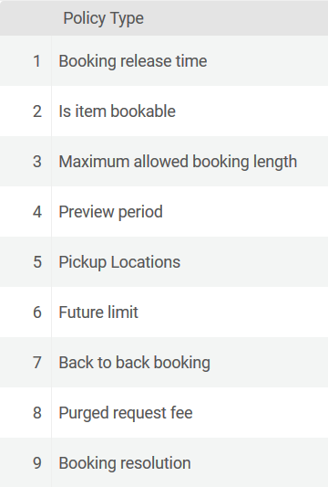
Booking Fulfillment Policies
Is Item Bookable: determines whether booking requests can be submitted for an item
Booking Resolution: determines how specific booking request start and end times can be (minutes, hours, days, days plus overnight)
Maximum Allowed Booking Length: determines the maximum length of a booking request
Future Limit: determines how far in advance booking request can be placed
www.suny.edu

Slide 6
Booking Fulfillment Policies
Preview Period: determines how far in advance of the start time that loans to other users are blocked, also determines when a requested item appears on the Pick From Shelf list
Booking Release Time: determines how long after the start time that the booking request is cancelled if the item is not picked up
Back to Back Booking: determines how long a user must wait to place a second booking request for a previously booked item
Pickup Location: determines where a requested item can be picked up
www.suny.edu

Slide 7
Booking Fulfillment Policies
Configuration | Fulfillment | Physical Fulfillment | Advanced Policy Configuration
Need the Fulfillment Administrator role to configure Booking fulfillment policies
www.suny.edu

Slide 8
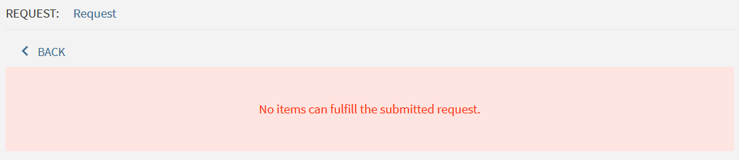
Booking Terms of Use
Configuration | Fulfillment | Physical Fulfillment | Terms of Use and Policies
Need the Fulfillment Administrator role to configure Booking TOUs
Be careful when mixing units of measurement within a Booking TOU!
www.suny.edu

Slide 9
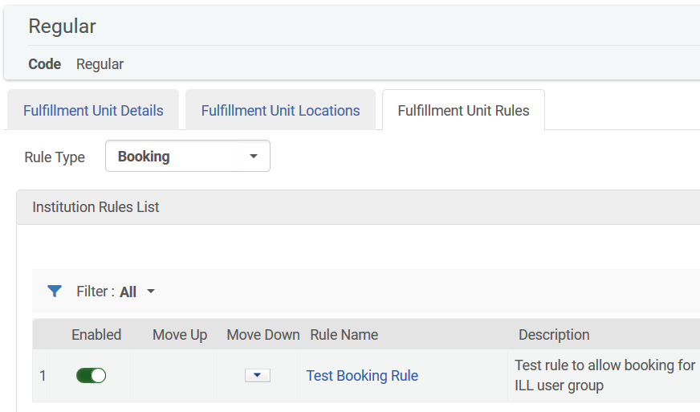
Booking Fulfillment Unit Rules
Configuration | Fulfillment | Physical Fulfillment | Fulfillment Units
Click Fulfillment Unit Rules tab and then select Booking from Rule Type dropdown
Need the Fulfillment Administrator role to configure Booking TOUs
Can apply Booking TOUs based on location, material type, item policy, and user group
On Shelf Request Policy does not matter!
Booking request form usability may shape your Booking TOUs, particularly your Booking Resolution and Maximum Allowed Booking Length
www.suny.edu

Slide 10
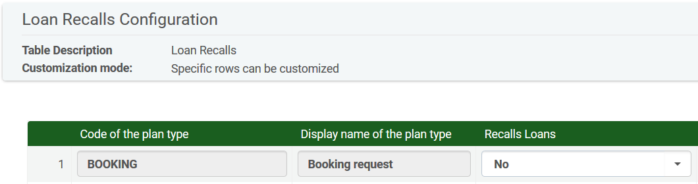
Booking Requests and Recalls
If you want a booking request to function as a recall request, you must:
  Make sure your Loan TOUs allow recalls
  Change the Booking setting in your Loan Recalls Configuration table to “Yes” (Configuration | Fulfillment | Physical Fulfillment | Loan Recalls Configuration)
www.suny.edu

Slide 11
Booking Request Form
Users must select both start and end date, which can be more difficult if your Booking Resolution is Hours or Minutes
  Hours listed in military time
  All 60 minutes in an hour are listed in the Minute dropdown
  Neither of these things can be changed
Users must also select an End Date that falls within your Maximum Allowed Booking Length period
  Selecting an End Date past the Maximum Allowed Booking Length period produces an unhelpful error message
  Auto-populating End Date based on Start Date and Maximum Allowed Booking Length has been added to the Ex Libris development roadmap
www.suny.edu

Slide 12
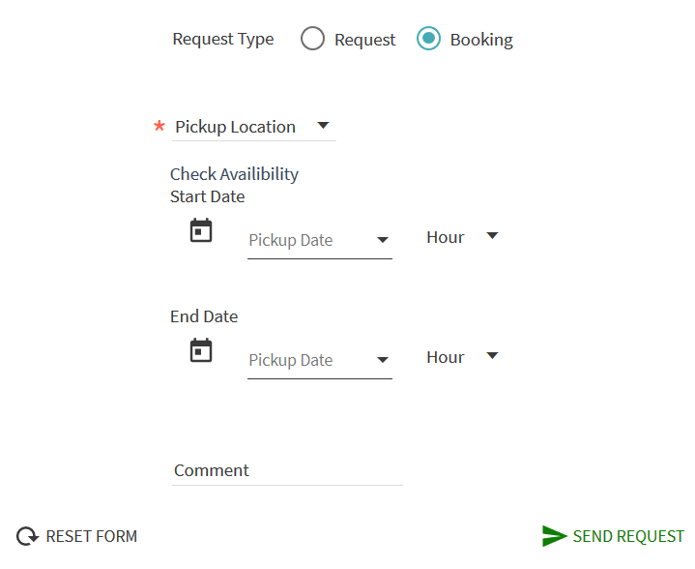
www.suny.edu

Slide 13
Editing the Booking Request Form
Changes to request form can be made in Configuration | Discovery | Display Configuration | Labels
Need Discovery Administrator role
Request Labels (#60)
  Check Availability: almaRequest.checkAvailability
  Start Date: almaRequest.startDate
  End Date: almaRequest.endDate
Request Tab Messages Labels (#62)
  Hour: nui.DatePicker.hour
www.suny.edu

Slide 14
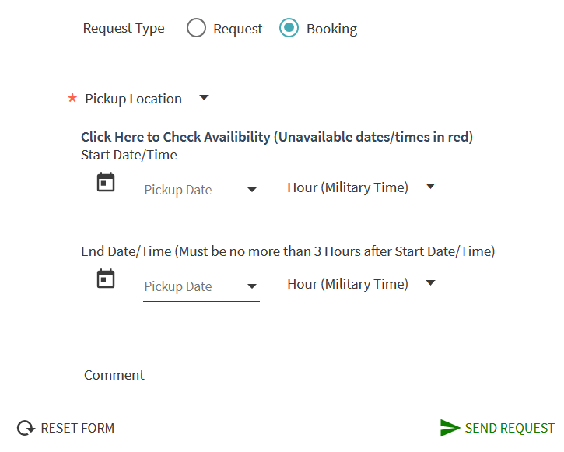
www.suny.edu

Slide 15
Booking Request Configuration Demo
www.suny.edu

Slide 16
Submitting Booking Requests
Users can submit Booking requests in Primo
  Form will default to Request (aka “Hold”) and must be switched to Booking if hold requests are allowed
Staff can create Booking requests for users in Alma
  Selecting Start and End dates is difficult
Once a Booking request is created, the requested item will appear on the Pick From Shelf list either at the start of the Preview Period or the Start Date (if there is no Preview Period)
Requested items will be placed on hold once they are scanned in
www.suny.edu

Slide 17
Submitting Booking Requests
If a user submits a booking request that exceeds the Maximum Allowed Booking Length, they will get an error message
If the user submits a booking request where the Start Date is outside your library’s operating hours, they will get an error message
  This makes same day booking impossible if your Booking Resolution is Days
If the user submits a booking request where the End date is outside the library’s operating hours, the End Date will be pushed out to the next open date
If a user submits a booking request for an item on loan, they will get an error message unless booking requests were configured to function as recalls or the Start Date is after the Due Date
  Booking requests will block or shorten renewals
www.suny.edu

Slide 18
Booking Request Behavior
If a user submits a booking request that exceeds the Maximum Allowed Booking Length, they will get an error message
If the user submits a booking request where the Start Date is outside your library’s operating hours, they will get an error message
If the user submits a booking request where the End date is outside the library’s operating hours, the End Date will be pushed out to the next open date
If a user is submitting a Booking request from a record with multiple items, they must request a specific item
www.suny.edu

Slide 19
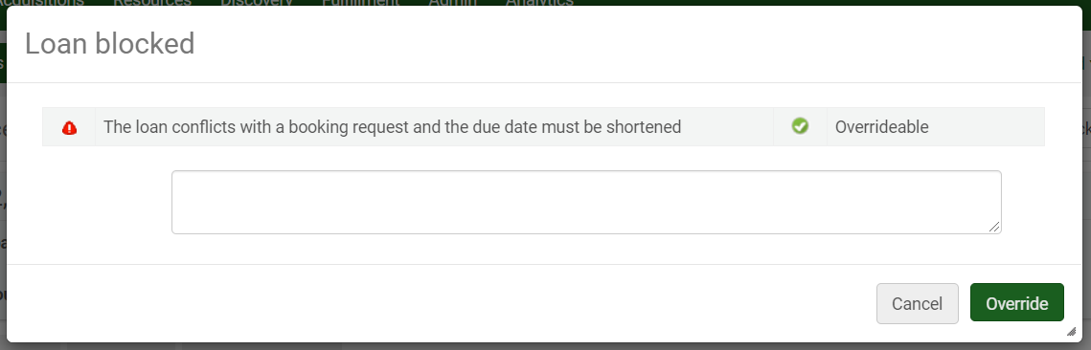
Booking Request Behavior
If the requesting user checks the item out before the Start Date, the request is cancelled
If someone tries to check out an item someone else has booked, a warning message will appear
  If you override the warning, the item will be checked out, but due date will be shortened to match the start of the Preview Period
www.suny.edu

Slide 20
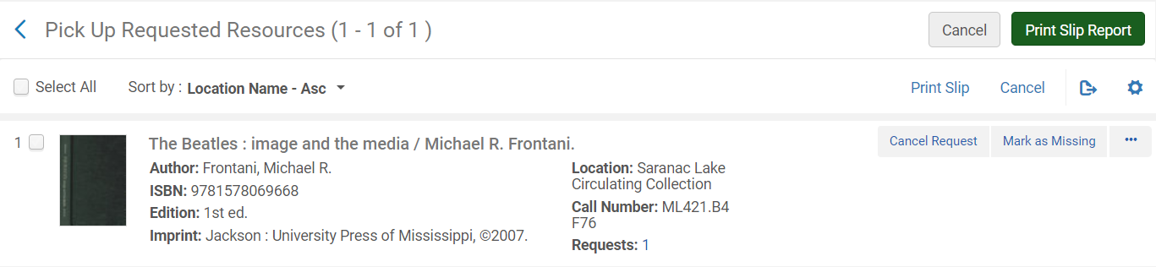
Booking Request Behavior
Booking Requests can be Cancelled or Marked As Missing
Booking Requests cannot be converted into Resource Sharing Requests
www.suny.edu

Slide 21
Booking Request Creation and Processing Demo
www.suny.edu

Slide 22
Need Help?
SLSS can assist with Alma/Primo configuration
Extended Support Campuses
  Post to your extended support Basecamp
All Other Campuses
  Email info@slcny.libanswers.com
FAQ: https://slcny.libanswers.com/faq/313892
www.suny.edu

Slide 23


Questions or Discussion?
www.suny.edu

