Slide 1

Better Together
Family Café:
Cooking up
Healthy Lifestyles
Notes:
Trainer Note: Introduce yourself and welcome participants to the cafe.

Slide 2




Let's get ready!
Rename yourself if your screen does NOT say your name.
Move the mouse over your picture until you see 3 little dots in the top right corner.
Click on the dots and then click on “Rename” and type your first and last name.
Please be actively engaged during our time together
Participating in the chat box, discussing topics, contributing to the conversation
1
4
2
Type the following information in the chat box:
First and last name
Tell us the name of the ECE Program your child attends
5
Please stay muted unless you have a question or comment.
Please turn on your video at this time.
If two of you are watching together, we must be able to see both of you throughout the training.
If you get kicked off during the training due to a technology issue, please log back in using the same link in your confirmation email.
3
6
Notes:
Trainer Note: Omit this slide if you are hosting the cafe in person.

Slide 3
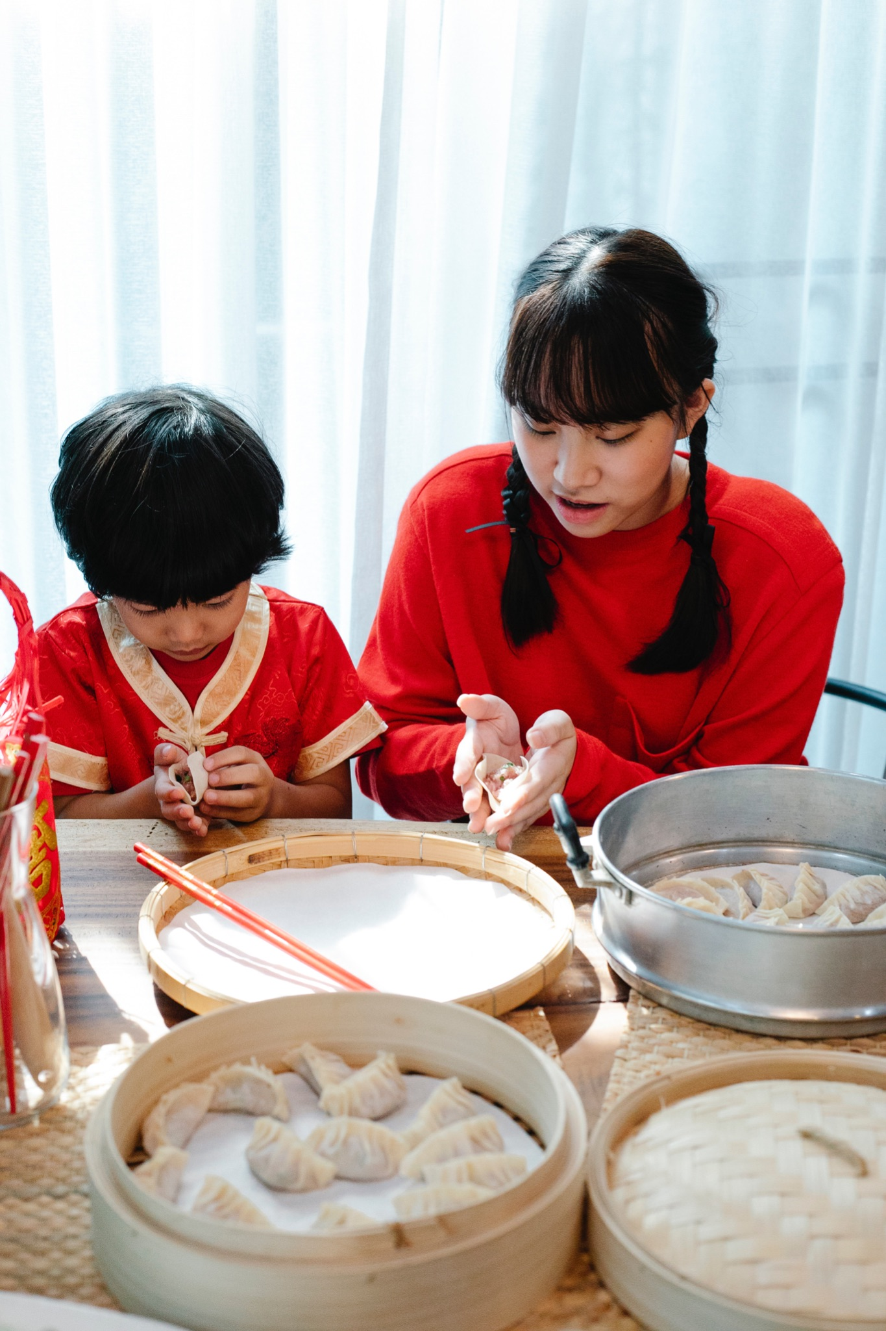
Welcome!
Can you remember a favorite everyday food from when you were growing up?
Notes:
Can you remember a favorite everyday food from when you were growing up?
What is a positive childhood memory you have associated with food?
Trainer Note: Share your own response to start the conversation.
Thank you all for sharing! Now let’s find out a little more about what we’re going to be discussing.

Slide 4
Objectives
To understand how the Four Building Blocks of HOPE (Healthy Outcomes from Positive Experiences) support the development of the child and family
To engage in conversations about creating positive experiences with healthy foods and mealtime activities
Notes:
Objectives for this Better Together Cafe:
To understand how the Four Building Blocks of HOPE (Healthy Outcomes from Positive Experiences) support the development of the child and family
To engage in conversations about create positive experiences with healthy foods and mealtime activities
We will start by discussing the Building Blocks of HOPE.

Slide 5

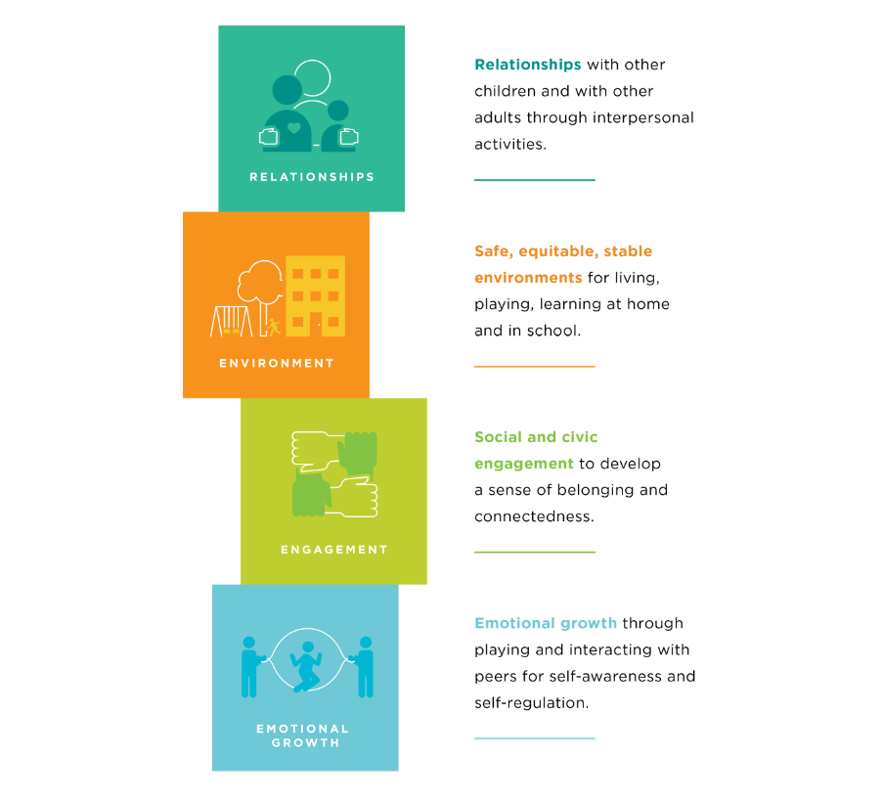


The Four Building Blocks of HOPE
Sege and Browne. Responding to ACEs with HOPE: Health Outcomes from Positive Experiences. Academic Pediatrics 2017; 17:S79-S85
Notes:
Just as ACEs (Adverse Childhood Experiences) are organized into categories or domains, we see that PCEs (positive childhood experiences) can be organized into the Four Building Blocks. HOPE (Healthy Outcomes from Positive Experiences) centers around key Positive Childhood Experiences (PCEs) that buffer against the negative lifelong health effects caused by Adverse Childhood Experiences. These Building Blocks are essential for healthy development - even in the absence of ACES.
Research shows that positive experiences promote children’s long-term health and well-being. They allow children to form strong relationships and meaningful connections, cultivate positive self-image and self-worth, provide a sense of belonging, and build skills to cope with stress in healthy ways.
Now we will look deeper into each of the Four Building Blocks: Relationships, Environment, Engagement, and Emotional Growth
Background Information:
Information about HOPE & the Mission- Spreading-HOPE_FINAL_2.2.2021.pdf (positiveexperience.org)

Slide 6
The Four Building Blocks of HOPE: Relationships
Sege and Browne. Responding to ACEs with HOPE: Health Outcomes from Positive Experiences. Academic Pediatrics 2017; 17:S79-S85
Notes:
Being in nurturing, supportive relationships are critical for children to develop into healthy, resilient adults.
Having key foundational relationships: parents/caregivers who respond to a child’s needs and have warm, responsive interactions.
Having adults outside of the family that take a genuine interest in a child and support their growth and development.
Having healthy, close, and positive relationships with peers.
Trainer Note:
Below is more information regarding this HOPE Building Block. It provides more relatable context. However, if you have already covered the HOPE Building Blocks with the group you are working with in a previous session, please use your discretion in reviewing the information.
For child care providers: Individuals that recall having these types of relationships during childhood experience significantly lower rates of depression and poor mental and physical health during adulthood. When working with families, especially vulnerable families affected by trauma, it is important to ask about the types of positive relationships a parent may recall from their childhood. This information can then be celebrated and used to help create opportunities for their children to experience the types of relationships encompassed by this Building Block of HOPE.
For parents/families: Individuals that recall having these types of relationships during childhood experience significantly lower rates of depression and poor mental and physical health during adulthood. We encourage you to think about these types of positive relationships from your own childhood. Reflecting on this yourself can then be used to help create opportunities for your own children to experience these types of relationships encompassed by this Building Block of HOPE.
As you think about the positive relationships in your life - what characteristics have they had?
Maybe the relationships have been trusting, nurturing, supporting, etc.
The next Building Block we will discuss is Environment.

Slide 7
The Four Building Blocks of HOPE: Environment
Sege and Browne. Responding to ACEs with HOPE: Health Outcomes from Positive Experiences. Academic Pediatrics 2017; 17:S79-S85
Notes:
Children who live, learn, and play in safe and stable environments are less likely to experience poor mental and physical health as adults. So what do we mean by safe and stable environments?
A safe, stable environment, secure in meeting a child’s basic needs, including adequate food, shelter, and healthcare
A school or home where children feel emotionally safe
A stable school environment where children feel valued and receive high-quality education.
A community environment to play and interact with other children safely.
Trainer Note:
Below is more information regarding this HOPE Building Block. It provides more relatable context. However, if you have already covered the HOPE Building Blocks with the group you are working with in a previous session, please use your discretion in reviewing the information.
For providers: It is crucial to ask caregivers about the types of environments their children are experiencing. Celebrate the positive and work with families to help ensure their child has the opportunity to live, learn and play in safe and nurturing environments.
For parents/families: It’s important to think about the type of environment your children are experiencing. Celebrate the positive and work to ensure your child has the opportunity to live, learn, and play in safe and nurturing environments.
Think about your child's environment - what positive things does your child experience in their environments?
Do they have friends in their neighborhood they like to play with? Do you have a garden where they can enjoy learning outside?
Now let’s talk about the Engagement Building Block.

Slide 8
The Four Building Blocks of HOPE: Engagement
Sege and Browne. Responding to ACEs with HOPE: Health Outcomes from Positive Experiences. Academic Pediatrics 2017; 17:S79-S85
Notes:
Children need opportunities for social engagement and to develop a sense of connectedness. Developing a connection to and sense of belonging in a community, as well as a sense that you matter to your community, describes the essence of the third of the Four Building Blocks of HOPE. What are some examples of social and community engagement?
Being involved in projects, peer-mentoring, or community service through one’s school or religious organization.
Partaking in family cultural traditions.
Participating in organized music, art, or sports.
Trainer Note:
Below is more information regarding this HOPE Building Block. It provides more relatable context. However, if you have already covered the HOPE Building Blocks with the group you are working with in a previous session, please use your discretion in reviewing the information.
Children need to feel connected to their communities, loved, and appreciated. Having this type of engagement (involvement in social institutions and environments, awareness of cultural customs and traditions, and a cultivated “sense of mattering” and belonging) helps children develop into secure and resilient adults.
Have any of you experienced positive benefits or had good experiences being part of a community group or friend group that you would be comfortable sharing?
Trainer Note: Add a personal story or experience here if participants don’t feel comfortable sharing.
Now let’s move on to discuss the last Building Block- Emotional Growth.

Slide 9
The Four Building Blocks of HOPE: Emotional Growth
Sege and Browne. Responding to ACEs with HOPE: Health Outcomes from Positive Experiences. Academic Pediatrics 2017; 17:S79-S85
Notes:
The final Building Block of HOPE Emotional Growth: through playing and interacting with peers for self-awareness and self-regulation.
Children need opportunities for social and emotional development. What do we mean by social and emotional development?
Developing a sense of emotional and behavioral self-regulation
Having the ability to respond to challenges in a productive manner
Developing key socially and culturally appropriate communication and interpersonal skills
Children need to have ample opportunity to develop their sense of social and self-awareness, learn how to self-regulate emotions and behaviors, and acquire skills needed to respond functionally and productively to challenges.
Trainer Note: (emphasize this point)- Opportunities to develop these skills arise during child-centered play. Children need the support of adults to name and understand make meaning of their emotions. Whether a child needs help developing these skills or they naturally pick up on them, these skills are critical for children to be able to become resilient, emotionally healthy adults.
Trainer note:
Examples of what play and social emotional development looks like-
Play pretend with baby dolls with your child. This helps develop empathy as young as 18 months. Narrating what you’re doing by responding to the baby “crying” and naming their feelings. “Oh the baby must be sad”. Then give the doll to your child and encourage them to do the same.
Playing dress up and imitating housework activities to help them develop a sense of independence.
Practice taking turns. Grab a race car, and give a car to the child. Use cues such as “my turn, your turn, I love the way you’re being patient as you are waiting for your turn”. You can even practice this skill with an infant by playing games such as peek a boo and cooing back and forth.

Slide 10
Why HOPE?
Positive experiences help children grow into resilient, healthy adults, and they can help lessen the effects of adversity.
HOPE aims to evolve our understanding and support
of these key experiences.
Notes:
By promoting the HOPE Building Blocks, we aim to support resiliency for our families. We want to encourage positive experiences and the Building Blocks to help children grow into resilient, healthy adults, and to help lessen the effects of adversity.
We will now move into our partner activity.

Slide 11



Partner Activity
“Friendship is born at that moment when one person says to another: ‘What! You too? I thought I was the only one.” -C.S. Lewis
Share with your partner an unusual food pairing that you love.
Notes:
Trainer Note:
Ten minute activity: Four minutes in groups or breakout rooms, six minutes to debrief upon return
Pose question to participants: Share with your partner an unusual food pairing that you love.
Send participants to groups or breakout rooms in groups of two-three. Allow four minutes total, approximately two minutes for each partner to share.
Debrief:
We invite anyone to share your own thoughts or share something from your partner, whatever you are most comfortable with.
Trainer note:
If no one speaks up during debrief, trainer can share example first.
Relate experiences to the point that all taste buds are different, and everyone has their own preferences when it comes to taste, food, and texture. Encourage participants to keep this in mind moving through the session as we begin to talk about children developing their own food preferences.
Thank you all for participating in our partner activity!

Slide 12

Did You Know?
Many children need to be offered a food 8-10 times before they will try it. Keep offering a variety of foods, and watch what happens over time!
Notes:
Children might not like a new fruit or vegetable on the first try. Many children need to be offered a food about eight-ten times before they will try it, and it can even take as many as eighteen tries (or more) for a child to consider a new food to be normal! Be patient and look for small wins. Offer foods on many different occasions. Encourage them to put it on their plate, touch it, pick it up, and taste it. All are signs of curiosity that can eventually lead to acceptance. However, we do not force a child to touch or taste a food. It’s okay to give very, very small portions. It's okay for children to try ONE bite of something rather than a full portion. Especially when they’re just trying, that’s a win!
It is also important to note that a common misconception is that they don’t like what is served if they don't eat everything on their plate. If they don’t eat a full dinner, it may just be that they aren’t hungry. It’s not necessarily that they don’t like the food offered. Sometimes they eat, sometimes they don't. Consider, is the child really hungry?
We are now going to dive into some things to consider when planning a healthy meal.
Background Information:
Great article discussing food exposure and influences: https://www.ncbi.nlm.nih.gov/pmc/articles/PMC4717879/
The optimal number of required exposures is at least five–six exposures to a new food, and perhaps as many as eight–twelve exposures. (source: https://www.ncbi.nlm.nih.gov/pmc/articles/PMC4717879/)

Slide 13
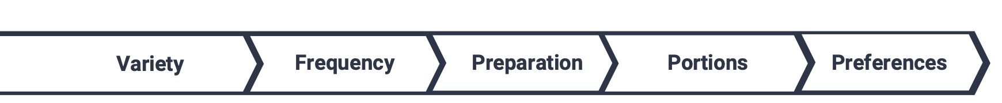
Considerations for Planning Healthy Meals
Which foods are served across a variety of food groups?
How often are foods served?
How is food prepared?
How much food is served?
What are your children's food preferences?
Notes:
Trainer Note: Add personal experience when discussing these points
Providing healthy foods can seem overwhelming because there are so many important considerations to keep in mind. Right now, we will focus on what we know is nutritionally best for children.
Variety: For complete nutrition, children need to eat a variety of foods, including different food groups and different types of foods within each food group.
Frequency: Offer fruits and vegetables multiple times a day so children have many opportunities to try or explore these foods.
Preparation: How the food is prepared
Choosing cooking methods like baking instead of frying. Fresh foods are a great choice, but when choosing frozen and canned items look for items with less sodium and no or low added sugars. This will help build a solid foundation for a healthy menu.
Think through your week and have a plan. Map out which meals need to be prepared in advance, or meals that need to be “quick” due to extra curricular activities (baseball games, older sister has piano, etc). If you have 5 minutes to spare, chop your veggies and have them in the fridge. Grill a large portion of meat at one time so you have protein for multiple meals.
Portions: How much is served
Children’s appetites can vary widely from day to day and week to week.
Recall that sometimes a child may not be hungry and it’s okay to give them something small.
Preferences: Children can have their own food and eating preferences!
They may refuse or be reluctant to try fruits, vegetables, other new foods, or foods prepared in new ways. You don’t want food to go to waste, so you serve foods you know children will like and eat with minimal fuss. We often call these children “picky eaters,” but aversions to certain foods, tastes, and textures are a normal part of child development. There are solutions to help children become more willing to explore new foods. Important note: We should not label children as picky eaters (some children will inadvertently try to live up to this label), but continue to encourage them to try new and unfamiliar foods.
Also remember children growing up in different cultures have different food aversions. For example, in Asian cultures where dairy is not part of the traditional diet, young children may turn away from mac and cheese!
However, we can have the most beautifully plated, nutritious meal in front of our kiddos, but they too have responsibilities when it comes to feeding.

Slide 14
Division of Responsibility in Feeding
What foods are served across a variety of food groups.
Adult’s responsibilities:
Children's responsibilities:
What food is served
When food is served
Where eating takes place
Whether or not to eat
How much to eat
Notes:
We have to understand the roles in the feeding relationship in order to help children learn to develop healthy eating habits.
Adults are responsible for what (foods are served), when (mealtime is happening), and where (meals are eaten)
Children are responsible for whether or not to eat and how much they want to eat.
Infants are a bit different since their eating can ebb and flow with their own eating patterns. So, for infants, we need to listen and watch for hunger cues and respond.
We, as adults, can only control so much when it come to feeding our children. One thing we can control, is our language we use around food and mealtime, which we will explore next.

Slide 15
Phrases that Hinder vs. Phrases that Help
“Good job finishing all of your food!”
“What was your favorite part of the meal? What would you like to have again?”
“You have to eat that.”
“These radishes are crunchy! What other vegetables are crunchy?”
“If you try the new food, you can have dessert.”
"I see you still have peas and mashed potatoes on your plate. Which would you like to taste first?"
Notes:
“Kids should not eat to please someone else.” -Dr. Bob (HOPE)
Instead of saying, “Good job finishing all of your food”, say —> ”What did you like? What was your favorite part of the meal? What would you like to have again?” (Avoid praising for eating all their food.) We often say "good job" or "that's awesome" as a way to let children know they have pleased us. Instead, we want to focus on asking children to reflect on their preferences. Eating is just one place where we can model this behavior in how we talk.
“You have to eat that.” → “These radishes are crunchy! What other vegetables are crunchy?” Spark curiosity and exploration to get them thinking about what they may want to try on their plate.
“If you try the new food, you can have dessert.” → "I see you still have peas and mashed potatoes on your plate. Which would you like to taste first?" Remember choices are a powerful tool. (Trainer Note: reiterate that if they decline when giving them choices; it's not a power struggle.) Also notice using the word “taste” is an exploratory word. It encourages curiosity and exploration. Answers to what something tastes like are more descriptive, where the phrase “try it” leads the child to think “yes or no”.
Trainer notes:
Remind participants to:
Model trying new foods. Remember children are always watching you – the adult they want to copy. Watching you eat new foods and especially talk about those you like will encourage children to consider trying new foods.
Tell stories about the first time you tried a new food. Did you like it the first time or did it take several opportunities to try before you liked it? Share that experience with children. Trying new foods helps our taste buds learn to like different things.
Talk about different ways to prepare foods. Give an example of how you may not like a food prepared in one way (i.e. canned asparagus) but may LOVE it prepared a different way (ie. grilled asparagus). And, remind them of times when this is true for them if you have specific examples.

Slide 16
Additional Strategies
Take the “Bread and Jam for Frances” approach
Wrap up the plate and save it for later
Offer a safety food
Offer new foods along with foods they are familiar with
Get the child involved in planning and preparation
“Thank you” bites
Notes:
You may wonder, what if they eat nothing on their plate? What do I do then?
One strategy for picky eaters is the “Bread and Jam for Frances” (a book by Russell Hoban) approach. Offer a single boring but acceptable alternative if the child is hungry. Yogurt, peanut butter and jelly sandwich etc. That way parents can feel that they are offering their children something to eat without a challenge. Eventually, children get bored of the alternative and explore on their own. This preserves the Relationship Building Block and also promotes the child's own emotional growth, as they feel respected and allowed to explore.
Trainer Note: Background of the book “Bread and Jam for Frances”-Frances is a fussy eater. In fact, the only thing she likes is bread and jam. So she's delighted when Mother and Father grant her wish and give her bread and jam at every meal.
Wrap it up and save their dinner for later. When the child comes back hungry, you can let them know you saved their dinner plate!
Offer a “safety food” with the original meal- a safety food is a food they are familiar with and you know they enjoy. Not necessarily endless mac & cheese, but if they have tried corn, and like corn, offer it as an additional side option.
Trainer Note: This is a strategy adapted from Solid Starts, which is listed in our resources on the handout that goes along with this session.
When offering a new food, do it one at a time along with other foods the child likes. This allows them to have “safe” options on their plate.
Getting kids involved with meal prep. Let them help by washing fruits or veggies, using a kid friendly knife to cut up softer produce like strawberries or mushrooms, etc. When planning your meals, get the kids involved and start a conversation about adding in a new food.
“Thank you bites” can always be helpful- encouraging the child to take at least one bite. After they take a bite, they can then say “no thank you” if they do not wish to eat any more of that particular food.
The overarching message is that the emotional environment of eating is (usually) more important than getting children to eat a particular food. Most children go through phases with their eating, be prepared to continue to offer new foods AND have a fallback for the expected food refusals. We want to preserve the relationship between parents and children, and allow the child to develop the autonomy that they need.
As we will get into the discussion questions, you will be able to learn and adapt more strategies from the families in this Cafe.

Slide 17
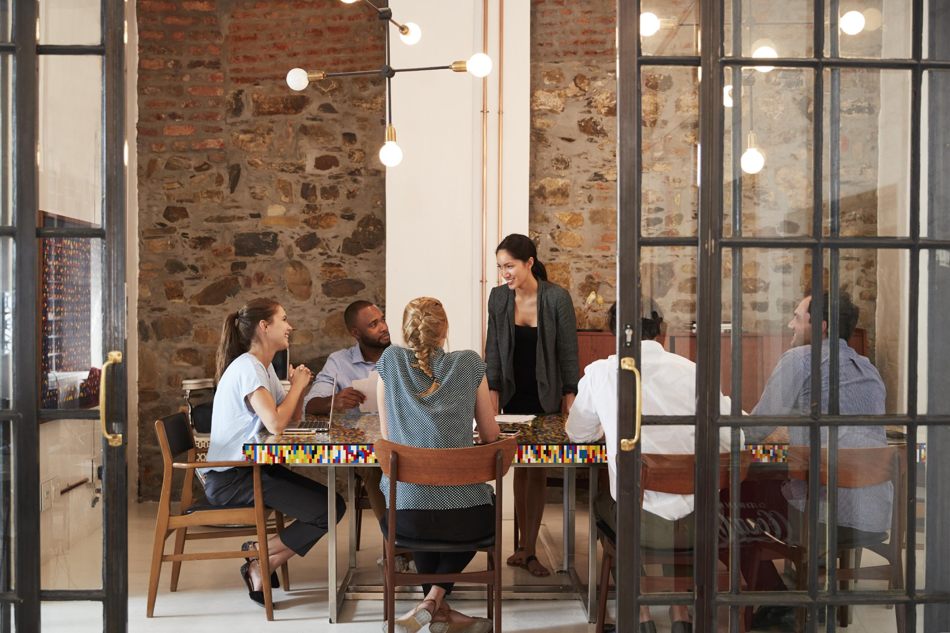
Creating an Emotionally Safe Environment
Active listening
Judgement free zone/safe place
Confidentiality
All responses welcome!
Notes:
Before we move into the discussion, we want to make sure we are setting a space for a positive environment and experience for all who are participating today. This will help set the stage for our conversations.
Active listening- truly listening to everyone sharing and being present
Judgement free zone/safe place- This is a judgement free zone in order to help create a safe place.
Confidentiality-What happens in the café, stays in the café!
All responses welcome! We encourage everyone to be open in sharing their thoughts and experiences. That's what makes a cafe so special!
Any questions? Alright, let’s dive into the Cafe questions.

Slide 18
Cafe Questions
Cooking up Healthy Lifestyles
Notes:
Trainer Note: Based on the number of participants, divide into groups of up to five people. Breakout rooms will be used for each of the cafe questions. Small group discussions should last for eight-ten minutes.
If the Cafe is in person, refer to the Better Together Family Cafe Toolkit for facilitation instructions.
At this time, give a brief explanation of how the cafe portion works to the participants.
Sample Script (This will vary based on several factors: in person/virtual, large group/small group, etc):
We are about to move into the cafe questions. During this time, you will have about eight minutes with your group to discuss the each question. This is an opportunity to connect and collaborate with each other. After each cafe question, we will come back together to debrief our discussion with the whole group.

Slide 19

#1
When have you felt successful in your meal planning/preparation? What made it feel successful?
Notes:
When have you felt successful in your meal planning/preparation? What made it feel successful?

Slide 20

#2
What are some creative ways you have supported your children in trying new foods?
Notes:
What are some creative ways you have supported your children in trying new foods?
Trainer Note:
Share a couple of examples listed here, or your own examples to get participants thinking. Examples- special names, fun ways to prepare and serve the food, have child help in food preparation; introduce before mealtime and allow children to learn about it first, then introduce it as a food option at another time; cut in interesting shapes; allow child to choose which new thing to try. How have you managed a situation where they don’t like food that's offered?

Slide 21

What are some strategies you learned today and how will you apply them when introducing new foods to your child?
#3
Notes:
What are some strategies you learned today and how will you apply them when introducing new foods to your child?

Slide 22
Reflection
How do you feel after listening to the responses from the other participants?
How did you feel sharing your own thoughts and experiences?
What is one thing you will take away from today?
Notes:
Trainer Note: It is important to ask each reflection question individually and allow wait time for responses.

Slide 23
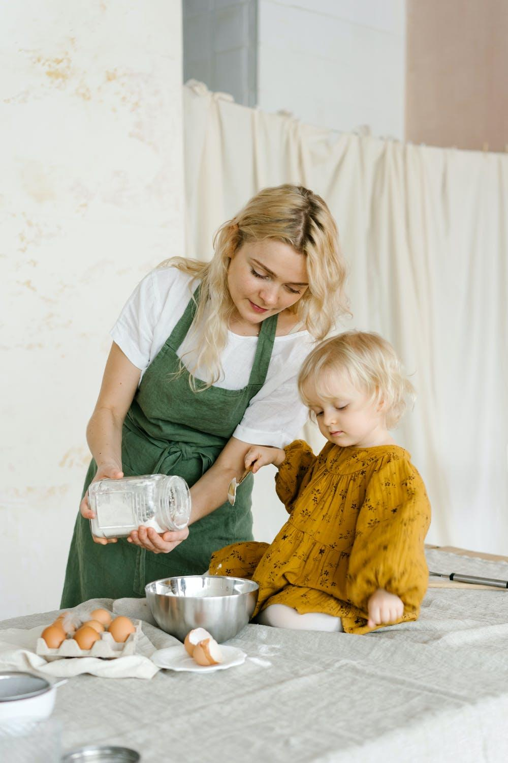
Note to Self
What is one way you can incorporate one or more of the HOPE Building Blocks into your mealtime routine?
Notes:
What is one way you can incorporate one or more of the HOPE Building Blocks into your mealtime routine?
Trainer Note:
Examples include:
-Eating as a family supports relationships & emotional growth BB
-Meal prep- supports relationships & environment BB

Slide 24
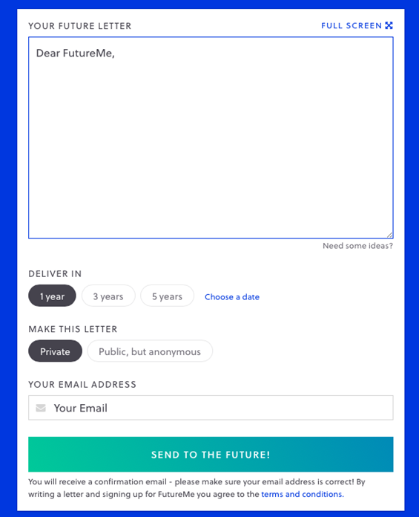
Futureme.org
Type response after reflecting on the
“Note to Self”
Click ‘Choose a Date”
  Enter the date two weeks from today
Make this letter private
Type in your email address
Click “Send to the Future!”
Notes:
Trainer Note: Only use this slide if you are hosting the cafe virtually. If you are hosting in person, please refer to the Better Together Family Cafe Toolkit for more details.
Futureme.org is a website we suggest using for the Note to Self. Type in your response, click “Choose a Date” and enter the date two weeks from today. Keep the letter private. Type in your email address. Click “Send to the Future!” On your selected date, your note to self will arrive in your email to serve as a reminder of the positive experience you wanted to create for your family.
Background Information:
https://www.futureme.org is a website participants can use, especially virtually, to send the note to self. The link and information should be included in the follow up email if the cafe is done virtually.

Slide 25
Questions?
Notes:
Trainer Note: This slide can be used to discuss any questions, evaluations, next steps, etc.

Slide 26


THANK YOU!
Notes:
Type your notes

