Slide 1
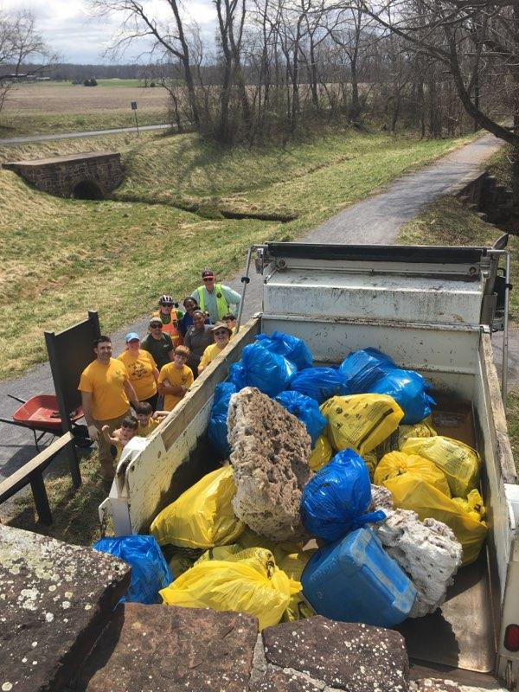
5th Annual Chesapeake and Ohio Canal Clean Up
Saturday, April 5th and Sunday, April 6th, 2025
Open to
Cubs, Scouts BSA and other interested organizations.
Register here: https://scoutingevent.com/082-MontSvcArea2025CO
Once again, we are planning on having three sessions, spread over two days, with each session being at a different location:
Saturday morning, April 5th, 2025, from 8:45 am until noon at the White’s Ferry parking Lot, 24801 Whites Ferry Road, Dickerson, MD 20842.
Saturday afternoon, April 5th, 2025, from 1:00 pm until 4:00 pm at the Dickerson Conservation Parking Lot, 20700 Martinsburg Road, Dickerson, MD 20842
Sunday afternoon, April 6th, 2025, from 1:00 pm until 4:00 pm at the Monocacy Aqueduct Parking Lot, 21115 Mouth of Monocacy Road, Dickerson, MD 20842 (drive to the end of Mouth of Monocacy Road to get to the parking area)
Open to scouts of all ages!
Scout service hours and Montgomery County Student Service Learning (SSL) hours will be earned.
Trash bags and gloves will be provided.
If you can bring a wheelbarrow to haul trash back to the collection site, that would be appreciated!
Note that this event qualifies for part of the requirements for the Scouting for Clean Waterways Award
All volunteers will need to fill out a Volunteer Service Agreement, which is required by the National Park Service. Make sure both sides of the form are filled out.

