Slide 1

Shared LSP Update
November 25, 2019
www.suny.edu

Slide 2
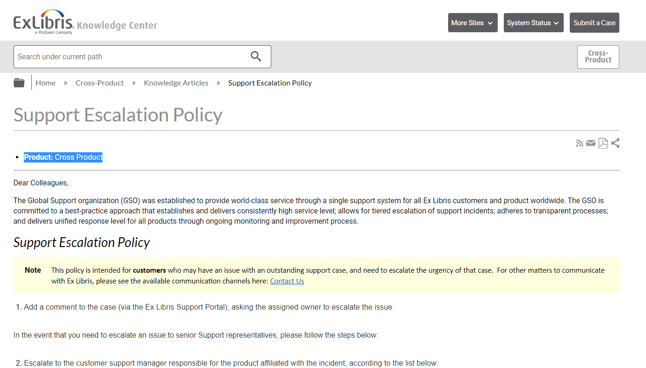
Support Update
SLSS/SLC met with:
  ExLibris support managers on November 20th.
Continuing targeted discussions on Primo VE issues.
If you have issues, please submit Salesforce cases.
Don’t hesitate to escalate or provide feedback if you want an update on your case.
https://knowledge.exlibrisgroup.com/Cross_Product/Knowledge_Articles/Escalation_Policy
www.suny.edu

Slide 3
General Support Trends and Comments
Linking issues are still taking a while to resolve.
Many cases sitting for a long time waiting for information from campus or pending customer response.
The more focused the question, the better the response.
The time to response for tier 1 analysis is an area where we’re looking for improvement.
Think critically about the priority on the case. ExLibris takes these seriously. So, if something’s a high priority, let them know.
We’re starting to get a sizable and growing number of “pending release” and “pending development” cases.
www.suny.edu

Slide 4
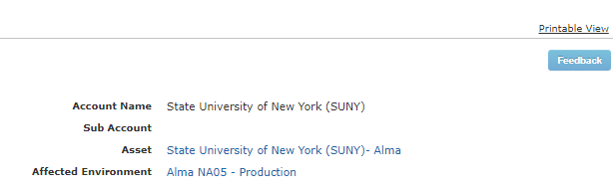
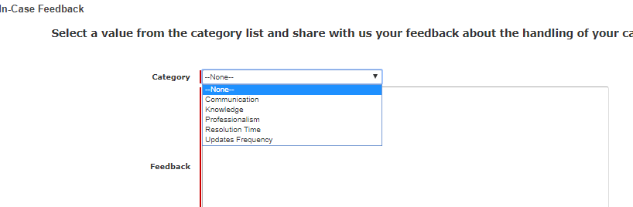
Follow Up Matters
If you’re not getting a response in the time you’d like (within Response Level requirements), please:
  Add a comment asking directly for an update.
  Submit in-case feedback
  If the issue is highly problematic, escalate it.
www.suny.edu

Slide 5
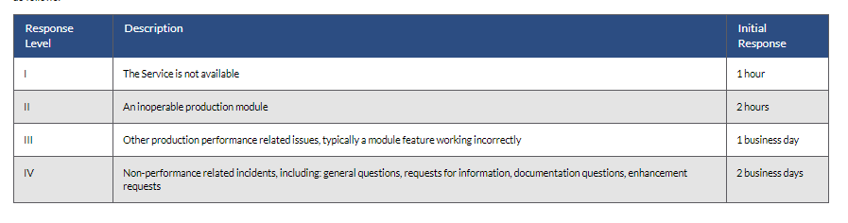
How you can help us.
Seeing many cases that are not meeting SLA response times, especially for Response Level IV.
After 2 business days, please leave case feedback “Updates Frequency,” and then leave comment that there has been no response.
https://knowledge.exlibrisgroup.com/Alma/Product_Materials/050Alma_FAQs/General/Support
www.suny.edu

Slide 6
New Method for SLSS Initiatives
SLSS will be providing webpage of initiatives that we’ll be working on over the next year.
Initiatives will be divided by quarter of the year to give you a general sense of when we’re planning to begin/implement activities.
Will post initiatives document to Basecamp later this week.
Ideas or suggestions for initiatives should be sent to appropriate SLC Working Group.
www.suny.edu

Slide 7
Institutional Leads + Other Campus Contacts
Thanks to everyone who updated their campus contacts.
Resource Sharing contact and Cataloging contact added.
If SLSS staff need something from either cataloging and/or Resource Sharing, they will reach out directly to the person who is the contact in that area.
www.suny.edu

Slide 8
SIS Integration
SLSS and SICAS discussed upcoming improvements to include preferred names, handling of preferred addresses and missing address information, and other improvements to required fields.
SICAS forming a focus group to review SORYALM in near future, and SLSS has sent suggested campuses and contacts.
No firm date set for focus groups or release of new versions of SORYALM.
Only 2 campuses have not run SIS integration at least once.
SLSS has developed processes to handle file and data manipulation for campuses who have unique local needs or situations regarding SIS synchronization.
www.suny.edu

Slide 9
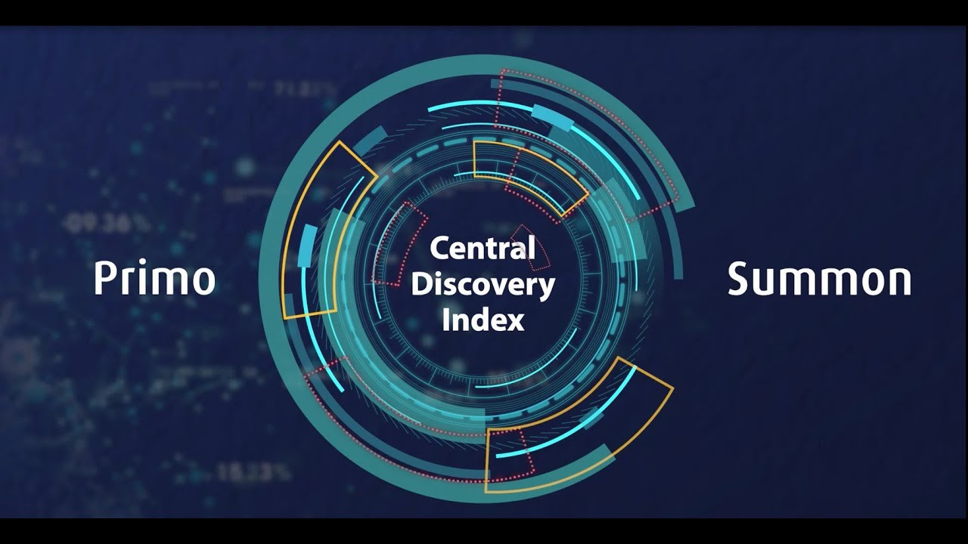
Central Discovery Index Update
Coming soon!
CDI Task Force has begun testing:
  Week 1 Move Report
  Week 2 Alma Activation workflow
  Week 3 – end of testing: comparing PCI and CDI searching
Communicating with Ex Libris via Basecamp group
Deliverables at end of test period will be:
  SUNY HQ Basecamp update on findings
  Best Practices documentation for SUNY
  CDI Training
Ex Libris YouTube https://www.youtube.com/watch?v=9k-JZdtSuo8
www.suny.edu

Slide 10

December Alma/Primo Highlights
Alma Release Notes
Primo VE Release Notes
Alma: new merge patron option
Primo: Pending Approval codes added to Loans List Labels code table to improve the messages displayed in My Library Card during the loan renewal process
Virtual Browse: can choose to include electronic material
www.suny.edu

Slide 11

Café Alma:
December is Discovery month. Pick up some tips to help you trim your Primo VE tree over the winter break. Spruce up your discovery skills and share your holiday joy with your colleagues.
December 5 | Discovery - Web Design
December 12 | Discovery - Widgets
December 19 | Discovery - Central Discovery Index (CDI) and Indexing
January 9 | Discovery - Open Call
Visit Café Alma online for sign up info, session links, presenter and host guidelines, and other details.
www.suny.edu

Slide 12
Statistics: 5 Months since Go-live!
110
FAQs Added
211
Tickets Answered
Busiest Search Time:
10 AM
Most Viewed FAQ:
How do EBSCO databases work in Alma and Primo, and what is alternative coverage?
708 views
Top Search Terms:
Resource Sharing
ILLiad
19,752
FAQ Views
Busiest Search Day:
Wednesday
www.suny.edu

Slide 13

Resource Sharing Update
Timothy Jackson
www.suny.edu

Slide 14
November Resource Sharing Volumes
Top 10 Borrowers |  | Top 10 Lenders
Campus | Volume | Campus | Volume
1. University at Buffalo | 624 | 1. University at Albany | 207
2. SUNY Geneseo | 128 | 2. Binghamton University | 190
3. Binghamton University | 120 | 3. University at Buffalo | 87
4. University at Albany | 112 | 4. The College at Brockport | 71
5. SUNY Purchase | 111 | 5. SUNY New Paltz | 66
6. SUNY New Paltz | 58 | 6. Erie Community College | 56
7. SUNY Oneonta | 33 | 7. Buffalo State College | 54
8. SUNY Oswego | 32 | 8. SUNY Oswego | 54
9. The College at Brockport | 32 | 9. SUNY Oneonta | 53
10. Hudson Valley Comm. Coll. | 24 | 10. SUNY Potsdam | 39

Slide 15
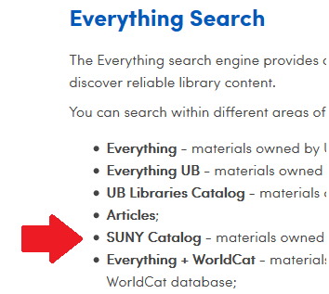
November Resource Sharing Volume Takeaways
The University at Buffalo is still the biggest borrower in SUNY by a wide margin because they’re one of the few libraries to add the SUNY Catalog scope to their Everything search
Using customized rotas to divert more lending requests to Buffalo
  Thank you to SUNY Geneseo for testing this
Will be reaching out to other libraries about customized rota management over winter break
www.suny.edu

Slide 16
Resource Sharing Turnaround Time and Fill Rate Statistics
Month | Fill Rate | Turnaround Time
August | 50.2% | 4.7 days
September | 54.0% | 4.3 days
October | 56.1% | 4.3 days
November | 59.5% | 3.9 days
www.suny.edu

Slide 17
Resource Sharing Turnaround Time and Fill Rate Takeaways
Turnaround times are improving
Fill rates are also improving
Recent improvements likely the result of work done to divert article requests from Alma to ILLiad (thank you, Kristy Lee!)
Tim & Michelle will be conducting session on ILLiad GES & Display Logic on December 11
Continuing to work with Ex Libris on potential locate issues
www.suny.edu

Slide 18
Other Resource Sharing Issues
Printouts queue now available to all user roles
Issues with Alma’s Conditionals feature have been resolved, so that function will be added to everyone’s RS Workflow Profiles soon
Some RS request statuses are not being monitored on a consistent basis (locate failures, renewal requests)
Training sessions on more advanced resource sharing workflows will be held in December
  Lending: Friday, December 6 at 1:00pm
  Borrowing: Friday, December 13 at 1:00pm
www.suny.edu

Slide 19


November Alma Release
New method for exporting unfilled resource sharing requests to ILLiad
Uses an API, not ILLiad's email import feature
How to Configure:
  https://slcny.libanswers.com/faq/274823
How it Works:
  https://slcny.libanswers.com/faq/274840
Working on borrowing NCIP addon to improve ILLiad/Alma integration
www.suny.edu

Slide 20
Network Zone
Maggie McGee
www.suny.edu

Slide 21
Network Maintenance
Purging physical ghost bib records in the NZ has been post-poned to allow campuses more time to link their unlinked IZ bib records to the NZ
On-going deletion of e-resources in the NZ that do not have campus holdings. The e-resources in the NZ were either:
  Migrated
  Imported into the NZ from:
    OCLC nightly jobs
    OCLC NZ export via the NZ OCLC export in Alma
Updated the NZ filter used for import profiles to refine the exclusion of e-resource into the NZ
  008 position 23 of q – direct electronic
  337 $a with computer
www.suny.edu
Notes:
Good attendance and engagement for all sessions. A successful switch to registration-based training, which makes it easier to communicate with and count participants.

Slide 22
API Based Ordering Task Force
Members:
  Marla Gruner, Ulster CC
  Kate Jones, Oswego
  Maggie Mcgee, SLSS, Chair
  Jason Parker, Buffalo
  Noah Roth, Broome Community College
  Marian Stern, Binghamton
Task force commenced on 11/4/2019
Expected completion of the task force is February/March 2020
Focus of the task force is to evaluate how API based ordering will work with the SUNY Network Zone environment and to create policies and best practices on our findings
Task Force Libguide: https://slcny.libguides.com/api-task-force
www.suny.edu
Notes:
Good attendance and engagement for all sessions. A successful switch to registration-based training, which makes it easier to communicate with and count participants.

Slide 23
OCLC New FTP Server
OCLC customers are required to move to their new ftp server by 12/31/2019
  OCLC documentation on the upcoming server changes: https://help.oclc.org/Librarian_Toolbox/Exchange_files_with_OCLC
Testing of the new OCLC ftp server revealed a problem that Alma does not allow the absolute path to be used. As a resullt, publishing profiles files being sent to OCLC from Alma are not being sent to the correct folder in the OCLC Worldshare data sync collections
The SLSS is working with Ex Libris and OCLC to resolve this issue
  Case 00736685 was opened on October 4, 2019
  Met with Ex Libris and OCLC on November 22, 2019
  Case 00736685 was escaleted on November 22, 2019
www.suny.edu
Notes:
Good attendance and engagement for all sessions. A successful switch to registration-based training, which makes it easier to communicate with and count participants.

Slide 24
Alma Releases Related to Resource Management
November
  Institution Zone and Network Zone included as Search Resources in Search Profile
    https://public.3.basecamp.com/p/WXcqXbmJjQxB4Y17eaF9XeEG
December
  Physical items export will now include the "other system number" - 035 $a (OCLC number)
  Semi-annual re-indexing will be run to improve Alma's search mechanism
  A local call number duplication check was added, with 905$s added to MARC21& Kormarc options. In order to enable this feature, contact Ex Libris customer support
  In MD Import, the ISBN (exact subfield match)/024/035 match method found matches between 020$$z of the imported record and 020$$a of the existing record, as did the ISSN (exact subfield match)/024/035 match method with 022 fields, correspondingly. This was fixed. Matches are now found only between the same subfields
  Loan statistics will be viewable from a physical title repository search
www.suny.edu
Notes:
Good attendance and engagement for all sessions. A successful switch to registration-based training, which makes it easier to communicate with and count participants.

Slide 25
Training Update
Jennifer Koerber
www.suny.edu

Slide 26
Recent Trainings
"A New Method for Exporting Unfilled Resources Sharing Requests from Alma to ILLiad" – Nov 5, webinar
"Analytics Basics Training" – Nov 6 & 7, full-day sessions in person at Syracuse and Middletown
"Unpaywall Linking and Monitoring CZ Tasks" – Nov 15, webinar
"Alma's New Letter Editing Features" – Nov 20, webinar
www.suny.edu
Notes:
Good attendance and engagement for all sessions. A successful switch to registration-based training, which makes it easier to communicate with and count participants.

Slide 27
Upcoming Trainings
"Advanced Search or Analytics?" on December 3, 11am
"EBook Activation" on December 4, 11am
"Advanced Resource Sharing Lending Workflows," December 6, 1pm
"Ordering eBooks in the IZ", December 10, 10am
"'Share With Network' in the MDE," December 12, 10am
"Managing RS Requests from Link Resolver," December 11, 1pm
"Advanced Resource Sharing Borrowing Workflows," December 13, 1pm
"Making OER Content Discoverable in Primo" December 16, 10am
"Merging Brief Records in the MDE," December 17, 10am
"Keeping Local Collections Up to Date" on December 18, 11am
SiS Load Working Sessions, December 19 & 20 and January 6 - 8
www.suny.edu
Notes:
As trainings are scheduled, we'll add them to the training calendar, which is where all registration information, pre-requisites or pre-work, and webinar information will be.

Slide 28
Looking Ahead
Bookmark the Training Calendar: https://slcny.libcal.com/calendar/training/
  "Alma/Primo VE Analytics Overview" (1 session, TBD in December)
  "Creating Analytics Dashboards," (1 session, TBD in December)
  Monitoring Resource Sharing Request Lists & Active Notes
  (2 sessions, TBD)
Working on both a 6-month training plan and curriculum maps,
to provide training on a more regular schedule
www.suny.edu

Slide 29
Looking Ahead
First functional area training guides will be published in December
  Alma & Primo VE Training overview guide (aka, "Where do I start?")
  Alma Search & Navigation
  Fulfillment
  Analytics
See Alma Sets & Jobs for an example:
https://slcny.libguides.com/training-sets-jobs
www.suny.edu

Slide 30


Questions or Discussion?
www.suny.edu

