Slide 1
SUNY Shared LSP Project Update 1-18-2019
Shannon Pritting
State University of New York

Slide 2
Releasing Resource Sharing
Currently, 13 campuses have Resource Sharing configured for past month and a half to test functionality and configuration.
Tests have gone well, and we think we can now release RS more widely.
Remaining campuses will have RS delivered in the next 6 weeks.
Group 1: 1/21-2/1
Group 2: 2/1-2/15
Group 3: 2/15-3/1
Resource Sharing requires time intensive system configuration, and we’re estimating this will take at least 70-90 hours to configure for campuses.
Thanks to Heidi for analyzing config. needed, and thanks to initial RS config. cohort for testing.
Details at: https://public.3.basecamp.com/p/1uUAvVkW1CjiqSbHFzXtAfSX

Slide 3
E-Resource Migration Consultations
Project Team has finished most consultations, and has met with over 50 campuses for an average of an hour.
Addressing Ebsco Holdings Management issues (as this is our source system for most), and getting input from campuses about finalizing link resolver forms, P2E, and creation of collections in Alma.
Plan is to finalize e-resource migration files by the end of March at latest, and deliver to campuses who can revise/edit as they see fit before cutover load.
This is our attempt to have the best e-resource migration that we can.

Slide 4
Banner/SIS Update
Banner patch and application to extract data in format needed for Alma released to Oneonta within next 7-10 days.
After testing with Oneonta, will release application to 5 additional beta testing campuses for further testing.
Release of application to all Banner campuses estimated in late February, but timetable can be flexible if this isn’t a good time for your campus.
For non-Banner campuses, if you have questions about format needed for export of users into Alma, please let us know.
Many thanks to Maggie McGee for her leadership in this initial stage.

Slide 5
Change in Weekly Schedule
Why we’re doing this:
Need to shift from demos to having campuses ask questions and engage with issues to get assistance.
Q and A sessions not as productive as they had been.
When we’re doing this:
Will begin new schedule first week of February.
Weekly schedule:
Two group sessions:
Monday at 12, and then Thursday at 12
Groupings released soon.
Wednesday 11:00 a.m. sessions will be focused topics that will benefit a majority of campuses.
Friday afternoon (in the 2-4:00 timeslot) will have other focused topic presentations.

Slide 6
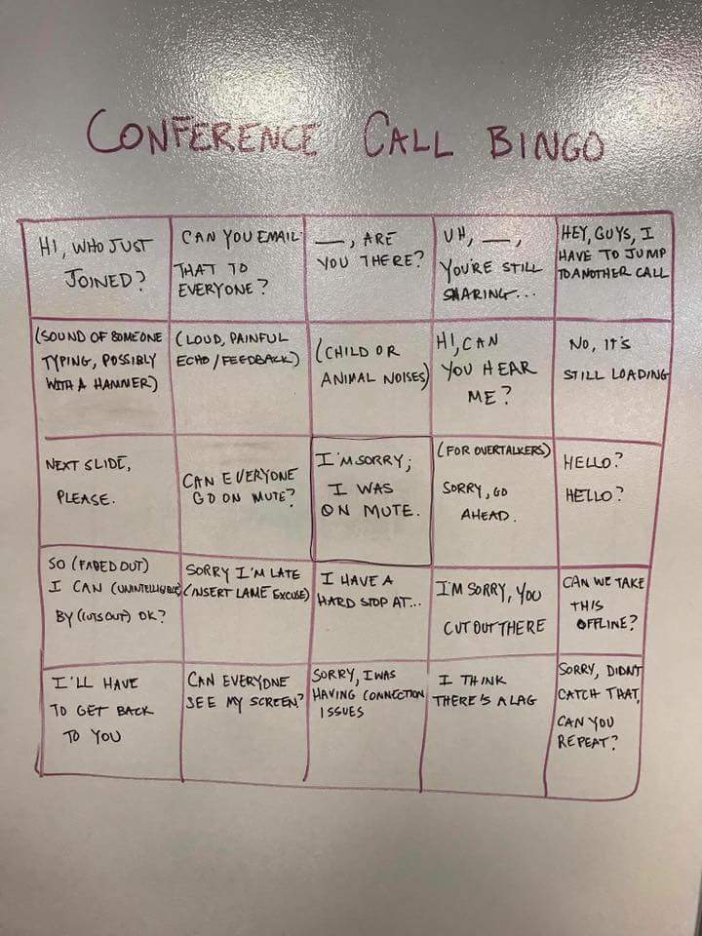
Switch from WebEx to Zoom
Will be moving weekly sessions from Webex to Zoom with the hopes of reducing technical issues and connection difficulties.
Will reassess to see if Zoom is an easier platform to use for sessions.

Slide 7
Primo VE Administrator Short Course
All campuses must have at least 1 Primo VE certified person by go-live.
Primo VE Admin. Test is much easier to achieve than Alma Admin. Certification.
SUNY has developed a two-week short course to guide individuals through the Primo Certification Process.
Will begin on 2/1 and run for 2 weeks.
Guide is available (but is still in draft and should be finished soon): https://slcny.libguides.com/primovecert
Two sessions provided on 2/8 and 2/15 to cover content that is in the Cert. videos and exam.
Goal is to have all campuses have a Primo Admin certified person by the end of February.

Slide 8
Acquisitions Start Up Task Force
Finishing up work of group.
Focusing on documentation for all acquisitions methods to help SUNY to deliver more focused acquisitions training.
Thanks to group for working through acquisitions workflow issues and configuration.
More widespread Acq. Training will be pushed back a bit, and will likely be released in mid-February.
We’d much

Slide 9
We know training and documentation is important.
The project teams and other groups are making more step-by-step documentation a priority.
https://slcny.libguides.com/training is best place to begin looking for documentation.
Expect to see more being added continuously.

Slide 10
Upcoming Training Sessions
1/23 Creating E-Resources Local Collections
1/24 Importing MARC records in bulk
1/25 Standing Orders
1/30 Introduction to Resource Sharing
1/31 NZ Maintenance TF Presentation
2/6 Work Orders
2/8 Ebook Central Integration
2/19 ILLiad Integration
2/20 PDA/DDA
2/27 Licenses and Attachments
3/8 Booking
3/13 Record Mgmt (Deleting records of all kinds)
3/15 FY rollover process
3/22 Overdue and Lost Loan profiles
Targeted training is also being scheduled.
More may be added as needs arise.
Email us with other training session requests at:
info@slcny.libanswers.com

Slide 11
In-Person Training Sessions
Focus will be on brief presentations, and then guided exercises.
Intended audience is small group/implementation team (3-4 people from each campus), not entire staff.
Locations and Dates:
Finger Lakes Community College (March 20th)
Niagara Community College (March 5th)
Plattsburgh (March 19th)
SUNY Polytechnic Institute (March 11th)
Purchase (March 12th)
Further details coming soon.
There will be registration fees for cost recovery.

Slide 12
Fulfillment In-Person Training
Reminder that fulfillment training (not just RS) will be covered in IDS RUGs.
Non-IDS Members must pay registration fee as cost recovery.
Info. at: http://idsproject.org/usergroups.aspx
Still working on dates for RUGs and finalizing agenda.

Slide 13
Thanks!
Thanks to our hosts for these in-person sessions, with special thanks to:
Sarah Moon at FLCC
Rebecca Hewitt, Allison Fiegl, and Rick Shelton at SUNY Poly
Parker O’Mara at SUNY Plattsburgh
Keith Landa at Purchase
Jean Linn at Niagara
Thanks to the many other campuses to offered to host, as well.

Slide 14
Cutover and Go-Live Planning
Delivered plan to ExLibris with groupings. No changes have been proposed, and these groupings are not expected to change.
Will get formal acceptance of groupings from ExLibris migration soon.
No campuses requested fulfillment gap load, so all campuses except for University Centers will rely completely on offline circulation.

Slide 15
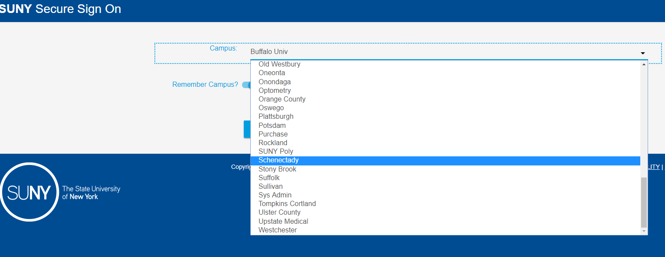
SUNY Federated Authentication Update
Have successfully set this up at a campus.
Met with analyst who manages SUNY federation, which is SAML based.
SUNY federation managers must configure each Alma environment in their system, which is as much/more work than a campus setting up using its own identity management system.
In sum: SUNY federation is an option if local authentication isn’t possible, but shouldn’t replace local configuration if this can be set up.
We’re continuing to communicate with SUNY Federation analysts on this issue.
Please contact SUNY Project mgrs. If authentication is an issue for your campus, and you think that SUNY federation is your only option.

Slide 16
Update on OCLC Publishing Profiles
Currently testing OCLC data sync process and set up needed in Alma.
Developing step-by-step documentation for campuses to use.
Ensuring that project team understands the process well enough to guide campuses on this.
Estimated completion/delivery of documentation:
Mid-Late February
Note that your campus may not want to do this until close to your cutover dates.

Slide 17
Work to Map Out Next 4-5 Months
SUNY Project Managers working to map out all the activities happening in next 4-5 months, and including granular SUNY To-Dos and events on the ExLibris master schedule.
We’ve been trying to do this throughout, but we’re being much more assertive in our approach now.

Slide 18
Health Checklist
We realize it’s a pretty broad document, and you can’t perform everything yet.
Please try to take the form as seriously as possible.
Submission information available here:
https://public.3.basecamp.com/p/bQUx9pY4kahfuMjgzUgEFkTT
Will submit 2 more times.
Training guide at:
https://slcny.libguides.com/healthchecklist

Slide 19
Questions

