Slide 1

Wolf Trap District
Roundtable
January 09, 2025

Slide 2

Pledge
Opening Ceremony by Troop 345

Slide 3
Welcome
New to Roundtable?
Please introduce yourself!

Slide 4
Agenda
7:20-7:30 Sign in and Networking
7:30-7:45 Opening – Troop 345
Council /District Updates
Announcements
7:45-7:55 Hot Topic
7:55-8:00 Safety Moment
8:00-8:05 Membership Moment
8:05-8:15 Cracker barrel/Networking
8:15-8:45 Cub Scout Breakout – AOL to Scouts BSA, Video & Discussion
Scouts BSA Breakout – Guide to Advancement Changes for 2025, Matt Burns and Q & A
- Preparing for Your New Cub Scouts, Video & Discussion
8:45-9:00 Closing – Troop 345
Cracker barrel /Networking

Slide 5
Questions/Clarification about Read-ahead?

Slide 6
Council Announcements
District Changes in my.scouting.org – still being worked
Renewals – Send any issues to ruspittman@gmail.com (please include unit type/name, name(s), BSA IDs and emails)
  Parents/Registered Adults - Can register without email notice. https://my.scouting.org, login, Menu, My Application, My Renewals (on the top, middle of page), Click “Start Renewal”
  Don’t See their Youth – Email Rus Unit Type/#, Youth Name & BSA ID, Parent Name & BSA ID (if have one), Parent Email
  Executive Officers – Register by sending EO information to Jay E. No fee. Emailed Key 3 & UCs.
  EO or COR Changes – Paper New Unit Application for EO; Paper Adult App (with CBC and YPT Certificate) for COR.
  MBC/District MAL Only – Renew same way as unit Scouters
$100 Payment – COR (and maybe the CM/SM or CC) can pay online. Units do not need to wait for their Youth and Adults to renew to pay the fee. Can be an issue if don’t have required number of leaders or any expired YPTs. Guide.
Annual Charter Agreement – Paper copy only. Note, different ACA for Catholic organizations. Good through all 2025.
Journey To Excellence - https://www.scouting.org/awards/journey-to-excellence/
Unit Balances – Report in Basecamp. Unit can request check from NCAC for their balance. Need your CC or COR to send an email to Liz with specific wording, “I am the Committee Chair for Pack XXX. Please mail a check for $XXX to (address). Please make the payment line to (insert name the bank knows your unit as – e.g., “Pack 1132”).” Complete the email with their name, position and unit in signature line.

Slide 7
General Announcements

Slide 8
District and other Award(s)
Presentation of Commissioner Position Patches & Commissioning Ceremony

Slide 9

District Court of Honor
To recognize adults who served/are serving at the unit level.
Two awards:
  Unit Commissioner’s Unit Scouter Award – 1 per unit
  Unit Appreciation Award – Maximum 8 per unit.
Please provide a sentence or two describing the individual’s service.
Submit Unit Commissioner’s Unit Scouter Award to Unit Commissioner.
Unit Appreciate Award to gm.adultrecognition@gmail.com
Must have all submissions by no later than March 22, 2025.
Will confer awards at District COH in April 2025.

Slide 10

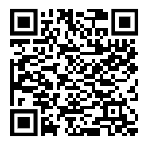

2025 Wolf Trap District
Merit Badge Day
March 8th, 2025 at Fairfax Presbyterian Church in Fairfax.
Registration is currently open. Link: https://site.corsizio.com/portal/5bf2f8e8e6dfc6f1ca7cbd64
Need Unit Merit Badge Day Coordinator names and contact details by January 30 to Jason Dalton at wolftrapmeritbadgeday@gmail.com
Encourage Scouts to get merit badge books as soon as possible. Read the requirements and start tackling “pre-work” before Merit Badge Day.
Note: The “pre-work” is not the same as a “prerequisite.” The “pre-work” consists of tasks/activities that the Scout is advised to do in advance of the Merit Badge Day. A Scout can still participate in the Merit Badge Day class if he hasn’t completed the pre-work but failure to complete the pre-work may mean the Scout leaves the Merit Badge Day with a partial badge. A prerequisite is something that must be done in order to qualify to take the class. The only prerequisite we are aware of for the George Mason Merit Badge Day attendance is that the Scout must be a registered member of the Boy Scouts in a participating unit.
Feedback and Communication to Jason Dalton is at wolftrapmeritbadgeday@gmail.com

Slide 11














Merit Badges currently available:
Citizenship in the Community, Nation and World
Personal Management
Emergency Preparedness
Engineering
Genealogy
American Heritage
Geology
Chess
Public Speaking
Family Life
Collections
First Aid

Slide 12
Safety Moment
https://www.scouting.org/health-and-safety/safety-moments/

Slide 13
Membership Moment
https://www.scouting.org/commissioners/roundtable-support/roundtable-planning-resources/

Slide 14
Cracker Barrel (10 min):
Move to your Breakout Session
Breakout Sessions:
Scouts BSA/Venture Crews - stay here
Cubs - follow John K

Slide 15
Scouts BSA Program

Slide 16

District Life to Eagle Seminar – February 8, 2025
Saturday, 8 February 2025
1:00 to 4:00 p.m.
Virtual
Register at: National Capital Area Council - 2024 Wolf Trap (Virtual) Life to Eagle Seminar
Who should attend:
Life Scouts or advanced Star Scouts who want to pursue the Eagle Rank
Eagle advisors, coaches or unit leaders that haven’t attended a seminar in two years
Parents of Scouts working on Eagle or other adults interested in Scouting
Registration is live now and must be registered by 6 February 2025 to get the Zoom link.
Any questions contact Matt Burns at 703-938-9550 or at gm.advancement @gmail.com.

Slide 17

SCHOLARSHIPS
Deadlines Approaching!!!
BSA Scholarship page - https://www.scouting.org/awards/scholarships/
American Legion Eagle Scout of the Year – Deadline is March 1 2025 – Apply to local Legion Post. Open to Scouts in units sponsored by an American Legion Post or who have a parent or grandparent that is a member of the Legion. Applications at: American Legion Eagle Scout of the Year Scholarship | The American Legion
Sons of American Revolution – Deadline ASAP Arthur M. & Berdena King Eagle Scout Contest – National Society Sons of the American Revolution)
National Eagle Scout Association – Deadline January 31, 2025 Scholarships - The National Eagle Scout Association

Slide 18

Glenn A. and Melinda W. Adams Award
Recognizes a noteworthy Eagle Scout Service Project.
Deadline is January 15, 2025
The Scout or a registered Scouting America volunteer can make a nomination. 2025 Adams Award Application
Scout must sign application to document their “consent.”
Also needs an electronic copy of the project workbook.
Some nominations include video.
Winners can receive:
  $300 at the Territory level.
  $3,500 for National winner.

Slide 19
Scouts BSA Breakout -
Guide to Advancement Changes
Video
Discussion

Slide 20
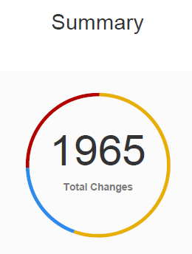
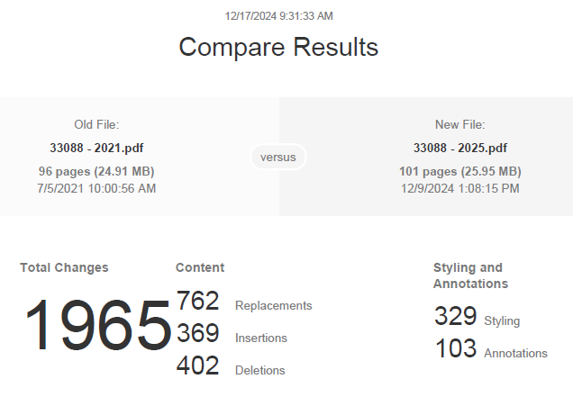
Changes in Guide to Advancement (GTA)
Guide to Advancement 2025 | Boy Scouts of America

Slide 21
Significant GTA Changes
The following only includes a few of the GTA changes.
  National Policy – “No council, committee, district, unit or individual has the authority to add to, or subtract from advancement requirements or deviate from policies in this publication.”
  Rank Approval - Once a Scout is tested and signed off by an approved tester, approval cannot be rescinded (4.2.1.2)
  Active Participation - revised significantly. Time doesn’t have to be recent or consecutive. The board can grant the rank regardless of recent activity as long as the Scout was active for the required length of time during tenure at the rank. (4.2.1.3)
  Unit Leader Conference – part of the unit leader conference can be to confirm that all requirements were met.. (4.2.3.5)
  Children of Scoutmasters – While an SM may conduct conferences with any member, including their own children, delegation to an assistant unit leader over 21 is highly recommended (4.2.3.5). GTA makes a similar recommendation later regarding the children of Committee Chairs and ESRAs.
  Generative AI and Other Tools – may be used by a Scout to assist with written requirements, but their use must be fully disclosed and the final output must be the Scout’s own original work. (5.0.8.0)
Take this home and share with unit Advancement Coordinators, Assistant Scoutmasters and others working with Life Scouts, Merit Badge Counselors, Board of Review schedulers, etc.

Slide 22
GTA Changes to Merit Badge Counseling
  Definitions for Discuss, Explain and Demonstrate – new text describes how the National Office views each of these. (5.0.8.0)
  SM Signs Blue Card – After Scout completes the badge, the Scout and unit leader should discuss experience. If the unit leader believes the badge was unearned, they may conduct a review as outlined in 7.0.4.7 (7.0.0.2)
  Meeting SM Before Starting Merit Badge – A Scout MUST meet with the SM before starting work on a badge. A Scout who avoids or ignores the unit leader’s role and completes a badge without first discussing it should be counseled and discussion documented. If the Scout (or parents) continue to ignore the established procedure, merit badges will not be recorded as “earned” until the Scout demonstrates they met all requirements to an MBC of the SM’s choosing. (7.0.0.3)
  Counselors Confirm Scout Met Unit Leader - Counselors must first confirm with the Scout that they have discussed with the unit leader their interest in working on the merit badge. (7.0.3.0)
  Small Groups – Hands-on interactive experience is hardly ever achieved except when a counselor works with a very small group – generally no more than three Scouts and always following Youth Protection. (7.0.3.0)
  Fund Raisers Prohibited – Using merit badge events as fundraisers, however, is prohibited, and councils must not approve them. (7.0.4.10)
  Online Merit Badge Classes – New section governing online classes and guidance regarding preferrable practices. (7.0.4.12)

Slide 23
Other Significant GTA Changes
  Scheduling Boards – Must be scheduled promptly (8.0.0.2)
  Recording Boards – Taking notes is acceptable but recording, either voice or video is prohibited. (8.0.1.0)
  Time Extensions – Must be a Life Scout to apply. (9.0.4.0)
  Eagle References – Number changed from 6 to 4 (9.0..1.7)
  ESRA Signatures for Children of Unit Leaders – If the unit leader or committee chair is also the Scout’s parent, it is recommended they delegate signing the Eagle Scout Rank Application to an assistant unit leader or committee member.
  Scout Requests References – The Scout is responsible for requesting references from the four people listed on the Eagle Scout Rank Application.
  Advancement for Members with Special Needs – Rewritten (10.1.0.0)

Slide 24
Time for Cracker Barrel
Minutes and slides available on the WTD web site (District Resources, Roundtable). Password is “GMDRT”
Next meeting – February 13, 2025, at Thoreau Middle School

Slide 25
Backup Slides

Slide 26

Current 2025 Wolf Trap Calendar
02/08/25 – Virtual Life to Eagle Seminar (1pm)
02/22/25 – University of Scouting, Alexandria, VA
03/08/25 – WTD MB Day, Fairfax Presbyterian Church, Fairfax, VA
03/22/25 – DCOH Award Nominations Due
03/28/25 – 03/30/25 – Joint Lodge Ordeal, Camp Snyder, Haymarket, VA
04/10/25 – District Court of Honor, Thoreau MS, Vienna, VA
04/25/25 – 04/27/25 – 2025 OA Spring Fellowship
05/03/25 – 19th NCAC Scout Orienteering Meet, PWD, Triangle, VA
05/XX/25 – 05/XX/25 – WTD Spring Camporee
05/XX/25 – 05/XX/25 – WTD Hike-O-Ree
05/10/25 - Jamboree on the Trail (JOTT)
05/26/25 – Memorial Day Flags In, National Memorial Park, Falls Church
05/08/25 – Program Launch, Thoreau MS, Vienna, VA
05/31/25 – OA Election Season Closes

Slide 27
STEM
Akela Chess Classic
  Cub Scout Tournament – 02/01/2025 at MSSC
  Scouts BSA Tournament – 02/15/2025 at MSSC
Burke Lake District NOVA Nights (Last Friday of Month)
  01/28/2025 at Prince of Peace Lutheran Church
  02/25/2025 at Prince of Peace Lutheran Church
  03/25/2025 at Prince of Peace Lutheran Church
Ancient Earth: Birth of the Sky (on PBS) - link
Anytime – DC STEM Trek- Showcases 24 government agencies, private organizations and monuments related to the tenets upon which STEM is based. Two hikes - 10.57 miles, or 4.75 miles
NCAC STEM contact is Bruce Donlin (bruce.donlin@scouting.org; 240-395-0601)

Slide 28
Scouts Deserve a Trained Leader
Wolf Trap Training site: https://www.ncacbsa.org/george-mason/training/
Cub Leader Position Specific (C40)
  Available on-line (117 min),
  01/11/25 – Alexandria, VA
  02/01/25 – Alexandria, VA
  03/08/25 – Alexandria, VA
  04/05/25 – Alexandria, VA
  05/03/25 – Alexandria, VA
Cub Scout Den Leader Specific (C42)
  Available on-line (125 min)
  01/11/25 – Alexandria, VA
  02/01/25 – Alexandria, VA
  03/08/25 – Alexandria, VA
  04/05/25 – Alexandria, VA
  05/03/25 – Alexandria, VA
Basic Adult Leader Outdoor Orientation (BALOO;C32) – BALOO consists of two sessions, an online portion (https://my.scouting.org, Menu, My Training, Cub Scouts, Catalog, search on BALOO) that takes 35 minutes and a hands-on overnight session. The overnight sessions are listed below.
  03/29/25 – 03/30/25 – TBD, VA (Request permission to attend)
  06/14/25 – 06/15/25 – Lorton, VA (Contact Dominick dscscouting@aol.com for permission to register)
Scoutmaster Position Specific Training(S24)
  Available on-line (192 min)
  01/11/25 – Alexandria, VA
  02/01/25 – Alexandria, VA
  03/08/25 – Alexandria, VA
  04/05/25 – Alexandria, VA
  05/03/25 – Alexandria, VA
Introduction to Outdoor Leadership Skills (IOLS; S11)
  06/14/25 – 06/15/25 – Lorton, VA (Contact Dominick dscscouting@aol.com for permission to register)
Wilderness First Aid (N02)
  01/25/25 – 01/26/25 – Camp Snyder, Haymarket, VA
  02/22/25 – 02/23/25 – Camp Snyder, Haymarket, VA (Waitlist only)
  03/22/25 – 03/23/25 – Camp Snyder, Haymarket, VA
  04/26/25 – 04/27/25 – Camp Snyder, Haymarket, VA
  05/17/25 – 05/18/25 – Camp Snyder, Haymarket, VA
Miscellaneous:
Outdoor Ethics/Leave No Trace (D78)
Outdoor Ethics Newsletter
Scouterhorn Operations Training
TBD
University of Scouting
02/22/2025, Alexandria, VA (2024 Course Materials available on Basecamp)
Youth Protection Training (YPT)
Online (72 minutes)
2025
BCOLS:
Spring: 03/01/25 & 4/26-27/25
Fall: 09/20/25 & 10/18-19/25
Trainers Edge: 08/09/25 & 12/06/25
University of Scouting: 02/22/25
Wood Badge:
Spring: 4/4-6/25 & 5/3-4/25
Fall: 09/12-14/25 & 10/4-5/25

Slide 29
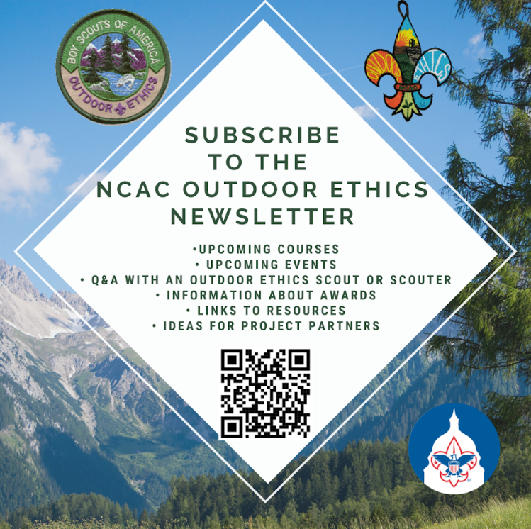
Outdoor Ethics
Newsletter

Slide 30


Merit Badges
The online Merit Badge Counselor registration.
New Merit Badge Counselors must complete online merit badge counselor training, in addition to YPT. Be sure the counselor uses his/her legal name – no nicknames.
Merit Badge Counselors, or the unit Dean/Leader, also need to scan and send Margee the Merit Badge application form listing the badges the counselor is applying to teach and providing a justification of his/her qualifications.
Youth Protection Training is the essential first step. Don’t hit “send” on the application without it!
Contact Margee if you have questions at GM.MB.Dean@hotmail.com.
Did you know:
The National Council does not limit the number of merit badges a youth may earn from one counselor, though a unit leader is permitted to do so, as long as the same limit applies to all Scouts in the unit. Ideally, Scouts should work with a variety of adults. (GTA 7.0.0.3)
Partial Merit Badges have no expiration except the Scout’s 18th birthday. (GTA 7.0.3.3)
Due to the BSA policies related to Youth Protection and two-deep leadership, a merit badge counselor must have another adult present during all merit badge counseling sessions. However, the parent or legal guardian of the Scout may serve as the second adult. This parent or legal guardian does not have to be a registered leader.
If the requirements for a merit badge differ between the merit badge pamphlet and the current edition of Scouts BSA Requirements, the requirements in the Scouts BSA Requirements book supersede all others.

Slide 31

GM High
Adventure
Members of the High Adventure Committee are available to assist units in planning and training for their upcoming high adventure trips – Contact Brian Heath for more information
Important notes for this month
  Registration for BSA’s high adventure bases – https://www.scouting.org/outdooradventures/open4adventure/
    2025 National High Adventure Base Reservations
      Registration for 2025 for all high adventure bases are now open
      OPIC: 25% off remaining slots for this winter!!
      PHILMONT
        Registration is mostly full – Only a few crew start dates still available
        Philmont is continuing to accept provisional attendance and will attempt to match them with crews willing to take them
      SUMMIT, NORTHERN TIER, & SEA BASE still have availability
    2026 National High Adventure Base Reservations
      NORTHERN TIER: Reservations open Jan 15, 2025
      SEA BASE: Reservations open Jan 16, 2025
      SUMMIT: Reservations open Jan 14, 2025
      PHILMONT: Lottery closed on Oct. 16, 2024
        Very close to being sold out
2025 NCAC-Organized High Adventure Trips
  Philmont – HAC is working with 1 crew – Slots may be available on this crew – Contact me for more information
  Lenhok’sin – Gathering interest for forming a crew – Contact me if you’re interested
High Adventure Preparation Training
  Philmont Crew Training
    Online Sessions - January 5, March 23, 2025
    In-Person Session - April 5, 2025 – Camp Snyder
  Philmont Adult Advisor Practice Hikes – March 8 & 16, 2025
  Northern Tier Training – In-Person - April 5, 2025; Online – April 19, 2025
  BCOLS Spring 2025 – Online Session - March 1; In-Person Session - April 26-27
  Wilderness First Aid – Multiple dates at Camp Snyder
Jan 2025
Notes:
Sea Base Trip on Jul 29-Aug 3, 2024 - FULL

Slide 32
GM High
Adventure
High Adventure Preparation Training
  Philmont Crew Training
    Online Sessions - January 5, March 23, 2025
    In-Person Session - April 5, 2025 – Camp Snyder
  Philmont Adult Advisor Practice Hikes – March 8 & 16, 2025
  Northern Tier Training – In-Person - April 5, 2025; Online – April 19, 2025
  BCOLS Spring 2025 – Online Session - March 1; In-Person Session - April 26-27
  Wilderness First Aid – Multiple dates at Camp Snyder
National High Adventure Base Quick Links
  Philmont: https://www.philmontscoutranch.org/register/
  Northern Tier: https://www.ntier.org/provisional-scout-connections/
  Sea Base: https://www.bsaseabase.org/scouts/scout-connections/
  Summit: https://www.summitbsa.org/registration/scoutconnections/
Council-Run High Adventure Bases
  Lenhok'sin @ Goshen Scout Reservation
  Adirondack High Adventure Area
  Maine High Adventure Area
  Pamlico Sea Base - Blounts Creek, NC
  Montana Outdoor High Adventure Base
Other useful links for high adventure information and opportunities
  NCAC High Adventure website - https://www.ncacbsa.org/high-adventure/
List of units with available slots in their upcoming high adventure trips - https://public.3.basecamp.com/p/xWpkdrKHKAA9pCzwmHMNdbWb
Jan 2025 (cont.)
Notes:
Sea Base Trip on Jul 29-Aug 3, 2024 - FULL

Slide 33
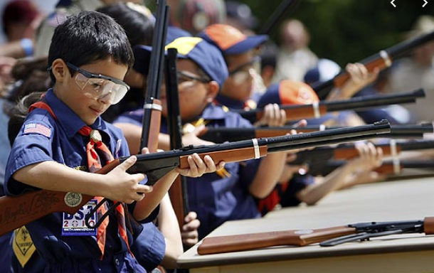
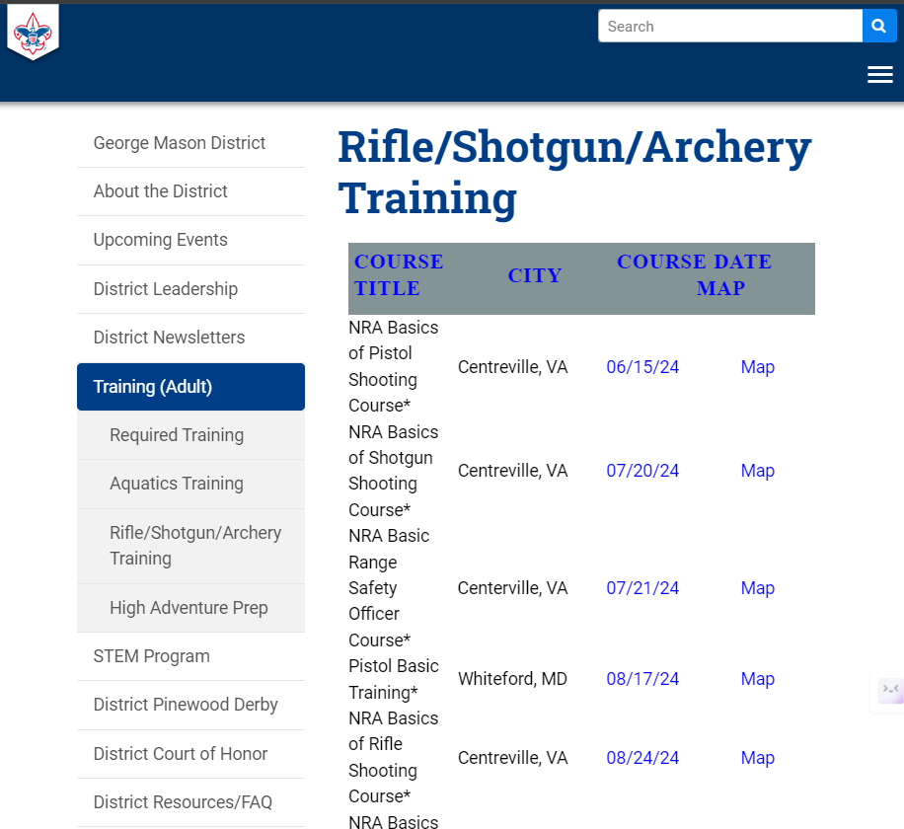
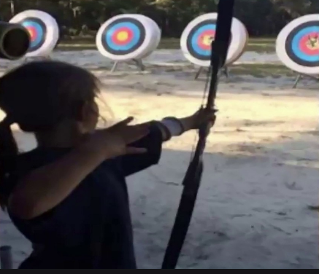
Range and Target Activities
Requests for Shooting Events – Lead Time!
  50+ scouts - 6mos
  Less than 50 scouts - 3mos
Shooting on private land:
  Requirements
  Permissions/protocols
R&TA web page
R&TA Instructor Classes

Slide 34
Order of the Arrow
  Brian Fleck is Chapter Advisor.
  2025 Dues can be paid online: https://wipit470.org/dues.html
  Registrations open online https://wipit470.org/index.html under “Events”

