Slide 1
DULCE: Strengthening Families Prenatally through Early Childhood ECHO® Strength in Collaboration: The DULCE Model and the Power of Interdisciplinary Problem Solving
Facilitator: Susanne Campbell, RN MS PCMH CCE
Faculty Presenter(s): Rebecca Kislak, Esq. | Jeff Gilbert, MPH
Case Presenter(s): Jalyn Alzate, CHW, DULCE Family Specialist at the Family Care Center
Date & Time: June 4, 2025
PLEASE NOTE: Project ECHO case consultations do not create or otherwise establish a provider-patient relationship between any clinician and any patient whose case is being presented in a project ECHO setting

Slide 2
Agenda
Time | Topic | Presenter
12:00PM – 12:05PM | Welcome & Faculty Introduction
12:05PM – 12:25PM | Strength in Collaboration: The DULCE Model and the Power of Interdisciplinary Problem Solving | Rebecca Kislak, Legal Key Jeff Gilbert, Legal Key
12:25PM – 12:40PM | Case Presentation | Jalyn Alzate, CHW, DULCE Family Specialist at the Family Care Center
12:40PM – 12:55PM | Q&A and Discussion
12:55PM – 1:00PM | Wrap up; Evaluation; Announcements | Susanne Campbell, CTC-RI
Notes:
Sue

Slide 3
Welcome
Please note that the didactic portion of an ECHO session will be recorded for educational and quality improvement. The case presentation portion of an ECHO session will never be recorded.
Remember to never disclose protected health information (PHI), verbally or in writing, to preserve patient confidentiality.
We are participating in an open and welcoming learning environment. Thank you for generously sharing your knowledge and experience so that all can benefit from it!

Slide 4
Video Meeting Etiquette
Mute your microphone when not talking.
Limit distractions as best as possible.
Use reactions & the raise hand feature.
Use the chat to ask introduce yourself, ask questions and share resources.
Engage - ask questions, offer feedback, provide support.
Engage and turn your camera on if you are able.
Notes:
Sue

Slide 5
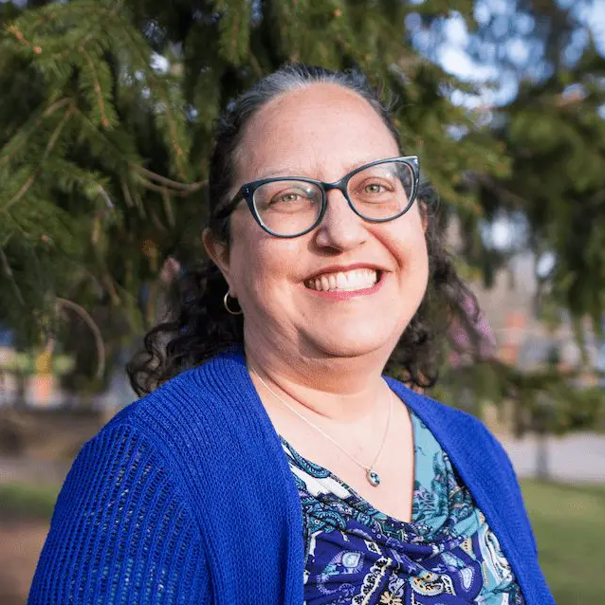
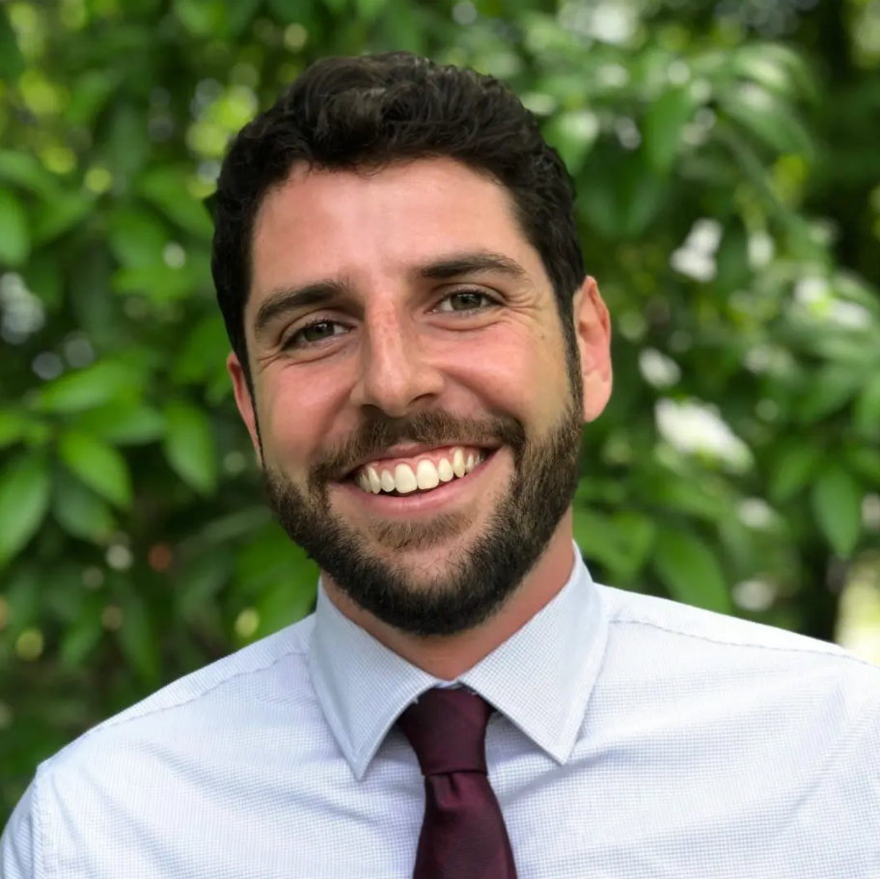
Faculty Introduction
Rebecca M. Kislak is a Law and Policy Consultant whose career is rooted in collaborative law and policy. Rebecca was a founding attorney of the Medical-Legal Partnership at Community Legal Aid in Worcester, MA, and director of the initial Rhode Island Medical-Legal Partnership program. She also served as Policy Director and Counsel at the Rhode Island Health Center Association. Rebecca teaches health policy as an adjunct professor at Rhode Island College and the Brown University School of Public Health and represents her Providence district as a State Representative in the Rhode Island General Assembly. A graduate of Georgetown University Law Center and Brown University, she is licensed to practice law in RI, MA, and PA.
Jeff Gilbert is the Partnership & Project Manager at Legal Key and a long-time champion of health equity and sustainable food systems. He previously worked in the intersection of partnerships and communications at the Somerville-based urban agriculture company Green City Growers. Jeff received a Master of Public Health degree in Health Behavior from the University of North Carolina at Chapel Hill Gillings School of Global Public Health where he provided mixed-methods evaluation support to the Granville-Vance Public Health Department and the Inter-Faith Food Shuttle. He received his Bachelor of Arts from Lehigh University.
Notes:
Pat

Slide 6
Disclosures
Session presenters have no financial relationships with a commercial entity producing healthcare-related products used on or by patients. If CME credits are offered, all relevant financial relationships of those on the session planning committee have been disclosed and, if necessary, mitigated.

Slide 7
Learning Objectives
Describe the key components of the DULCE intervention within prenatal and primary care practice.
Identify the roles and responsibilities of DULCE interdisciplinary team members.
Recognize evidence of positive DULCE outcomes.
Notes:
3 Learning Objectives that are very specific and measurable (and clinically relevant/focused)

Slide 8
About DULCE
Mission Statement
Through the collaborative efforts of early childhood, health, and legal systems, DULCE transforms the way that families with infants experience the delivery of support and services. To do this, we employ a cross-sector, team-based model that proactively supports the health of families with infants in communities that are under-resourced and have been marginalized by racist systems.
Vision Statement
When DULCE is fully implemented nationwide, all families with infants will experience holistic, connected care and receive the support they need to provide newborns with a healthy start in life.
Notes:
DULCE brings together 3 sectors, Health, Legal, and Early Childhood to implement its mission and vision. The mission of DULCE is to transform the way that families with infants experience the delivery of support and services. To do this, we employ a cross-sector, team-based model that proactively supports the health of families with infants in communities that are under-resourced and have been marginalized by racist and oppressive systems.
DULCE’s vision is that when DULCE is fully implemented nationwide, all families with infants will experience holistic, connected care and receive the support they need to provide newborns with a healthy start in life.
The Center for the Study of Social Policy (CSSP) is a national, non-profit policy organization that connects community action, public system reform, and policy change to create a fair and a just society in which all children and families thrive.

Slide 9
About DULCE
Mission Statement
Through the collaborative efforts of early childhood, health, and legal systems, DULCE transforms the way that families with infants experience the delivery of support and services. To do this, we employ a cross-sector, team-based model that proactively supports the health of families with infants in communities that are under-resourced and have been marginalized by racist systems.
Vision Statement
When DULCE is fully implemented nationwide, all families with infants will experience holistic, connected care and receive the support they need to provide newborns with a healthy start in life.
Notes:
DULCE brings together 3 sectors, Health, Legal, and Early Childhood to implement its mission and vision. The mission of DULCE is to transform the way that families with infants experience the delivery of support and services. To do this, we employ a cross-sector, team-based model that proactively supports the health of families with infants in communities that are under-resourced and have been marginalized by racist and oppressive systems.
DULCE’s vision is that when DULCE is fully implemented nationwide, all families with infants will experience holistic, connected care and receive the support they need to provide newborns with a healthy start in life.
The Center for the Study of Social Policy (CSSP) is a national, non-profit policy organization that connects community action, public system reform, and policy change to create a fair and a just society in which all children and families thrive.

Slide 10
DULCE: What Does it Mean?
Developmental Understanding: Supporting the relational health of infants and their families – in collaboration with the Brazelton Touchpoints Center.
Legal Collaboration: Helping families access the concrete supports they want and are legally entitled to.
For Everyone: Reaching families where they already bring their babies – universal access in primary care clinics
Notes:
The Center for the Study of Social Policy (CSSP) is a national, non-profit policy organization that connects community action, public system reform, and policy change to create a fair and a just society in which all children and families thrive.

Slide 11
DULCE: The Intervention
First 4 well-child visits: screening for caregiver depression, intimate partner violence (IPV), and barriers to concrete supports, Touchpoints-informed focus on the baby’s developing temperament, personality, anticipatory guidance and related parent coaching.
6-month visit: wrap-up to the intervention, transition plan implementation to assure ongoing support within the family-centered medical home.
Weekly interdisciplinary case review: assures all positive screens are addressed on ongoing basis.
Leveraging of legal partnerships throughout: to help families overcome barriers to concrete supports (including rapid response representation).
Continuous Quality Improvement: to monitor implementation and allow data-based adaptation to local environments.
Notes:
What happens to a family during DULCE?
(CLICK)
When a DULCE family comes to their newborn, 1 month, 2 month, and 4 month routine clinic visits, a specialized community health worker known as the Family Specialist as well as the primary care team screen for maternal depression
barriers to concrete supports to meet basic needs (health related social needs,
HRSN), and
Use the NBO and Touchpoints to help families understand how their baby is growing and changing and to provide targeted parenting coaching grounded in their relationship with their baby
(CLICK)
Breena:
At the 6 month visit, the Family Specialist
Wraps up the intervention,
Focusing on a tailored transition plan to assure the family knows where to go for support within the family-centered medical home
(CLICK)
Amy:
The rest of the Interdisciplinary team is involved directly in 2 ways: (CLICK)
First, Weekly interdisciplinary case review brings the entire team (including the primary care provider, Family Specialist, Mental Health representative, Early Childhood System representative, Clinic administrator, and legal partner) to the table: to engage in collaborative problem solving and planning for each positive screen
Just as the primary care provider is involved in day to day management of families medical issues, the legal partner assists families with barriers to concrete supports to meet basic needs OUTSIDE the courtroom through:
🡪 training of the Family Specialist on legal issue spotting
🡪 Supporting the Family Specialist in problem solving to provide families with information
🡪 Direct consultation with families
🡪 and They also still provide direct rapid response support to families INSIDE the courtroom if it is needed
Finally, all throughout DULCE’s implementation, Interdisciplinary teams engage in data collection and analysis through continuous quality improvement to monitor implementation and allow data-based adaptation to local environments.

Slide 12
Why the Three Sectors?
Accountable for building a local system for young children and their families.
Immersed in the community’s supports to address SDOH.
Able to drive evidence-informed practices and programs.
Organized to influence policy and practice.
Universal reach.
Longitudinal relationships with families.
Well-versed in the use of standard protocols to improve quality of care.
Well-versed in family rights and system responsibilities.
Professional orientation toward problem-solving and advocacy.
Policy lens and expertise.
Early Childhood
Health
Legal

Slide 13
DULCE’s Universalist Approach
A 2022 article comparing DULCE families using traditional risk criteria (low-income, foster care, first-time parent, teen parent) used by targeted programs) demonstrated:
Commonly used indicators to identify families for targeted interventions are poor proxies for known threats to healthy development
Systems intended to support families with infants in low-resource communities may miss nearly three quarters of families with health-related social needs by utilizing targeted approaches exclusively.
Data from Arbour, et al. (2022)
Notes:
Data from eight DULCE sites across three states serving 1677 families between January 2017 and May 2020 showed:
More than half of the DULCE families did not meet four traditional risk criteria (income, foster care, first-time parent, teen parent) utilized by targeted programs had HRSN:
Very few of these families were accessing resources at DULCE enrollment; half were connected to resources during DULCE participation.
Most (72%) of families with HRSN would have not been identified if risk-based enrollment criteria had been used.
Many of the families who were already utilizing HRSN resources before DULCE , including SNAP, WIC, and TANF, had unmet needs at DULCE enrollment.
Amy: Systems intended to support families with infants in low-resource communities may miss nearly three quarters of families with health-related social needs by utilizing targeted approaches exclusively

Slide 14
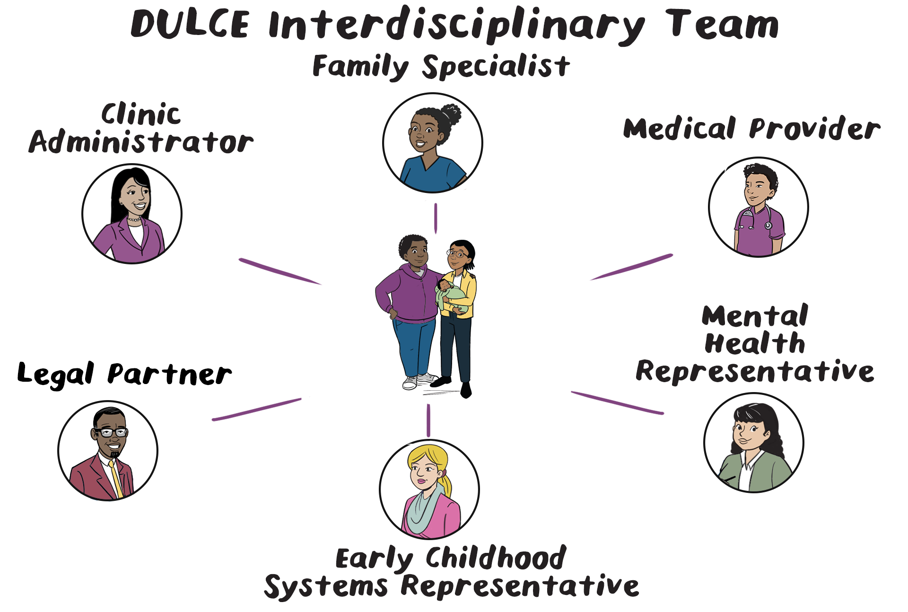
DULCE Interdisciplinary Team Members
Existing Primary Care Team
Medical provider
Medical assistant and/or nurse
Clinic administrative and support staff
DULCE Team For First 6 Months of Life
Early Childhood Systems Representative
Family Specialist
Legal Partner
Mental Health Representative
Notes:
Team-based care is not new.
There is already a team at the primary care clinic, with medical providers, nurses, medical assistants, clinic admin and scheduling staff interacting and sharing the patient care tasks and related duties in existing practices that are familiar, but carefully designed, right? It is a dance that is set up to be smooth and efficient.
DULCE brings these additional team members, during the first 6 months of life; Most of these team members are not sharing the clinic space and patient care visits.
The shifts in “the workflow dance” are really about the how the FS-medical provider and clinic staff share the care together. Based on a DULCE site’s configuration, these roles that I am about to describe may be filled by one or more people

Slide 15
Notes:
Place the link to the animation on the multi-disciplinary team in the chat.
https://www.youtube.com/watch?v=-I_da9Xd2YI

Slide 16
Family Specialist
Works with the Pediatrician or Nurse Practitioner as part of the primary care team.
Meets with families at well child visits until the 6 month check-up.
Utilizes developmental-relational Touchpoints framework to:
Provide strengths-based parenting support and anticipatory guidance.
Support families in addressing unmet health-related social needs.
Notes:
The specialized community health worker known as the Family Specialist is at the center of DULCE’s Interdisciplinary team. The presence of the Family Specialist at the clinic creates an enhanced primary care team.
The Family Specialist works directly with the pediatrician as part of the primary care team.
Meets with families at well child visits until the 6 month check-up.
Utilizes developmental-relational Touchpoints framework with families to:
Provide strengths-based parenting support and anticipatory guidance.
Support families in addressing unmet health-related social needs.

Slide 17
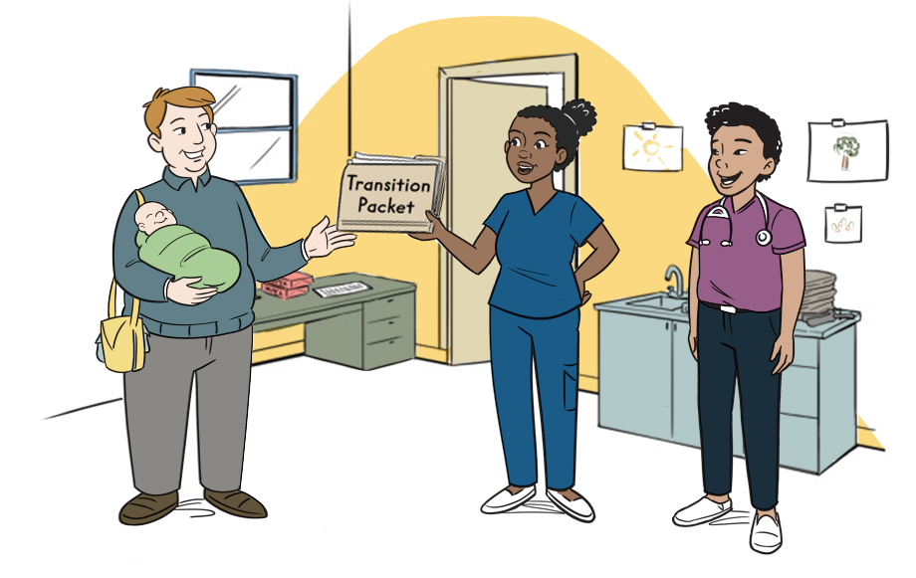
What Does the Family Specialist Do?
Meets with families at clinic visits and accompanies them in the exam room to provide support. Acts as support between medical visits.
Screens for health-related social needs, provides resources for identified needs, and documents the data.
Uses relational strategies from Brazelton Touchpoints model and Newborn Behavioral Observation to provide parenting support and anticipatory guidance.
Notes:
Having the Family Specialist in the exam room prevents miscommunication, provides a united message for families, builds relationship-based care with the whole team. Makes valid screening more likely through the building of TRUST.
Acts as support between medical visits.
Follows up to confirm connections to resources.
Available for questions between visits and collaborates with Physician/Nurse Practitioner to address them.

Slide 18
Medical Provider
Collaborates with Family Specialist to address families’ needs.
Represents DULCE to clinic staff and administrators.
Supports other participating Physician/Nurse Practitioner staff in implementing DULCE.

Slide 19
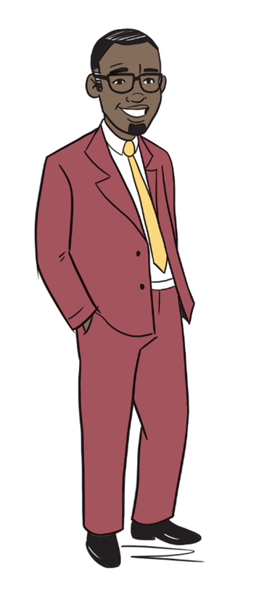
Legal Partner
Collaborates with Family Specialist to address families’ needs.
Represents DULCE to clinic staff and administrators.
Supports other participating Physician/Nurse Practitioner staff in implementing DULCE.
Notes:
Amy:
The legal partner has public interest law expertise and supports the Interdisciplinary Team, and Family Specialist specifically, in how to effectively address SDOH based on legally entitled supports
The legal partner provides the necessary legal education so that the Family Specialist can support the Interdisciplinary Team in identifying legal risks, rights, and remedies.
Ask an existing legal partner to share one thing they have contributed to team case review and patient care thus far.
Ask one onboarding legal partner to share one wondering about what it will be like to join a team and help families access resources.

Slide 20
Mental Health Representative
Helps respond to urgent mental health needs.
Works closely with Family Specialist, providing clinical and reflective supervision
Boundary setting, attentiveness to vicarious trauma.
Assists with monitoring family status.
Helps manage data entry and workflow to optimize caseload balanced with competing responsibilities.
Monitors Family Specialist’s ongoing professional development to optimize competencies and shared problem-solving role.

Slide 21
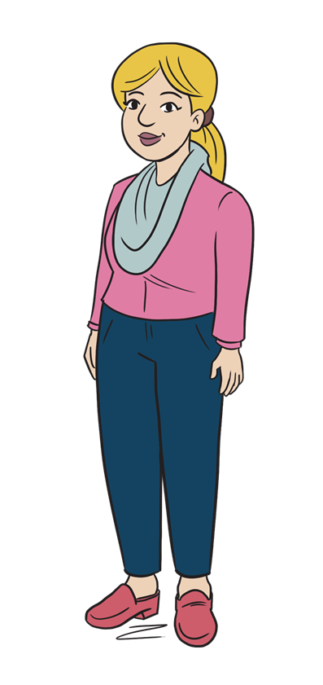
Early Childhood System
Representative
Representative of lead agency.
Supports DULCE implementation and sustainability.
Connects clinic to early childhood system.
Supports family access to community resources and opportunities.
Identify system gaps and unaddressed needs using DULCE data to inform system building efforts in the early childhood system.

Slide 22
Cross-Sector Case Rviews
Weekly meetings to review all new families, families with positive screens and families transitioning out of DULCE.
Opportunity for multi-disciplinary review of families’ goals and needs.
Highlights trends in service gaps for early childhood system to assist in filling.
Serves as one aspect of clinical supervision for Family Specialist.
Notes:
Breena:
DULCE’s impact is made possible through the Interdisciplinary Team weekly case review
The DULCE Interdisciplinary Team is comprised of the Family Specialist, Medical Provider (pediatrician, nurse practitioner), Mental Health Representative, Early Childhood System representative, Legal Partner, and Clinic Administrator
The team meets on a weekly basis to review all new families, families with positive screens for health related social needs, and families transitioning out of DULCE.
Amy:
Bringing the Interdisciplinary Team together enables the opportunity for a multi-disciplinary review of families’ goals and needs. Teams are able to discuss community resource strengths and systems gaps so that the Early Childhood System can identify and provide support to families.
Weekly case review also serves as one aspect of clinical supervision for Family Specialists from the Mental Health Representative. It is also an important time for relationship building between the Family Specialist and the legal partner so that the Family Specialist is better able to conduct legal issue spotting with families.
“The conversations and coordination that occurs at the weekly case review makes high quality care and resources easier for caregivers to access and understand. If our team can help make information more streamlined, or provide a resource for families to ease their stress, we know we're making a positive impact.”

Slide 23
DULCE Evidence and Outcomes
100% of families offered choose to enroll and 79% of families complete DULCE.
65% of families receive all well-child visits on time, with DULCE implementation and CQI increasing this proportion by 50%.
70% of well-child visits occur with the DULCE Family Specialist present.
DULCE helps clinics implement highly reliable universal screening practices; 92% of families are screened for seven HRSN.
95% of DULCE families with concrete support needs received resource referrals at time of positive screening results.
Data from Arbour, et al. (2021)

Slide 24
Voices from the Field
“I’m on the ground and I hear the stories, not just giving a phone number to a person. Other programs give a phone number to a family and that’s it. DULCE is a back-and-forth relationship. I want to empower that family to speak up.”
Family Specialist
“The conversations and coordination that occurs at the weekly case review makes high quality care and resources easier for caregivers to access and understand. If our team can help make information more streamlined, or provide a resource for families to ease their stress, we know we're making a positive impact.”
DULCE Early Childhood Systems Representative
“DULCE is more integrated and collaborative [than other medical-legal partnerships]. You’re directly working with the Interdisciplinary Team, figuring out solutions to families’ problems. I get to hear not only legal but other solutions.”
Legal Partner

Slide 25
Resources
Legal Key Partnership for Health and Justice - https://legalkeypartnership.org/
Reflective Practice Training
Bradley Reflective Supervision Brochure
RIAIMH - https://riaimh.org
Standing Up DULCE
Center for Study of Social Policy
DULCE Learning Platform
DULCE Partner Portal
Data and Collection Guide
Well-Child Guidance
Care-giver Survey
Implementation Resources
Additional Resources (info on training, CHW billing, DULCE Tools): https://public.3.basecamp.com/p/Ykjwf9XYsmQzhP53R9jYYM6w/vault
Brazelton Touchpoints Training
Brazelton Trainings with Brazelton Touchpoints Center
RIAIMH - https://riaimh.org/Professional-Development
CHW Training
CHWARI Training Website
CHWARI Resource Page
Workforce Development Resources for RI Employers of Community Health Workers

Slide 26
DULCE: Strengthening Families Prenatally through Early Childhood ECHO® Case Presentation
Presenter(s): Jalyn Alzate, CHW, DULCE Family Specialist, Family Care Center
Mary Beth Sutter, MD, FAAFP, Academic Director of FMOB, Pawtucket, Assistant Professor of Family Medicine, Teaching Scholar, Director of Maternal and Child Health, Family Care Center
Contact Info: jalzate@kentri.org
marybeth_sutter@brown.edu
PLEASE NOTE: Project ECHO case consultations do not create or otherwise establish a provider-patient relationship between any clinician and any patient whose case is being presented in a project ECHO setting

Slide 27
Reasons for Selecting this Case
Do Not Include PHI
Why did you select this case? | Full circle of care coordination Multiple levels of need – social, emotional, medical, legal, safety
Goal for this case presentation? | Identify resources that can make an impact on the family Discuss how social and medical needs interrelate Discuss how community and medical staff can communicate and collaborate
What questions do you have for the group? | How do others use collateral information to help bridge barriers for patients How to work with constraints in medical system and in social system

Slide 28
Information about the Case
Do Not Include PHI
What is the family identifying as the concern? | Language barrier Housing and food insecurity Transportation needs Health system education/ medical literacy
What is the provider/clinician see as the concern? | Behavioral health concerns Interpersonal violence Safety Cultural differences around birth, raising a baby, starting solids

Slide 29
Patient and Family Information (as relevant)
Do Not Include PHI
Age (0-5) | Mother- 25- involved from second trimester of pregnancy Baby- now 8 mo, involved since birth
Gender | female
Race/Ethnicity (if relevant) | Haitian
Insurance | Public; medicaid
Family composition | Mom, father of baby, baby Extended family living in community nearby
Current living situation | Initially with fathers' extended family in one room (not a bedroom) designated for family, now in an apartment 1 bedroom

Slide 30
Patient and Family Information (as relevant) - continued
Do Not Include PHI
Health related social needs | Housing, food, general resources for establishing a home and incorporating a baby, recent transition to US from Haiti
Parent and Family Health/ Wellbeing | Mother with preeclampsia, recurrent chlamydia during pregnancy
Community Connections & Supports | Initial connection made through Children's friend home visitor who is also Haitian creole speaking
Safety Concerns | No bed for baby, low resources for diapers, food, formula, improper use of car seat restraints
Nutrition and Feeding | Maternal food insecurity, baby on WIC, cultural differences with starting solids
Behavior Concerns | Tension between mother and father of baby, IPV Mother with past trauma
Sleep Concerns | Able to address getting a pack and play in pregnancy

Slide 31
What goals does the family/caregiver have?
Do Not Include PHI
Have a healthy pregnancy
Raise a healthy happy baby
Feel safe with a home/ space of her own
Understand medical care recommended

Slide 32
Family Identified strengths/successes/challenges:
Do Not Include PHI
Strengths & Successes
Challenges
Healthy
Strongly desired pregnancy
Lack of understanding of social services in US
Language barrier
Lack of monetary resources
Interpersonal relationship with father
No matriarch role model for mother

Slide 33
Practice Identified successes/challenges:
Do Not Include PHI
Child Strengths & Successes
Family/Caregiver Strengths & Successes
Healthy
Easy feeder, sleeper
Mother supportive of baby
Child Challenges
Family/Caregiver Challenges
First child of family, no direct role models
Financial instability
Housing and food insecurity
Legal status
Trauma hx/ PPD
Power dyanmic with father

Slide 34
What impact did this case have on you as a clinician?
Do Not Include PHI
Do you have thoughts or feelings about your work with this family?

Slide 35
1. Facilitator Summary & Clarifying Questions
2. Recommendations from the group

Slide 36
Questions? And Contact information
Didactic:
Rebecca Kislak, Legal Key, rkislak@legalkeypartnership.org
Jeff Gilbert, Legal Key, jgilbert@legalkeypartnership.org
Case Presentation:
Jalyn Alzate, CHW, DULCE Family Specialist, Family Care Center jalzate@kentri.org
Notes:
Pat

Slide 37
Announcements & Reminders
Next Session Date: | July 11, 2025 @ 12:00pm
Topic: | When Immigration Disrupts Care: Planning for Unexpected Absences in Family Support Work
Didactic Presenter: | Rebecca Kislak, Legal Key, rkislak@legalkeypartnership.org Jeff Gilbert, Legal Key, jgilbert@legalkeypartnership.org
Case Presenter: | Manuela Andres, CHW, Blackstone Valley Community Health Center

Slide 38
Evaluation & CME
Please provide us your feedback! Evaluation/Credit Request Form :
Please request CME credits or a certificate of participation when filling out the evaluation at the end of the meeting.
Application for CME credit has been filed with the American Academy of Family Physicians. Determination of credit is pending.

