Slide 1

Designing Primo VE: 6 month tune-up
January 22, 2020
Michelle Eichelberger
www.suny.edu

Slide 2
Plan for Today
Top 10 (or maybe 14) things to do now that you've caught your Primo VE breath
Some topics are pretty straight-forward and some are a bit more complicated. We'll walk through all the steps needed.
There will be time for questions at the end of the presentation
www.suny.edu

Slide 3
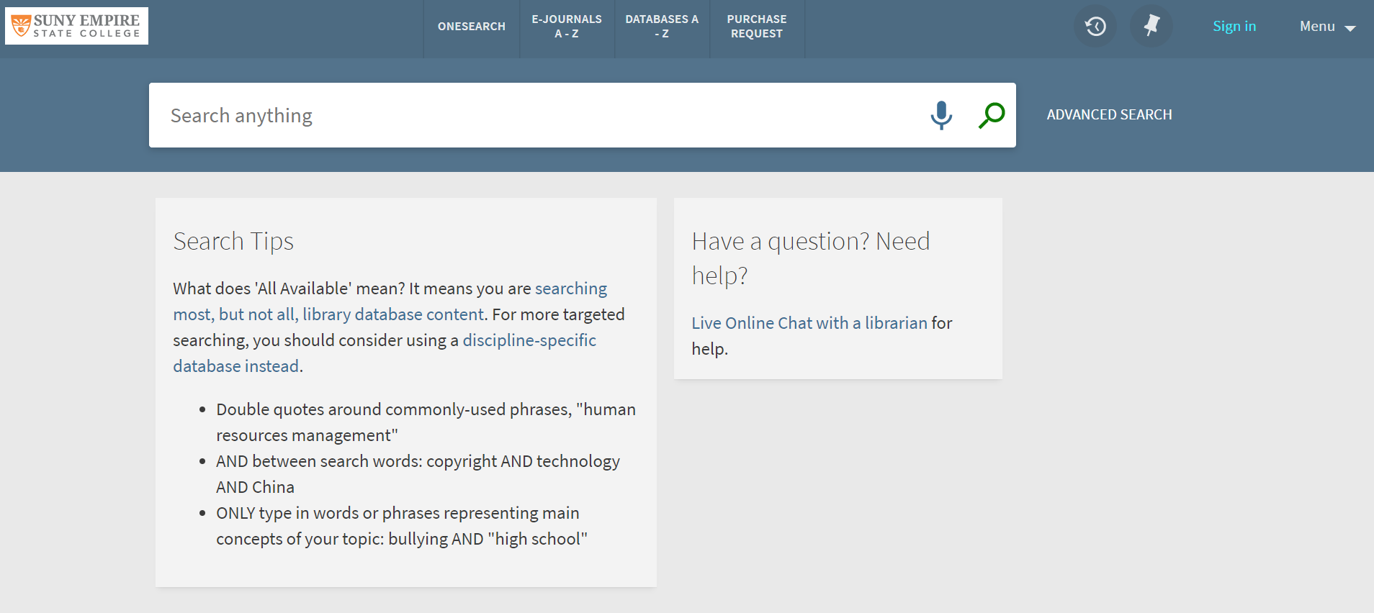
Look & Feel: Change content on landing page
Controlled by homepage_en.html
www.suny.edu

Slide 4
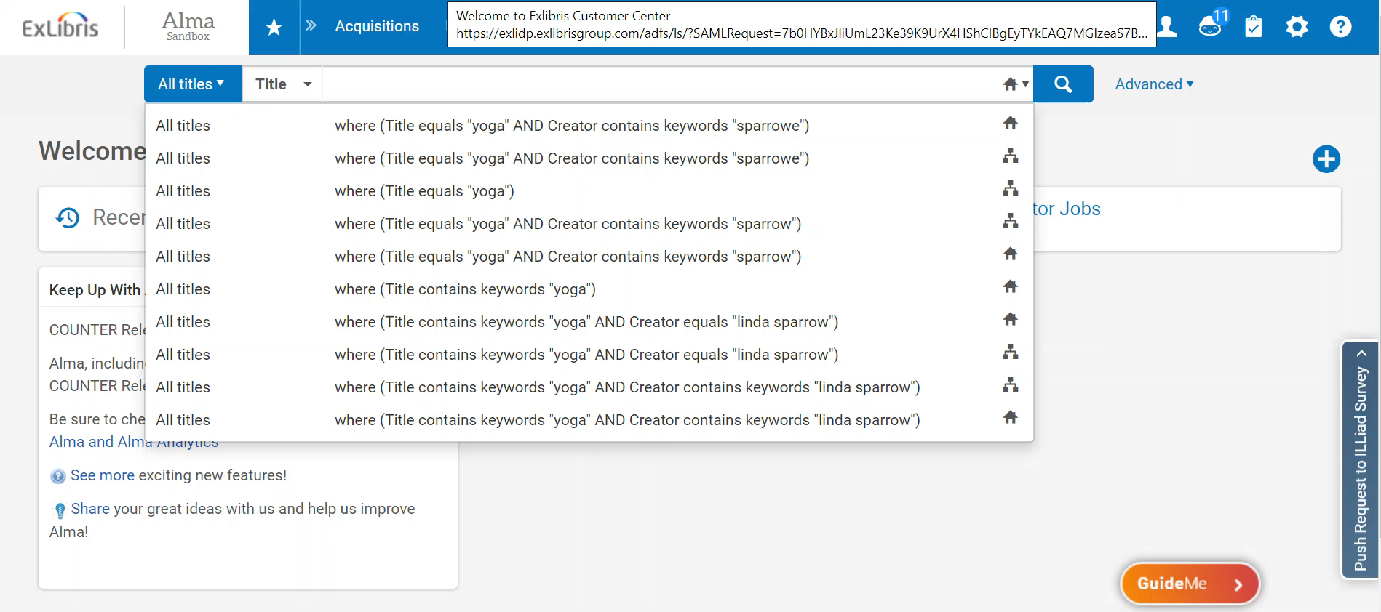
Look & Feel: Change content on landing page
Download Customization package:
www.suny.edu

Slide 5
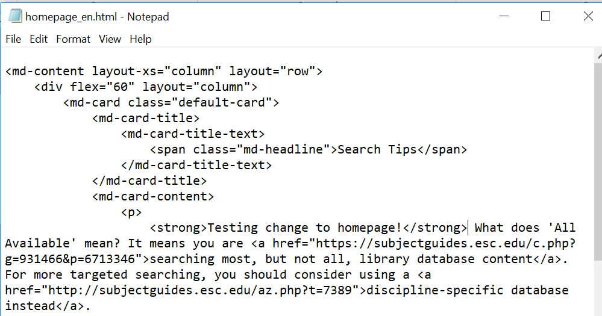
Look & Feel: Change content on landing page
Edit your notepad file and save:
www.suny.edu

Slide 6
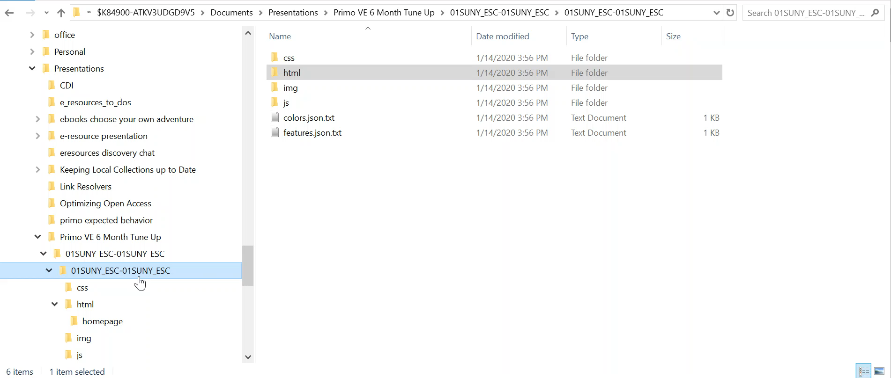
Look & Feel: Change content on landing page
Zip package, picking correct level, upload to Alma and save:
www.suny.edu

Slide 7
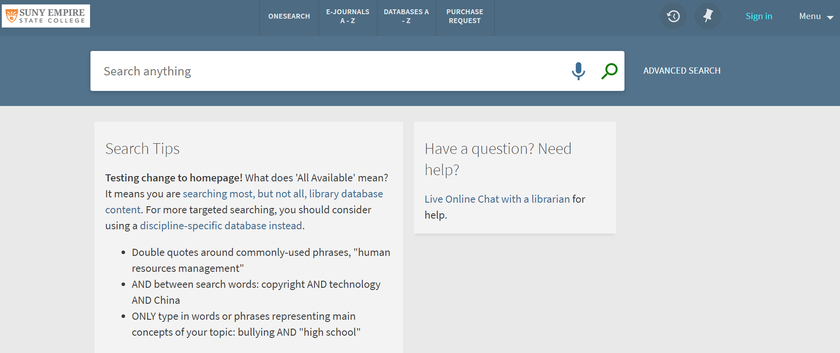
Look & Feel: Change content on landing page
www.suny.edu

Slide 8
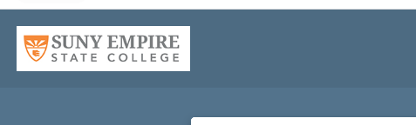
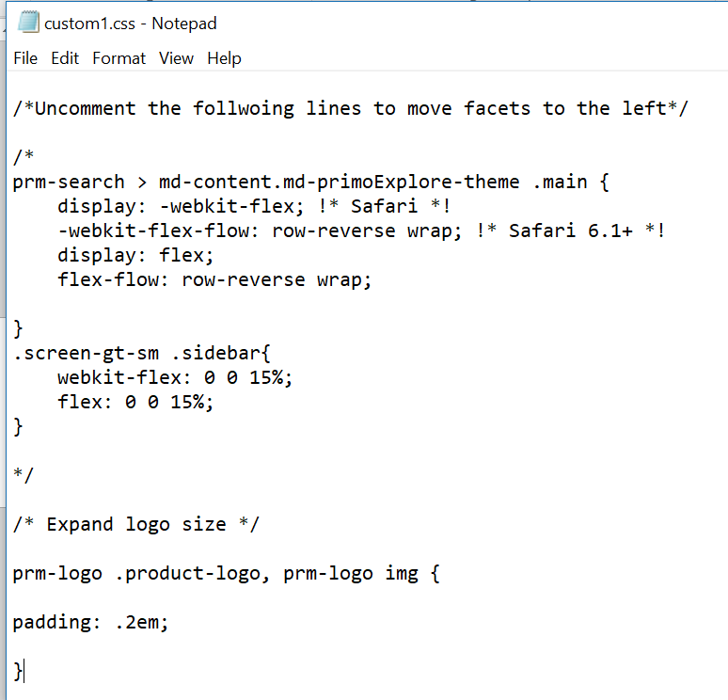
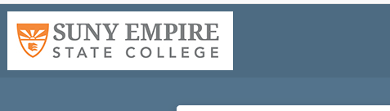
Look & Feel: Make logo bigger
Use same steps as changing homepage – download package from Configure View
This time edit custom.css then save, zip, upload, and save again
Add this code at bottom of file:
/* Expand logo size */
prm-logo .product-logo, prm-logo img {
padding: .2em;
}
www.suny.edu

Slide 9
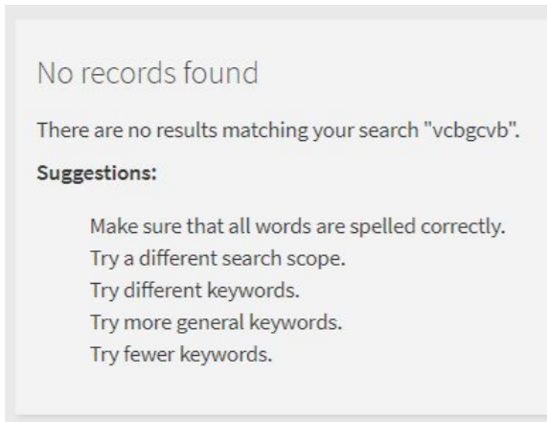
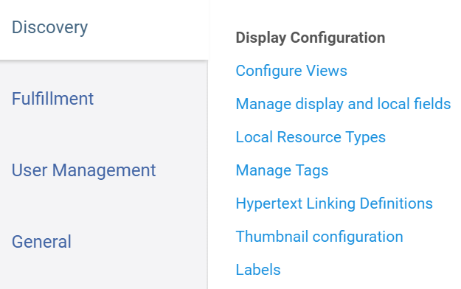
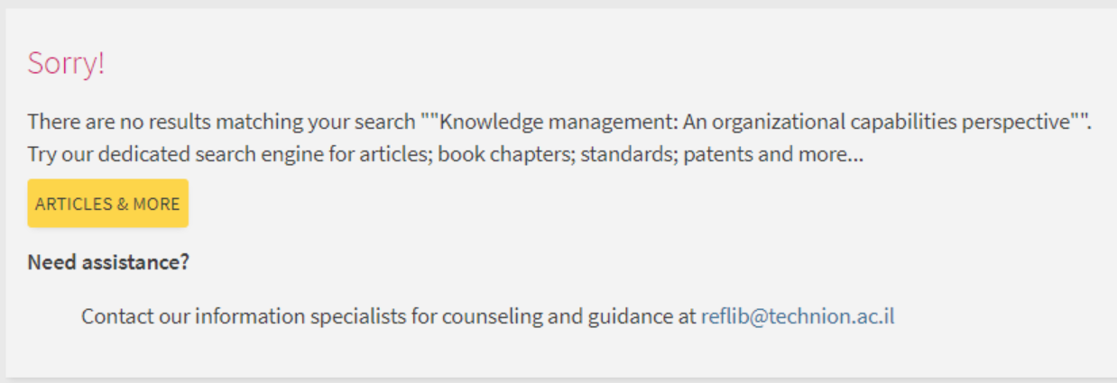
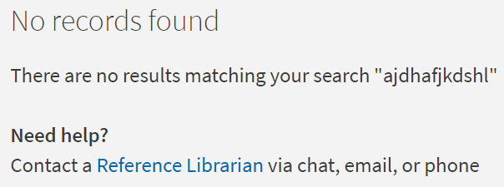
Look & Feel: Edit “No Records Found” Page
You change this in the labels area. Might want to add note about expanding search.
www.suny.edu

Slide 10
Look & Feel: Edit “No Records Found” Page
From Technion Primo VE Customization Guide:
Code: nui.noresults.title
Description: <font color="#CE0F69">Sorry!</font>
Code: nui.noresults.description
Description: There are no results matching your search "{term}}".</br>Try our dedicated search engine for articles; book chapters; standards; patents and more...</br><a href="https://search.ebscohost.com/login.a...term}}&lang=en" onmouseover='this.style.textDecoration="none"'> <button class="md-raised md-button md-ink-ripple" type="button" ng-transclude="" aria-label="Search articles" style='margin-left:0;margin-right:0; background-color: #FDD54A; font-size: 14px;'>Articles & More</button> </a>
Labels, continued:
Hide Code: suggestions2 through suggestions5
Description: <tech class="tec_hide">NOT_DEFINED</tech> or
Description: <tech class="tec_hide">suggestions3</tech>
Add this to custom.css:
.tec_hide {
display: none;
}
ul {
list-style-type: none;
}
www.suny.edu

Slide 11
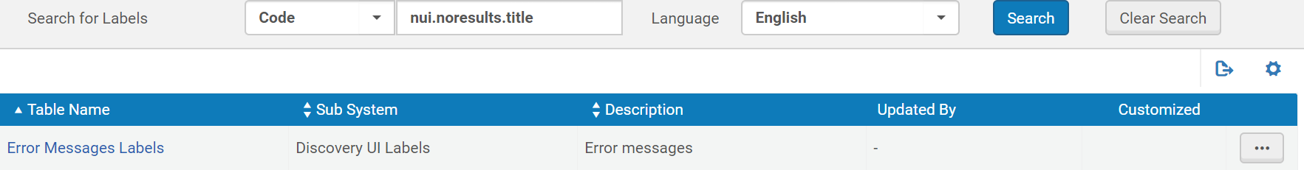
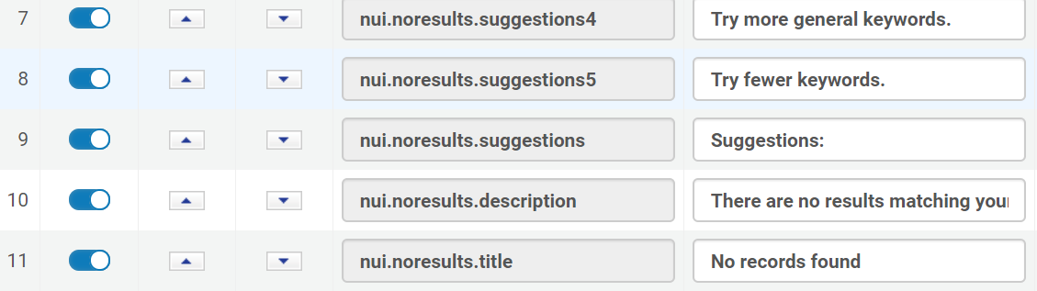
Look & Feel: Edit “No Records Found” Page
www.suny.edu

Slide 12
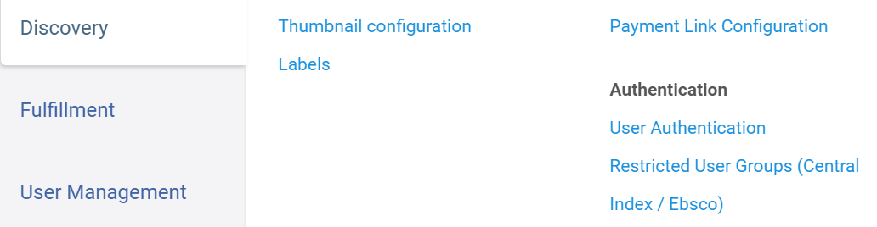
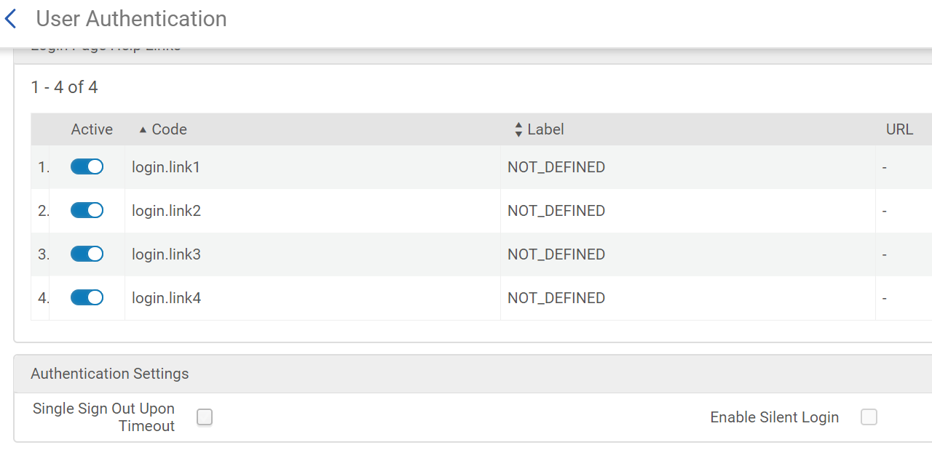
Authentication & My Account: Silent Login
This is straight-forward to set up.
Why set it up?
Will automatically log patrons in if they’re already logged in to Blackboard or another system using same login method in same browser.
Saves patron from needing to login if they want to request something or look at their account.
Note: doesn’t always work if they open a link resolver page from Google Scholar or stand-alone database
www.suny.edu

Slide 13
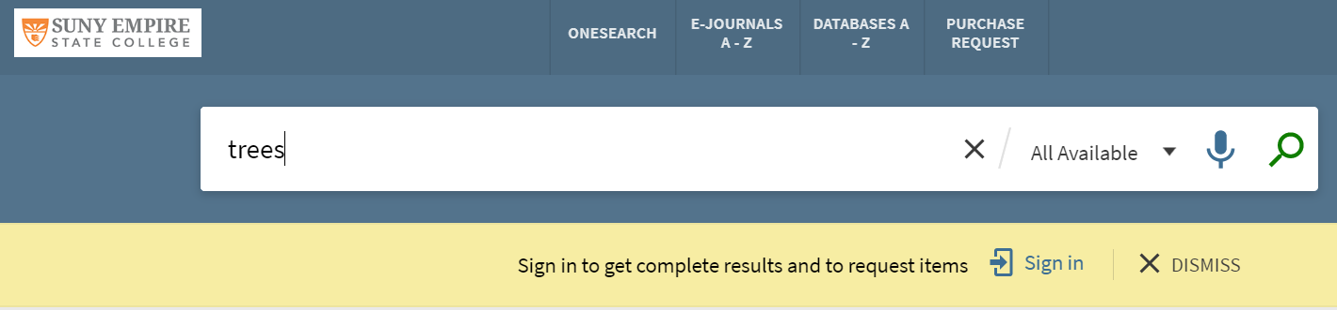
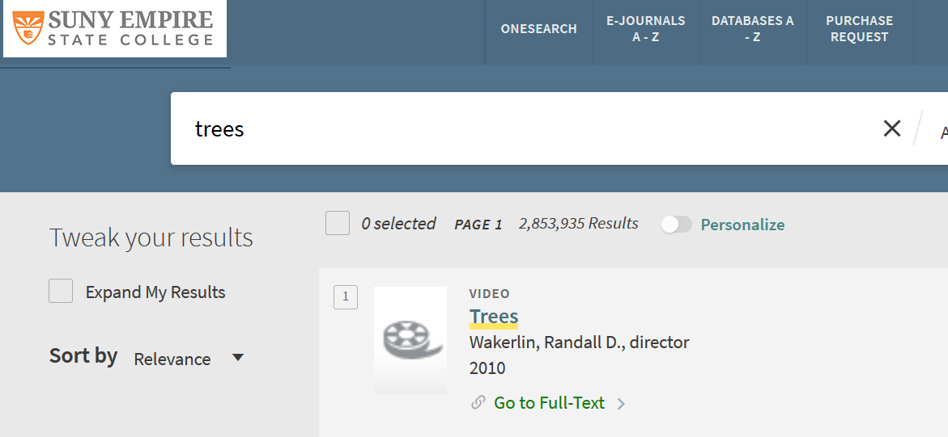
Authentication & My Account: Hide Login Bar
Why hide? Usability studies have shown that users don’t see it – they have “banner blindness”
How to hide:
Add this code to the end of your custom.css file:
/************* Remove the yellow alert banner ***************************/
prm-search > prm-alert-bar {
display: none;
}
www.suny.edu

Slide 14
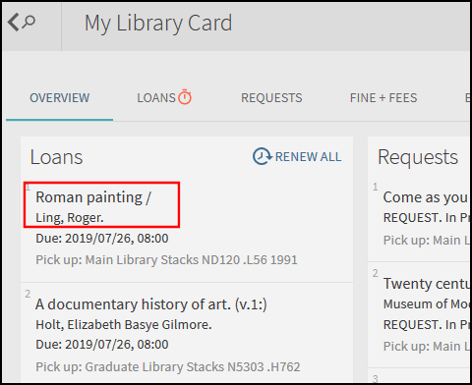
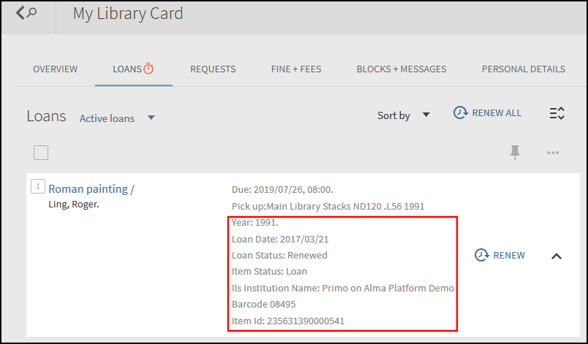
Authentication & My Account: Configure My Account
You can configure what displays in the My Account/My Library Card area via Config->Discovery->Library Card Configurations
www.suny.edu

Slide 15
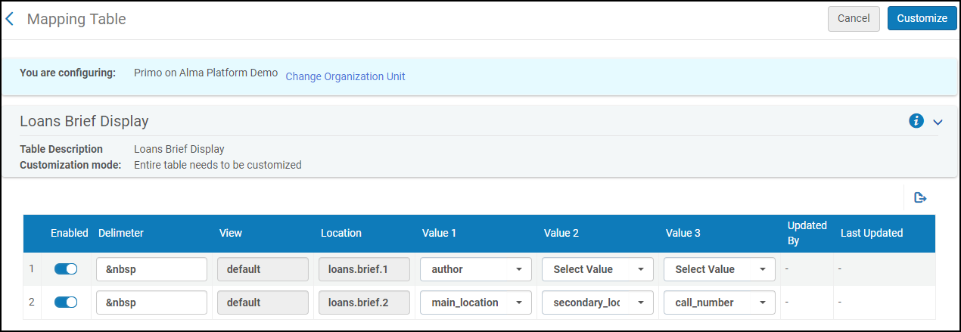
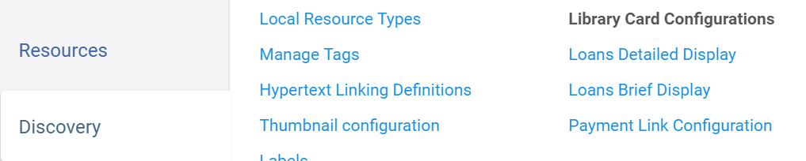
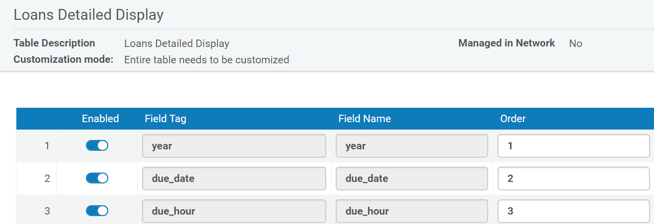
Authentication & My Account: Configure My Account
You can configure what displays in the My Account/My Library Card area via Config->Discovery->Library Card Configurations
https://slcny.libguides.com/training-primo-discovery/config-mylibrarycard
www.suny.edu

Slide 16
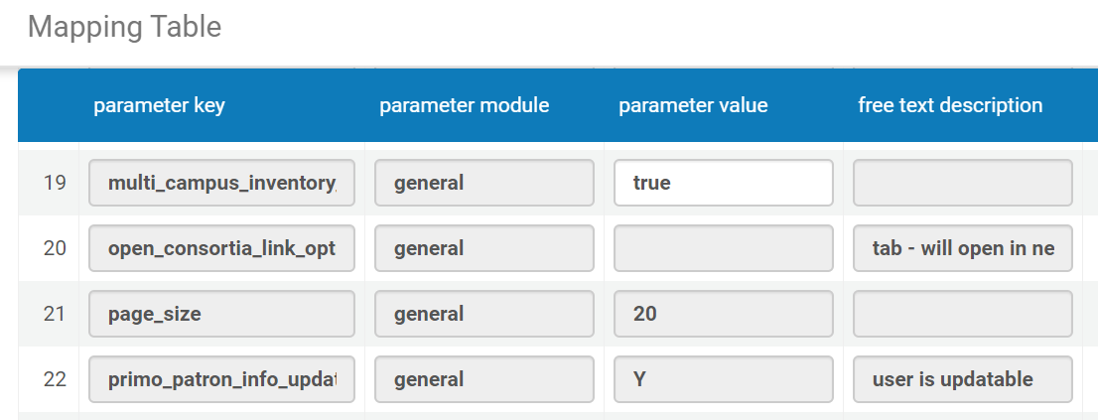
Authentication & My Account: Restrict Patron Changes
Why?
If you're setting up your patrons as external users, you won't want them to be able to change their contact information in the Library Card area in Primo because it will just be wiped out the next time the data is loaded from your SIS.
To hide the "edit details" option, go to Alma Configuration > General > General Configuration > Other Settings > parameter key: primo_patron_info_updatable (free text description: user is updatable) = N
www.suny.edu

Slide 17
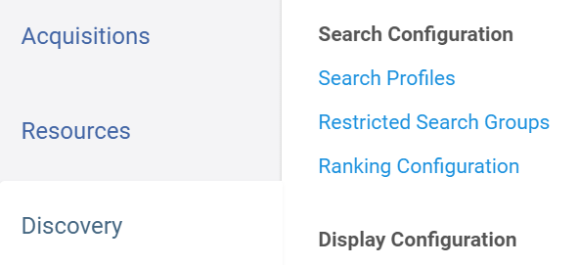
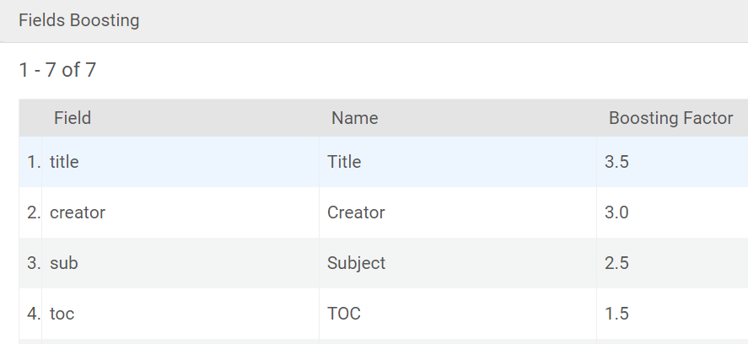
Searching: Boosting
You can boost by field, date, and resource type for local content.
How to:
The Ranking Configuration page (Configuration Menu > Discovery > Search Configuration > Ranking Configuration) allows you to modify the out-of-the-box ranking algorithm used to order items in the results list. See Configuring the Ranking of Search Results in Primo VE."
www.suny.edu

Slide 18
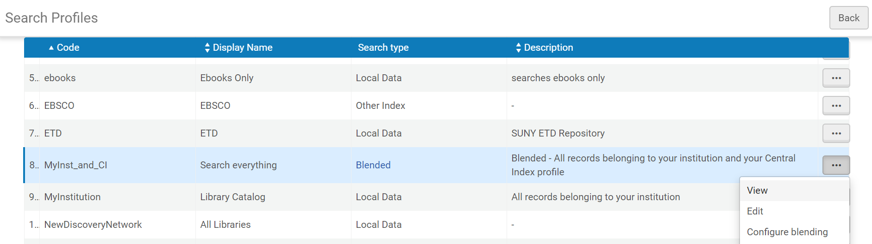
Searching: Boosting
You can also boost in blended scopes. Caveat: be careful!
Go to Search Profiles and click the three dots next to any blended search:
www.suny.edu

Slide 19
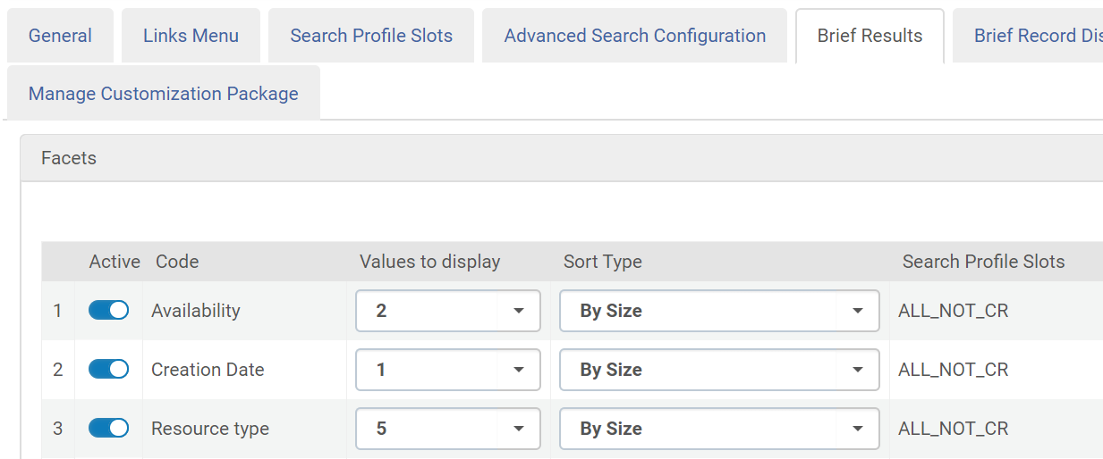
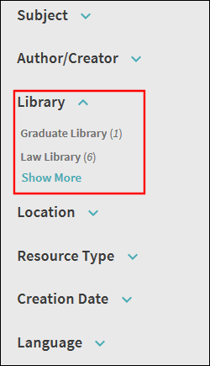
Searching: Facets
You can change the facets that display and how many entries show underneath them in your View Configuration->Brief Results area:
Values to display:
ALL_NOT_CR – This option selects all search profiles (including custom search profiles) except for CourseReserves.
www.suny.edu

Slide 20
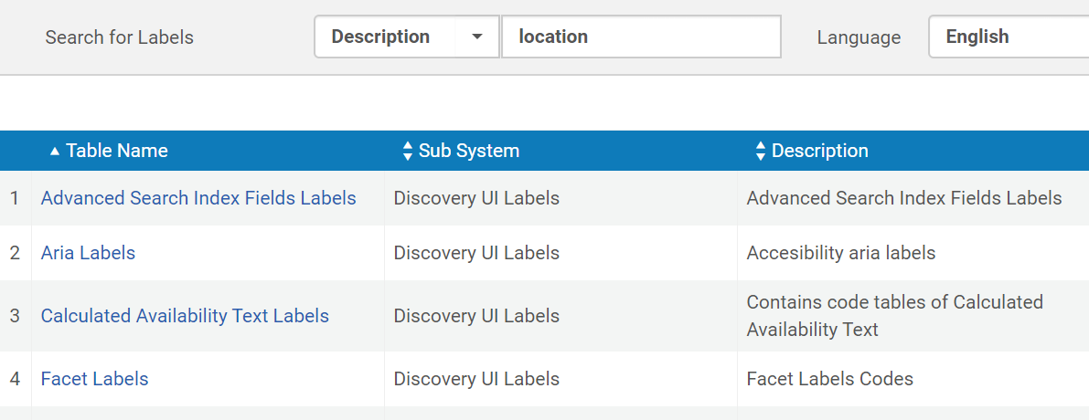
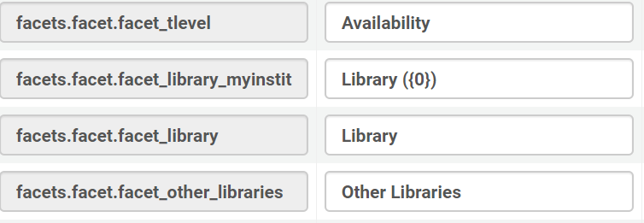
Searching: Facets
You can change the names of facets in the labels tables – look up by description:
https://slcny.libguides.com/training-primo-discovery/config-results
www.suny.edu

Slide 21
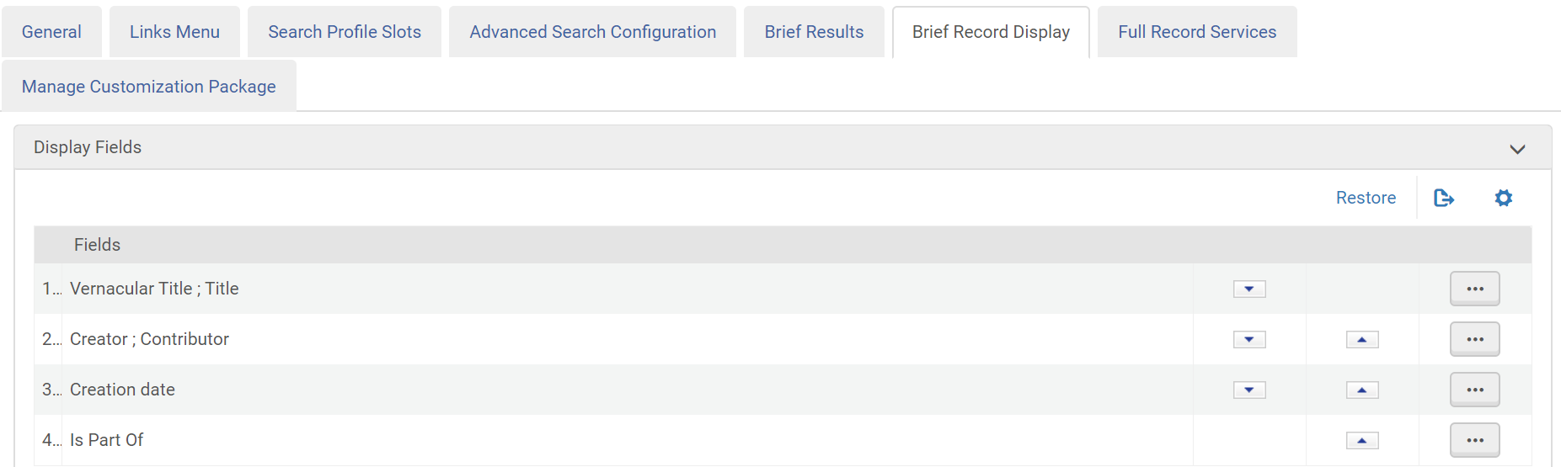
Brief Results: Citation Information
You can change the fields that display in your brief citation in the Configure Views area:
You get 4 lines to play with, and you can have more than one field on a line. Click the three dots to edit what shows on the line.
www.suny.edu

Slide 22
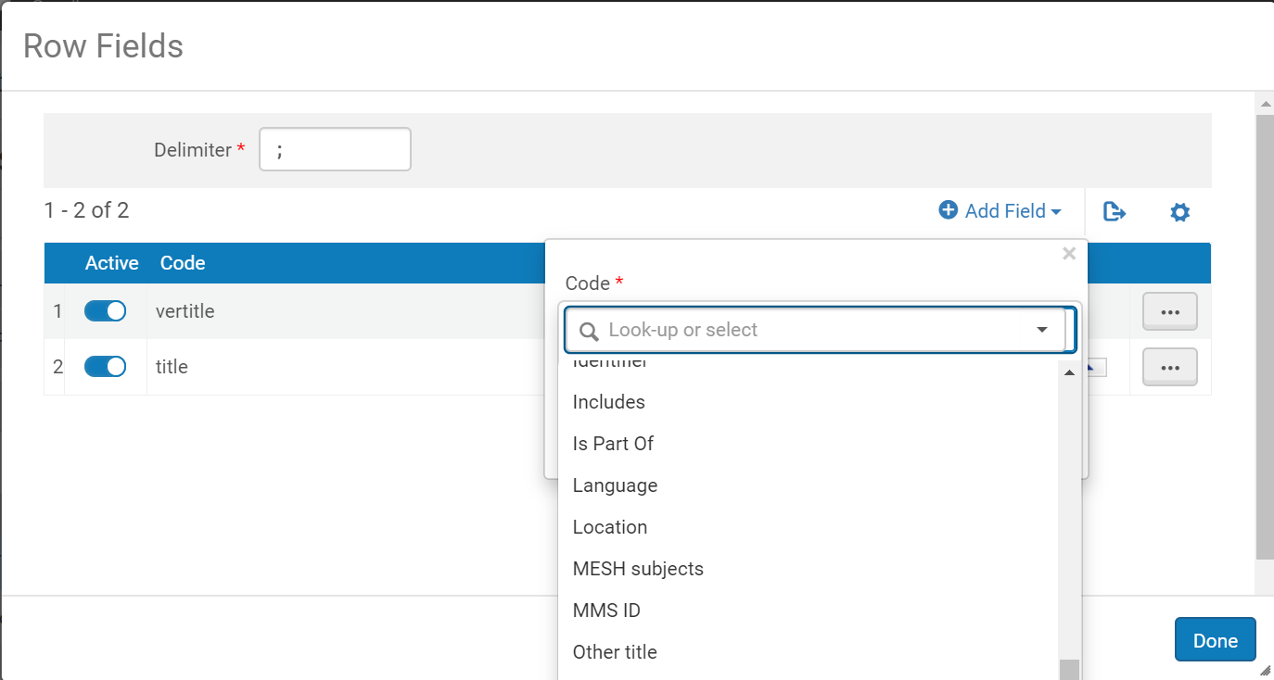
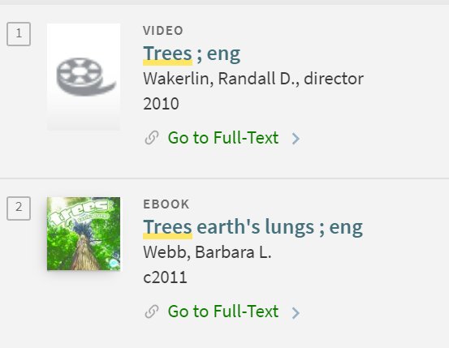
Brief Results: Citation Information
For example, if you wanted to add Language, you could edit the line and look up and add the field:
If you don’t like the display, you can add a display normalization rule to show full language instead of eng, fre, etc.
www.suny.edu

Slide 23
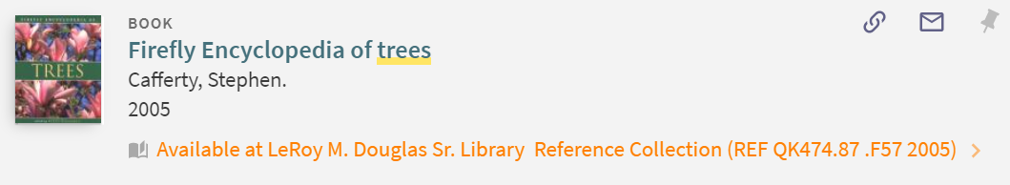
Brief Results: Configure Print Availability Display
Had a campus ask if you could add content to the way that the print availability displays, such as adding Call Number before the call number. This is from the Alma-L:
  The CSS that I used, which is a bit of a hack using the angular attribute as the selector…
  /* call number hack */
  span[ng-if="$ctrl.currLoc.location.callNumber"]:nth-of-type(2n+1)::before {
  content:"Call Number: ";
  }
  Ben
New wording would go here
Try at your own risk ☺
www.suny.edu

Slide 24
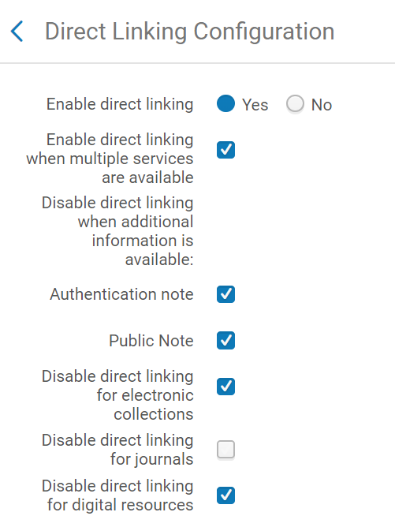
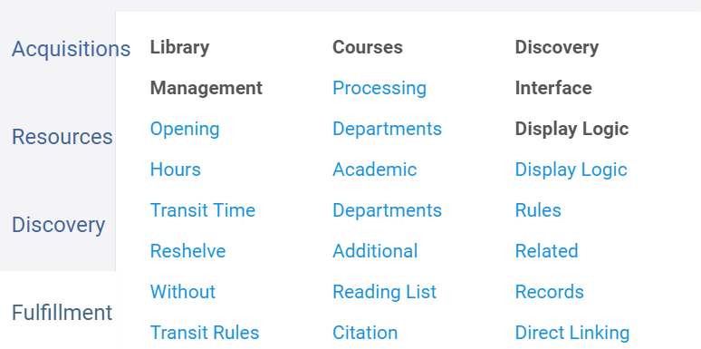
Brief Results: Direct Linking
Problems with dropped proxy for direct linking were fixed with January release – maybe try direct linking again? Better user experience for patrons, except when links fail.
www.suny.edu

Slide 25
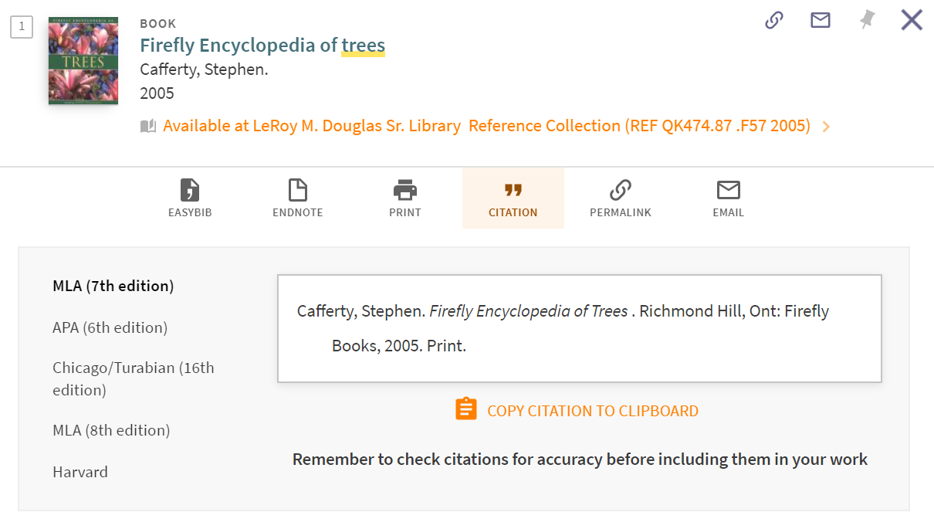
Full Records: Managing Citations
Out of the box default is MLA 7
www.suny.edu

Slide 26
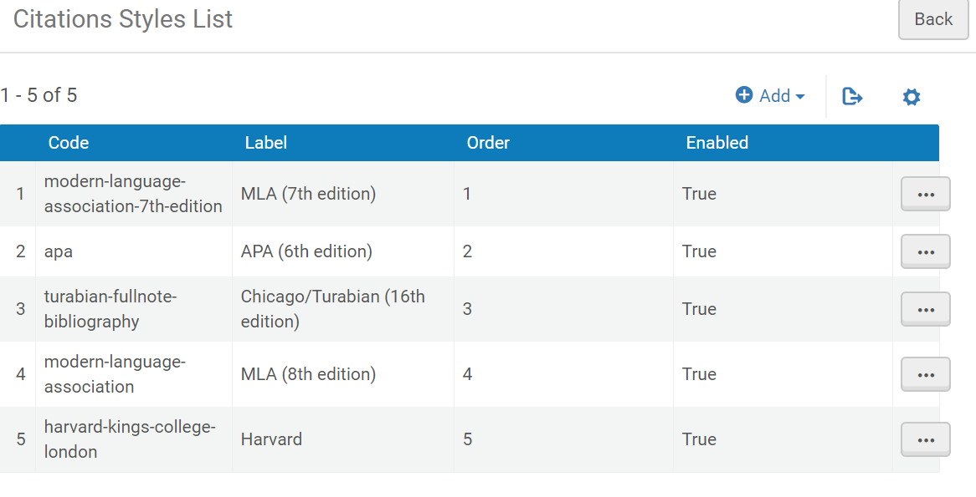
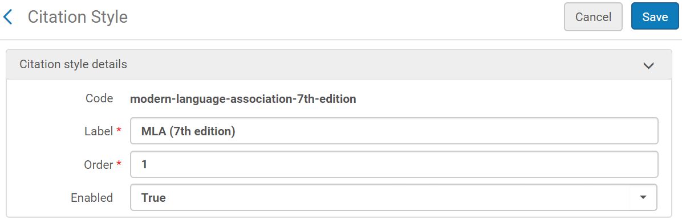
Full Records: Managing Citations
How to change:
Discovery->Other->Citations Styles
www.suny.edu

Slide 27
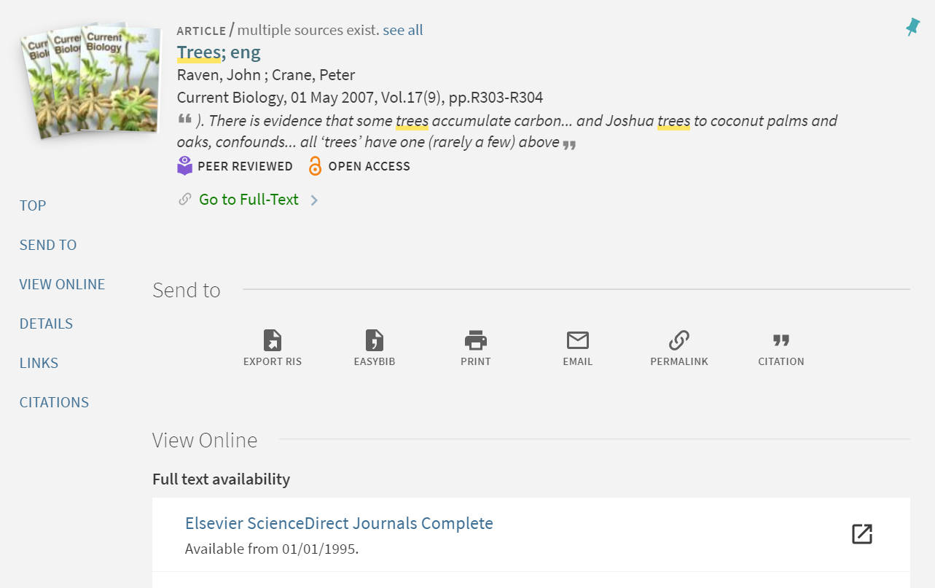
Full Records: Changing Section Order
Default section order is Send to, then View Online. You can change this.
How to (from From Technion Primo VE Customization Guide):
Sections re-order (locate "Send to" above "Details")
We have moved the "Actions" section, default label "Send to" to be placed above the Details of the record.
The changes are in done by CSS but has an effect on 2 places:
  The sections (the brief, item location, send to, details, links., etc.)
  The navigation menu inside the detailed record.
Note! The aria-label in the left navigation code is in accordance with the "Description" given in Alma code table. Make sure you change them accordingly.
www.suny.edu

Slide 28
Full Records: Changing Section Order
/********************* Location change of sections ************************/
#full-view-container >*:first-child {
display: flex;
flex-direction: column;
}
#brief {
order: 0 !important;
}
#getit_link1_0 {
order: 1 !important;
}
#getit_link1_1 {
order: 2 !important;
}
#action_list {
order: 3 !important;
}
#details {
order: 4 !important;
}
#links {
order: 5 !important;
}
#virtualBrowse {
order: 6 !important;
}
/******** Location change of links in left navigation bar **************/
[aria-label="Top"] {
order: 0 !important;
}
[aria-label="Find Online"] {
order: 1 !important;
}
[aria-label="Find in library"] {
order: 2 !important;
}
[aria-label="Send to"] {
order: 3 !important;
}
[aria-label="Details"] {
order: 4 !important;
}
[aria-label="Links"] {
order: 5 !important;
}
[aria-label="You May Like"] {
order: 6 !important;
}
www.suny.edu

Slide 29
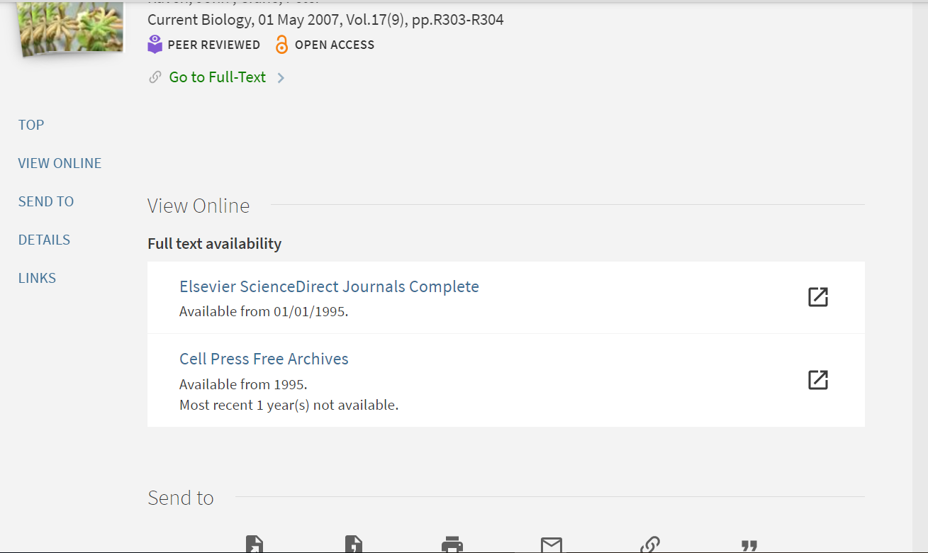
Full Records: Changing Section Order
Citation navigation missing
www.suny.edu

Slide 30
References
Technion Primo VE Customization Guide – starting to get a little dated – September 2018 – but great source of how-to info
SLSS Discovery/Primo Training Guide – incorporates SLSS FAQs, training videos, Ex Libris documentation links
Discovery Working Group SUNYLA 2019 Presentation – includes some of what we’ve covered but also a few more configuration options from Technion doc and the group’s experience
www.suny.edu

