Slide 1
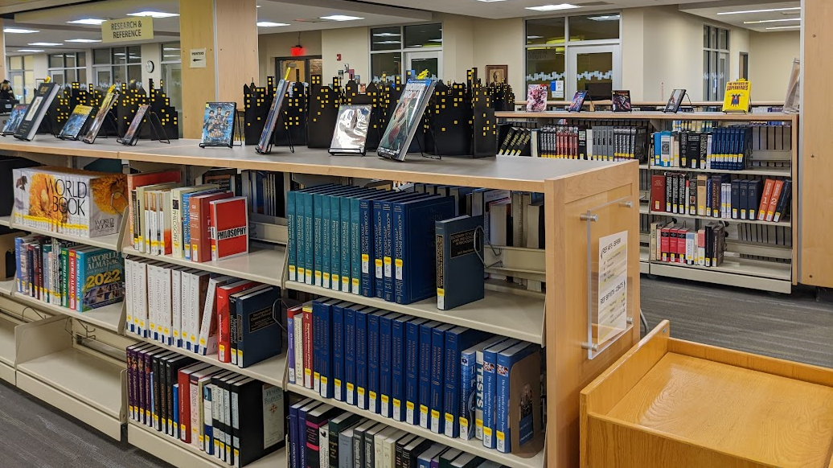
We’ve Got an Outcome for That: Faculty Information Literacy Workshops for Authentic Core Competency Assessment
Lisa Hoff and Michelle Malinovsky

Slide 2
Who We Are
Lisa Hoff
Librarian, Associate Professor
Library Department Chair
Lisa is the campus coordinator for Open Education Resources and is a long-standing member of the Faculty Committee for Learning Outcomes and Assessment. Lisa is the librarian liaison for the School of Health and Math, Science, & Engineering. She earned her MSLIS at Syracuse University in 2011.
Michelle is the librarian liaison for the School of Liberal Arts and the School of Art, Design, Media, and Music as well as the lead on Instructional Services through Coulter Library. Michelle earned her MLS at Clarion University of Pennsylvania in 2010. She also holds an MA in English and Creative Writing from SNHU.
Michelle Malinovsky
Librarian
Associate Professor of English

Slide 3
Context: Idea to Plan
Past practice for Information Literacy (IL) assessment was a check box on the Curriculum Form
Learning Outcomes & Assessment Committee (LOAC) surveyed Department Chairs asking how IL was being assessed
Responses showed that improvements were needed
New SUNY General Education Requirements provided an opportunity to make meaningful changes
LOAC survey responses, along with Librarian observations, showed that Faculty needed professional development in IL
Michelle is a member of Curriculum Committee & Lisa is a member of LOAC
Both roles are beneficial in assuring that authentic assessment and outcome alignment is happening for IL moving forward

Slide 4
Across Campus Coordination: Title III
Connection with Title III Coordinator
Previous work with Title III through ENG department
First-Year Learning Outcomes (FYLOs)
Year 4 of the grant
Academic Integrity Inclusion
Clarified connection for grant approval
Proposal Creation
Financial Incentive for Participants
Grant funded, $200 for faculty who attended

Slide 5
Workshop Development & Plan
Development Of Workshop
Final Workshop Structure
Researched For Ideas
Idea from College & Research Library News found “The Information Literacy Imperative in Higher Education”
Shared with faculty prior to the workshop as preparation for common ground discussion
Focus on assessment ideas and integration into current assignment(s)
Article discussion and quotes
Definition of Information Literacy both from ACRL and clear, easy to understand terms
Discussion Questions
SUNY GenEd Language
Each competency with assessment ideas

Slide 6
Information Literacy & Academic Integrity
We Have An
Outcome For That!
This Photo by Unknown Author is licensed under CC BY-SA-NC

Slide 7
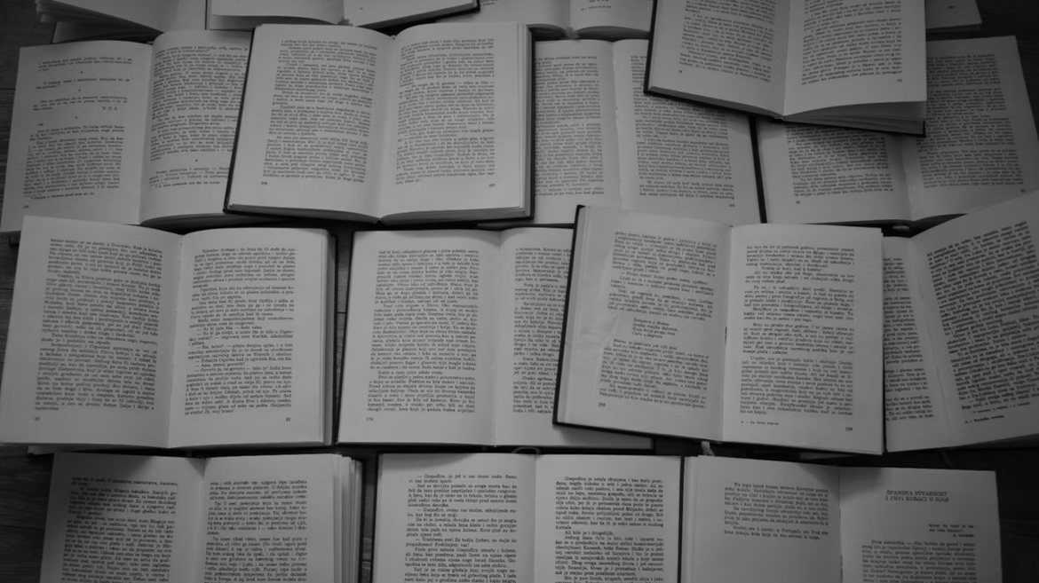
“The Information Literacy Imperative in Higher Education” By Todd J. Wiebe Liberal Education Fall 2015/Winter 2016
“Convenience Searching,” Googling, and social media sharing “creates an illusory comfort within vast pools of information and a sense that ‘finding stuff is easy.’ But this fluidity within the ‘familiar’ simply does not carry over into situations requiring serious inquiry and deep investigation using a variety of source types and mediums.”
“When students either discover for themselves or are straight out told that a particular assignment is going to require a very specific type or types of information (not just something that sounds good and seems to be from ‘credible’ source) their old system crashes.”

Slide 8
Association of College
and Research Libraries
Information literacy is the set of integrated abilities encompassing the reﬂective discovery of information, the understanding of how information is produced and valued, and the use of information in creating new knowledge and participating ethically in communities of learning.
“Information literacy is more than just a contrived educational buzzword librarians like to use for ‘how to search the library’ or ‘beware of Wikipedia.’”

Slide 9
What Information Literacy Really Means
Considering different types of information, each with its own origin, purpose, and place
Knowing how to navigate through a variety of information environments, and why to do so
Habitually evaluating, questioning, and verifying what information you find
Understanding that there is no perfect source
Being mindful about appropriately and ethically incorporating intellectual property
Understanding that a format or medium does not define the quality or appropriateness of information
Acknowledging that efficiency is not always the primary goal in gathering information
This Photo by Unknown Author is licensed under CC BY-SA-NC

Slide 10
What misconceptions or insecurities have you noticed your students have when asked to complete a research assignment?
What “go-to” skills have you observed your students relying on for finding information?
What are the chronic deficiencies you see when it comes to student research skills?
How might intentional information literacy instruction support your course objectives and classroom goals?

Slide 11
SUNY Gen Ed: Core Competency
Information Literacy
Students will:
locate information effectively using tools appropriate to their need and discipline;
evaluate information with an awareness of authority, validity, and bias; and
demonstrate an understanding of the ethical dimensions of information use, creation, and dissemination

Slide 12
Outcome 1
Locate information effectively using tools appropriate to their need and discipline
Suggestions:
Revise the assignment to include:
Language indicating acceptable sources
Examples of acceptable sources
Include a rubric category assessing source appropriateness
Include course content on source selection and source expectation
Google vs. Databases
Academic Journals vs. Popular Magazines
Internet/News Sources vs. Reference Works
Request a Library Instruction Session
Assessment: % of students who complete with a C or better

Slide 13
Outcome 1
Locate information effectively using tools appropriate to their need and discipline
Example:
Rubric Category for Assessment
Criteria | A | B | C | D-F
Research and Outside Sources | Sources chosen are relevant and clearly related to topic and are all credible. All are appropriate to the topic and consideration evident. Has the required number. | Sources chosen are mostly relevant and most are related to topic. Most appear credible, all are appropriate to the topic and most include evident consideration. Has the required number. | Sources are connected to topic, but some fail to clearly relate or do not appear credible. Some questions on appropriateness, but some consideration evident. Has the required number. | Sources fail to be connected to topic and are not credible. Lacks relevancy. Sources are not appropriate for the selected topic. Does not have the required number

Slide 14
Outcome 2
Evaluate information with an awareness of authority, validity, and bias
Suggestions:
CRAP Test (Currency, Reliability, Authority, Purpose)
Annotated Bibliography
Evaluation within text/source introduction and validity
Create or Modify An Assignment
Assignment Instructions require students to discuss sources, such as an adapted Literature Review
Assessment: % of students who complete assignment (or complete with a C or better or Satisfactory)

Slide 15
CRAP Test
 | 1 Point | 2 points | 3 points | 4 points | Score
Currency | No publication dates. No revisions within the last 18 months | No updates in the past year. | Updated in the last 6 months. | Publish date is listed OR has been updated within the last 3 months.
Reliability | Information is not verifiable. Resources not documented. | Some resources are not documented. Some links do not work. | Most resources are documented. All links work. | Well organized. Resources documented. All links work.
Authority | No author listed and no contact info provided. | No author listed. Contact info included. | Author is listed without credentials. Unsure if the author is creator. | Author is listed with credentials. Author is originator of information. Contact info is provided.
Purpose | Too much advertising makes content unclear. | Purpose is to sell, entertain, or persuade. Source contains a lot of advertising and bias. | Purpose is to inform and teach. Contains some advertising. Minimal bias. | Purpose is to inform and teach. Contains very little advertising. Minimal to no bias.
*(A good source will have a total score of 14-16) TOTAL SCORE:
Website & URL:
Citation:
Would you use this website for your project? Why or Why not?

Slide 16
Outcome 3
Demonstrate an understanding of the ethical dimensions of information use, creation, and dissemination
Citations
Include course content on source integration
Direct Quotations & Paraphrasing
In-Text Citations
Full Citations, Work Cited/Reference Page
Discuss Accidental/Unintentional Plagiarism
Library Resources (Instruction, Handouts, LibGuides)
Assessment: % of students who correctly include citations (or complete with a C or better or Satisfactory)

Slide 17
Outcome 3
Demonstrate an understanding of the ethical dimensions of information use, creation, and dissemination
Example:
Rubric Category for Assessment
Criteria | A | B | C | D-F
MLA Citations and Formatting | Every citation follows MLA formatting with no or minimal errors. Outside sources correctly handled in-text. Works Cited listed in order, correct grammar, indents, and overall formatting. | Every citation follows MLA formatting with minor errors. Outside sources clear in-text. Works Cited listed in order, almost correct grammar and overall formatting. | Attempts to follow MLA formatting with errors. Attempted in-text citations with consistent errors. Works Cited attempts at correct overall formatting with consistent errors in order, grammar, indents, or content. | Major errors in MLA formatting. In-text citations are inconsistent or missing. Work Cited lacks any attempt at correct citations or not included. Major errors in regard to the handling of outside sources.

Slide 18
Need more ideas? Reach Out! *Make sure to add your name to the participants list before you leave!
Thank You!
Michelle Malinovsky
m.a.malinovsky@sunyocc.edu
Lisa Hoff
l.m.hoff@sunyocc.edu
General Questions:
library@sunyocc.edu

Slide 19
Results & Faculty Response
Workshop Discussions and Questions
Faculty attention to assignment wording
Consideration for course content
Library instructional sessions
Assumptions of student knowledge
Discussion of student intimidation
Faculty Follow-Up Post-Workshop
Three Faculty Requested Help in Assignment Revision
Title III Coordinator attended Session 1, asked for 2 more sessions
Outreach
Participants from historically “hard to reach” departments attended and responded positively
29 total participants
Looking Ahead

Slide 20
Questions? Discussion?
Thank You!
Michelle Malinovsky
m.a.malinovsky@sunyocc.edu
Lisa Hoff
l.m.hoff@sunyocc.edu

