Slide 1
Serials Ordering and Receiving Post Migration: For Campuses Who did not Use Acquisitions Prior to ALma
Shared Library Services Platform Project
Maggie McGee

Slide 2
Requirements for Serials Receiving in Alma
Order Record
All serials in Alma require an open Order record for Print Journal – Subscription or Physical Journal - Subscription in order to receive through the acquisitions work order department
Acquisitions Department receiving desk
Unless you have another desk configured to receive acquisitions
Description templates configured
Configuration>Resources>General>Description Templates
Role to receive:
Receiving Operator

Slide 3
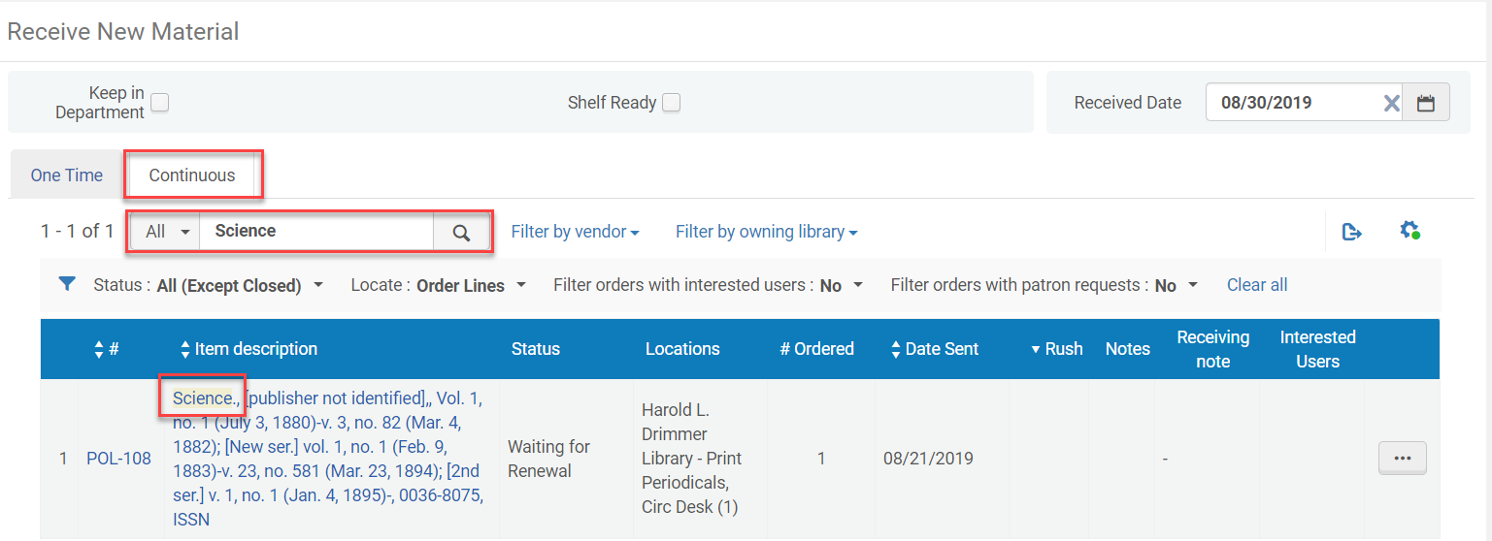
How to Tell if Serials can be Received in Alma
Make sure you are in the acquisitions work order department location
Change to the acquisitions work order department if it is not already selected
Go to Acquisitions>Receiving and Invoicing>Receive
Click on the Continuous tab
Search for the serial title

Slide 4
Steps to Prepare to be able to Receive Serials in Alma
Review serial records for existing active order records
Create a POL if no order record exists for the serial(s)
Create a template for the first POL created for serials to make the POL creation process quicker and consistent
Associate the POL to the holding record with existing items associate to it
Delete the newly created holding record from the POL
Set up description templates
One-time step
May require tweaking to refine them

Slide 5
Review serial records for existing active order records
Shared Library Services Platform Project
Maggie McGee

Slide 6
Reviewing Serial Records for an Existing Order
Perform a All Titles Repository Search in the IZ
An order exists if Orders: # is in the brief bib record view from the repository search
You will need to Order the serial record if no active POLs exists

Slide 7
Create a POL for serials without order records in order to be able to receive
Shared Library Services Platform Project
Maggie McGee

Slide 8
Ordering Serial Records to be able to Receive
Perform an All Titles repository search for the serial title
Order from the correct NZ record, unless it is an exception that meets MSP-3’s criteria
Check the IZ bib record does not have an order

Slide 9
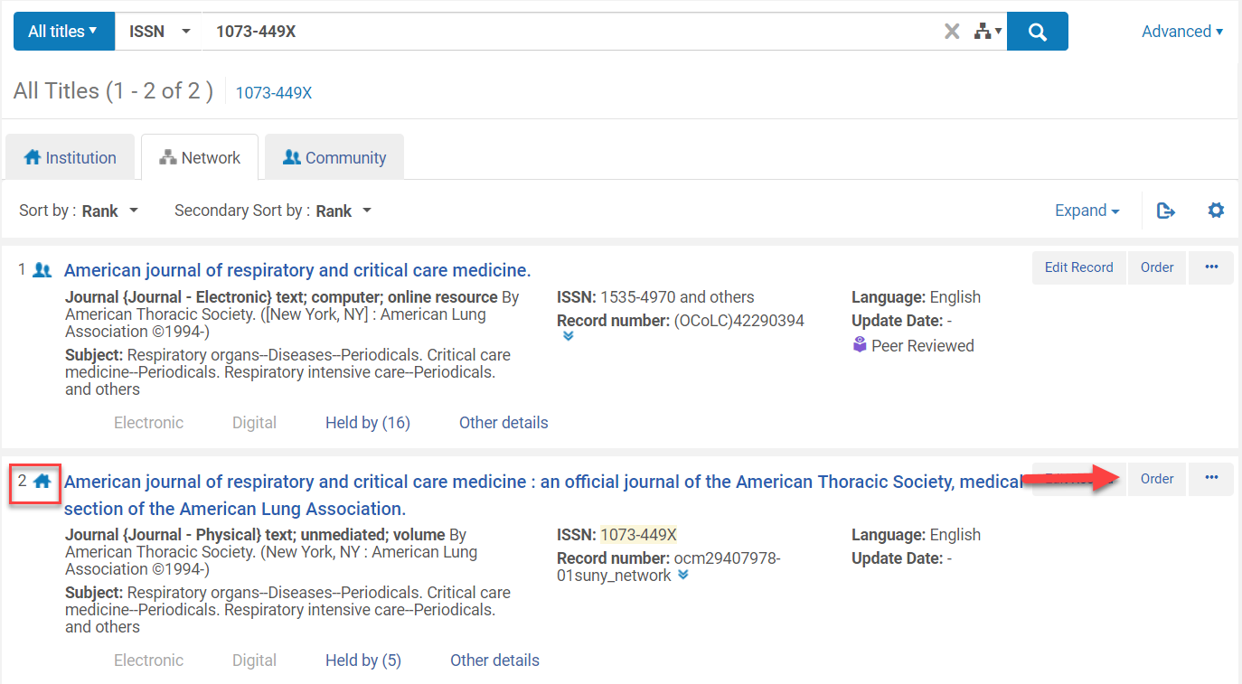
Ordering Serial Records to be able to Receive
Click on the Network tab
Click Order from the correct bib record

Slide 10
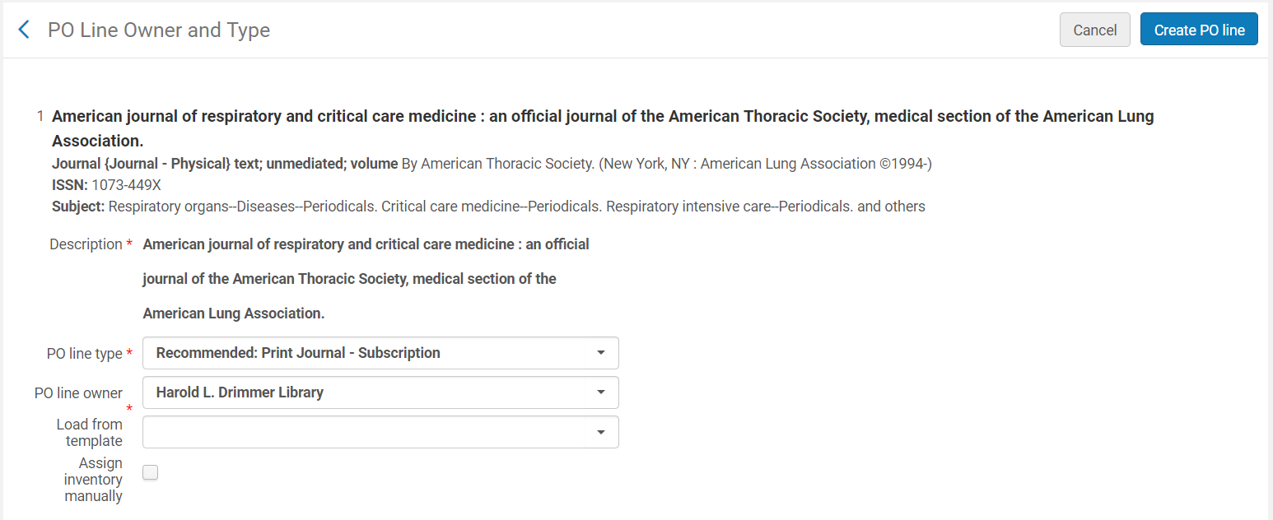
Ordering Serial Records to be able to Receive
The PO Line Owner and Type screen opens
PO Line Type: Print Journal– Subscription
PO Line Owner: [ordering library]
Load from template: [once created this can be selected here]
Click Create PO Line

Slide 11
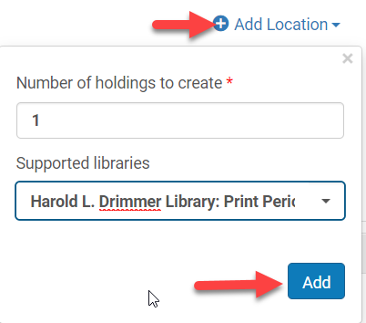
Ordering Serial Records to be able to Receive
The Purchase Order Lines Screen Opens
Delete the default holding location under Ordered Items if you are not using a template
Click Delete from the ellipses of the default holding record
Click Add Location and add the physical location where serial titles live

Slide 12
Ordering Serial Records to be able to Receive
Select the Material Supplier
Add Pricing (if you are using Purchase at Vendor System as the Acquisitions Method)
If you are using simplified acquisitions with an Acquisition Method of Technical leave this blank
Add Fund (if you are using Purchase at Vendor System as the Acquisitions Method)
If you are using simplified acquisitions with an Acquisition Method of Technical leave this blank

Slide 13
Ordering Serial Records to be able to Receive

Slide 14
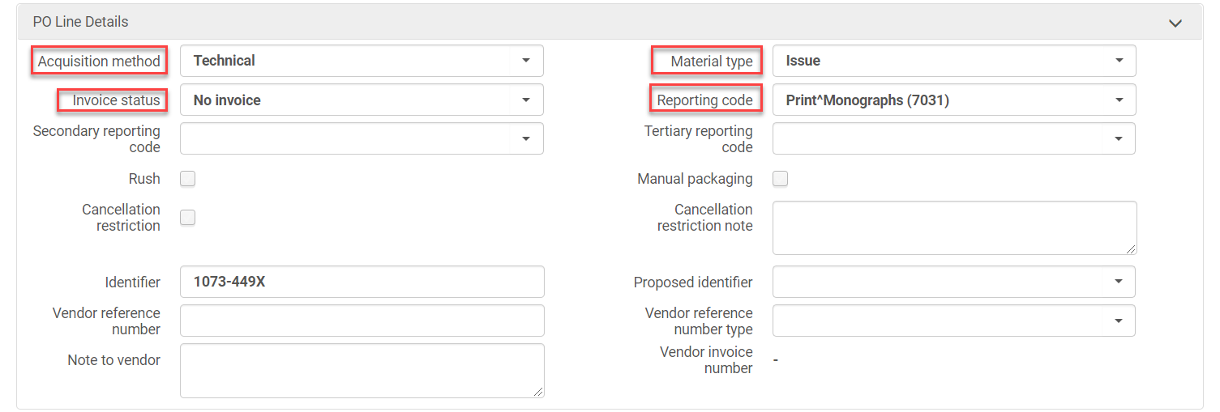
Ordering Serial Records to be able to Receive
Acquisitions Method: [Purchase at Vendor System or Technical]
Material Type: Issue
Report Code: [populate if using]
Reporting Codes can be added under Configuration>Acquisitions>Purchase Orders>Reporting Codes
Invoice Status: [No Invoice, Partially Invoiced]

Slide 15
Ordering Serial Records to be able to Receive
Uncheck Manual Renewal
Unchecking this box will allow PO lines for the renewal to be processed automatically
Subscription from date: [informational only]
Subscription to date: [leave blank]
The PO line closes when the automatic renewal job detects that the Subscription to date has passed.
Renewal date: [date subscription is to be renewed]
Renewal reminder period (day): [number of days you want to be notified prior to the renewal date]
Renewal cycle: [select 1 year, 3 year, or 5 year]

Slide 16
Ordering Serial Records to be able to Receive
Click Save as Template (This speeds up the POL creation process of subsequent serials)
Template Name: [name the template]
Public template: [Yes if multiple people order]
Click Save

Slide 17
Ordering Serial Records to be able to Receive
Click Order Now
Order Now creates the POL without running the POL packaging job
Click Confirm when the confirmation message appears
The information: The ordered resource already exists in the inventory (# items) indicates you already have a record with x number of items associated with it
In the next step, the POL that was just created will be associated to the items

Slide 18
Associate the POL to the Existing Serial Holdings/Item Records
Shared Library Services Platform Project
Maggie McGee

Slide 19
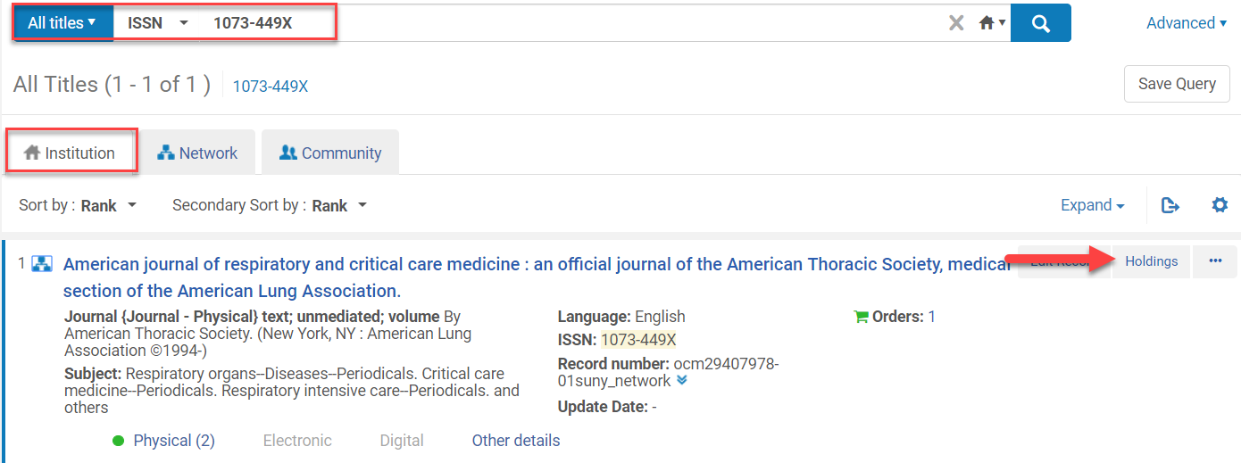
Associating the POL to the Existing Holdings/Item Records
Perform a repository search in the IZ for the serial record
Click Holdings

Slide 20
Associating the POL to the Existing Holdings/Items Records
Click Associate a PO Line from the ellipses of the holdings with the existing item records
Select the POL #
Click Update

Slide 21
Associating the POL to the Existing Holdings/Item Records
Click Edit from the ellipses of the newly created holdings records without any associated items
Select File>Delete Record (Ctrl + D) from the MD Editor
Click Yes when the Confirmation required message pops-up

Slide 22
Associating the POL to the Existing Holdings/Item Records
Click Close when the Information message pops-up
Click Back

Slide 23
Creating Description Templates
Shared Library Services Platform Project
Maggie McGee

Slide 24
Before Creating Description Templates
Required role (one of these roles):
Repository Administrator
Catalog Administrator
General Administrator
Create a list of the various description patterns your library uses. Some basic patterns:
vol.no.(year:month)
no.(year:month)
vol.(year)
(year/month)
Year
Review the spacing and punctuation to be used
Spaces and punctuation need to be included in the description template

Slide 25
Creating Description Templates
Go to Configuration>Resources>General>Description Templates
Click Add Rule

Slide 26
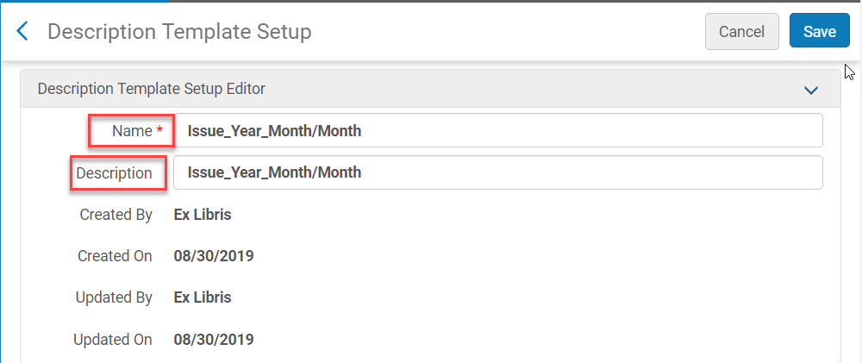
Creating Description Templates
Name: [mandatory]
Description: [optional, but informative]

Slide 27
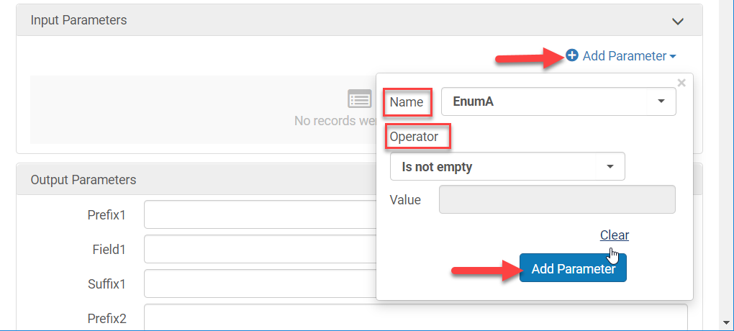
Creating Description Templates
Click Add Parameters
Order them in the way they appear in the description
Include Enum and Chron even if it will be empty
Name: [select the Enum or Chron]
Operator: [select the correct operator]
Click Add Parameter

Slide 28
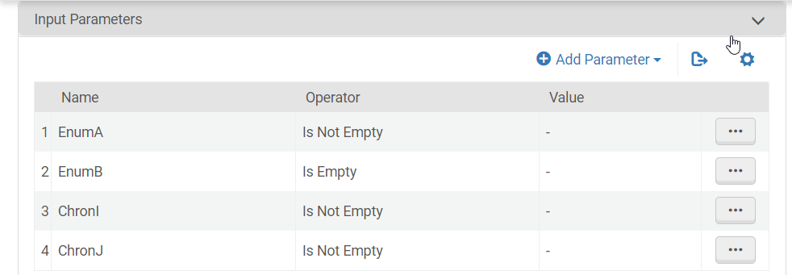
Creating Description Templates
Repeat this process for any other Enum and Chron fields that are part of the pattern

Slide 29
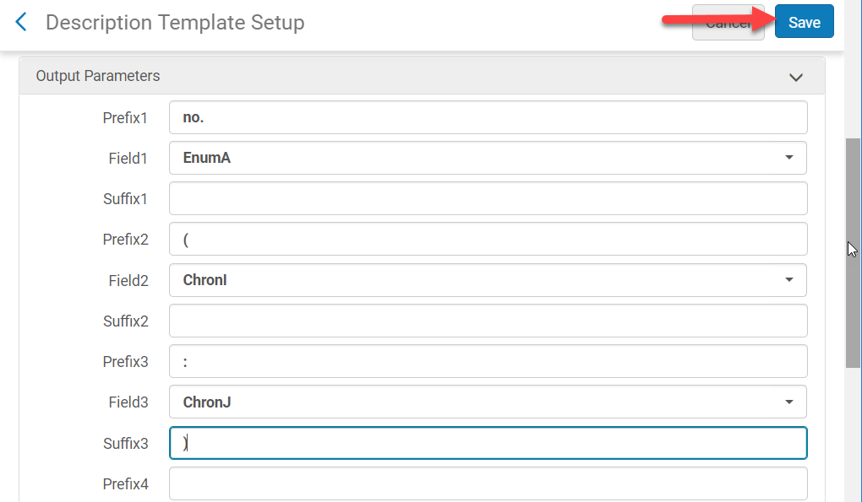
Creating Description Templates
Fill out the Output parameters to reflect the description template output and the parameter above
This is where spacing and punctuation are added
Click Save

Slide 30
Splitting Holdings: when other format holdings are on a print serial Bib Record
Shared Library Services Platform Project
Maggie McGee

Slide 31
Splitting Holdings Records
Identify the correct serial bib record in the NZ
Order the correct serial bib record from the NZ
Create a POL
Move the items to the new bibliographic record

Slide 32
Splitting Holdings Records: Create a POL
Perform an All Titles repository search in the NZ for the correct format serial bib record
Export the bib record from OCLC if it is not in the NZ
Click Order from the NZ bib record

Slide 33
Splitting Holdings Records: Create a POL
The PO Line Owner and Type screen opens
PO Line Type: Physical– Subscription
PO Line Owner: [ordering library]
Load from template: [once created this can be selected here]
Click Create PO Line

Slide 34
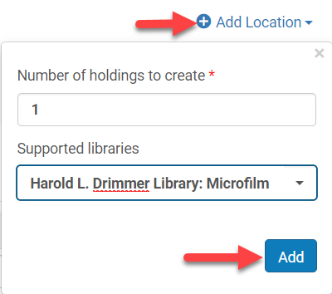
Splitting Holdings Records: Create a POL
The Purchase Order Lines Screen Opens
Delete the default holding location under Ordered Items if you are not using a template
Click Delete from the ellipses of the default holding record
Click Add Location and add the physical location where serial titles live

Slide 35
Splitting Holdings Records: Create a POL
Select the Material Supplier
Add Pricing (if you are using Purchase at Vendor System as the Acquisitions Method)
If you are using simplified acquisitions with an Acquisition Method of Technical leave this blank
Add Fund (if you are using Purchase at Vendor System as the Acquisitions Method)
If you are using simplified acquisitions with an Acquisition Method of Technical leave this blank

Slide 36
Splitting Holdings Records: Create a POL

Slide 37
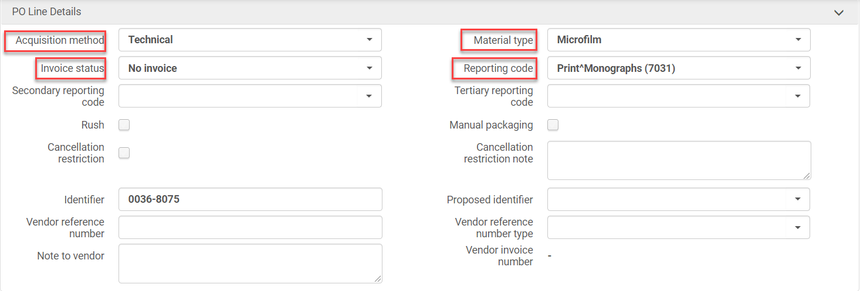
Splitting Holdings Records: Create a POL
Acquisitions Method: [Purchase at Vendor System or Technical]
Material Type: [select the correct material type]
Report Code: [populate if using]
Reporting Codes can be added under Configuration>Acquisitions>Purchase Orders>Reporting Codes
Invoice Status: [No Invoice, Partially Invoiced]

Slide 38
Splitting Holdings Records: Create a POL
Uncheck Manual Renewal
Unchecking this box will allow PO lines for the renewal to be processed automatically
Subscription from date: [informational only]
Subscription to date: [leave blank]
The PO line closes when the automatic renewal job detects that the Subscription to date has passed.
Renewal date: [date subscription is to be renewed]
Renewal reminder period (day): [number of days you want to be notified prior to the renewal date]
Renewal cycle: [select 1 year, 3 year, or 5 year]

Slide 39
Splitting Holdings Records: Create a POL
Click Save as Template (optional – only needs to be done once)
Click Order Now
Order Now creates the POL without running the POL packaging job
Click Confirm when the confirmation message appears

Slide 40
Splitting Holdings Records: Moving Holdings/Item Records
Perform a Physical Titles repository search for the serial records
Click Holdings on the print serials bib record
Click Relink from the ellipses of the non-print holdings record

Slide 41
Splitting Holdings Records: Moving Holdings/Item Records
Type in identifiable search terms (OCLC#, ISSN, ISBN, etc.)
Click Search

Slide 42
Splitting Holdings Records: Moving Holdings/Item Records
Click Relink from the correct bib record
Click File>Save and Release Record (Ctrl+Alt+R)

Slide 43
Splitting Holdings Records: Moving Holdings/Item Records
Search for the bib record that holdings/items were relinked to
Click Holdings
Click Associate a POL from the ellipses of the holdings record that was relinked

Slide 44
Splitting Holdings Records: Moving Holdings/Item Records
Type if the POL #
Click Update
Click Edit from the holding without items associated with it

Slide 45
Splitting Holdings Records: Moving Holdings/Item Records
Go to File>Delete Record to delete the holding record
Click Yes from the pop-up confirmation message
Click Close from the information pop-up message
Click Back

Slide 46
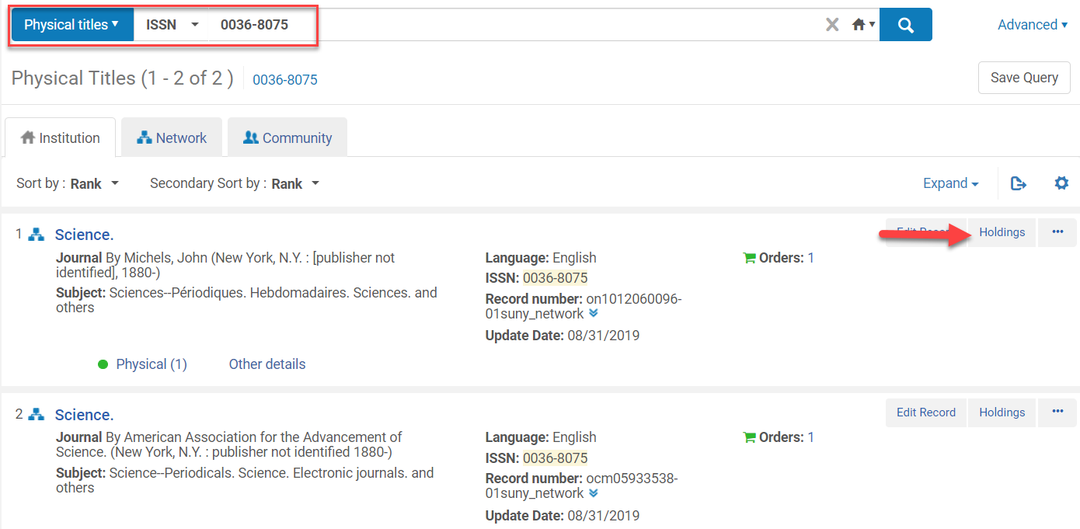
Splitting Holdings Records: Moving Item Records
Perform a Physical Titles repository search for the serial records
Click Holdings on the print serials bib record

Slide 47
Splitting Holdings Records: Moving Item Records
Click View Items from the ellipses of the holdings record that will be moved
Click into the check box above the item records
Click Relink to another bib

Slide 48
Splitting Holdings Records: Moving Item Records
Click into the Select Bibliographic Record or on the list icon
Perform a repository search in the IZ

Slide 49
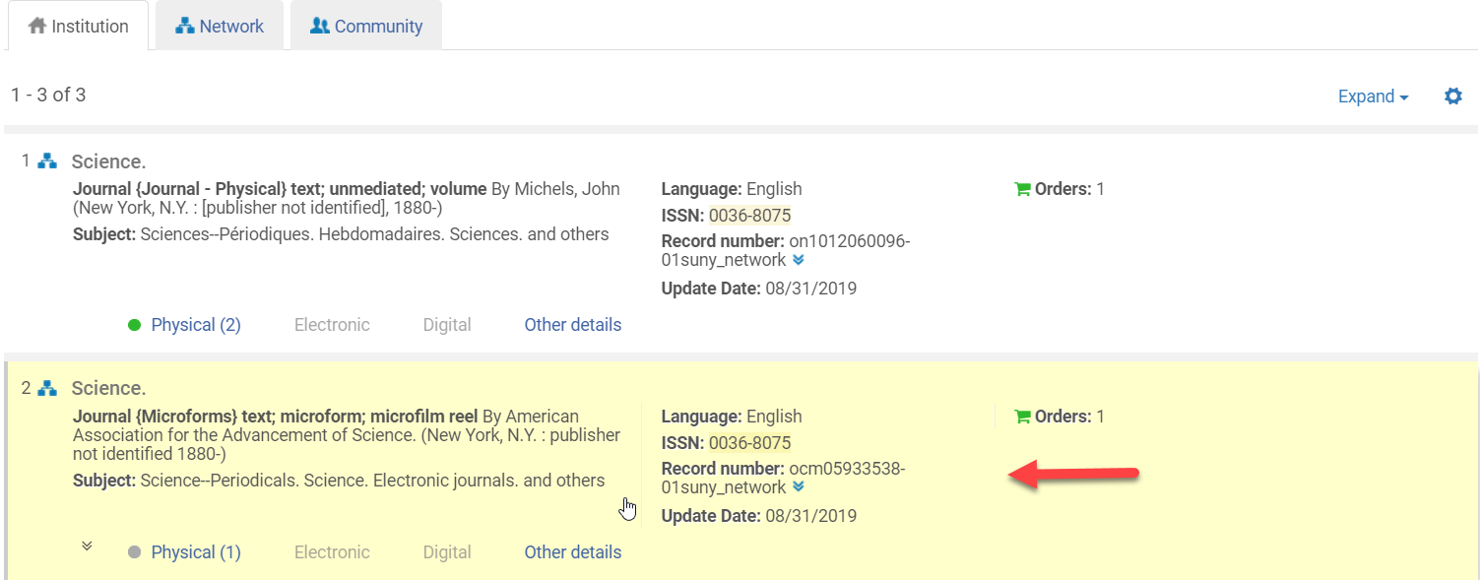
Splitting Holdings Records: Moving Item Records
Click on the bib record the items will be moved to (it will be highlighted yellow)

Slide 50
Splitting Holdings Records: Moving Item Records
Click on the radio button for the holding record associated with the selected bib record
Click Select
Steps 4-10 may need to be repeated if there are more than 50 items to move at a time
If you use this method do not forget to update the new holdings record with MARC fields 853, 863, or 866

Slide 51
Receiving Serials in Alma
Shared Library Services Platform Project
Maggie McGee

Slide 52
Receiving Serials in Alma
Go to Acquisitions>Receiving and Invoicing>Receive
Click on the Continuous tab
Click Receive or Manage items from the ellipses of the serial being received
Receive - used for Ad hoc serials check-in
Manage items – used for prediction patterns or to see items already received

Slide 53
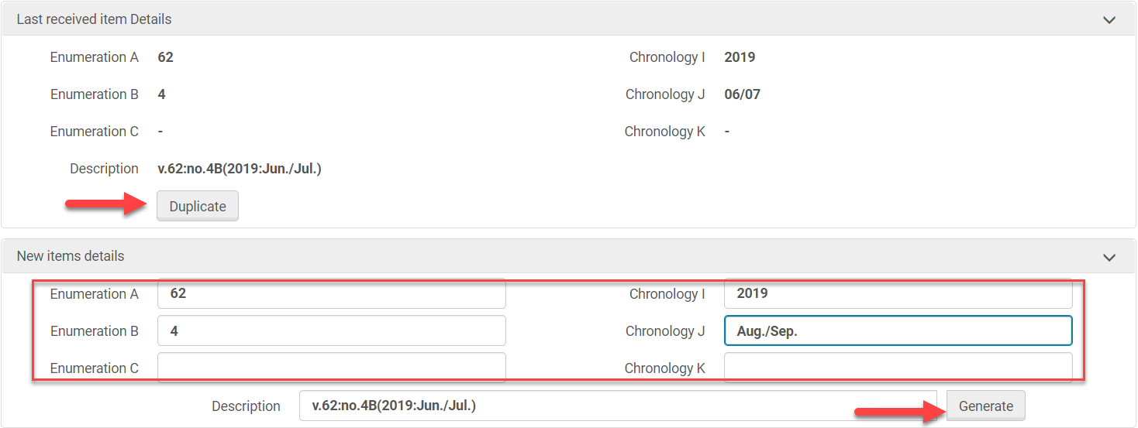
Receiving Serials in Alma: Receive Option
Click Receive
Click Duplicate
Edit the New Items Details
Click Generate

Slide 54
Receiving Serials in Alma: Receive Option
The new description is displayed
Click Save and Set Barcodes or Save and Receive
Save and Set barcodes – is barcode serials
Scan in barcorde
Click Submit
Save and receive – if barcodes are not used or added after receiving
Click Confirm when the pop-up confirmation box appears with the following message: The item does not have a barcode

Slide 55
Receiving Serials: Manage Items Option
Click Manage Items from the ellipses of the serial being received
Click Receive New items
Follow same instructions as using the receiving option
Scan in barcode and click Receive from the ellipses of the item being received if publication patterns are being used

Slide 56
Receiving Serials: Prediction Patterns with Barcodes
Click Manage Items from the ellipses of the serial being received
Scan in the barcode for the item being received
Click Receive from the ellipses of click in the check box next to the item and click Save and Receive

Slide 57
Receiving Serials: Prediction Patterns without Barcodes
Click Manage Items from the ellipses of the serial being received
Click in the check boxes next to the item(s) being received
Click Save and Receive

Slide 58
Receiving Serials: Prediction Patterns without Barcodes
Click Confirm when the pop-up message appears

Slide 59
Links to supporting documentation
Shared Library Services Platform Project
Maggie McGee

Slide 60
Links to Supporting Documentation
POLs:
Manually creating a PO Line: https://knowledge.exlibrisgroup.com/Alma/Product_Documentation/010Alma_Online_Help_(English)/020Acquisitions/020Purchasing/020Creating_PO_Lines/030Manually_Creating_a_PO_Line
PO Line: https://knowledge.exlibrisgroup.com/Alma/Product_Documentation/010Alma_Online_Help_(English)/080Analytics/080Shared_Dimensions/020PO_Line
Reviewing PO Lines: https://knowledge.exlibrisgroup.com/Alma/Product_Documentation/010Alma_Online_Help_(English)/020Acquisitions/020Purchasing/040Reviewing_PO_Lines
Processing renewals: https://knowledge.exlibrisgroup.com/Alma/Product_Documentation/010Alma_Online_Help_(English)/020Acquisitions/040Renewals/020Processing_Renewals

Slide 61
Links to Supporting Documentation
Description templates:
Configuring description templates: https://knowledge.exlibrisgroup.com/Alma/Product_Documentation/010Alma_Online_Help_(English)/040Resource_Management/080Configuring_Resource_Management/150Configuring_Description_Templates
Receiving
Receiving: https://knowledge.exlibrisgroup.com/Alma/Product_Materials/050Alma_FAQs/Acquisitions/Receiving
Receiving continuous material: https://knowledge.exlibrisgroup.com/Alma/Product_Documentation/010Alma_Online_Help_(English)/020Acquisitions/020Purchasing/090Receiving_Material/010Receiving_Physical_Material#Receiving_Continuous_Material

Slide 62
Links to Supporting Documentation
Print Serials
Print Serials: https://knowledge.exlibrisgroup.com/Alma/Product_Materials/050Alma_FAQs/Print_Resource_Management/Print_Serials
How to move items from one bib record to another: https://knowledge.exlibrisgroup.com/Alma/Knowledge_Articles/How_to_move_items_from_one_BIB_record_to_another%3F

