Slide 1
Demographic Data Quality Improvement Initiative
Mid-Point Learning Collaborative| September 18th, 2024

Slide 2
Agenda
Item | Presenter | Time
Welcome & Updates | Yolanda Bowes | 10 mins
LGBTQ+ Communities in Rhode Island: Joys, Challenges & Focused Priorities | Siri Colom, PhD, Worcester State University | 20 mins
Practice Reports Baseline vs Mid-Point Data REL& SOGI Successes & Opportunities – Key Questions | Sue Dettling Kerri Costa | 50 mins
Questions/Discussion | Group | 10 mins

Slide 3
Thank you to our funders

Slide 4
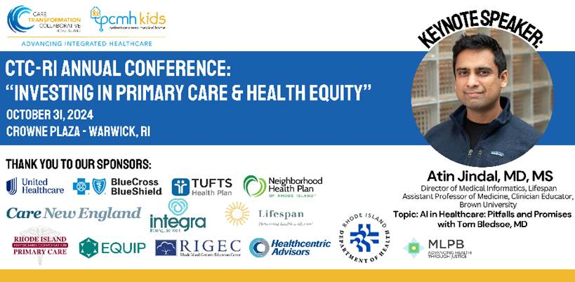
Announcement
CTC-RI Annual Conference – Oct 31, 2024
Register here: https://bit.ly/CTCRIConference2024

Slide 5
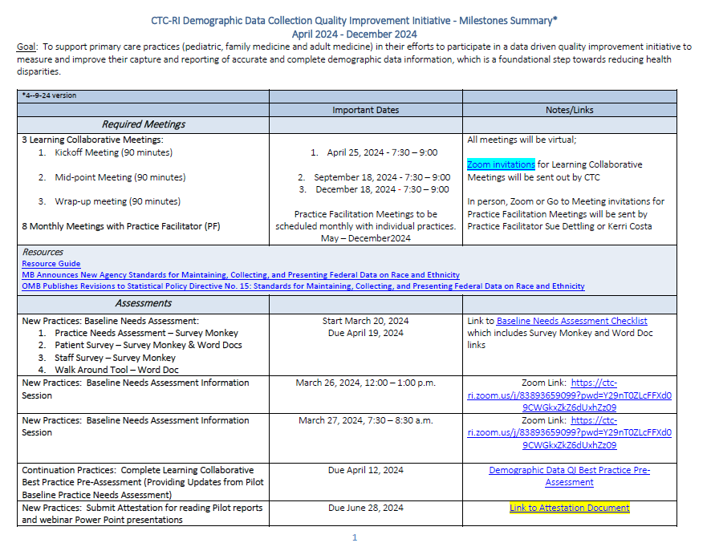
Milestone Document
Project Updates
September 11, 2024
Midpoint Measure Reporting for REL and PDSA 2 Completeness
September 18, 2024
Mid-Point Learning Collaborative Meeting-
December 4, 2024
All Practices: Complete Learning Collaborative Best Practice
Post-Assessment
December 11, 2024
Final Measure Reporting for REL and PDSA 2 Completeness
Completed PDSA #1 and #2
December 18, 2024
Final Learning Collaborative Meeting
January 8, 2024
All Practices: Program Evaluation Due
Notes:
Sue & Kerri

Slide 6
LGBTQ+ Communities in Rhode Island: Joys, Challenges & Focused Priorities
Siri Colom, PhD,
Worcester State University

Slide 7
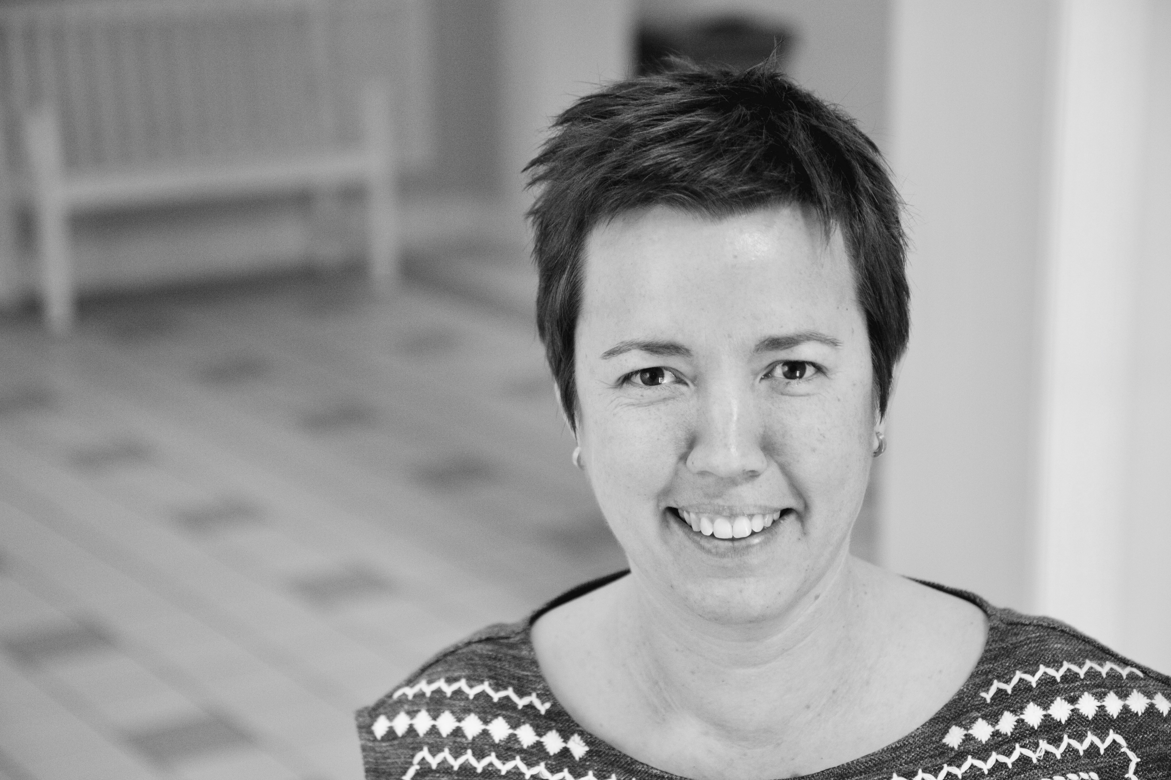
Today's Speaker
Siri Colom is an Assistant Professor of Sociology at Worcester State University. Her research focuses on race, environment, and urban politics, with a particular focus on the ways communities come apart and together after disasters. She uses the lens of sociology to think about how structural oppression manifests and emerges in the everyday politics of people attempting to rebuild lives and homes. She co-authored a research project on the LGBTQ community for the Rhode Island Foundation (2023). Currently, she is mid-production on an audio documentary on how an LGBTQ church in San Francisco survived the social and political disaster brought about by the AIDS epidemic during the 80s and 90s. She holds a PhD in Sociology from the University of California Berkeley.

Slide 8
Practice Reports
REL & SOGI
Successes and Opportunities

Slide 9
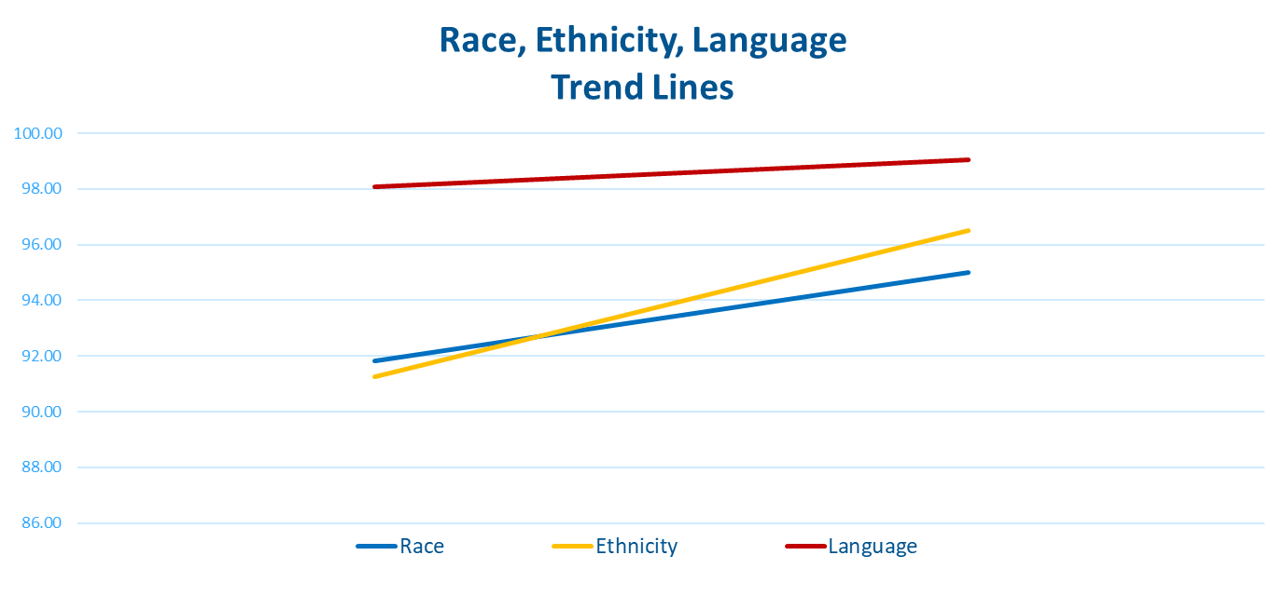
Aggregated Data & Trendline
Program Goal: to support primary care practices in an effort to measure and improve capture and reporting of accurate and complete demographic data information, which is a foundational step towards reducing health disparities
Notes:
R Blue from 91.81 to 94.99% 3.17% E Yellow from 91.26 to 96.52% 5.26% L Red from 98.09 to 99.05% 0.96%
Race Clinica Esperanza 19.32 increase Concilio Peds 55.39% increase most maintaining in this measure Ocean Medical 6.77%
Pilgrim Park 14.67%

Slide 10
Aggregated Data & Trendline
Program Goal: to support primary care practices in an effort to measure and improve capture and reporting of accurate and complete demographic data information, which is a foundational step towards reducing health disparities
Notes:
SO Blue from 41.05% to 66.85%
GI Yellow from 45.10 to 70.78%
Wide range of improvements – some just starting, many had significant increases

Slide 11
Chad P Nevola, MD, Inc
Practice Team
Chad Nevola, Provider
Romina Lima, Office Manager
Ariana Forte, MA
Thomas Lindquist, QI Specialist
Practice Facilitator
Sue Dettling
Measure | Baseline | Goal | Midpoint
Race | 80.8% | Increase by 10% | 85.84%
Ethnicity | 87.73% | Increase by 5% | 87.61%
Language | 92.53% | Increase by 5% | 93.51%
Sexual Orientation | 4.07% | 75% | 68.18%
Gender Identity | 8.94% | 75% | 71.82%

Slide 12
Chad P Nevola, MD, Inc.
Provider Exam Room Workflow
What works well with the provider asking the SOGI questions in privacy of exam room vs. front desk?
Exam room works best for patient SOGI data (privacy), many new patients to practice
REL is collected by staff – conversation at front desk
Per patient survey (60 collected) – majority most comfortable sharing with provider
Well child visit forms – all are on MyChart – this has increased enrollment in portal – demographic data may be entered on portal and will be future focus
Challenges:
Pre-charting functionality – record needs to be open/ patient needs to be present to enter data
Data is scattered (social history, substance use, SOGI – all on different tabs)
Encounters only – non-well check (sick, telephonic) – data more difficult
Taking on significant number of new patients due to several pediatricians retiring

Slide 13
Chad E Lamendola, MD, Ltd
Practice Team
Dr. Chad Lamendola, Provider
Pamela Laramee, Office Manager
Brenda Cox, QI Specialist/IT
Practice Facilitator
Sue Dettling
Measure | Baseline | Goal | Midpoint
Race | 96.13% | Increase by 2% | 96.89%
Ethnicity | 97.07% | Increase by 2% | 97.23%
Language | 99.87% | Maintain | 100%
Sexual Orientation | 52.87% | Increase by 50% to 80% | 91.52%
Gender Identity | 56.61% | Increase by 50% to 82% | 92.73%

Slide 14
Chad E Lamendola, MD, Ltd
Provider Exam Room Workflow
What works well with the provider asking the SOGI questions in privacy of exam room?
Workflow & Patient education:
Previsit planning note – Dr. Lamendola sees this / prompts to ask patient/ real time communication
Front desk is also using laminated patient forms; if notice that data is missing, they will have conversation with patient, also staff may send Dr. Lamendola a note in chart or conversation (before, during, after visit)
Comprehensive yearly exam, SOGI questions asked in sensitive way in social history, foundation of trust is built
Dr. Lamendola has conversations in the private exam room, explaining the why for SOGI and REL data
Additional efforts to encourage patients to join the patient portal (data forms, billing)
Patient survey data supports this workflow
150 collected;
majority comfortable reporting to staff or doctor, but most comfortable with provider;
81% feel this data important for care; 55% it is important to explain why;
71% feel important to know how data used;
49% prefer verbally during visit (21% verbally at reception)

Slide 15
Concilio Pediatrics – Sue Dettling Practice Facilitator
REL – Baseline data ((Jan, Feb, March 2024)
R: 193/193 = 100%
E: 80/193 = 41%
L: 179/193 = 93%
REL - Mid-point data (June 1 - Aug 31, 2024)
R: 83/83 = 100%
E: 80/83 = 96%
L: 83/83 = 100%
Practice Specific Measure – Improve CHADIS survey responses for patients aged 12-16 yrs. Baseline Data (April/May 2024 – chart review of 20 patients aged 12-16 yrs.) 4/20 patients aged 12-16 responded to CHADIS survey = 25%
Mid-point data (June 1 - Aug 31, 2024) Chart review of 32 patients aged 12-16 with an encounter in June/July/Aug to see % compete CHADIS surveys 8 completed CHADIS surveys/32 patients = 25%
Stratification of REL for all 32 patients Race: 100% white Ethnicity: 5/32 =.15 – 15% Hispanic/Latino Language: 100% English speaking Stratification of REL for 8 patients completed survey Race: 4 Asian and 4 Not Hispanic/Latino Ethnicity: 4 Asian and 4 White Language: 8 English
Practice Team
Gerardo Concilio, Provider
Amalia Concilio, Office Manager

Slide 16
Concilio Pediatrics
Patient education
What resources do you use to educate patients?
RIPCPC Poster – in waiting room, exam rooms;
Front desk educated and speaks to patients about race, ethnicity language
Patient appointments run promptly on-time
How is education used? (ie. Posters, brochures, definition sheets)
Patients are directed to look at information
Information is explained at front desk
Unique approaches
Waiting room is locked, so affords each patient has privacy to have conversation with Amalia
Also promoting patients to complete CHADIS survey online before appointment (focus 12-16 yrs old patients
Additional (verbal) education is provided about a) importance of completing CHADIS survey and ability to skip questions if patient/parent is not comfortable responding
Practice will look at REL of survey respondents vs. those who declined to respond

Slide 17
Medical Associates of RI, Inc
Practice Team
Leslie Mohlman, Provider
Maria Molineros, Provider
Ann Quintin, Practice Manager
Kerri Calabro, Quality Program Manager
Zulmira Verissimo, Front Office Supervisor
Elena Williams, Director of Operations
Practice Facilitator
Sue Dettling
Measure | Baseline | Goal | Midpoint
Race | 98.12% | Maintain | 97.18%
Ethnicity | 98.18% | Maintain | 97.08%
Language | 98.24% | Maintain | 97.29%
Sexual Orientation | 0.13% | Increase by 10% | 38.71%
Gender Identity | 0.12% | Increase by 10% | 38.46%

Slide 18
Medical Associates of RI, Inc
Staff training
How did you educate staff?
Trainings targeted to staff/role: Provider, Medical Assistants, Reception Supervisor/Practice manager
Trainings were presented in group meetings, as well as individually as needed. For example, one on one meetings with our Reception Supervisor who would be responsible for overseeing and managing the new workflow, identifying and communicating any issues.
Training and education was provided on both conceptual level (WHY?) and practical level (HOW?)
Focus:
Discussion around WHY we collect demographic data information. Felt that it was important to not only answer this according to a compliance standpoint, but to begin to educate how it is important to patient care, how demographic information allows us to better know patients/understand their needs, and the importance of providing a mainstream, structured opportunity for patients to share.
Data collection to be more patient-centered, with proceduralized opportunities to update annually or as needed, where to look for SOGI data (see if missing), pay attention to and utilize existing SOGI, ie. Preferred pronouns
SDOH screening – new workflows/assistance with identified needs. Be attentive to requests for assistance. Built in staff “pop-up” notifications to provide resources and/or referrals when certain screening questions were answered.
Challenges:
Multiple practice sites, not everyone in at once, used hybrid training (some in person/some virtual); multiple trainings needed; staff feelings toward change; coordinating workflows between staff roles;
What Resources did you use?
We Ask because we care – brochure initially used with staff; Training Videos; Guidance from regulatory programs such as NCQA

Slide 19
Barrington Pediatric Associates
Practice Facilitator
Sue Dettling
Practice Team
Jennifer Mileikowsky, Provider
Stephanie Souza, Office Manager
Junko Cookson, IT Analyst
Carly Angel, MA/Front Desk
Nicole Parsons, MA
Measure | Baseline | Goal | Midpoint
Race | 91.94% | Increase by 5% | 92.92%
Ethnicity | 93.07% | Increase by 5% | 93.87%
Language | 97.88% | Increase by 1% | 97.89%
Sexual Orientation | 40.13% | Increase to 60% | 41.36%
Gender Identity | 40.13% | Increase to 60% | 41.15%

Slide 20
Barrington Pediatrics
Front Desk Workflow
How do you collect REL/and or SOGI data?
Paper registrations form (SOGI 18 plus) – new patients, yearly physicals
Scanned into electronic health record
Some providers are also asking SOGI questions in exam room
What has changed to be more successful?
Consistent workflow in place now after start of project
What tools do you use?
SOGI and REL built into eCW
Staff training
How did you educate staff?
In person SOGI training over 2 days- Quinten Foster from EBCAP
watched videos from CTC resources, viewed all the CTC webinar information/resources
Videos and recording may be used for new staff training

Slide 21
Northeast Internal Medicine
Practice Team
Sadia Iftikhar, Provider
Griselle Rohena, Office Manager
Krystal Cookson, Medical Secretary
Justin Kelly, QI Specialist
Practice Facilitator
Sue Dettling
Measure | Baseline | Goal | Midpoint
Race | 96.69% | Maintain or increase by 1% | 97.19%
Ethnicity | 91.96% | Maintain or increase by 5% | 94.2%
Language | 99.05% | Maintain | 98.91%
Sexual Orientation | 19.24% | Increase by 80% to 45% | 49.64%
Gender Identity | 35.79% | Increase by 50.5% to 60% | 62.95%

Slide 22
Northeast Internal Medicine
Front Desk Workflow
How do you collect REL/and or SOGI data?
Using the RIPCPC – paper and laminated patient registration form
Also use medical history form (has preferred pronouns; sex at birth)
These forms used at annual physicals and for new patients
What has changed to be more successful?
New form is comprehensive and allows for all data collection
Targeted initiative/ workflow has helped
Great team effort to improve the data collection – “get it done” attitude
What tools did you use?
CTC resources – educational videos were helpful; validated approach to asking question

Slide 23
Ocean Medical Practice, Inc
Practice Team
Jibran Khan, Provider
Nazia Khan, Office Manager
Jacquelyn Allen, Medical Assistant
Nchabanu Chacha Wheeler, QI Specialist
Practice Facilitator
Sue Dettling
Measure | Baseline | Goal | Midpoint
Race | 99.79% | Maintain | 99.83%
Ethnicity | 96.9% | Maintain | 99.67%
Language | 91.74% | Increase by 5% | 98.51%
Sexual Orientation | 89.87% | Increase by 5% | 98.34%
Gender Identity | 91.47% | Increase by 5% | 98.34%

Slide 24
Ocean Medical Practice, Inc
Front Desk Workflow
How do you collect REL/and SOGI data?
Front desk staff is collecting the data, if anything is missing Dr. Khan will ask about missing data
Jackie, at front desk, is very comfortable asking questions; trust with patients after working with them for many years
What has changed to be more successful? / Tools used
In beginning, questions asked verbally, but some patients uncomfortable
As of June, started using laminated forms for those patients who didn’t wish to disclose REL/SOGI information at front desk verbally at check in

Slide 25
Pilgrim Park Physicians
Practice Team
Joseph Grande, Provider
Susan Clark, Medical Receptionist
Thomas Lindquist, QI Specialist
Practice Facilitator
Sue Dettling
Measure | Baseline | Goal | Midpoint
Race | 81.98% | Increase by 15% to 95% | 96.65%
Ethnicity | 97.59% | Increase by 1% to 99% | 98.59%
Language | 99.62% | Maintain | 100%
Sexual Orientation | 10.8% | Increase by 128% to 50% | 82.72%
Gender Identity | 13.93% | Increase by 112% to 50% | 83.6%

Slide 26
Pilgrim Park Physicians
Provider Exam Room Workflow
What works well with the provider asking the SOGI questions in privacy of exam room vs. front desk?
Patients appreciate the privacy and 1:1 time with provider
Small office doesn’t have much privacy
Long standing trust of patients with Dr. Grande – they are more comfortable
Practice also had SOGI training (virtual)
Sometimes use the patient registration form with REL/SOGI questions
22 patient surveys collected - majority comfortable reporting to staff or doctor, but most comfortable with provider; re: data collection; 50% prefer paper collection of data; 59% verbally during visit, 23% verbally at reception

Slide 27
University Internal Medicine
Practice Team
Derick Robinson, Provider
Amanda Aptt, Practice Manager/IT
Practice Facilitator
Kerri Costa
Measure | Baseline | Goal | Midpoint
Race | 92.63% | Increase by 4% | 96.83%
Ethnicity | 92.24% | Increase by 4% | 96.59%
Language | 99.98% | Maintain | 100%
Sexual Orientation | 94.29% | Increase by 3% | 96.06%
Gender Identity | 95.55% | Increase by 2% | 96.47%

Slide 28
University Internal Medicine
Refresher Staff Training & Reporting
Front Desk and MAs trained on collection of R/E/L and SOGI
Utilized the roll-play videos from CTC pilot program
Updated patient registration form
Discussed importance of patients completing registration form AND ensuring staff is updating the information in the EHR (discovered by spot checking and running reports)
Reports are regularly shared with the Staff so they understand what information is missing
Discovered “other” ethnicity field was not matching up with the registration form (staff reviewed data and fixed information in the EHR).
Utilized R/E/L definition sheet with patients

Slide 29
Clinica Esperanza Hope Clinic
Practice Team
Joseph Desrosiers, Provider
Morgan Leonard, Office Manager
Sharon Farrar, Quality Improvement/Clinical Director
Julia Testa, IT/EMR Data Analyst
Practice Facilitator
Kerri Costa
Measure | Baseline | Goal | Midpoint
Race | 45.33% | Increase by 45% | 64.65%
Ethnicity | 100% | Maintain | 100%
Language | 100% | Maintain | 100%
Sexual Orientation | 0.07% | Increase by 50% | 0%
Gender Identity | 0.07% | Increase by 50% | 0%

Slide 30
Clinica Esperanza Hope Clinic
The Advanced Navigante Training Program
Navigante’s are hired at the clinic and complete training to obtain the following credentials:
Community Health Worker (Community Case Manager)
Medical Interpreter (Primarily English/Spanish)
Lifestyle Educator (Chronic disease prevention, physical movement, etc.)
How the Program has Helped with Demographic Data Collection
They were provided education on SOGI
They ensure patients complete the SOGI data during registration. If not, a Navigante is assigned to the patient to complete the information while on-site.
If patient is still uncomfortable, the SOGI Navigante will reach out to the patient after the visit to discuss, answer questions and explain why the collection of this data is so important.
Outcome / Success
Staff is now comfortable asking SOGI questions and having discussions with the patients which as increased our SOGI baseline percentage.
Resources used – Demographic Data pamphlet, SOGI PowerPoint presentation from pilot program (translated to Spanish)

Slide 31
Your Health
Practice Team
Munawar Azam, Provider
Uzma Azam, Practice Manager
Kabo Thao, Quality & Performance Specialist
Practice Facilitator
Kerri Costa
Measure | Baseline | Goal | Midpoint
Race | 96.3% | Increase by 2% | 98.92%
Ethnicity | 96.94% | Increase 2% | 98.92%
Language | 99.84% | Maintain | 100%
Sexual Orientation | 41.82% | Increase by 20% | 89.87%
Gender Identity | 52.24% | Increase by 15% | 92.46%

Slide 32
Your Health Inc.
SOGI Training & Improvement
Staff Education
Created SOGI forms for patients to complete
Utilized SOGI Definition Sheet
RIPCPC training including:
PowerPoint slides (compilation based on CTC demographic data pilot program)
Definitions & How to Ask
How to address and speak patients
Patient Focus & Education
Posted RIPCPC patient education posters in lobby / at check in window
Implemented process to obtain information prior to appointment and encouraged e-Check In
Addressed patients that left answers blank or had difficulty answering
Utilized RIPCPC quality assistance to conduct pre-visit planning audits that include missing REL fields
Goal: Add SOGI information to pre-visit planning process

Slide 33
NRI Pediatrics, PC
Practice Team
Kristin Grimes, Provider
Kathy Martinez, Practice Manager
Nchabanu Chacha Wheeler, QI Specialist
Practice Facilitator
Kerri Costa
Measure | Baseline | Goal | Midpoint
Race | 97.98% | Increase by 1% | 98.18%
Ethnicity | 97.24% | Increase by 1% | 100%
Language | 100% | Maintain | 100%
Sexual Orientation | 35.02% | Increase by 40% | 69.16%
Gender Identity | 35.02% | Increase by 40% | 69.16%

Slide 34
NRI Pediatrics, PC
Staff Training
SOGI Training Program for Staff
Conducted In Person SOGI training for Front Desk Staff
Updated Registration form to include SOGI questions
Training included CTC SOGI training resources (roll playing videos, Demographic Data Pilot program webinars / links)
Resources used
Updated Registration form
Staff Post Training Survey Conducted
100% of Front Desk Staff feel “very comfortable” collecting all demographic data for patients (improvement from 50% very uncomfortable/ 50% uncomfortable)

Slide 35
Middletown, Tiverton & Portsmouth
Southcoast Health
Practice Team
Trent Ainsworth, Provider
Jennifer DiPasqua, Population Health/QI Manager
Doug Sylvia, Middletown Practice Manager
Sheila Duckett, Tiverton Practice Manager
Jennifer Ferreira Portsmouth Practice Manager
Robert Hiipakka, IT/Data Analyst
Kathelyn Ferreira Health Equity Manager
Practice Facilitator
Kerri Costa

Slide 36
Tiverton Family Medicine; Portsmouth Family Practice; Middletown Family Practice
Southcoast Health
Data Category | Middletown Baseline Goal Mid-Point |  |  | Tiverton Baseline Goal Mid-Point |  |  | Portsmouth Baseline Goal Mid-Point
Race | 99.74% | Maintain baseline or increase | 99.84% | 99.86% | Maintain baseline or increase | 99.86% | 99.92% | Maintain baseline or increase | 100%
Ethnicity | 92.01% | Increase by 5% | 97.13% | 91.71% | Increase by 5% | 94.02% | 95.27% | Increase by 2% | 96.55%
Language | 100% | Maintain baseline | 100% | 99.68% | Maintain baseline or increase | 99.62% | 99.92% | Maintain baseline or increase | 99.95%
Sexual Orientation | 63.81% | Increase baseline by 10% | 76.3% | 59.72% | Increase baseline by 15% | 66.28% | 62.70% | Increase baseline by 15% | 67.76%
Gender Identity | 66.87% | Increase baseline by 10% | 84.21% | 64.47% | Increase baseline by 15% | 75.16% | 70.16% | Increase baseline by 10% | 84.37%

Slide 37
Southcoast Health
Tiverton Family Medicine; Portsmouth Family Practice; Middletown Family Practice
Staff Training
SOGI Training Program for Staff
Southcoast created SOGI training modules
Training included scripting and videos (including roll-play)
Training was required for Registration, Front Desk and Call Center
Training was optional for all other roles/departments
Resources used
We ask Because We Care pamphlet in English, Spanish,
Portuguese
Laminated copies of demographic data forms – NEW for SOGI
questions
Staff Post Training Survey conducted

Slide 38
Resources
Why We Ask Tri-Fold Brochure
Demographic Data Collection Policy & Procedure
Post SOGI Training Staff Survey
Demo Data Resources

Slide 39
Discussion
Next Steps
What did you learn today?​
December 4, 2024
All Practices: Complete Learning Collaborative Best Practice Post-Assessment
December 11, 2024
Final Measure Reporting for REL and PDSA 2 Completeness
Completed PDSA #1 and #2
December 18, 2024
Final Learning Collaborative Meeting
January 8, 2024
All Practices: Program Evaluation Due
Notes:
What stood out to you?
What did you learn today?
Did you learn anything from your peers that you plan to implement in your practice?
How are you getting the patient perspective?
Do you plan to do surveys with your staff or patients again?

Slide 40
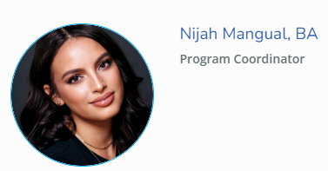
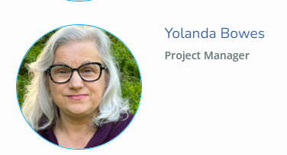
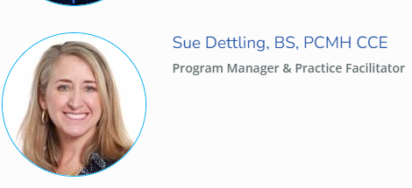
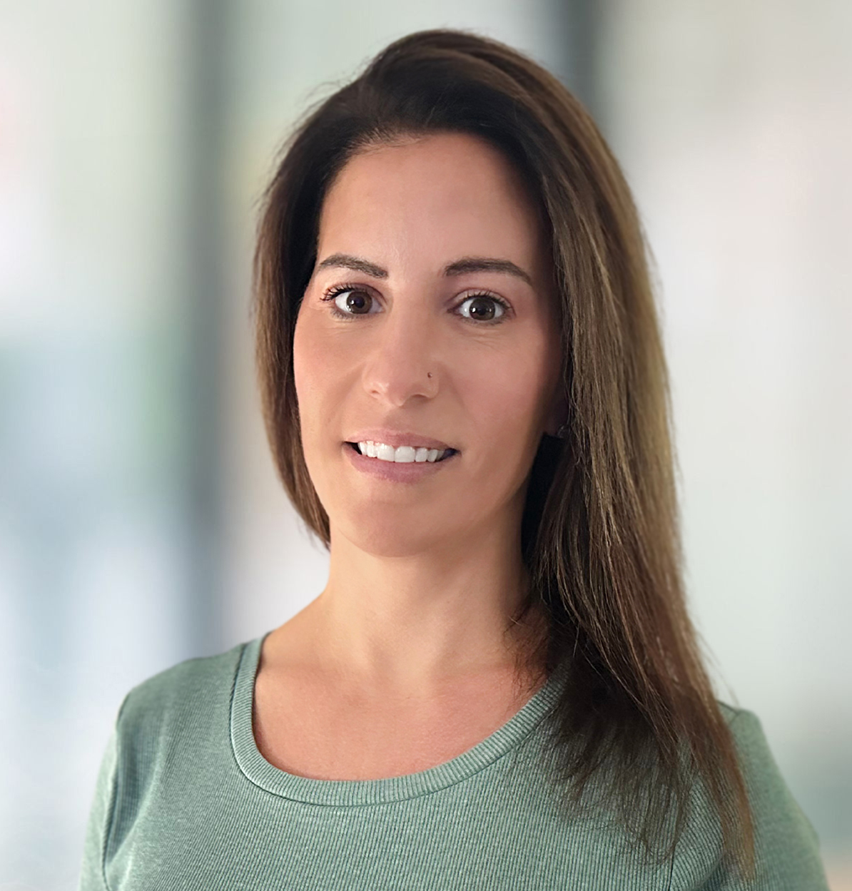
Thank you, from your Project Team
Ybowes@ctc-ri.org
Nmangual@ctc-ri.org
Scampbell@ctc-ri.org
Kerri Costa, MBA, CMHP
Practice Facilitator
k12costa@outlook.com
Sdettling@ctc-ri.org

Slide 41
THANK YOU
Debra Hurwitz, MBA, BSN, RN
dhurwitz@ctc-ri.org
www.ctc-ri.org
ctc-ri

