Slide 1
FULFILLMENT CONFIGURATION: ITEM POLICIES, CALENDAR MANAGEMENT, ADDING LOCATIONS, AND CIRC CREATED RECORDS
SUNY Shared Library Services
Shannon Pritting

Slide 2
Today’s Agenda
ITEM POLICIES: WHEN AND HOW TO USE
CREATING AN ITEM POLICY
FULFILLMENT CONFIGURATION TOOL
CALENDAR MANAGEMENT
CIRC CREATED RECORDS

Slide 3
ITEM POLICIES
When are they worth the effort?

Slide 4
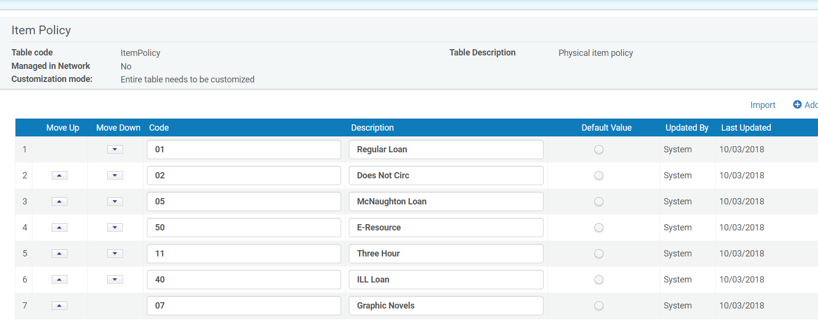
Item Policies: Don’t I have a lot already?

Slide 5
Current Alma Item Policies Were Likely Migrated from Aleph.
Item statuses in Aleph migrated as Item Policies.
But, these item policies don’t have any TOUs or Fulfillment Unit Rules attached.
Most of these item policies are not needed as they’re handled by locations, and can be deleted. But, deletion should be done after cutover.

Slide 6
Item Level Policies
Item policies create exception rules in the fulfillment unit rules so that specific items in a certain location will circulate differently than the typical items stored in this location.
Or, put another way, if you don’t have enough items that have different policies to create another location, this is a way to manage and apply their TOUs.
Institution-Level ONLY

Slide 7
Pros and Cons of Item Policies
Pros
Cons
Can get granular with TOUs.
Flexibility with changing TOUs for only these items.
Reduce number of locations needed.
Needs to be added to each item.
Same amt. of set up as a location.
Adds more complexity to fulfillment units.

Slide 8
Basic Process of Item Policy
Item policy in Mapping Table
Terms of Use
Fulfillment Unit Rule(s)
Item policy in item
Item policy applied to loan, request, booking

Slide 9
How do I configure item policies?
Configuration Menu > Fulfillment > Physical Fulfillment > Item Policy
Only Fulfillment Administrator can do this.

Slide 10
How do I apply an item level policy?
Search for the item
Click on the Physical tab
Click Items (or use the row actions menu)
Click the barcode (or click Edit under actions)
Change the policy

Slide 11
How do I apply item policies in bulk?
Search for the items you want to create an item policy for.
Run the job “change physical items.”

Slide 12
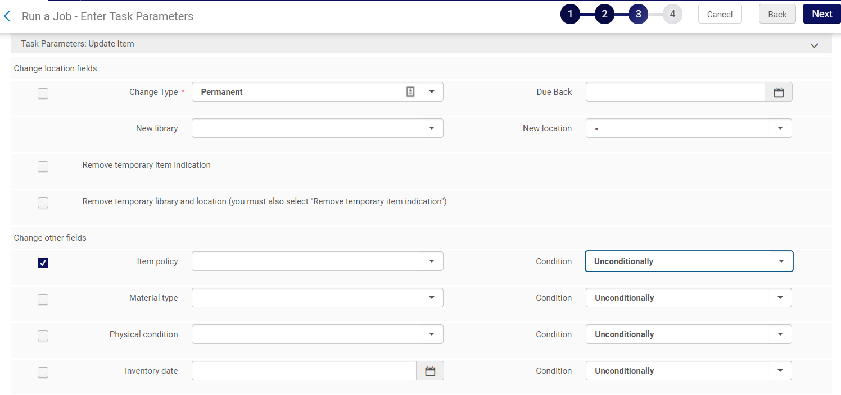
Change Physical Item Job can apply item policy in batch.
Notes:
Can choose to add item policy:
Unconditionally, if field empty, if field not empty.

Slide 13
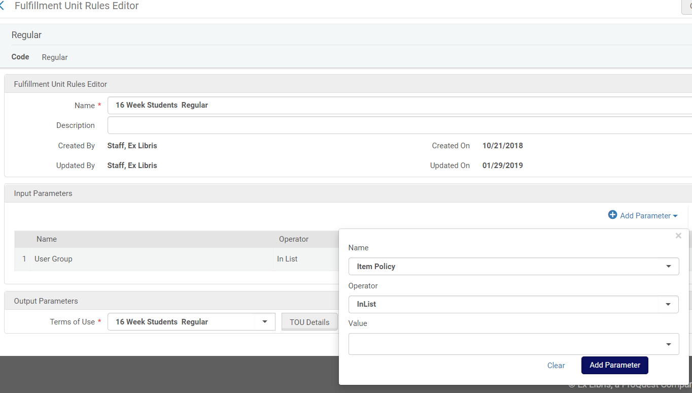
An item policy needs to then be linked to the rest of the Fulfillment Unit.

Slide 14
Item Policy Use Case Example
You have 10 keys for study rooms that are currently in 2-Hour Reserves.
All the policies are the same as Reserves, except the fines, grace period, and reloan limit are different.

Slide 15
Discussion
Is anyone using item policies? If so, what are the use cases at your institution?

Slide 16
OPEN HOURS/CALENDAR MANAGEMENT

Slide 17
Roles Needed to Manage Calendar
To configure calendar information for an institution or library, you must have one of the following roles:
General System Administrator
Fulfillment Administrator (library only)
In addition, Ex Libris can enable the following roles to perform configure calendar information for a library (contact Ex Libris support to enable this).
Circulation Desk Manager
Circulation Desk Operator
Circulation Desk Operator Limited
Requests Operator

Slide 18
Where should I make calendar changes?
Libraries inherit events and exceptions from the institution.
However, libraries do not inherit institution opening hours; opening hours must be defined for each library.

Slide 19
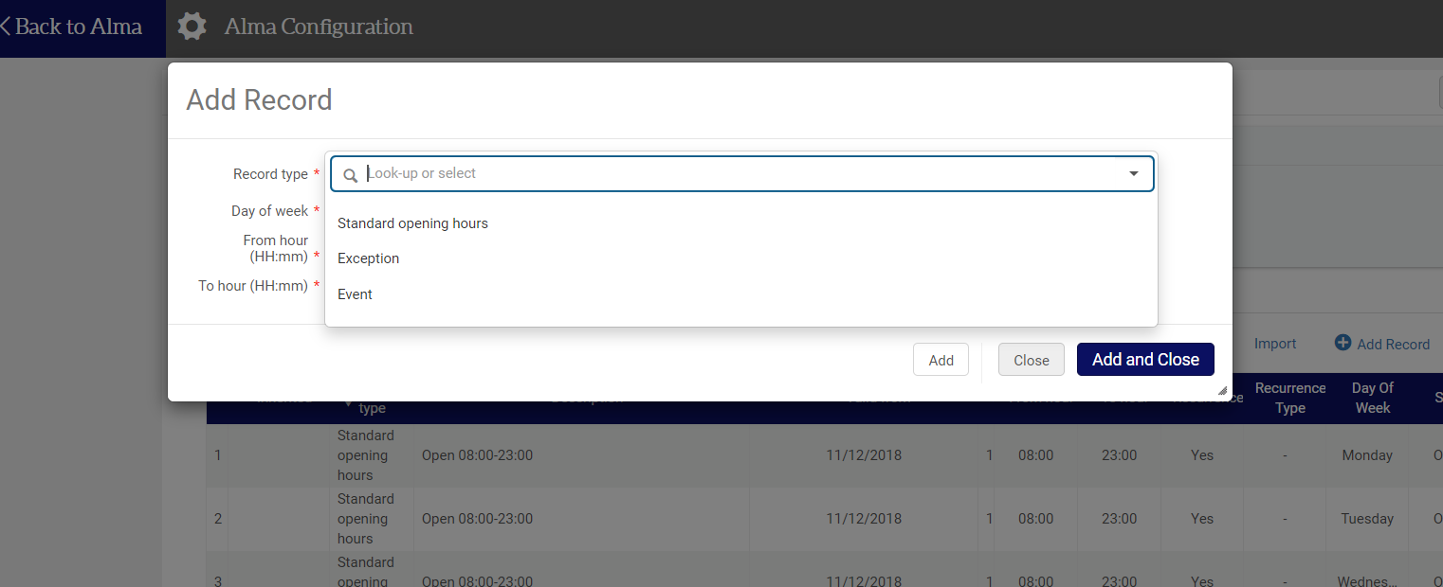
Record types

Slide 20
Calendar Entry Record Types
Event – Special dates, such as the end of the year, the end of the semester, or an exhibition. Institution events appear in library calendars, but do not indicate whether the library is open or closed.
Exception – Exceptions for open/closed dates and times, such as holidays.
Standard Operating Hours – Regular dates and times during which the institution or library is open, based on a day of the week.

Slide 21
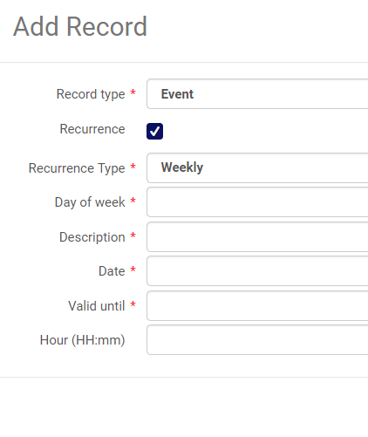
Events Configuration
Can be a single date.
Recurrence: Weekly or Yearly
Day of Week
Date
Valid Until
Hour

Slide 22
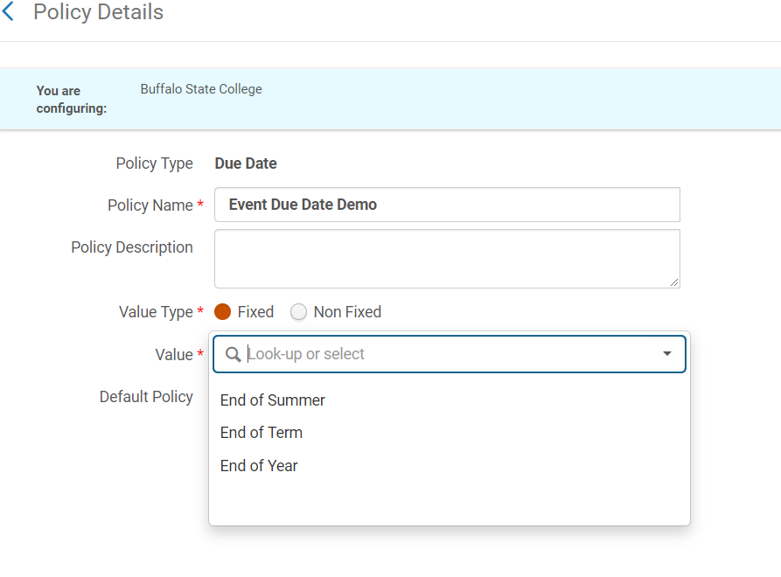
Events can be used in TOU for due date
In due date policy of TOU, can add events.
Must be in value type fixed.

Slide 23
Events Use Case
Single: End of term or single date that all loans are due.
Recurring:
Force equipment due back x amount of minutes/hours before library closed.

Slide 24
Exceptions
Can be used to shorten hours from standard open times.
Add a time exception with “closed’
Can be used to extend hours from standard open times.
Add a time exception with ‘open’

Slide 25
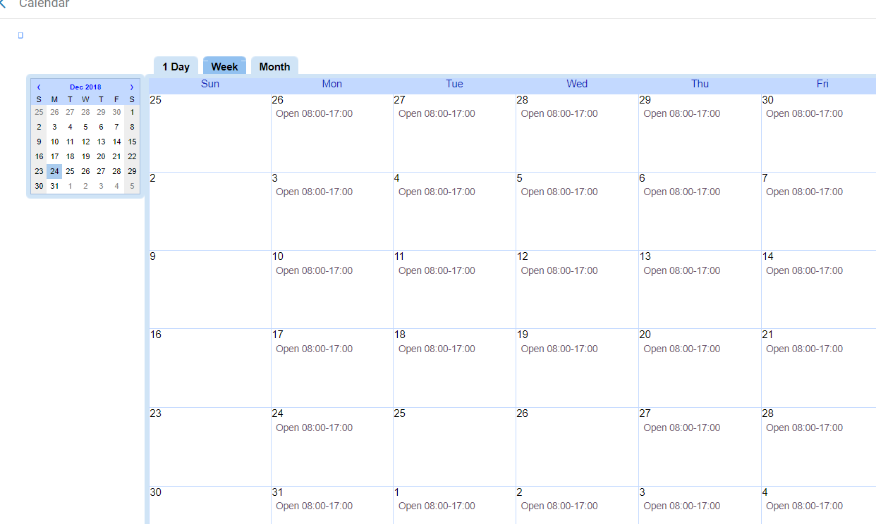
Check full calendar to make sure that change to calendar is saved.

Slide 26
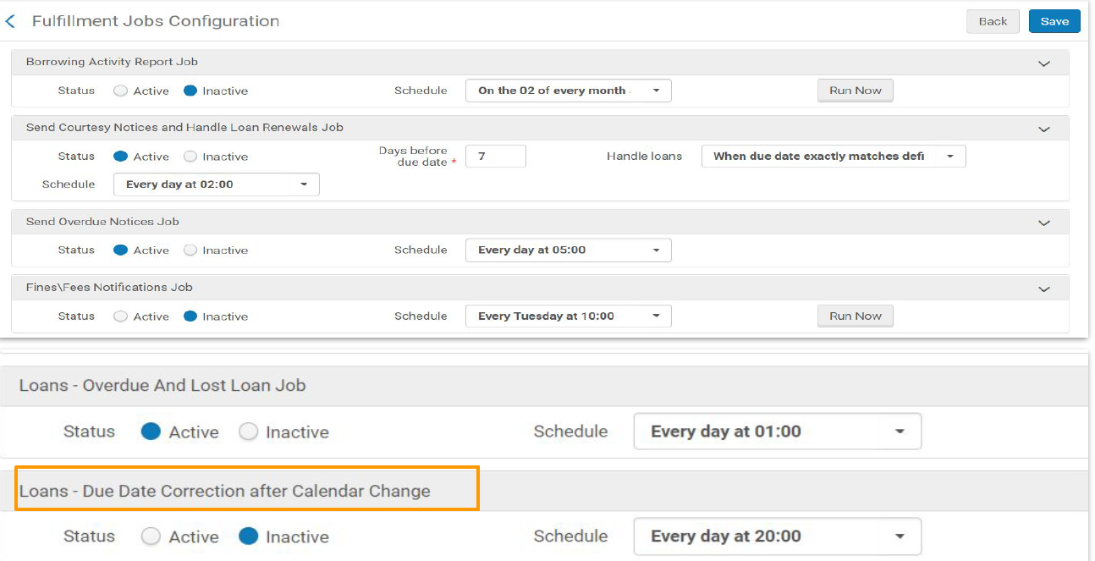
Pro Tip: Turn off the Due Date Correction Job

Slide 27
Discussion
Has anyone set up events or exceptions? Do you have any tips to share based on your testing?
How do you plan on managing your calendar? Every semester or for the entire year?

Slide 28
Physical Locations
Adding and deleting

Slide 29
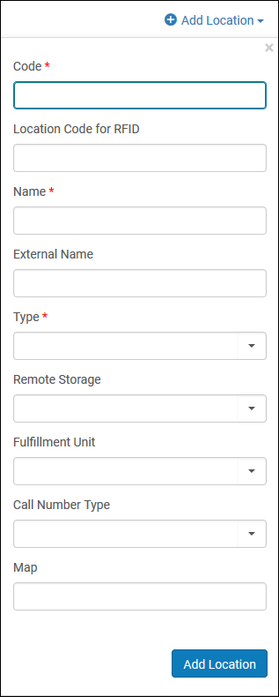
How do I add a physical location?
SCOPE TO LIBRARY
Configuration Menu > Fulfillment > Locations > Physical Locations
Add Location
Requires Fulfillment Administrator role
Note: Multiple Locations can have the same external name

Slide 30
Deleting a Location
As long as no inventory is in the location, it’s as easy as selecting the location and deleting.
Must move or delete all inventory before location can be deleted.

Slide 31
Circ-created or On-the-fly records
It’s so easy, even an administrator could do it.

Slide 32
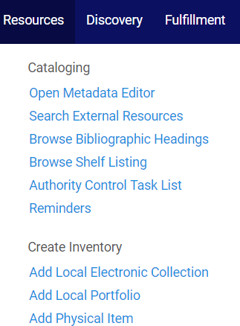
Creating on-the-fly records
Physical Inventory Operator role required (extended for delete).
Can create from existing or new holdings.
Easy to use interface.
Only title and location required.

Slide 33
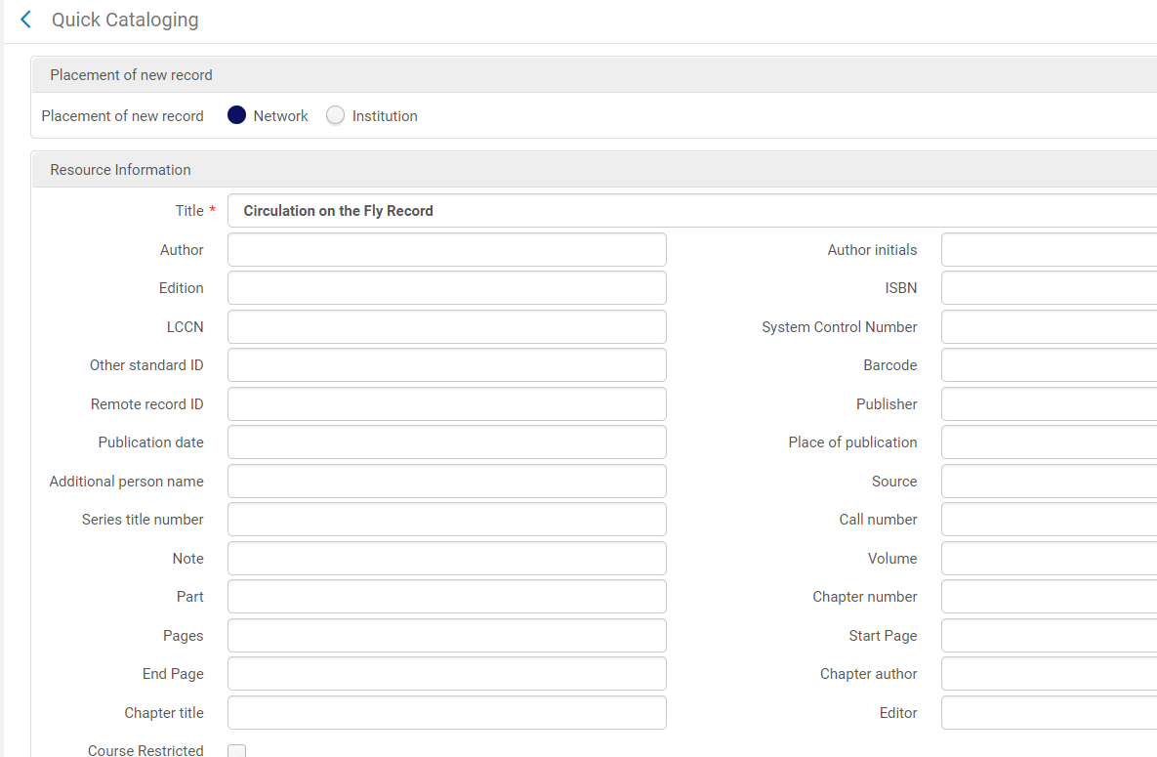
Quick Cataloging Form

Slide 34
Important Quick Cataloging Form Fields
Placement of New Record (NZ is default)
Title
ISBN (required for all NZ records)
Course Restricted
Suppress From Discovery
Note

Slide 35
Troubleshooting Policy Issues
Fulfillment Configuration Utility

Slide 36
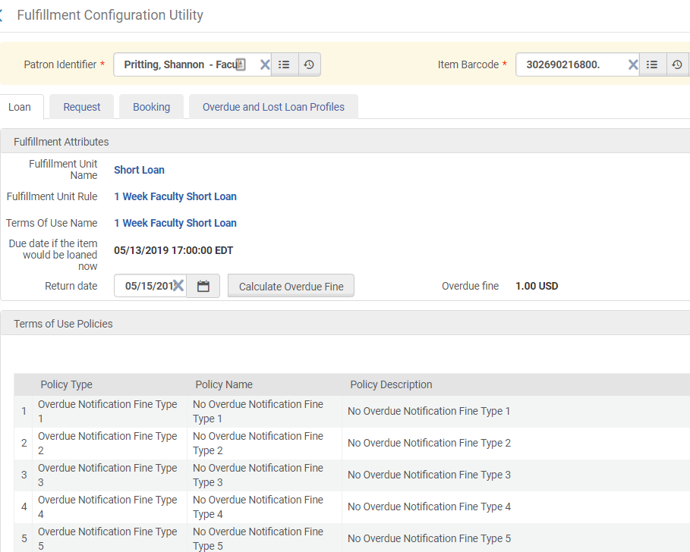
Fulfillment Configuration Utility

Slide 37
QUESTIONS?
Thanks!

