Slide 1

Moving Toward Collaborative Solutions
to the Waste Crisis
SCRCOG Solid Waste and Recycling Working Group
June 24, 2024
Presented By: Carl Amento, SCRCOG Executive Director
Pamela Roach, SCRCOG Consultant

Slide 2
1. Waste Crisis – Nationally and in Connecticut
MOVING TOWARD COLLABORATIVE SOLUTIONS TO THE WASTE CRISIS
2. Unit-Based Pricing and Food Waste Diversion
3. SCRCOG Grants Awarded and Upcoming Grants
4. Lessons Learned and Challenges
5. Vision for Collaborative Solutions

Slide 3
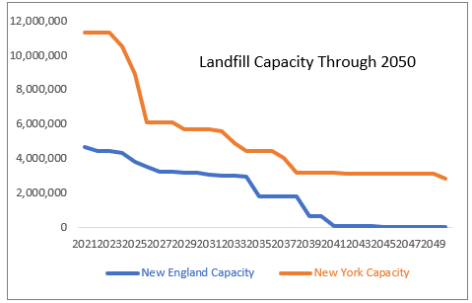
National Waste Crisis will cost all CT residents
As WTE’s and landfills close 39-Million residents living in New York and New England will all be fighting for the space in the landfills in lower states.
Difficult to Site New Facilities – NIMBY
Not Enough Space for CT’s Waste
CT’s shrinking waste capacity (MIRA closed, aging incinerators) has caused us to ship 60% of our Waste (over 860,000 tons) to out-of-state landfills in PA, OH and VA
Shipping out-of-state increases GHG Emissions
NIMBY – CT is shipping to someone else’s backyard, EJ communities
Transportation costs and Lack of capacity increasing disposal costs
In Action means even higher costs
Graph provided by WasteZero 2021

Slide 4
Out of State Waste May Not Always Be an Option
Facts About Trash
CT has 4 remaining incinerators – all over 30 years old
The State of CT produces 2,188,394 tons of Waste
870,000 tons ~40% is being shipped out of state
Shipping Connecticut's waste to other peoples back yards is an environmental justice issue
New Hampshire introduced two bills in 2024 Session
New Hampshire Landfills have been accepting out of state waste for years
One Bill seeks to take on the Interstate Commerce Law and will ban out of state material from landfills (HB 1145)
Second Bill to limit waste from out of state (HB 1632)
Headline News – Bills Target Out of State Trash

Slide 5
1. Waste Crisis – Nationally and in Connecticut
MOVING TOWARD COLLABORATIVE SOLUTIONS TO THE WASTE CRISIS
2. Unit-Based Pricing and Food Waste Diversion
3. SCRCOG Grants Awarded and Upcoming Grants
4. Lessons Learned and Challenges
5. Vision for Collaborative Solutions

Slide 6
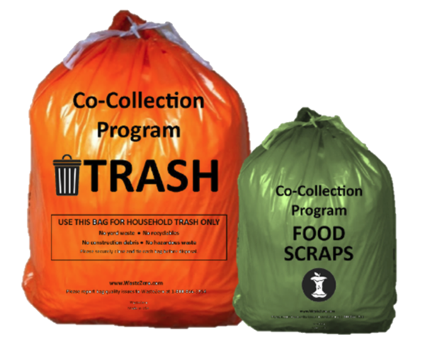
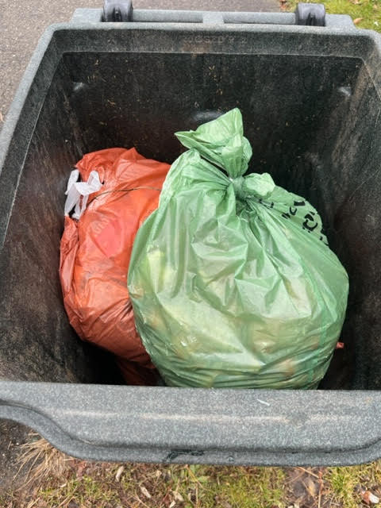
SMM Co-Collection Food Scrap Pilot Programs
15 CT Municipalities awarded DEEP’s SMM Grant
Reduced Waste 12% - 17%
Increased Recycling upwards of 32% and 44%
Food Scraps collected during pilot over 2 million lbs.
Convenience of curbside, trash/food in same trash cart, sorting facility, AD
With co-collection, here are no extra pickup routes (extra routes are expensive)
Residents pay attention to their waste
Divert more – food, brush, recycling, donation
Education, Education, Education
Data provided by WasteZero to CT DEEP November 2023

Slide 7
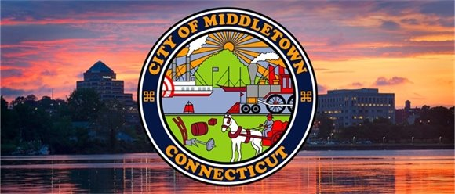
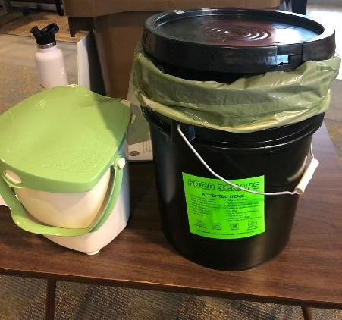
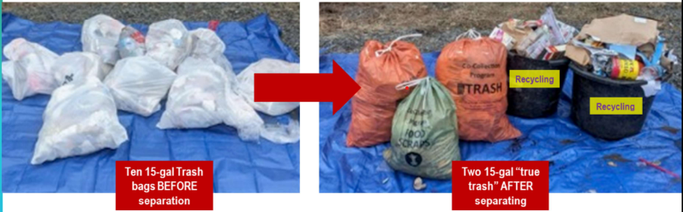
Middletown Sanitation District
First in CT to make co-collection program mandatory. UBP for trash and food scraps
Sanitation bills were reduced, the City shifted the cost of trash disposal to the bags.
Food Scrap Buckets and Countertop Containers for food scraps are available at no charge
87,000 lbs. of food scraps from Nov to May, 75%-95% participation depending on route
30% waste reduction, $100,000 reduction tipping fees, 2,500 households/businesses
75-95% participation depending on the route
Enforcement by tagging carts (spot-checks) and leaving non-compliant trash
Swap Shop at Middletown Recycling Center and Donation Bins
Year-round free brush collection curbside
Additional recycling carts at no charge
Repair Cafes, swap events, collaborations
with local zero waste stores
Notes:
Middletown Sanitation District
First in CT to make co-collection program mandatory. UBP for trash and food scraps
Sanitation bills were reduced, the City shifted the cost of trash disposal to the bags.
Food Scrap Buckets and Countertop Containers for food scraps are available at no charge
70% participation at the start, 90% participation today
26,000 lbs. of food scraps already collected during the first 2 ½ two months of the program
Compared to 7500 lbs. from entire city at two drop off locations
Beginning enforcement by tagging carts (spot- checks) and leaving non-compliant trash
OFFERING WASTE AUDITS TO HELP WITH LESS IN ORANGE BAG - ALSO
Swap Shop at Middletown Recycling Center and Donation Bins
Year-round free brush collection curbside
Additional recycling carts at no charge
Repair Cafes, swap events, collaborations with local zero waste store
It is possible to reduce your trash by using the bags more efficiently, recycling better and separating out food waste.

Slide 8
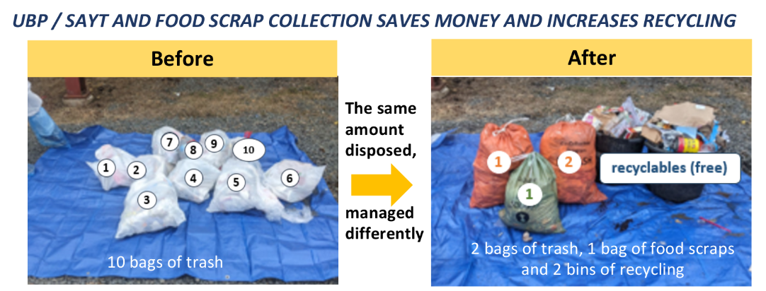
Reducing Waste by Sorting Properly
FEWER PLASTIC BAGS, LESS WASTED WASTE

Slide 9

Positive Feedback From Residents
With this program, I have so much more recycling and so little trash
I feel like a good citizen
Separating my food scraps is easy and I have so much less trash now
We have drastically reduced the amount of “true trash” we throw out each week
Happy to be part of this urgent and important quest-not just for our state, but globally
What can I do with what is left in my orange bag?

Slide 10
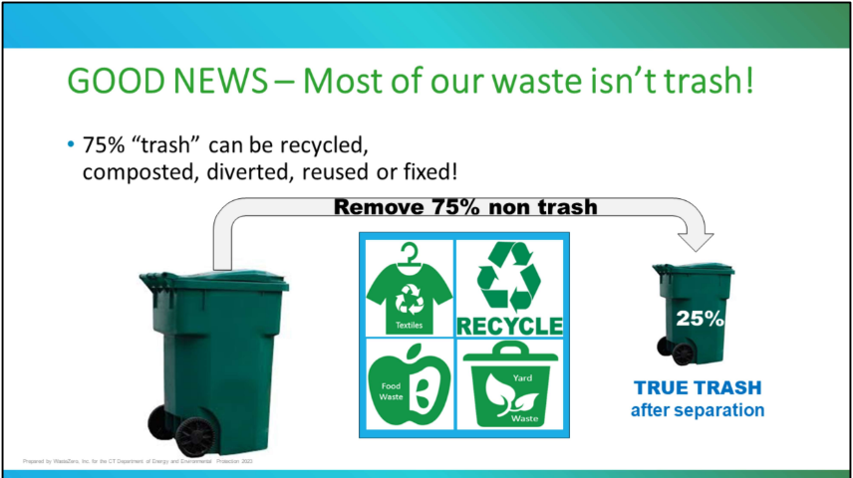
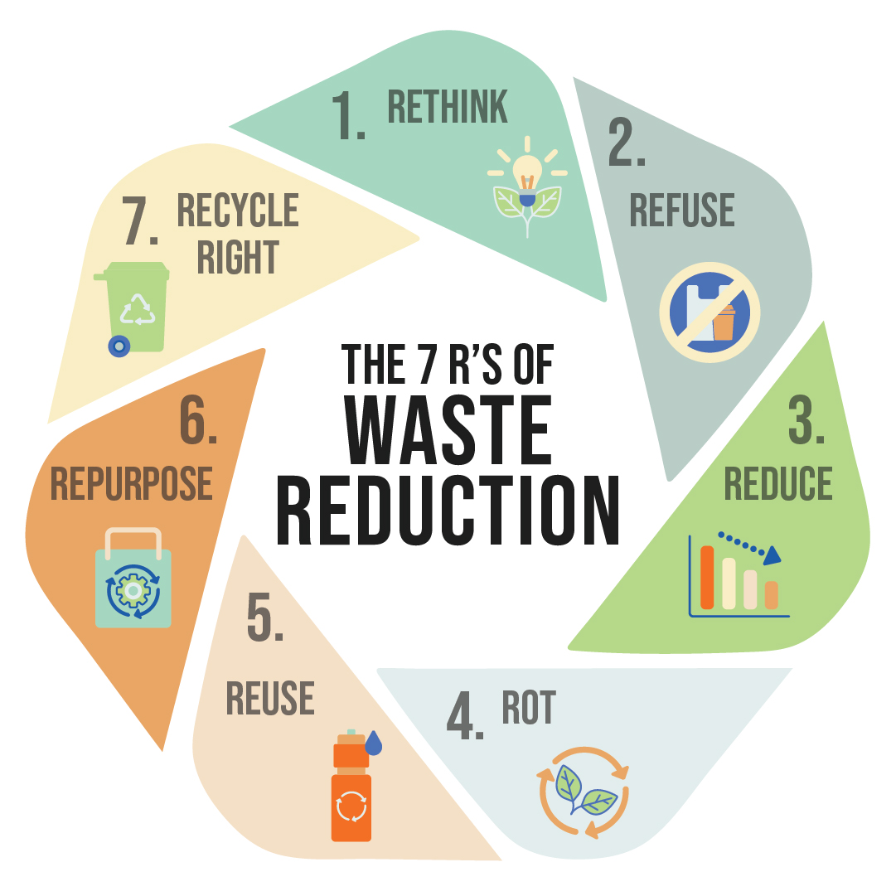
Notes:
The good news is that most the garbage we presently put in our garbage cans is not “true trash.”
75% of it can be pulled out and put other places
Textiles (old clothing/rags) can be reused by putting in textile bins or donated.
RECYCLING Most plastic, glass, metal food and beverage containers, paper, cardboard, and other metal can be recycled. Make sure that recycling is loose in the blue cart, no plastic bags!!
Food waste is a resource and can be composted or turned into clean energy.
Yard waste should not go in the garbage but instead can be brought to your local transfer station, recycling center or brush recycling site
If we work to remove non-trash items, the trash that goes to out-of-state landfills or incinerators would be significantly reduced.

Slide 11
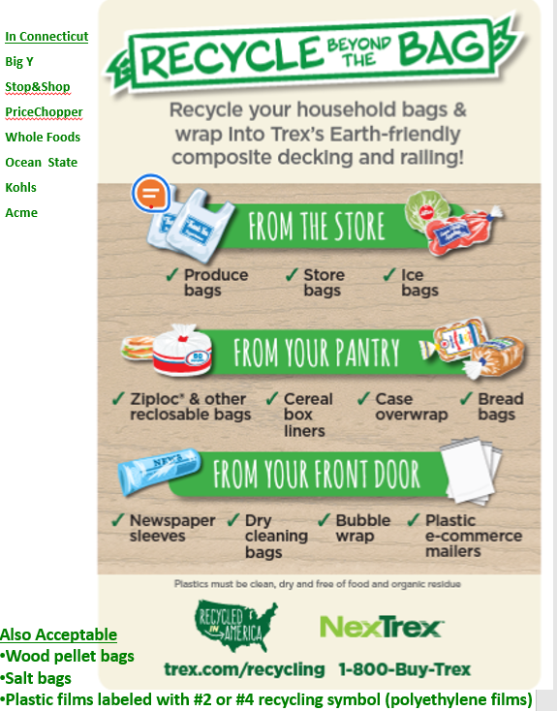

Slide 12
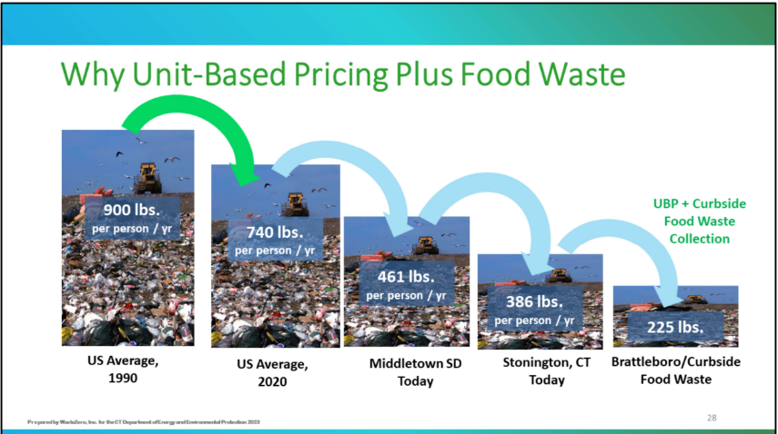
Per Capita Disposal with Unit Based Pricing plus Food Waste
UBP is the single most effective action that a municipality can take to reduce waste
Over 550 municipalities in the Northeast have UBP with an average of 44% waste reduction.
Notes:
Per Capita Disposal with UBP plus Food Waste
UBP is the single most effective action that a municipality can take to reduce waste. Over 550 muni’s in the Northeast have UBP with an average of 44% waste reduction.
US Avg in 1990 = 900 lbs./pp/yr.; then BB, convenience of SS recycling
In 2020 = 740 lbs. pp/yr.;
Middletown has already shown a reduction in waste by over 30%, bringing us to a 461 lbs. per capita.
Stonington’s UBP Program 386 lbs./pp/yr.;
Brattleboro/Curbside/Waste Reduction = 225 lbs.
Vermont’s Universal Recycling Law – DISPOSAL BAN – Food Scraps Banned from Disposal
UBP – all Vermont towns had to require waste collectors to charge for trash based on its volume or weight. Similar to paying for the amount of electricity used instead of a flat fee, people in Vermont can pay less if they produce less trash. FAIRER

Slide 13
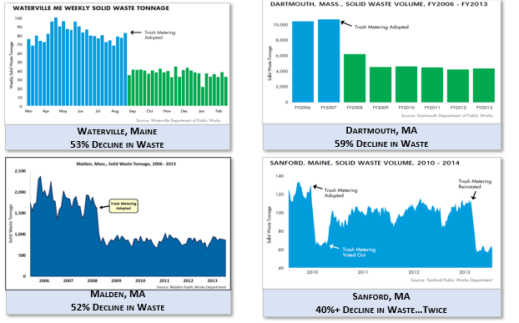
UBP Results are Immediate and Predictable and Sustained Over Time
Hundreds of Communities around US have implemented UBP
Data provided by Waste Zero

Slide 14
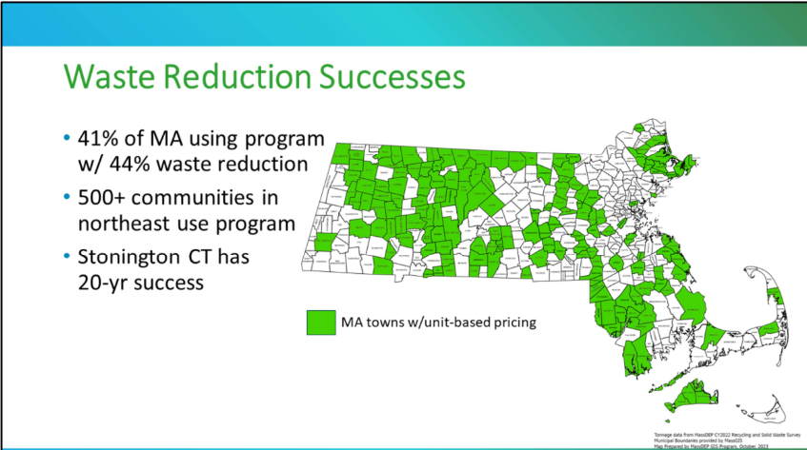
Notes:
41% of the MA municipalities are using a similar unit-based pricing program which has been very successful. They have had an average waste reduction of 44% in trash with this system.
In the northeast, there are presently over 500 communities using a unit-based pricing program
These programs are new to most of CT with only a handful of towns utilizing this system in some form. Stonington has had a program since 1992 and has saved over $7 million in avoided disposal costs due to their reduction in waste.

Slide 15
Residential Organic Waste Diversion by Program
Residential Estimates for Annual Food Scrap Diversion by Program Type as a % of Total Waste Stream. UBP coupled with curbside food scrap collection is exponentially more effective than any other program.
Total Waste (128,000 tons)
1%
Diversion =
Transfer Station Drop Off
3%
Diversion =
Voluntary Curbside Collection (10% of Homes Maximum Participation)
68%
Diversion =
Municipal Curbside Collection + UBP
*TS Drop Off = 10x the volume of Glastonbury
**Voluntary curbside assumes 10% of homes sign up and divert nearly 100% of food waste
***Municipal curbside example South Portland Maine
****UBP + Curbside food scrap collection example Brattleboro VT
WasteZero Slide October 2021

Slide 16
SCRCOG SMM Grant
DEEP extended SCRCOG’s SMM Grant for an additional 18 months out to November 2025
DEEP will be reallocating the $63K remaining funds in the contract to be re-directed to $50K for hiring a consultant that will engage up to three interested SCRCOG municipalities to launch a UBP program and/or co-collection program that divert food scraps. Remaining $13k in funds will be allocated to SCRCOG staff time.
To Date:
  New Haven is asking for a full analysis of their waste so they can determine the best path forward to reduce their trash, i.e. food waste diversion and UBP.
  Guilford/Madison – Waste Transfer Station consensus is that when a sorting site is permitted, possibly in Deep River, they will consider co-collection (would be a demo permit because the State currently does not have a permit for this yet).
  Milford is interested in receiving technical assistance on food waste diversion and UBP options. They want to manage composting within their borders maybe via an In-Vessel System

Slide 17
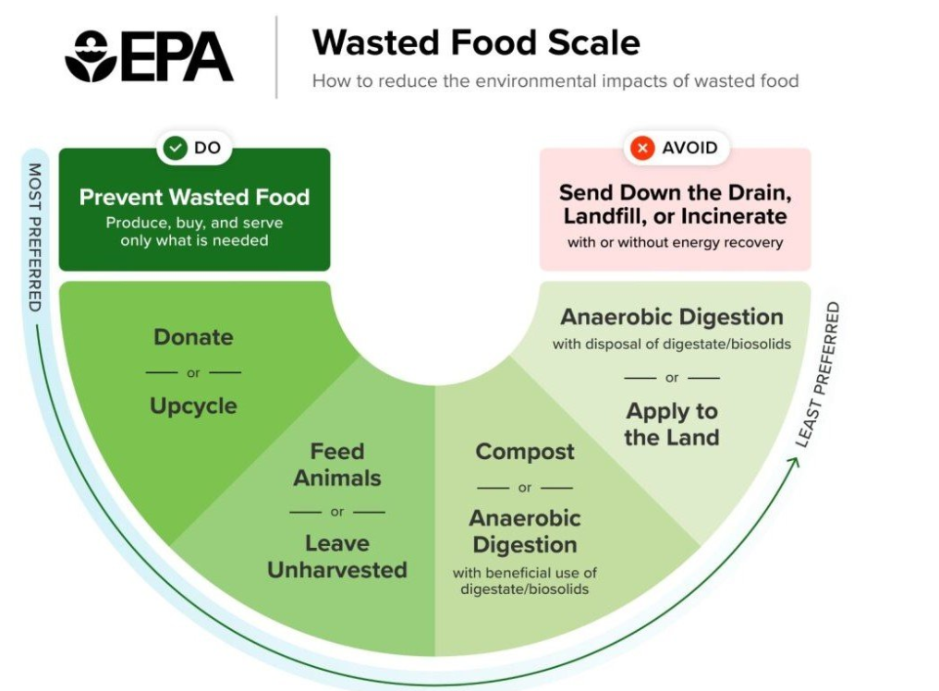
EPA Wasted Food Scale
58% of methane emissions from landfills come from food waste
Methane is responsible for about a 1/4 of global warming
Project Drawdown ranks food waste #1 of 93 global solutions for reversing climate change, that food waste represents 8% of global GHG
Households are the largest contributor
UN’s Goal is to reduce food waste by 50% by 2030
The importance of food scrap diversion is reflected in REFED's presentation here:
https://portal.ct.gov/DEEP/Waste-Management-and-Disposal/CCSMM/Increased-recycling

Slide 18
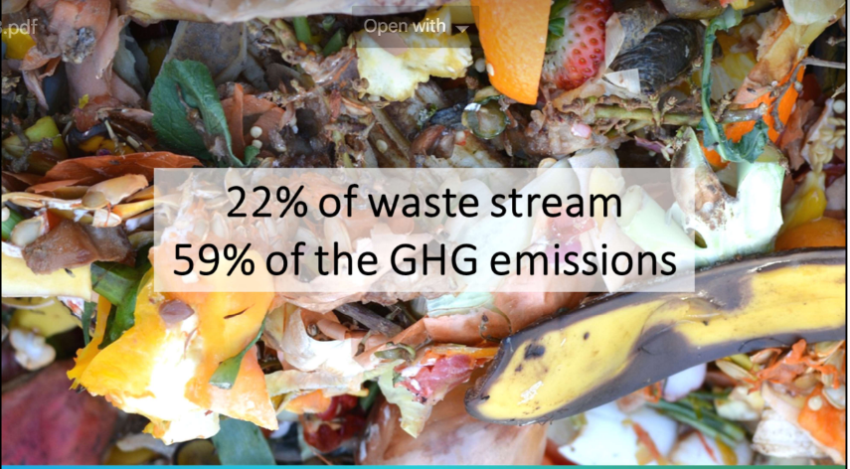
Why Food Scrap Diversion?
Food is not Waste
It Does Not Belong in the Trash
  Heavier to haul
  Harder to burn
  Wasted valuable resource
  Produces huge amounts of methane

Slide 19
Food Waste Diversion Programs
Transfer Stations – Guilford/Madison, Branford, Hamden, Orange
West Haven Regional Food Waste Composting Site TBD – already permitted
Big Belly Food Waste Containers – New Haven planning to distribute around the City
Schools
  Mary R Tisko Elementary School in Branford
  Bear Path Elementary School in Hamden
  New Haven Academy
  Barnard Environmental Magnet High School in New Haven
  High School in the Community in New Haven
  John S. Martinez Magnet School in New Haven
  Engineering and Science University Magnet School (ESUMS) School in West Haven
  Beecher Road Elementary School in Woodbridge.
* CT Organics Law effective 1/1/25 will require schools that generate more than 26 tons of food waste scraps/year to divert said food scraps for recycling. The Town of Cheshire has calculated that schools that have more than 700 students produce more than 25 tons/year. In the SCRCOG region, this would include most high schools (~14) and some middle schools (~8).

Slide 20
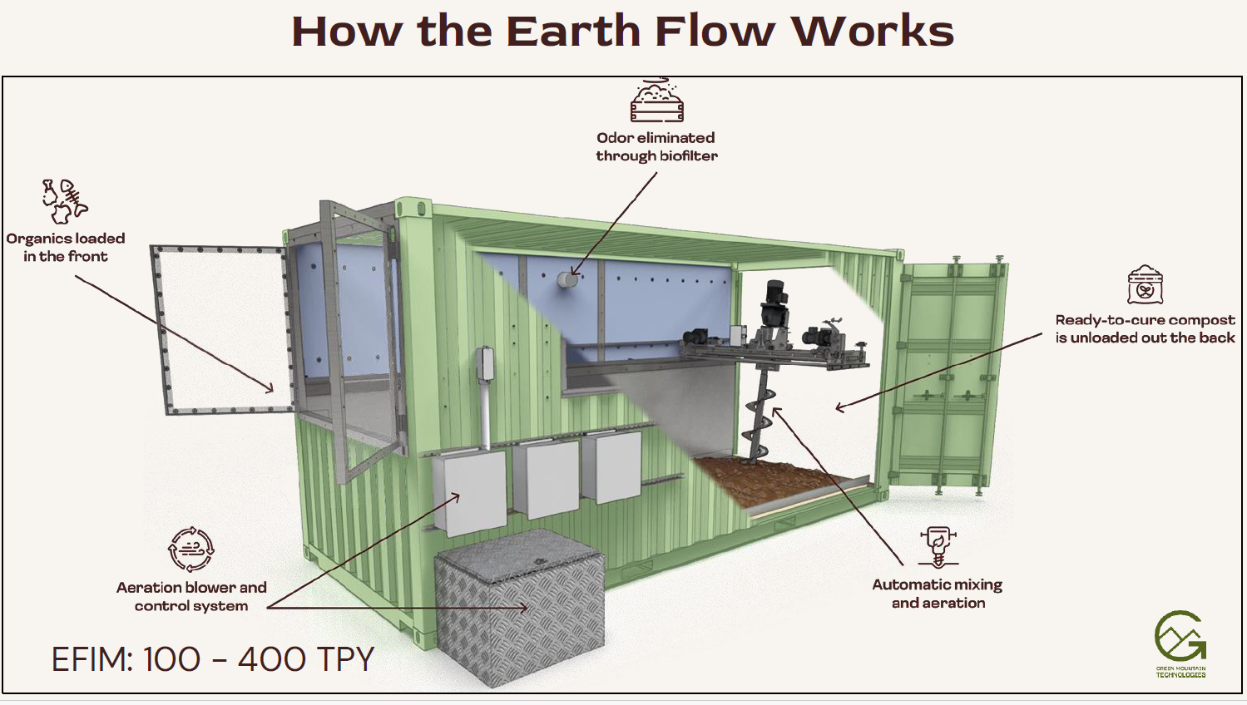
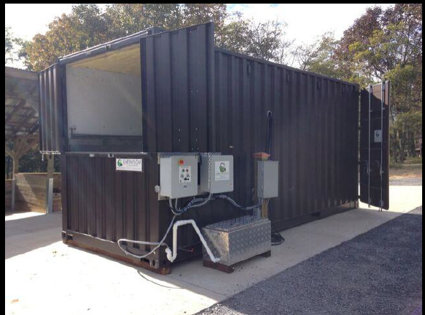
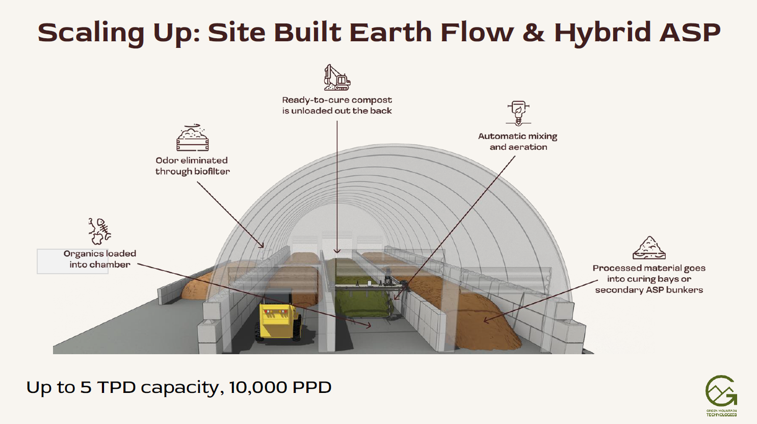
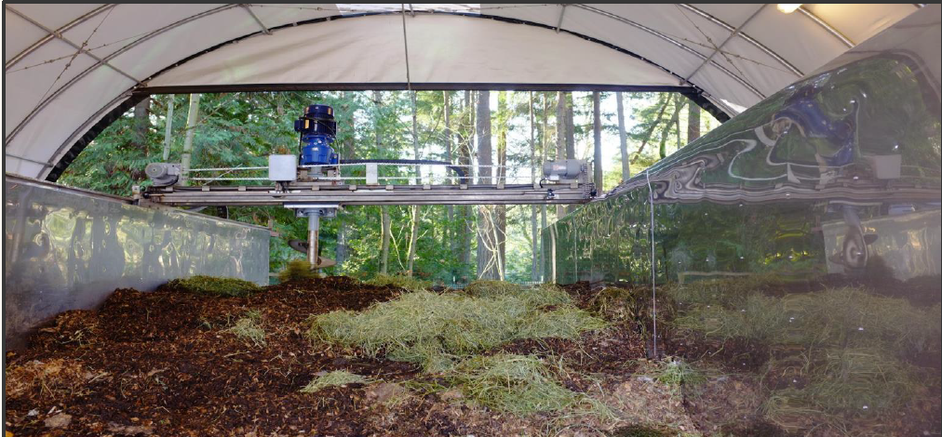
Green Mountain Technologies Composting Systems

Slide 21
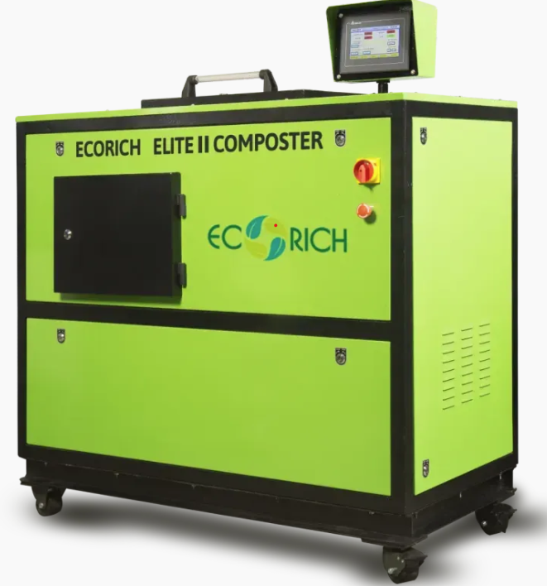
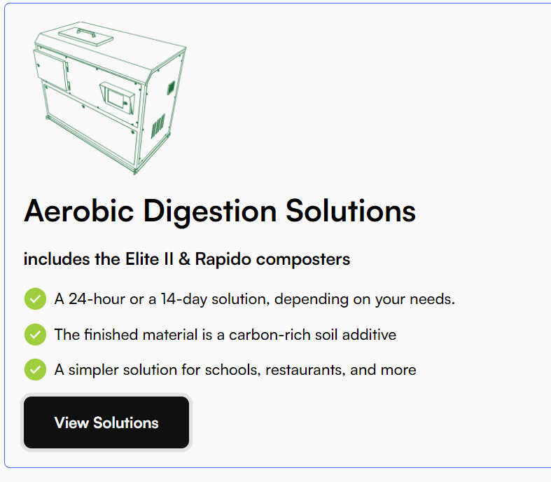
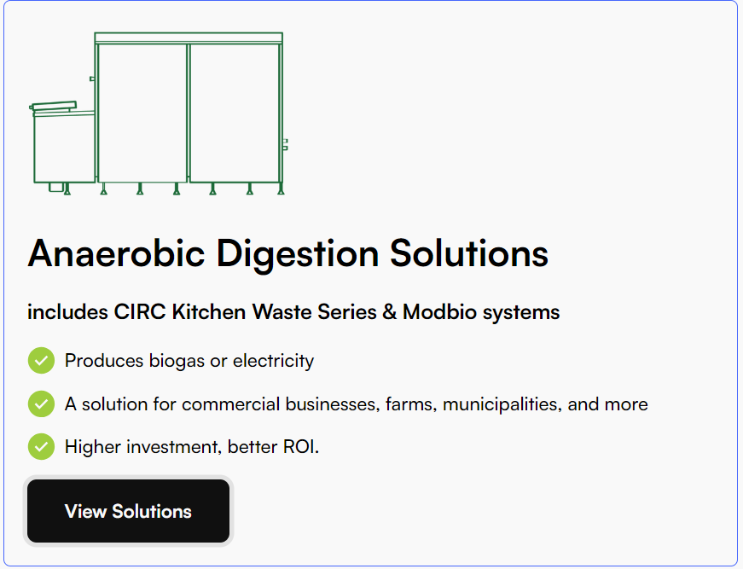
EcoRich Composting Systems

Slide 22
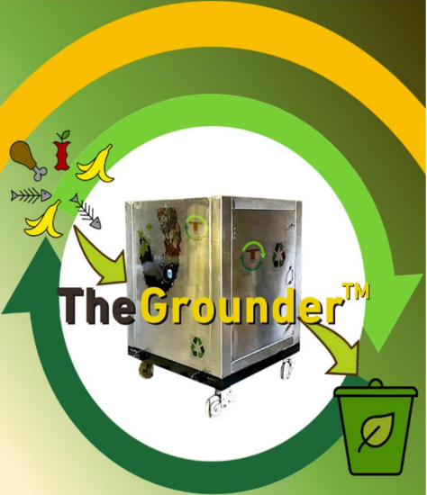
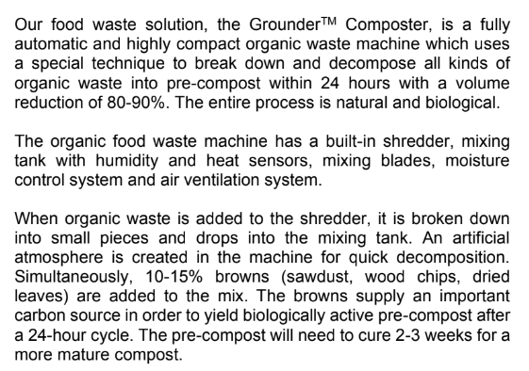
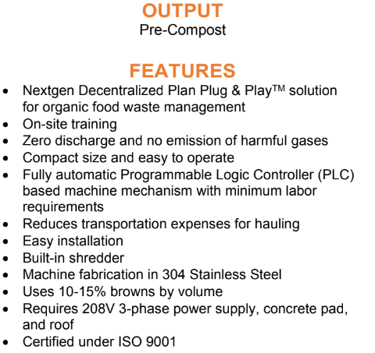
T2G Table To Ground In-Vessel Composter
info@table2ground.com

Slide 23
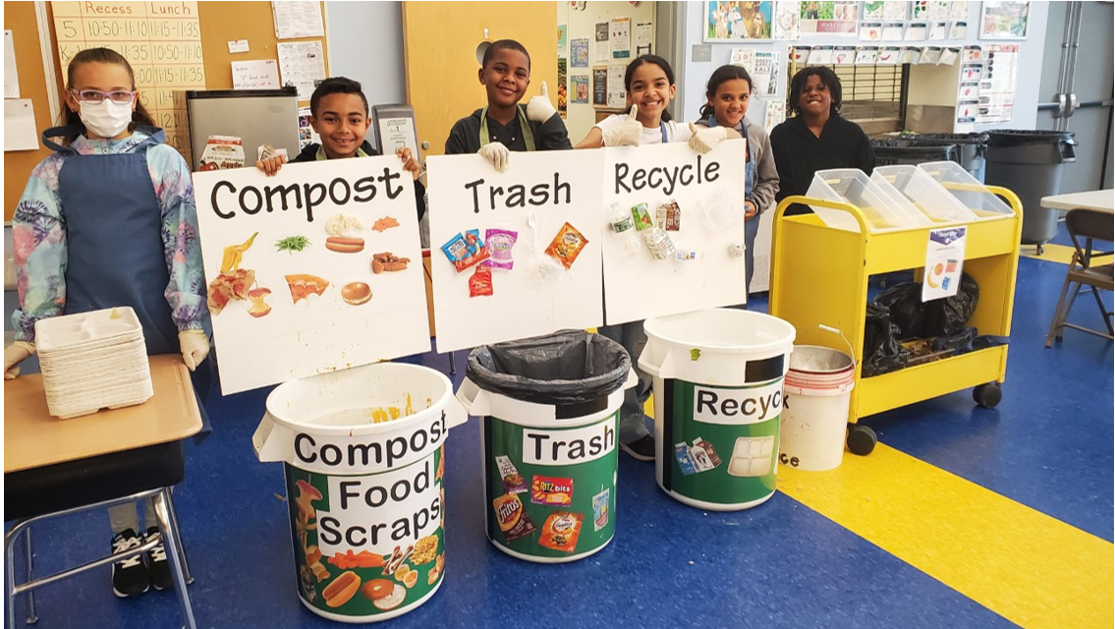
4th Grade Bear Path Elementary School Green Team

Slide 24
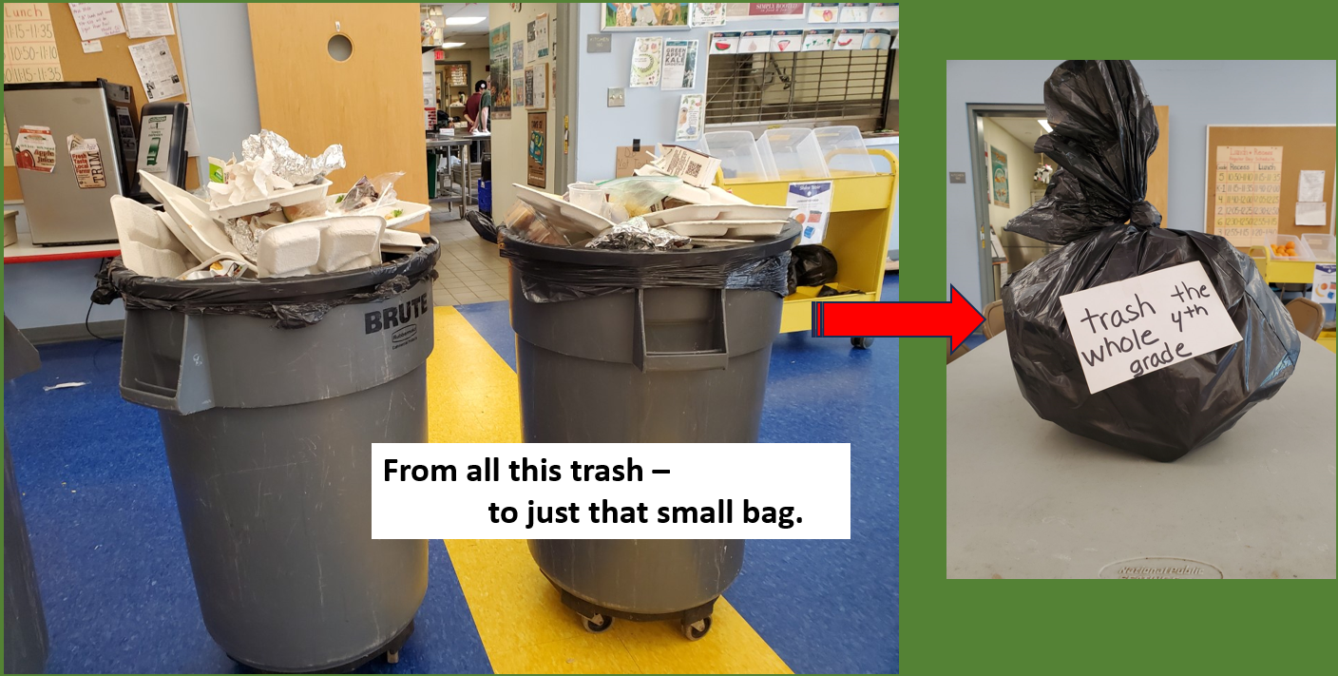

Slide 25

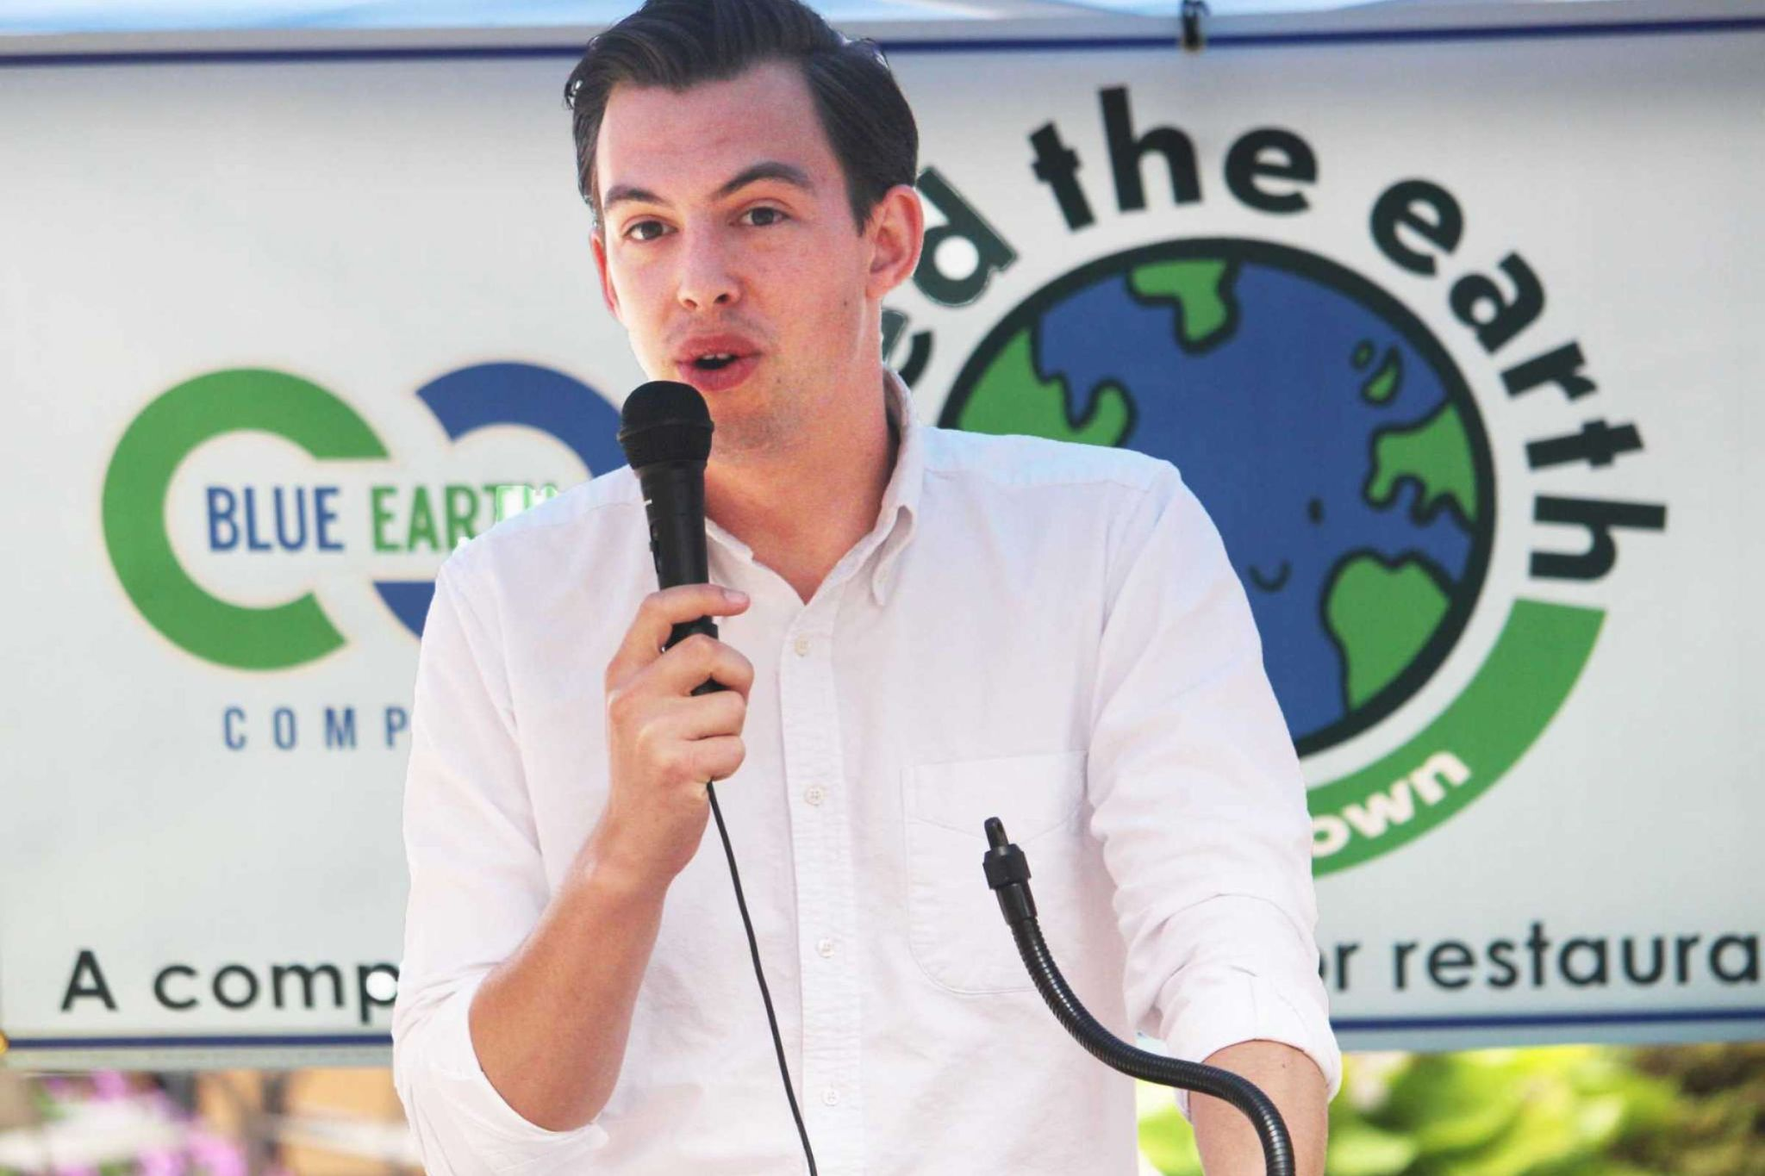
OUR SERVICES - MUNICIPAL
There are are many methods for getting food scraps out of the waste stream to lower your MSW costs and improve your community's environment. We provide them all:
Subscription-based services
Transfer Station Collections
Curbside Collection
Commercial Districts
Schools
TOWNS WE
WORK FOR
Deep River, Woodbury, Greenwich, Wilton, Suffield, Granby, Middletown, East Haddam, Haddam, Branford, Preston, New Hartford, Cheshire, Chester, Killingworth, Guilford, Cromwell, Portland, Middlebury, West Hartford, Westport, Old Saybrook, Glastonbury, and Rocky Hill
Residential: 1,200 households
CT DEEP 2015 WASTE CHARACTERIZATION STUDY
Notes:
Thank you Commissioner Dykes, and the folks in the Solid Waste division at the DEEP.
I appreciate the opportunity to participate in this working group conversation
Recognition – The facility and team who operates the facility have been recognized in many arenas… I’m honored and proud to represent both on this call today.

Slide 26
1. Waste Crisis – Nationally and in Connecticut
MOVING TOWARD COLLABORATIVE SOLUTIONS TO THE WASTE CRISIS
2. Unit-Based Pricing and Food Waste Diversion
3. SCRCOG Grants Awarded and Upcoming Grants
4. Lessons Learned and Challenges
5. Vision for Collaborative Solutions

Slide 27
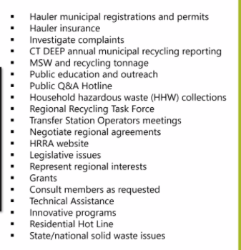
Regional Waste Authority (RWA) Grant $353k
Services that may be provided to member municipalities through an RWA:
Purpose:
Evaluate potential to expand existing New Haven Authority (draft ordinances, inventory Waste Management)
Engage in planning activities for waste diversion and infrastructure development programs
Phase 1 Study by May 30, 2025
Phase 2 Legal Docs by June 30, 2026
Join existing RWA (New Haven)

Slide 28
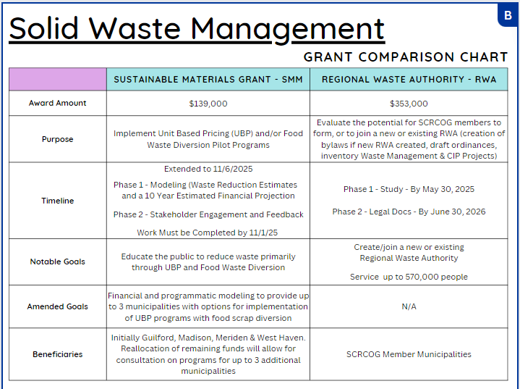

Slide 29

NIPS Refunds To Date
Town | # Containers 4/1/23 - 9/30/23 | PD 4/1/23 - 9/30/23 | 10/1/21 - 9/30/23 Total To Date
Bethany | 27,588 | $1,379.40 | $4,507.80
Branford | 395,922 | $19,796.10 | $77,396.70
East Haven | 437,421 | $21,871.05 | $85,492.25
Guilford | 104,005 | $5,200.25 | $20,036.95
Hamden | 852,092 | $42,604.60 | $154,095.10
Madison | 104,183 | $5,209.15 | $18,970.55
Meriden | 987,889 | $49,394.45 | $186,163.25
Milford | 718,869 | $35,943.45 | $137,209.80
New Haven | 2,091,600 | $104,580.00 | $410,270.95
North Branford | 150,938 | $7,546.90 | $30,925.80
North Haven | 276,538 | $13,826.90 | $52,295.30
Orange | 78,542 | $3,927.10 | $15,621.80
Wallingford | 621,259 | $31,062.95 | $124,286.00
West Haven | 1,021,460 | $51,073.00 | $193,743.50
Woodbridge | 3,122 | $156.10 | $439.15
TOTAL | 7,871,428 | $393,571.40 | $1,511,454.90
Statewide | 47,297,793 | $2,364,889.65 | $8,986,536.15

Slide 30
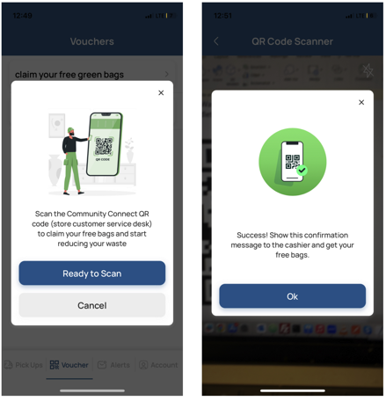
Community Connect APP
Free Mobile APP for Residents
Support from Town/Vendors
Easy to Use Dashboard Controls
Tracks residents signing up for program
Calendar Management – tracks collection types, i.e. textiles, bulk, brush/leaves, mattresses, Christmas trees
Route Building
Collection Types
Addresses
Surveys
Voucher Programs
Payments
Alert and Notifications
Core communication between residents and town
Residents can message the town with comments and questions
Alerts can be sent to just residents in an affected collection disruption area
Notifications encourage behavior and inform about upcoming events
Works on Apple, Android (Google), iPads and other tablets
*Does not require personally identifiable information but residents may choose to create a profile to save preferences, provide payment for collections and redeem vouchers or incentives.

Slide 31

Sustainable CT Community Match Fund
Matches funds for tangible projects that align with Sustainable CT objectives
Sustainable CT has partnered with Patronicity - a non-profit crowdfunding platform that provides one on one fundraising support
Eligible projects will receive a dollar for dollar matching funds from Sustainable CT
Applicants can be: Municipalities, Schools, Land Trusts, Community Groups
Marina Sencalar the Connecticut Program Manager 512-831-2215 or marina@patronicity.com
https://sustainablect.org/funding/
Projects: https://online.fliphtml5.com/cfvnc/ckbz/#p=1
Notes:
Not Registered: East Haven, North Branford, Orange, Wallingford
7.6 Recycle Additional Materials and Compost Organics
7.8 Develop a Food Waste Prevention and Food Scraps Recovery Campaign
10.1 Implement Your Own Sustainability Action
Bethany - $11k – School Composting and Recycling Program
Hamden _ $30k – expanding work in Hamden to recover good, excess food and redirect it to people by engaging more food donors and community sites as sponsors.
New Haven Land Trust -$42k Composting and Youth Green Jobs

Slide 32
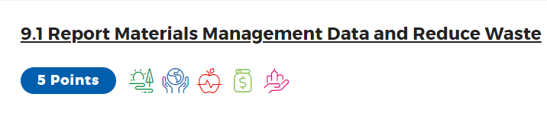
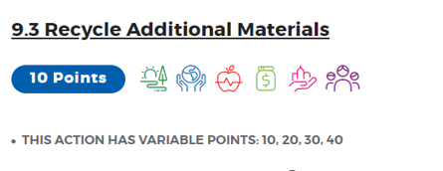
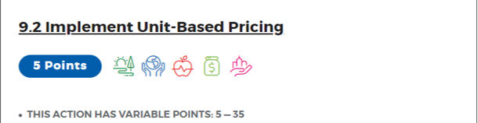
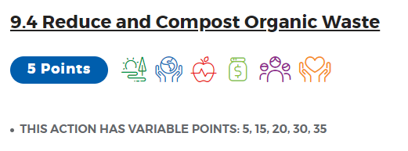
Earn Sustainable CT Points for
UBP Planning, Research and Implementation
THIS ACTION HAS VARIABLE POINTS: 5-105
Actions Page: https://sustainablect.org/actions-certifications/actions

Slide 33
More Grants and More Waste Reduction Activities
$10m bonding allocated for waste, recycling and organics programs - DEEP will begin meetings soon to discuss what will be eligible how $$ be distributed
EPA Grants – REO, SWIFR and others
Sustainable CT Community Match Fund – ex Hamden Food Recovery, Cheshire Composting Bins, East Haven Trash Cleanups
CT Green Bank – meeting to learn how SCRCOG may benefit from their new environmental Infra mission
Oops Tags – tagging program that reduces recycling contamination significantly
Community Connect APP - free mobile APP for residents
Glass Recycling at Transfer Stations – two options 1) Pat Grasso at Urban Mining or 2) Mike Stallings at EyeRecycle
NIPS fund – use for recycling coordinator, food scrap diversion in school cafeterias, maybe oops tags…fund printing of tags and a team of people to tag carts - 22%-35% of Connecticut’s recycling is contaminated
Repair Café – Guilford and Woodbridge held a Repair Café in this fiscal year
Bottle Bill - EyeRecycle and CLYNK are offering convenient reimbursement options for drop-off by the bag
Composter and Rain barrel Sales – Woodbridge held a sale this year by partnering with Jeff at Brand Builders through their online sale platform.
Schedule more of DEEP’s WIWO Recycling Workshops
FoodCycler - converts food waste into a nutrient-rich byproduct overnight using a grinding and dehydrating process, recommends municipal subsidy programs
Transfer Stations – West Haven and North Branford do not currently have transfer stations but have been considering it

Slide 34
1. Waste Crisis – Nationally and in Connecticut
MOVING TOWARD COLLABORATIVE SOLUTIONS TO THE WASTE CRISIS
2. Unit-Based Pricing and Food Waste Diversion
3. SCRCOG Grants Awarded and Upcoming Grants
4. Lessons Learned and Challenges
5. Vision for Collaborative Solutions

Slide 35
Lessons Learned and Challenges
Need Infrastructure – Sorting Sites, Compost sites
Political Challenges
Facebook Challenges
Misconceptions takeover social media
Grant Program – complicated and slow going – needs to be streamlined
Need Statewide Education, Policy, Enforcement

Slide 36
1. Waste Crisis – Nationally and in Connecticut
MOVING TOWARD COLLABORATIVE SOLUTIONS TO THE WASTE CRISIS
2. Unit-Based Pricing and Food Waste Diversion
3. SCRCOG Grants Awarded and Upcoming Grants
4. Lessons Learned and Challenges
5. Vision for Collaborative Solutions

Slide 37
Vision for Collaborative Solutions
Discussion Topics
  Food Waste Diversion
  Unit-Based Pricing
  Composting Sites
  Regional Solid Waste Authority

Slide 38
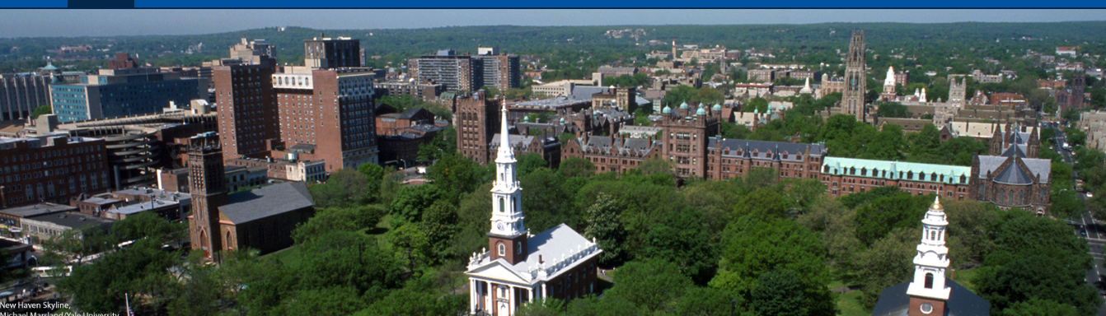
Thank you for your attention.
Pamela Roach, SCRCOG Consultant
PDRicciRoach@gmail.com
203-804-0387
Notes:
Now I would like to welcome Randy Hartman – Randy can you share your screen? - from Keep America Beautiful presenting on Best Practices in Environmental Behavior.
Randy is the Senior Director of Affiliate Operations. Welcome Randy. You should be able to share your screen now.
Thank you Randy.
Does anyone have any questions for Randy?
Now I would like to welcome Elizabeth Schussler (sh UH s ler) – Elizabeth can you share your screen? – Elizabeth is from the Recycling Partnership presenting on Transforming Recycling for Good by Breaking Down Behavior Change.
Elizabeth is the Senior Director of Program Design for The Recycling Partnership. She is a creative thinker with Keen Insights on Behavior Change.

