Slide 1
Care + Community + Equity
Best Practice Sharing Meeting
Type Name & Organization in the Chat
December 7th , 2022
Notes:
For attendance purposes, please type name/organization into the chat.

Slide 2
AGENDA – December 7, 2022
Welcome and Introductions | 5 minutes | Der Kue, PMP (RIHCA)
CHN Updates | 5 minutes | Kelsea Tucker, MS (RIDOH)
QRS update and stratification ideas | 10 minutes | Adrian Bishop (AHP)
Tri-County Community Action Program Clinical Care Teams Present on Diabetes and Pre-Diabetes as part of the CCE incentive work | 15 minutes | Casey Sardo Team Lead Registered Dietitian-CDOE at Tri-County
Comprehensive Community Action Program Clinical Care Teams Present on Diabetes and Pre-Diabetes as part of the CCE incentive work | 15 minutes | Dr. Jason Villa Assistant Medical Director, Clinical Champion at CCAP
CODAC Behavioral Health Mobile Unit | 10 minutes | Alayna Woodley (CODAC) Ashley Fortes (CODAC) Carolyn James (CODAC)
Medicaid Beneficiary Enrollment Pilot (MBEP) funded by NACDD/CDC- RIDOH and Coastal Medical | 15 minutes | Benvinda Santos (RIDOH) Sustainability Manager Diabetes Heart Disease and Stroke Krystal Bevilacqua, PharmD CDCES CDOE CVDOE Clinical Pharmacist- Diabetes Program Manager- Coastal Medical
Open Discussion | 10 minutes | Jayne Daylor, RN MS (RIDOH)
Closing Thoughts and Evaluation 2023 Meetings: March, June, September Please complete today’s meeting evaluation and indicate best day for next meeting in March | 5 minutes | Der Kue, PMP (RIHCA)

Slide 3
In Memoriam: Marvin Ronning The Brown University School of Public Health mourns the loss of Marvin Gene Ronning, deputy director of the Rhode Island Free Clinic, an unstinting champion for vulnerable families across the state.

Slide 4
CHN Referrals 1-1-22 through 11-30-22
 | Jan. | Feb. | March | April | May | June | July | Aug. | Sep. | Oct. | Nov.
Well One Pascoag |  |  |  |  | 1 | 1
Well One NK | 2 |  |  |  |  |  | 2 |  | 1 | 1
Well One Scituate | 1 |  | 1 |  | 1 | 1 | 1
Well One Foster |  |  |  |  | 1
Tri County Johnston | 2 | 1 | 3 | 5 | 18 | 36 | 1
Tri County N. Providence | 2 | 1 | 3 | 3 | 1 | 2 |  | 1
Clinica Esperanza |  |  | 1 |  |  |  | 1 | 1 | 2
CCAP Coventry
CCAP Cranston
CCAP Warwick |  |  |  |  | 1 |  |  |  | 1
Thundermist WW |  |  |  |  |  |  | 1
RI Free Clinic |  |  |  |  |  |  | 1 | 2 | 3 | 5 | 2
Wood River |  |  | 2
Notes:
Just because a chronic condition isn’t listed here, doesn’t mean we don’t have something for you. For example, we’ll talk about the EnhanceFitness program and CDSMP, both of which are great for a variety of other chronic illnesses other than these. Another think to keep in mind, is that if you are someone without a chronic illness, some of these programs may benefit you. The DPP is a great example of that and we’ll talk about that a little later.

Slide 5
Quality Reporting System Addendum – Use Case Project
QRS Work Completed so far:
Work with IMAT to complete the data mapping process for each of the following measures:
Diabetes in Poor Control
HTN in Control
Statin Therapy
Continue to implement the data validation plan submitted during the previous contract year. Throughout the data validation process, resolve issues or errors for each measure independently with IMAT or with support from the EHR consultant.
To demonstrate completion of data validation, submit results or final reports for each measure to RIDOH and the EHR consultant for approval.
Current Period of Performance Scope:
June 30th, 2022 – September 29th, 2023

Slide 6
Use Case Vision – Define the Problem
Identify care gap:
Using existing data identify a potential population health care gap (CVD and Diabetes):
Equity of Care
Underserved race / ethnicity
Underserved communities
Social Determinants of Health
Patients with multiple chronic conditions
Patients with cooccurring conditions
Define the Perceived Problem:
Document the Problem Statement
Plan for change:
Select team
Schedule meetings
1

Slide 7
Use Case Vision – Measure the Problem
Quantify the Problem
Gather baseline data
Existing reports (e.g. UDS, CTC, ACO reports)
EHR Data
QRS Data
Define Project Scope and Expectations
Project Boundaries
What population?
What timeframe?
What attributes?
Project Constraints
Measures of Success
What do we hope to achieve (within the project period and with the resources allocated)
Document the Quality Improvement Plan
What outcome that you hope to achieve?
How success will be captured and evaluated
2
3

Slide 8
Use Case Vision – Analyze the Data
Analyze the Data
Use QRS data
Data stratifications and drill down
IMAT / RIDOH Team will provide support
Identify Causes
Probably multiple causes
Priorities actions (where to start)
“Low hanging fruit”

Slide 9
Use Case Vision – Improve
Quality Improvement
Use QRS data
Generate solutions
Evaluate solutions
Use “rapid cycle” pilot to validate and optimize corrections made
Plan and Implement Solution(s)
Current scope activities
Plan future expanded scope activities

Slide 10
Use Case Vision – Improve
Control the Gains
Identify control mechanism(s) to establish for long-term actions that maintain improvement in measures observed:
Revised policies and procedures
Staff trainings to establish for long-term actions that maintain improvement in measures observed
Identify ongoing data collection and reporting requirement that are needed to
Document changes to workflows
Train staff
4

Slide 11
Casey Sardo, RD, LDN, CDOE (C+C+E Team Lead)
Amanda DeSimone, RN (Clinical Nurse Manager)

Slide 12
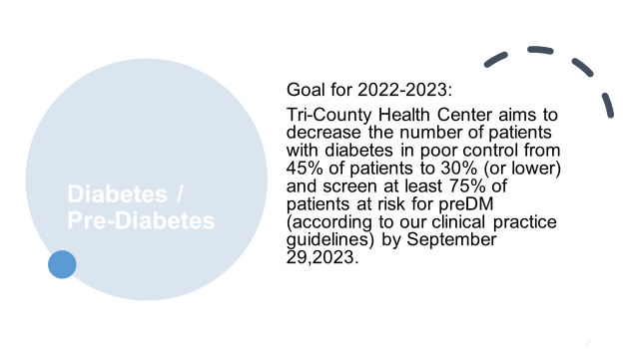

Slide 14
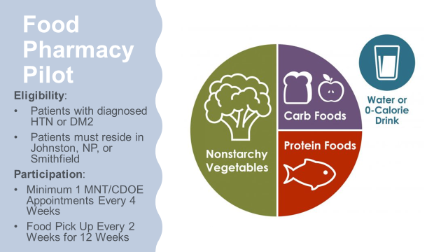

Slide 20
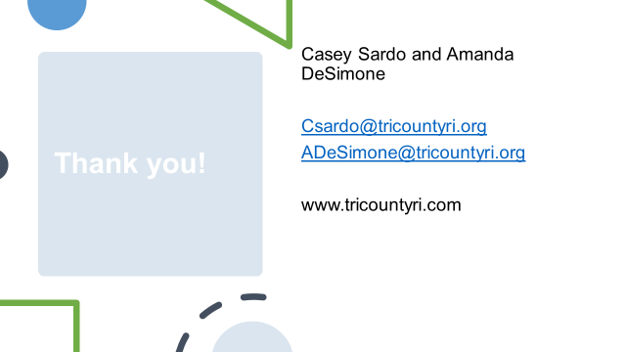

Slide 41
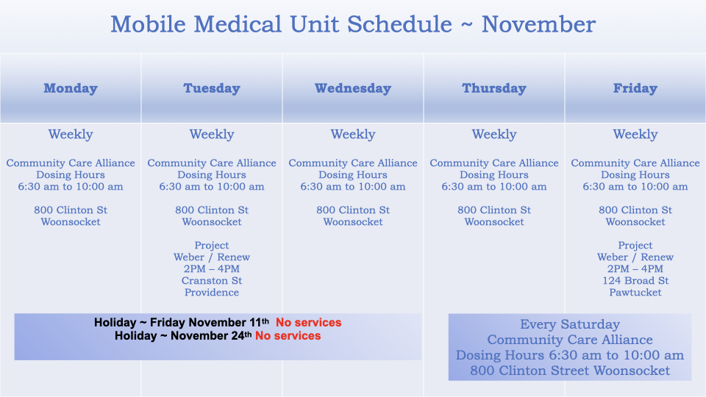

Slide 42
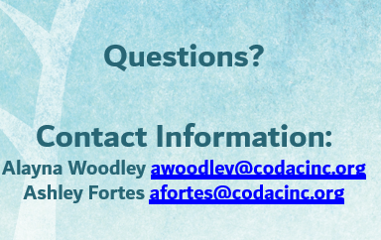

Slide 43
Medicaid Beneficiary Enrollment Pilot (MBEP)
Benvinda Santos, MPA
Sustainability Manager
Diabetes, Heart Disease, and Stroke Program
Rhode Island Department of Health
Benvinda.Santos@health.ri.gov
Krystal Bevilacqua, PharmD CDOE, CVDOE, CDCES
Clinical Pharmacist | Diabetes Program Manager Coastal Medical
kbevilacqua@coastalmedical.com

Slide 44
Medicaid Beneficiary Enrollment Pilot (MBEP)
Goals: Build systems that advance access to and utilization of the National DPP; Medicaid coverage Scope of work: Outreach, recruit, enroll, and, retain (80) Medicaid beneficiaries in the National DPP Priority Population: African American and Latino adults at high risk of developing type 2 diabetes Timeline: August 1, 2022 – July 31, 2023
Partners: RIDHDS, Coastal Medical (Accountable Entity), Lifespan Community Health Institute (LCHI) a CDC-recognized DPRP site, Rhode Island Parent Information Network (RIPIN)/ Community Health Network (CHN). * Expand partnerships with Accountable Entities and DPRP sites.
Coastal Medical use internal systems to identify eligible beneficiaries for National DPP. Conduct outreach, recruitment, and make referrals to the Community Health Network (CHN) managed by the Rhode Island Parent Information Network (RIPIN). RIPIN assigns interested beneficiaries to bi-lingual Patient Navigators/trained CHWs to facilitate program registration, identify and address participation barriers, and make referrals for social service needs as needed. Navigators send registration roster to National DPP sites for enrollment. Lifespan Community Health Institute (LCHI) and other CDC recognized DPRPs trained Lifestyle Coaches conduct readiness assessment, enroll, deliver, and retain participants in the National DPP. Delivery modes in-person, virtual, and or hybrid. * Expand evidence-based program infrastructure, support a workforce of cross trained Lifestyle coaches and Community Health Workers, establish systemic referrals, and expand Medicaid coverage.

Slide 45
Goal: To help our highest risk patients with diabetes improve glycemic control and self-management
Initial visit with diabetes nurse educator for diabetes education and assessment
Ongoing review & interpretation of BG readings with optimization of med regimen
Coordination of coverage for diabetes supplies or medications
Coordination of referrals to Diabetes Prevention Program
Group Patient Education Sessions
Key Performance Indicators 2021
Patient Impact:
1850 patients enrolled and engaged
30% of patients on remote patient monitoring
1.6% reduction in average A1C levels
Clinician Satisfaction:
4.67 out of 5 stars in clinician satisfaction
Notes:
H: Our Diabetes Management program has changed the way we care for our patients with diabetes
O: This slide gives a little overview of what our Diabetes program entails and some of the success of our program over the past year
P: We started in 2015 and developed Coastal's first population health management program
Patients that participate have consistently seen an A1C reduction of 1.6%.
We've served over 4000 patients through this program since inception with 2000 patients identfied and enrolled each year.
Additionally, this program is the highest program for clinician satisfaction we have.
T: One of the areas we always wanted to target but did have the resources for historically was diabetes risk and prevention

Slide 46
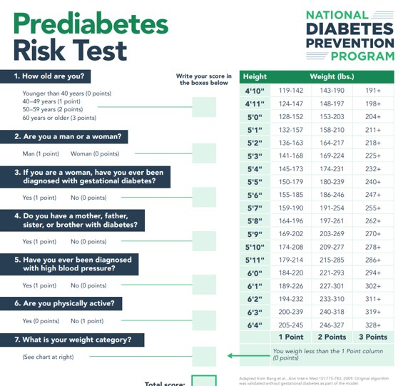
Eligibility
Notes:
H: We were so excited to begin to offer expanded services in pre-diabetes in collaboration with our partners in this grant
O: This slide overviews the criteria and prediabetes risk tool to identify patients eligible for DPP
P: Patient identification was a critical first step. We learned through this that organizationally, we did not have a great way to identify patients. We spent a lot of time with our data analytics team to build a logic to capture patients with established prediabetes or with known risk factors.
-This identification allowed us to develop targeted campaigns and over time has allowed to us to be more creative with identifying eligible patients at a high opportunity time T: So with our data reports created, we worked closely with our partners and marketing team to develop a communication and outreach plan that we'll walk through together next.

Slide 47
1st Wave (Nov-Dec 2021)
Letters mailed/Emails sent to 300+ population with follow up call/text from DMP team
2nd Wave (Jan – March 2022)
Letters mailed/Emails sent with preDM test to 400+ patients, follow up call/text from DMP team
3rd Wave (Jun – November 2022)
Targeted email to all Medicaid patients and Prediabetes Information Session
Flyer for offices and chart flagging
Total Patients Referred: 55
Total Patients Referred: 25
Total Patients Referred: 45
Targeted patients with diagnosis of preDM or A1c 5.7-6.4%
Targeted patients who would score 5+ on Diabetes Risk Assessment based on known risk factors
Close collaboration with pilot office (Hillside Family Medicine) brainstorming ways to improve buy in and increase referrals
Notes:
H: We've tried a few different systems to identify and engage patients.
O: This slide provides a timeline of our efforts.
P:
-Through our efforts, we've been able to refer 125 patients overall to the DPP
-We've found that the strongest referrals come at point of care, but our providers and staff needed a reminder system of which patients were eligible.
-Conversations aren't always possible, but when they can they create the greatest patient buy in that we've observed. (and likely also retention in the program)
T: So once we had a stronger way to identify and communicate with these patients, our next step was to create a smooth referral pathway.

Slide 48
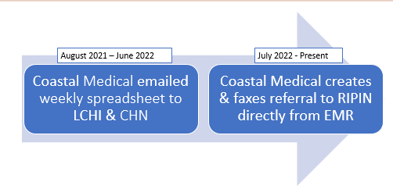
Notes:
H: So when we first started, our referral process was manual and took a great amount of team time.
P: We worked to add in DPP fax information into our E H R so that referrals can be sent directly to the CHN by a provider, as any other specialist referral would be managed.
We then also have the opportunity to monitor and close the loop on these referrals from our E H R.
T: So as we entered the second year of this program, our workflows are much more established and refined.

Slide 49
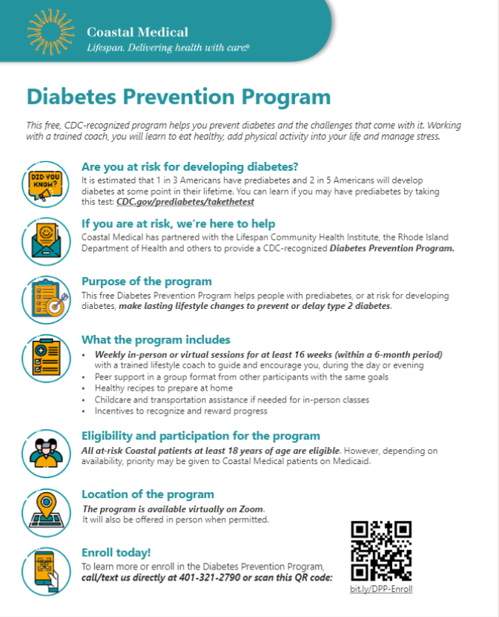
Current State
Proactive patient identification & chart flagging
Discussion of Diabetes Prevention Program at point of care
Ongoing patient-driven enrollment
Notes:
H: The ability to identify and refer patients when they are most engaged is critical
O: This describes the current state of our referral system for DPP and the flyer we currently provide to patients about DPP.
P:
Chart flagging has been effective in generating referrals
Patients walk away with information about the program, and have a contact mechanism to get back in touch with us if they would like to enroll.
T: While we've seen good success, we've learned a lot along the way.

Slide 50
Challenges:
Limited staff/time to outreach to patients
Limited provider awareness/buy-in
Time commitment of program
Limited follow up between enrollment and start of a session
Opportunities:
Internal CHW to outreach to patient and discuss DPP
Engagement between enrollment and start of session to keep patients motivated
Enhanced collaboration between Coastal Medical & LCHI via care conferences
Notes:
H: Starting the conversation about prediabetes earlier is the true success of this pilot.
O: This slide outlines the challenges and opportunities provided.
P:
We've observed a consistent increase in referrals over the past several months with the changes discussed.
-We've started working very closely with one practice to train staff and clinicians in more detail about DPP
-We anticipate direct provider/office referrals will continue to increase
-We are building a CHW program over the next year and we hope they will help to serve as strong patient advocates to improve referrals in the next year for our Medicaid patients.
At this time, I'd be happy to open to any questions/feedback!

Slide 51
Lifespan Policies
Questions?

Slide 52
Open Discussion
January meeting for all sites. Consider your experience with CCE over the last four years such as: Core work, incentive work, BPS meeting, PF site visits, QI/PDSA work, stratification, AHA initiatives, CHN resources ,measure specifications, RIDOH support, CTC Portal, CCE programmatic updates, BP training, SOW, etc….
Thoughts so far with CCE work?
Suggestions for future CCE work?
Thoughts on how the contracts were structured?
How has CCE added value to patient care?
How has CCE added value to patient outcomes?
What part of the work was important for you?
What hasn’t gone so well?
How can the process be improved?
How has this collaborative changed your practice?
What did you least?
What did you best?
What was challenging?

Slide 53
Closing Thoughts
&
Evaluation
Best wishes for a happy and healthy holiday!
2023 Meetings: March, June, September
Next data submissions due: January 15, 2023
Please continue working on CVD stratification with your Practice Facilitators and finalizing incentives.
Give us your feedback!
Remember to take our meeting evaluation. Take Survey HERE
Notes:
https://www.surveymonkey.com/r/RQ33MBD
Please take the meeting evaluation and indicate availability for our March meeting

