Slide 1
December 21, 2018 Shared LSP Update
Shannon Pritting
SUNY Shared LSP Project Director

Slide 2
Go-Live Strategy
SUNY will go live in groups to reduce technical services down time, and to make the cutover period as short as possible.
Instead of having a single technical services freeze, we will group campuses and have freeze dates that depend on go-live dates.
Process for go-live expanded for entire project, but shortened for individual campuses.

Slide 3
Cutover and Go-Live Plan
SUNY’s cutover and go-live process will begin the last week of May, and end the first week of July 2019.
University Centers will go-live in two groups that will last two weeks each.
All others will go-live in four groups that will last 10-13 days each.
Only University Centers will have fulfillment gap loads; all others will use Alma’s offline circulation during go-live period, unless a gap load is specifically requested.
Current Alma environments will be copied to implementation server on May 26th.

Slide 4
Alma Freeze
Alma will be copied on May 26th, but will be available after that date for training.
However, no config. or other changes made after that date will be reflected in go-live production system.

Slide 5
Building the Network Zone
Worldcat Collection Manager Records will be delivered to ExLibris on May 26th; the query to retrieve records will be submitted at the end of day on May 17th (Friday).
We will employ the same strategy as with test load.
Using Worldcat Master Records as basis of NZ.
Will include physical resources only.
Excluding the same fields as we did on the test load:
http://slcny.libanswers.com/faq/239032

Slide 6
University Center Groups
Two groups of two University Centers each.
First group will go through cutover and go-live process in first two weeks of June.
Second group will go through cutover and go-live process in last two weeks of June.
Group 1:
Binghamton University and Stony Brook University
Group 2:
University at Buffalo and University at Albany
Will develop plans for each of these groups (i.e. when data is extracted, etc. with campus and ExLibris).

Slide 7
Factors Leading to Cut-Over and Go-Live Plan
ExLibris is extracting almost all of SUNY’s data, which we did not contract for, but have thankfully been provided.
Desire to have a shortened technical services freeze, and a limited time using offline circulation.
Grouping by go-live will allow for project team and campuses to learn the process and help others later in the process to go-live smoothly.

Slide 8
Grouping Considerations
Groupings need to have equal balance between the two Aleph Shared Server Environments.
Balance of large and small bibliographic environments.
Need to have good mix of campuses with small and large staffs so SUNY Project Managers don’t get overwhelmed with support while also managing the larger project.

Slide 9
Cutover and Go-Live Timeline
Total 4 Week Cutover Timeline: June 2- July 1
6/17:
UC Group 1 and SS Group 1 and 2 Live
UC Group 1: June 2-June 17
UC Group 2: June 16-July 1
7/1:
All SUNY Live
6/8
SS Group 1 Go Live
Shared Server Group 1:
May 29-June 10
Shared Server Group 2:
June 5-June 17
Shared Server Group 3:
June 12-June 24
6/25
SS Group 3
Go Live
Shared Server Group 4:
June 19-July 1

Slide 10
Shared Server Cutover and Go-Live Process
10-13 Day Cutover and Go-Live Process
Day 1 Wed
Day 2 Thu
Day 3 Fri
Day 4-7
Day 8-9
Day 10-13
Tech Services Freeze begins at 5:00pm/ close of business
Manage 37
kicks off in early
morning
Circulation Freeze begins at 5:00pm/ close of business
Aleph Data Extracts
Anticipated to start on Day 4 (Sat)
Data Verification
Go-Live
OPAC Circ. Functions Disabled

Slide 11
Group 1: May 29-June 10th
Brockport
Buffalo State
Canton
Downstate
Dutchess CC
Environment Science and Forestry (ESF)
Erie CC
Fredonia
Maritime
Morrisville
North Country CC
Oneonta
Suffolk CC
Tompkins CC

Slide 12
Group 1 Plan
10-13 Day Cutover and Go-Live Process
May 29
May 30
May 31
June 1-4
June 5-7
June 7-10
Tech Services Freeze begins at 5:00pm/ close of business
Manage 37 kicks off in early morning
Circulation Freeze begins at 5:00pm/
close of business
Aleph Data Extracts
Anticipated to start on Day 4
Data Verification
Go-Live
OPAC Circ. Functions Disabled

Slide 13
Group 2: June 5-17
Adirondack
Cobleskill
Corning
Cortland
Empire State
Farmingdale
Finger Lakes
Geneseo
Hudson Valley
Nassau CC
Niagara CC
Platsburgh
Potsdam
Sullivan
Upstate

Slide 14
Group 2 Plan
10-13 Day Cutover and Go-Live Process
June 5
June 6
June 7
June 8-11
June 12-13
June 14-17
Tech Services Freeze begins at 5:00pm/ close of business
Manage 37 kicks off in early morning
Circulation Freeze begins at 5:00pm/ close of business
Aleph Data Extracts
Anticipated to start on Day 4
Data Verification
Go-Live
OPAC Circ. Functions Disabled

Slide 15
Group 3: June 12-24
Alfred State
Broome
Columbia
Delhi
Fashion
Fulton
Herkimer
Jamestown
Mohawk Valley
Monroe CC
Optometry
Oswego
Rockland CC
Ulster

Slide 16
Group 3 Plan
10-13 Day Cutover and Go-Live Process
June 12
June 13
June 14
June 15-18
June 19-20
June 21-24
Tech Services Freeze begins at 5:00pm/ close of business
Manage 37 kicks off in early morning
Circulation Freeze begins at 5:00pm/ close of business
Aleph Data Extracts
Anticipated to start on Day 4
Data Verification
Go-Live
OPAC Circ. Functions Disabled

Slide 17
Group 4: June 19-July 1
Alfred Ceramics
Alfred University
Cayuga
Clinton
Genesee
Jefferson
New Paltz
Old Westbury
Onondaga CC
Orange CC
Poly
Purchase
Schenectady
Westchester

Slide 18
Group 4 Plan
10-13 Day Cutover and Go-Live Process
June 19
June 20
June 21
June 22-25
June 26-27
June 28-July 1
Tech Services Freeze begins at 5:00pm/ close of business
Manage 37 kicks off in early morning
Circulation Freeze begins at 5:00pm/ close of business
Aleph Data Extracts
Anticipated to start on Day 4
Data Verification
Go-Live
OPAC Circ. Functions Disabled

Slide 19
Institutional Go-Live Dates
Many factors went into go-live groupings to ensure that data extracts will go without problems, and that SUNY is available to assist.
Campuses can request a change in their go-live grouping, but must do so by no later than January 9, 2019.
Not all requests will be accepted, and decisions will be based on overall effect on the project.
Campuses should only request changes in go-live dates based on major campus issues or events, and not solely on preference.
All requests must be justified with a major reason or event that would make change necessary.

Slide 20
Campus Expectations for Cutover and Go-Live
All campuses must have adequate staffing to evaluate data and respond within two business days that data loads are accurate.
All campuses must have at least one individual who is Alma Administrator Certified who will be available for final system review and configuration.
If campuses are not able to provide adequate staffing, the campuses will not have the opportunity to review final data extracts. Campuses failing to review data will not receive additional support or services to rectify or clean up any problematic data.
Campuses who do not have adequate certified and trained staff will not receive additional support to configure or troubleshoot system issues during June and July.
Note: Guided Path has consistently confined to migration forms, and does not include the SUNY team configuring your system or other advanced support in preparation for go-live.
https://slcny.libguides.com/ld.php?content_id=44100775

Slide 21
Fulfillment Gap Loads and Offline Circulation
Gap loads will mean extra coordination with ExLibris, and even if a gap load occurs, campuses would still have to use offline circulation for 3 days.
Gap loads will only be allowed for non-University Centers upon special request.
DEADLINE FOR REQUESTING A FULFILLMENT GAP LOAD IS: FRIDAY JANUARY 11TH
Mixture of gap load and offline circulation within a 12-day period makes only offline circulation the most reasonable approach for almost any campus.

Slide 22
Benefits of This Cutover and Go-Live Plan
ExLibris will be able to provide specific dates for data extracts and cutover process and go-live. If this strategy isn’t employed, a much larger window for tech. services freeze and go-live planning would be provided to campuses.
Shortened time of freeze in technical services.
ExLibris data migration dealing with smaller groups of campuses, and will likely have fewer variables within a group, leading to most accurate dates for campus planning.

Slide 23
Potential Issues With Go-Live and Cutover Planning
SUNY Project Team will need to manage a more complex and drawn-out process.
Go-Live is in June, earlier than anticipated, which may require further planning for fiscal year closeout.
Month-long total go-live process will mean that resource sharing will not likely be functional until at the end of the overall cutover.
Most campuses will likely want to have their “public” go-live of Primo on July 1st.

Slide 24
The Transition from “Go-Live” to Fully Operational
Process for moving from implementation to support will take approximately 4-6 weeks.
We will be moving from Basecamp into using Salesforce almost exclusively so that any open issues will stay with implementation for resolution.
Project team will need to meet with support management to review outstanding issues.
Campuses will receive training and information on move from implementation to support.

Slide 25
Campus Planning Considerations
Ensure that you have coverage during June and July, and that you have a plan to transition from current systems to Alma/Primo.
If someone will be out, campuses must find someone to fill in or serve as backup, and communicate that information to the Project Team.
If we get no response or your campus doesn’t participate, you will be deemed ready to go-live, and Project Team will not perform work on your behalf.

Slide 26
Aleph Availability
Aleph available for 6 weeks after go-live for Shared Server campuses.
University Centers have 3-month additional use for license, and would need to review their hosting agreement for period of use.
For Shared Servers, OPAC will not have patron empowerment features at dates defined in the group’s cutover plan.
Campuses should realize that, after the tech. services and circulation freeze, any work in Aleph will not migrate, and would be wasted effort. No support for migrating/reconciling any activities done in Aleph after tech. services/circ. freeze will be provided. Offline Circulation will be performed in Alma.

Slide 27
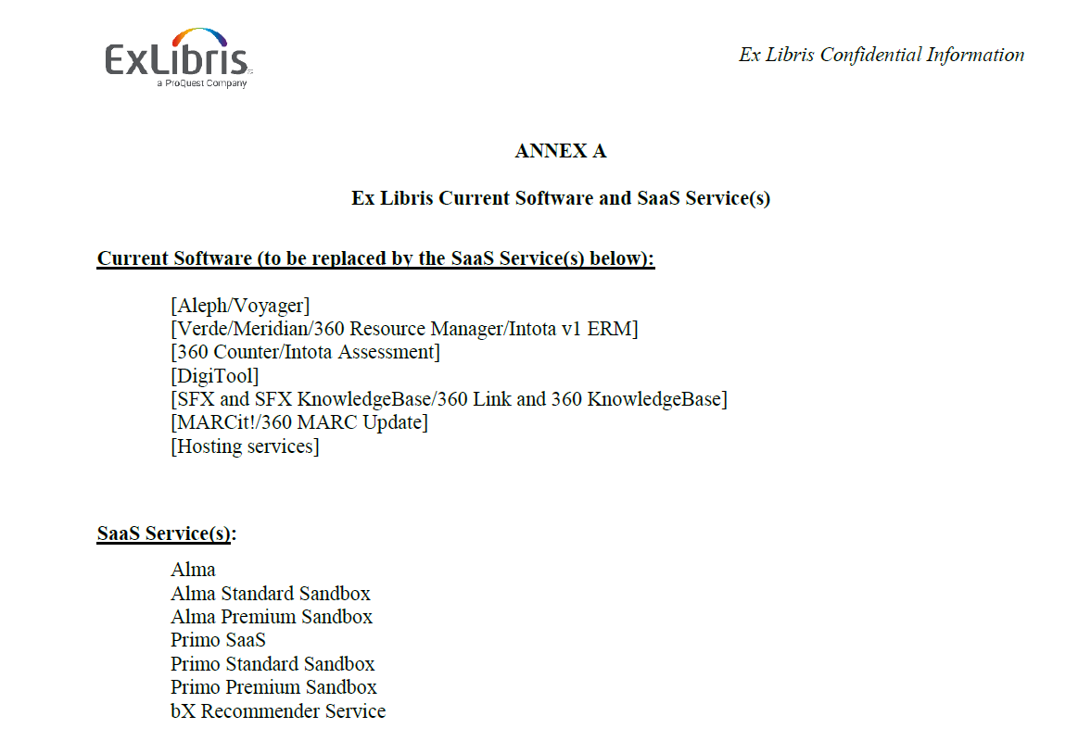
Proquest Umbrella Products
ExLibris contract includes 3-Month cost free availability of the following Proquest products:
360 Link
Summon
See p.43 of Master Agreement.
Replaced software/services defined in Annex A

Slide 28
EDS and Holdings Management Availability
EDS and Holdings Management/Full Text Finder available until end of September 2019.
Extension to contract for 15 months (which included an additional 3 months past contract) approved by SLC board on 2/1: see Board minutes online:
https://slcny.libguides.com/ld.php?content_id=40927577
Please review how you’ll transition from Aleph/EDS to Primo VE and the timeline to make sure you’re aware of how you’ll need to message to your campus stakeholders.

Slide 29
Why Would I Want to Keep Using EDS, 360 or Summon After Go-Live?
To reduce any disruptions to users, should test Alma/Primo before swapping out systems everywhere.
It may take some time to replace links, link resolver information, and other settings in related systems.
If you don’t want links to fail, plan to transition from current systems to new system over the course of a few weeks after go-live.

Slide 30
When will the last Discovery (EDS/Summon) Exports happen from Aleph?
May 31 – Group 1
June 7 – Group 2
June 14 – Group 3
June 21 – Group 4
For any resources that had custom catalogs, and are not available to activate via the CZ, campuses will want to determine how they are going to manage in Alma/Primo.

Slide 31
SUNY Staffing Planned to Be In Place During Cutover and Go-Live
At Cutover and Go-Live:
Kristy in role of Implementation Project Manager: FT
Heidi in role of Implementation Project Manager: .5 Time
Gail in role of Alma Sr. Support Specialist: FT
Shannon in role of Shared LSP Director: FT
Bill in role of Implementation Project Support: .2 Time
TBD Training Support: .2 Time
NZ Manager anticipated hire date May 2019: FT
Resource Sharing Program Mgr. anticipated hire date: April-May 2019: FT
OLIS support: .75 FTE (Maureen and Natalie)
2-3 Release Time Staff for Implementation Support: .4 FTE Total
7 FTE
and 13 individuals, all funded by OLIS

Slide 32
SUNY Staffing After Go-Live Through 2020
Kristy Implementation Project Manager: FT until 1/2020
Gail in role of Alma Sr. Support Specialist: FT
Shannon in role of Shared LSP Director: FT
Bill in role of Implementation Project Support: .2 Time
TBD Training Support: .15 Time
NZ Manager
Resource Sharing Program Mgr.
Discovery and Resource Management Program Mgr.
E-Resources Program Mgr.
1-2 Alma/Primo Support Specialists
8 Total FTE
in Place by 2020

Slide 33
What’s Coming Up in the Project
For Guided Path: we’re making e-resource migration consultation appointments beginning now until the end of January.
Consultations needed to approach P2E and Link Resolver Activation Forms/360 Link Strategy.
Banner Integration planned for first quarter of 2019; specific dates to be determined.
Resource Sharing configuration will begin rolling out more broadly in February 2019.
Need to plan for Primo Certification in the near future.

Slide 34
Alma Health Checklist
Use this as a guide to determine where you’re at with understanding Alma/Primo at your institution.
We should be further in recommended set up for some of the resource management areas early in 2019.
Assistance with acquisitions config. and training coming in 2019 as well.
Will need to fill out again before go-live.
https://slcny.libguides.com/healthchecklist

Slide 35
Questions and Reminders
Reminder of Deadlines:
January 9th Request for change in grouping.
January 11th Request for Fulfillment Cutover (Gap) Load
January 25th Alma Health Checklist.

