Slide 1

SUNY Library Shared Services Update
June 23, 2020
www.suny.edu

Slide 2
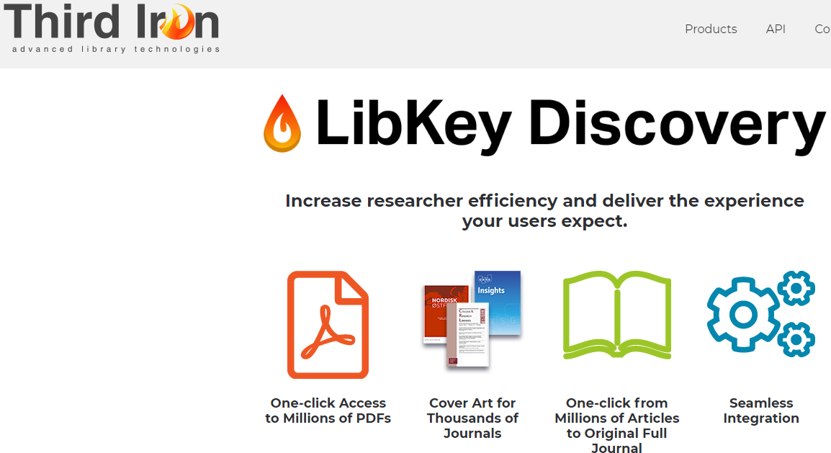
Libkey
Finalizing contract with vendor.
Will be removing configuration and shutting down campuses that will not be moving forward with Libkey.
  This may take a few weeks, and we’ll communicate with institutional leads.
  Ended with about 1/3 of SUNY subscribing to Libkey.
www.suny.edu

Slide 3
Follow Up on Repository Jobs Issue
    Met with ExLibris administration on 6/23 to review their response and discuss root cause.
    SUNY submitted a business impact memo that was reviewed by ExLibris.
    Root cause:
      Defect with activation jobs update in March/April that was released to help jobs restart and pick up where they left off. Defect instead made activation jobs continuously loop back to the beginning.
      ExLibris fixed issue on April 16th, but then found that we had a large backlog of Primo indexing.
        Several injections and enhancements to get through indexing backlog.
www.suny.edu

Slide 4
OCLC Agreement Update
We're waiting for final signature from SUNY, but this should be done this week before last year's amendment ends.
Reminder that all pricing remains at last year's rates.
Will be communicating soon about steps for OCLC agreement(s) going forward.

Slide 5
SUNY Library Accessibility Cohort
Cohort Members:
  Michelle Eichelberger and Shannon Pritting, SLSS
  Carli Spina, FIT
  Nazely Kurkjian, Sys Admin
  Andrea Kingston, Monroe CC
  Jennifer Whittaker, SUNY Canton
  Cara Howe, Upstate
  Barbara Scheibel, Onondaga CC
  Rebecca Oling, Purchase
  Laura Harris, Oswego
  Carlos Zamora, Albany
  Claire Payne, Stony Brook
www.suny.edu

Slide 6
SUNY Library Accessibility Cohort
Testing of cohort model for building and sharing expertise.
Major deliverable will be reviewing accessibility documentation, and developing a process for reviews for SUNY Library Accessibility Repository.
Training and group analysis of SUNY wide issues and opportunities related to accessibility will be what the group works on as well.
www.suny.edu

Slide 7
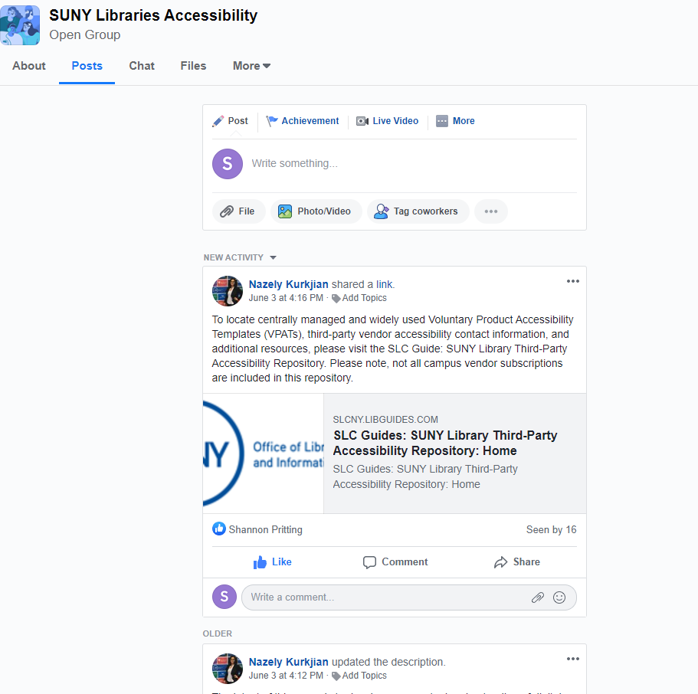
SUNY Library Accessibility Cohort Workplace Group
Open group for discussing SUNY Libraries Accessibility Initiatives:
  https://fb.me/g/6rySNz83J/onSV9THY

Slide 8
Support Update: the Highlights from June Meeting
Re
Review of variety of content issues
  SUNY will be working to escalate specific cases, and working with EXL to get more regular connections with content administration.
Review of Saved Searches letter
  Will need to escalate
Discussion of Gale linking issues.
Review of course reserves indexing issues.
  All but one iteration has a fix scheduled within the next few months. But, need to find another example for the case where the root cause couldn't be identified.
www.suny.edu

Slide 9
SUNY "Top 5"
ExLibris agreement with SUNY to identify top issues that support isn't able to work through, or priority development. Cases are:
  Title match is pulling wrong info. and sometimes wrong bib on link resolver page. (811103)
  Locate failure percentage high for RS requests. (835428)
  Recalculate rota assignment function not deleting original rota (844446)
  Ability to boost IZ results in Primo VE
  Provide the option to request print book if the library owns E (811103)
  Pop up shows when lender tries to check in item that borrower never received (709070)
Will be able to add another 1-2 issues in August/September.
www.suny.edu

Slide 10
Timeline & Testing
Status | Expected release | Issue
SUNY to test and provide feedback | 2020 July release | Addition of a pop-up when a lender tries to check-in an item that the borrower never received
SUNY to test and provide feedback | 2020 August release | Show RS request options where the library owns an ebook
Testing pending development | 2020 September release | Title match is pulling up wrong fulfillment information and sometimes wrong bib information on link resolver service page
Testing pending development | 2020 Q3 - Prioritized | High rate of lending locate failures for article resource sharing requests
Testing pending development | 2020 Q4 - Prioritized | Recalculate Rota Assignment
Once a design is ready, Ex Libris will share with SUNY | 2020 Q4 | Boost Institutional Search Results in Primo VE
Next meeting – August 17th ?

Slide 11
LSP Advisory Board Updates
  Thanks to founding members of LSP Task Force/Advisory Board:
    David Schuster, Binghamton
    Joe Riggie, Buffalo State
    Angela Rhodes, Morrisville
  Congratulations to new LSP Advisory Board Members:
    Nancy Babb, University at Buffalo
    Lauren Jackson-Beck, Potsdam
    Fatoma Rad, Farmingdale
  Jessica Olin, Genesee CC now is chair.
www.suny.edu

Slide 12
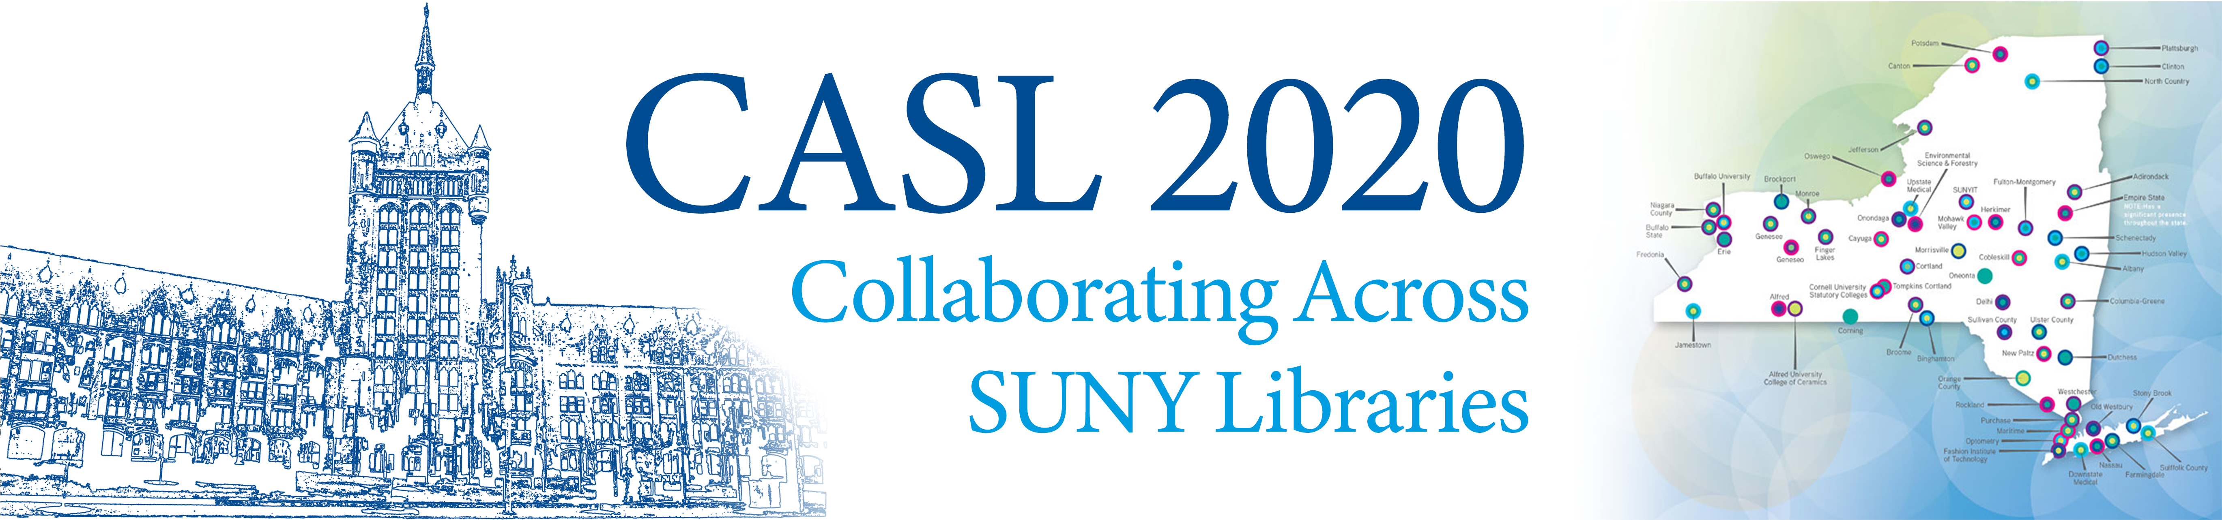
$35 per workshop
Financial assistance available to untenured librarians
July 7 – 17: Imagining a Truly Shared Collection for SUNY with Michael Levine-Clark
  Registration closes July 9th; form forthcoming. More info: https://public.3.basecamp.com/p/SjbY2tRafMcdLBCubrAoLPNd
August 3 – 17: Facilitated Leadership for Collaboration and Project Management with Galadriel Chilton
  Registration closes July 27th; more info and registration form: https://sunycpd.eventsair.com/casl/casl-info
www.suny.edu

Slide 13

Discovery & E-Resources
Updates
Michelle Eichelberger
www.suny.edu

Slide 14
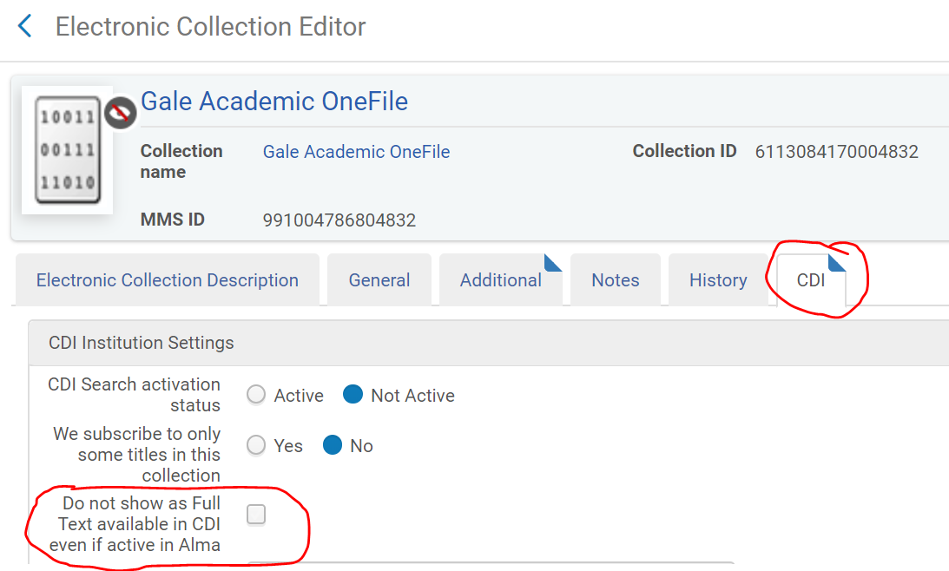
CDI and eBooks
eBook collections will now automatically show as search results because anything full-text is automatically searchable in CDI
Will give duplicate results in Primo: one record from Alma, one record from CDI
Will make eBooks show up in your article scope, which is based on active content in the CDI
You can control this:
  Make sure you have CDI Operator role
  Identify collection from the View Online link
  Look up collection in Alma, edit collection, go to CDI tab, and put a checkbox in "Do not show as Full Text available in CDI even if active in Alma"
  Will take 48-72 hours to apply
www.suny.edu

Slide 15
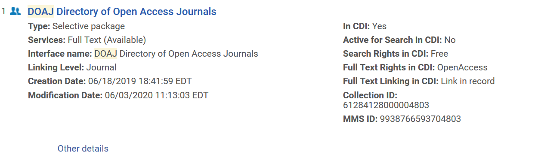
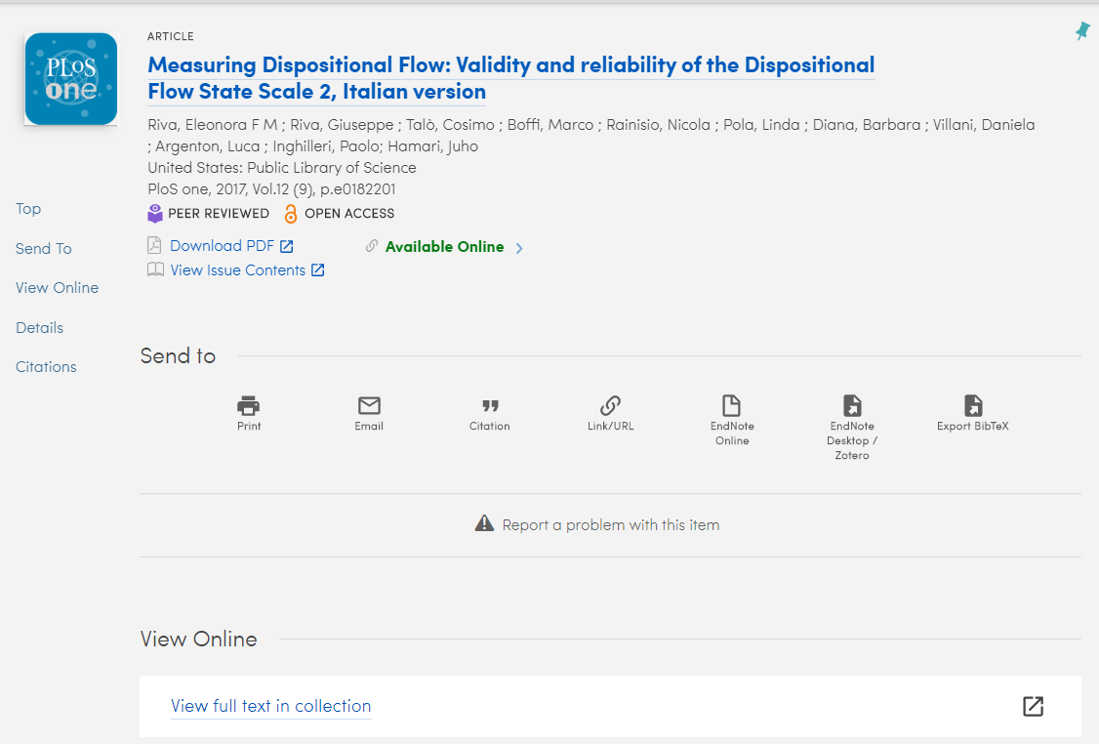
Selected CDI Known Issues
July release: Open Access "Link in Record" links are currently preferred in CDI results. This will be changed so that links to subscription content are prioritized.
Missing collection names
Problems with resource types, local portfolios, availability
https://knowledge.exlibrisgroup.com/Primo/Content_Corner/Central_Discovery_Index/Documentation_and_Training/020Your_Move_to_CDI/Known_Gaps_and_Issues
www.suny.edu

Slide 16
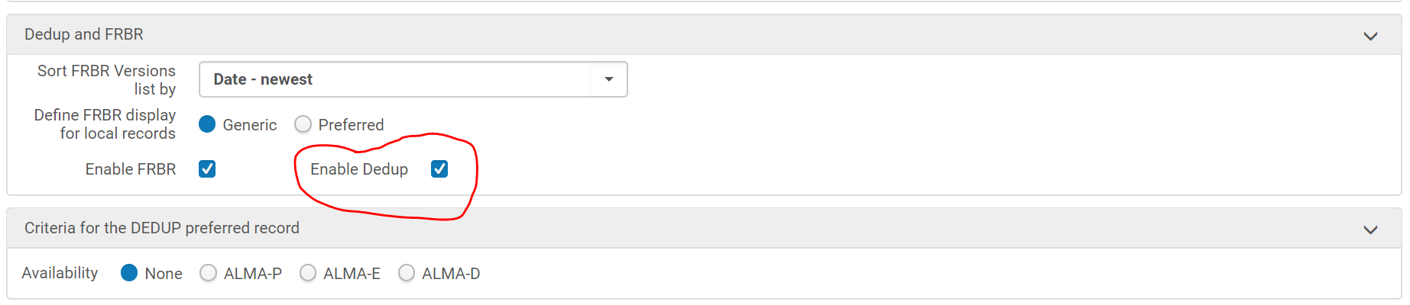
Salesforce Cases about Linking
00852380: Disappearing View Online links (BUF, BRO, OSW, COB) - escalated
Temporary fix: uncheck "Enable Dedup" box in Discovery->Configure Views->Brief Results, scroll to bottom
www.suny.edu

Slide 17
Salesforce Cases about Linking, cont.
00847235: Direct linking not working for Unpaywall and NZ activated content
00850889: Links to Sciencedirect content going to other packages like OVID (probably DOI related)
00850884: View Online links not showing until you refresh page (indexing problem – need to report to EL for fix)
00850455, 00847128: Gale linking problems
00845875: CDI Metadata causing bad linking
www.suny.edu

Slide 18
Primo July Release
Duplicating a view resulted in a corrupted current customization package. This has been fixed.
Searches with and without apostrophes returned different results. This has been fixed.
Creation date was not consistent with facet. This has been fixed. - Published case 00672095: "The Publication/creation search section should ONLY use the field 100$a/9-12 and not the field 100$a00-03"
Facets failed when specific searches contained asterisks and quotation marks. This has been fixed.
Saved Searches Alert failed to send emails. This has been fixed.
https://knowledge.exlibrisgroup.com/Primo/Release_Notes/002Primo_VE/2020/010Primo_VE_2020_Release_Notes
August Sneak Peek:
Increase the maximum number of local fields to 100
Configuring local resource types - Add more conditions to allow the resource type to be determined by multiple fields
Enhance Purchase Request Form - Add indication when library already holds the item being requested
www.suny.edu

Slide 19
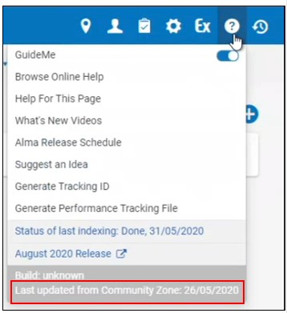
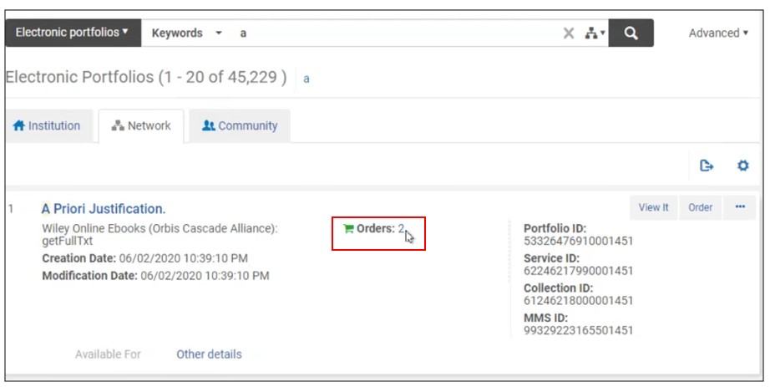
E-Resources July Release
CZ update date added to Help Menu
Skipped jobs: "The status of jobs that need to be skipped was changed to 'Skipped'. Previously, the status of these jobs was indicated as 'Failed', which was misleading."
"In a Collaborative Network where electronic resources are managed centrally in the Network Zone and the orders are managed in the individual Institution Zones, institutions can order electronic collections or portfolios managed in the NZ."
www.suny.edu

Slide 20
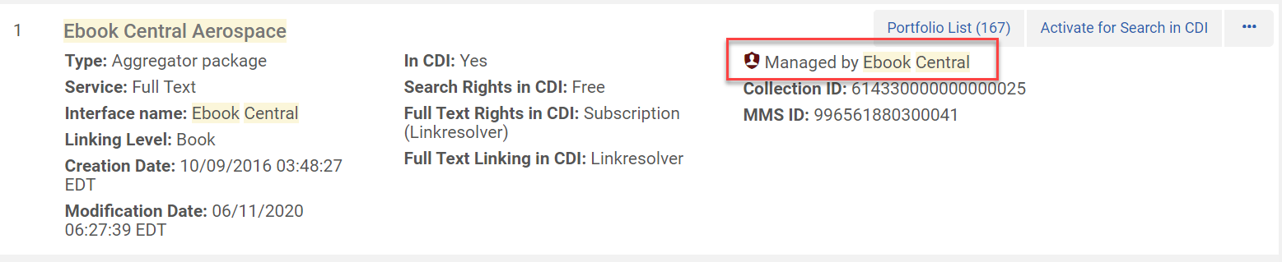
Provider Zone
ProQuest Books, IEEE and SAGE will continue to gradually take ownership of additional collections in the Alma Community Zone.
Will still submit Salesforce cases if data is bad, but vendor has to fix
https://knowledge.exlibrisgroup.com/Alma/Content_Corner/Release_Notes/2020_Alma_CKB_Release_Notes
www.suny.edu

Slide 21
SUNY Shared Collections Updates
Esta Tovstiadi
www.suny.edu

Slide 22
Want Some Help in Reviewing What to Cut?
SLSS is offering a service to assist you with identifying cuts in your collections.
Send us a request via libanswers (info@slcny.libanswers.com), and we'll work with you to help make the best decisions on resources that can be cancelled to meet demands for budget cuts.
Will need administrative logins (for usage data), a spreadsheet or other information about resources, target percentage for cuts, and any other relevant information.
We'll do as many of these consults as we can.
Please give us at least 3-4 days advance notice before any deadlines/meetings you have.
www.suny.edu

Slide 23
Resource Sharing Update
Timothy Jackson
www.suny.edu

Slide 24
Alma Article Resource Sharing
Article resource sharing is available for low volume libraries who need a cost-effective alternative to ILLiad/OCLC resource sharing
9 SUNY libraries currently borrowing articles in Alma
  4 additional SUNY libraries currently testing article borrowing
  Email timothy.jackson@suny.edu if your library would like to test Alma article RS
9 libraries currently lending (Albany, Binghamton, Buffalo, Stony Brook, Fredonia, Oswego, Purchase, Upstate Medical, Empire State College)
Improvements to article delivery workflow expected in August 2020 release
  Current workflow requires borrowing staff to manually forward PDF email attachments to users
  New workflow should allow users to receive email with download link direct from lending library
www.suny.edu

Slide 25
Alma Physical Resource Sharing
SLSS monitoring Empire Library Delivery restart requests
If you want ELD service to resume at your library, please be sure to request a restart date via ELD Service Restart Date Survey
  https://docs.google.com/forms/d/e/1FAIpQLSfDM2EW8jyCdWcaz27JB4IAK_qGspzN4KwKGOm5UfnvgHFrmA/viewform
SLSS will reach out to you about Alma RS once your restart date is "Pending"
Alma physical resource sharing will resume once we have enough lenders to assure good service
  Current plan: 2 university centers and at least 8 other libraries
  1 university center and 4 other libraries will be able to lend by the end of June
Toolkit containing information on handling materials during COVID-19 pandemic will be available soon
www.suny.edu

Slide 26
Alma Resource Sharing Beyond SUNY
Alma RS fill rates are still low (60%), and some SUNY libraries plan to stop using ILLiad/OCLC, so expanding access to materials via Alma RS is a major goal
Working with Union College on physical resource sharing in Alma
  Also having discussions with Ithaca College, St. John Fiser College, Nazareth College, Canisius College
Working with MnPALS and CSCU systems on possibility of article resource sharing in Alma
Having conversations with CUNY about Alma RS
www.suny.edu

Slide 27
Temporary SLC Resource Sharing Policies
Temporary Policies:
  All RS loans have 16 week loan period with three renewals
  Users can return items to any SUNY campus
  Walk-in borrowers can submit resource sharing requests
Expire on July 31, 2020, but ASRS working group has proposed extension until July 31, 2021 (still needs to be approved by SLC)
ASRS is investigating the possibility of implementing a Fulfillment Network for SUNY
  Would allow users to pick up and return items at any SUNY campus
  Major change that will require a great deal of testing and feedback from campuses
  Ex Libris providing assistance with testing
www.suny.edu

Slide 28
Returns from Other SUNYs
If a user from another SUNY returns an item to your library, please use this form to provide SLSS with the item barcode
  https://slcny.libwizard.com/f/othersuny
FAQ of libraries accepting returns
  https://slcny.libanswers.com/faq/302298
Please keep SLSS informed of your library's ability to accept returns
  https://slcny.libwizard.com/f/returns
www.suny.edu

Slide 29
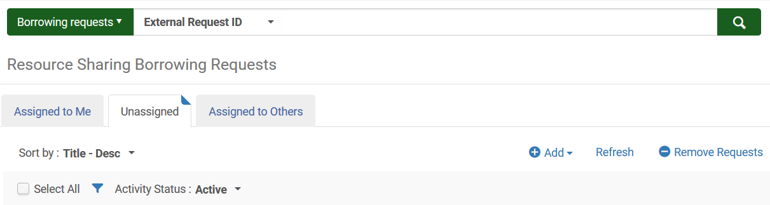
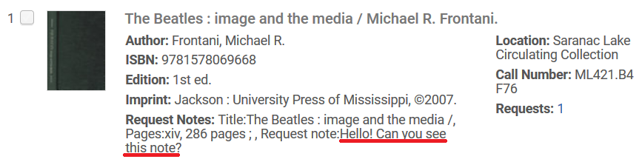
Recent Resource Sharing Updates
Request searching function has been folded into Alma's regular searching function
Request notes now appear in Pick From Shelf list and on pull slips
July 2020 release will include warning message when a lender is about to accidentally complete a request!
www.suny.edu

Slide 30
Network Zone
Maggie McGee
www.suny.edu

Slide 31

SUNY Local Subject Headings Initiative Update
SUNY Local Subject Heading Initiative to change the LCSH "illegal aliens" to "undocumented immigrants" and "aliens" to "immigrants" in Alma/PrimoVE:
  Phase 1: Display Normalization rules implemented on June 19, 2020
    Only impacts the display of Library of Congress subject headings (LCSH)in PrimoVe for records originating in Alma
    It does not impact CDI bibliographic records
    Subject headings need to be searched using the LCSHs
www.suny.edu
Notes:
Good attendance and engagement for all sessions. A successful switch to registration-based training, which makes it easier to communicate with and count participants.

Slide 32
SUNY Local Subject Headings Initiative Update
SUNY Local Subject Heading Initiative to change the LCSH "illegal aliens" to "undocumented immigrants" and "aliens" to "immigrants" in Alma/PrimoVE:
  Phase 2: Implementation of Alma Normalization Rules to change the LCSH at the IZ level
    Impacts the metadata of IZ only physical bibliographic records
    Updates all IZ integration and import profiles' normalization rules to change the LCSH to SUNY local subject heading for physical bibliographic records
    CZ bibliographic LCSH are not impacted, but display norm rules are applied
    CDI records are not impacted
    IZ only physical bibliographic records can be searched in PrimoVE by the SUNY local subject headings
    May include other configurations of the full record display in PrimoVE
www.suny.edu
Notes:
Good attendance and engagement for all sessions. A successful switch to registration-based training, which makes it easier to communicate with and count participants.

Slide 33
SUNY Local Subject Headings Initiative Update
SUNY Local Subject Heading Initiative to change the LCSH "illegal aliens" to "undocumented immigrants" and "aliens" to "immigrants" in Alma/PrimoVE:
  Phase 3: Implementation of Alma Normalization Rules to change the LCSH at the NZ level
    Impacts the metadata of NZ physical bibliographic records
    Updates the NZ OCLC integration profile normalization rules to change the LCSH to SUNY local subject heading upon import from OCLC
    Updates NZ integration/import profiles using the SUNY Norm rule upon import
    CZ bibliographic LCSH are not impacted, but display norm rules will be applied
    CDI records are not impacted
    IZ and NZ physical bibliographic records can be searched in PrimoVE using the SUNY local subject headings
www.suny.edu
Notes:
Good attendance and engagement for all sessions. A successful switch to registration-based training, which makes it easier to communicate with and count participants.

Slide 34
SUNY Local Subject Headings Initiative Update
SUNY Local Subject Heading Initiative to change the LCSH "illegal aliens" to "undocumented immigrants" and "aliens" to "immigrants" in Alma/PrimoVE:
  Resources:
    SUNY "Change the Subject Project" libguide
  Configuration Questionnaire:
    Full Record Display Configuration Questionnaire
www.suny.edu
Notes:
Good attendance and engagement for all sessions. A successful switch to registration-based training, which makes it easier to communicate with and count participants.

Slide 35

MARC 264 _4 $c Copyright Display in PrimoVE
The NZ bib records that contain MARC 264 _4 $c have been updated to copy the field to MARC 976
  Creation date display norm rules use a Rota approach to populating the Creation date in PrimoVE's full record display
  A local field is required to allow the display of the Copyright date originating from MARC 264 _4 $c in addition to the Creation date
  Local MARC 976 needs to be configured at the NZ and IZ to impact display of MARC 264 _4 $c
    IZ optional
  The configuration of Local MARC 976 can be incorporated as part of Phase 2 of the SUNY Local Subject Heading Initiative
www.suny.edu
Notes:
Good attendance and engagement for all sessions. A successful switch to registration-based training, which makes it easier to communicate with and count participants.

Slide 36
Alma July 2020 Release Notes
Acquisitions:
GOBI API Real-Time Orders will match to the CZ
  In cases where Alma does not find a matching portfolio in the relevant Community Zone collection or if the relevant collection was not activated in the institution, a stand-alone portfolio will be created in Alma will not be linked to a Community Zone portfolio.
Change the Owner for an invoice after it has been edited
Creation of Several Itemized Sets From File in Parallel
  Multiple itemized sets can be created at the same time
www.suny.edu
Notes:
Good attendance and engagement for all sessions. A successful switch to registration-based training, which makes it easier to communicate with and count participants.

Slide 37
Alma July 2020 Release Notes
Network Zone:
Local sets can now be saved in the NZ
  The Save in Network action was added to the Manage Sets page
  This is useful in use cases where a set can only be built in the Institution Zone because the query uses search criteria from either localized fields in the bibliographic record or from the inventory (holdings, items, portfolio, etc.)
  NOTE: Normalization rules cannot be run on Network Zone bibliographic records from within the Institution Zone, since non-localized fields in the Network Zone bib records cannot be changed from within an Institution Zone
www.suny.edu
Notes:
Good attendance and engagement for all sessions. A successful switch to registration-based training, which makes it easier to communicate with and count participants.

Slide 38
Alma July 2020 Release Notes
Resource Management
MARC 21 have been updated for bibliographic, authority, holdings, classification, and community information formats from the Library of Congress (LOC)
Manage selected physical items display the links in a drop-down menu called "Managed Selected." Add Items is still displayed as a link and not included in the drop-down Manage Selected list
www.suny.edu
Notes:
Good attendance and engagement for all sessions. A successful switch to registration-based training, which makes it easier to communicate with and count participants.

Slide 39
New Metadata (MD) Editor
10 volunteer members from SUNY libraries make up the New MD Editor testing team. The team will:
  Test the New MD Editor's current functionality
  Test new functionality as it is released
  Open and track cases with Ex Libris when appropriate
Resource Management Training will be schedule for Fall 2020
  The Resource Management Training libguide will be updated to include the New MD Editor's workflow to be used in conjunction with training
New MD Editor Libguide
www.suny.edu
Notes:
Good attendance and engagement for all sessions. A successful switch to registration-based training, which makes it easier to communicate with and count participants.

Slide 40
Training Update
Jennifer Koerber
www.suny.edu

Slide 41
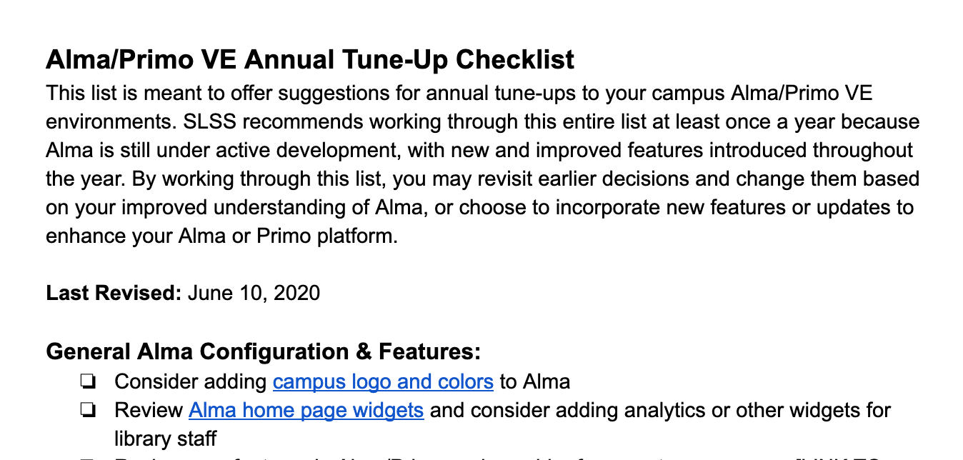
Annual Alma & Primo "Tune Up"
https://slcny.libguides.com/annual-checklist
www.suny.edu

Slide 42
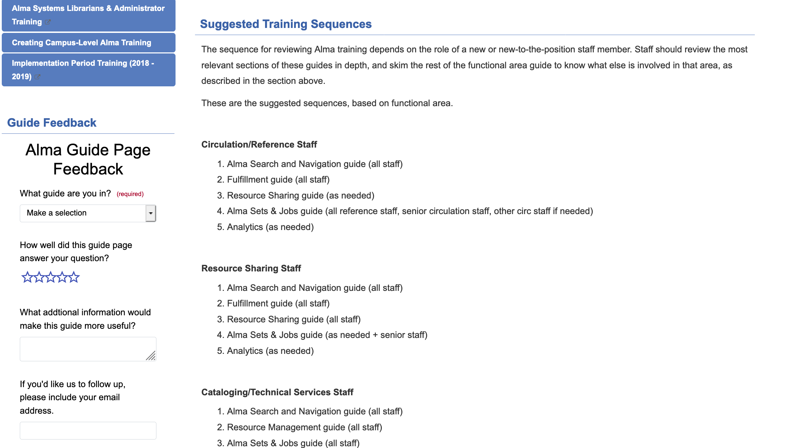
www.suny.edu

Slide 43
Implementation & Go-Live Training Wrap-Up
Training & Documentation Materials
Training Sessions
Alma & Primo VE Training Guides:
https://slcny.libguides.com/lsptraining
SLSS FAQs:
https://slcny.libanswers.com/
Local/Campus Documentation & Training:
https://public.3.basecamp.com/p/JPL8a7pseBKYzqv3hpTinzsm
Basecamp Brief Users' Manual:
https://slcny.libguides.com/basecamp
Webinars & Presentations
  More than 100 training webinars since go-live
  Café Alma Online Learning Circles
  https://slcny.libguides.com/cafealma
In-Person Trainings
  Analytics (November)
  Remainder moved online due to COVID-19
Online Courses
  E-Resources (March/April)
  Fulfillment Configuration (May)
  Acquisitions (June)
www.suny.edu

Slide 44
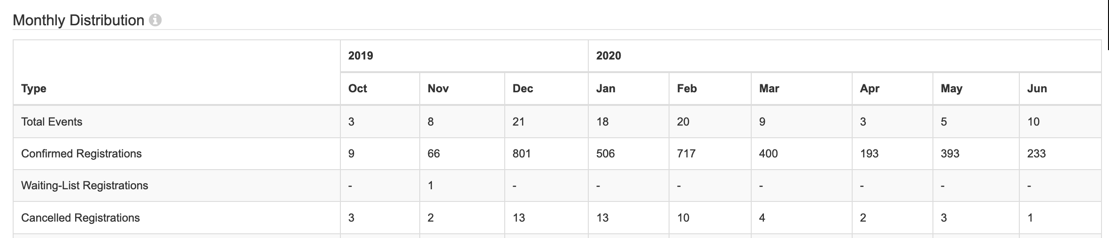
SLSS Webinars, October 2019 – June 2020
www.suny.edu

Slide 45
Training Transitions
Will continue to focus on maintaining FAQs and other documents.
Timely webinars on using Alma at point of need or covering new features/changes.
  Examples are recent series on cancellations and FY rollover.
Based on feedback from 4-week sprints, will be developing cohorts.
  Accessibility cohort happening now; currently planning others.
Training may also include courses with registration and fees, as we've received positive feedback on these experiences.
Development of more flexible Q and A in specific areas.
Maintain development of "persona" based guides for self-directed learning.
www.suny.edu

Slide 46


Questions or Discussion?
www.suny.edu

