Slide 1
LibGuides Accessibility Best Practices
October 7, 2021
Michelle Eichelberger
www.suny.edu

Slide 2
Plan for Today
Review Best Practices for:
Links
Content
Styling
SortSite Service
www.suny.edu

Slide 3
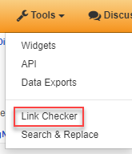
Links
May not be considered traditional accessibility topic, but broken links mean no one can get to your content.
Best Practices:
Use “add link” functionality rather than adding links in rich text. LibGuides has link checker tool that can help you stay on top of bad links.
Can sometimes get false positives for broken links, but you can “add to exclusions” in the LibGuide report and it’ll stop checking them
Other benefit of adding content as link item is that you can reuse links and then only have to change them once if they need to be updated
www.suny.edu

Slide 4
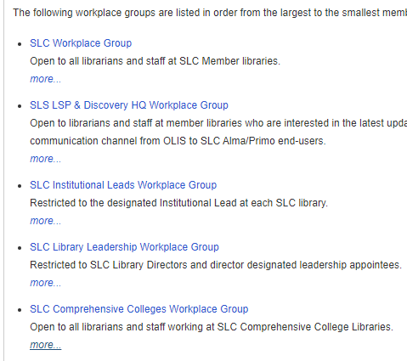
Links, cont.
Best Practices:
Open link in same window: easier to navigate with screenreader than if new window pops up. LibGuides default is new window.
Don’t use vague links like “more” – put the link on the thing that it’s going to. Note that LibGuides extra description will end up behind “more” link, along with Librarians page links
Don’t use URL as the link name unless you have to – awkward for screenreader to read
www.suny.edu

Slide 5
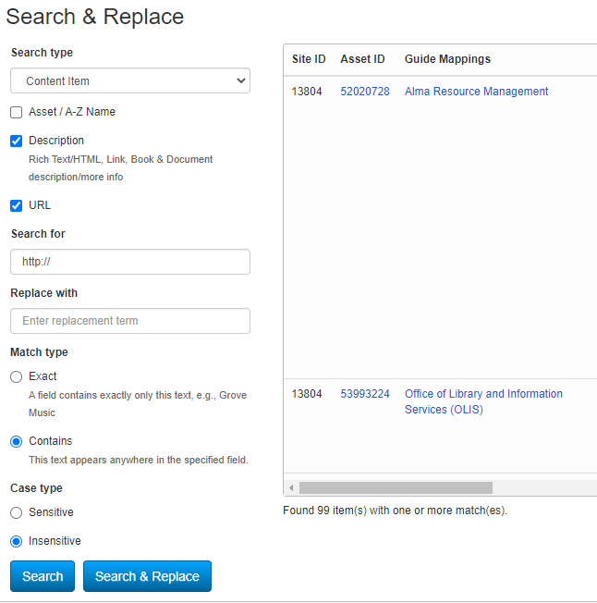
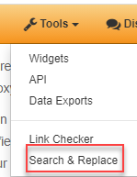
Links: Search and Replace
Good way to find content on site in rich text, link descriptions, images, etc.
Best Practices:
Use “Search” before replacing anything. Can use search to identify problems and fix manually.
Check for links with http:// instead of https://
Search for links to Aleph: e.g. https://dut.sunyconnect.suny.edu
www.suny.edu

Slide 6
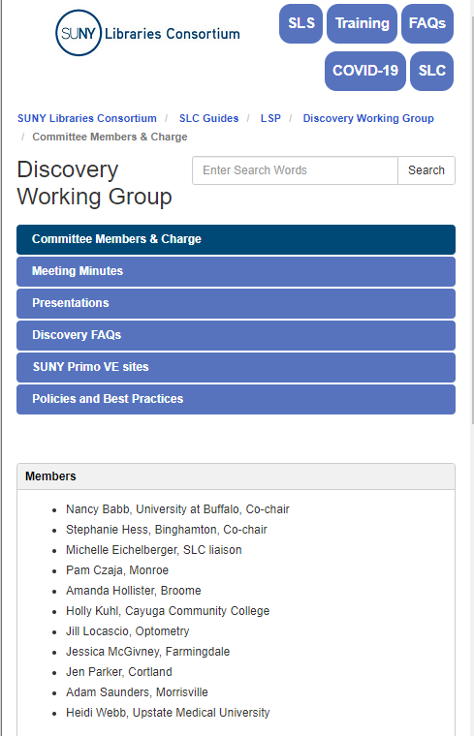
Content
Best Practices
Try to keep page length not too long, so that users don’t have to do a lot of scrolling to find the information that they need.
Think about how content will look on various devices and try to be concise. LibGuides is responsive, and you can resize browser to see how content will scale.
Use clear, non-jargony language and as few acronyms as possible.
www.suny.edu

Slide 7
Copying and Pasting
If you’ve already got documentation on something, or if you find information online that you want to copy, it’s tempting to copy it directly into LibGuides. BUT, this can introduce bad code that interferes with your site defaults for font and style and creates a lack of site cohesion.
Best Practices
Use Ctrl-Shift-V to paste without formatting, or paste content into Notepad and then copy from there to get clean content
If you don’t want to lose links or other formatting, you can paste into LibGuides and then use View Source to either manually clean up code or copy it into Notepad and use find and replace to clean it up
www.suny.edu

Slide 8
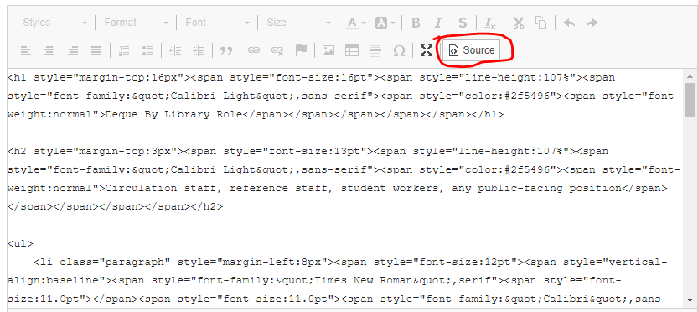
Copying and Pasting, cont.
Can bring in ids or css classes from other sites that won’t be applied in your environment:
www.suny.edu

Slide 9
Copying and Pasting: Spaces
One thing that can happen when you copy and paste content is that you might end up with &nbsp; in place of spaces. This is formatted as a space on the screen, so you probably wouldn’t notice unless you look at the code, but it can cause spelling errors or reading errors for screenreaders, and it can throw off your layout.
Best Practices
Take a quick look at your source code to see if there are any &nbsp; that should be replaced with a space.
www.suny.edu

Slide 10
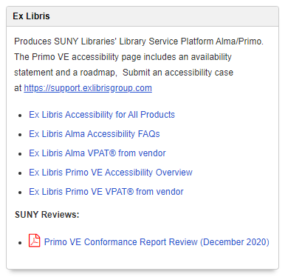
Documents
Best Practices
It’s better to link to docs/pdfs on external sites than put them in libguides
You're responsible for accessibility of anything in libguides, and Word and PDFs take work to make accessible
You’ll need to remember to check for new editions of content
It’s good to have content in page rather than in doc that patron navigate away from your site to open. Less clicking = good
www.suny.edu

Slide 11
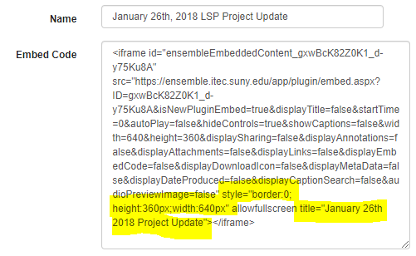
Media
Best Practices
If you want to embed a video or other media on a page, it’s best to use the add media object/widget so that you can easily keep track of your media type content
iframe and frame elements must have a title attribute
It's good to also update any outdated styling, like height="350" instead of style="height:350px;"
www.suny.edu

Slide 12
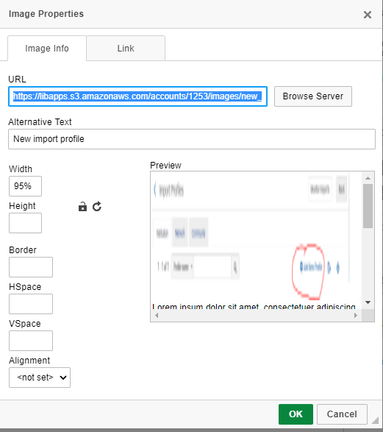
Images
Best Practices
Load image into LibGuides instead of pasting: good reminder to add alt text and use responsive design
Responsive design: try not to hard code image height and width because it won’t scale to be used on small devices. Instead, use width as a percentage with no height, or figure out code to change image if page is accessed on a phone or tablet
Alt tags: give enough information to describe the image, don’t include words like “example of,” “image of,” “picture”. Decorative images can use single space in alt-text box.
www.suny.edu

Slide 13
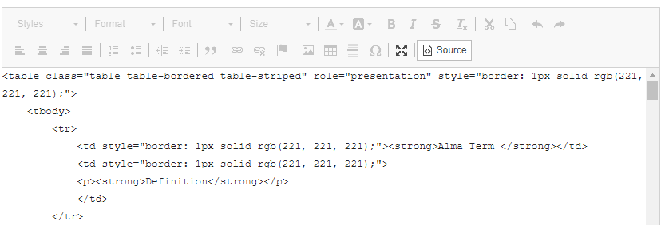
Tables
Best Practices
Identify row and column headers in data tables using th (table header) elements, and mark layout tables with role=presentation.
Use divs for layout where possible
www.suny.edu

Slide 14
Forms
Best Practices
Form fields need labels
For more information, see https://www.w3.org/WAI/tutorials/forms/labels/
www.suny.edu

Slide 15
Style & Color
Best Practices
Don’t use underlines for emphasis – people expect links
Make sure that you’re selecting the whole word for styling. If you miss a letter and then style that separately, it can do weird things for spelling for screenreaders.
Fix deprecated code: <b>, <i>, align=, border=, cellpadding=, cellspacing=, font=, width=, height=. W3schools has helpful info about how to style correctly with css
Ensure that text and background colors have enough contrast.
www.suny.edu

Slide 16
SortSite Service
What is it?
SLS staff will run your site through SortSite accessibility checking software
We’ll identify fixable errors found in the report and offer suggestions on how to fix them
We’ll rerun the report a limited number of times to help you track improvements
www.suny.edu

Slide 17
Resources
SLS Best Practices for Web Design
Wave Browser Plugin
American Foundation for the Blind Screenreader List
Deque University
www.suny.edu

