Slide 2
NC AHEC Overview
This slide deck can be used as an orientation tool for new staff or as a helpful resource for staff who want to learn more about other areas within NC AHEC.
For presentations with partners, check out About NC AHEC

Slide 3
NC AHEC
The mission of the NC AHEC Program is to provide and support educational activities and services with a focus on primary care in rural communities and those with less access to resources to recruit, train, and retain the workforce needed to create a healthy North Carolina.
Our vision is a state where everyone in North Carolina is healthy and supported by an appropriate and well-trained health workforce that reflects the communities it serves.
3

Slide 4
NC AHEC MAP

Slide 5
NC AHEC – CORE STRATEGIES
NC AHEC provides and coordinates services and support to achieve our results.
Recruit
Train
Retain
To ensure an appropriate supply of trainees/students to pursue health careers, particularly those who reflect their communities
To encourage health professions trainees/students and healthcare professionals to practice in interprofessional and primary care settings in rural and under-resourced communities
To retain the health workforce with a focus on the diversity of providers, interprofessional teams, and primary care settings in rural and under-resourced communities
5

Slide 6
NC AHEC – ORIGINATION
NC AHEC evolved to leverage NC’s medical schools and community hospitals to respond to national and state concerns with the supply, distribution, retention, and quality of health professionals
A national focus on the health care workforce coincided with a growing effort in NC to establish statewide community training for health professionals and to reverse a trend toward shortages and uneven distribution of primary care physicians in the state’s rural areas.
Interview with Dr. Cutchin on AHEC’s History
The NC General Assembly approved and funded a plan to create a statewide network of nine AHEC regions in partnership with NC medical schools and community hospitals.
The NC AHEC Program began in 1972 with three AHEC regions under a federal AHEC contract with the UNC Chapel Hill School of Medicine.
By 1975, all nine AHECs were operational.
1970s
1972
1974
1975
There are AHECs across the country in other states- to find out more about national efforts visit NAO
6

Slide 7
REGIONAL AHECS – GOVERNANCE & EXPENDITURES
AHEC | 501(c)(3) or Contractual Agreement
Area L | 501(c)(3)
Eastern | 501(c)(3)
Piedmont | Moses H. Cone Memorial Hospital
Mountain | 501(c)(3)
Northwest | Wake Forest University Health Sciences
South East | Novant Health New Hanover Regional Medical Center, LLC
South Piedmont | Wake Forest University Health Sciences/Atrium Health
Southern Regional | 501(c)(3)
Wake | WakeMed
Duke AHEC Program Office | Supports Southern Regional AHEC
7

Slide 8
NC AHEC PROGRAM – STATE FUNDING EXPENSES, FY23
Total NC AHEC Expenditure = $48,730,103
8

Slide 9
Operating More Like A System
Define the use of state funds: 5-year operating contract
Define the work: Annual Work Statement
Measure the work: Performance Measures
Improve the work: RBA and our Strategic Plan
Align finances and the work: Unallocated funds & Budget Guidelines
This positions us to:
respond to opportunities
understand gaps and opportunities for alignment and efficiency
demonstrate need for additional funding
FY23-25
Strategic Plan

Slide 10
Infusing Results-Based Accountability (RBA) Concepts in NC AHEC
The NC AHEC Strategic Plan adopted Results-Based Accountability as our framework to translate strategies into program results.
RBA teaches there are two types of accountability: population accountability and performance accountability. Being accountable for the performance of our programs is our direct responsibility. We use data and disciplined thinking to tell how much we do, how well we do it, and most importantly, if anyone is better off from the service(s) we provide.
RBA “turn the curve thinking” ensures accountability for the performance of our programs and demonstrates our contribution toward achieving the NC AHEC population result: “Everyone in North Carolina is healthy and supported by an appropriate and highly competent health workforce that reflects the communities it serves.”
Each AHEC and the Program Office have at least one certified RBA professional as their in-house resource.
Notes:
Claire
What is RBA?
RBA is a straightforward method of measuring impact that starts with the aim in mind and works backward to the means. It is a method of thinking and doing that can be used to enhance the lives in communities, cities, counties, states, countries, and program performance.
RBA was developed by Mark Friedman and described in his book Trying Hard is Not Good Enough.
RBA is being used in all 50 States and in more than a dozen countries around the world to create measurable change in people’s lives, communities, and organizations.
Give examples of who using it
Where is RBA being used in North Carolina?
SHA -SHIP
CHA-CHIP-SOTCH
Strategic Plans
Hospitals/health systems beginning to use it in their community health improvement work
Funders

Slide 11
NC AHEC – CORE SERVICE LINES
NC AHEC weaves through all sectors of health care education and workforce.
Health Careers & Workforce Diversity
Student Services
Graduate Medical Education Support
Continuing Professional Development
Practice Support
Library Services
11

Slide 12
HEALTH CAREERS & WORKFORCE DIVERSITY

Slide 13
Health Careers & Workforce Diversity
Training starts early with NC AHEC.
K-12th grade students, particularly from racially and ethnically diverse, rural, and under-resourced communities, are exposed to various health professions allowing them to consider those professions as possible future careers.
Upon graduation from the AHEC Scholars Program, students enter the health workforce, preferably in NC and in a rural and/or under-resourced community
13

Slide 14
Highlights from Health Careers & Workforce Diversity
in 2023
In 2024
Launched NC AHEC Pathways to Maternal Health Careers Summit in collaboration with Maternal Health Innovation (MHI) team in NC DHHS’s Women’s Health Branch
HCWDEI team successfully developed and executed core Statewide Common Core Curriculum delivery for AHEC Scholars
AHEC Scholars curriculum for 8 HRSA core topics was delivered virtually
Pathway program efforts were showcased in the North Carolina Medical Journal (NCMJ with a key emphasis on the Perinatal Workforce Pipeline
Statewide AHEC Scholar Didactic conference in February 2024 will provide a distinct opportunity for all regional AHEC Scholars to convene to obtain 20 didactic contact hours, network, and learn from content experts to elevate our common statewide experience
Actively working to add Community Health Workers in response to HRSA requirement that AHECs support the capacity to develop CHWs and other professionals to address social determinants of health
NC AHEC

Slide 15
STUDENT SERVICES

Slide 16
Student Services
NC AHEC supports students, clinical instructors, preceptors, and health science schools.
16
NC AHEC

Slide 17
Definitions of Student Services Activities
AHEC student housing – started in the 1980s to make community training sites more accessible to health science students on clinical rotations. AHEC housing is open to all health science students, but preference is given to students from affiliated partners (below).
Affiliated Academic Partners (for housing purposes) – in-state four-year health science schools that have elected to pay for their students’ use of housing at a lower rate (currently $7 night).
AHEC Consortium for Clinical Education and Practice (CCEP) - formed in 2008 by Wake AHEC to streamline and enhance the clinical placement process for health science students in NC. (note: CCEP is not gatekeeping, it does not decide where or when students are placed but simplifies the process for schools and sites to follow)
Interprofessional education (IPE) - two or more professions (students, residents and health workers) learn with, about, and from each other to enable effective collaboration and improve health outcomes
Interprofessional education and practice (IPEP) - occurs when multiple health workers from different professional backgrounds work together with patients, families and communities to deliver the highest quality of care.
Onboarding – the processes in which new participants are integrated into an organization including various types of clinical learning experiences and credentialing components
Gatekeeping - when all student placements for a site processed/scheduled through a central person/organization
Preceptor Development – educational activities for health care practitioners to develop their teaching skills (adult learning principles, giving/receiving feedback, evaluation & grading, conflict resolution, etc.)
Preceptor recognition/appreciation – activities that recognize or show appreciation to providers who teach students, such as awards, plaques, appreciation dinners, etc.
Other Related Definitions:
Community precepting: Refers to teaching students “off campus” away from an academic center and could include both outpatient and inpatient sites.
Preceptor: Any healthcare provider (nurse, physician, physician assistant, pharmacist, allied health professional….) who teaches a student(s) at their practice setting.
Preceptor site (also referred to as clinical training sites or teaching sites/practices): Refers to the setting where a preceptor is based.

Slide 18
Student Services Initiatives
Nursing Grants/Awards/Partnership Allocations
Clinical Site Development: Develop training sites in priority settings and communities for both pre licensure and graduate nursing. Over 400 grants provided since 1989 legislation.
Educational Mobility Nursing Grants/Awards/Partnership Allocations: Support Licensed Practical Nurses and/or Associate Degree RNs in obtaining a higher degree (BSN+). Over 2,000 students support since 1989; primarily two schools in the last decade; re-prioritizing in current FY.
Behavioral Health Supervision
Provides funds for supervision of psychiatry residents & fellows
AHEC Student Housing
Provides 52,000 nights of short-term lodging annually for students completing clinical rotations in 51 counties across NC.
Faced with an ever-changing healthcare environment and increased pressures to see more patients, community providers are also valued teachers (or preceptors) of our future healthcare workforce. They provide a real-world experience not found on-campus.
Consortium for Clinical Education and Practice (CCEP)
Formed in May 2008 (originally called The Triangle Clinical Consortium) to identify, prioritize and address clinical placement issues for nursing students in the Triangle Region of North Carolina.
Now statewide, clinical and academic partners meet regularly to address undergraduate nursing clinical capacity issues, facilitate placement of nursing students in the region, and standardize the credentialing process.
Interprofessional Education and Practice
Efforts to prepare the health care workforce to work collaboratively

Slide 19
Nursing Partnership Allocations
Clinical Site Development (CSD)
Open to nursing programs in NCCCS, UNC System, and NCICU
Focus on developing clinical sites for prelicensure or graduate nurses in priority areas
Educational Mobility
Open to UNC System nursing schools only, encouraged to partner with a community college
Focus on mobility from LPN/ADN to BSN or LPN/ADN/BSN to MSN, DNP/PhD
Nursing Clinical Instructor Partnership (CIP) Program
Open to nursing programs in NCCCS, UNC System, and NCICU
Focus on developing academic-practice partnership for the role of CIP
For all allocations:
Regional AHEC nurses and PO work with faculty to develop proposals that meet priorities.
Proposals are submitted in April and reviewed by PO committee using standardized rubric.
AHEC Nurse Council is the statewide group for this initiative

Slide 20
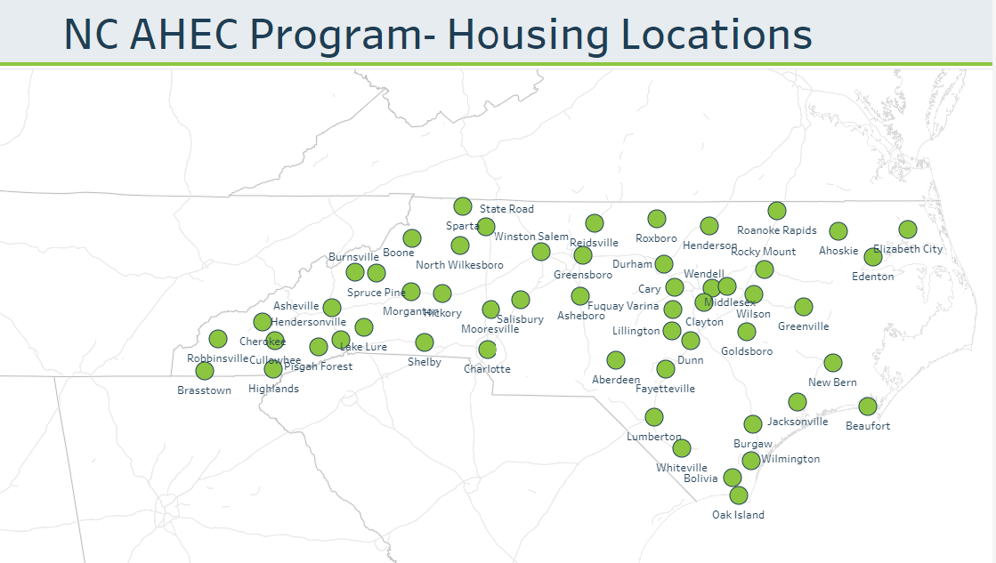
AHEC Student Housing
Purpose: All 9 regional AHECs support students across NC in distant clinical learning experiences through housing access in those areas
Description:
Housing is available to affiliated schools
Housing is owned/leased by the regional AHEC or their parent organization
Housing is maintained by the regional AHEC
Every AHEC and the PO has a housing coordinator
Process:
Statewide housing database managed by the PO
Reservations made through MyAHEC by student. Requests over 60 nights are considered on a case-by-case basis (average is 35 nights).
Regional AHEC manages the logistics of the reservation
Every year in December and June, Program Office (PO) sends invoices to the affiliated schools for their students. Sometimes the school then charges the student.
*Statewide Housing Coordinators meet twice per year for alignment

Slide 21
Student Housing: AHEC Affiliated Schools
“AHEC Affiliated” schools:
Students receive preference over students from non-affiliated schools
Affiliated status applies to students from all programs, including allied heath, public health, dentistry, nutrition and genetic counseling (it’s more than just medicine, nursing, physician assistant and pharmacy). For example, a nutrition student from an affiliated university is given the same housing preference as a medical student from that same university.
Affiliate schools/programs are charged $7/night rate. Rate changes to $14/night in FY25.
Funds go into a statewide Trust that is used by regions to maintain housing/access new housing
Unaffiliated schools:
Unaffiliated schools (usually outside NC or non-student) are charged approximately $25/night. Rate may change in FY25.
Unaffiliated fees are coordinated and billed by the regional AHEC (they work with the student, not the school).
All 17 UNC System Universities and Campuses are considered AHEC Affiliated, but many of them have not had students request AHEC housing so their Universities do not currently have MYAHEC accounts (and some do not have relevant programs).
Affiliations are made with the PO. PO updates the list and notifies AHECs as new schools come onboard.
Current AHEC-Affiliated Schools with Housing Accounts

Slide 22
Consortium of Clinical Education and Practice (CCEP)
Mission: The primary mission of the consortium is to support and grow the healthcare workforce by addressing clinical placement issues for students’ consortium-affiliated facilities.
Objective: All health science students and faculty in NC complete a common core orientation currently endorsed by the North Carolina Hospital Association, housed on the Wake AHEC website.
Three areas:
standardizing and streamlining the clinical faculty/student credentialing process
developing a standardized common “core” orientation
streamlining the clinical placement process
Goals:
Implement the standardize credentialing process for all healthcare disciplines’ students and faculty statewide
Maintain common core orientation training for students and faculty for statewide distribution
Replicate these effective tracking mechanisms for student credentialing statewide
Maintain common clinical placement process and clinical request information for documentation
Establish supportive resources for new clinical faculty
Have representation (leaders) at each Regional AHEC participate in “CCEP Leaders Group” meetings/conference.
*A statewide coordinator for CCEP was established in 2022 at Wake AHEC, supported by PO. The second statewide CCEP meeting occurred in March.

Slide 23
NC Interprofessional Education Leaders Collaborative (NC IPELC)
Mission: To facilitate communication, partnership, and teamwork among and between existing and future healthcare-related interprofessional education initiatives within the state of North Carolina, with the goal to share, implement, and refine best practices for interprofessional education and practice.
Vision: NC IPELC is a national leader in Interprofessional Education.
Result: All students and trainees in NC health professions’ programs are inclusive, collaborative practice ready change agents
2023-2025 Strategic Plan Goals
GOAL 1: Build and organize the resources needed to develop, support, and evaluate interprofessional activities across the state.
GOAL 2: Build an infrastructure that guides and promotes the development of partnerships, collaborations, and teamwork across the state and in regions.
GOAL 3: Amplify the value and benefits of interprofessional education and advocate for the growth and development of NC IPELC.

Slide 24
Housing
IPEP
CCEP

Slide 25
GRADUATE MEDICAL EDUCATION (GME)

Slide 26
Graduate Medical Education (Residency) Support
NC AHEC improves the distribution and retention of primary care physicians.
We help support—and in rural and underserved areas of the state, operate—the residency programs necessary for primary and community care. Residents in AHEC-based and AHEC-supported primary care residencies stay to practice in NC, particularly in rural and under-resourced communities.
26
NC AHEC

Slide 27
UME/GME
UME= Medical school
Has not been a significant part of AHEC role- Medical education precepting is a developing part of the service line
GME= Graduate Medical Education
AHEC started in large part to support community-based GME and contribute to solving access problems away from large cities
Most of the resources are pass through funds designated as ‘stipend’ and ‘non-stipend’ dollars

Slide 28
Funds
Stipend Funds
293.1 positions, $11,790 each, $3,455,649 total
Almost all primary care, mostly family medicine
Awarded to Cabarrus Family Medicine, Duke University, EAHEC, MAHEC, NWAHEC, Piedmont, SEAHEC, South Piedmont, SRAHEC, UNC, and Wake AHEC
In many cases, these resources were critical to launching new family medicine residency programs
Non-stipend funds
More focused on innovation, faculty development, and faculty support
Awarded to most regional AHECs, including EAHEC, NWAHEC, Piedmont, SEAHEC, South Piedmont, SRAHEC, MAHEC, and Wake

Slide 29
General Organization
Relationship of Regional AHEC to GME varies
In two cases (MAHEC and SRAHEC) the AHEC is the sponsoring institution of the residency
In other cases, the relationship varies due to such factors as dual roles (AHEC director leads GME at institution), position of AHEC in health system (independent agency versus hospital department) and historical relationship
There is no service line group for GME because some AHECs have a less active role in GME

Slide 30
GME Collaborative
Quarterly meeting of GME administrative leadership to problem solve and network
Annual in-person meeting
Quarterly meetings of Designated Institutional Officials (DIOs)
Other support of primary care workforce development
State Health Improvement Plan (SHIP) Primary Care Work Group
NC AHEC HNC2030 Primary Care workgroup

Slide 31
Support for Community-Based GME (In Development)
Faculty Development
Staff Development
Mentorship
Networking
Coaching

Slide 32
CONTINUING PROFESSIONAL DEVELOPMENT (CPD)

Slide 33
Continuing Professional Development
NC AHEC meets the ever-evolving education and training needs of health professionals.
Healthcare providers and healthcare teams, particularly in rural and under-resourced communities, have access to coordinated, innovative, and efficient training activities that addresses their needs.
33

Slide 34
Continuing Professional Development (CPD) Our continuing professional development (CPD) programs are important resources that provide health care professionals with the training and continuing education they need to meet state licensure and specialty certification and to stay abreast of new research, emerging technologies, and the latest innovations and advancements in their fields.
Over 57,000 unique participants
Over 9,500 events offered
100 counties covered
300,000 participants
Provide CPD services for occupations within the following disciplines: Allied Health, Behavioral Health, Continued Medical Education (CME), Nursing, Oral Health, Pharmacy, Public Health
Credit requirements vary by accreditation
Regional AHEC CPD staff structure varies, and some staff work with multiple disciplines
Programs are often taught by health sciences faculty from universities and health centers, bringing university experience to NC communities
Programs are planned based on needs assessments, partner requests, contracted work
Delivery formats include in-person events, live webinars, modules, and more
View current offerings in the Visual Course Catalog
*FY23 Data

Slide 35
Discipline Groups vs. Discipline Chairs
7 Discipline Groups
Disciplines: Allied Health, Behavioral Health, CME, Nursing, Oral Health, Pharmacy, Public Health
Composition: Regional AHEC CPD experts; group is Chaired by elected Regional AHEC representative
Facilitate communication and partnership between Regions within discipline
Develop statewide goals for discipline
Collaborate on CPD activities, when appropriate
Form relationships with partners doing work in the discipline area
Discipline Chairs
Composition: Chair of each of the seven discipline groups
Develop, share, and execute initiatives that pertain to statewide training and education needs of an interprofessional workforce
Create clear expectations about how disciplines are to work collaboratively
Assure effective communication about statewide interprofessional continuing education activities
Discipline Chairs
Allied Health Chair
Behavioral Health Chair
Pharmacy Chair
Public Health Chairs
CME Chair
Nursing Chair
Oral Health Chair

Slide 37
E-Learning Software and Tools Support CPD
Learning Management System
Content authoring tools
Virtual conferencing
Cloud storage and collaboration
Video/audio management
Translation and closed captioning
Each region has an eLearning resource that serves as a connection point to the PO
Trainings on products are available via PO or product vendors
License ownership varies (NC AHEC, PO, region- or project-specific)

Slide 38
AHEC Learning Academy (ALA)
The AHEC Learning Academy (ALA) is a centralized approach to developing the NC AHEC Program and its workforce. The professional development offered through the ALA can be utilized by all service lines and staff within the NC AHEC system.
One Regional AHEC assesses needs and plans at least four ALAs throughout the calendar year.
Recordings of previous ALAs can be found on the AHEC Resource Hub.

Slide 39
PRACTICE SUPPORT

Slide 40
Practice Support
NC AHEC works with medical practices to transform delivery of care.
Our practice support teams ensure that our state’s health workforce provides high quality, cost-effective, and inclusive care to all individuals in NC, while thriving in a value-based care environment, ultimately reducing costs and improving quality of care.
40
NC AHEC

Slide 41
Practice Support
The aim is to help practices thrive with value-based care across their entire patient panel including Medicaid, Medicare and all other payors.
This service is offered at no cost via a team of 42 practice support coaches located at 9 regional AHEC centers across North Carolina.
Our coaches work 1:1 with independent primary care practices and specialists, FQHCs, rural health centers, health departments with primary care services, behavioral health providers and some health system primary care/specialist practices.

Slide 42
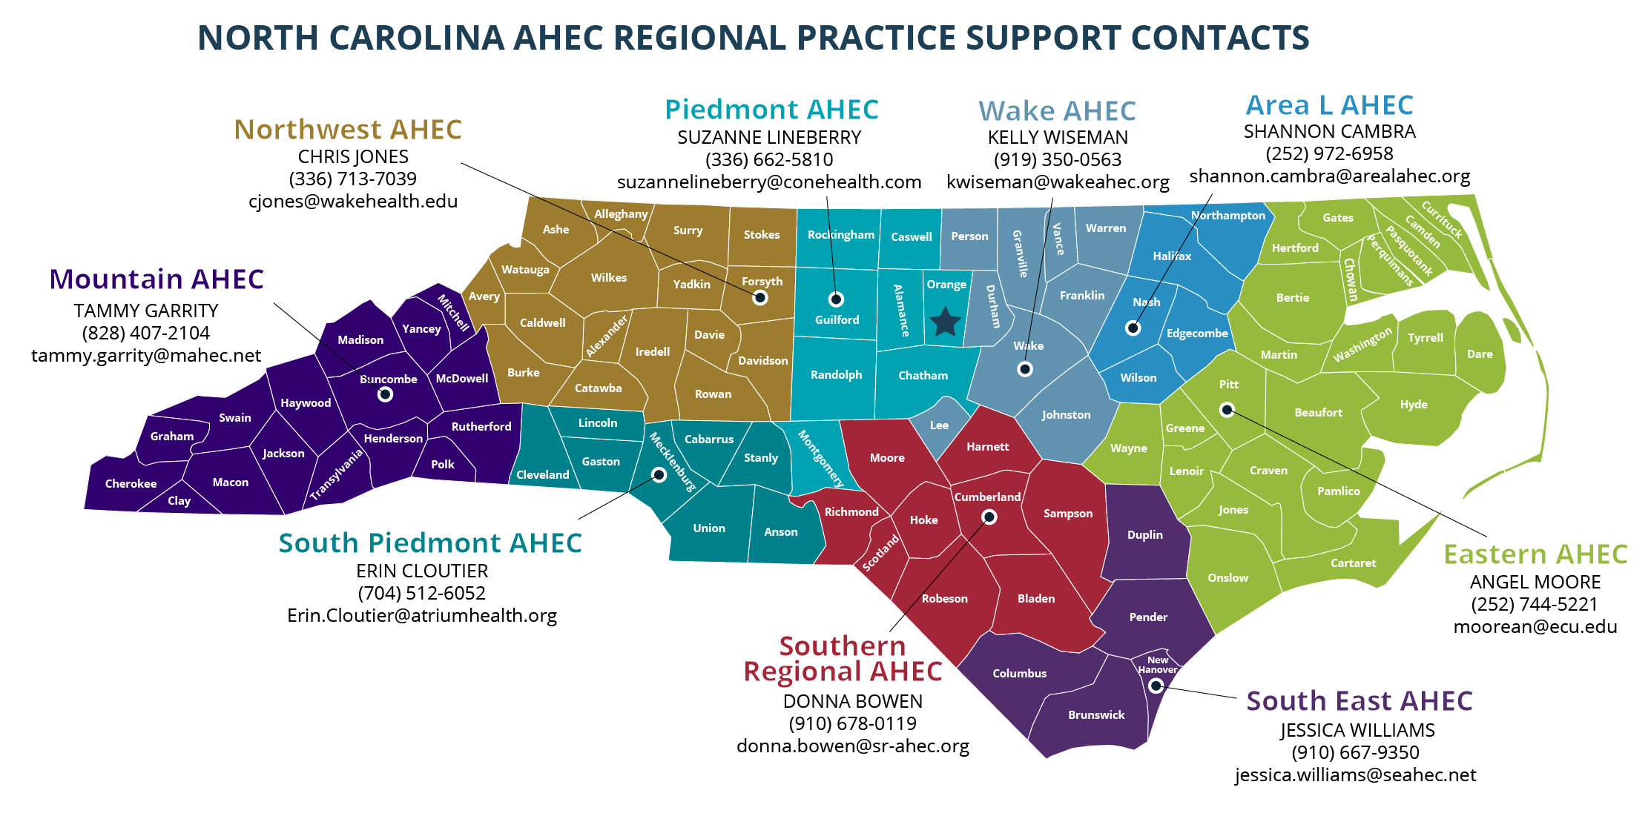
Alleghany
Surry
Stokes
Rockingham
Warren
Northampton
Gates
Currituck
Caswell Person
Granville
Vance
Hertford
Camden
Halifax
Pasquotank
Watauga
Wilkes
Yadkin
Forsyth
Orange
Chowan
Perquimans
Mitchell
Avery
Alamance
Durham
Franklin
Nash
Bertie
Madison
Yancey
Caldwell
Alexander
Davie
Guilford
Edgecombe
Tyrrell
Iredell
Davidson
Wake
Martin
Washington
Dare
Buncombe
McDowell
Burke
Catawba
Rowan
Randolph
Chatham
Wilson
Pitt
Swain
Haywood
Rutherford
Lincoln
Lee
Johnston
Beaufort
Hyde
Graham
Henderson
Cabarrus
Harnett
Wayne
Greene
Jackson
Polk
Cleveland
Gaston
Mecklenburg
Stanly
Montgomery
Moore
Lenoir
Craven
Cherokee
Clay
Macon
Transylvania
Cumberland
Pamlico
Union
Anson
Richmond
Hoke
Sampson
Jones
Scotland
Duplin
Onslow
Cartaret
Robeson
Bladen
Pender
Columbus
New Hanover
Brunswick
(9
5/19/2022.v4
1/1

Slide 43
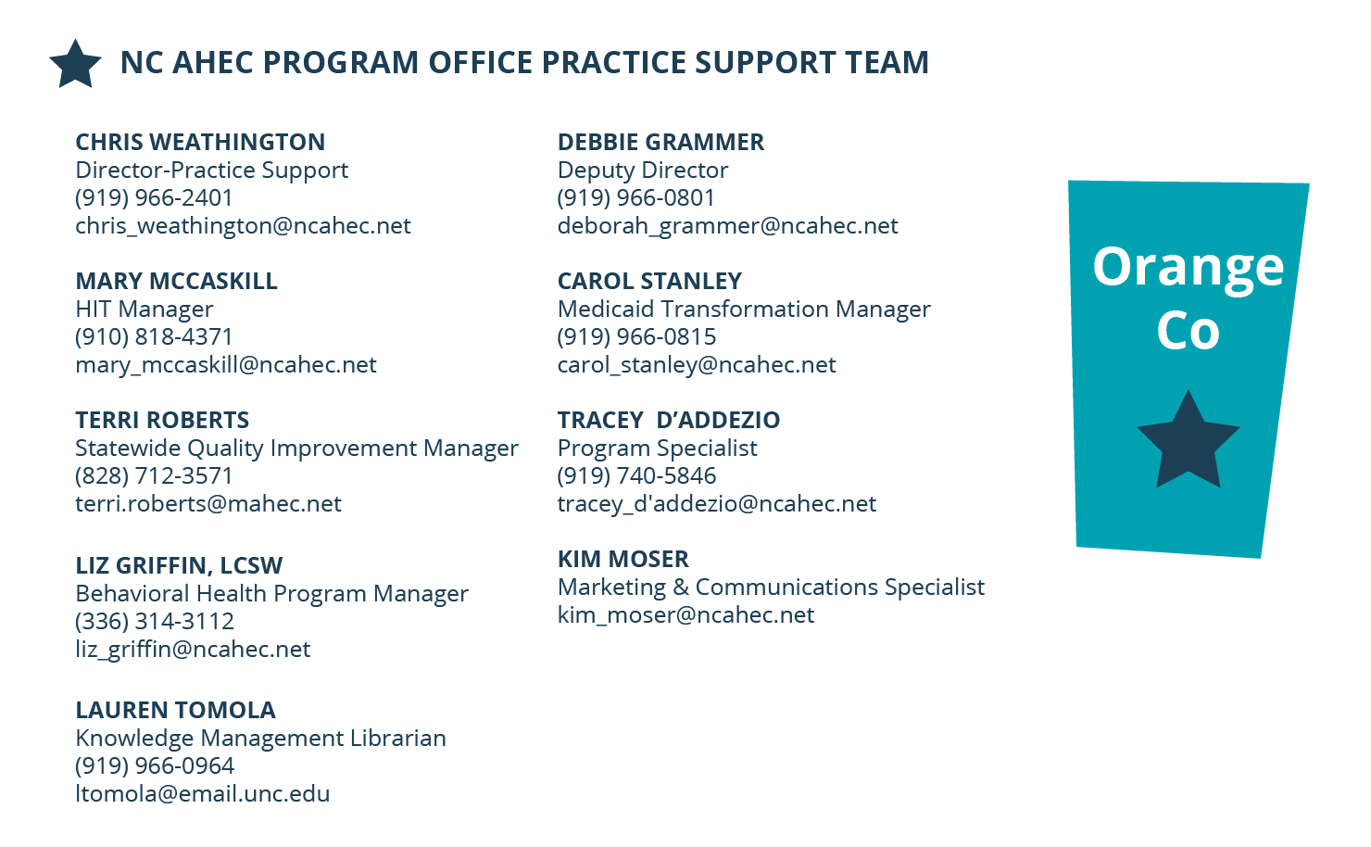
Alleghany
Surry
Stokes
Rockingham
Warren
Northampton
Gates
Currituck
Caswell Person
Granville
Vance
Hertford
Camden
Halifax
Pasquotank
Watauga
Wilkes
Yadkin
Forsyth
Orange
Chowan
Perquimans
Mitchell
Avery
Alamance
Durham
Franklin
Nash
Bertie
Madison
Yancey
Caldwell
Alexander
Davie
Guilford
Edgecombe
Tyrrell
Iredell
Davidson
Wake
Martin
Washington
Dare
Buncombe
McDowell
Burke
Catawba
Rowan
Randolph
Chatham
Wilson
Pitt
Swain
Haywood
Rutherford
Lincoln
Lee
Johnston
Beaufort
Hyde
Graham
Henderson
Cabarrus
Harnett
Wayne
Greene
Jackson
Polk
Cleveland
Gaston
Mecklenburg
Stanly
Montgomery
Moore
Lenoir
Craven
Cherokee
Clay
Macon
Transylvania
Cumberland
Pamlico
Union
Anson
Richmond
Hoke
Sampson
Jones
Scotland
Duplin
Onslow
Cartaret
Robeson
Bladen
Pender
Columbus
New Hanover
Brunswick
(9
5/19/2022.v4
1/1

Slide 44
Practice Support Team
42 experienced and knowledgeable practice support coaches in physical and behavioral health across 9 regional teams
1 embedded health science librarian and digital library resource
Clinical Advisor- Dr. Adam Zolotor, Family Physician
Program Office with expertise in program management, fiscal and contract operations, quality improvement, Medicaid managed care, behavioral health integration, health information technology and communications
Practice Managers
Health Educators
HIT Specialists
QI Specialists
Behavioral Health Specialists
Nurses and Clinicians
44

Slide 45
Practice Support Services
Quality & Health Equity Improvement (Medicaid, Medicare QPP/MIPS, All Payors)
Medicaid managed care education & issue resolution
Clinical workflow redesign & process improvement
Behavioral health integration (including Collaborative Care Model)
COVID19 vaccine & clinical workflow assistance
Practice operational assessments
EHR optimization, telehealth integration
HIE training and optimization
Revenue cycle management
Billing & coding guidance
Advanced Medical Home (AMH) tier education and support
Tailored Care Management (AMH+/CMA) support
Community Health Worker integration and training
Social Drivers of Health Workflow & NCCARE 360 Optimization
Virtual Collaborative Educational Programming

Slide 46
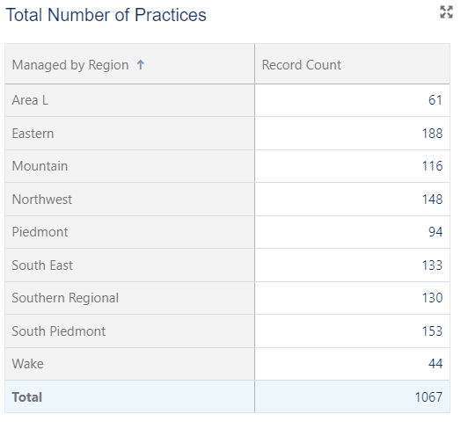
NC AHEC Practice Support Covers 1,067 Practices Serving 100 Counties

Slide 47
Practice Satisfaction Surveys Report Strong User Experience with AHEC Coaches
Practice Satisfaction Survey
2022 Results
Recommend NC AHEC Practice Support?
Satisfied with Quality of Information & Assistance by NC AHEC Practice Support Coach?
99%
90%

Slide 48
LIBRARY SERVICES

Slide 49
Library Services
NC AHEC librarians support the clinical, educational, and research activities of medical professionals and students across the state.
Each of the nine AHEC locations has library resources, including librarian staff prepared to meet the unique needs of the healthcare providers in their counties. All current and prospective healthcare professionals in NC have access to evidence-based information to promote the health and well-being of the communities they serve.
49

Slide 50
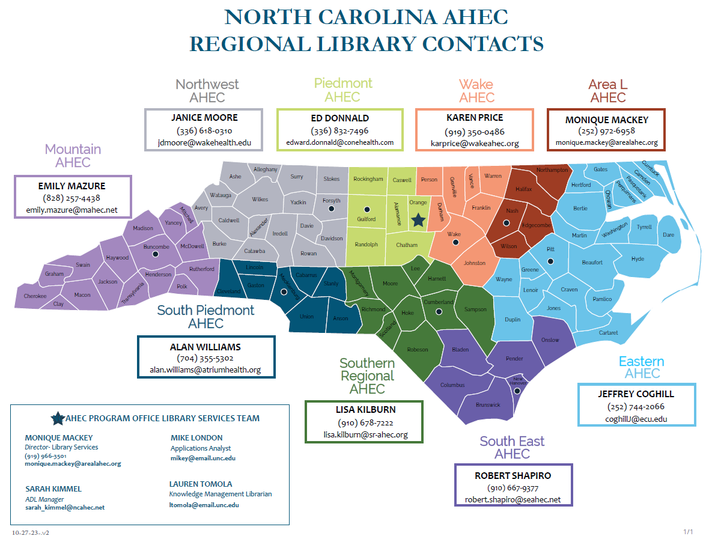
Structure
50
50

Slide 51
Structure
Libraries That Support AHEC Residencies
HOSPITAL LIBRARIES
Mountain AHEC
Southern Regional AHEC
PIEDMONT AHEC
SOUTH EAST AHEC
SOUTH PIEDMONT AHEC
WAKE AHEC
LIBRARIES THAT SUPPORT REGIONAL AHECS
Area L AHEC
Eastern AHEC
Northwest AHEC

Slide 52
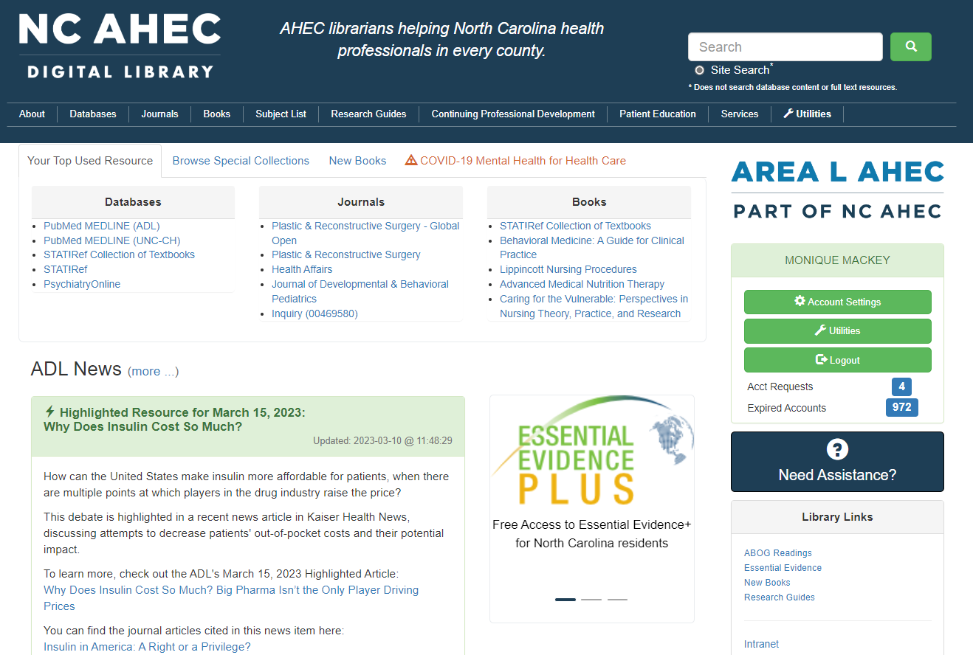
52
52

Slide 53
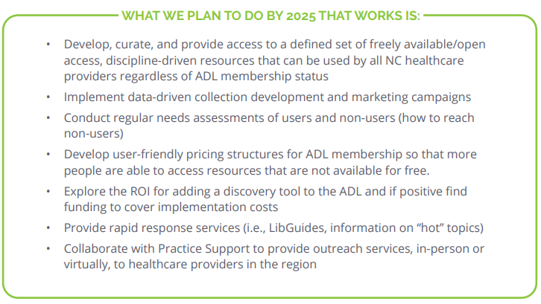
LIBRARY SERVICES IN THE 1980’s
2023-2025 STATEGIC PLAN
Providing current information for health professionals on a timely basis is the primary function of the North Carolina AHEC Library and Information Services Network.
The operative words for AHEC libraries are networking and sharing.
Information service in the AHEC network is more than a collection of books, journals, and audio-visual materials. The focus is on new ways to access information rather than on building larger collections.
Another key strength of the AHEC Library and Information Services Network is the continuous assessment of needs and existing resources of each region.
The AHEC Library and Information Services Network serves as the practitioner’s gateway to information resources.
The Network not only joins practitioners, institutions, and agencies with statewide and national biomedical communications networks, it also links local agencies and practitioners so that expertise and resources can be shared at all levels.
NC AHEC ILS Network Vision: Health professionals affiliated with health system, independent, or rural, underserved hospitals and clinical practices across the state have access to high-quality, current, authoritative, clinical care information.
53
53

Slide 54
Want to Learn More?
Join the NC AHEC Staff Mailing List
Visit the NC AHEC Internal Depository

