Slide 1
Primo Analytics
September 21, 2021
Michelle Eichelberger
www.suny.edu

Slide 2
Plan for Today
Overview of access means
Out of box reports
Creating reports from scratch
Using reports to drive Primo redesign
www.suny.edu

Slide 3
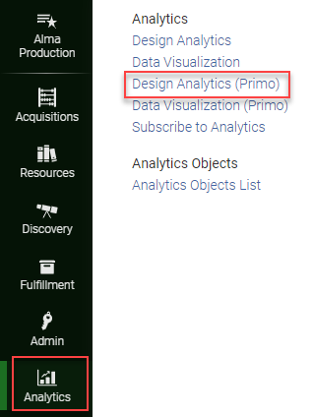
Overview
Separate from Alma Analytics
Much of the documentation is for Primo Back Office and hasn’t been updated for Primo VE
Need Analytics Administrator and Designs Analytics roles
Dates at bottom of Analytics pop-out show you currency of data:
www.suny.edu

Slide 4
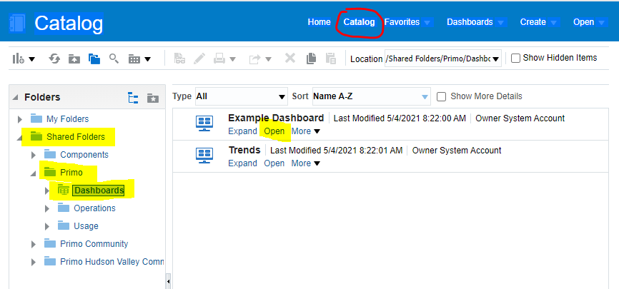
Out of the Box Reports
May be all that you need
Doesn’t give you link usage – database usage comes from vendor sites and can be imported with SUSHI
Go to Catalog, Shared Folders, Primo, Dashboards, and Open Example Dashboard
www.suny.edu

Slide 5
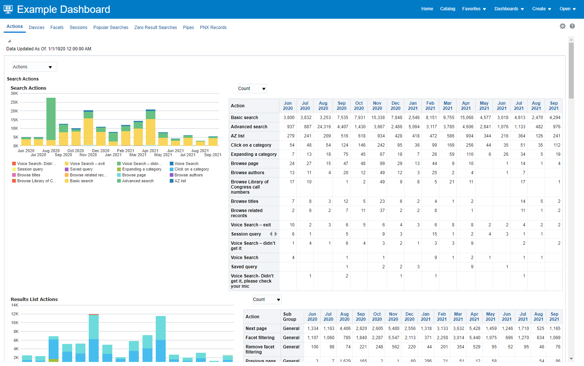
Out of the Box Reports cont.
Your data
You can copy any of the underlying reports to your own analytics area and edit them
Both graphs and tables for data
Ex Libris Documentation
www.suny.edu

Slide 6
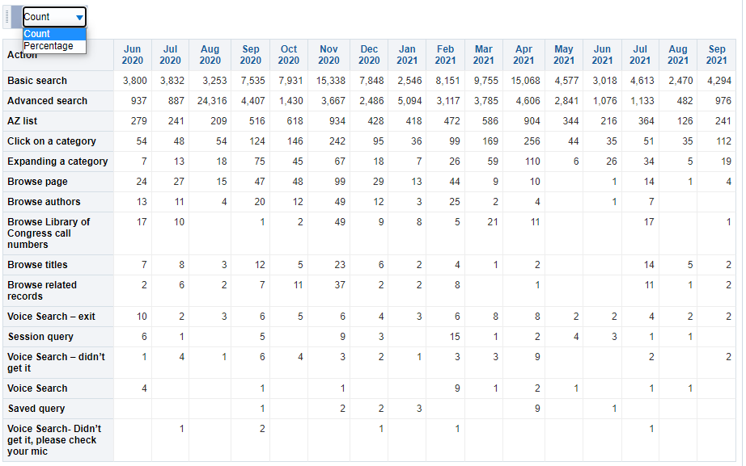
Out of the Box Reports: Search Actions
Can view by Count or Percentage
Show how people are searching
Doesn’t show widget vs. direct search
Training impact: teach voice search? Teach saving searches?
Design impact: Move browse into visible header links?
AZ list?
www.suny.edu

Slide 7
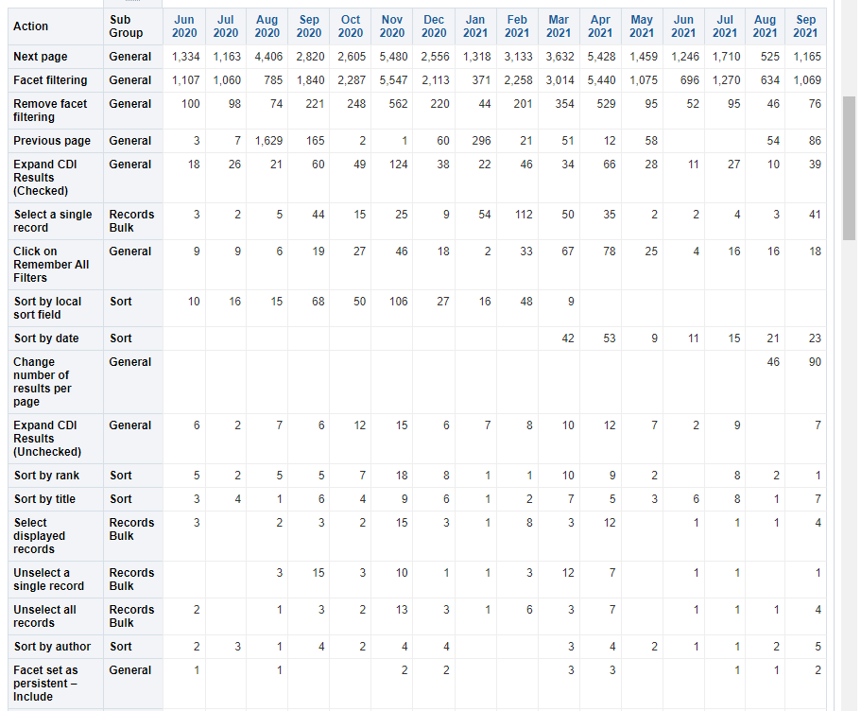
Out of the Box Reports: Results List Actions
Shows what people do with results
Training impact: do people know to expand their results if they don’t get what they want?
Design impact: Make default search expanded?
www.suny.edu

Slide 8
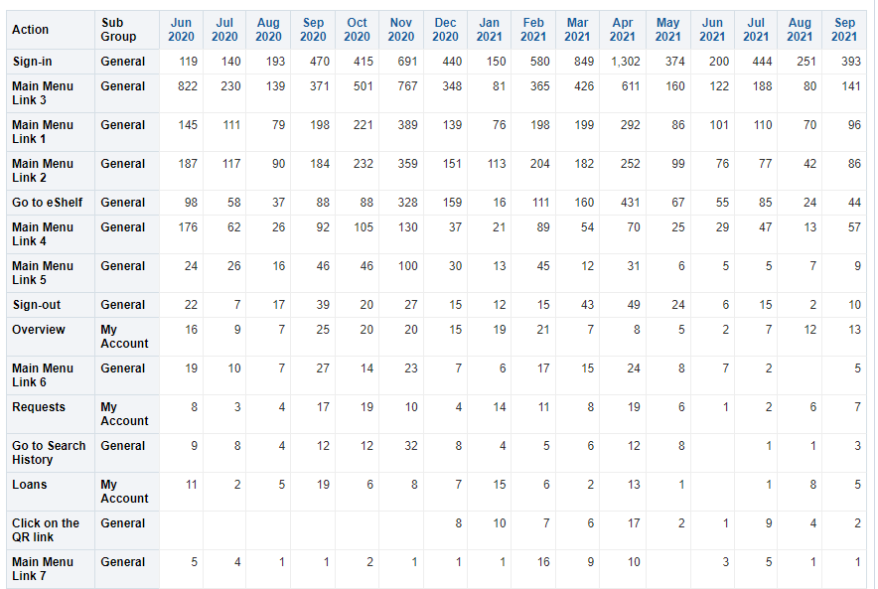
Out of the Box Reports: General Actions
Shows general actions
Training impact: do people need training on “my account”?
Design impact:
Important to know if people are signing in – can impact request display, subscription CDI results like Artstor.
Which header links are being used?
Set up silent login?
www.suny.edu

Slide 9
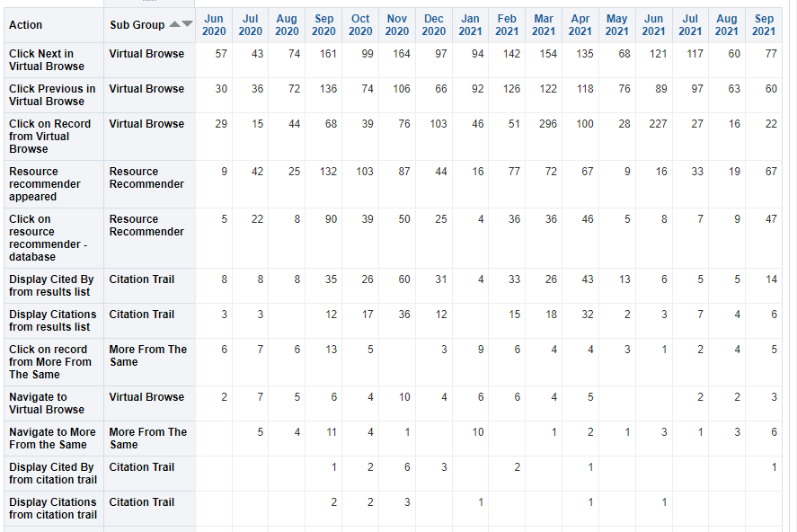
Out of the Box Reports: Exploration Actions
How are people navigating in system?
Training impact: do people need training on citations? On browsing?
Design impact:
Are citation labels up to date?
Are you resource recommender entries up to date with current database urls?
Move browse option to header?
www.suny.edu

Slide 10
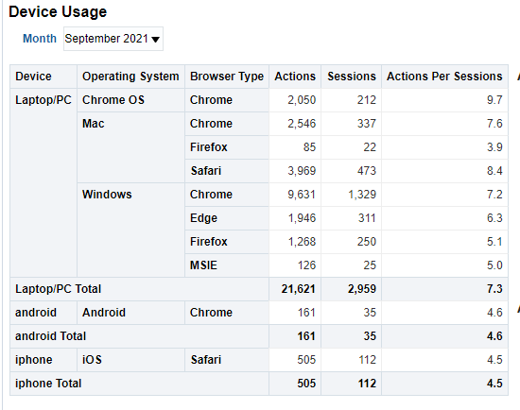
Out of the Box Reports: Devices
How are people accessing your Primo VE?
Design impact:
Are you testing changes on all devices?
Is your site responsive and accessible?
www.suny.edu

Slide 11
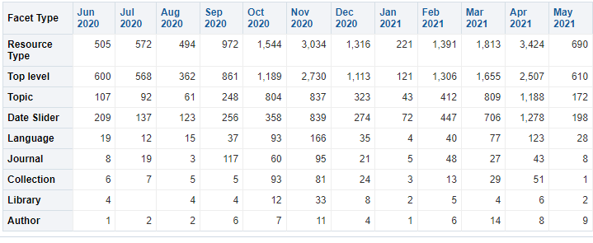
Out of the Box Reports: Facets
What facets are being used?
Training: do you need to do more training on facets?
Design:
Do you have facets that aren’t being used? Should you rename or remove them?
Should you reorder facets according to use?
www.suny.edu

Slide 12
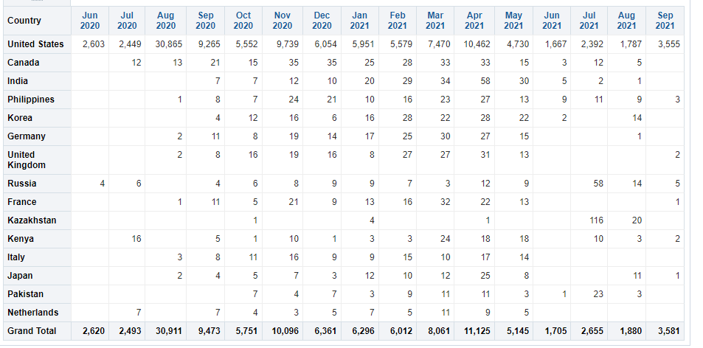
Out of the Box Reports: Sessions
Where are people coming in from? How often are they coming in?
Design: Do you need to consider activating additional languages?
www.suny.edu

Slide 13
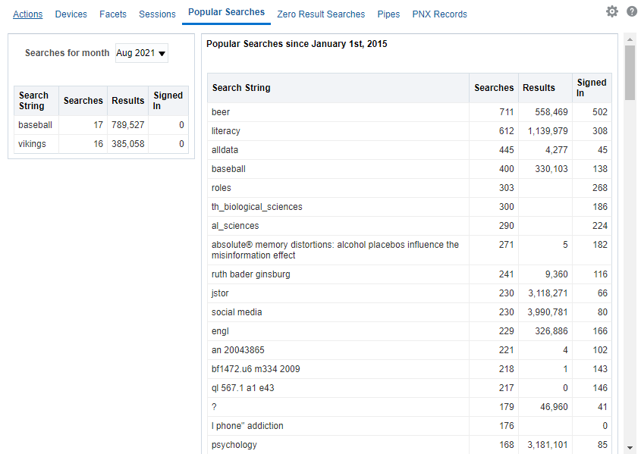
Out of the Box Reports: Popular Searches
What are people searching for?
Training: Do you need to do more training on how to search? Are top searches associated with various projects/courses?
Collection development: do you need to order more content for these areas? Create a resource recommender entry for things like “hours” search?
www.suny.edu

Slide 14
Out of the Box Reports: Zero Result Searches
What searches aren’t working? Is it you or is it them? Do you need to make expand search your default? More search training?
www.suny.edu

Slide 15
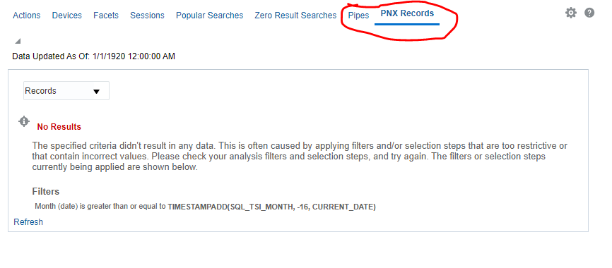
Out of the Box Reports: Pipes and PNX Records
You can ignore this – it’s for Primo Back Office
www.suny.edu

Slide 16
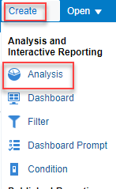
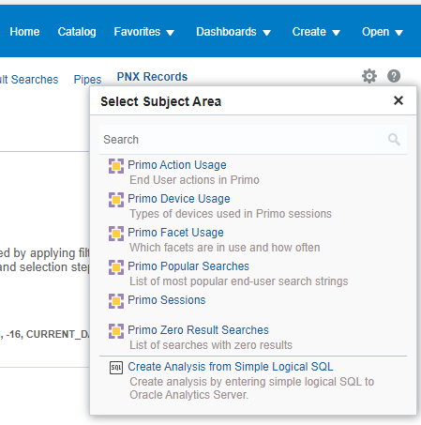
Create Report from Scratch
Choose Create, Analysis, then pick your subject
Same areas as in out of the box reports
www.suny.edu

Slide 17
Live Demo
www.suny.edu

Slide 18
Questions?
Resources:
https://knowledge.exlibrisgroup.com/Primo/Product_Documentation/Primo/Analytics/030General_Primo_Analytics_Procedures
https://knowledge.exlibrisgroup.com/Primo/Product_Documentation/Primo/Analytics/Primo_Analytics_Subject_Areas
Primo VE – Become an Expert: Primo Analytics (April 15): WebEx, PDF
www.suny.edu

