Slide 1
SMARTLY
NEETs in the EU labour market
Evaluation of the situation of NEETs on the post-pandemic labour market
and policy recommendations
14/11/2023
CASE-Center for Social and Economic Research

Slide 2
Agenda
EU labour market prior to, and post, the COVID-19 pandemic
Rewiev of already present policies and their evaluation
Recommendations for the policies relevant for youth employment and employability

Slide 3
EU Labour Market – global pandemic
Unemployment: spike in unemployment, felt most by the youth aged 15 to 24
( from 15.6% to 17.6% in 2019-2020)
Rate of activity: the youngest cohort (15-24) witnessed the largest fluctuation on the labour market
(cohorts aged 25 to 64 remained almost unchanged)
Employment:15-24 year-olds - fall of employment rate (by 2%)
Young people specifically affected by the COVID crisis
Overall rates of employment, unemployment, and labour market activity did not see extreme fluctuations

Slide 4
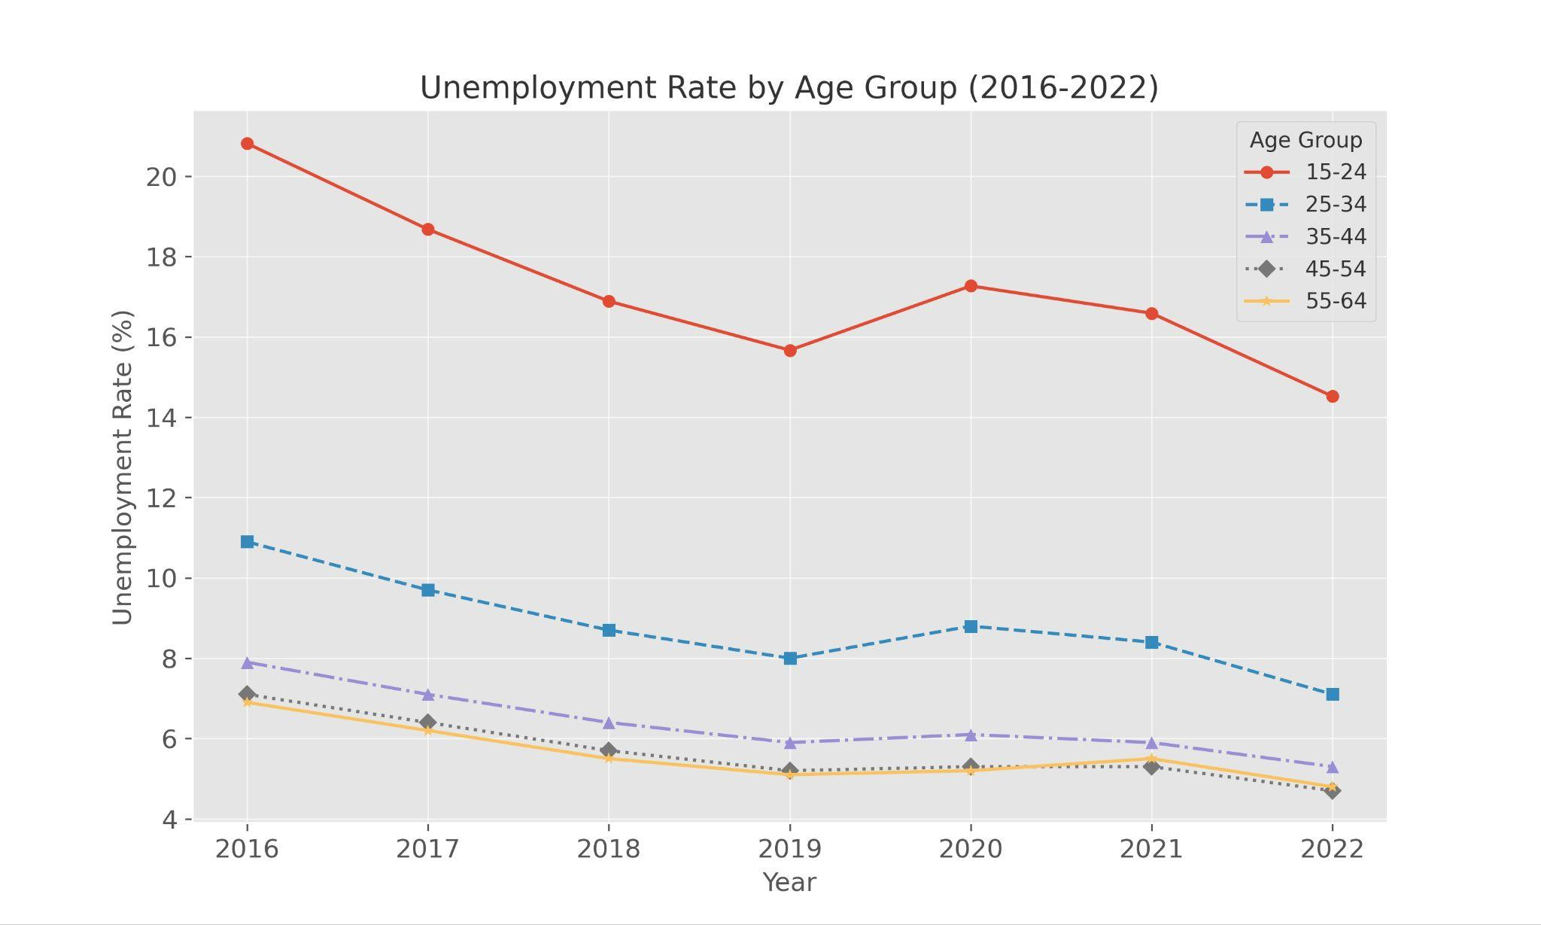
Labour market developments
Almost immediate growth of the rates of employment and activity, especially among the youngest cohort, could be seen in 2021 and 2022
HOWEVER overall unemployment rate (6%) reached almost natural level in 2022, it still remains high for people aged 15-24 (14.5% )
Young people with limited professional experience are more vulnerable to unstable employment
High participation of older workers -> future need for replacement
Lower participation of the youth may lead to significant labour shortages

Slide 5
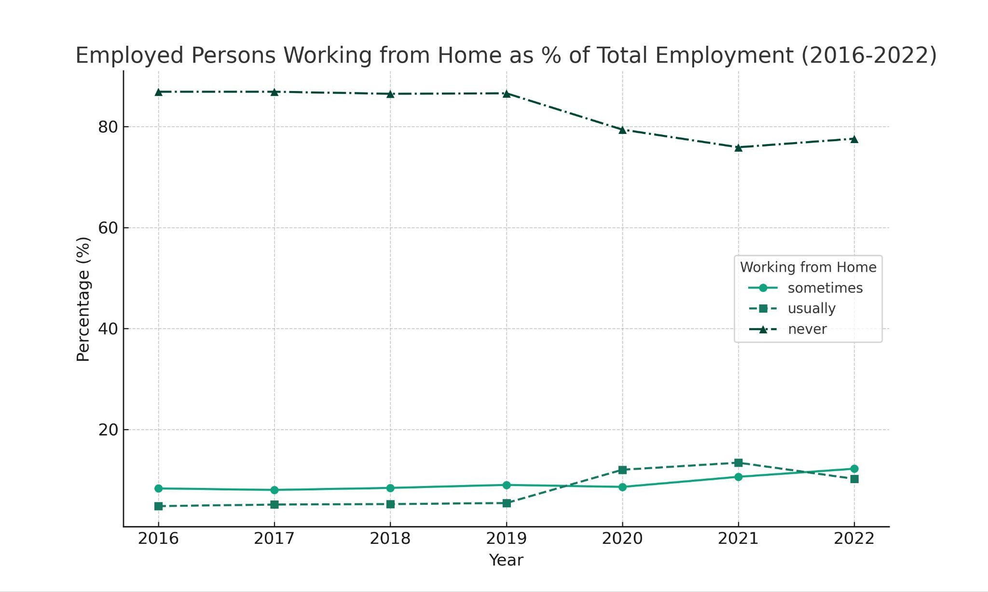
EU Labour Market development
Digital tools for collaboration – in top ten digital skills listed in job offers (2021)
Mismatch between skills demanded and supplied – insufficient digital skills
Increased demand of high-skill labour vs decline in entry level jobs
Young people more vulnerable to unstable employment

Slide 6
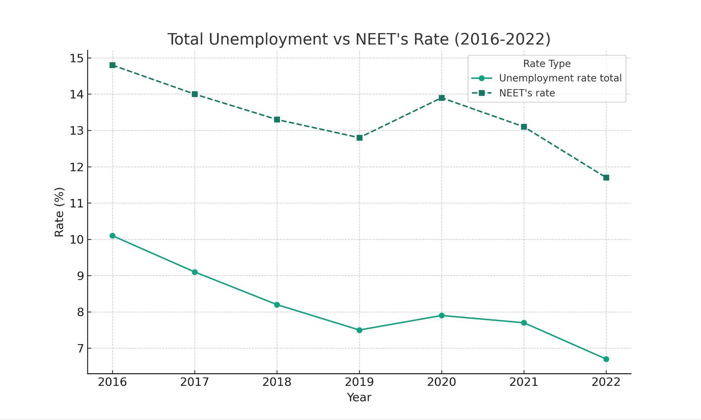
Development of NEETs situation
COVID: spike of NEET rates in 2020 coupled with youth unemployment
Post-covid: continued falling trend (but above EU goal of 9%)
Women caring for a family member (18%)

Slide 7
How did COVID 19 impact the NEETs?
Spike in youth unemployment larger than that of older cohorts
Fluctuations in youth employment larger than the overall fluctuations
Spike in NEETs rate during COVID due to growth in youth unemployment

Slide 8
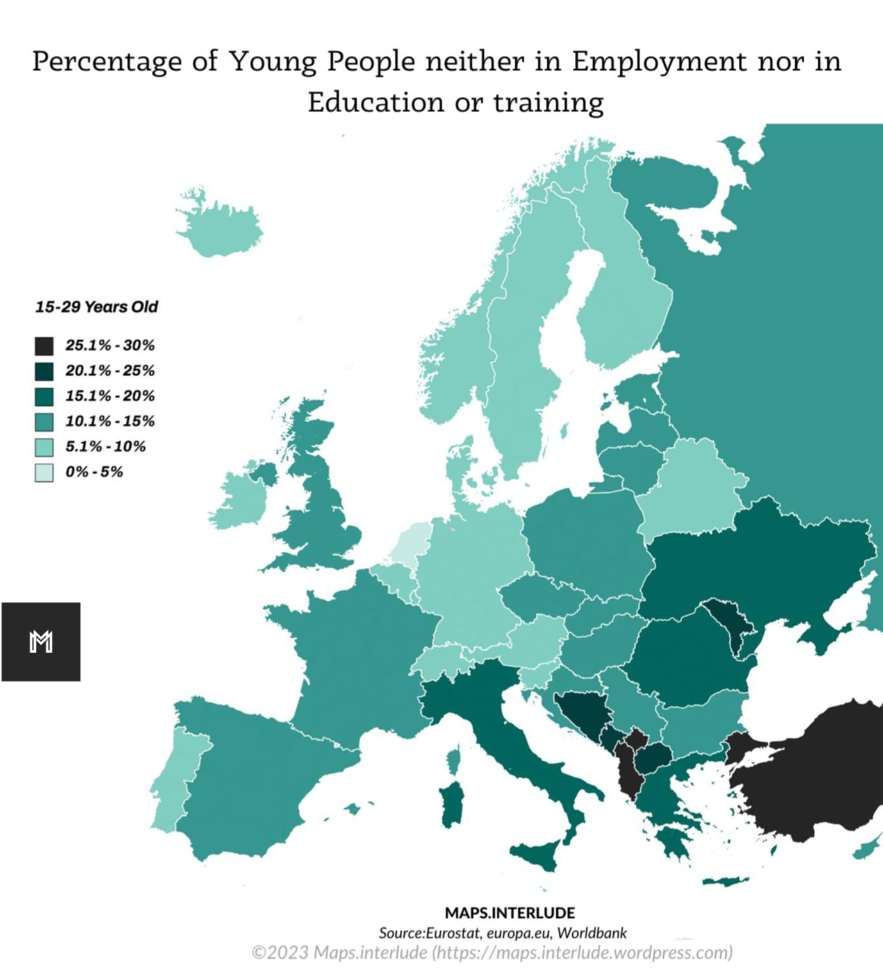
What is the relevance of NEETs?
High NEETs rate (11.7%)
More job vacancies than people in the labour market
People who could potentially fill those vacancies are not engaged in the labour market

Slide 9
Current NEETs policies
EU: Youth Guarantee, European Pillar of Social Rights Action Plan
Italy: NEET Plan
France: Pix, 1 Youth, 1 Solution
Most
policies aim at increasing employability, rather than improving employment stability
EU: Youth Guarantee, European Pillar of Social Rights Action Plan
Italy: NEET Plan
France: Pix; 1 Young person, 1 Solution
Most policies focus on boosting youth employment, rather than improving employment stability

Slide 10
Policy recommendations
Enhancing youth employment stability
Increase of entry-level jobs
Upskilling in terms of digital skills
Support policies for women caretakers

Slide 11
SMARTLY
Thank
You.
CASE – Center forSocial www.case-research.eu
and Economic Research case@case-research.eu

