Slide 1

George Mason District
Roundtable
October 13, 2022

Slide 2

Pledge

Slide 3
Council Update
Charter Renewal – 11 of 39 units have logged into the Charter Renewal system.
Family Den Pilot Program – Still time to sign up
Fall Family Camping (Snyder; $35/person) – BB, Archery, Scouterhorn, Crafts, Leatherwork, Woodshop.
  11/18-20/2022 - https://www.gotosnyder.org/year-round-events/cub-scout-expo/
Goshen 2023 Registration is open – https://www.gotogoshen.org
New Applications – Effective date will be the date posted – not back dated beyond 1st of the month.
Insurance – Insurance certificates (2 weeks) & Out-of-Council Insurance (National’s Policy could take longer)
BSA Branding Guidelines - https://scoutingwire.org/bsa-brand-center/brand-identity/
My.Scouting.org
  Update Adult email/address/phone
  Organizational Manager
    COR/ COR Delegate can change positions
    New Position - Unit Treasurer
Fund Raising
  Popcorn distribution this weekend – Alexandria, VA
  Right Response First Aid Kits – Sign-up Dec-Feb; sales Mar-May

Slide 4
Updates to my.scouting.org
07Oct2022
Recalibrate BeAScout Pins to reflect true GPS location
Add the listing of all active units to the Detailed Advancement Reports
Create a new “Detail Cub Scout Membership Totals Report – Found in Organization Manager”
30Sep2022
Allow Unit to make Changes in Position Manage even if the CBC flag is not present
Remove Unit Participant from drop down positions available
Fix Screening question issue in Online Registration
09Sep2022
Change the application flow for Online Applications to provide a better user experience. – Moved the My.Scouting account creation to the end of the process
Fixed the ability for a unit to acknowledge an online application
Fixed Report issue for Training reports cutting off list at 254 characters in the CSV version
Fixed issue where units in application manager could view other units’ note

Slide 5
Updates to Scoutbook
10/7/22
Bug Fixes
  None
New Features
  CS Advancement and Adventure Report
    Just in time for December Recharter and JTE, a new report has been released for Cub Scout Packs. This report is accessible from the Pack Reports menu on the Pack page. This report has a selectable time frame (defaulting to a typical program year as specified in current JTE metrics). This will return a listing of Scouts who earned a rank and/or adventures during the time period (Bobcat is included, so rank may be more than “1”). A checkbox allows for including Scouts with no advancement in the set time frame. This should aide in an overview of Cub Scouts for the Pack and their advancement activity.

Slide 6
Updates to Scoutbook
10/5/22
Bug Fixes
  Adult Leader Positions - Adults can only be listed as leaders in Scoutbook if the BSA Member ID attached to the Scoutbook account is registered with the BSA. An issue that allowed some unregistered adults to be listed as leaders in Scoutbook has been fixed. Any adult that has an unregistered BSA Member ID attached to their Scoutbook account has had any leadership positions in Scoutbook ended.
  Calendar Reminders - An issue that prevented some non-registered adults from receiving certain calendar reminders when their Scout was not invited to the event has been fixed.
  Delete Account - The function to delete a youth Scoutbook account if there is no BSA Member ID attached has been restored to the Edit Extended Information page.
  Merit Badge Counselor Unit List - The Unit List for Merit Badge Counselor visibility previously did not require the B designator for boy troops. Scoutbook has been updated to require either a B or G designator for all Scouts BSA troops in the MBC unit visibility list. For example Troop 1234B or Troop 1234G must be entered.
New Features
  Grand Slam and Triple Crown Awards - The requirements for the Grand Slam and Triple Crown Awards are now linked so that updating a requirement for one award will update the corresponding requirement for the other award.

Slide 7
Aquatics Committee
SCUBA (Course Fee: $650)
  PADI Certification by Age / Scouts BSA Merit Badge
  Contact the PADI Divemaster Andrew Blanco (ABSEAS2@aol.com) to schedule
  Minimum age 14 years
Partial Merit Badge Completion Clinic
  18 Scout Limit
  12/11/22 and 12/18/22 from noon-5pm at Fairland Sports & Aquatics Center, Riverdale, MD.
  Sign-up will be put on NCAC calendar when pricing has been established.

Slide 8
Awards
Steve Banowit (T0987) – 10 Year Veteran Award
Allen Mohaber (P0675) – Den Leader Training Award
Edward Roggenkamp (P1537) – Den Leader Training Award

Slide 9

Big Rock – Scouting for Food

Slide 10

Hunger is still out there, and so are we!
GEORGE MASON DISTRICT
SCOUTING FOR FOOD
2022

Slide 11
The Basics:
  Saturday, November 5: Put the Scouting for Food stickers on doors in your unit’s assigned zone
  Saturday, November 12: Pick up the food and deliver to the unit’s assigned food pantry
I still need POCs from the following units:
  Pack 833, Pack 882, Troop 918, Troop 976, Troop 979, Troop 987B and G, Troop 1113, Troop 1996

Slide 12

Good news: Stickers for each Unit are in the back
  We have about the same as last year, but I know some units were short last year
  Through Basecamp, let me know if you have extras, and if you need more
Bad news: They don’t have dates on them
Rules to keep in mind:
  YPT: drive as families or two adults per car
  Respect no soliciting signs
  Don’t go inside people’s homes
  Be careful crossing streets
  Don’t ring doorbells

Slide 13
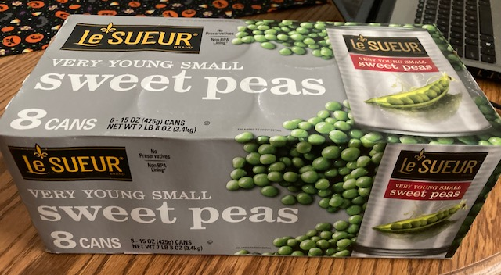
OPTIONAL: Awareness-building during the week
  Weekly bulletins
  Neighborhood Facebook pages
  Signs
If possible, try to get the food pantry to weigh each unit’s donation and record the weight. If not, you can estimate: A full bag is about ten pounds (welcome better methodologies from the crowd)
  8 cans=7.5 pounds

Slide 14
Data Capture
Unit’s fill out at:
https://www.ncacbsa.org/scouting-for-food-unit-data/
District: George Mason District
Number of Scouts and Other Youth Participants (siblings, friends, etc.)
Number of Adult Participants
Pounds of Food Collected
Food pantry delivered to
For your Scouts: Express the weight in fun terms, for example
  Vehicles, animals, dinosaurs

Slide 15


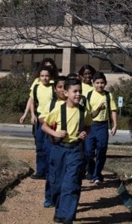

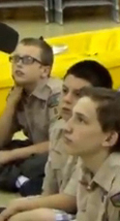


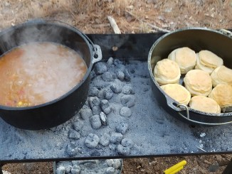
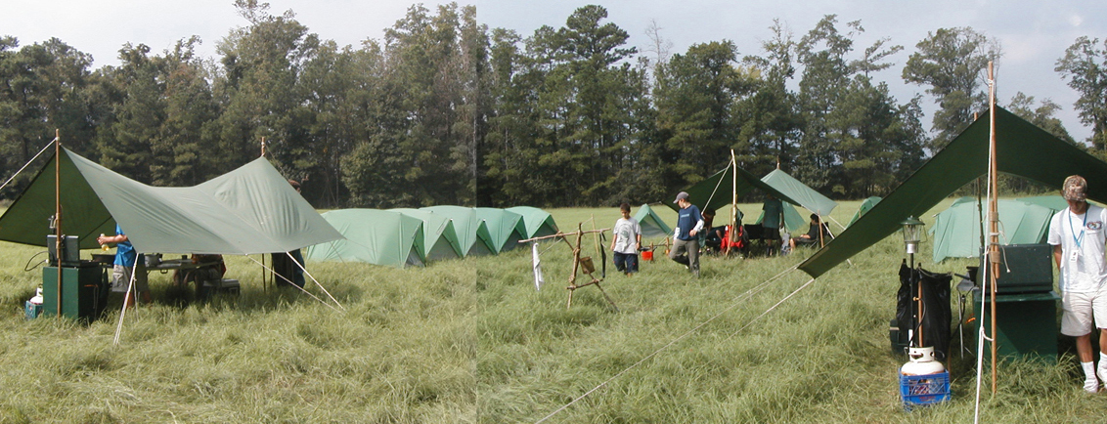
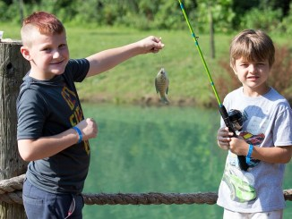
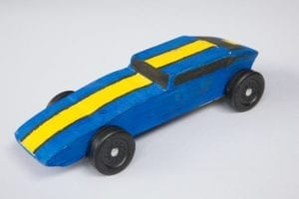
George Mason Program
John Drisco, Vice Chair Program
Matt Burns, Deputy Vice Chair Program
George Mason District

Slide 16

Current 2022 GM Calendar
October 28-30, 2022 – Fall Camporee- Pioneering Blue Ridge Regional Park, VA
November 5, 2022 – Scouting for Food Tag Distribution
November 11,2022 – Flags in, National Memorial Park, Falls Church
November 12,2022 – Scouting for Food Bag Collection
December 2022 – Peace Light of Bethlehem
February 25, 2023 - University of Scouting
March 4, 2023 – Merit Badge Day at Fairfax Presbyterian Church
March 25, 2023 – Pinewood Derby at Fairfax Presbyterian
Church
May 5-7, 2023 – Spring Camporee TBD

Slide 17

STEM
STEM Expo & Pinewood Derby – (Rescheduled) 15 October @ Camp Snyder
  STEM Expo is open to all! Register by 7 October
  https://scoutingevent.com/082-pwd
Chess Tournaments
  Cubs – 4 February 2023
  SBSA – 11 February 2023
DC STEM Trek- Showcases 24 government agencies, private organizations and monuments related to the tenets upon which STEM is based.
  10.57 miles
  4.75 miles
  https://www.ncacbsa.org/wp-content/uploads/2022/09/DC-STEM-Trek-2.pdf

Slide 18
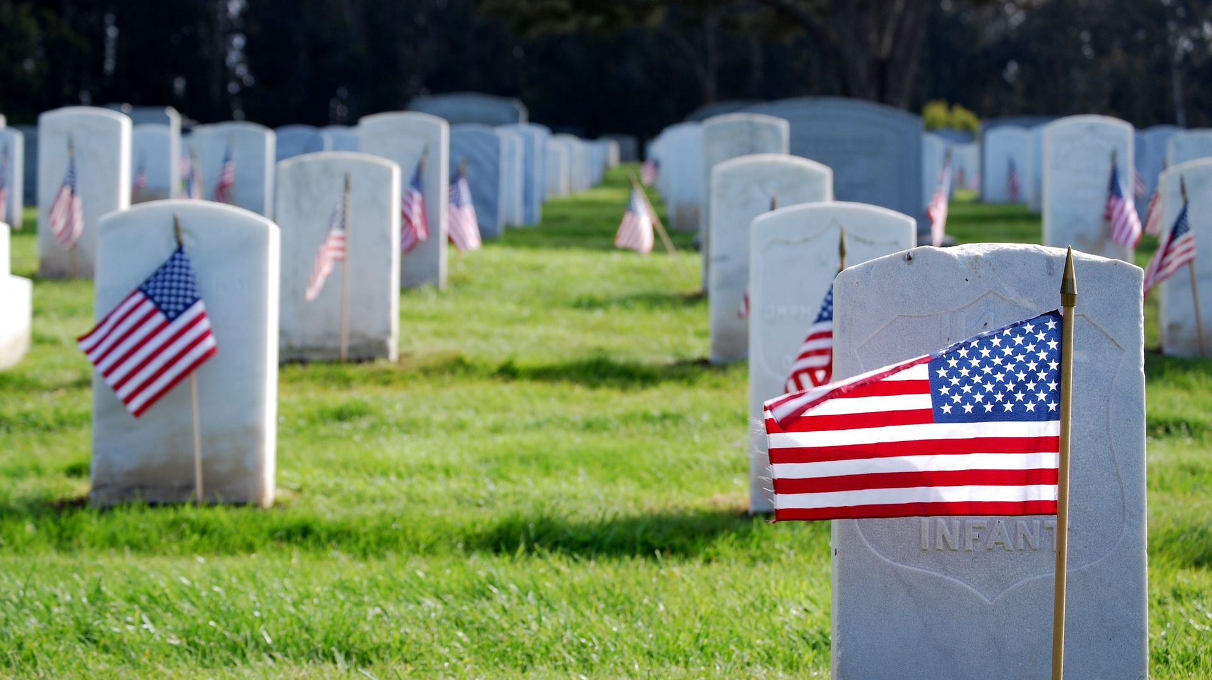
Flags In
November 11, 2022 (Veterans Day)
Flag placement will start at 12:00 noon
Social distancing – bring a mask.
National Memorial Park,
7482 Lee Highway, Falls Church
All Scouts, including Girl Scouts, are welcome.
Class A Uniforms
For more info, contact Russell Pittman at ruspittman@gmail.com.

Slide 19
SCOUTS BSA Roundtable

Slide 20

George Mason Fall Pioneering Camporee 2022
October 28th – October 30th at Blue Ridge Regional Park
19178 Blue Ridge Mountain Road, Bluemont, VA 20135

Slide 21
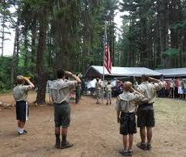
Future Camporees
Save the Dates!!!
George Mason Fall 2022 Camporee – October 28 - 30, 2022
  Pioneering Theme at Blue Ridge Regional Park
George Mason Spring 2023 Camporee – May 5-7, 2023
  Theme and Site TBD
Please factor this into unit calendars/planning.
Scouts are loyal – including loyalty to District activities.

Slide 22

Training https://www.ncacbsa.org/george-mason/training
        Akela’s Trail (formerly Pow-Wow)
        – 11/19/22 – Zoom https://scoutingevent.com/082-63597
        Cub Leader Position Specific (C40) / Cub Scout Den Leader Specific (C42)
        - 11/19/22 – Alexandria, VA
        - 12/17/22 – Alexandria, VA
        Basic Adult Leader Outdoor Orientation (BALOO;C32)
        - 10/15/22 – 10/16/22 - Reston, VA
        - 11/05/22 – 11/06/22 – Lorton, VA
        Introduction to Outdoor Leadership Skills (IOLS; S11)
        - 11/05/22 – 11/06/22 – Lorton, VA
    National Youth Leadership Training (NYLT; S78)
    - 01/20/23 - 01/23/23 & 01/27/23 - 01/29/23 - Camp Snyder, Haymarket, VA (Waitlist)
    Outdoor Ethics/Leave No Trace (D78)
    - 10/17/22 (Introduction), Virtual & 10/22/22 (Fieldwork), Camp Snyder, Haymarket, VA
    - 11/13/22 For Guides and their Advisors, Camp Snyder, Haymarket, VA
    Mental Health First Aid https://www.fairfaxcounty.gov/hscode/ereg/Registration.aspx?groupID=47
        - Two classes in November; Two Classes in December (Thursdays 9am – 3:30pm)
        University of Scouting
        - 02/25/23 – Alexandria, VA

Slide 23

GM High Adventure
NCAC High Adventure Committee (HAC) updates and announcements: https://www.ncacbsa.org/high-adventure/
  2024 Philmont lottery is now open: https://registerphilmont.org/entry/2024
  NCAC HAC Treks and training schedules are posted. Many of the pre-trek training opportunities and shakedowns are available. (See HAC website)
  Information on HAC-planned Lenhok’sin and James River Canoeing 50-Miler treks will be released shortly.
  HA Sourcebook: https://www.ncacbsa.org/high-adventure-information/
  Now is the time to refine your summer 2023 trek plans – many inexpensive, local opportunities are available.
Contact Joe Knecht at knechtjoe@yahoo.com if you have questions regarding high adventure planning or resources.
October 2022

Slide 24
GM High Adventure
High Adventure Bases
  - Northern Tier
  - Winter 2022-2023 and summer 2023 – first come/first serve
  - 2024 reservations should open January 2023
  - Philmont - Lottery open 10/1/22 – 12/1/22
  - Seabase
  - Some 2022 & 2023 availability https://www.bsaseabase.org/scouts/register/
  - 2024 Reservations should open January 2023
Training
              - Northern Tier Classroom Training (email: BSA2XS@gmail.com)
    03/04/23; 03/25/23; 04/15/23 – Holy Cross Lutheran, Herndon, VA
    - Philmont
    11/20/22 – Orientation for Crew Members and Parents (Zoom)
    01/08/23 – Advisors & Crew Leader Training
    03/12/23 & 03/18/23 – Philmont Advisor Hikes (email: wcdubi@gmail.com)
    03/25/23 – Skills Training (Zoom)
    04/01/23 – Skills Training (In-Person, TBD)
October 2022
(cont.)

Slide 25
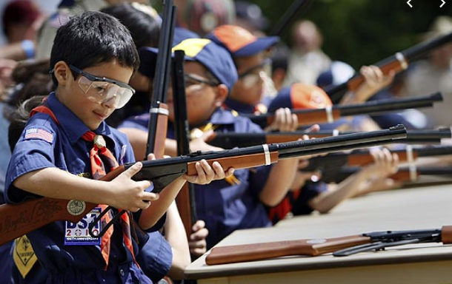
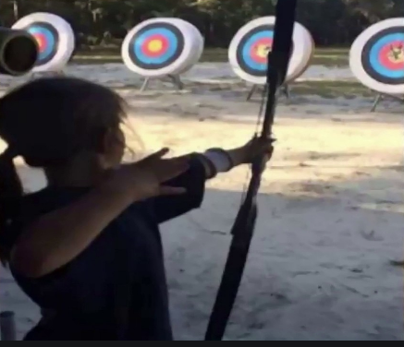
Shooting Sports
Requests for Shooting Events – Lead Time!
  50+ scouts - 6mos
  Less than 50 scouts - 3mos
Shooting on private land:
  Requirements
  Permissions/protocols
Shooting Sports web page
Shooting Sports Instructor Classes:
  Rifle/Shotgun
  Archery (Virtual classes available)

Slide 26


Merit Badges
Every merit badge counselor needs to be on the District charter.
Scouters registered only in the unit are not automatically merit badge counselors.
https://my.scouting.org/VES/OnlineReg/1.0.0/?tu=UF-MB-082gm23 This is the URL for MBC online registration. Online registration is preferred.
New Merit Badge Counselors must complete online Merit Badge Counselor training, in addition to YPT. Existing Merit Badge Counselors have until 12/31/22 to complete training.
Special training is required for Shooting Sports and Water Sports. See the Guide to Advancement for specifics.
Citizenship in Society also requires Diversity, Equity and Inclusion as well as the council specific training for this merit badge.
After taking all required training and registering online, submit the completed Merit Badge Counselor Information Form to the District Merit Badge Dean. Also submit specialty training such as BSA Safety Afloat, BSA Aquatics Instructor, American Canoe Association, NRA Shotgun Instructor, etc.
Each unit is recommended to have a Unit MB Dean to assist adults in MB submissions.
Contact Margee if you have questions at GM.MB.Dean@hotmail.com.

Slide 27
Other Topics
Order of the Arrow
General Announcements
District Executive Minute
District Chair Minute
District Commissioner Minute
Minutes and slides available on the GMD web site (District Resources, Roundtable). Password is “GMDRT”
Next meeting – November 10, 2022 (Thoreau MS)
  6:30pm – Troop Expo
  7:30pm - Roundtable

