Slide 1
What is
EIT Food
InfraBooster Foundation?
Unlocking the hidden value of European research infrastructures.
Foundation

Slide 2
EIT Food InfraBooster promotes the effective use of publicly-funded research infrastructures owned by universities or research institutes and relevant to the R&D efforts of private sector agri-food companies and start-ups.
EIT Food InfraBooster is a modular training program for representatives of scientific organisations that own agri-food research infrastructures.
Participants will be able to leverage the existing assets: commercially-relevant research infrastructures, skills and knowledge of research teams.
InfraBooster will bring research infrastructures closer to the industry, increasing the collaboration, international exposure and innovativeness of the institution, and help establish new sources of revenue.
What is InfraBooster?

Slide 3
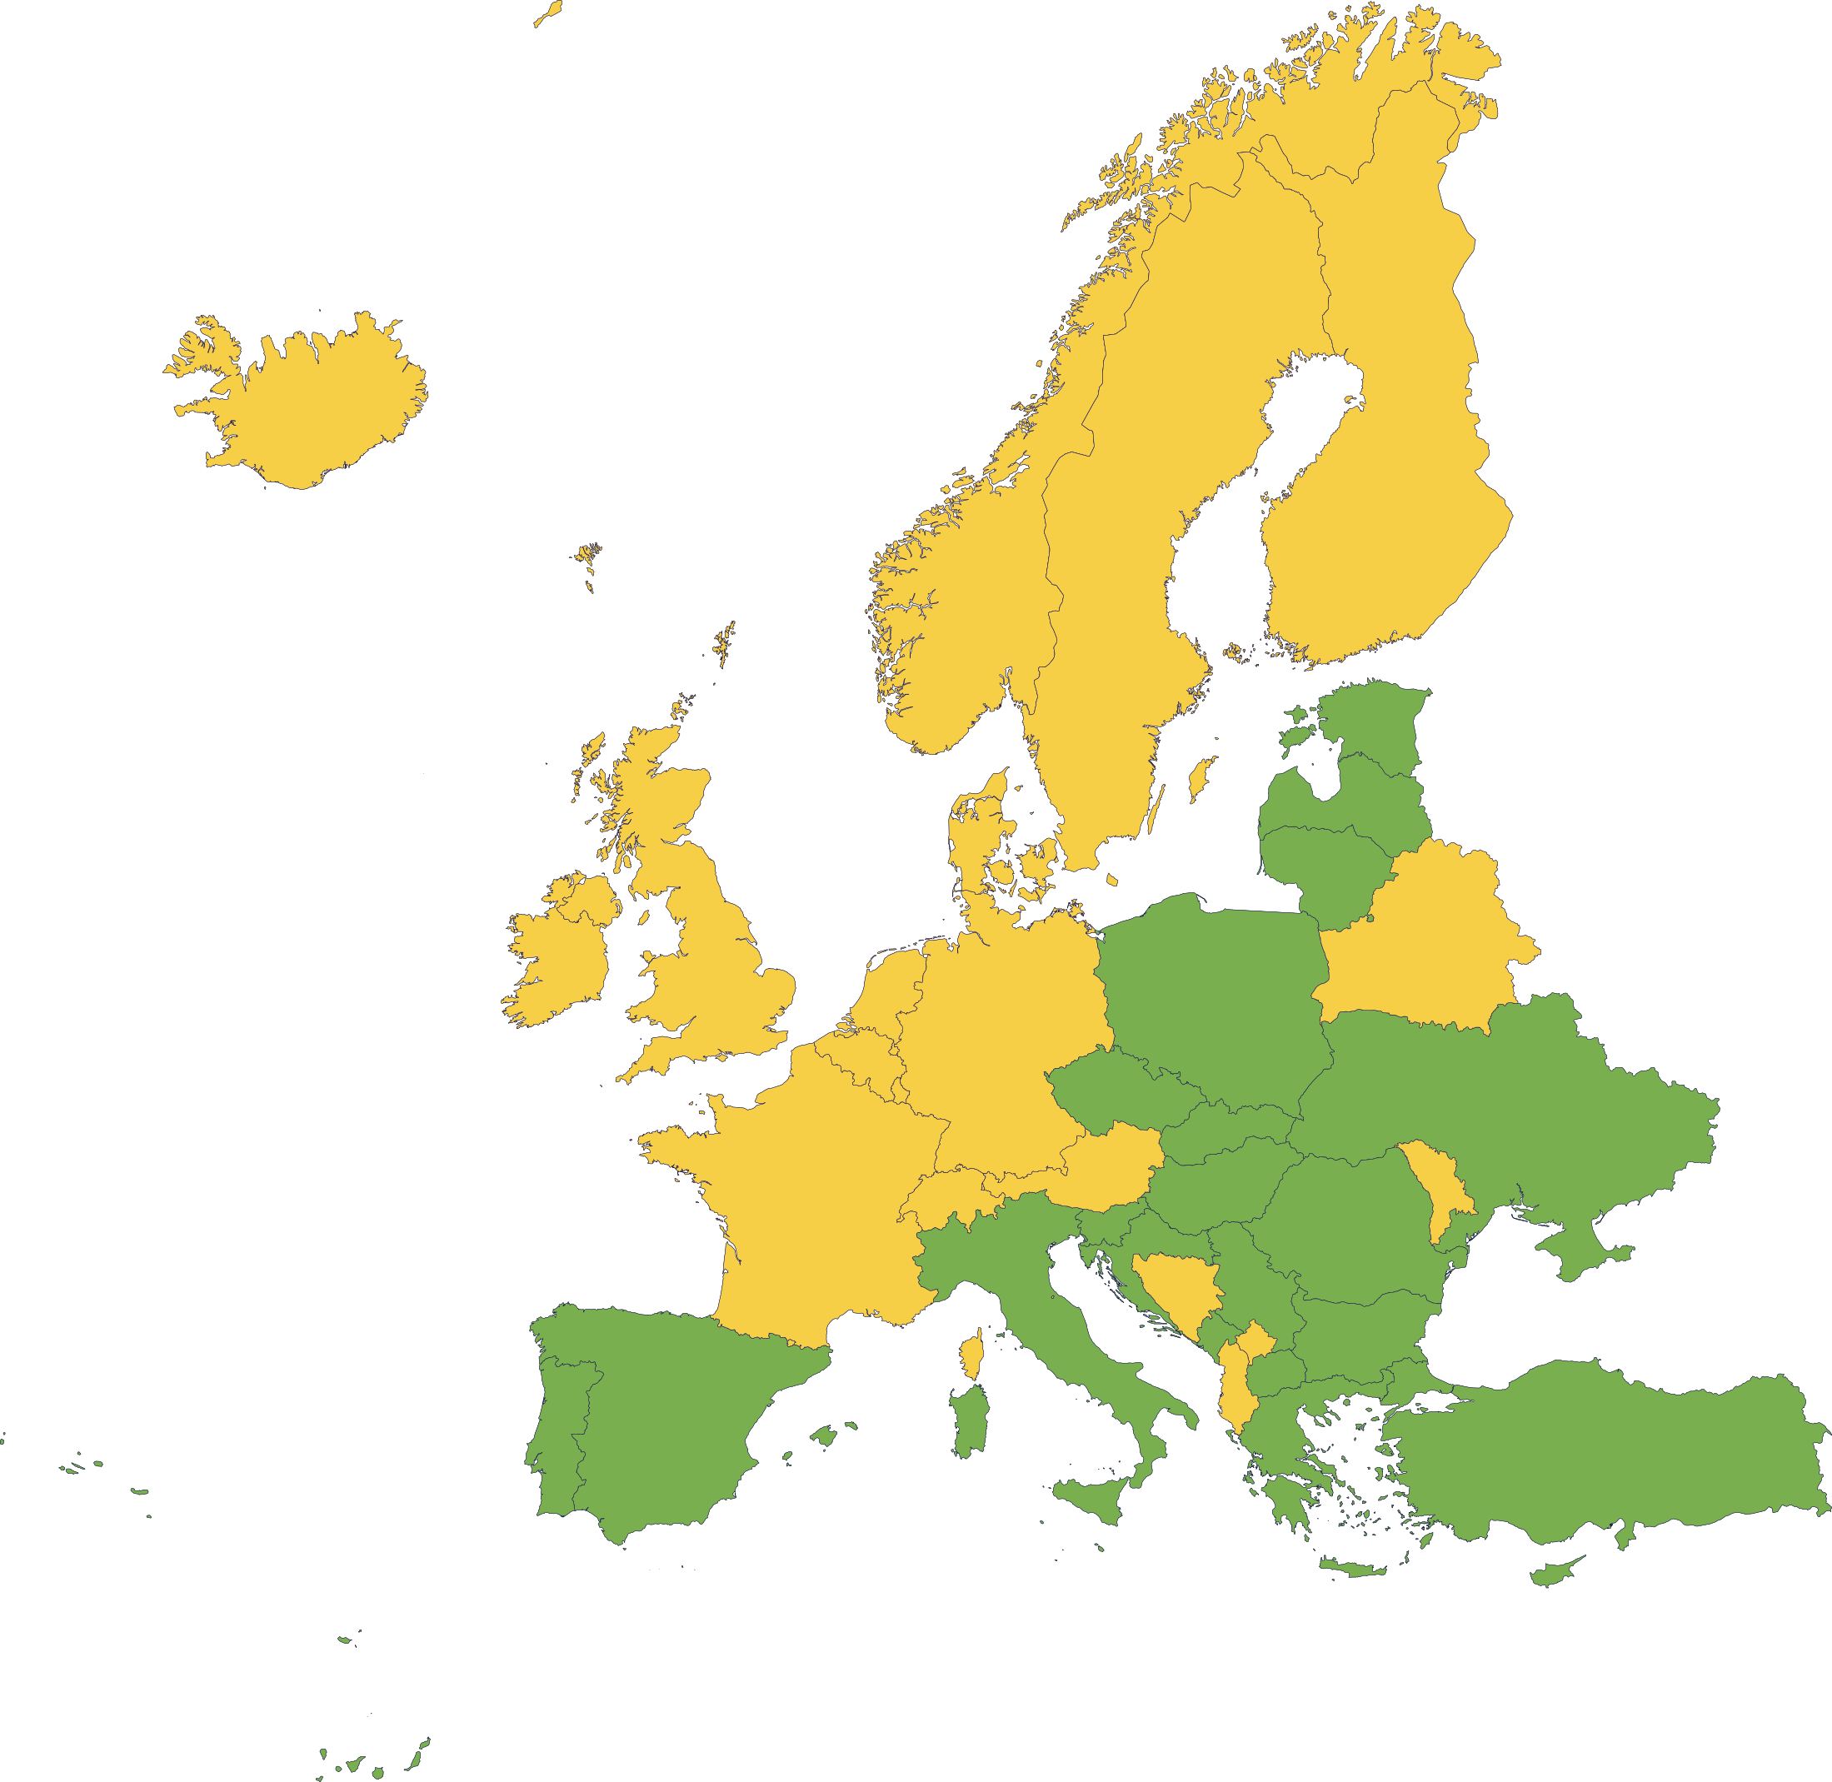
For scientific institutions that own specialist laboratory equipment, research tools, software and databases that are used for research purposes, useful for potential industrial partners, who would collaborate to benefit from access to the infrastructure.
Focus areas: targeted nutrition, sustainable aquaculture, sustainable agriculture, alternative proteins, digital transformation of traceability, and circular food systems.
Participants from: countries covered by the EIT Regional Innovation Scheme and Western Balkans.

Slide 4
Training based on highly interactive learning methods allows participants to gain an understanding of innovative contexts.
Lectures offering insights on how to identify and leverage research infrastructure for use in commercially oriented activities in the agri-food sector.
An opportunity to develop profession-related competencies.
Required for EIT Food InfraBooster certification pathways.
Participants from public sector organisations from RIS countries do not pay tuition.
What
are key features?

Slide 5
Visit course information page at: https://www.eitfood.eu/projects/infrabooster or contact the EIT Food InfraBooster Foundation coordinator:
Mansour Esmaeil Zaei at mez@wz.uw.edu.pl.
Foundation

