Slide 1

SCRCOG Webinar
January 6, 2025
Textiles
Propane Tanks
Backyard Composting

Slide 2
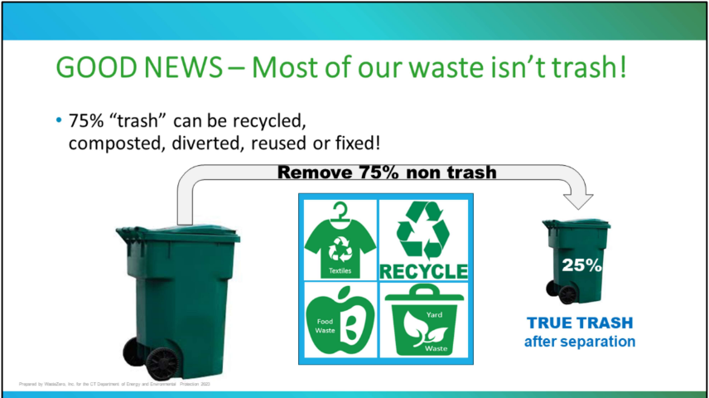
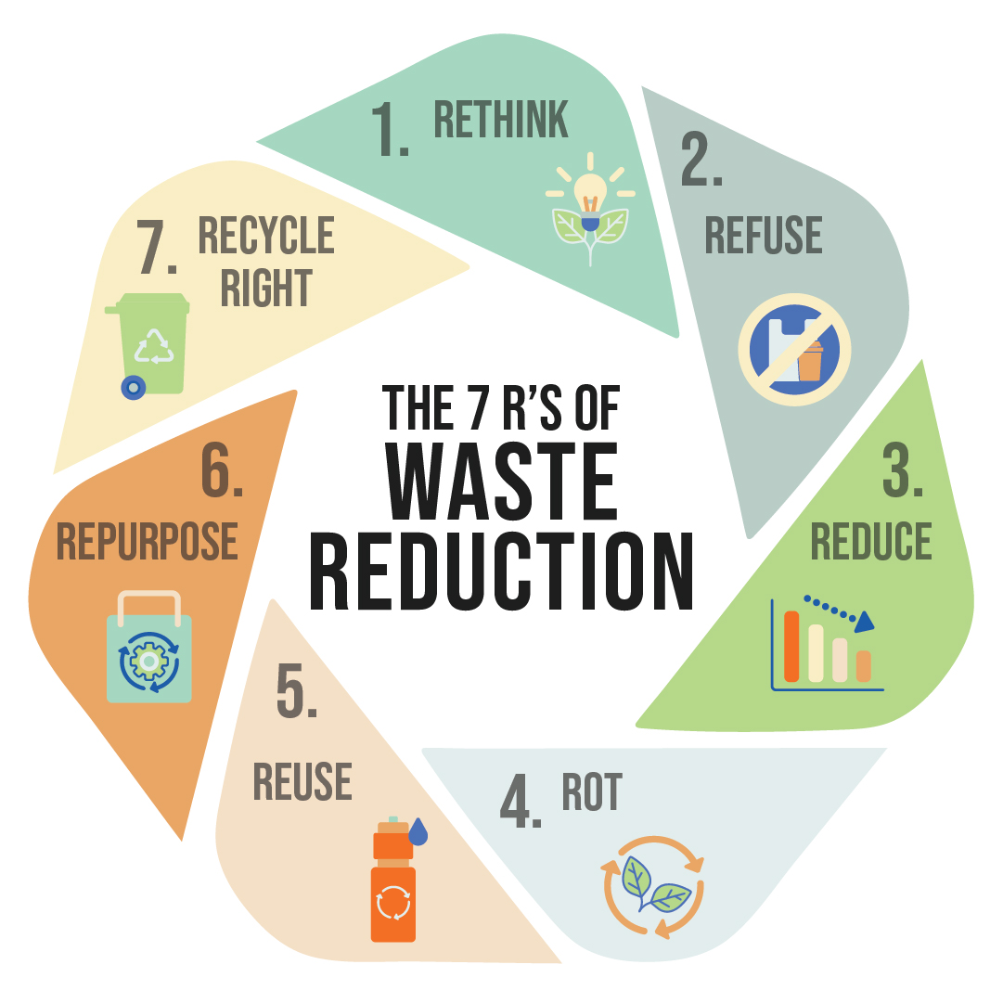
Notes:
The good news is that most the garbage we presently put in our garbage cans is not “true trash.”
75% of it can be pulled out and put other places
Textiles (old clothing/rags) can be reused by putting in textile bins or donated.
RECYCLING Most plastic, glass, metal food and beverage containers, paper, cardboard, and other metal can be recycled. Make sure that recycling is loose in the blue cart, no plastic bags!!
Food waste is a resource and can be composted or turned into clean energy.
Yard waste should not go in the garbage but instead can be brought to your local transfer station, recycling center or brush recycling site
If we work to remove non-trash items, the trash that goes to out-of-state landfills or incinerators would be significantly reduced.

Slide 3
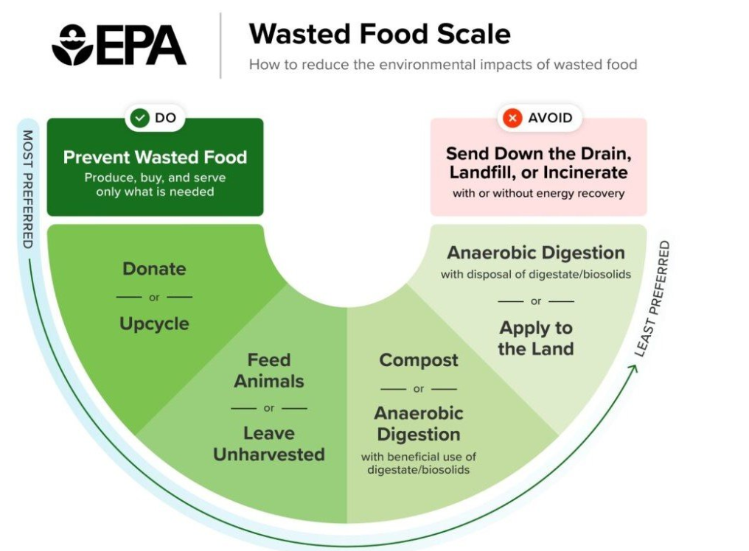
EPA Wasted Food Scale
58% of methane emissions from landfills come from food waste
Methane is responsible for about a 1/4 of global warming
Project Drawdown ranks food waste #1 of 93 global solutions for reversing climate change, that food waste represents 8% of global GHG
Households are the largest contributor
UN’s Goal is to reduce food waste by 50% by 2030
The importance of food scrap diversion is reflected in REFED's presentation here:
https://portal.ct.gov/DEEP/Waste-Management-and-Disposal/CCSMM/Increased-recycling

Slide 4
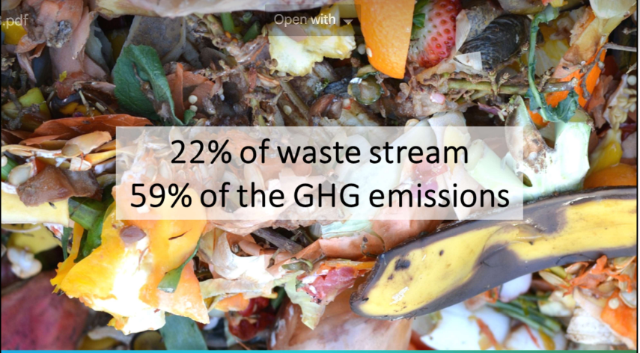
Why Food Scrap Diversion?
Food is not Waste
It Does Not Belong in the Trash
  Heavier to haul
  Harder to burn
  Wasted valuable resource
  Produces huge amounts of methane

Slide 5
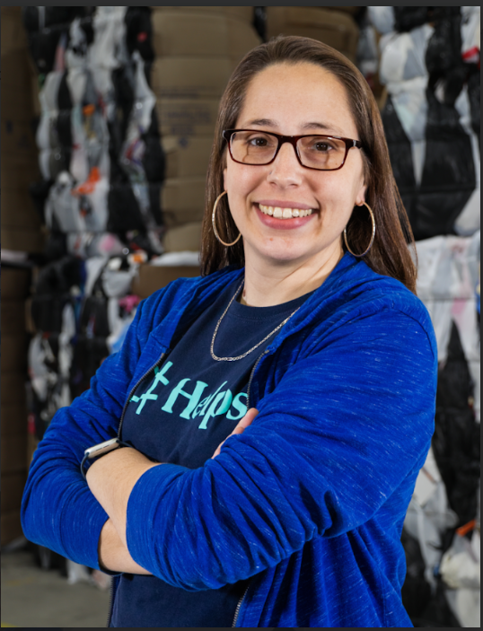
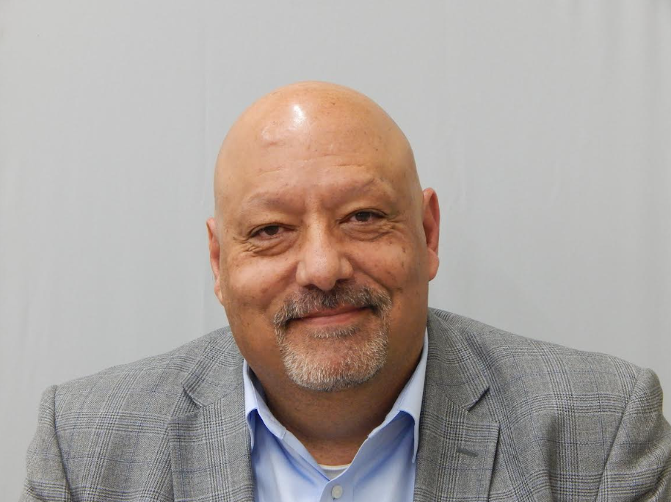
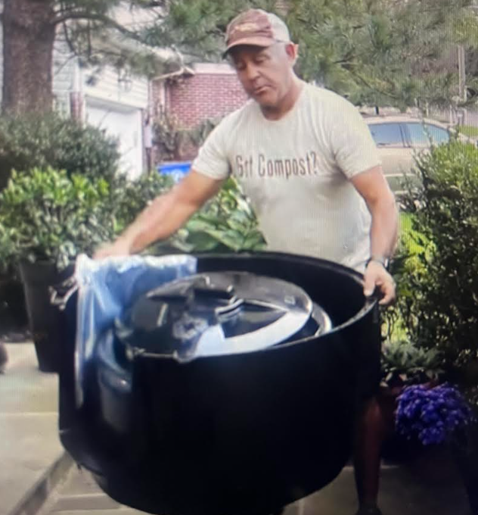



TODAY’s SPEAKERS
Nicole Pellegrino David Keeling Jeffrey Brown
Sr. Relationship Mgr. Executive Director BrandBuilders, LLC
nicole@helpsy.co The Cylinder Collective jeffrey@brandbuildersllc.com
917-238-2976 DavidKeeling@cylinderindustry.org 234-COMPOST
414-630-9382 201-452-4636
Additional Textile Recycling Option:
BAYSTATE Textiles – Cori Cea-Curry, cori.baystatetextile@gmail.com, 508-681-5651

Slide 6

Thank you for your attention.
Pamela Roach
Solid Waste and Recycling Consultant
PDRicciRoach@gmail.com
203-804-0387

Slide 7


nicole@helpsy.co
www.helpsy.com
1

Slide 8
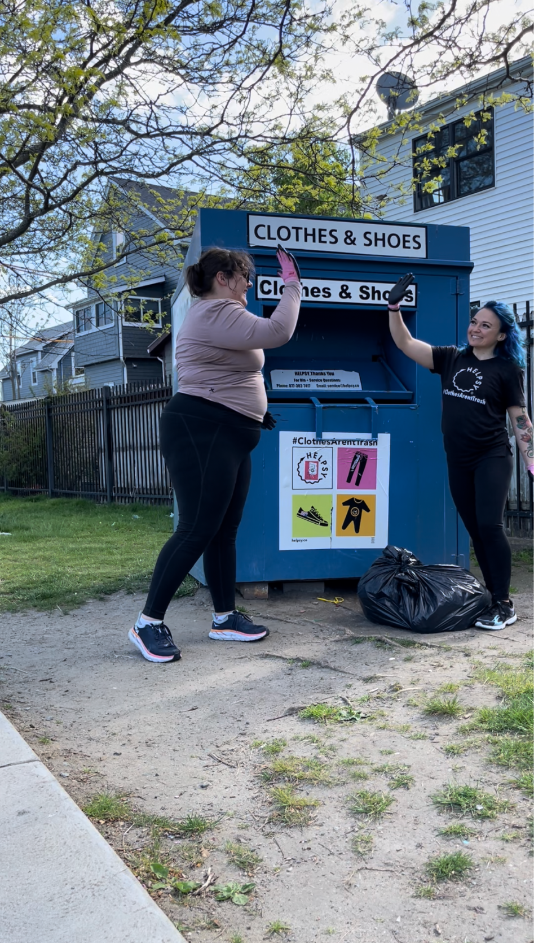

Hi, we’re Helpsy
Helpsy’s mission is to keep clothes out of the trash, provide honorable work, and earn growing profits.
We are a Certified B Corp and Public Benefit Corporation.
We are proud to meet high standards of verified social and environmental performance.

Slide 9
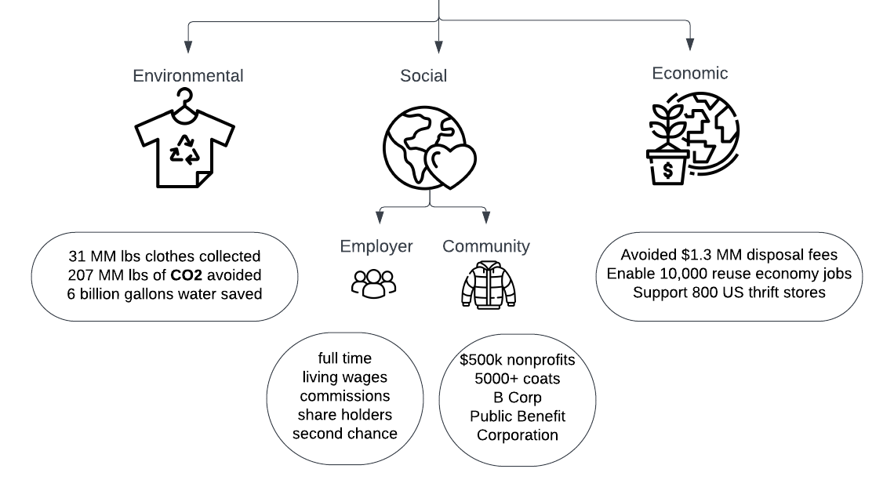
Why We Do What We Do
+ 2023 Impact

Slide 10
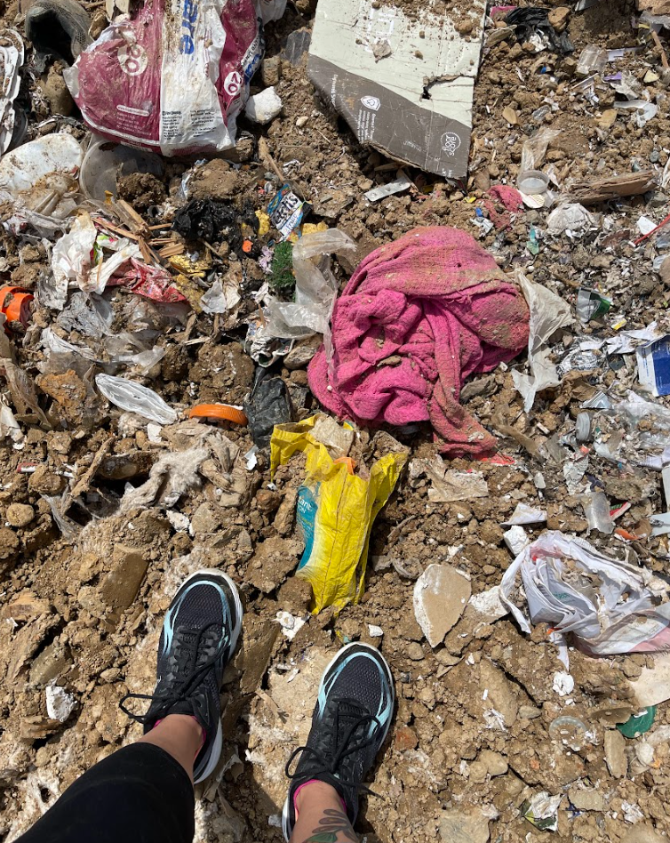
Textile Waste Problem
In the US, we discard 104 lbs textiles per person per year (EPA, 2018)
Per capita, textile waste grew 55% between 2000 and 2018 (NIST, 2021)
Textile production reached ~100 MM metric tons in 2020, ~2x in last 20 years (Niinimaki, 2020)
More than half fast fashion produced is disposed of in under 1 year (RRS, 2020)
85% ends up in municipal waste stream
(EPA, 2018)
May 2023, MD landfill
Photo Credit: Helpsy

Slide 11
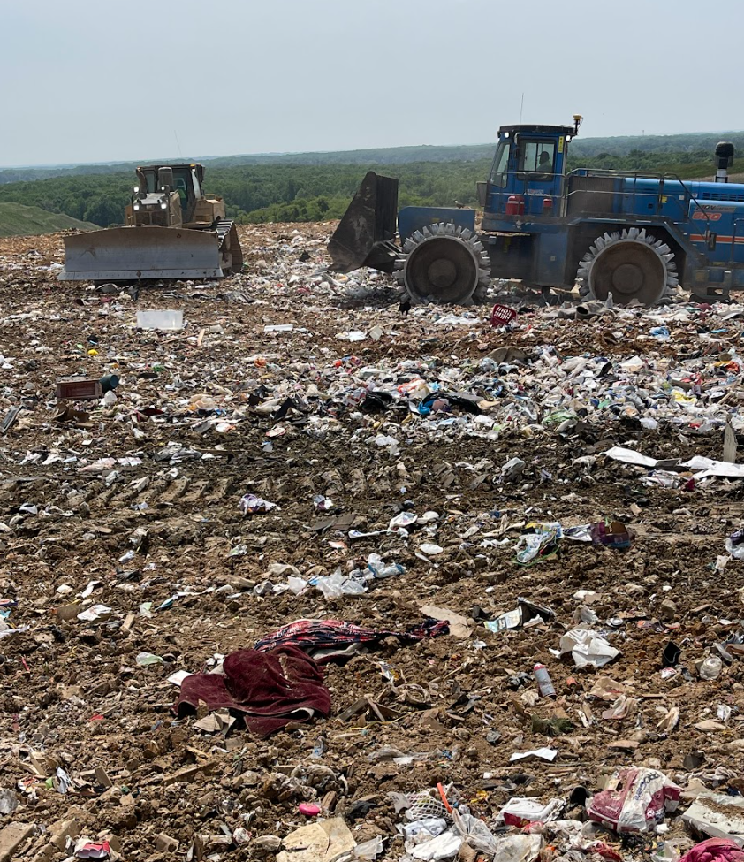
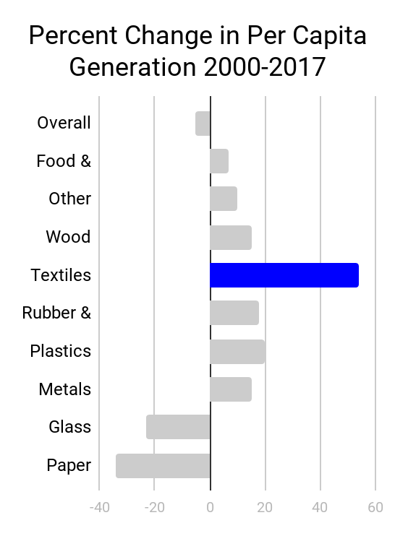
Textiles are the Fastest Growing Waste Stream
Source: EPA From 2000-2017, % Change in Per Capita Generation
Notes:
https://docs.google.com/spreadsheets/d/1e6D3VjciZmJyk6AOoSzOnZN72dFEjlRDKuPoPyyEz3Q/edit#gid=1310286399 ←- fresh data 2022 tab
Add hyperlink of EPA report
https://www.epa.gov/facts-and-figures-about-materials-waste-and-recycling/advancing-sustainable-materials-management ←- EPA report
https://docs.google.com/spreadsheets/d/17pO5OTNILGg0gm9L5CQDq6V-Ic4GozsFwqz-J0Aiv6U/edit#gid=995712486 ←- for water
https://drive.google.com/drive/u/0/folders/1geg6GEaa6WUb5VnEtFIGt_cEnmxx7Twz ←- for tipping fee

Slide 12
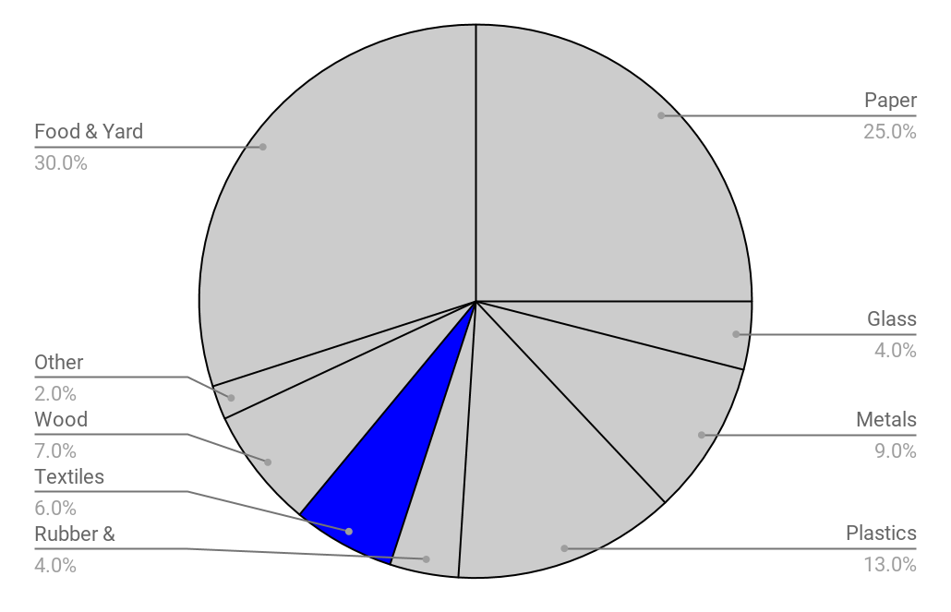
Textiles are 6% of Municipal Waste
Source: EPA
Notes:
EPA Advancing Sustainable Materials Management

Slide 13



Helpsy Operates 3 Lines of Business
Collect
31 MM lbs/yr
1,200 locations
10 states
Source
Proprietary sorting tech
Supply 6,000 thrift stores and resellers
Trading
12 MM lbs/yr brokered
Used clothes, shoes, toys, household items

Slide 14
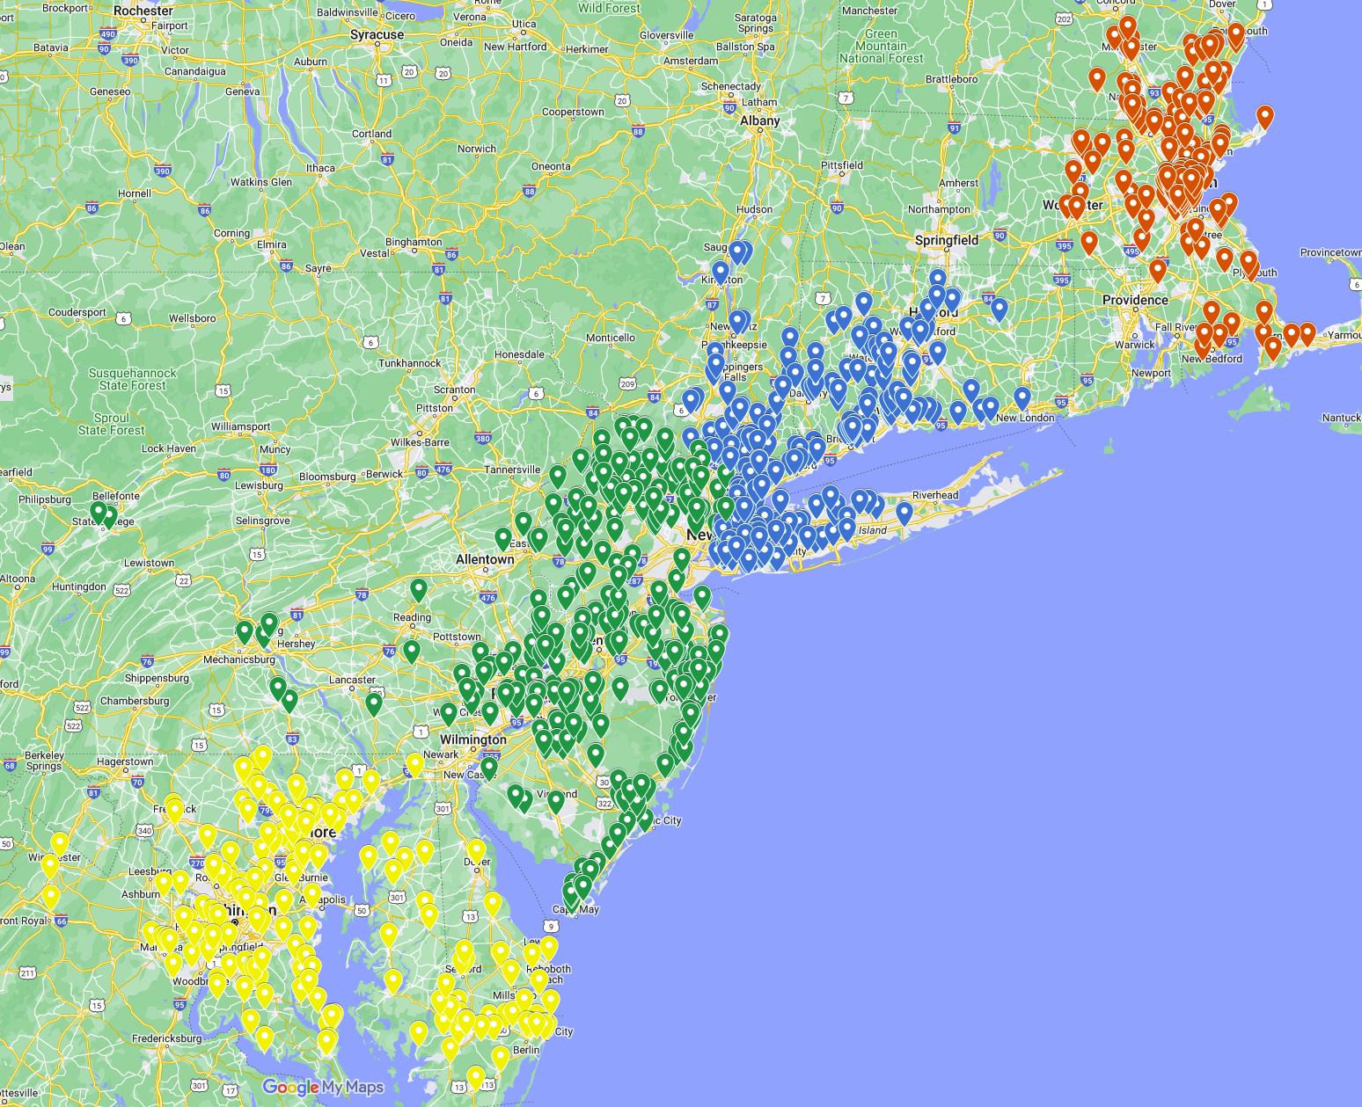
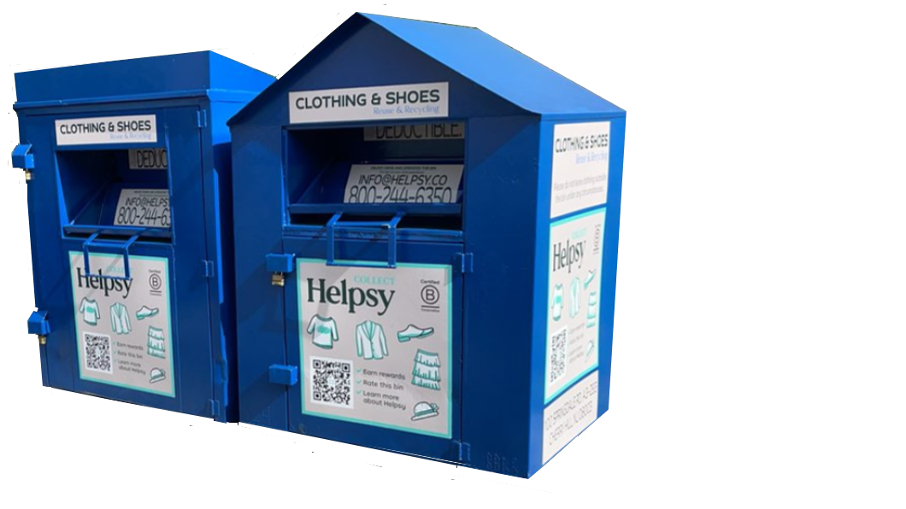
Helpsy Collects From 1,200+ Locations in 10 States

Slide 15
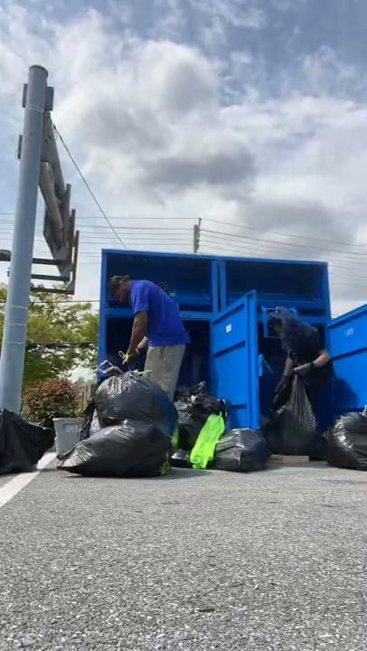
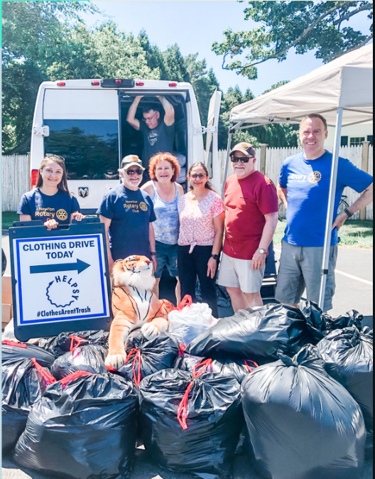
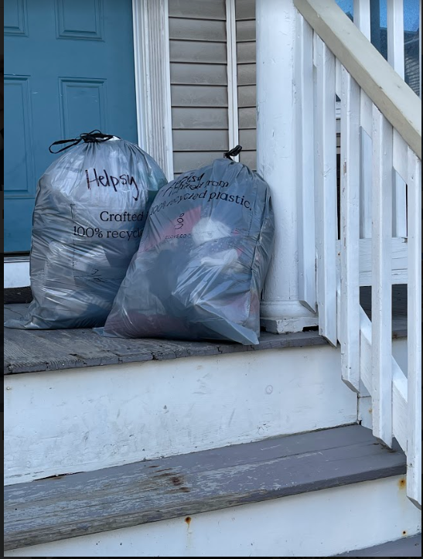
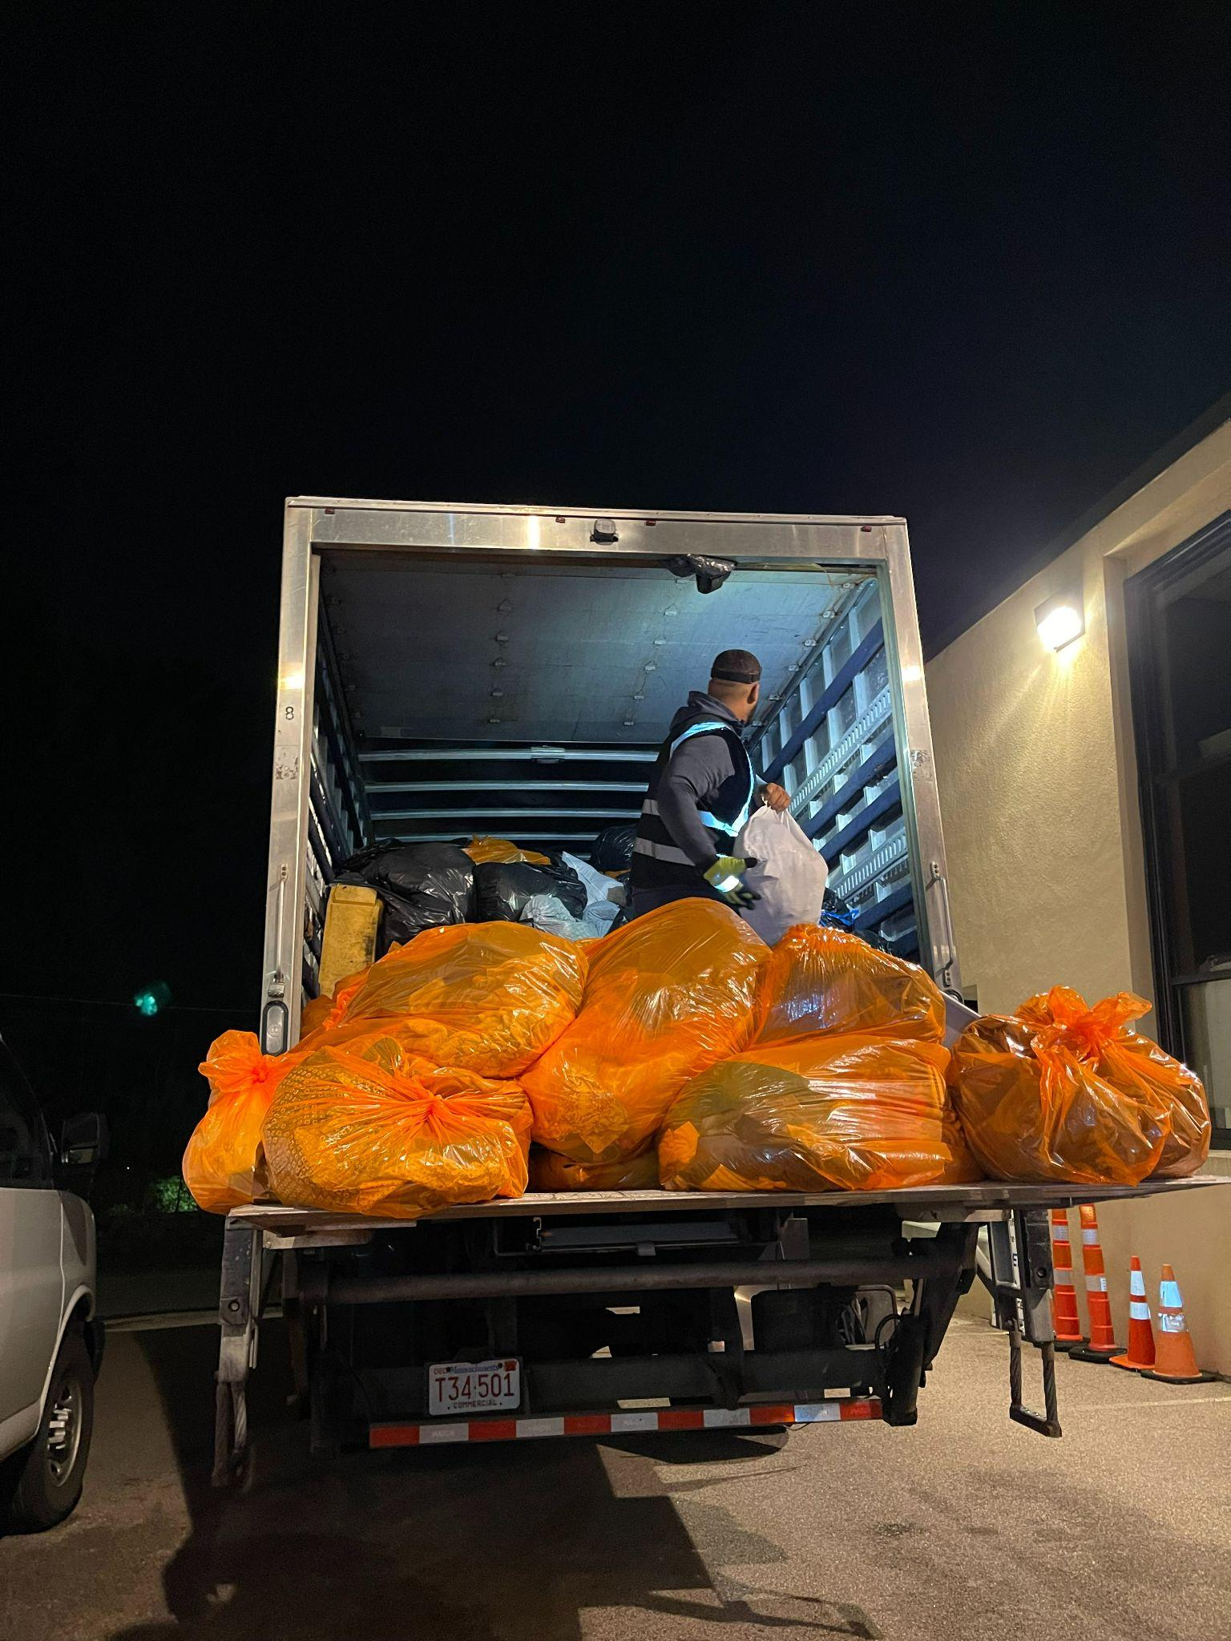
Clothing Collection Methods
Bins
The classic collection method.
Clothing Drives
Fundraising opportunities for community organizations.
Home Pickups
Free service offered in select municipalities.
Thrift Stores
Pickup of excess or unwanted clothing + sell curated inventory

Slide 16
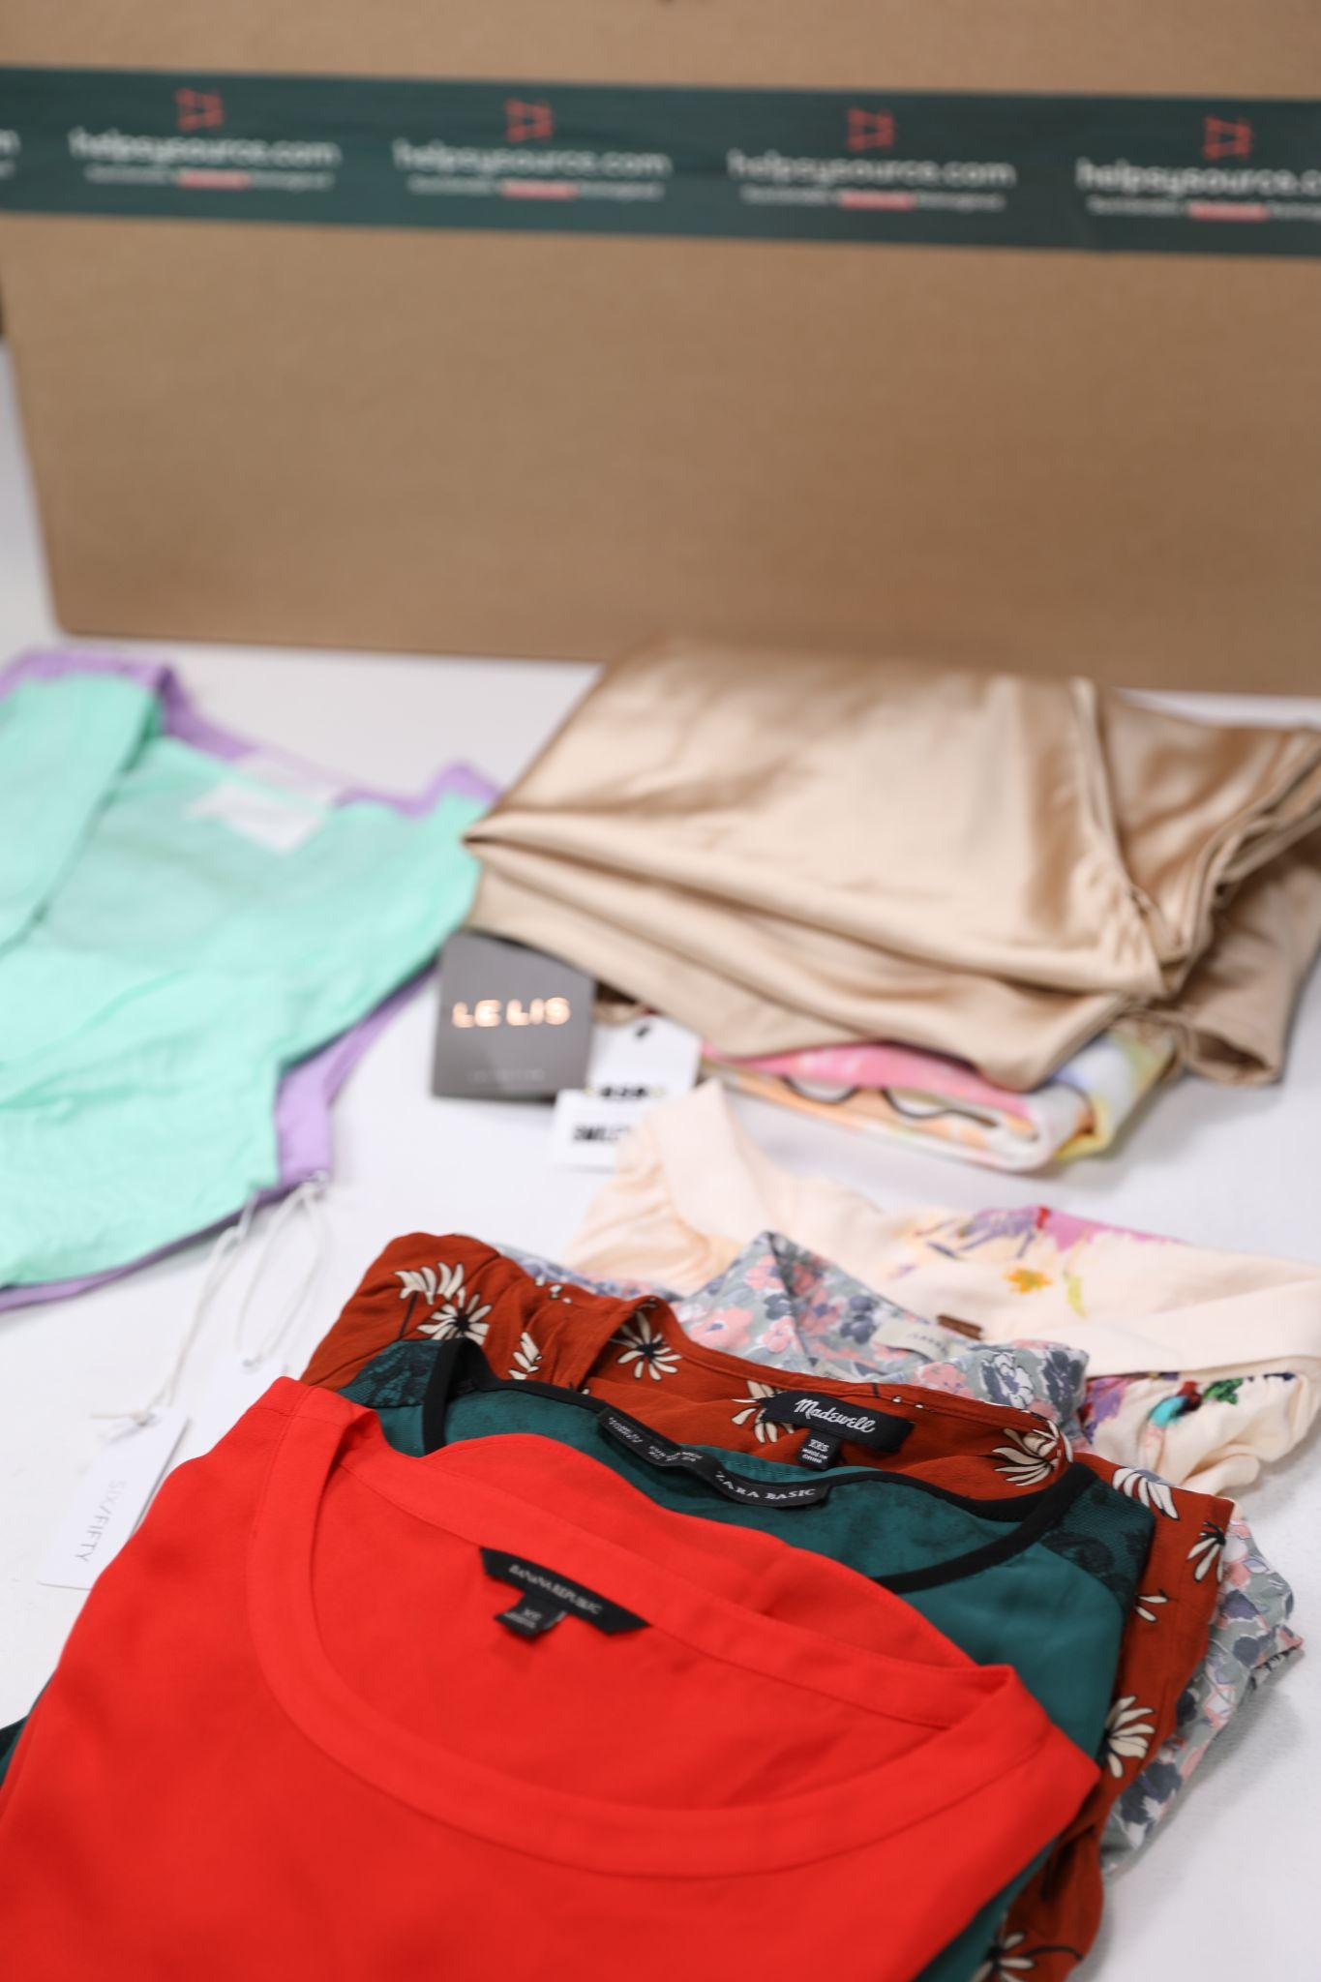
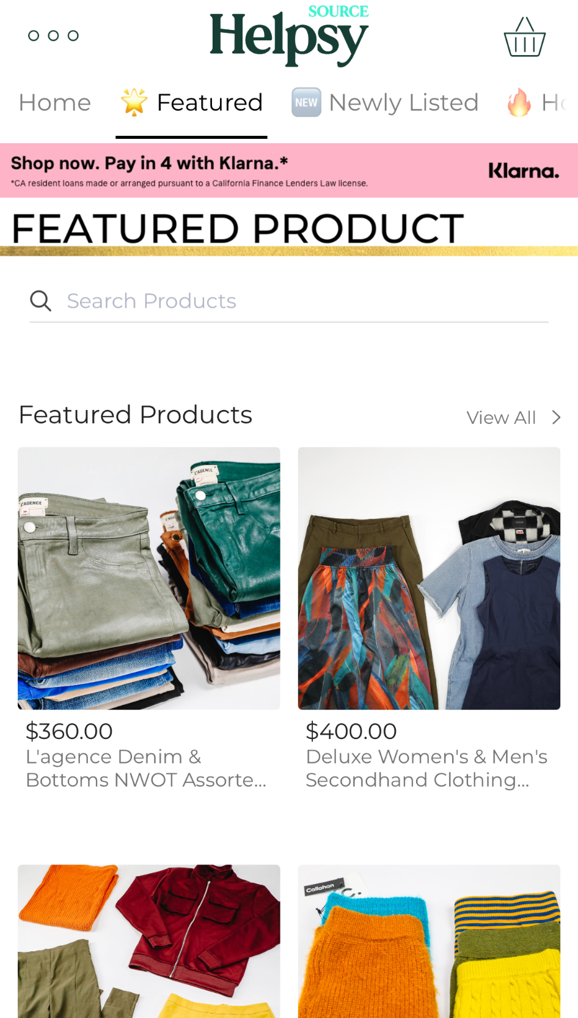
Helpsy Source: Supplying Branded Inventory
We use proprietary technology to sort clothes by brand and condition.
Our tech provide rich brand and damage data.
We provide thrift stores and resellers inventory by brand and condition.

Slide 17
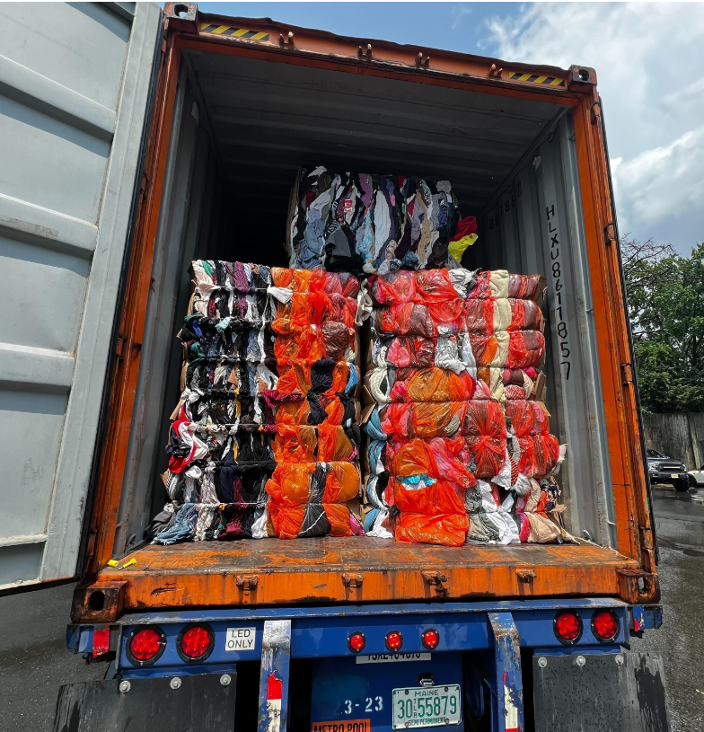
Helpsy Trading
Helpsy buys millions of pounds of used goods from large thrift stores, smaller collection companies, and wiper rags manufacturers.
We sell to clothing sorters, secondhand sellers, and industrial users.

Slide 18
What Happens to the Clothes?

Slide 19
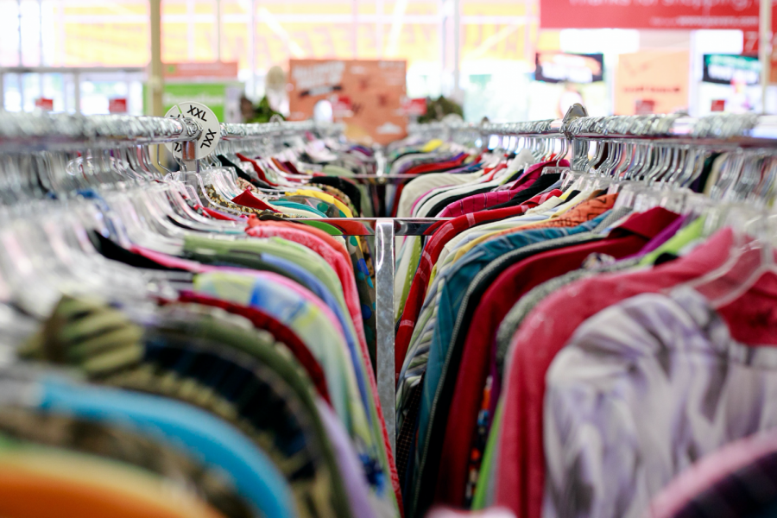
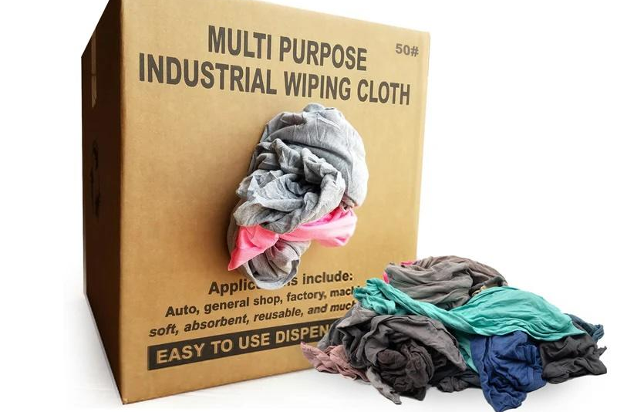
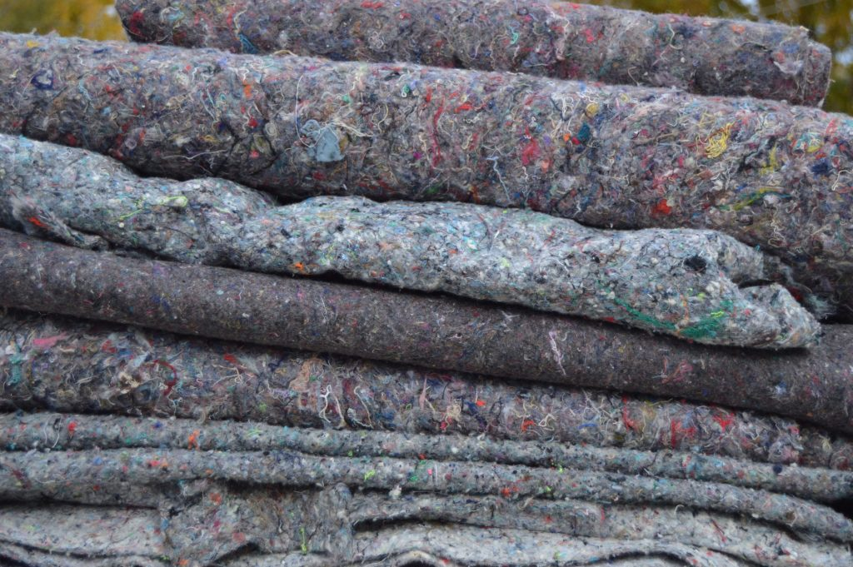
What Happens to Used Clothing?
85% end up in municipal waste stream (trash, landfill, incinerator)
However 95% could be reused as clothing or something else:
45% reuse apparel 30% wipers 20% insulation
etc
source: SMART, 2024
Notes:
NH, despite recent legislation, is still a trash importer

Slide 20
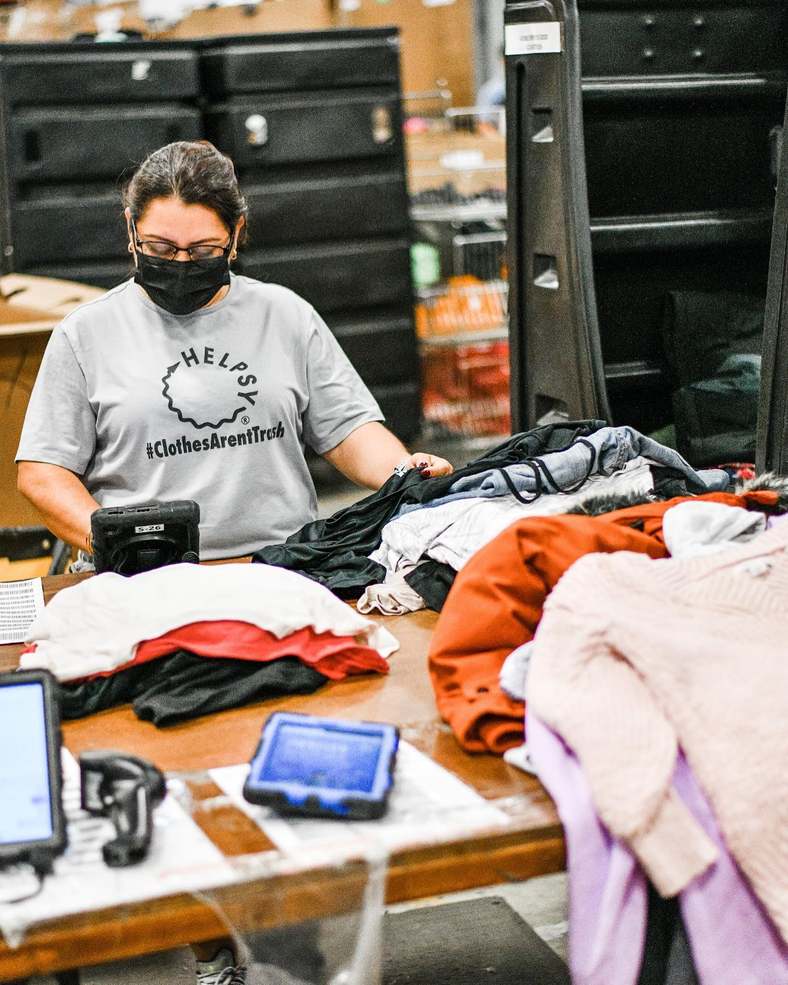
Helpsy focuses on Reuse + Recycling
95% of the clothes we collect are sold for reuse or recycling. 5% unusable, contaminated
Of the clothes we sell, 90% are sold to bulk graders and thrift stores
While it’s a global market, Helpsy has many domestic partners and we have a history of buying back plus sizes and coats
A growing % is being sorted at our HQ in New Jersey
We’re establishing new pathways to support mechanical and chemical recycling
Source: SMART: Secondary Materials and Recycled Textiles

Slide 21
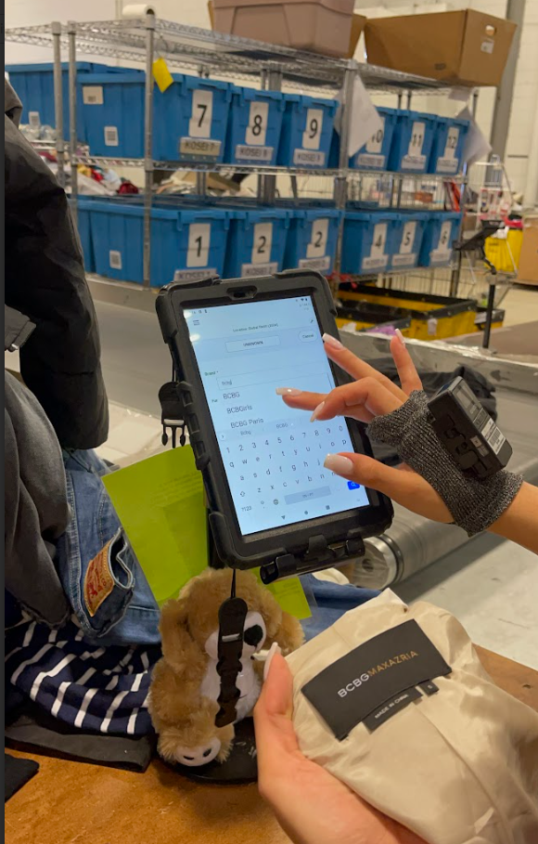
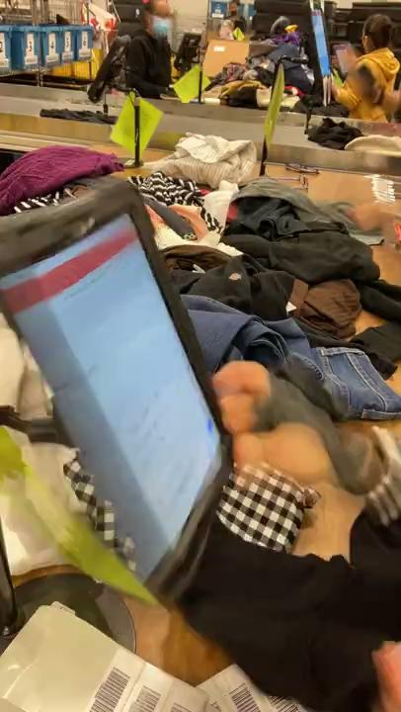
How We Sort

Slide 22
Thank you!
Any questions?
Please reach out to:
nicole@helpsy.co

Slide 23
TODAY’s SPEAKERS
Nicole Pellegrino David Keeling Jeffrey Brown
Sr. Relationship Mgr. Executive Director BrandBuilders, LLC
nicole@helpsy.co The Cylinder Collective jeffrey@brandbuildersllc.com
917-238-2976 DavidKeeling@cylinderindustry.org 234-COMPOST
414-630-9382 201-452-4636
Additional Textile Recycling Option:
BAYSTATE Textiles – Cori Cea-Curry, cori.baystatetextile@gmail.com, 508-681-5651

Slide 24
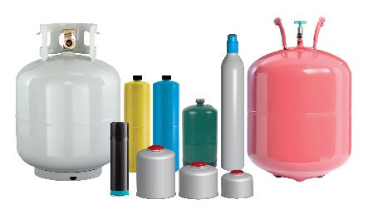
Update on The Cylinder Collective Stewardship Program for Pressurized Cylinders in Connecticut
South Central Regional Council of Governments
Solid Waste and Recycling Zoom Meeting
January 6, 2025
David Keeling
Executive Director
Pressurized Cylinder Industry Association/
The Cylinder Collective
414-630-9382 Mobile
DavidKeeling@cylinderindustry.org
www.cylinderindustry.org/
www.cylindercollective.org/

Slide 25
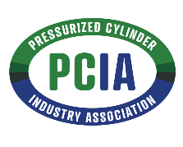

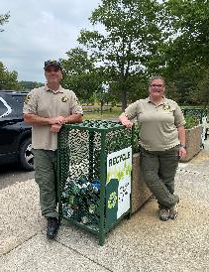
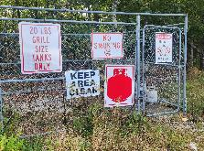
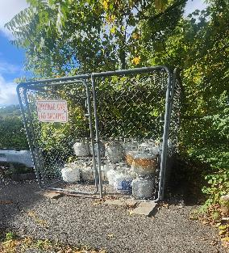
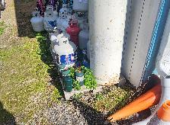
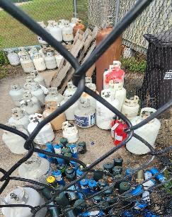
Milestones
Pressurized Cylinder Industry Association (trade association) and The Cylinder Collective (producer responsibility organization) incorporated.
Executive Director hired August 2024.
Voluntary parks pilot program conducted last two camping seasons. Third year will expand types of cylinders collected and come under TCC control.
Hired State Program Coordinator to begin on February 3rd.

Slide 26
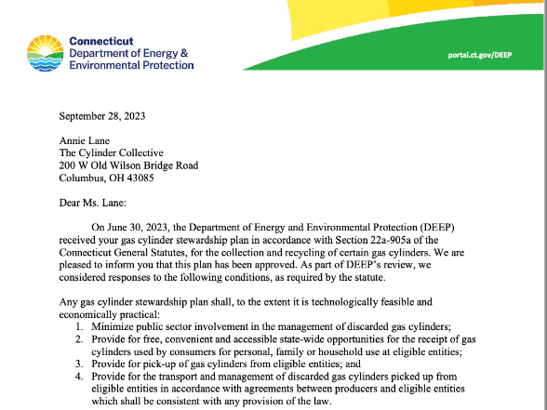

The Cylinder Collective Stewardship Program
Plan was approved by CT DEEP on September 28, 2023.
First year concentrated on resourcing the organization, establishing systems, and outreach to key contacts.
Now, focused on producer recruitment, developing contracts with vendors, and securing collection sites.
Future development of outreach and education program and materials.
www.cylindercollective.org/

Slide 27

Participating Producers
Connecticut’s extended producer responsibility (EPR) law for gas cylinders CT Public Act 22-27 and the amendments passed into law by CT Public Act 24-133 required producers to join an approved cylinder stewardship program by
October 1, 2024
The list below includes producers participating in The Cylinder Collective as of October 21, 2024.
Worthington Industries Inc. 7. BSD Trade LLC (jo Chef)
Johnson Outdoors Inc. 8. Liberty Mountain Sports, LLC
YSN Imports LLC dba Flame King 9. Cascade Designs, Inc.
GSI Outdoors, LLC 10. Sterno Group
Manchester Tank & Equipment Co. 11. Snow Peak USA
The Coleman Company, Inc. 12. Unique Industries, Inc. For Information on brands:
visit
www.cylindercollective.org/
Representation by The Cylinder Collective is open to all pressurized cylinder producers.
Two other program plans from Sodastream and Propane Gas Association of New England (PGANE) were approved by CT DEEP. The Cylinder Collective plans to collaborate with the other gas cylinder programs.

Slide 28
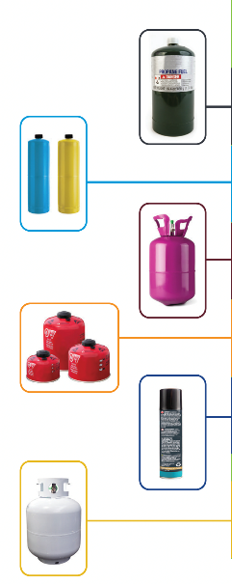
In Scope / Exclusions
Types of Cylinders
Non-Refillable
16 oz Propane
14 oz Fuel Torches (Propane, MAPP)
Helium
4 – 16 oz Isobutane
5 – 8 oz Butane
Refillable
under 20lb propane (20 lb. Tank collected by PGANE program)
In Scope:
    all refillable and non-refillable types of designated cylinders (with a water capacity between 0.5-50lbs) that participating producers supply into Connecticut
Plan will adjust if new members subscribe (e.g., refillable and non-refillable CO₂ cylinders)
Exclusions:
    Supplied to industrial, commercial and institutional consumers and pressurized cylinders
    Containing oxygen, refrigerants, acetylene, hydrogen, ethylene and foam adhesives
    Fire extinguishers
    Water capacity of under 0.5 lbs or over 50 lbs

Slide 29







Collection System
Collection system will rely on various locations:
  Municipal drop off sites/events
  Transfer stations/recycling facilities
  Campgrounds – public and private campgrounds
  State parks – 12 state parks w/ overnight, 2 state forests w/ overnight
  Possible future pilot at retail locations
Where collection gaps exist, the program will explore options in those geographic areas
  Collection sites would be required to meet program operational standards, e.g.,
  Compliance w/ reg. requirements for collection, handling & staff training
  Secure storage
  Record keeping
  No charge for residents to drop off cylinders
  Collection services will be monitored to identify:
  Best practices that could be adopted by other collection sites
  Geographic areas that would benefit from additional collection service
  Collection sites that are not used by residents.
MUNICIPAL
DROFF-OFF
DISPOSAL &
RECYCLING
FACILITY
TRANSFER
STATION
HHW EVENTS
PILOT AT
RETAIL
STATE
PARKS
CAMPGROUND

Slide 30
Pick-up, Transport & Management
Agreements will be established with licensed transporters and processors.
Transporters and processors will be required to meet program operational standards including timely pick-up services, tracking of materials and compliance with regulatory requirements.
Collection sites will be serviced by transporters either on a regular schedule or an on-call basis, as appropriate for a specific collection site.
TCC CT Program Coordinator will be responsible for coordinating on call pick up schedule.
Refillable pressurized cylinders delivered by residents to a program collection location will be transported to a facility where:
  Cylinders will be inspected, recertified, refilled, and returned to the exchange system / other reuse opportunities; or
  If a cylinder cannot be recertified, the residual gas and cylinder will be properly managed.
Empty non-refillable cylinders will be transported to a facility where the residual gas and cylinder will be properly managed.

Slide 31
Promotion & Education
Focus on the following objectives:
  Increasing awareness of how to properly manage pressurized cylinders;
  Encouraging the use of the 20 lb. refillable cylinder exchange system; and
  Influencing behavior change to manage non-refillable pressurized cylinders through delivery to the program collection network.
Education and outreach to engage Connecticut residents will be provided through communication tools such as:
  Program website that provides a central hub to educate consumers on why, how, and where to recycle cylinders accepted by the program. The website will include a list of searchable collection locations by address and zip code that will be regularly updated to ensure timely, accurate information for consumers. Search-engine optimization (SEO) will make the website more visible on search engines like Google, and the website address will be featured prominently in communications. In addition, the website will include program annual reports.
  Print materials, including messaging and graphics that can be used in brochures, fact sheets, backgrounders, fliers, signs and posters at partner locations (e.g., state parks, municipal and retail locations)
  Development of The Cylinder Collective logo that could be used by members as part of product labels to assist with messaging.
  www.cylindercollective.org/

Slide 32
Performance Goal
 | Collection and Diversion
Accessibility (both refillable and non-refillable cylinders) | At a minimum in the first year, 50 collection sites or events in the State
Non-Refillable Cylinder Performance Target | By the 5th year of the program, 100,000 cylinders collected per year
A performance target for refillable cylinders has not been proposed as it is not possible to determine the percentage of cylinders not returned through the exchange system.

Slide 33
Tracking & Measuring Performance
Proposed annual performance metrics for refillable and non-refillable:
  # of collection locations by type (municipal, campground, park, retail) and # of special events in each county
  # of refillable and non-refillable cylinders collected
  # of refillable cylinders recycled/reused (i.e., returned to the exchange system and number sent to scrap metal recyclers)
  Tons of non-refillable cylinders sent to scrap metal recyclers
  Collection Rate (%) = [Tons of non-refillable cylinders collected / tons of non-refillable cylinders supplied to consumers] x 100
  Diversion Rate (%) = [Tons of non-refillable cylinders recycled / tons of non-refillable cylinders supplied to consumers] x 100

Slide 34
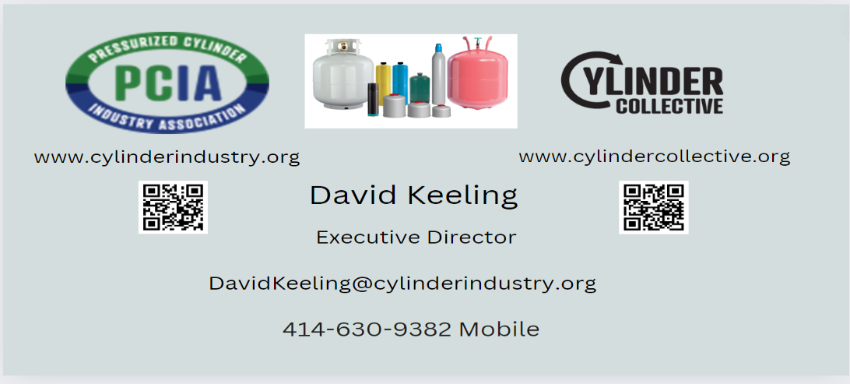
Questions and Feedback
Topics for Discussion:
Access to your municipal transfer stations and HHW collection facility and one day events restricted to only municipal residents?
Does your municipal transfer station have contract with, loyalty to, or receive payment from current 20 lb. propane tank vendor?

Slide 35
TODAY’s SPEAKERS
Nicole Pellegrino David Keeling Jeffrey Brown
Sr. Relationship Mgr. Executive Director BrandBuilders, LLC
nicole@helpsy.co The Cylinder Collective jeffrey@brandbuildersllc.com
917-238-2976 DavidKeeling@cylinderindustry.org 234-COMPOST
414-630-9382 201-452-4636
Additional Textile Recycling Option:
BAYSTATE Textiles – Cori Cea-Curry, cori.baystatetextile@gmail.com, 508-681-5651

Slide 36
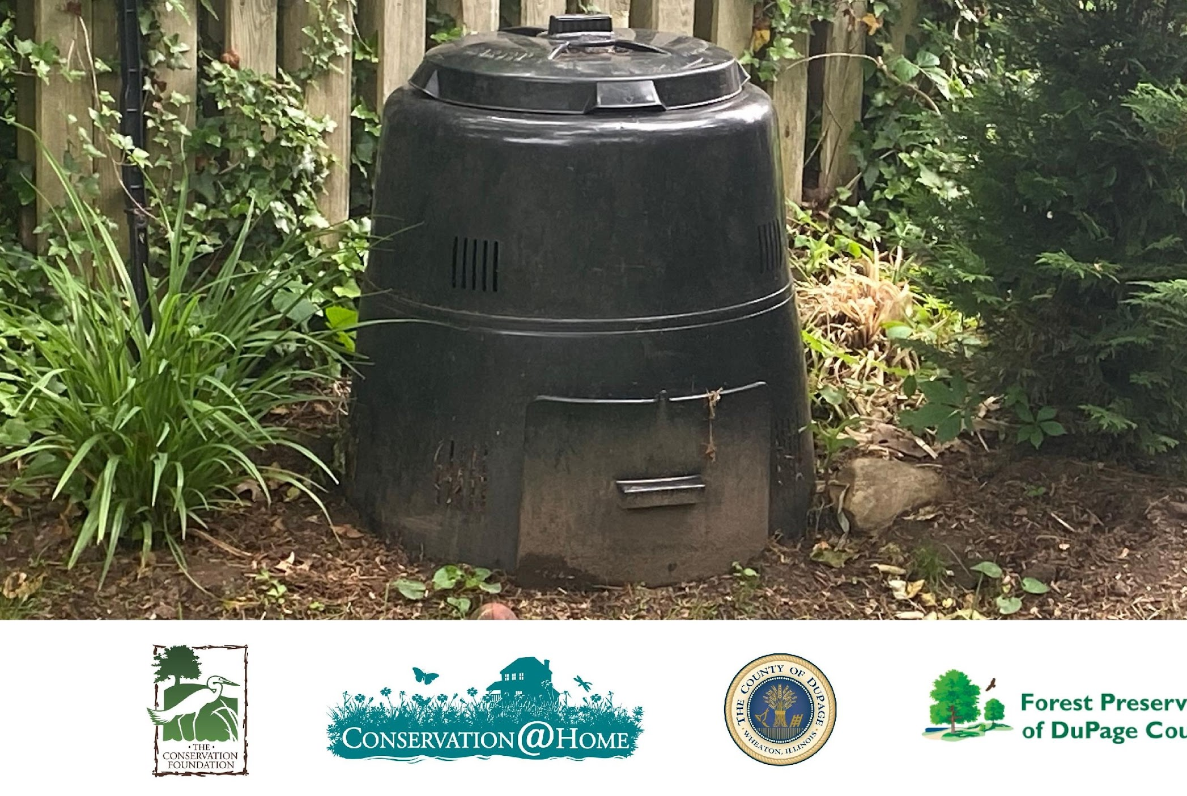
Residents are willing to do it in their backyard

Slide 37
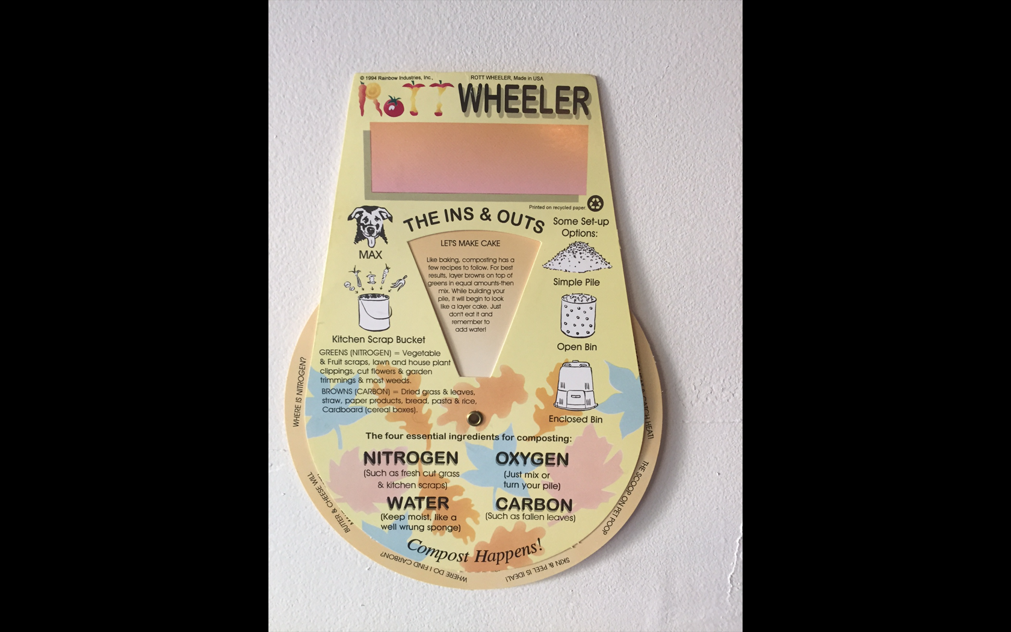
Leaders in Education – the key to a successful program

Slide 38
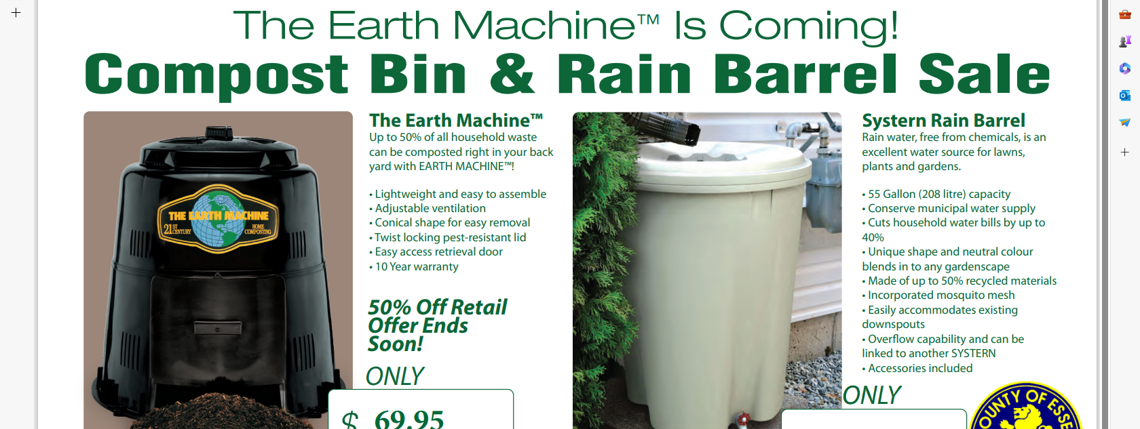
We include a custom poster with QR Code

Slide 39
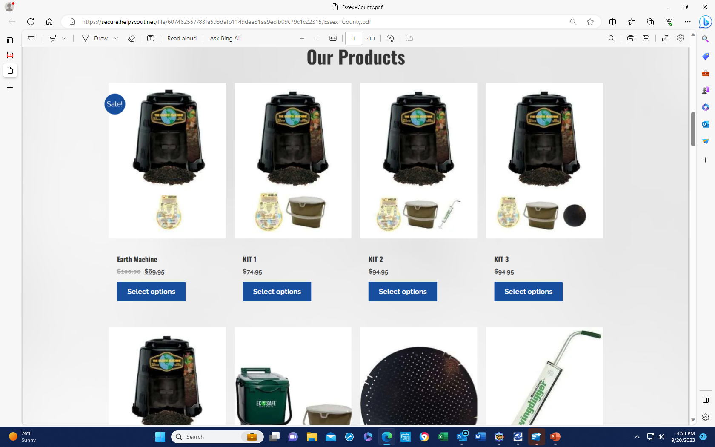
Just pick your items

Slide 40
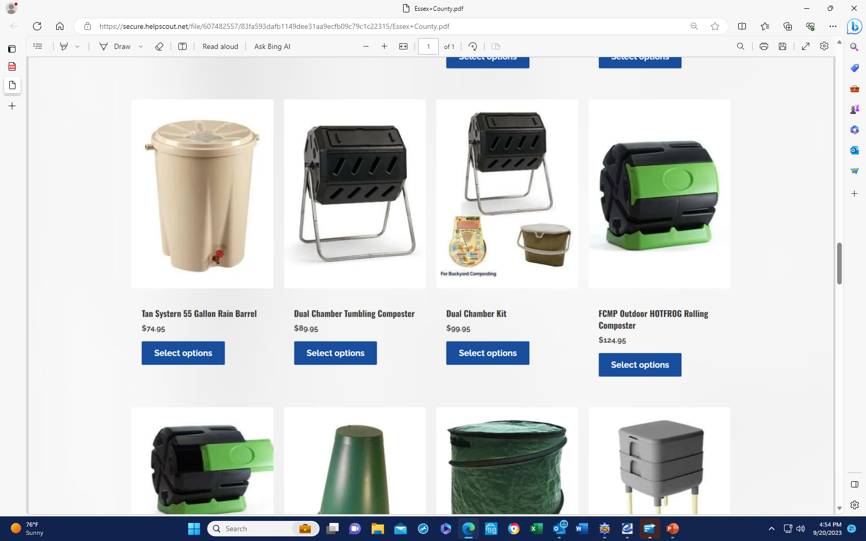
Much to choose from!

Slide 41
How to get started:
*Cost to build a custom store: $250.00, free with Grant sales (reduced prices)
*Timing: 1 week to build a store, should stay open for 6 – 8 weeks.
*Ordering: 20/pallet, 5 pallet minimum
CONTACT: Jeffrey Brown – P: 234-COMPOST
jeff@compostersale.com
https://compostersale.com

Slide 42
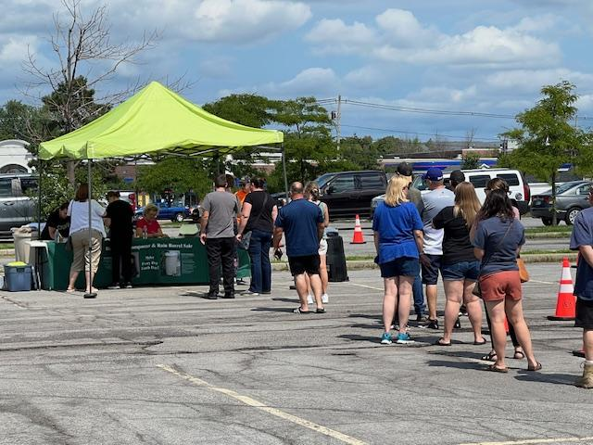
Erie County – 2,100 rain barrels & 600 composters were picked up in 1 day!

Slide 43
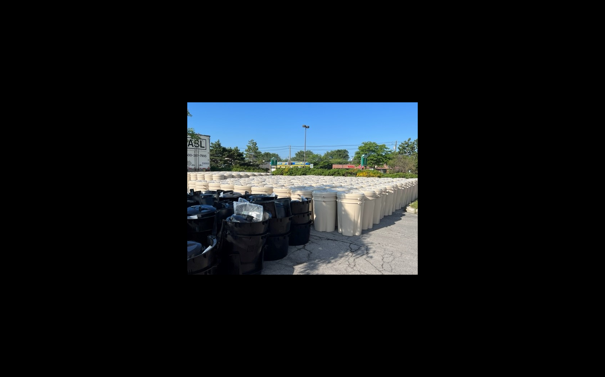
Erie County, NY August 26-27,
2,150 Rain Barrels & 600 Composters

Slide 44
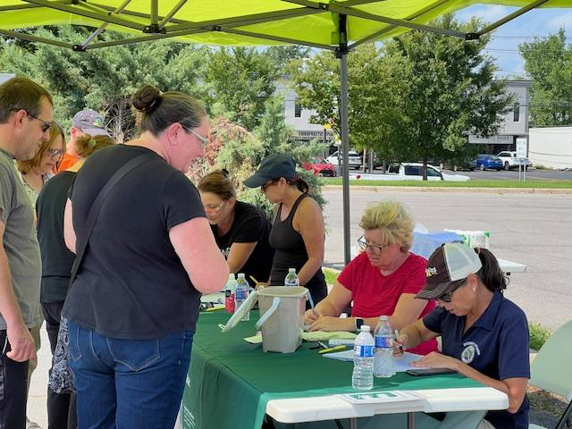

Slide 45
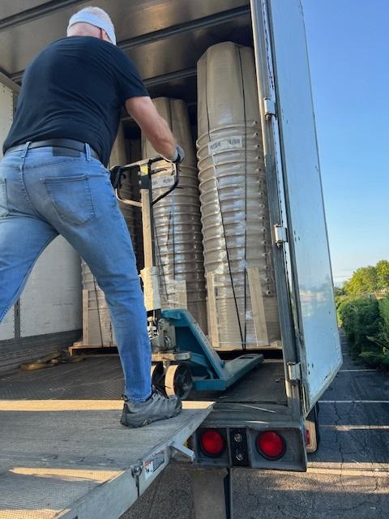

Slide 46
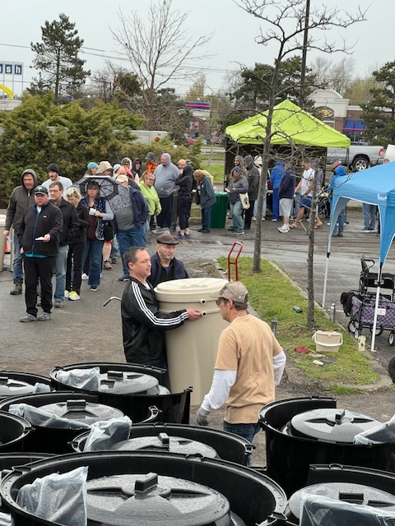

Slide 47
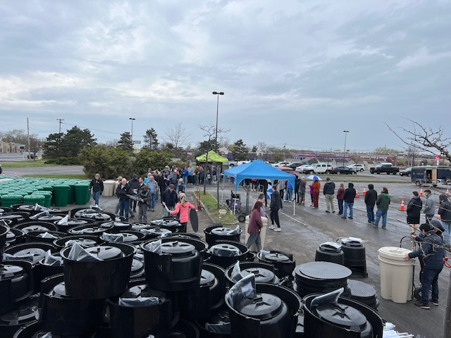

Slide 48
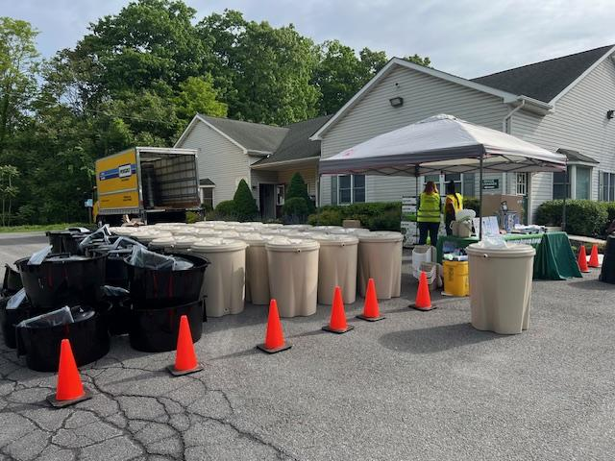
Ulster County, NY

Slide 49


Slide 50

Organic Waste Diversion Backyard Composting
The Earth Machine
https://compostersale.com
jeff@compostersale.com
P: 234-COMPOST

