Slide 1
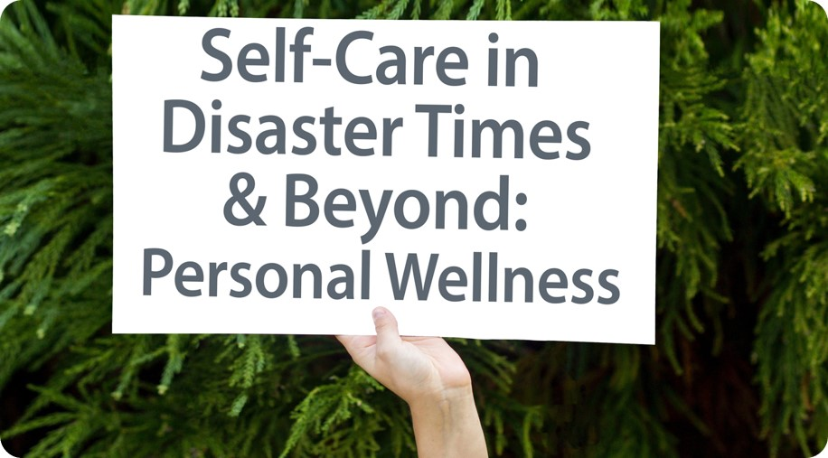
Notes:
Self-care for responders rests both within individual approaches to wellness, as well as organizational wellness culture. During and after a disaster, emergency or crisis event, it becomes critical to lead by example in order to reduce stress for your team(s).
For this reason, it's helpful for leaders to take time to care for themselves before/while supporting their staff and organization. In the spirit of role modelling, consider taking some time to explore the personal wellness information and exercises in the slides to follow, along with the team and organization-specific information and activities. We also encourage leaders to use the Self-care Toolkit Workbook their own self-awareness and to guide team and organizational self-care planning, for disaster times and beyond. Engagement with the materials can also offer perspective about what may fit or benefit from adaptation or additional strategies, to best meet your team/organizational wellness needs in times of disaster and emergency.

Slide 2
Learning Objectives
Recognize role of self-care within the unique context of disaster and emergency response and recovery.
Know how and when to engage self-care strategies for myself.
Understand my warning signs/red flags for stress.
Know when to seek help from others.
Reflect on and develop a self-care plan.

Slide 3
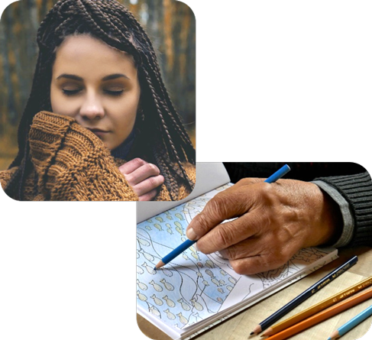
Self-Care Opening Practice
Before continuing, we encourage you to take a few minutes to orient yourself towards self-care and wellness.
Choose one of the activities below or use one of your own.
Mindfully enjoy a moment with a warm cup of tea or coffee.
Breathing exercise (e.g., box breathing, HeartMath®)
Guided meditation or mindful reflection
Prayer, smudge, or other spiritual practice
Stretching, yoga, or short walk
Calming music
Drawing, coloring, or doodling
Notes:
We encourage you to take a moment to orient yourself toward self-care and wellness by taking time out to practice before diving into the following content. There will be opportunity for personal reflection and/or team discussion along the way as you progress through the information in the toolkit. Feel free to use the accompanying workbook to supplement your reflections and activities along the way.
If you're practicing self-care with your peers or your team, you may wish to choose one activity as group, or your can invite each person to choose an individual self-care activity, within a set time frame (5-10 minutes). If you decide to practice as a group or team, consider individual (diverse) preferences and needs regarding the type of self-care activity (e.g., physical, mental, emotional, spiritual).

Slide 4
The Story of Self-Care in Alberta Disaster Response & Recovery
Emerged from:
Southern Alberta floods
Recognized need for more focus on responder self-care
AHS Partnered with:
Dr. Patricia Watson
Interviews with affected AHS & community staff and leaders across Alberta
Slave Lake fire
Southern Alberta floods
Regional Municipality of Wood Buffalo / Horse River Wild Fire
Notes:
Context for the Self-care Project and Toolkit:
Following many of the disasters that have happened in Alberta between 2011- 2017 there was an increased recognition that staff supporting the recovery were impacted. They were taking on additional work, while still trying to balance their day to day life and regular workload.
After the fires in Slave Lake in 2011, an external review highlighted how staff and volunteers providing emergency response were experiencing a high amount of stress and burnout. Many individuals were dually impacted, particularly those that were both the ‘helpers’ and residents of the area.
AHS Mental Health Promotion and Illness Prevention (MHPIP) team consulted with Dr. Patricia Watson, the Senior Education Specialist for the National Center for PTSD, and Assistant Professor in the Department of Psychiatry at Dartmouth Medical School Clinical Psychologist focusing on educational training for post-disaster, military, and first responder settings. The MHPIP team interviewed (18+) individuals who supported the response and recovery with the FMM fires, the Southern Alberta floods, and the Slave Lake fire to understand recurring themes with self-care & disaster response/recovery work & to develop this workshop.
In the interviews and pilot workshops, many organizations, teams and leaders recognized the need for self-care but acknowledged the difficulty setting aside time for comprehensive, sustainable staff self-care/wellness planning beyond periodic activities or debriefs (with particular difficulty finding time for a longer workshop dedicated to self-care/wellness during stressful post-disaster/recovery times). As such, this toolkit was born.
It has evolved even further as self-care project materials were incorporated into the development of the Psychological First Aid (PFA) for Pandemic webinar, given the widespread and enduring impacts of the COVID-19 pandemic. As self care has been identified as an area of growing interest/need, 30 minutes of interactive self-care discussion has been incorporated in the 2 hour PFA webinars. As the pandemic has progressed, requests have increased for resources to support individual self-care and team wellness in the ever-changing and uncertain events of the pandemic. We hope that you will find the resources and information herein helpful and supportive of your individual, team and organizational self-care journey, as you support your communities and teams through the this response and recovery work.

Slide 5
Notes:
Individual reflection and/or Team discussion questions:
What do you think of when you hear self-care?
Does this term resonate?
Do you use other words?
Examples of self-care concepts: Wellness, Well-being, Positive mental health, Why do we often acknowledge its importance, but have trouble doing it?
Reflect on or discuss our attitudes and perspectives toward the concept of Self-care. For example, it means spending lots of money, it’s grand gestures vs it’s small things (e.g., selfish, self-indulgent) . At no point are we ever “done” knowing how to best take care of ourselves. Our needs change and evolve.
Analogy: just because we eat a big meal one day, we would never expect that would mean we’ve eaten enough for the next week or month; the need to eat continues, just like our needs for rest, fun, purpose, will always be there and always need tending.
Things to consider:
Interviews with and feedback from AHS and community responders and leaders indicated that self-care was both lacking AND a priority for many first responders/frontline staff and managers and that those impacted were playing dual roles.
Within teams and organizations, differing perspectives and values about self-care and personal or team wellness may impact approaches to self-care (and should influence how we approach development of organizational wellness strategies and leadership approaches in disaster times and beyond.
Examples: Working long hours, no time to deal with own personal emotional reactions to disaster or pandemic impacts, balancing work and family.
Story
When we were starting to put this workshop together, we realized that some people really liked the term ‘self-care’ and others had a strong, negative reaction to it. We decided to do a little ‘poll’ of the people we interviewed, our own office mates, and our families. We asked people if they personally use the word/phrase ‘self-care’. What do you think our results were?
To our surprise, nearly everyone said they do NOT use the term for themselves. We had interesting discussions of how people do talk about this concept in a way that makes sense and feels right to them.

Slide 6
Psychosocial Preparedness
Disaster and emergency response work carries potential impacts for your well-being; self-care will be a natural need.
We become a better responder for our family and community when we pay attention to our own self-care.
Recognizing your signs of stress and making self-care a part of your regular routines, individually, in your teams, and your organizations can help to sustain you in your response work.
Notes:
“A successful primary prevention program requires that we know at least one modifiable risk factor, an have a way to modify it.” McDowell, I., & University of Ottawa. (2015).

Slide 7
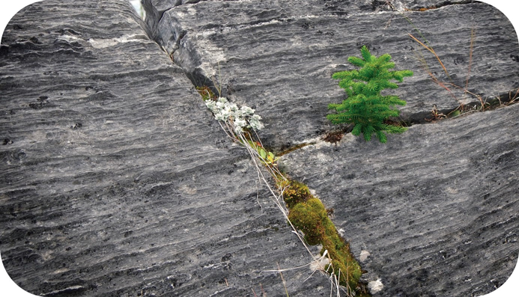
Self-Care is key to resilience
“If you’re able to have self-care as part of the makeup, then when disaster hits, you’re not taken to threshold right away.”

Slide 8
Impacts of Supporting
Disaster & Emergency Response & Recovery Work
Notes:
Although there are risks associated with disaster work, which we will address shortly, it’s important to acknowledge that there are positive features of this type of work
Question for Reflection/Discussion:
From your experience/observations, what are the potential positives of being involved with emergency/disaster response and recovery work?

Slide 9
Positives of Response & Recovery Work
Disaster/Emergency response can lead to:
A sense of strength, confidence, connectedness, contribution, meaning, and respect for human resilience.
Serving others may be:
Rewarding, satisfying, and may provide a wealth of personal skills such as coping skills and problem-solving.
It may remind us to consider what's important in our lives.
Notes:
Some individuals look at disaster work as satisfying; they feel as though they’re making a contribution that is meaningful and rewarding.
Although there's stress involved, not everyone will experience the same level. Despite what some might think, job turnover and loss of support workers is generally low.
Going through a disaster, or being a support person to those impacted, reminds you what its important in life. It can be life altering in terms perspective.
Pandemic Considerations: A Pandemic impacts everyone, which can serve as a unifying factor, can foster empathy and connection, and can motivate us to make changes, individually/together.

Slide 10
Challenges of Response & Recovery Work
Severity and rarity of the event.
Duration of the event (e.g., a pandemic)
Staff may be affected themselves.
A heightened sense of responsibility and putting their own needs aside.
Self-imposed time pressure to react—an internal need to hurry.
Long hours for an extended period.
Getting too involved emotionally with affected individuals.
Intra-agency or interpersonal conflicts.
Notes:
These challenges are based on research about the stressful features of Disaster Response and Recovery Work, including responding to a pandemic.
Reminder: not everyone is going to respond the same way. Everyone will deal in their own way.
Key factors:
The severity and rarity of the event. For example:
Disaster might have happened in past; staff may able to apply ways they’ve dealt with similar situations. There may also be emotional/psychological triggers when another event occurs.
Staff may be affected themselves (as per the pandemic). Consider: In what ways are the staff personally impacted?
A heightened sense of responsibility and high standards. For example:
Someone that is in a management or supervisory role might feel that they are responsible for taking care of others. Or they might be the type of person that puts other’s before themselves, neglecting their own needs. Their family and normal activities may be set aside; spending long hours providing disaster response can lead to both personal and professional conflicts (especially if tending to factors such as family job loss and homeschooling responsibilities for children, as per during COVID-19 Pandemic).
Intra-agency or interpersonal conflicts. (e.g., Stress of disaster may stir pre-existing disagreements between staff/management from different agencies about community service priorities. COVID-19 pandemic has at times brought to the surface differences in beliefs and values related to public health, science, leadership and perception of individual vs. collective rights).
Ongoing uncertainty, risks, micro-losses, and anticipated losses amid a pandemic–everyone is impacted, helper/responder and client/community member alike, which can add stress to the responder role.
Reflective/Discussion questions:
What examples of disaster and/or responder stress have you seen or experienced in your roles?
What did your organization do to support its people?

Slide 11
Human Performance and Stress
Adapted from: Center on the Developing Child at Harvard University. (2017) ; Diamond, D. M., et al. (2007) ; Swank, R.L., & Marchand. W.E. (1946) ; Watkins. A. (1997).
Notes:
(Workbook page 2)
Stress is a natural reaction to a range of experiences in our daily lives. Positive stress motivates us and helps us rise to challenges, helps us learn, problem solve and grow. However, in times of disaster/emergency, when demands increase, often for more prolonged periods, if we push our performance and internal resources beyond the period of maximum efficiency, we begin to experience high stress, and can shift to auto-pilot, at which point we may experience overconfidence (a phase during which errors in judgment, work performance and boundaries begin to show up).
Once we move past the limits of tolerable stress, we become hyper-reactive, fatigued and dysregulated, showing signs/symptoms of toxic stress and possible mental health problems. If we continue to push ourselves to perform beyond this point, we put ourselves at risk for further problems, and possibly illness. In fact, research has shown that if people are supported to step away from their responder role and ensure proper self-care before the period of overconfidence, they are likely to be better equipped to sustain self-efficacy and wellness during their recovery and response work. In short, some level of stress is expected during disaster response and recovery work, but it can become hazardous to our health and helping roles if we push ourselves too far, particularly if we have also been personally impacted by the event.
Adapted from:
Center on the Developing Child at Harvard University. (2017). Toxic Stress. Retrieved from https://developingchild.harvard.edu/science/key-concepts/toxic-stress/print/
Diamond, D. M., Campbell, A. M., Park, C. R., Halonen, J., & Zoladz, P. R. (2007). The temporal dynamics model of emotional memory processing: a synthesis on the neurobiological basis of stress-induced amnesia, flashbulb and traumatic memories, and the Yerkes-Dodson law. Neural plasticity, 2007, 60803.
Swank, R.L., & Marchand. W.E. (1946). Combat neuroses: development of combat exhaustion. Archives of Neurology and Psychology, 55, 236-247.
Watkins. A. (1997). Mind-Body Medicine: A Clinician's Guide to Psychoneuroimmunology.

Slide 12
Long-term Response & Recovery Stress
Sometimes the effects of the stress are masked.
Staff stress may go unnoticed until well after (or into) the event.
Staff will often not realize the impact until they:
develop a medical problem.
take time off and then realize the contrast between stress levels before and after their time off.
Due to the stressful impacts for the organization as a whole, senior leadership may not receive or have opportunity to seek feedback until the problems are more serious.
Notes:
There are some long-term factors unique to response and recovery work that put responders at higher risk for potential stress reactions, including:
Staff stress may go unnoticed until well after the event or in the In the case of a pandemic, it could be several months before it’s noticed due to it being masked, or until it's too late and it becomes a medical issue, resulting in absenteeism and perhaps requiring a leave from work.
There may be resource, time, and communication barriers along with the simple fact that these stressful events often impact an entire organization that result in leadership being unaware of the nature and severity of problems. This speaks to the value of building in consistent, transparent communication channels, trust, and rapport prior to major events, to enhance communication and mitigate these risks.

Slide 13
Long-term Response & Recovery Stress
Burnout: Gradual wearing down; emotional & physical exhaustion due to external work and personal stressors (including limited work & personal supports, high workload demands, and limited resources).
sadness, apathy, cynicism, feeling discouraged, irritability
Compassion Stress/Fatigue: Stress and wearing effects of helping or wanting to help impacted individuals (effects of the difficult and intensive work/needs therein).
helplessness, frustration, self-isolation, physiological & emotional exhaustion
Notes:
Reflective/discussion question:
What signs do you associate with burnout?
Burnout Symptoms:
Exhaustion due to work demands, low energy, inefficiency, and hopelessness
Feeling apathetic or callous toward clients, co-workers, leadership/the organization can be function detaching ourselves from others and work or family
Feeling incapable to fulfill job responsibilities, worrying about not getting work done, and isolating oneself from colleagues
Contributing Factors for Burnout:
High work demands, lower level of autonomy (e.g., schedule inflexibility, highly detailed reporting and supervisory monitoring), insufficient resources and support (workplace/organizational factors)
A lack of family support or conflict between work and family domains
Perfectionism and self-doubt can add to these effects
Compassion Stress/Fatigue: This can happen to any caregiver who has direct or indirect contact with trauma survivors and individuals with intensive emotional and physical care needs.
It can be a result of knowing about a trauma experienced by clients and/or a loved one and may have sudden onset
“Disaster Fatigue” can set in, as stated by a community leader working in disaster recovery, “At some point, you just can’t hear one more story about the [disaster].” followed by feelings of guilt, “You feel like a jerk, but you just don’t want to hear it anymore!”.
COVID (Pandemic) Fatigue: People begin to loosen adherence to public health measures. In some cases, people are actively resisting these measures amid the enduring and ever-uncertain nature of the pandemic. They move towards expressing frustration and trying to regain a sense of control.

Slide 14
Long-term Response & Recovery Stress
Secondary/Vicarious Traumatic Stress: Cumulative stress reactions over time due to supporting multiple trauma survivors.
avoidance/detachment or over-involvement, and may include PTSD-like symptoms; symptoms may appear similar to the survivors they are supporting
Post-Traumatic Stress Disorder (PTSD):
intrusive symptoms (e.g., nightmares, flashbacks), hyper arousal, numbing, anxiety and/or depression
Notes:
Secondary/Vicarious trauma: Cognitive, emotional, social, and behavioral changes that may occur while working with traumatized individuals. Responders’ views about self and others may be called into question - particularly, views of trust, safety, control, and esteem. The responder’s symptoms and behaviour may begin to parallel the experiences of people they are helping.
Five Types of Most Common Vicarious Stress Reactions*:
Intrusive Preoccupation
Strong emotional reactions, disillusionment, changes in beliefs/ values
Avoidance / Detachment
“Numbing out,” difficulty with concentration and memory
Over-involvement
Difficulty maintaining appropriate boundaries, Strong urge to protect/”do for” and become the caretaker
Professional Alienation
Lack of support, fear of being viewed as inept, difficulty disclosing the emotional impact and “burdening” others with the realities of work
Professional Satisfaction
Heightened sense of meaning and reason for being (which may lend to over-involvement)
*Wilson, J. P., & Thomas, R. B. (2004). Empathy in the treatment of trauma and PTSD.

Slide 15
Post-Traumatic Stress Disorder (PTSD) in Disaster Workers
Contributing factors for post-traumatic stress symptoms in disaster workers:
Pre-disaster factors
Experience/training
Income
Life events/health
Job satisfaction
Economic downturn
Post-disaster factors
Impact on life
Peri-disaster factors
Exposure
Poor leadership
Lack of inter-agency cooperation
Unclear expectations
Perceptions & experience of safety
Injury
Social factors
Coping strategies
Notes:
Important Note: Often time we may be mislabeling acute stress (normal/expected acute stress reactions including heightened mental, physical, emotional, and spiritual reactions as a result of recent exposure to an emergency or disaster) as PTSD.
An example of pre-disaster factors: Fort McMurray experienced an economic downturn prior to the 2016 wildfire, COVID-19, and 2020 flood (cumulative disaster experiences).
Stress reactions are normal and to be expected in adverse events. Although, there might be an assumption that PTSD is quite high in disaster workers, the rates vary from as low as 5% up to 40%, depending on factors before, during, and after a disaster (as per above)

Slide 16
Wave the Red Flag
Notes:
Activity (Workbook page 5)
Individual reflection or team discussion
Take a few minutes, close your eyes, and reflect on recent stressors (you may wish to write them down), answering the following questions for yourself (Questions are show on the next slide).
What have been your red flags about your own stress levels, that cue your self-care needs?
How did you become aware of your physical, mental, emotional, spiritual, or behavioural warning signs of stress?
Did you notice when this was happening for you; did someone else notice and express care/concern?
Are you able to identify any of your yellow flags? (earlier signs of increasing stress and self-care needs)?

Slide 17
Wave the Red Flag
What have been your red flags about your own stress levels and self-care needs?
How did you become aware of your physical, mental, emotional, spiritual, or behavioural warning signs of stress?
Did you notice when this was happening for you; did someone else notice and express care/concern?
Are you able to identify your yellow flags? (earlier signs of increasing stress and self-care needs)
Notes:
(Workbook page 5)
For self-reflection or group, peer, team or organizational discussion.

Slide 18
Self-Care Red Flags
Change in eating habits or weight
Loss of interest
Guilt
Taking lots of time off
Drinking, smoking, or vaping more
Conflict in relationships
Changes in sleep
Don’t give self a break
Isolating self
Feeling very busy or hurried
Physical changes
Memory or attention problems
Notes:
Take note of any parallels/differences in your own list(s)
Key message:
Know your own signs of burnout and stress (e.g., I get tired. Then I sleep more); Ideally, tune in often and early to catch your “yellow flags”
People who were interviewed shared about their own impacts of burnout, when self-care was limited (read quotes below):
“You would see people taking lots of time off, they would talk about drinking more, conflict in relationships – all the things we hear about. Eventually they changed attitude but for a long time it was about withdrawing.”
“Many were doing their job going through the motions, there was no ‘care’ anymore. And how do you talk about that? It’s hard.”
“Some people didn’t give themselves a break and did get sick, like serious physical ailments. I can’t for sure say it ties into it but [the disaster stress] triggers what’s already in your body.”
“Planning for relaunch (during COVID-19 pandemic) felt like just another push with no real answers or end in sight…you just lose your energy for it” (re: attempting to support students in post-secondary settings).
Story
It’s knowing when I’m not managing, or things are taking me longer, I’m not thinking as clear. There are cues for me to know. When my memory is going. When I have 4 to-do lists. I get less frustrated when things don’t get done in the timeframe I want. I see that as self-care. Being productive, I need to see evidence that I have done something. I can go home and garden for 4 hours. I did that and I feel better. My self-care isn’t always resting. Sometimes it’s organizing or being productive.
Story
I was struck by how similar the staff reactions were in both Slave Lake and Ft. McMurray. I think this shows we’re dealing with a normal response. Anger and out of control feelings around anger is normal. We just need to find a way to manage that.

Slide 19
Awareness: Stress Continuum Model
Adapted from: Government of Canada, National Defense & the Armed Forces Canadian. (2008). Road to Mental Readiness-Mental Health Continuum Model and The Big 4.
Watson, P., Nash, W., Westphal, R., & Litz, B. (2012). Combat Operational Stress First Aid Manual.
Notes:
Stress Continuum Model (Workbook page 6)
This table has been adapted from the Road to Mental Readiness-Mental Health Continuum Model and The Big 4 (Government of Canada, National Defense & the Canadian Armed Forces., 2008) and the Combat Operational Stress First Aid Manual (Watson, P., Nash, W., Westphal, R., & Litz, B., 2012).
It was originally developed in 2008 by the Canadian National Defense & the Armed Forces to use as a visual tool for assessing an individual's stress responses.
Stress responses lie along a spectrum of severity and type. Four stages: Ready (Green), Reacting (Yellow), Injured (Orange) and Ill (Red). It's important to note that 100% of people will react when faced with stressful stimuli. However, the way in which they respond will depend on how prepared they are for the stressor event and how they, as individuals, interpret it, along with environmental factors such as structural (i.e., work) and social supports.
There’s often stigma associated with reacting to stress. As such, people may try to hide stress reactions from supervisors to avoid medical or psychological intervention.
It’s usually not possible to keep these behaviors hidden from family members, colleagues and friends for long. When you recognize that someone is in trouble, it's important to help them get connected with the appropriate level of help as soon as possible; doing so may help prevent their reaction from progressing into the Red Zone. it's important to get them connected to treatment as soon as possible if they are in the Red Zone.
Take a moment to notice what resonates for you across these zones
Self-care needs and practices will change across these zones; in particular, as we progress towards Red, it can become increasingly difficult to practice self-care, especially if we haven’t been including it as part of our daily living.
Adapted from: Government of Canada, National Defense & the Canadian Armed Forces. (2008). Road to Mental Readiness-Mental Health Continuum Model and The Big 4.
Nash, W. P., Westphal, R. J., Watson, P. J., & Litz, B. T. (2012). Combat and Operational Stress First Aid Manual.

Slide 20
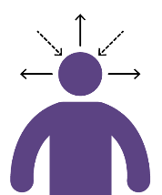
Self-Awareness
Notes:
Self-Reflection or Group Discussion Exercise (Workbook page 6)
Refer back to the Stress Continuum as marker points for the questions on the next slide. Think about your own Red flags and Self-care needs and strengths, across the Stress Continuum zones as you reflect on the questions to follow.

Slide 21
Self-Awareness Activity
Self-reflection questions:
What are your usual ‘go-to’ self-care strategies or activities?
When do they work best?
What does self-care look like for you when you’ve been in different Stress Continuum zones?
What do you do when your self-care strategies don’t seem to be working the way you need or want them to?
Notes:
Self-Reflection or Team discussion Exercise (Workbook page 6)
Take a moment to reflect on (and write down) answers to these questions.
The more awareness that we have, the greater our ability to identify and handle stress. Its helpful to be able to understand how our self-care needs might change as we move along the stress continuum and take appropriate action to mediate stress reactions. More consistent practice and regular reflection makes it easier to cope when stressful situations arise.
Pandemic Considerations: Because a pandemic may have multiple impacts and longer/repetitive response and recovery cycles, it may be helpful to discuss what strategies may require adjustments (or enhancement) amid this sort of ongoing disaster (e.g., consider impacts of any changes in social distancing/public health measures and ongoing effects of uncertainty and fears).
Note For Team discussion: Invite people to share what they learned as they reflected on these questions, if they like (with no obligation to share, of course).

Slide 22
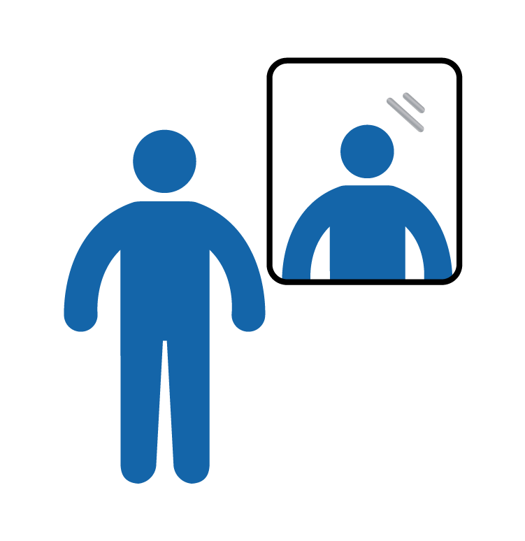
Tuning Into Ourselves
Self-awareness is our starting point for self-care.
We may do this on our own, or with our team, organization and/or personal supports.
Strategies may include:
Formal measurement tools (e.g., self-assessment scales).
Personal & organizational checklists.
Using technology (e.g., apps, calendar reminders).
Routine check-ins.
Accepting help & support from others.
Notes:
Self-Reflection/Discussion questions (Workbook page 7)
Why is it important to pay attention to ourselves?
Does your workplace currently have any strategies they use to support self-reflection and awareness?
What are your strategies to tune into yourself?
Examples of Self-Assessment tools include:
Professional Quality of Life (ProQuol) by Dr. Beth Hudnall Stamm
Website: proqol.org/uploads/ProQOL_5_English_Self-Score.pdf
Self-compassion scale by Dr. Kristin Neff
Website: self-compassion.org/test-how-self-compassionate-you-are/
Links can also be found on page 13 in the workbook

Slide 23
Before Responding to a Disaster
Questions to ask yourself:
What’s going on in my personal life right now?
Do I have personal or family commitments that would be affected if I was redeployed?
How is my current physical, emotional, mental, and spiritual well-being?
Notes:
A self-check in is taking time to survey your physical, mental, emotional, and spiritual health, your personal life and activities for current strengths and risks when responding in a high stress work environment.
it's important to take time to check in with yourself before, during and after disaster/emergency response work (e.g., evacuation reception centre work, ongoing changes in workload, deployment and service delivery during pandemic, during increased recovery service demands).
We often don’t take the time to understand how this type of work affects us emotionally. Part of being an effective provider to post-disaster/traumatic event situations is to know/anticipate personal risk factors that may create challenges for you.
Before volunteering as a responder in/after a traumatic event/disaster, ask yourself these simple questions to start a personal self care plan:
Consider your comfort level with the various situations you may experience while engaged in response/recovery work.
What is your personal situation like at the moment?
Are you ready to help?
Can you take time off to provide support?
What is your family’s ability to cope with you working in a disaster/emergency setting and your absence.
Are there life stresses or family commitments that need attention?
Assess your physical, mental, emotional and spiritual health.
What is your whole health like right now (as per the 4 domains above)?
How can you stay healthy during all phases of the disaster? (especially if it’s prolonged, like in cases of a pandemic)
It’s okay to pass on this work if the timing isn’t right for you.
Note: Consider your own situation or team circumstance with this statement, as it may be appropriate to volunteers and in some larger service centers, but perhaps less so for first responders who are mandated to provide these services and whose absence could significantly impact their work team, particularly for smaller and/or remote service centers with limited staff pool and services. it's helpful to acknowledge these factors if they apply to you/your team.

Slide 24
Self Check-Ins
How has checking in with yourself been helpful to you?
What makes it difficult to do?
Self Check-in
Ahead
Notes:
Self-Reflection or Team Discussion (Workbook page 8)
Note: These questions can be useful in smaller peer/team breakout groups as well. Allow for a minimum of 10 minutes for small group discussion.
A self-check in involves consciously taking time to examine your personal life and activities to assess current strengths and challenges for responding in a high stress work environment.
Sometimes we don’t pause to understand how this type of work affects us emotionally, especially when we are in the crisis pace of response work.
Part of being an effective responder is to understand and anticipate personal and environmental risk factors that may create challenges for you, as well as knowing your individual strengths, capacities and support networks that will allow you to sustain in your response role.

Slide 25
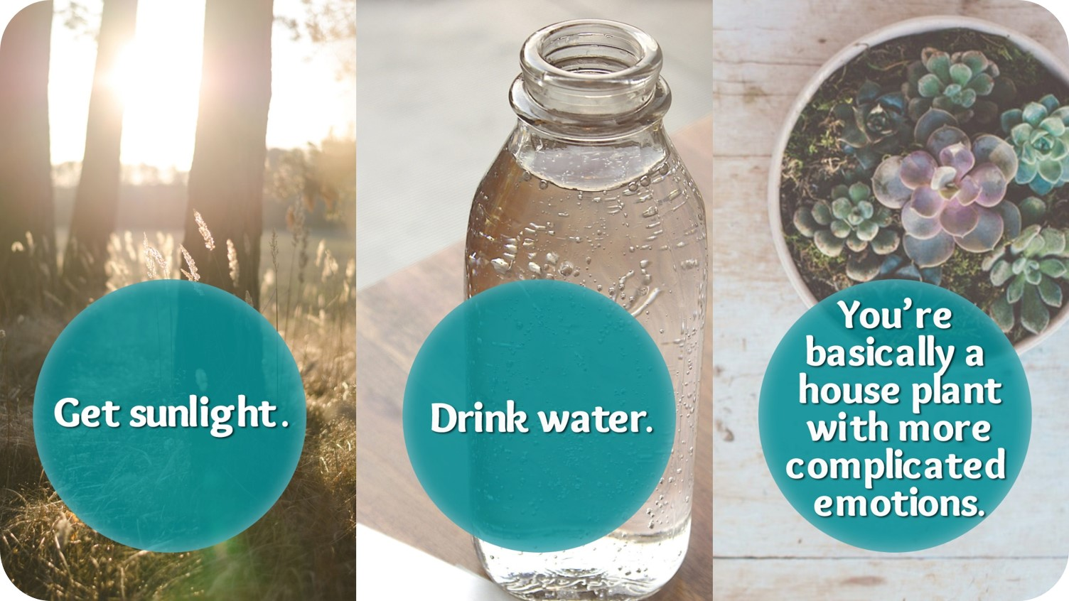
Don’t Forget:

Slide 26
What Works?
Personal
Self-awareness-knowing your personal warning signs of stress.
Having diverse strategies that work for you.
Being flexible with the learning curve & demands of disaster response & recovery work.
Structuring self-care into your personal routine.
Organizational
Avoiding a one-size-fits all approach.
Build adaptable strategies from within, with staff input.
Modeling self-care individually and structurally at a leadership level.
Check-in, Check-in, Check-in! At all levels of the organization.
Notes:
We learned from the responder interviews that both self-care and organizational strategies that start with awareness and preventative approach are important for reducing stress.
Example:
Being flexible about response and recovery work because of the steep learning curve. This is especially true in a pandemic due to multiple impacts, and the changing response and safety measures. Remember to be flexible with yourself and your own needs.
Having MANY personal strategies and supports that you can use, even for people who are ‘good at’ self-care, as new disaster experiences may bring new stressors and challenges.
Be kind to yourself. Know that it’s okay to not be okay or to not know what to do all the time. Be open to seeking and accepting support.

Slide 27
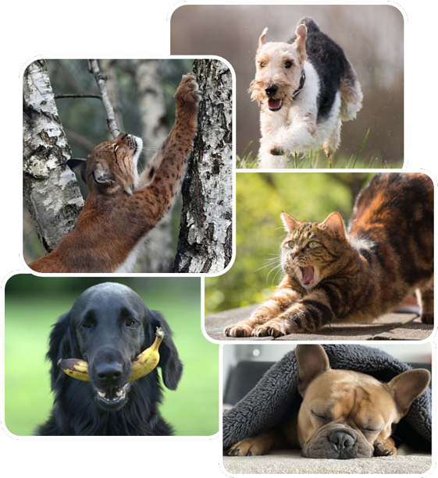
Physical Strategies
Strategies important to our overall health and well-being, which can contribute to reduced stress reactions:
Controlled breathing
Daily physical activity
Healthy eating
Sleep management
Time outside
Simple activities like stretching/yoga
Notes:
The following empirically researched strategies contribute to overall health and well-being, which can calm and contribute to reduced stress reactions:
Controlled breathing:
Slower, systematic, controlled breathing with a focus on expanding the belly, increases ventilation to the lungs. Reduces stress and decreases hypertensive symptoms.
What types of controlled breathing have you used before? (e.g., belly breathing; box breathing, breath counts (5 in, 5 out), yoga and meditation breathing exercises)
Daily physical activity or exercise:
Can improve both your physical and mental health. Benefits: increases energy, relieves stress, and increases positive social interactions with others.
Healthy eating:
Make every effort to increase healthy habits such as eating breakfast, taking lunch breaks away from your workstation, eat more slowly and mindfully, prepare or buy nutritious food options.
Sleep management:
Vital to good physical and mental health. Adequate sleep improves concentration, focus, mood and stress tolerance.

Slide 28
Cognitive Strategies
Increase:
Positive emotion-focused strategies:
Humour—watch a funny video.
Acceptance.
Reinterpreting the event in a positive light—positive self-talk.
Taking time out for yourself each day.
Gratitude practice (for work and home).
Mindfulness practices.
Notes:
The literature on burnout and secondary stress highlights that these cognitive strategies should be increased in order to improve well-being related to work stress tolerance and management.
Review a few and consider your own examples.

Slide 29
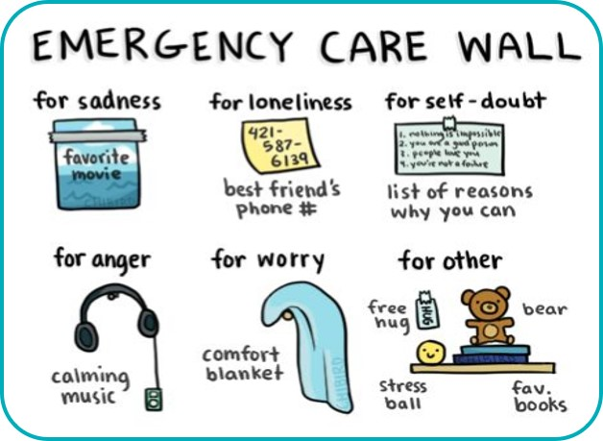
Cognitive Strategies
Problem-focused coping strategies:
Planning ahead.
Maintaining work balance with family and leisure activities.
Maintaining professional identity, values, and boundaries.
Seeking out additional training.
Positive and gratitude oriented self-talk.
Notes:
(Workbook page 9)
As per previous slide, research highlights that these problem focused strategies should be increased in order to improve well-being related to work stress and to prevent burnout or lessen the impact of secondary stress

Slide 30
Social Connections
Seek out contact with and foster a network of family, friends, and colleagues who understand and support you, even if distant.
Be open to different types of support from different people (it might come to you from people & places you hadn’t expected).
Help others.
Maintain routine in daily life and social activities.
Have a trusted person who can watch for and notice changes in you.
Notes:
During interviews with AHS and community staff who had been involved in response and recovery work across Alberta, it was evident that social connections within the workplace and personal life were important for self-care.
Individual examples:
“I had a group of girlfriends who used to go for dinner once a week. You don’t realize how much that supports you each week.”
“For my own self-care, made sure I was surrounded by supportive individuals. Those who experienced the same thing as well as those who didn’t experience any of it - friends and family outside the community. That was a place to disclose where I wasn’t going to offend anyone.”
“Regular self care was trying to maintain normalcy as much as possible, like coaching skating when that started again. Maintain normalcy and re-connect with people.”

Slide 31
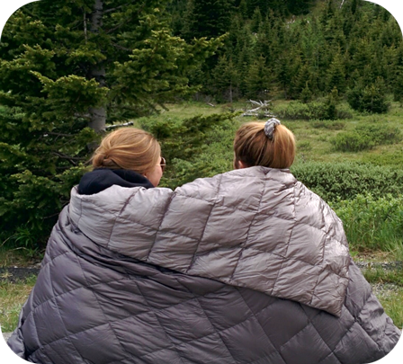
Social Strategies
Make time for personal social support.
Utilize coworker support.
Access mentors.
Seek your own therapy.
Notes:
The following social strategies have been shown in the research to support overall health and well-being, and reduced stress reactions:
Family support has been related to less emotional exhaustion at work, and social support is related to a sense of efficacy. Our support people help us see ourselves as capable and remind us that we can persevere, especially with support.
Utilize coworker support. Valuable support can come from those who understand and live through what you have experienced.
Linking with supportive, competent mentors is associated with lower levels of burnout, and higher levels of knowledge, growth, and satisfaction.
Cognitive-behavioral therapy can have positive effects for burnout.

Slide 32
Healthy Work Boundaries
Know your:
Role
Goals
Resources
Limits
Ensure that you:
Share your own experience appropriately (to connect & empathize, rather than to redirect focus to your experience).
Seek and accept peer support—also offer care and support to others.
Notes:
It’s important for a disaster responder to maintain healthy boundaries when supporting impacted individuals affected by disasters. These boundaries include knowing when it’s the right time for you to provide support, and knowing what your own limitations are (e.g., if you're sick, have family responsibilities, or are experiencing your own disaster impacts that affect your ability to offer support others).
Self-awareness, can be carried into your professional life, particularly by setting healthy work boundaries. For example:
In every interaction with those you support (in non-therapeutic roles), clarify your role. They might not understand that you’re there to support them, rather than to “diagnose” and “treat” them.
Clarify your role, your available resources, and criteria and process for referrals with your supervisor before making contact with individuals you’re supporting prior to promising outcomes.
Know your goals going in and think with an end state in mind. Keep your goals simple and don’t feel like you have to “fix” the person’s challenges or longstanding problems.
Refrain from sharing so much of your own story that your contact becomes as much or more about you than the person you’re supporting. Keep the focus on the person and on discussing their needs and priorities. Appropriate personal sharing can be helpful if it builds rapport and trust. Be thoughtful and purposeful about what and how much to share. Sharing too much of your own experience may become overwhelming or invalidating to the person you're helping, potentially adding to their stress.
Maintain confidentiality by talking only to your supervisor or those who need to know about what you discussed with the person you’re supporting (e.g., avoid sharing details with friends, family, volunteer settings, media, on your own social media).

Slide 33
Self-Care Barriers
Levels of exhaustion & stress in post-disaster life and work.
Considering self-care a luxury or indulgent.
Lack of awareness about self-care needs.
Being hard on self (e.g., “I shouldn’t need a break.”).
Denial (e.g., "I'm fine.”, “I don’t need it.”).
Western-European culture/value of over-work.
High workload demands; limited resources (e.g., staffing, funding, isolation).
Notes:
These themes were gathered from interviews with responders around barriers to self-care in response and recovery work.
Pandemic Considerations: The non-linear, ever-shifting nature of a pandemic can invite impatience, frustration, disappointment, and discouragement which may lend to self-care barriers. Repeated ups and downs in hope, anxiety, uncertainty, and setbacks as the pandemic progresses. Redeployments, shifting to working from home (perhaps while attempting to support kids’ virtual education) job disruption or losses, and job/role uncertainty can increase these feelings.
Reflection/Discussion question:
What prevents you from engaging in self-care, both in the moment and over time?
Quotes
“Once the hospital was up and running again there was a change in the narrative, which was ‘we are back to business’ and people weren’t actually back to business. There was a need organizationally to be seen to be back to normal and back in control. So in some ways there wasn’t a lot of appetite to hear about the distress of staff.”
“Once you get off your routine, it’s hard to get back on when the stress is there. How do you keep it going no matter what? Despite the changes that happen. That is the most challenging.”
“Some of the expectations were over the top for some of the leadership. We need to be more humane in our expectations. You can’t be everything to everyone, and people weren’t listening to what was happening at ground zero. The layers above me were frustrating - fending off those expectations.”
“Stress makes people hunker in but we need relationships and communication at that time. How do you keep building relationships and communicating when stress is high? We need to figure that out. Building trust. Hard to build relationships under stress .”
“I’d like never again to be told right after a disaster that it’s going to be 10 years until recovery. Because it’s not 10 years of that first year. The first year was about recovery and hope. The anger intensified in staff and the community in the 2nd year. The 3rd year was better but even 5 years out, we’re not recovered. Everything hits our now raw nerves.”

Slide 34
Unhelpful Approaches to Stress Management
Reduce
Avoidance techniques:
Hyper-focus on helping others to avoid own stress
Ignoring in hopes that the situation will go away
Misuse of substances or medication
Keeping stress to oneself
Negative emotion-focused strategies:
Denial
Repetitive Venting
Substance misuse
Withdrawal/numbing through use of internet/electronics
Notes:
Reflection/Discussion Question:
When do these self-care strategies become a problem?
When are you escaping or avoiding?
Example: People joke about having an “extra” glass of wine, or going out for a beer with friends – what would let us know when this potential social activity shifts toward becoming more harmful than helpful?
Consider when normal, healthy (for you) needs for alone time may begin to shift toward self-isolation and/or avoidance. (Keeping in mind and honoring your original preference for introversion or extroversion).
Literature on burnout and secondary stress highlights that these stress management strategies (on this slide) should be reduced in order to improve well-being related to work stress.

Slide 35
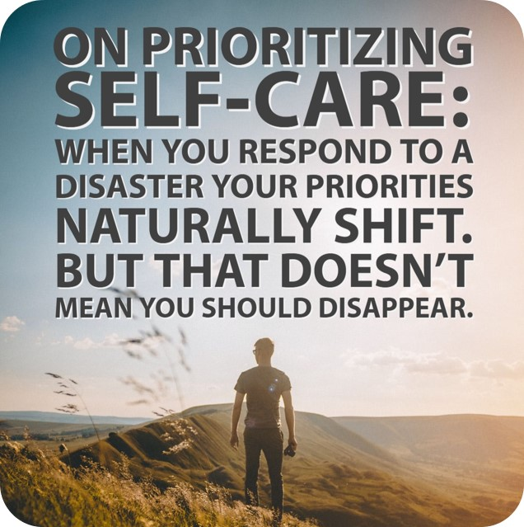

Slide 36
Self-Care Plan
Thinking back to the Red Flags activity:
What flags can I use to cue me to take action?
What is the minimum thing I can do for my self-care today?
What resources (e.g., social, practical) do I need to make my self-care strategies part of my regular routine?
What will I need to do after a disaster to ensure these actions continue?
Notes:
Reflection/Discussion (Workbook page 11)
Note for question 2 on slide: Our self-care minimum may change from day-to-day, depending on resources, energy, workload, supports etc. For example: one day your minimum my be walking during your lunch break, the next it might be taking 5 minutes to drink/enjoy your morning coffee/tea. The trick is to tune into yourself and commit to a minimum (which you can build to a maximum depending on where you’re at) each day.
Take time to plan more broadly for self-care routines in achievable, smaller steps (in the moment strategies, day-to-day plans), especially during stressful times. It can be helpful to seek and accept support with this planning and action. You can figure it out and practice together.

Slide 37
Self-Care in Action
Making little changes in routines and daily tasks.
Regular physical activity.
Doing simple activities like yoga or stretching.
Having creative activities or hobbies.
Reach out to social supports.
Giving time to yourself every day so you don’t get sick or overly stressed by:
taking a walk.
doing some deep breathing.
spending time with your pets.
watching a funny video.
Notes:
Consider that everyone can have a role to play in building and advocating for a healthy workplace and self-care culture, from showing appreciation and gratitude, validating your peers’ efforts, successes and challenges, eating/sharing healthy snacks, engaging in positive check ins (along with sharing concerns and debriefing challenges) and by modeling your own self-care along the way.
Suggestions from Alberta responders on reaching out to social supports:
Access support from peers and supervisors who understand responder work. However, also try to access social support from people who aren't immersed in disaster response work in order to give yourself a break from the disaster conversations.
Quotes
“It should be worked into your routines so you can always be topping up your gas tank, a little recharge on your battery.”
“It should involve simple, small changes, like choice of food because it’s a daily need, choices of TV shows, Facebook posts, choices about the people I want to be around, the things I do every day. Am I sitting outside every day? Am I benefitting from that? How long am I watching TV? These are things that are a given, and I take note of how I can make little changes to those.”
“Those that are really good at [self-care] are the ones who are physically active, have a regular routine, or who more likely go for a walk or a run or go to the gym after their shift. The active ones come back to work active and chatty and want to tell people about their experiences.”
“Having an activity that doesn’t require a gym or a team or any of those kind of things. Something you can do alone, such as yoga or stretching. And it’s always built into your day, and you have to do it.”
“When people looked out the windows, some people found it distressing. So we got window paints and people got to paint on the windows. Clients did that and staff did that as a way to depict their experience, or think about something. When people first came back we got big sheets of plywood and put chalk on them for people to write more hopeful resilient type words or pictures, so we did some things like that. For some people that seemed to be quite helpful for their self-care.”

Slide 39
Your opinion matters.
To tell us what you think of this resource, go to:
https://survey.albertahealthservices.ca/selfcare
Notes:
May you go gently into the important response and recovery work that you do, with new information, tools and resources to take care of yourself so that you're ready to help others.

