Slide 1
Central Discovery Index Update
Plans for Testing, Expectations, and Alma Changes Effective Mon 11/18

Slide 2
What is it
From Ex Libris: "CDI is a central discovery index – leveraging existing assets - that supports both Summon and Primo and delivers enhanced discovery, streamlines library management, and provides operational efficiencies. CDI will replace the Primo Central Index and the Summon Index to give access to Ex Libris provided data. The ingestion of local data will continue to function as before."
Translation: it's going to work more like the Summon index, with better holding publishing times, no more alternative coverage for EBSCO, and better resource types.

Slide 3
Highlights
Adding new electronic packages: full-text service availability and the ability to search at the article or chapter level can be activated at the same time, in the same workflow
EBSCOhost content: you will no longer need to set up alternative coverage
User roles: there will be a new user role (CDI Inventory Operator, can be combined with Electronic Inventory Operator)
Publish holdings to Primo: timing will improve from 7-10 days to 24-48 hours.
The CDI will offer more granulated resource types for PCI/CDI data (reports, AV, etc.) https://knowledge.exlibrisgroup.com/Primo/Content_Corner/Product_Documentation/Central_Discovery_Index/Resource_Types_in_CDI
Permalinks: Most but not all permalinks will be preserved in the migration
Primo VE: patrons should not see a disruption in service on the public-facing side, though they may see slight changes to ranking and searching

Slide 4
Timeline
Sunday, November 17: all SUNY campus PCI collections get copied to campus CDIs
November 17 through go-live: CDI and PCI systems will exist side by side in Alma, campuses will see references to CDI in Alma
November 19 - December 15: SUNY CDI Task Force will test CDI by comparing PCI and CDI search platforms
December 15-22: Project wrap-up and go-live scheduling
Winter Break: Expected go-live
Notes:
For campuses who accepted Central activations set up by SUNY Shared Library Services (including Gale databases, Medline, etc.), those activations will also be copied.

Slide 5
Testing
CDI Task Force:
Nancy Babb, UB, co-chair
Michelle Eichelberger, SLSS, co-chair
Amanda Hollister & Noah Roth, SUNY Broome
Rebecca Nous, Albany
Jen Parker, Cortland
Will test at local campuses and investigate outstanding issues (if time)
Will test:
Move Reports
Alma side: activations, user roles, etc.
Primo VE side: user experience, search results, etc.
Will report findings on Basecamp

Slide 6
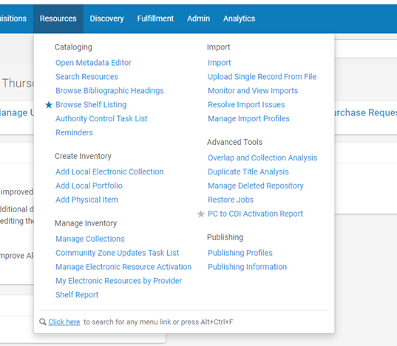
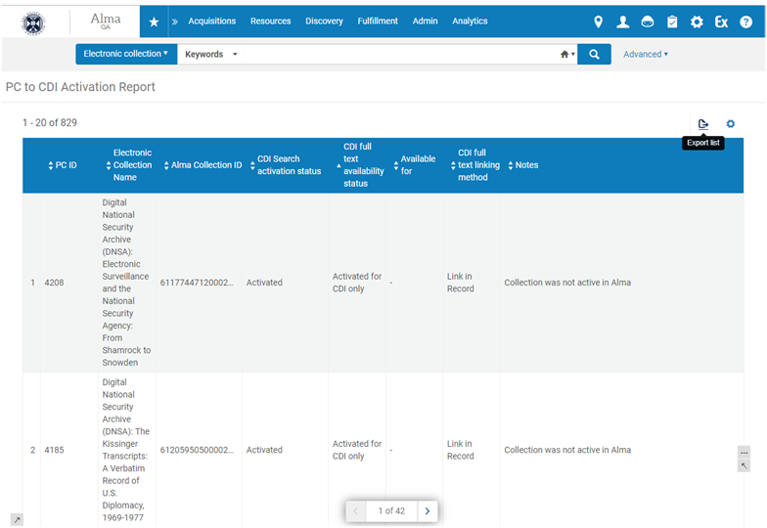
What will you see in Alma: Move Report

Slide 7
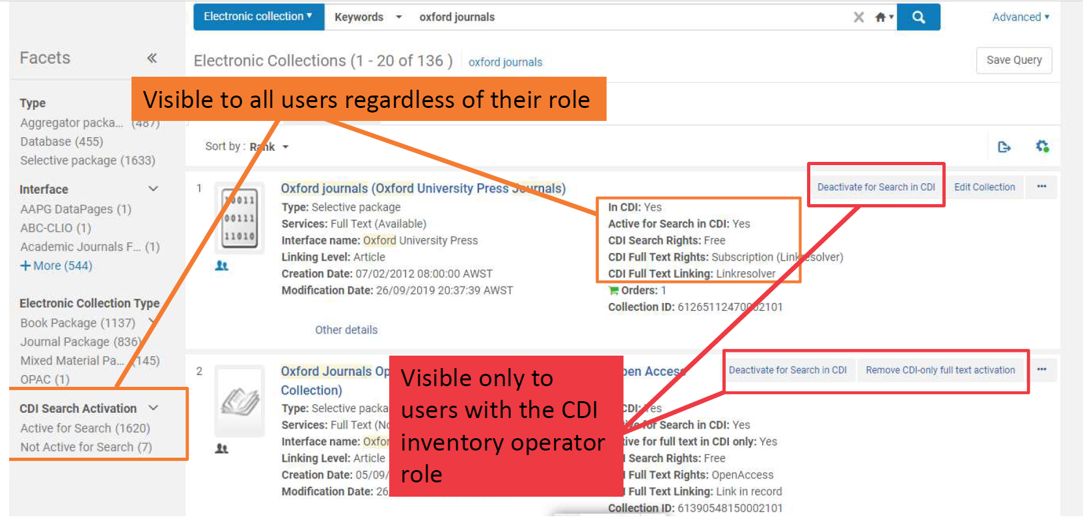
What will you see in Alma: Facets & Actions

Slide 8
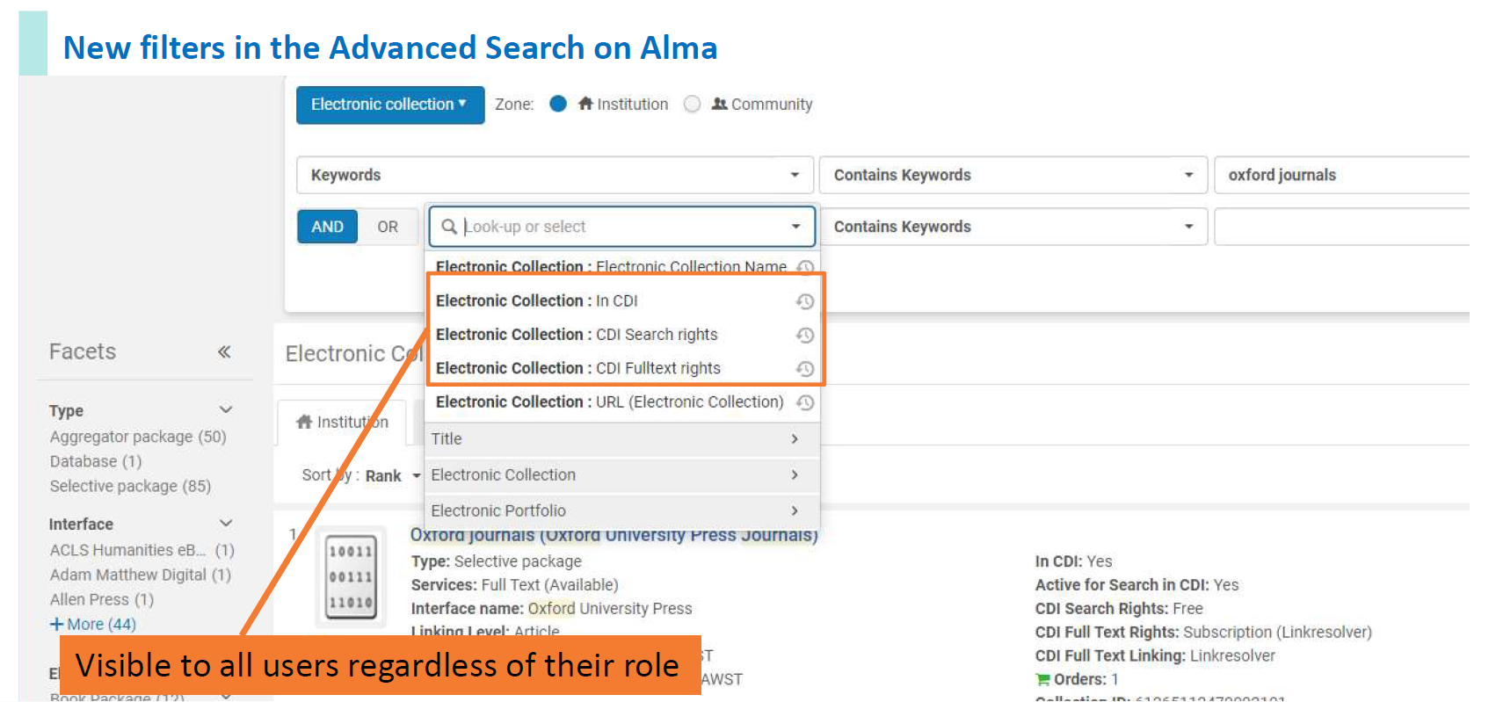
What will you see in Alma: Collection Search

Slide 9
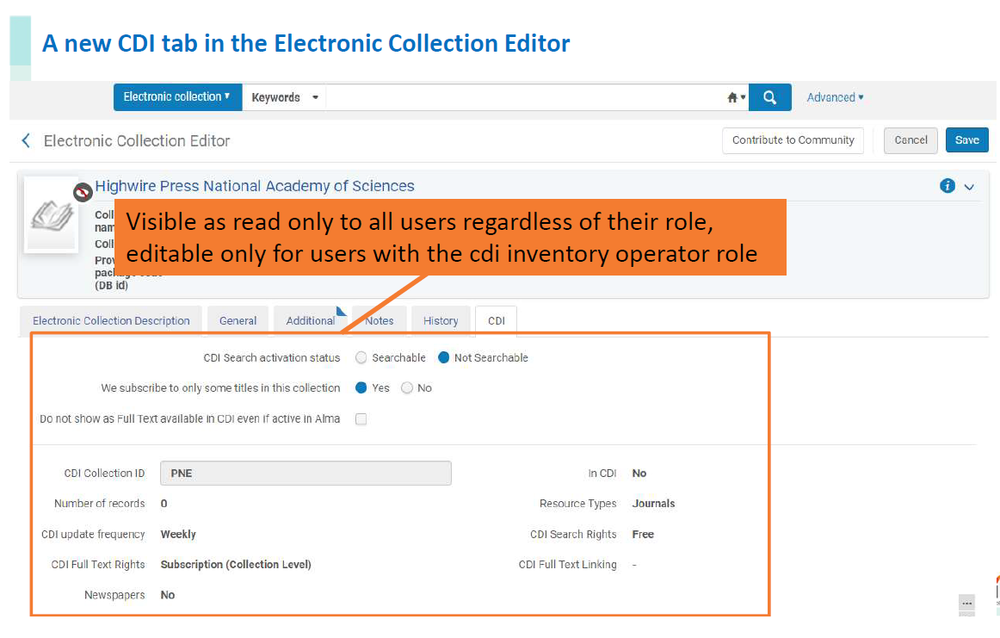
What will you see in Alma: Collection Tab

Slide 10
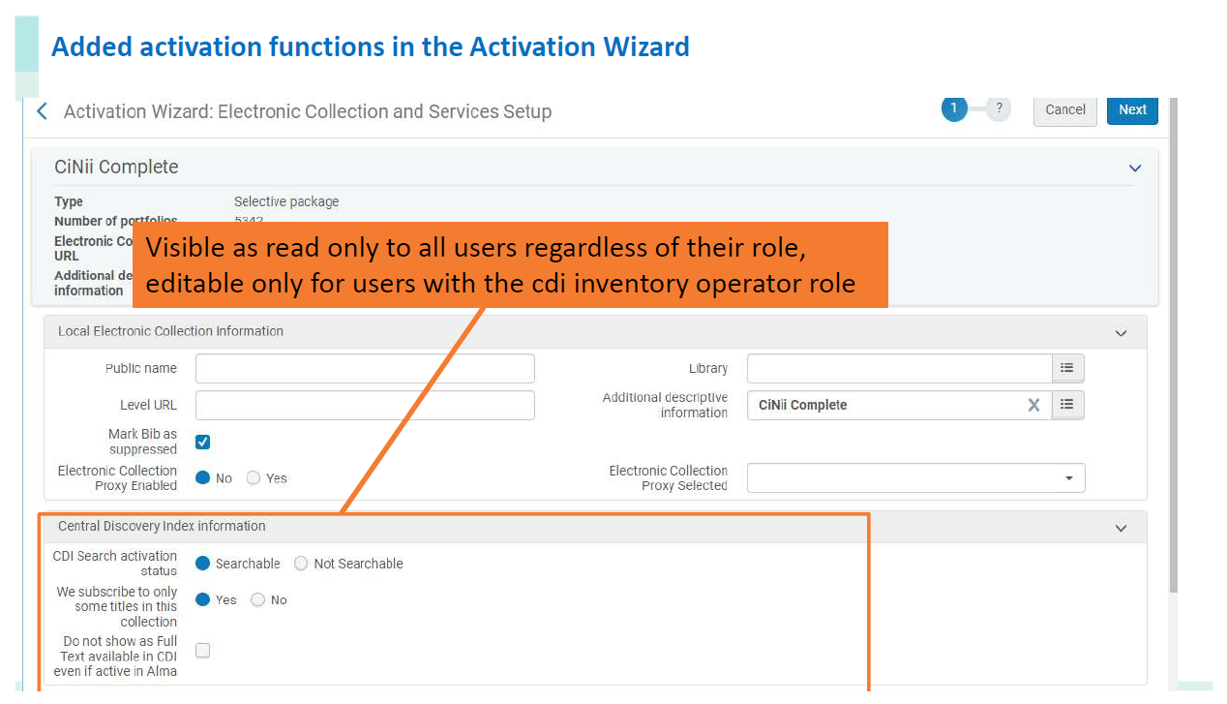
What will you see in Alma: Activation Wizard

Slide 11
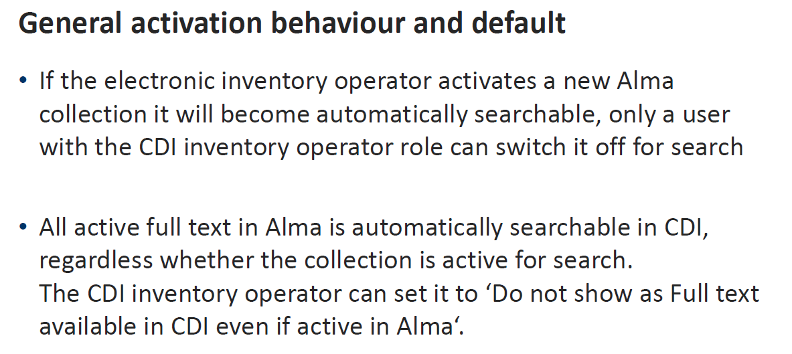
CDI General Behavior

Slide 12
What will you see in Alma: New ‘CDI Inventory operator’ role
Permissions for this role:
Use the actions in the electronic collection result list ‘Activate for search in CDI’ / ‘Deactivate for search in CDI’ / ‘Remove CDI-only full text activation’
Change the editable fields (such as the IsSelective, ‘activate/deactivate for search’) in the CDI tab of the Electronic collections Editor and the Alma activation wizard
Can be used on its own, or can be used in combination with the existing Electronic inventory operator

Slide 13
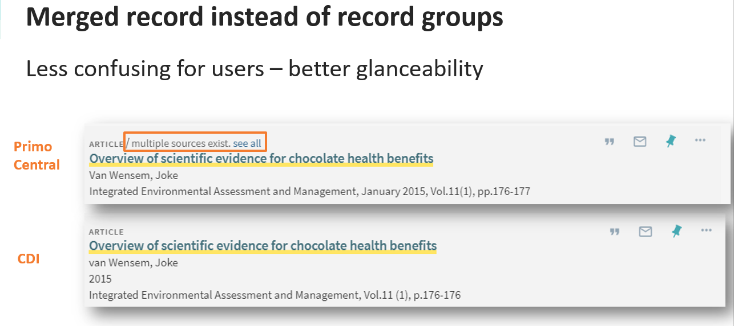
What patrons will see post-go-live
Merged records
Old direct links to articles may not work – id code will change for PCI records
Resource Types will be more granular
May see slight changes to ranking and searching

Slide 14
What this means for you
As of Monday, November 18
Changes to PCI need to be made in both CDI and PCI
New collections need to have CDI search suppressed if you don't want them searchable at go-live - they will automatically activate CDI searching at the same time unless you give yourself the new CDI Inventory Operator role and tell it not to do so.
CDI activations during the test period will have no effect on Primo VE searching.
After Go-live:
Review Move Report and make sure that all collections are represented
Do something with new role CDI Inventory Operator
Deactivate alternative coverage collections – no longer needed

Slide 15
Resources
https://knowledge.exlibrisgroup.com/Primo/Content_Corner/Product_Documentation/Central_Discovery_Index
Ex Libris Central Discovery Index (CDI) Update sessions are available for you to view as either a YouTube video, WebEx recording, or PDF file. It's also accessible on our Content webinar program page and also posted at the bottom of this CDI FAQ page in the Knowledge Center.
The Match & Merge Story: Improving Search Results, Reducing User Confusion recording is available for you to view as either a YouTube video, WebEx recording, or PDF file. It’s also accessible on our Content webinar program page.

