Slide 1

George Mason District
Roundtable
May 11, 2023

Slide 2

Pledge

Slide 3
Welcome
New to Roundtable?
Please introduce yourself!

Slide 4
Council Update
Scoutbook Email and Calendars - Fixed
Recharter Handbook – Updating; send ruspittman@gmail.com any updates needed
Membership Inventory – Compare to roster in https://my.scouting.org
My.scouting.org – Menu, Organizational Manager
  Key 3 Delegate
  Registration Inquiry
  COR Delegate
  Treasurer
  PIN
Webelos to Troop – Issue with parents not associated with Scout
https://bsarestructuring.org – Latest news of emergence from bankruptcy
2024 National Dues – Update in July
Activities – Please enter into Internet Advancement
Summer/Day/HA Camps – Please provide this information

Slide 5
Aquatics Committee (https://ncacbsa.org/aquatics)
2023 Training Schedule
Pre-Camp Swim Tests (Camp Snyder, Haymarket, VA)
  June 3rd and June 4th (9am-5pm) – hourly slots
Paddle Craft Safety (Still – Camp Snyder/Silver Lake; Moving – Riley’s Lock, MD)
  May 20 - Still Water Safety - Class Size 12 (Wait List)
  May 21 - Moving Water Safety - Class Size 12 (Wait List)
  Aug 26 - Still Water Safety - Class Size 12
  Aug 27 - Moving Water Safety - Class Size 12
Aquatics MB Completion (only for those that are missing a few requirements from camp)
  TBD (likely early Sept)

Slide 6
NCAC 2023 Unit Growth Conference
Who: Unit Key-3 Leaders, New Member Coordinators, Commissioners, and anyone looking to grow their unit's membership are invited to NCAC's 2023 Unit Growth Conference!
Topics Covered:
  How to market your Unit
  Best Practices for Joining Events
  NCAC's One-Stop-Shop for Membership
  Recruitment & Marketing material pick-up
Location: Prince of Peace Lutheran Church,
8304 Old Keene Mill Rd, Springfield, VA 22152
Date: Saturday June 10, 2023
Time: 9:00am - 12:00pm

Slide 7



Town Hall – Girls Recruitment
Our Goal: To discuss opportunities and successes to utilize going into recruiting season. Especially focusing on recruiting girls in Cub Packs and for girl Troops. We want to identify FAQs that people may have so that we can address them and support units in girl’s recruitment.
Date: May 24, 2023
Time: 7:00pm – 8:30pm
Zoom: https://ncacbsa-org.zoom.us/j/89213439029

Slide 8

Big Rock:
Sons of the American Revolution

Slide 9


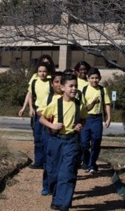

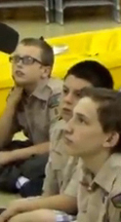


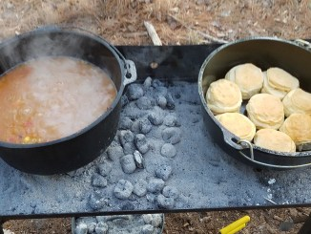
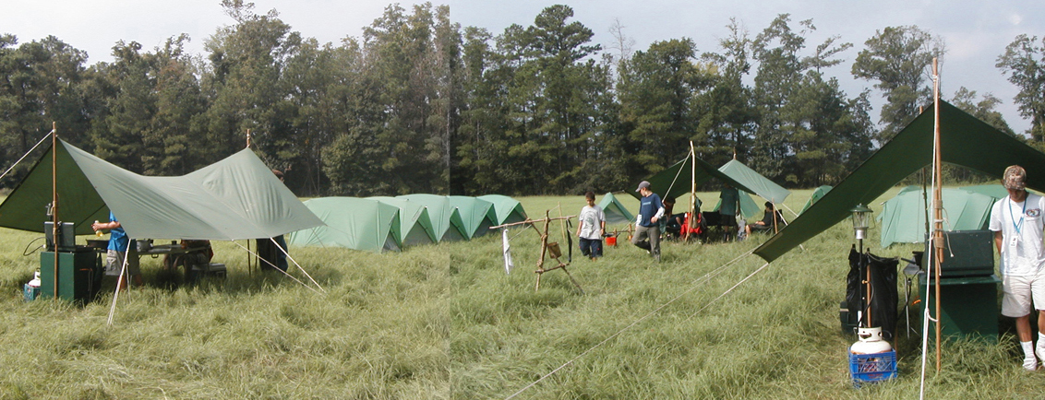
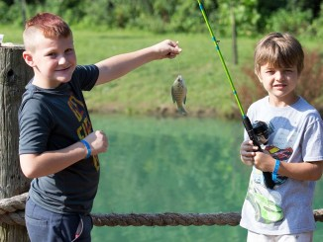
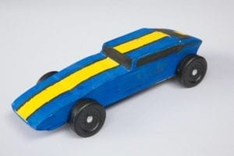
George Mason Program
John Drisco, Vice Chair Program
Matt Burns, Deputy Vice Chair Program
George Mason District

Slide 10

Current 2023 George Mason Calendar
May 13, 2023 – Jamboree on the Trail
May 13-14, 2023 – Patriot/GMD BALOO/IOLS
May 20, 2023 – District Hike-O-Ree
May 25, 2023 – Elks Youth Recognition Dinner for 2022 GM Eagles
May 29, 2023 – Flags In
June 3, 2023 – Life to Eagle Seminar (virtual)
September 23, 2023 – Life to Eagle Seminar (in-person)

Slide 11
STEM
05/13 – Techstravaganza 2023, Alexandria, VA
06/26-6/30 & 8/7-8/11 – STEM MB and Nova at Innovation Academy
07/16 – 07/21 – Scouts BSA Specialty Week, Camp Snyder
Anytime – DC STEM Trek- Showcases 24 government agencies, private organizations and monuments related to the tenets upon which STEM is based. Two hikes - 10.57 miles, or 4.75 miles

Slide 12
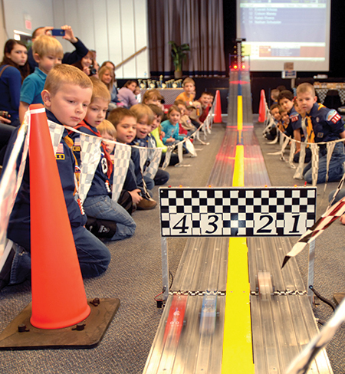
2023 NCAC
Pinewood Derby
When: May 20, 2023
Where: Camp Snyder
Cost: $20
Who: District 1st, 2nd, 3rd place in each den age group
Register here
Previous GMD race results and photos at:
https://www.ncacbsa.org/george-mason/district-pinewood-derby/

Slide 13

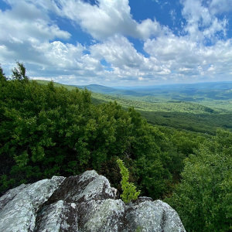

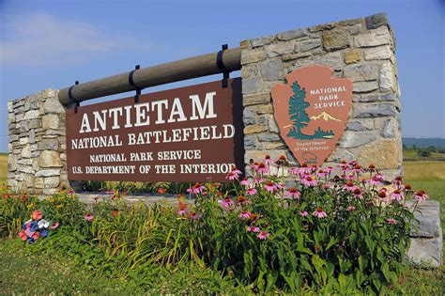
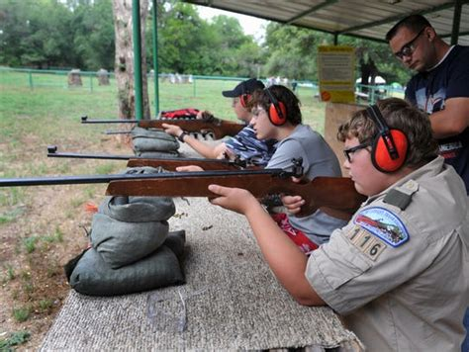
GMD Camporees
Spring 2023: Antietam/Rohrbach
Theme: White Canoeing &
Historic Hiking
Fall 2023:
Rock Enon
Theme: Shooting Sports
2024
???

Slide 14

George Mason District
Spring Camporee 2023
May 5-7
Rohrbach Group Campground, Sharpsburg, MD
Historic Hiking at Antietam Battlefield
Canoeing at Antietam Creek

Slide 15

Spring 23 Camporee
93 signed up
6 Troops Participating
50 Historic Hikers Completed 228.5 miles
59 Boaters Canoed 200 Creek Miles

Slide 16

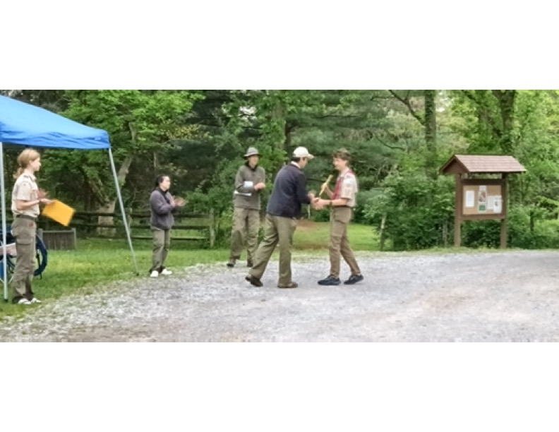
Outstanding performers
Most Hiking Miles: Troop 140 with 66 miles
Most Aquatic Miles: Troop 13 with 76 miles
Most Combined Miles: Troop 13 with 121 miles
Also Ran: GMD District Staff with 6 miles

Slide 17
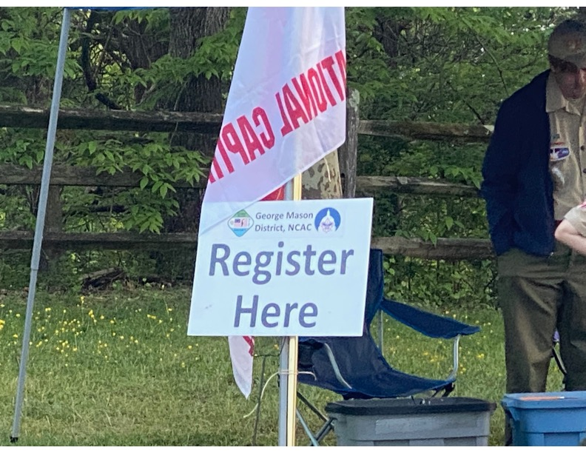
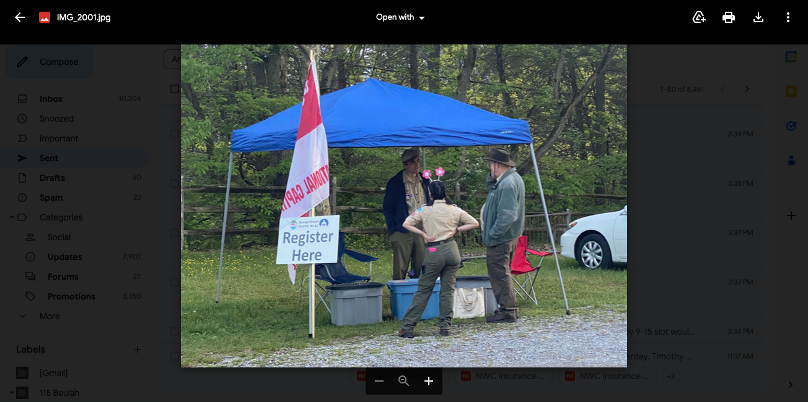
Registration

Slide 18
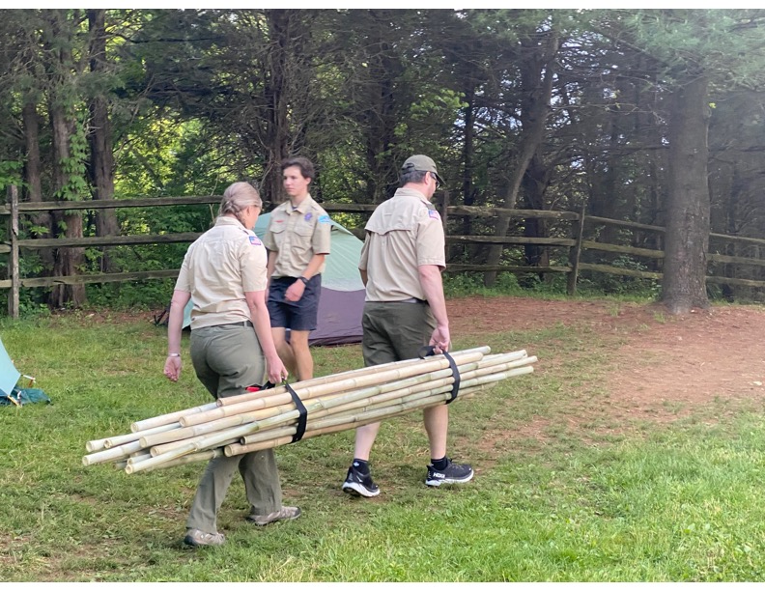
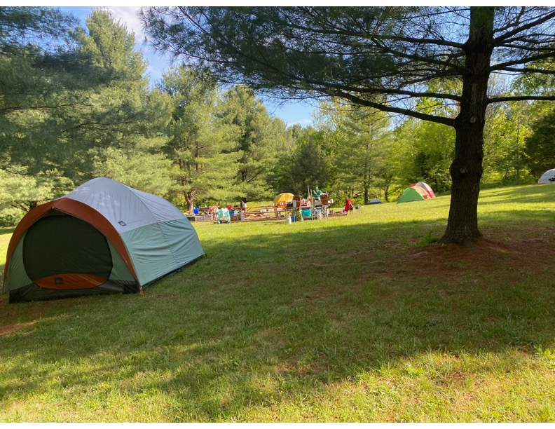
Setting up

Slide 19
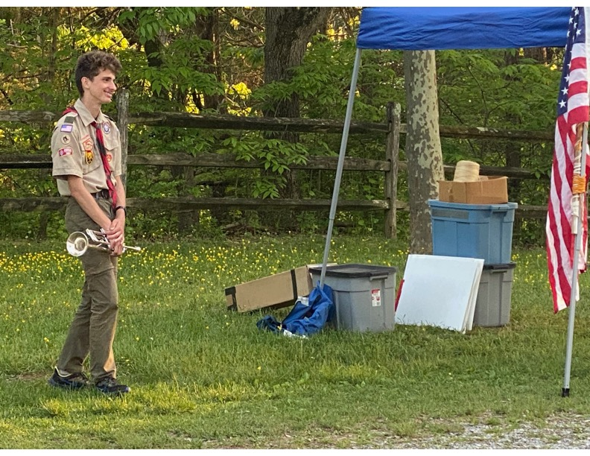
Flags (with bugler!)

Slide 20
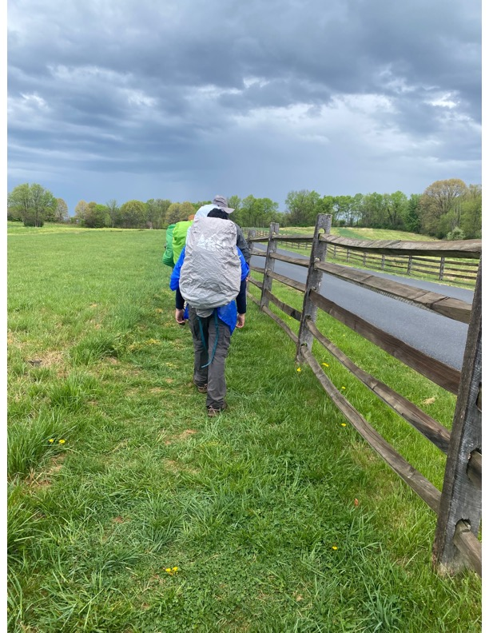
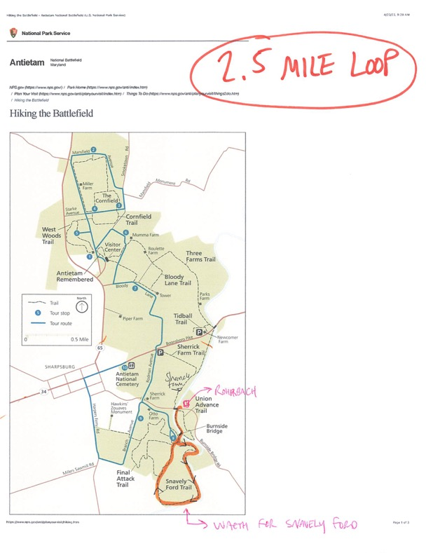
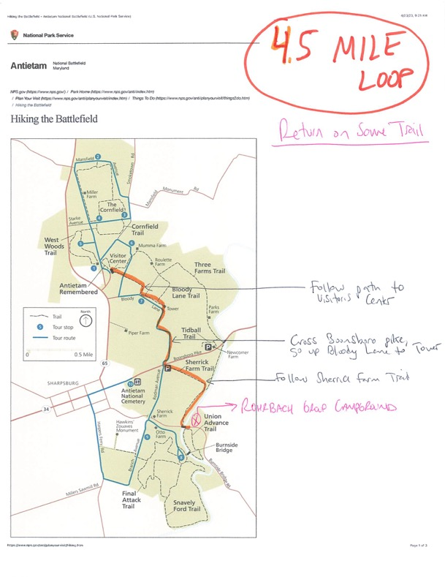
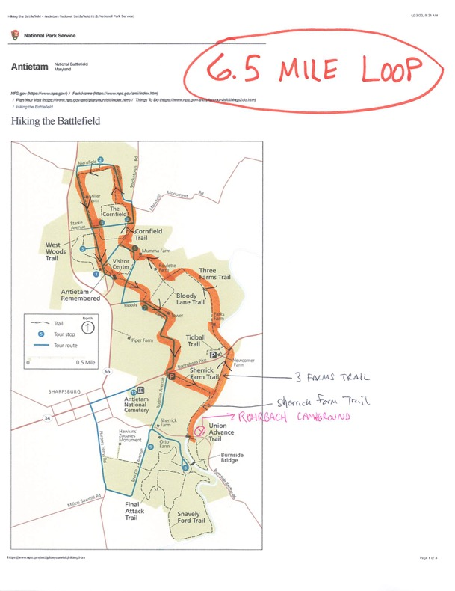
Historic hiking

Slide 21
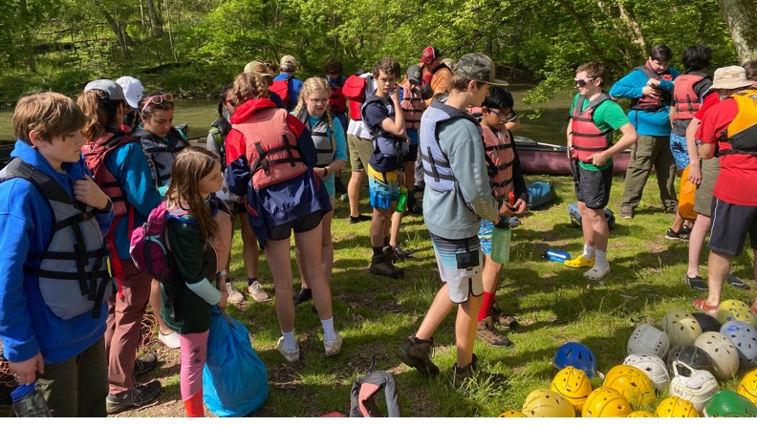
Canoeing on the creek

Slide 22
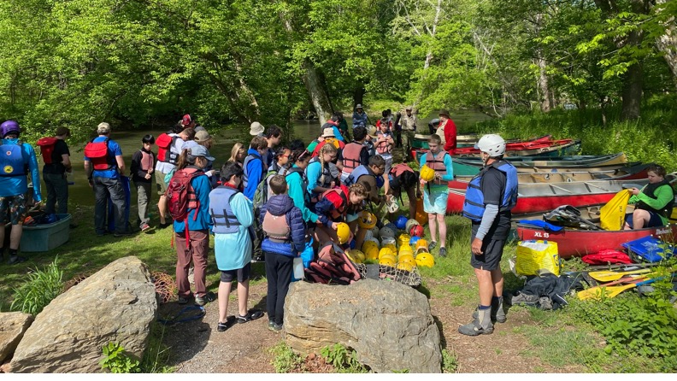

Slide 23
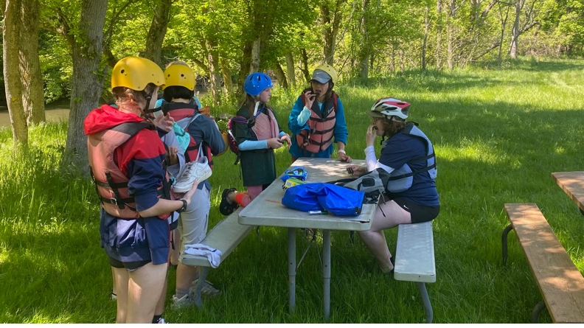

Slide 24
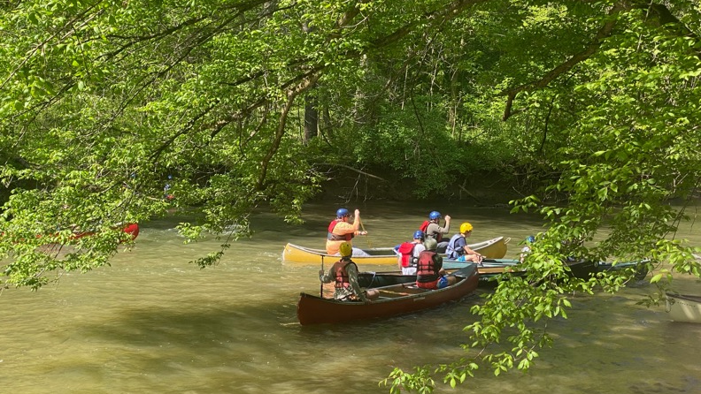

Slide 25

Campfire

Slide 26
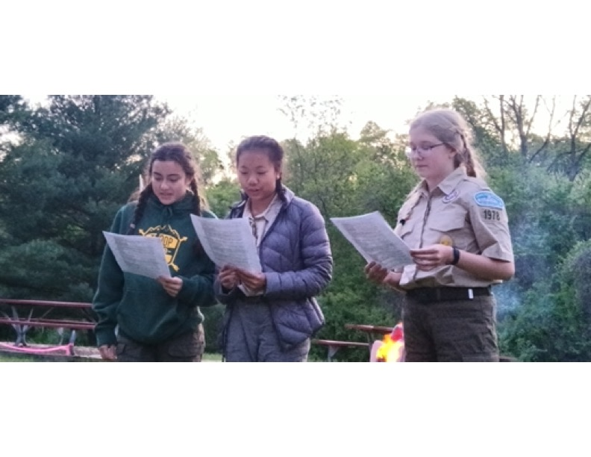
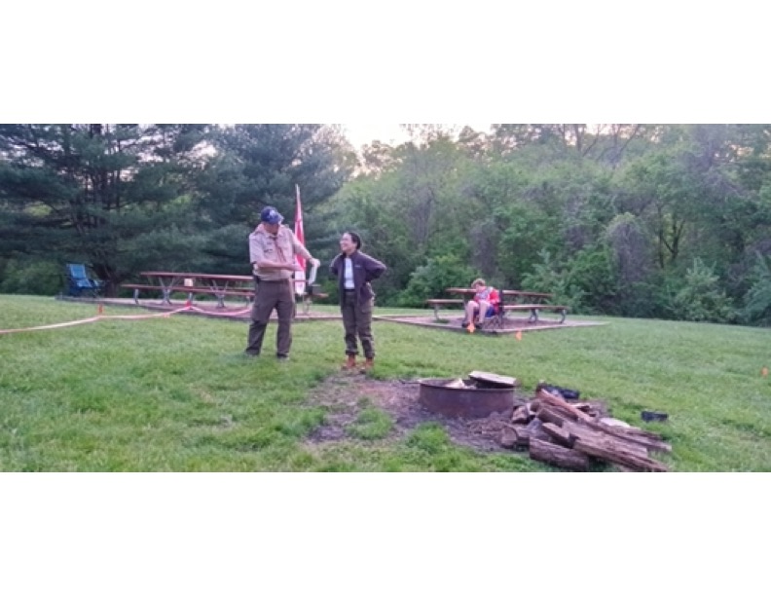
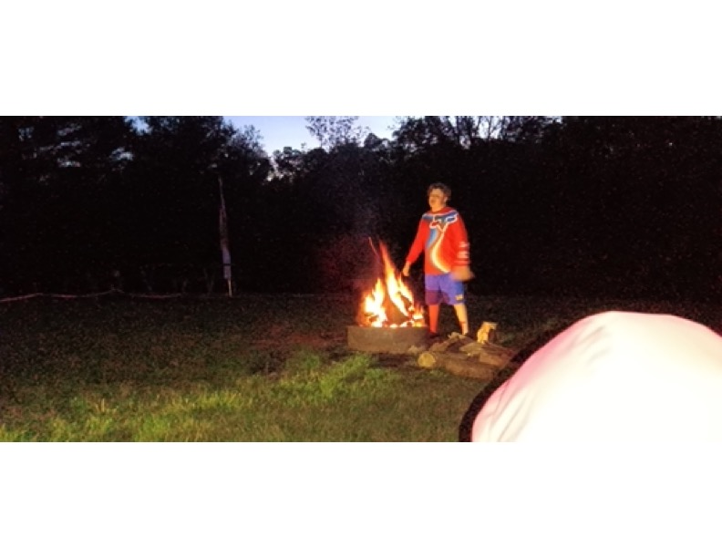
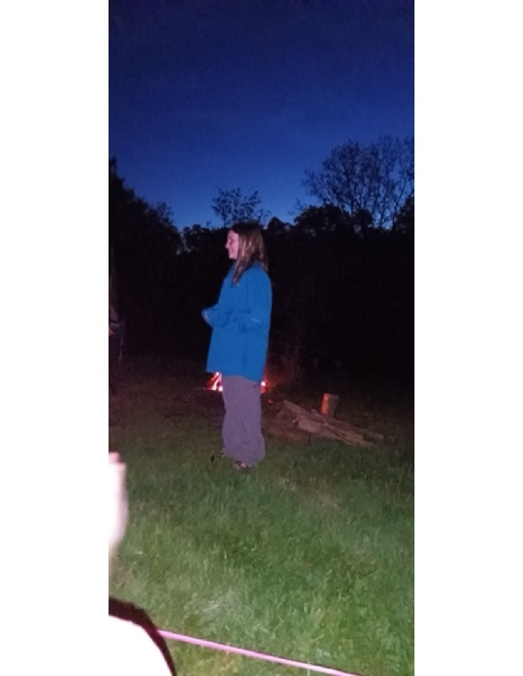

Slide 27
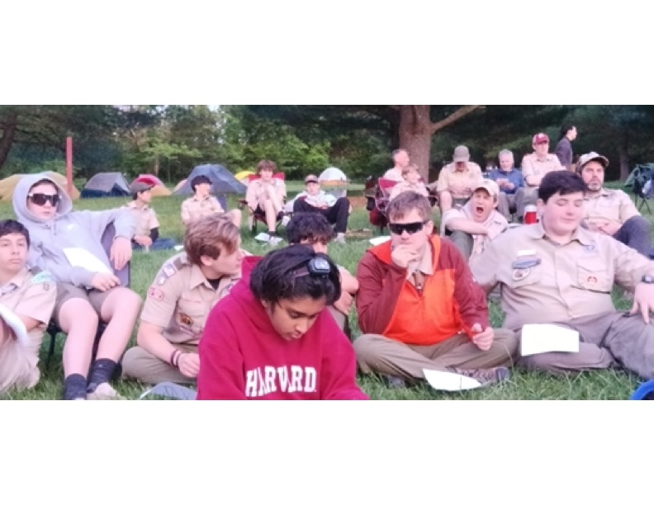
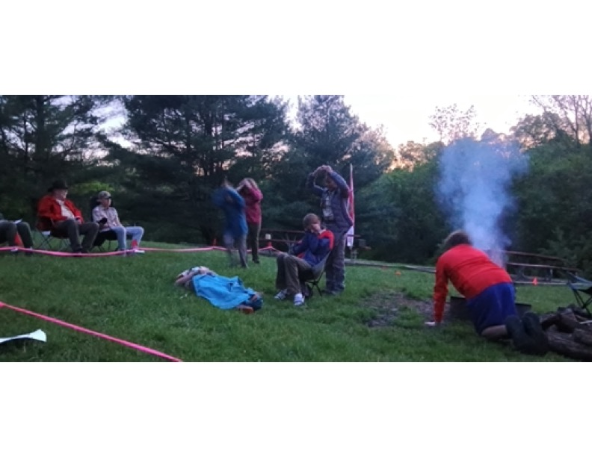
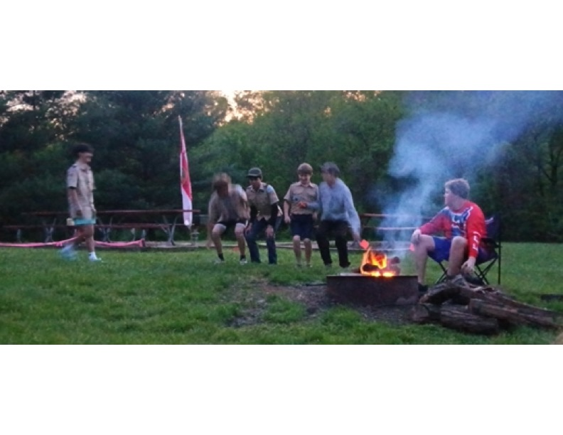
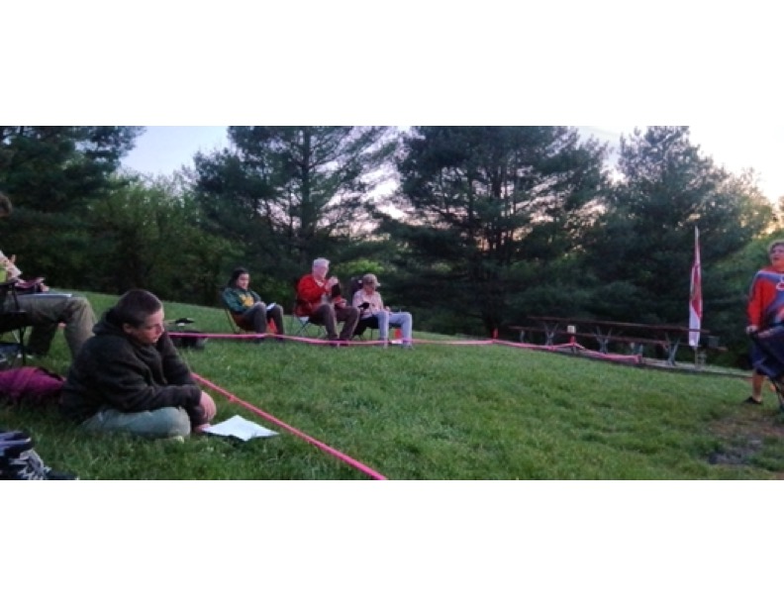

Slide 28
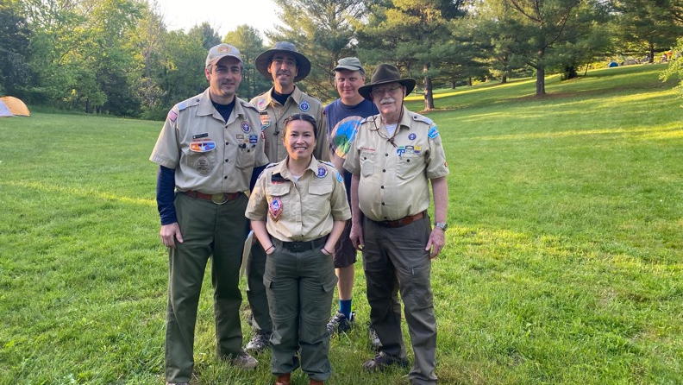

Slide 29

Fall Camporee: 10/20-22
October 20-22, 2023
Rock Enon
Shooting Sports & Merit Badge Carnival

Slide 30

Future directions
Lessons Learned from Spring 2023
GMD Camporee Spring 2024??
Other District Programming

Slide 31

George Mason Hike-O-Ree
3rd Annual GM Hike-O-Ree – Open to all (Cubs, Scouts BSA and Venturing Scouts), families and friends.
Two options to participate:
  Hike with the District on Saturday, May 20
  Hike at ANY time between May 12 and May 21.
Participants in both options will receive patches.
Any age, any place and any appropriate grouping – just keep track of how far you hiked.
Challenge – District Scouts, Scouters and families hike 2,023 miles.
Total the miles for each unit and notify Matt Burns at Burnsmj509@gmail.com. We’ll see how big a total we reach.

Slide 32
District Hike on May 20 – Option 1
Hike around Lake Mercer – gentle 4.3 miles.
Limited to first 99 registrants
Starting from South Run Recreation Center NLT 9:00 a.m. and finishing by 11:30 a.m.
YPT in effect – Every unit must have two registered, YPT current adults on hike.
Participating units must supply a third adult to help staff event.
Units must use the buddy system and account for all participants at start and end of hike – stay together!
Scouts working on Second Class can hike an additional piece of the trail to complete a five-mile hike.
Cost is $5.00 per person.
Register at: https://scoutingevent.com/082-67922

Slide 33
Unit or Personal Hiking During 2 Weeks – Option 2
For individuals or units that have a conflict and can’t attend the District Hike on Saturday, May 20
Hike at ANY time during the May 12 to May 21 time period.
Hiking can be done with a unit, with family or with friends.
Hiking can be done anywhere – national/state park, local park, neighborhood, etc.
There is no upper or lower limit on distance.
Remember to report results to burnsmj509@gmail.com.
Register to receive a patch. Cost is $5.00 per patch.
Register at: https://scoutingevent.com/082-68269

Slide 34

Jamboree on the Trail
May 13, 2023
An international event
The only requirement is to get out and hike.
Inaugural hike was in 1998.
Scouts of all ages can hike.
Register by March 31 to be certain of getting patches by May 13.
Register at: https://jamboreeonthetrail.org/registration/

Slide 35

2023 Elks Youth Recognition Dinner
For youth that earned Eagle in 2022 (i.e. their Eagle Board of Review was held in the 2022 calendar year) and their Scoutmasters.
Thursday, May 25, 2023
Elks Lodge 2188, 8421 Arlington Blvd., Fairfax, VA.
Will need unit leader help in contacting Scouts and obtaining an RSVP.
Scoutmaster are invited at no cost to them.

Slide 36
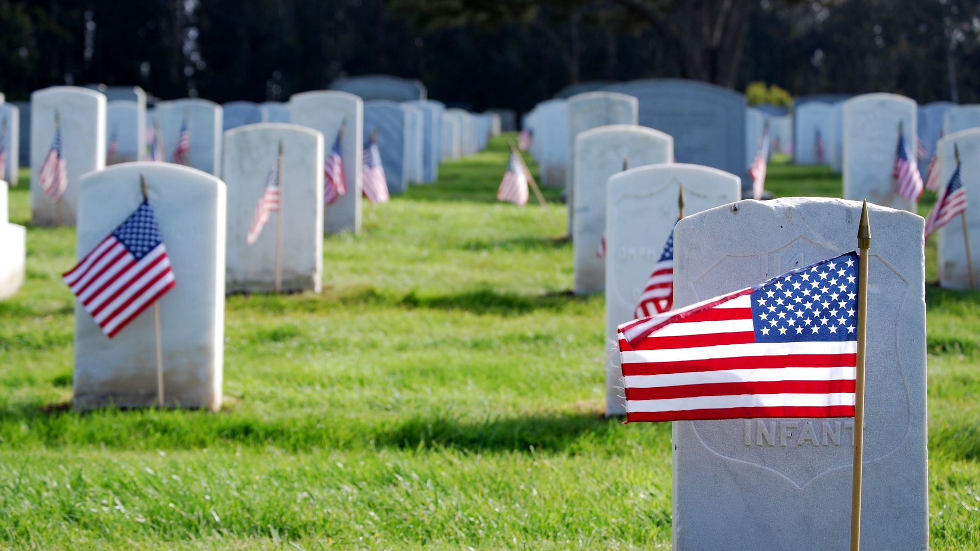
Flags In
May 29, 2023 (Memorial Day Monday)
Start at 10:00am – Pizza is available!
National Memorial Park,
7482 Lee Highway, Falls Church
All Scouts, including Girl Scouts, are welcome.
Class A Uniforms
For more info, contact Russell Pittman at ruspittman@gmail.com.

Slide 37

District Life to Eagle Seminar – June 3
Saturday, 3 June 2023
1:00 to 4:00 p.m.
Virtual
Register at: https://scoutingevent.com/082-70700
Who should attend:
Life Scouts or advanced Star Scouts who want to pursue the Eagle Rank
Eagle advisors, coaches or unit leaders that haven’t attended a seminar in two years
Parents of Scouts working on Eagle or other adults interested in Scouting
Registration is live now and must be registered by 1 June 2023 to get the Zoom link.
Any questions contact Matt Burns at 703-938-9550 or at gm.advancement @gmail.com.

Slide 38
District Life to Eagle Seminar – September 23
Saturday, 23 September 2023
1:00 to 4:00 p.m.
In Person at St. James Catholic Church in Falls Church
Register at: https://scoutingevent.com/082-70702
Who should attend:
Life Scouts or advanced Star Scouts who want to pursue the Eagle Rank
Eagle advisors, coaches or unit leaders that haven’t attended a seminar in two years
Parents of Scouts working on Eagle or other adults interested in Scouting
Registration is live now and must be registered by 21 September 2023.
Any questions contact Matt Burns at 703-938-9550 or at gm.advancement@gmail.com

Slide 39


Merit Badges
The online Merit Badge Counselor registration works for all Scouters who do not already hold another District position.
New Merit Badge Counselors must complete online merit badge counselor training, in addition to YPT. Be sure the counselor uses his/her legal name – no nicknames.
Merit Badge Counselors, or the unit Dean/Leader, also need to scan and send Margee the Merit Badge application form listing the badges the counselor is applying to teach and providing a justification of his/her qualifications.
Youth Protection Training is the essential first step. Don’t hit “send” on the application without it!
Contact Margee if you have questions at GM.MB.Dean@hotmail.com.
Did you know:
The National Council does not limit the number of merit badges a youth may earn from one counselor, though a unit leader is permitted to do so, as long as the same limit applies to all Scouts in the unit. Ideally, Scouts should work with a variety of adults. (GTA 7.0.0.3)
Partial Merit Badges have no expiration except the Scout’s 18th birthday. (GTA 7.0.3.3)
Due to the BSA policies related to Youth Protection and two-deep leadership, a merit badge counselor must have another adult present during all merit badge counseling sessions. However, the parent or legal guardian of the Scout may serve as the second adult. This parent or legal guardian does not have to be a registered leader.
If the requirements for a merit badge differ between the merit badge pamphlet and the current edition of Scouts BSA Requirements, the requirements in the Scouts BSA Requirements book supersede all others.
Merit Badge Opportunities:
05/13/23 – Welding, Alexandria, VA
07/16/23 – 07/22/23 - Camp Snyder Specialty Week, Haymarket, VA
09/09/23 – Americanism Merit Badge Workshop, Fredericksburg, VA

Slide 40

Training (https://www.ncacbsa.org/george-mason/training/)
Cub Scout Den Leader Specific (C42)
  05/20/23 – Alexandria, VA
  06/10/23 – Alexandria, VA
Scoutmaster Position Specific Training (S24)
  05/20/23 – Alexandria, VA
  06/10/23 – Alexandria, VA
Cub Leader Position Specific (C40)
  05/20/23 – Alexandria, VA
  06/10/23 – Alexandria, VA
Basic Adult Leader Outdoor Orientation (BALOO;C32)
05/12/23 – 05/13/23 – Huntingtown, MD
05/13/23 – 05/14/23 – Camp Snyder, Haymarket, VA
05/20/23 – 05/21/23 – Camp Snyder, Haymarket, VA
06/17/23 – 06/18/23 – Lorton, VA
Introduction to Outdoor Leadership Skills National Youth Leadership Training (NYLT; S78)
    Back Country Outdoor Leader Skills (BCOLS) – 09/23/23 (Heritage Pres Church, Alexandria, VA) & 10/21/23 -10/22/23 (Camp Big Mac, Markham, VA)
        Powder Horn – 08/17/23 – 08/20/23 – Camp St. Charles, Newberg, MD
        Wilderness First Aid (N02) Wood Badge (A90) - https://www.ncacbsa.org/wood-badge/
  05/12/23 – 05/13/23 – Huntingtown, MD
  05/12/23 – 05/13/23 – Camp Snyder, Haymarket, VA
  05/13/23 – 05/14/23 – Camp Snyder, Haymarket, VA
  06/17/23 – 06/18/23 – Lorton, VA
        06/18/23 – 06/23/23 – Session 23-2 – Camp Snyder, Haymarket, VA
        06/25/23 – 06/30/23 – Session 23-3 – Camp Snyder, Haymarket, VA
        07/23/23 – 07/28/23 – Session 23-4 – Camp Snyder, Haymarket, VA
        07/23/23 – 07/28/23 – Session 23-5 – Camp Snyder, Haymarket, VA
09/08/23 – 09/10/23 & 10/07/23 - 10/08/23
        09/08/23 - 09/10/23 & 10/07/23 – 10/08/23
BSA Leave No Trace Trainer Course – Outdoor Ethics
  10/16/23 (Zoom) & 10/21/23 (Camp Snyder)
Outdoor Ethics Orientation Course (Scouts and Cubs)
                06/10/23 – Brandywine, MD
            09/09/23 – Brandywine, MD
            12/03/23 – Brandywine, MD

Slide 41

GM High Adventure
High Adventure Opportunities for Individuals in 2023
  Lenhok’sin – Backpacking Trek, 07/02 to 07/08 (Week 2) – 4 slots left
  Several NCAC Units have space available for individuals in their crews
NCAC High Adventure Trips - 2024
  Philmont – Rocky Mountain Backpacking - Crew of 8-12, Jul 13-27, 2024
    Includes White Water Rafting & Pike’s Peak Railway!
  Northern Tier – Wilderness Canoeing - Crew of 6-8, Jul 23-Aug 3, 2024
  Sea Base – St Thomas STEM Eco Sailing - Crew of 6-8, Jul 29-Aug 3, 2024
  Lenhok’sin – James River Canoeing Trek - Crew of 6-12, July 7-13, 2024
  FOR INFO: highadventure@ncacbsa.org
Training
  Sea Base Session – 4:00pm, May 13 - Mechanicsville, MD
  Philmont 2024 Sessions: I – 11/19/23; II – 01/07/24; IIIa – 03/24/24; IIIb – 04/06/24
May 2023
Notes:
Sea Base Trip on Jul 29-Aug 3, 2024 - FULL

Slide 42
GM High Adventure (cont)
National High Adventure Base Quick Links
  Philmont: https://www.philmontscoutranch.org/register/
  Northern Tier: https://www.ntier.org/provisional-scout-connections/
  Sea Base: https://www.bsaseabase.org/scouts/scout-connections/
  Summit: https://www.summitbsa.org/registration/scoutconnections/
Other High Adventure Bases
  Adirondack High Adventure Area: https://public.3.basecamp.com/p/hLgsVbk7Suju6cuDzQQJaEn4
  Maine High Adventure Area: https://www.mainehighadventure.org/
  Montana Outdoor High Adventure Base: https://montanabsa.org/camps/high-adventure/
May 2023

Slide 43
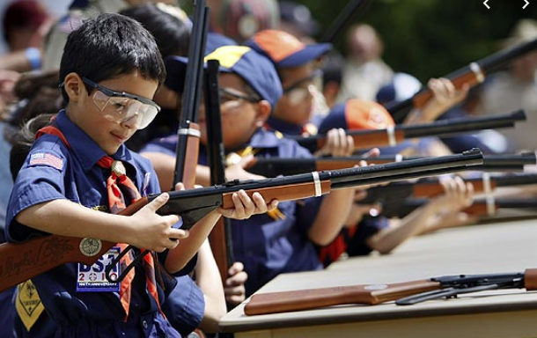
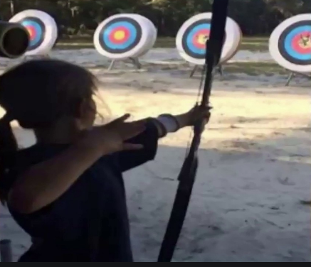
Shooting Sports
Requests for Shooting Events – Lead Time!
  50+ scouts - 6mos
  Less than 50 scouts - 3mos
Shooting on private land:
  Requirements
  Permissions/protocols
Shooting Sports web page
Shooting Sports Instructor Classes:
  Rifle/Shotgun
  Archery

Slide 44
Other Activities (for units, Dens/Patrols, or families)
Sundays (8am) – Dyke Marsh Bird Walks, Alexandria, VA
Thursdays – Films in the Park, Mosaic, Fairfax, VA
05/13/23 – 25th Annual Eagle Festival, Mason Neck State Park, Lorton, VA – reptile/hawk/owl/eagle
05/13/23 – EU Open House Embassy Tours (10am-4:30pm), Washington, DC
05/19/23 – 05/20/23 – McLean Days, McLean, VA ($)
05/27/23 – 05/30/23 – Viva Vienna, Vienna, VA ($)
05/27/23 – Bug Fest, Fairfax Lewinsville Historic House, McLean, VA ($8)
05/29/23 – Falls Church Memorial Day Parade (1pm), Falls Church, VA
06/01/23 – 06/04/23 – Herndon Festival, Herndon, VA ($)
06/04/23 – Clean the Bay Day, Various Locations
06/10/23 – Scout Family Field Day - Washington Commanders, FedEx Field, DC ($)
June/July/Aug (Tues, 10am) – Kids on the Green, Vienna, VA

Slide 45
Order of the Arrow
  2023 Dues can be paid online: https://wipit470.org/dues.html
  05/12/23 – 05/14/23 – Lodge Service Weekend at Goshen
  05/19/23 – 05/21/23 – Section Conclave at Rodney Scout Res.*
  06/18/23 – 07/01/23 – GOAT
  * Registrations open online https://wipit470.org/index.html under “Events”

Slide 46
Other Topics
General Announcements
District Executive Minute
District Chair Minute
District Commissioner Minute
Minutes and slides available on the GMD web site (District Resources, Roundtable). Password is “GMDRT”
Next meeting – June 8, 2023, at Thoreau MS
  7:00pm - Program Launch/Vendor Fair/Silent Auction
  8:00pm – Roundtable
  Invite your Den Leaders and ASMs!

