Slide 1

Using SLSS Resources to Offer Local Training
Jennifer Koerber
May 20, 2020
www.suny.edu

Slide 2
Agenda
Introduction & context
Review of SLSS Resources: Guides, FAQs, Recordings
Creating local documentation & training
Examples
Q&A
www.suny.edu

Slide 3
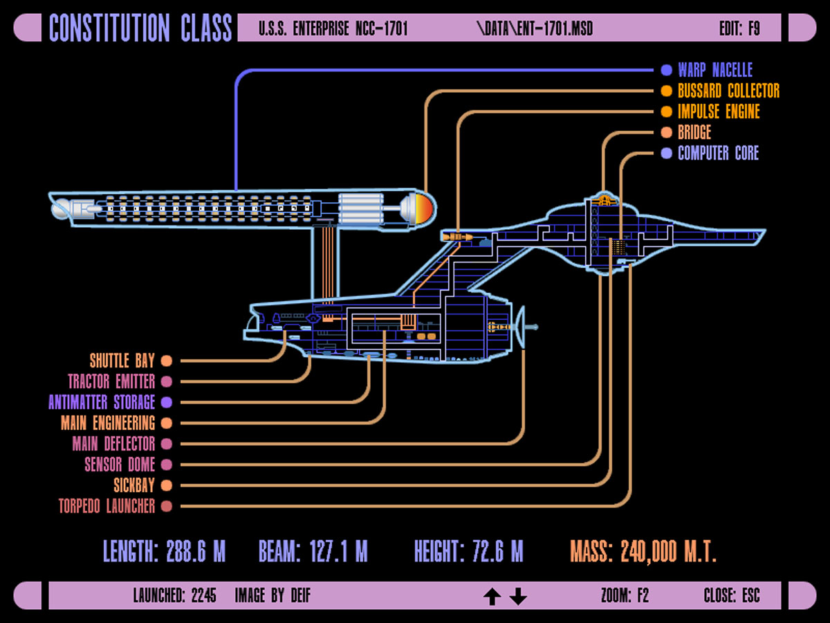
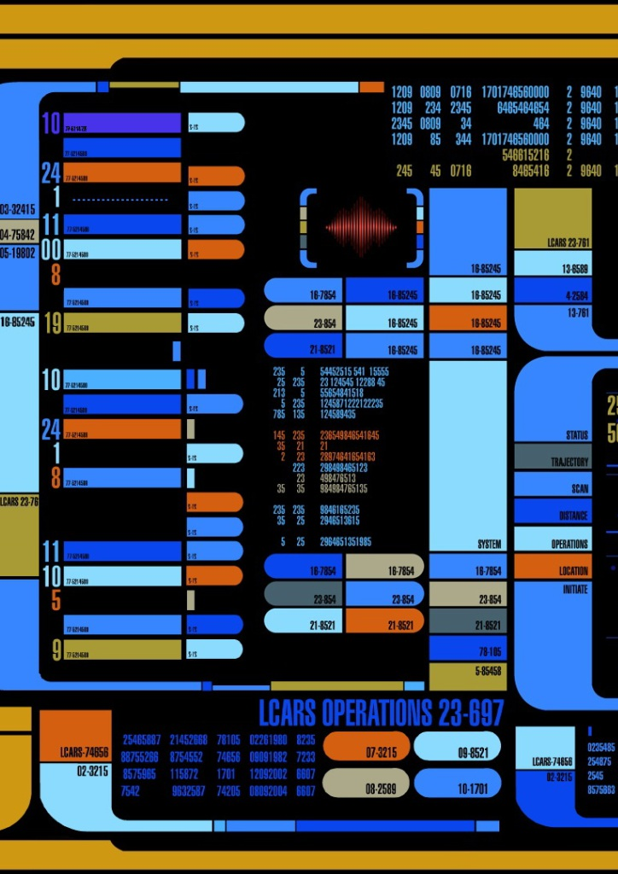
www.suny.edu
Notes:
Alfred University Libraries staff – “Learning Alma was like learning a spaceship console. First, you just get it to start, go forward, and stop. Then, you actually learn how to navigate, and maybe turn on your shields…”

Slide 4
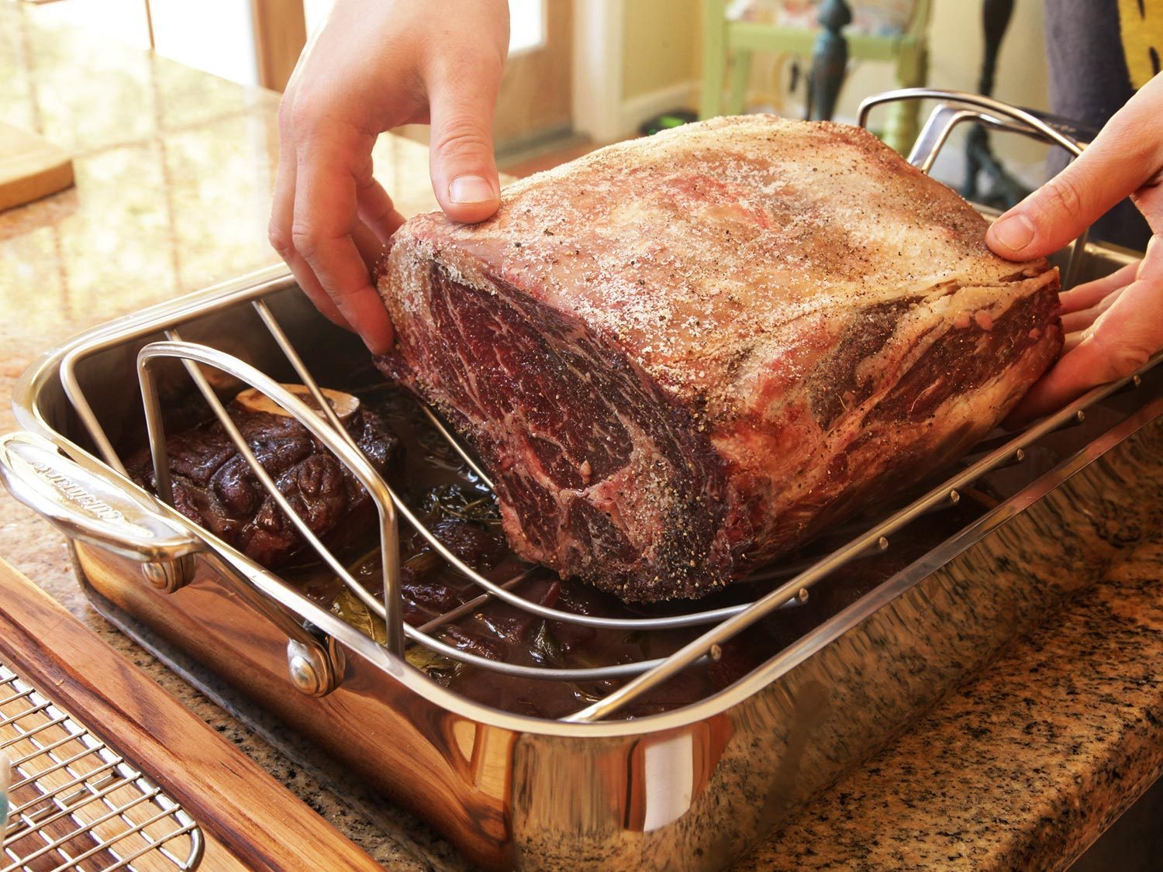
www.suny.edu
Notes:
“The new Jewish bride is making her first big dinner for her husband and tries her hand at her mother’s brisket recipe, cutting off the ends of the roast the way her mother always did. Hubby thinks the meat is delicious, but says, “Why do you cut off the ends — that’s the best part!” She answers, “That’s the way my mother always made it.”
The next week, they go to the old bubbie’s house, and she prepares the famous brisket recipe, again cutting off the ends. The young bride is sure she must be missing some vital information, so she askes her grandma why she cut off the ends. Grandma says, “Dahlink, that’s the only way it will fit in the pan!” – Snopes.com

Slide 5
Every Resource Has Its Place
Ex Libris materials are about the systems, go deep under the hood, and explain how Alma/Primo VE work together
SUNY documentation and presentations are about how SUNY is using the systems & include consortia-level policy & workflows
Campus materials should be about the local practice and workflows of your own campus/libraries
www.suny.edu

Slide 6
Local Training is About the Why
Teaching the institution as much as the system
Set aside non-training time to discuss policy, physical workflow, and job/duty changes
Include details in local documentation
Don’t reinvent the wheel – link out to SLSS or Ex Libris content and let them maintain the step-by-step instructions
www.suny.edu

Slide 7
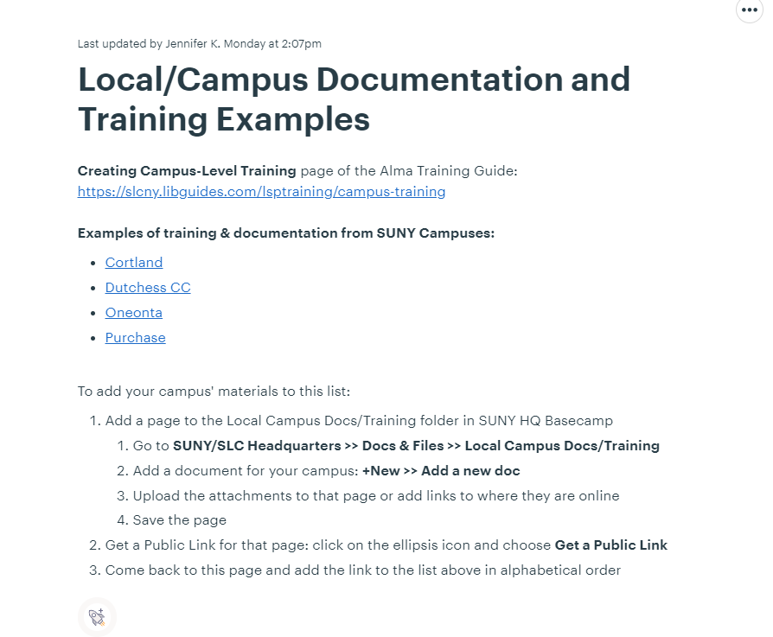
Get Inspired
Go to Basecamp HQ >> Docs & Files >> Local Campus Docs/Training
Go straight to here:
https://public.3.basecamp.com/p/JPL8a7pseBKYzqv3hpTinzsm
www.suny.edu

Slide 8
Working in a Remote Environment
Don’t spend group time reviewing the basics. Require staff to watch SUNY or Ex Libris recordings first, then attend group sessions.
Most people don’t have two screens. Participating in remote hands-on training is hard with just one monitor, so….
Use separate Q&A/demo sessions and “gardening glove” working sessions
  Q&A/demo = people ask questions about what’s stumping them, or a trainer walks through a specific sequence and answers questions
  Gardening glove session = working through specific procedures or workflows to get in the weeds and figure out details. Used to give training context and increase familiarity with troubleshooting.
www.suny.edu

Slide 9
Working in a Remote Environment
Multiple shorter sessions, not all-day events
Mix of synchronous & asynchronous interaction
Screensharing means that no one has to be on video, people may be more comfortable with that
Encourage interaction: voice, public chat, private chat, email before or after a session
www.suny.edu

Slide 10
Different Approaches
New Staff
  Systematic approach to all relevant Alma material
  Assuming no knowledge with the system or with SUNY
  Self-paced but needing more handholding/monitored learning
Refreshers/New Roles for Existing Staff
  More curated needs for material
  Assuming some knowledge of Alma/Primo VE, SUNY, or both
  More individual learning and very self-paced, but may require faster ramp up
www.suny.edu

Slide 11
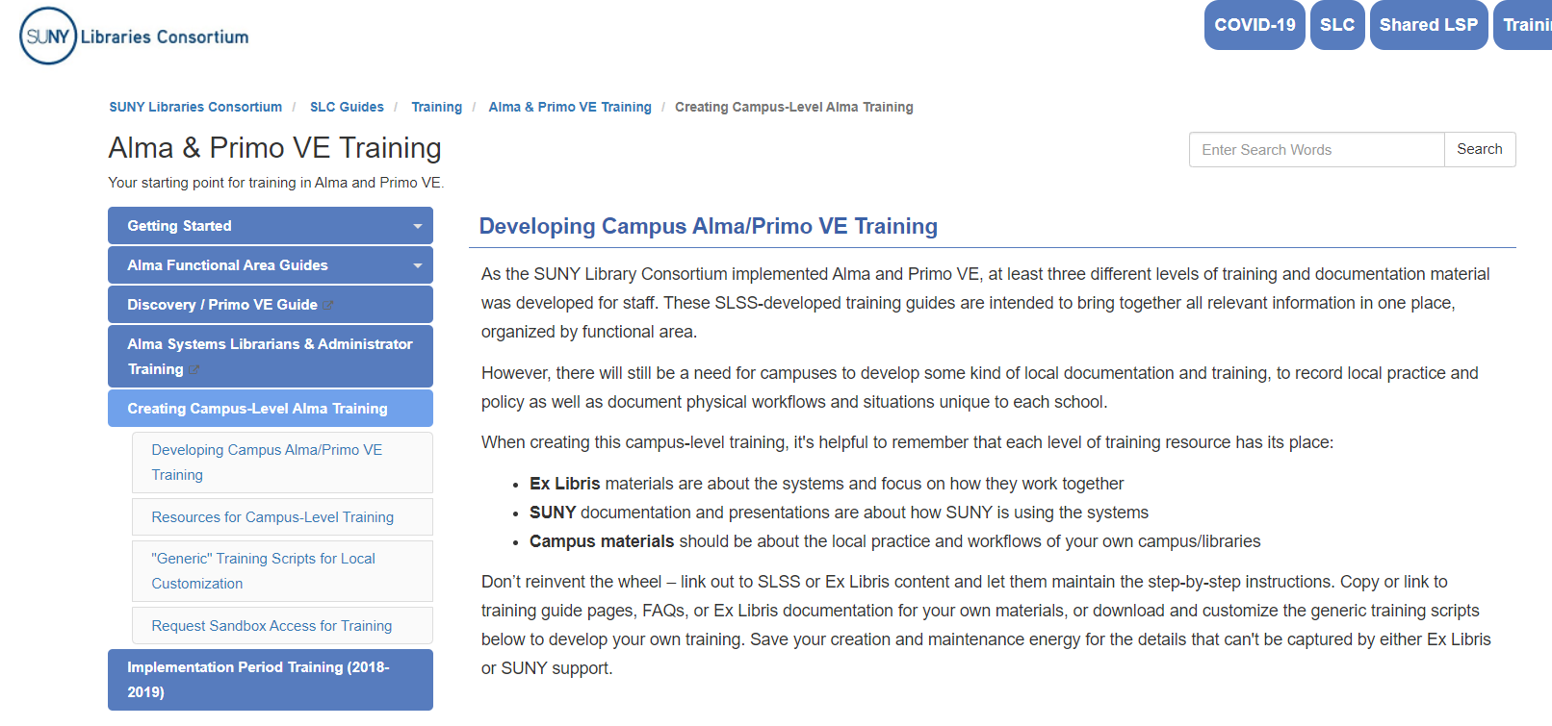
New Campus Training Page
https://slcny.libguides.com/lsptraining/campus-training
www.suny.edu

Slide 12
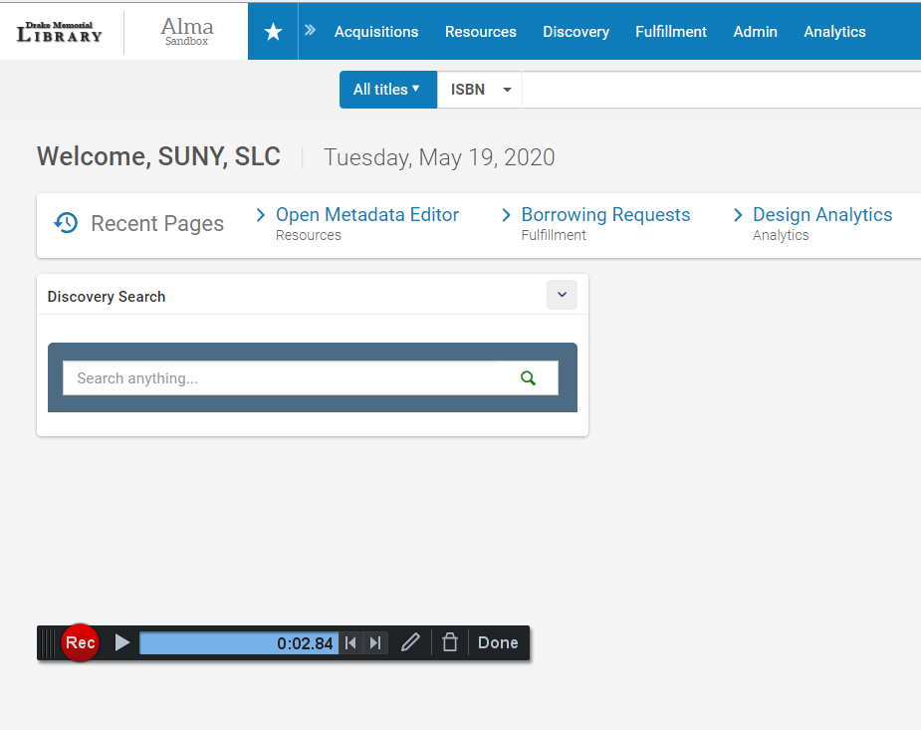
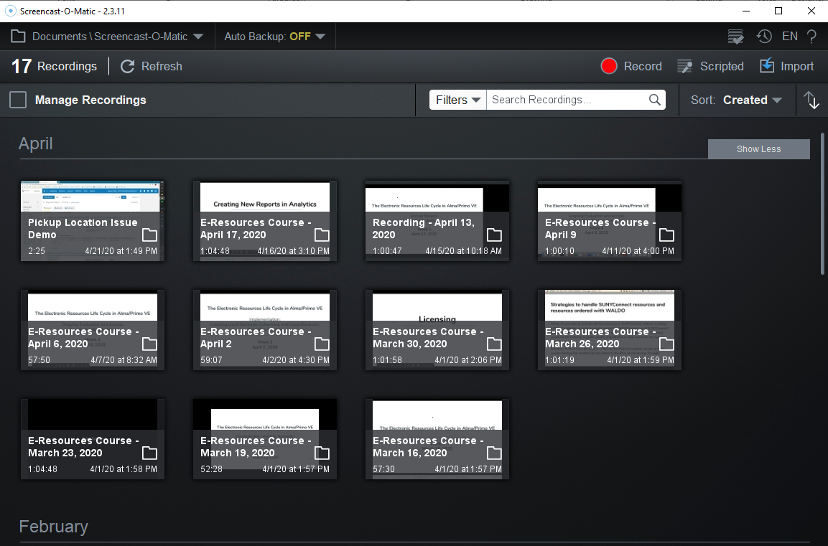
https://screencast-o-matic.com/
www.suny.edu

Slide 13
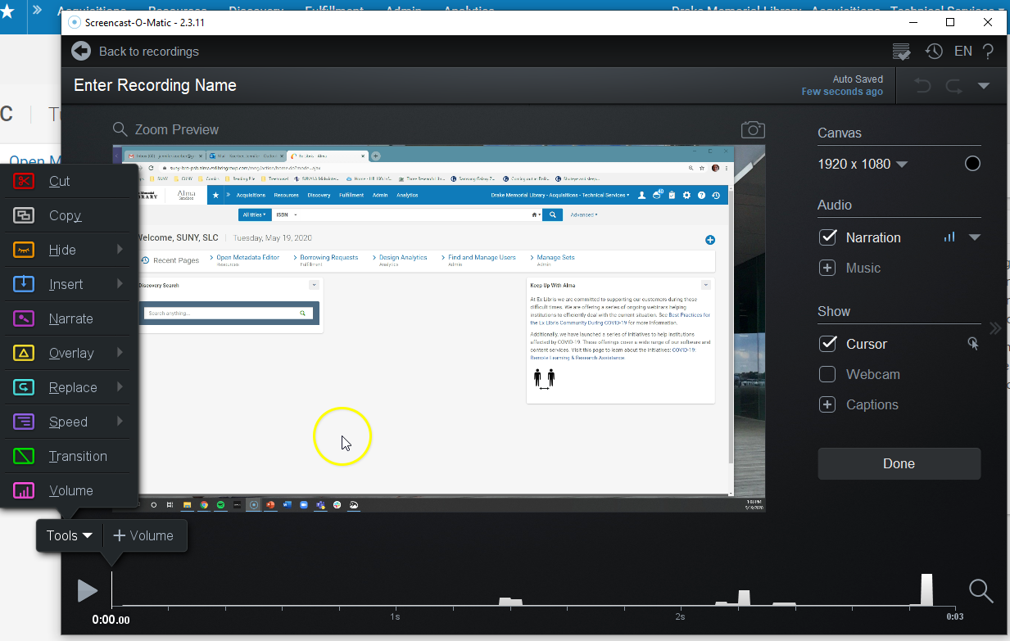
www.suny.edu

Slide 14
Bringing It All Together for Campus-Level Training
These are slides from the February 2020 webinar that are particularly relevant to campus-level training
www.suny.edu

Slide 15
Models of Training
Training
Individual Practice
Peer Learning
Within a unit
On a functional topic
Vendor-created
Locally created
Other institutions
High-Touch – lots of hands-on, customized content; detailed formal support for staff; highly structured
Medium-Touch – Anywhere in between
Low-Touch – Use mostly/only vendor-provided materials; self-paced & self-directed; mostly online + vendor in-person; most useful for tech-comfy staff
www.suny.edu
Notes:
The argument is that the vendor provided or even SLSS provided training isn’t specific enough for local needs. This is where campus-level training has the opportunity to fill the gap, to take the existing materials and then add in the local steps.
Medium touch is anywhere in between. Most balanced is to use vendor tools for the most general/straightforward elements and customized content for institutional/consortial-specific needs. Aka., The further you move from out-of-the-box use, the more you need your own training materials. Same for integrating policy/workflow information into the training, as opposed to training the system.
Tech-savvy vs. tech-comfy = not a judgment, just a fact. Don’t assume that because a person knows one system inside & out that they’ll be comfortable learning a new one. Tech-comfy (my term) implies that they’re generally comfortable with any technology, including learning it when they need to. A person can be generally tech-savvy, or they can be highly-specifically tech savvy in one or a few systems, but still not generally comfortable with “technology”. Think about the folks who are very comfortable working in and troubleshooting one system, but aren’t comfortable with personal technology.

Slide 16
Bringing it All Together – Intended Audiences
New Staff
  Systematic approach to all relevant Alma material
  Assuming no knowledge with the system or with SUNY
  Self-paced but needing more handholding/monitored learning
Refreshers/New Roles for Existing Staff
  More curated needs for material
  Assuming some knowledge of Alma/Primo VE, SUNY, or both
  More individual learning and very self-paced, but may require faster ramp up
www.suny.edu

Slide 17
Tools
Ex Libris Visits and Materials
In-Person/Hands-on Trainings
Individual Practice
Informal Peer Support
  Mentors or “buddies”
  Learning Circles, Working Groups
Web-Based Training
  Webinars
  Small Group Working Sessions
  Short Videos
  Documentation
    Training Guides
    Step-throughs
    Reference lists
    Policy
www.suny.edu

Slide 18
Bringing it All Together – Use the Tools
Turn guides into hands-on training, using the how-to doc & SLSS workflow as suggestions
Encourage staff to participate in SLSS trainings
Getting the most from Café Alma, Basecamp, and Salesforce
Use peer learning/learning circles to discuss local practices and work through specific examples and issues
Look to other institutions for ideas
www.suny.edu

Slide 19
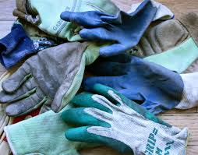

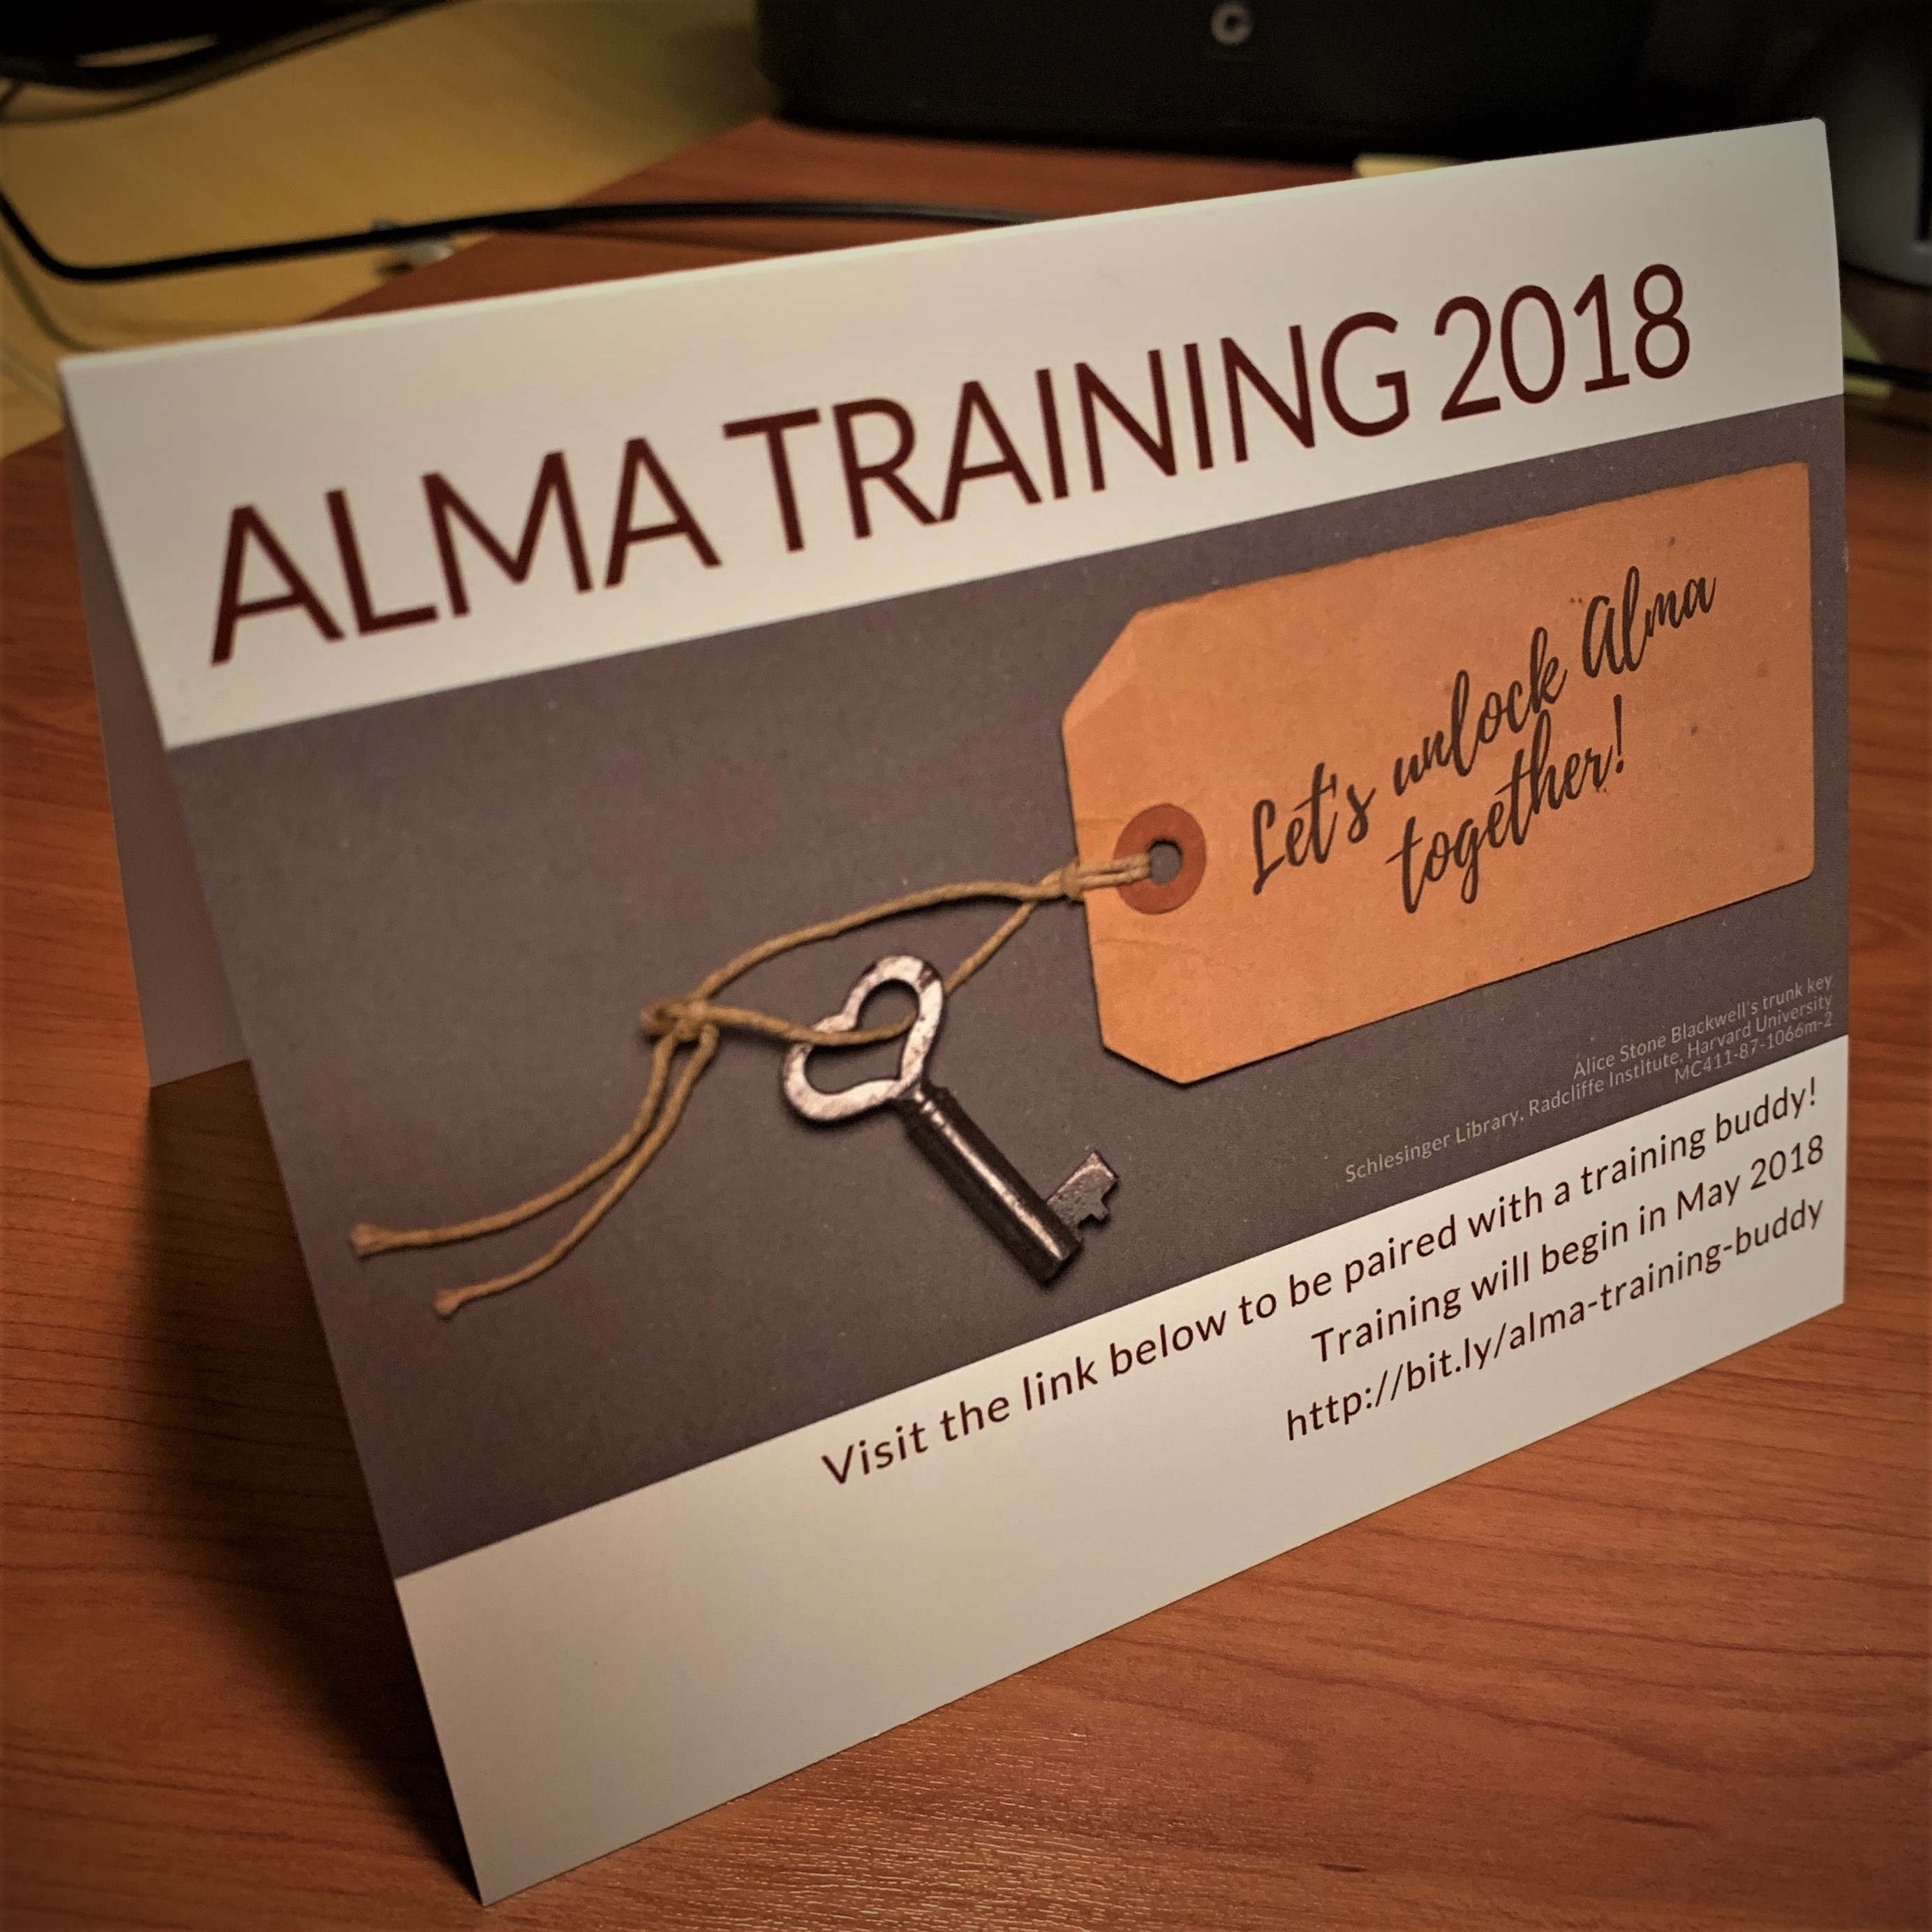
Informal Peer Support
Discussion lists or forums
Working Groups/“Gardening Glove” sessions
Learning Circles, Circles of Practice
  Café Alma as an online learning circle
Mentors
“Buddies” – like workout buddies, only for going through training!
www.suny.edu

Slide 20
Practice!
Sandboxes, then live sites
You will not learn everything you need just by attending
or watching training
CARLI: https://www.carli.illinois.edu/products-services/i-share/alma/sandbox , especially the Best Practices at the bottom
UPenn: https://guides.library.upenn.edu/alma
www.suny.edu

Slide 21
SUNY Alma/Primo Training Guides
Self-guided individual learning
Use them as the “textbook” for in-person or online training
Use the content and structure to develop your local training, augmented with local practices, policies, and examples
Mix with Ex Libris and SUNY Shared Services training and documentation for any of the above
Use as the homework or pre-reading for local discussions on policy, procedure, or training needs
www.suny.edu

Slide 22
How to Turn Tech Stuff Into Training Doc
Chunk wisely
Find narratives
“Teach the Tool”
Designate time for tangents (especially on local policy & workflows)
Hands-on whenever possible, with lots of time for practice during and after the session
More at https://public.3.basecamp.com/p/JPL8a7pseBKYzqv3hpTinzsm
www.suny.edu

Slide 23
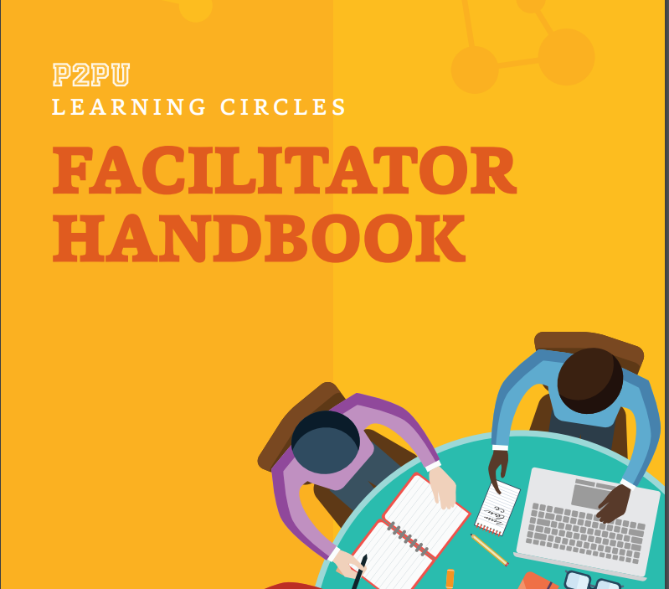
Learning Circles
Watch Ex Libris or SLSS videos
Read Ex Libris documentation
Come together to work through real-life, local examples
https://www.p2pu.org/en/facilitate/
www.suny.edu

Slide 24
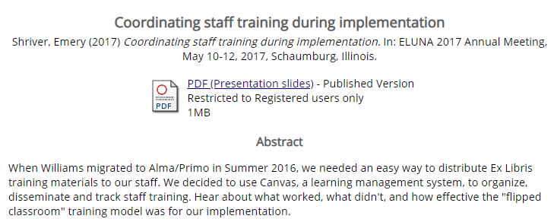
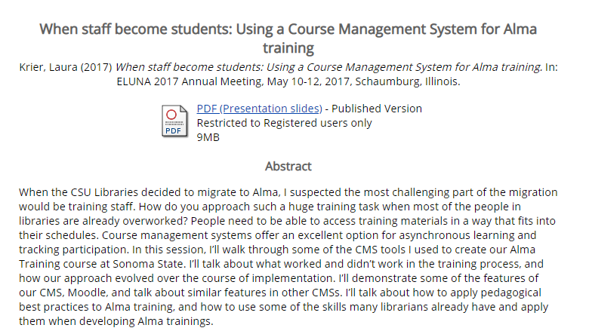
Williams College & Sonoma State (CSU)
http://documents.el-una.org/1514/
CMS provides structure
Vendor documentation for content
http://documents.el-una.org/1527/
http://documents.el-una.org/1639/
www.suny.edu
Notes:
Third one is Streamline Training of Student Library Assistants Using a Course Management System and Flipped Classroom Method, Altman, Emma and Todd, Carolyn (2018) Streamline Training of Student Library Assistants Using a Course Management System and Flipped Classroom Method. In: ELUNA 2018 Annual Meeting, May 1-4, 2018, Spokane, Washington.

Slide 25
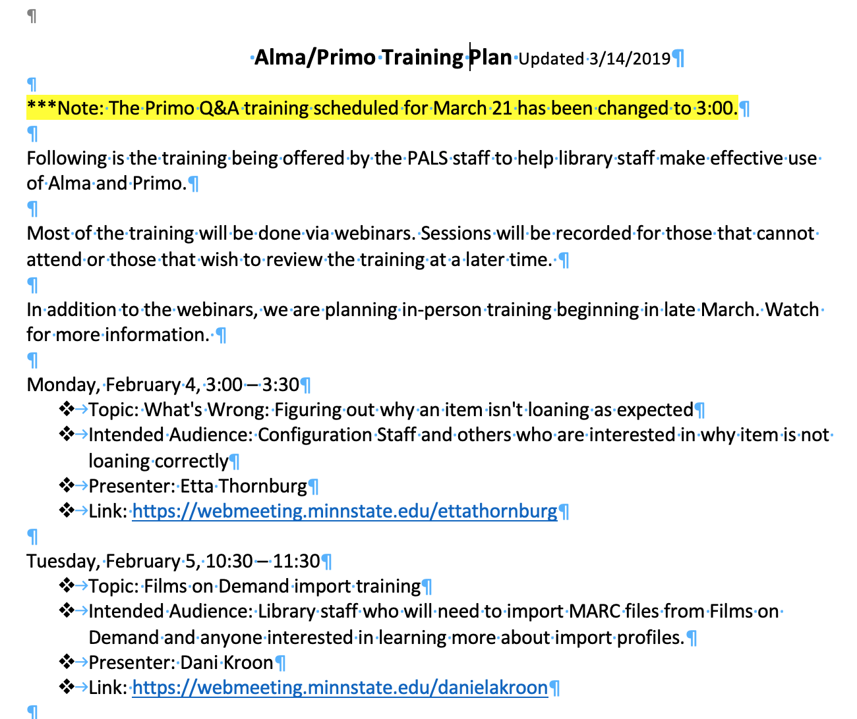
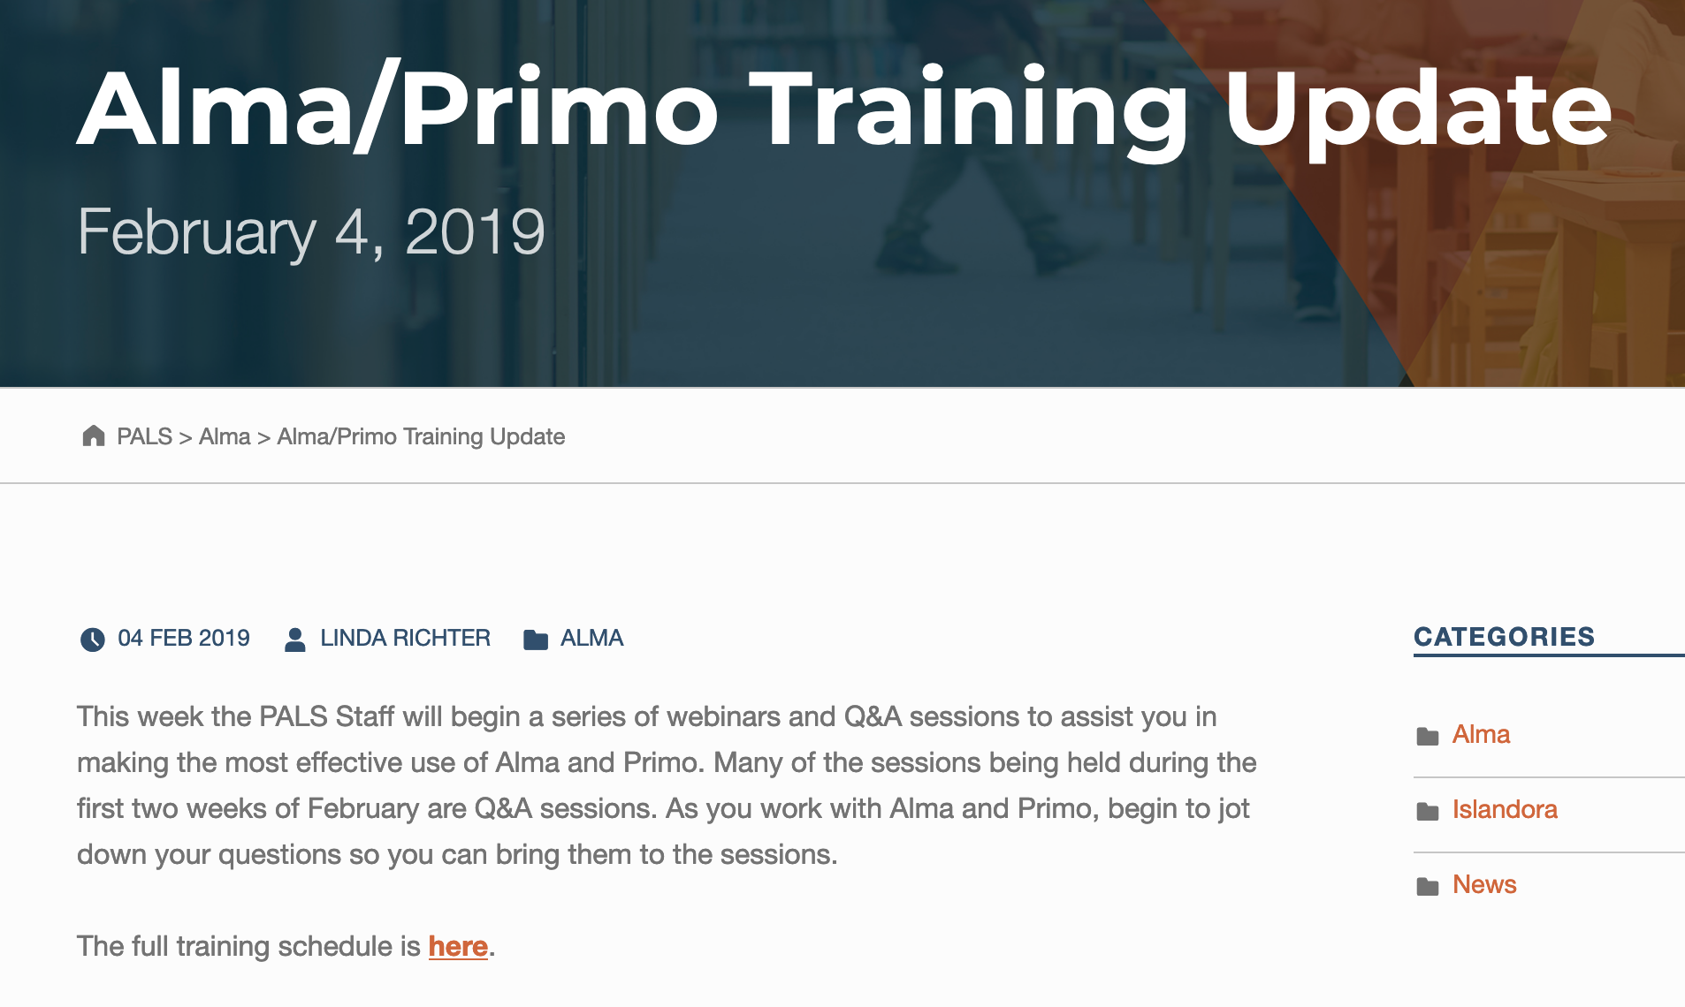
Minnesota State
https://www.mnpals.org/training-february_4_2019/
www.suny.edu

Slide 26
Resources
SLSS Training Guides
https://slcny.libguides.com/lsptraining
Developing Campus Training & Documentation
https://slcny.libguides.com/lsptraining/campus-training
Ex Libris Alma Libguide
https://exlibris.libguides.com/alma
www.suny.edu

Slide 27
Resources From Slides
Handout Examples
  https://guides.library.upenn.edu/alma
  https://www.carli.illinois.edu/products-services/i-share/alma/sandbox
Other Institution’s Staff Training
  https://www.mnpals.org/training-february_4_2019/
  http://documents.el-una.org/1639/
  http://documents.el-una.org/1514/
  http://documents.el-una.org/1527/
Peer2Peer University Facilitator’s Handbook https://www.p2pu.org/en/facilitate/
www.suny.edu

Slide 28


Questions or Discussion?
www.suny.edu

