Slide 1

Identifying the Correct Bibliographic Record when Ordering in Alma’s Network Zone (NZ)
SUNY Library Shared Services
Maggie McGee

Slide 2
What Records Reside Where in Alma?
Institutional Zone (IZ)
  E-resources
    eBooks
    Government document
    Streaming video
  MSP-3 exceptions
    Personal-copy course reserves
    Titles borrowed on ILL from outside the SUNY Libraries Consortium
    Inventory control of equipment
    Host bibliographic records for bound-withs
    Suppressed bibliographic records
    Vendor record sets that the library is not allowed to share

Slide 3
What Records Reside Where in Alma?
Network Zone (NZ)
  Physical bibliographic records
    Books
    Journals
    Maps
    Mixed Media
    Music
    Visual Materials
Community Zone (CZ)
  e-Resources
    Electronic Titles
      eBooks
    Electronic Portfolios
    Electronic Collections

Slide 4
Required: OCLC Connexion Client/Web Client
OCLC Connexion Client or Web Client is required to export bib records from OCLC to Alma’s NZ to order
  Limitation of the OCLC Connexion Web Client
    Can only have one export profile at a time
    Cannot configure it to prevent strange diacritics
      No UTF-8 Unicode Record Set Setting in the Web Client
      OCLC suggests using the OCLC Connexion Client as a solution: https://help.oclc.org/Metadata_Services/Connexion/Troubleshooting/UTF-8_Unicode_export_format_not_available_in_Connexion_browser
OCLC Export configured to the NZ
  OCLC Export to the NZ Configuration

Slide 5
Determine What Actions to Take When Ordering in the NZ
Perform an All Titles repository search in the NZ for the physical bib record
  Proceed to Step 2 if the bib record does not exist in the NZ
Search OCLC for the physical bib record
  Export the bib record to the NZ if the correct bib record exists in OCLC
  Proceed to Step 3 if the bib record is not in OCLC or the NZ
Create an NZ brief bib record when there is no master record in OCLC or in the NZ
*Benefits of exporting a bib record into Alma instead of creating a brief record is that is reduces human error and duplication:
Creating duplicated bib records in the NZ
Not updating the brief records with the 035 $a OCLC #

Slide 6
Searching for Physical Bib records in the Network Zone (NZ)

Slide 7
Searching for Bib Records in the NZ
Search bib records in the NZ using an All Titles search
  NZ bib records do not contain inventory and therefor an All Titles search must be used to find bib records in the NZ
Use one or a combination of the following:
  ISBN/ISSN
  Author
  Title
  Publication Year
  Publisher
  Resource Type

Slide 8
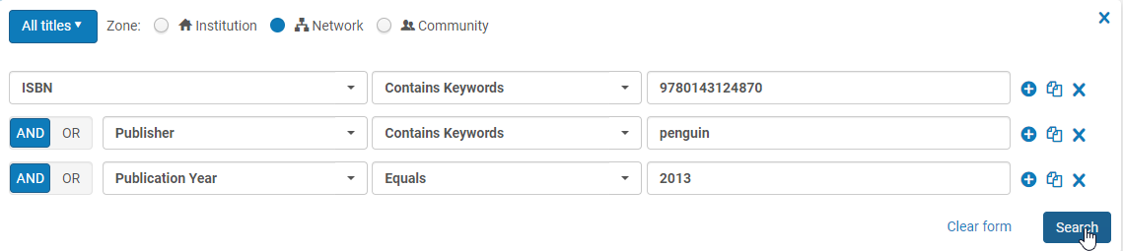
Performing a Repository Search in the NZ
Perform an All Titles in the NZ
  Types of Searches
    Simple Search
    Advanced Search

Slide 9
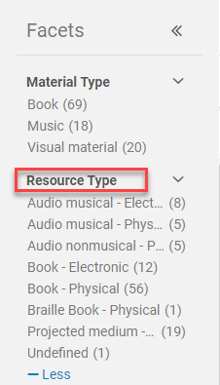
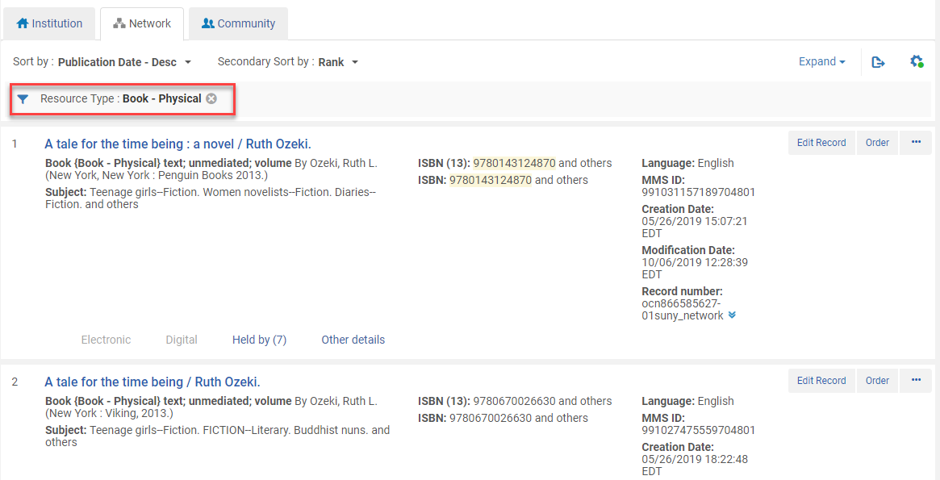
Using Facets to Limit Resource Type to Physical
The available resource types in the NZ for the bib record will appear in the facets
Click on the desired physical resource type to view available records in the NZ

Slide 10
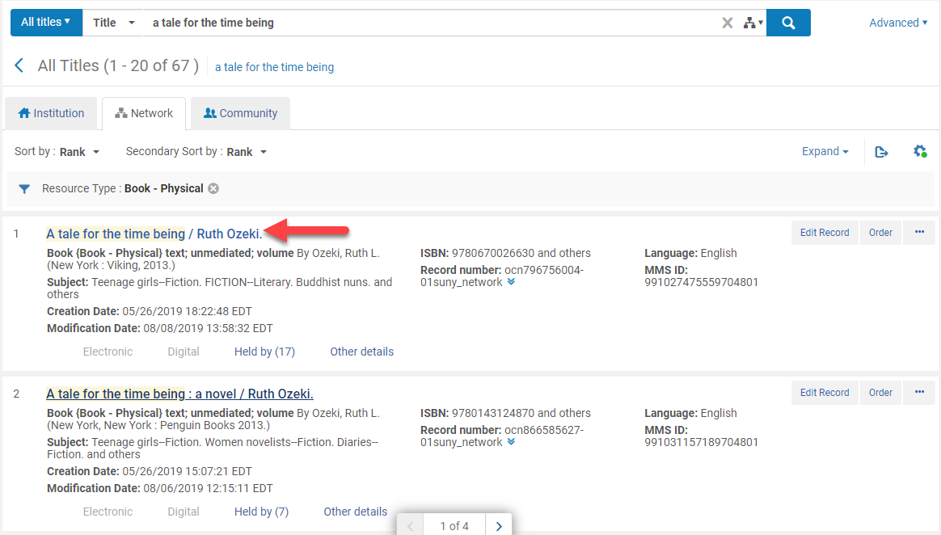
Viewing the Bib Record from a Repository Search
Click on the title link

Slide 11
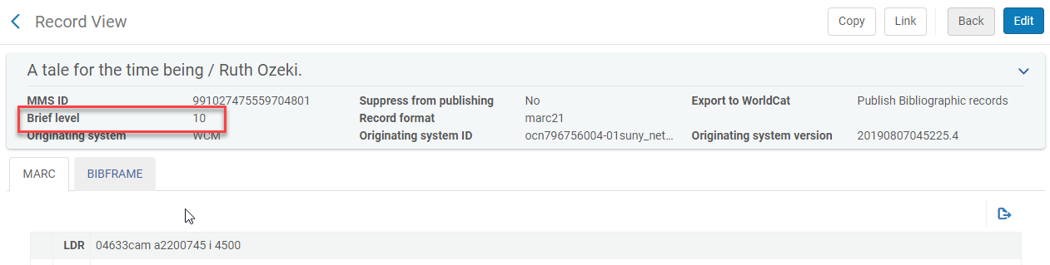
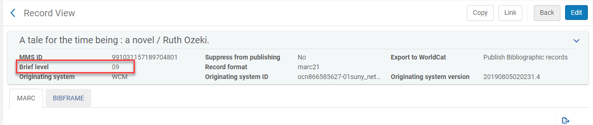
Review the Brief Level In Alma
Brief level – come from LDR 17

Slide 12
MARC Fields to Review in Alma
The following MARC Fields will tell you if it is the correct bib record or not:
020 (ISBN)
  For non-serial records
022 (ISSN)
  For serial records
024 (other standard number)
  For visual materials
040 $b (language of cataloging)
  $b eng only records are allowed in the NZ per MSP -12: Language of cataloging
100 $a (author)

Slide 13
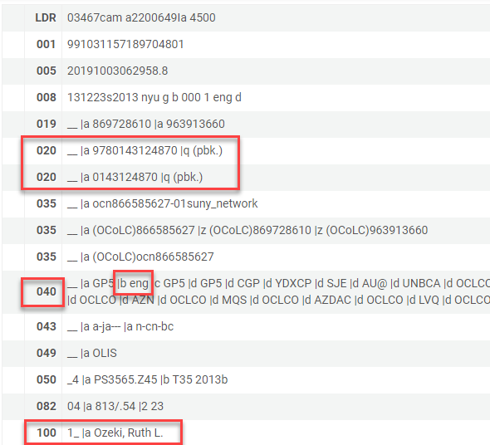
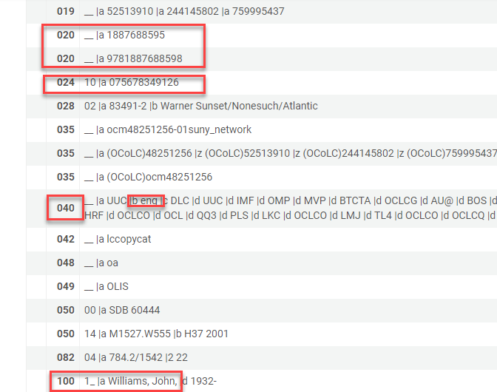
MARC Fields to Review in Alma

Slide 14
MARC Fields to Review in Alma
The following MARC Fields will tell you if it is a physical bib record or not continued:
245 $a (title)
245 $h (medium/General Material Designators or GMDs)
  For AACR2 bib records
  Examples; [electronic resource], [sound recording], [videorecording]
260/264
  $b (publisher)
  $c (publication date)
300 $a (extent of the item)
33X if an RDA record
  336 (content type)
  337 (media type)
  338 (Carrier type)

Slide 15
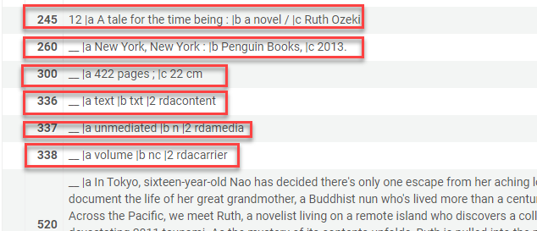
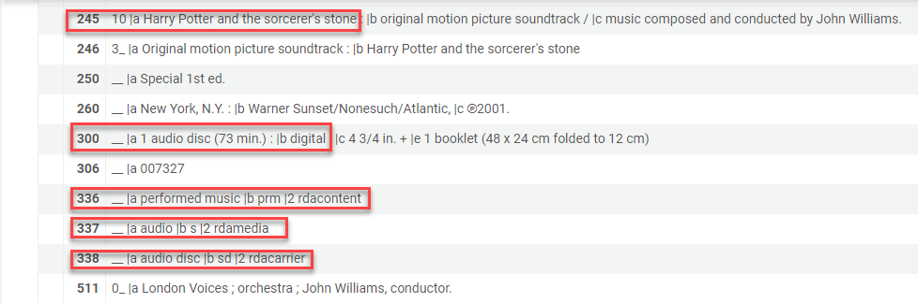
MARC Fields to Review in Alma

Slide 16
Searching in the NZ Exercise Examples:
Example 1:
  ISBN: 9780812993547
  Author: Ta-Nehisi Coates
  Title: Between the world and me
  Publication year: 2015
Example 2:
  ISBN: 9781476740188
  Author: Susan Orlean
  Publication year: 2018
Example 3:
  ISBN: 9780525655435
  Author: Oscar Cásares
  Title: Where we come from
  Publication year: 2019

Slide 17
Searching in the NZ Exercise Examples:
Example 4:
  ISBN: 9780143124870
  Author: Ruth Ozeki
  Title: A tale for the time being
  Publication year: 2013
Example 5:
  ISBN: 9780062797155
  Author: Heather Morris
  Title: The tattooist of Auschwitz
  Publication year: 2018

Slide 18
Searching for Physical BIB records in OCLC

Slide 19
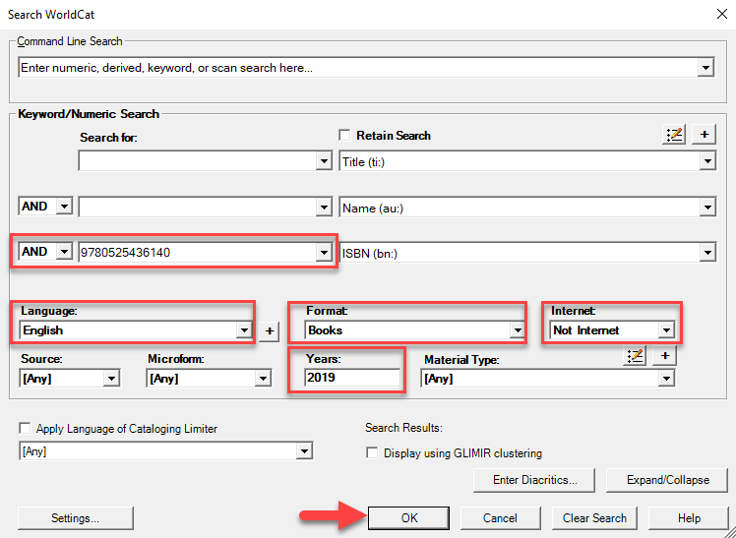
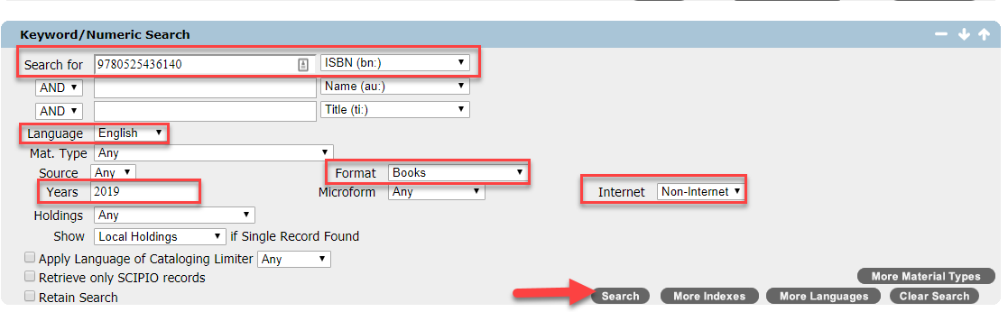
Searching for Bib Records in OCLC
Search in OCLC using one or combine of fields:
  ISBN
  ISSN
    Called Standard Number in OCLC
  Title
  Author
  Language type
    English
  Format
    Books also retrieves ebooks
  Internet
    Not Internet/Non-Internet
  Years

Slide 20
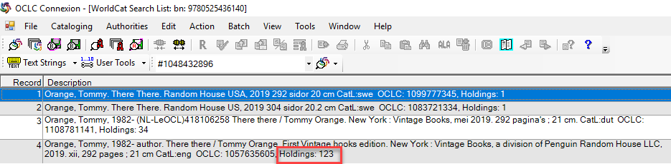
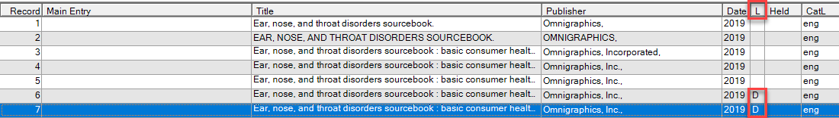
Searching Bib Records in OCLC: Search Results
Look for the following as indicators to the better bib record when retrieving search results:
  Number of holdings
  D or P next to the record results in the L column (L=Library Type)
    D = DLC (Library of Congress)
    P = PCC (Program for Cooperative Cataloging)

Slide 21
MARC Fields to Review in OCLC
The following MARC Fields will tell you if it is a physical bib record or not:
LDR
  Type (position 06)
  BLvl (position 07)
  ELvl (position 17)
020 (ISBN)
  For non-serial records
022 (ISSN)
  For serial records
024 (other standard number)
  For visual materials
040 $b eng (language of cataloging)

Slide 22
MARC Fields to Review in OCLC
The following MARC Fields will tell you if it is a physical bib record or not continued:
245 $a (title)
245 $h (medium)
  For AACR2 bib records
260/264
  $b (publisher)
  $c (publication date)
300 $a (extent of the item)
  Examples; # pages, # volumes, 1 online resource
33X: if it is an RDA record
  336
  337
  338

Slide 23
Searching in OCLC Exercise Examples:
Example 1:
  ISBN: 9780525436140
  Author: Tommy Orange
  Title: There there
  Publication year: 2018
Example 2:
  ISBN: 9781492588207
  Author: Nancy Gerstein
  Title: Motivational yoga
  Publication year: 2020
Example 3:
  ISBN: 9781250258038
  Author: Antonio Iturbe
  Title: The librarian of Auschwitz
  Publication year: 2017

Slide 24
MARc fields defined

Slide 25
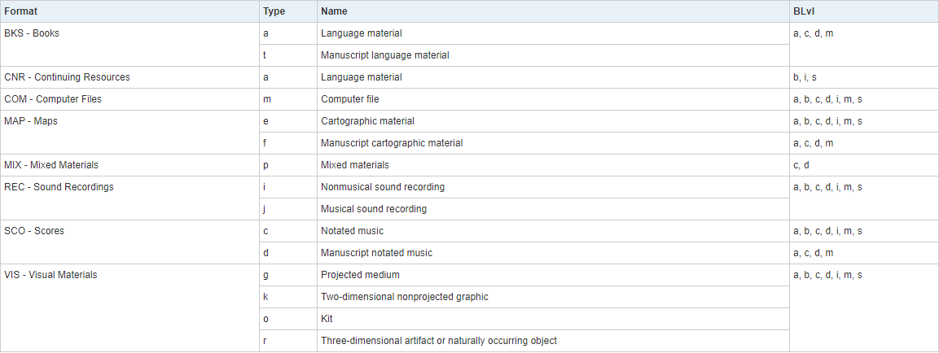
MARC Fields: LDR Position 06 & 07
LDR position 06: Type
LDR position 07: BLvl

Slide 26
MARC Field: 245 $h
MARC 245 $h is no longer used in OCLC MARC records. OCLC began removing $h as of March 2016 and replacing it with MARC fields 336, 337, and 338.
AACR2 and previous cataloging standards may still have $h General Material Designators (GMDs) in MARC field 245
Some common GMDs are:
  [electronic resource]
  [sound recording]
  [videorecording]
  [microform]
  [realia]
  [kit]
  [map]
  [art original]

Slide 27
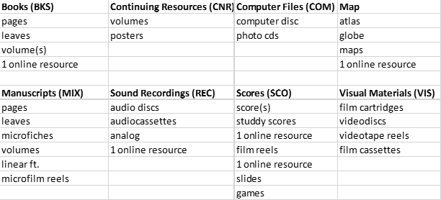
MARC Field: 300 $a
MARC field 300 is the physical description
  300 $a is the extent
RDA defines the extent as :
  “A number and type of unit and/or subunit of a manifestation.
  Unit: A physical or logical constituent of a manifestation. A unit includes a volume, audiocassette, film reel, a map, a digital file, etc.
  Subunit: A physical or logical subdivision of a unit. A subunit includes a page of a volume, a frame of a microfiche, a record in a digital file, etc.”

Slide 28
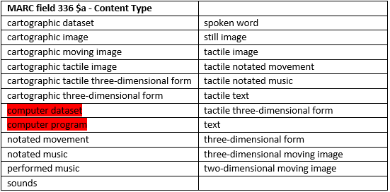
MARC Field: 336 – Content Type
RDA defines content type as:
  “A categorization reflecting the fundamental form of communication in which the content is expressed and the human sense through which it is intended to be perceived.”
OCLC defines content type as:
  “The form of communication through which a work is expressed. Used in conjunction with Type, which indicates the general type of content of the resource. Field 336 information enables expression of more specific content types and content types from various lists.”
* Highlighted in red are possible online resources

Slide 29
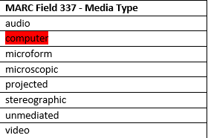
MARC Field: 337 – Media Type
RDA defines media type as:
  “A categorization reflecting the general type of intermediation device required to view, play, run, etc., the content of a manifestation.”
OCLC defines media type as:
  “Media type reflects the general type of intermediation device required to view, play, run, etc., the content of a resource. Used as an alternative to or in addition to the coded expression of Media type in field 007 subfield ǂa. Field 337 information enables indication of more specific media types and media types from various lists.”
* Highlighted in red are online resources

Slide 30
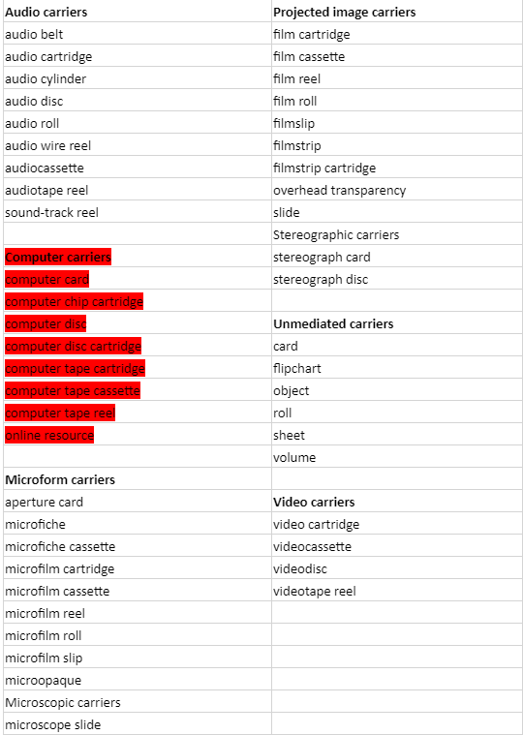
MARC Field: 338 – Carrier
RDA defines carrier type as:
  “A categorization reflecting the format of the storage medium and housing of a carrier in combination with the type of intermediation device required to view, play, run, etc., the content of a manifestation.”
OCLC defines carrier type as:
  “Carrier type reflects the format of the storage medium and housing of a carrier in combination with the media type (which indicates the intermediation device required to view, play, run, etc., the content of a resource). Used as an alternative to or in addition to the coded expression of carrier type in field 007 subfield ǂb. Field 338 information enables indication of more specific carrier types and carrier types from various lists.”
* Highlighted in red are possible online resources

Slide 31
Exporting a physical bib record from OCLC to the network zone (NZ)

Slide 32
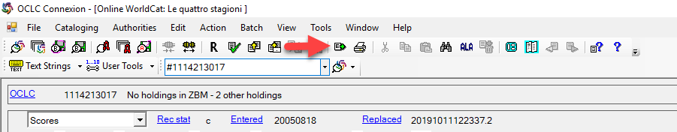
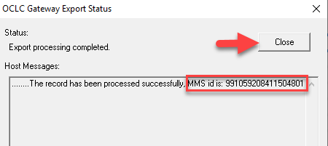
Exporting a Physical Bib Record from OCLC to Alma
From the OCLC Connexion Client
Click on the Export Icon or Edit>Export
An export gateway status appears with the MMS ID for the NZ, which ends in 4801

Slide 33
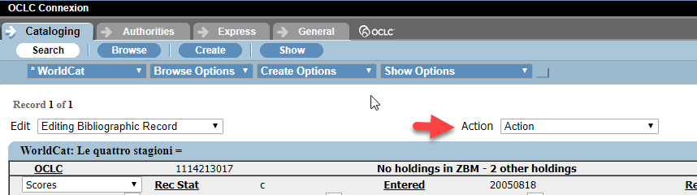
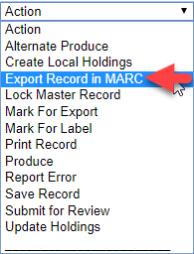
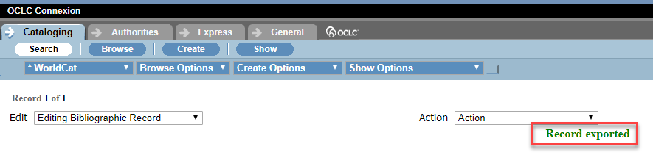
Exporting a Physical Bib Record from OCLC to Alma
From the OCLC Connexion Web Client
Go to the Actions drop-down menu
Click on Export Record in MARC
Record Exported in Green when successfully exported

Slide 34
Search the NZ for the Exported Physical Bib Record
After the physical bib record has been exported to Alma
Perform an All Titles Search in the NZ by the MMS ID or OCLC #
  MMS ID
  OCLC #

Slide 35
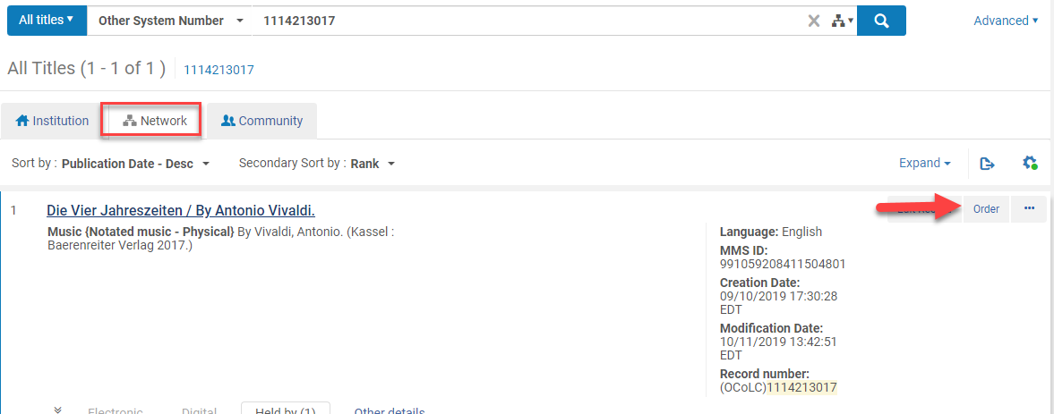
Place the Order on the Exported OCLC Bib Record
Click Order from the physical Bib record
Create a POL for a physical

Slide 36
Creating a physical brief bib record in Alma’s MD Editor

Slide 37
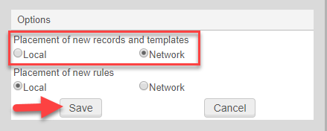
Creating a Brief Bib Record To Place an Order
Create a brief bib record to order from ONLY if:
  There is no bib record is in the NZ and
  There is no bib record is in OCLC
Go to Resources>Cataloging>Open Metadata Editor
Go to Edit>Options
Placement of New Records and Templates: Network
Click Save

Slide 38
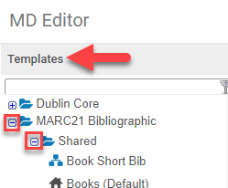
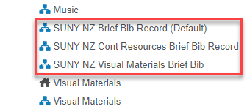
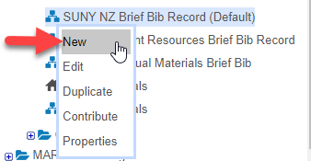
Creating a Brief Bib Record To Place an Order
Click Templates from the left-hand pane
Expand MARC21 Bibliographic
Expand the Shared Folder
Click on appropriate SUNY Brief Bib template
  SUNY NZ Brief Bib Record
  SUNY NZ Cont Resources Brief Bib Record
  SUNY NZ Visual Materials Brief Bib
Click New
Fill in the appropriate MARC fields
Go to File>Save and Release Record (Ctrl+Alt+R)
Order the bib record from the NZ

Slide 39
Additional Resources

Slide 40
Resources
OCLC
OCLC Bibliographic Formats and Standards
Connexion Browser Cataloging Quick Reference
OCLC Connexion Client Cataloging Quick Reference
SLC FAQs
How do I create an NZ brief bib record for Ordering purposes?
MSP Policies
Metadata Standards and Policies Working Group Approved Policies

