Slide 1
SUNY Library Accessibility Q3 Update
September 16, 2021
Michelle Eichelberger, Yvonne Kester, Shannon Pritting
www.suny.edu

Slide 2
Plan for Today
Update on Accessibility Cohort
Review of Accessibility Toolkit and Vendor Repository
Exception Workflow
Pilot Reciprocal Review Partner Program
Support Services
www.suny.edu

Slide 3
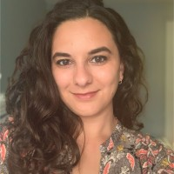
Accessibility Cohort Fall 2021
Farewell to Nazely Kurkjian
www.suny.edu
Notes:
1885 panoramic pictograph of Potsdam, New York, accessed from the Library of Congress at https://www.potsdam.edu/sites/default/files/inline-images/1885_Potsdam_Panoramic_Pictograph.jpg

Slide 4
Accessibility Cohort 2021-22
Deque University Renewal
SUNY has unlimited access to the full curriculum through August, 2022
To request an account, contact your campus EIT officer
SLS has developed suggested courses and paths for specific library positions. Will share after we've discussed with Library Accessibility Cohort.
www.suny.edu

Slide 5
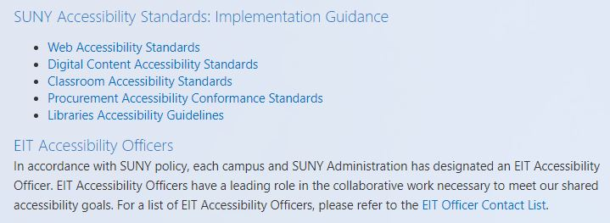
Accessibility Cohort 2021-22
SUNY EIT Accessibility (SUNY Blue)
SUNY Library Accessibility Cohort links
Libraries Accessibility Guidelines
EIT Officer Contact List
www.suny.edu

Slide 6
Accessibility Cohort 2021-22
Monthly meetings fall 2021
General shift of cohort to interest group
Group still refining its focus
Collection Development
Ebooks/OER (topic inspired by the recent College & Research Libraries article, Open but Not for All: A Survey of Open Educational Resource Librarians on Accessibility)
Beta/UX testing opportunities to advocate for accessibility
We encourage anyone who is interested to join us. Meetings are the third Friday of each month through December, from 10am-11am. Contact info@slcny.libanswers.com for a Zoom link.
www.suny.edu

Slide 7
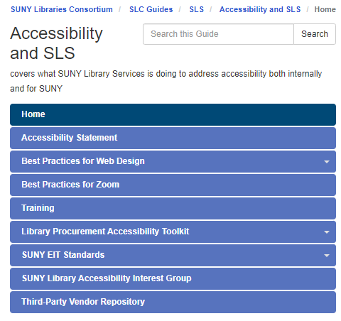
Accessibility Toolkit
https://slcny.libguides.com/slss-accessibility/home
Highlights:
Best practices for use of colors, images, forms/tables, etc. in web design
Library Procurement Accessibility Toolkit covering dealing with vendors, reviewing VPATs, etc.
SUNY EIT Standards
www.suny.edu

Slide 8
Vendor Repository
Organized by vendor, 48 completed reviews so far
Info includes VPAT®s, vendor accessibility websites and contacts
Option to request a review
Submit ticket to info@slcny.libanswers.com for password
www.suny.edu

Slide 9
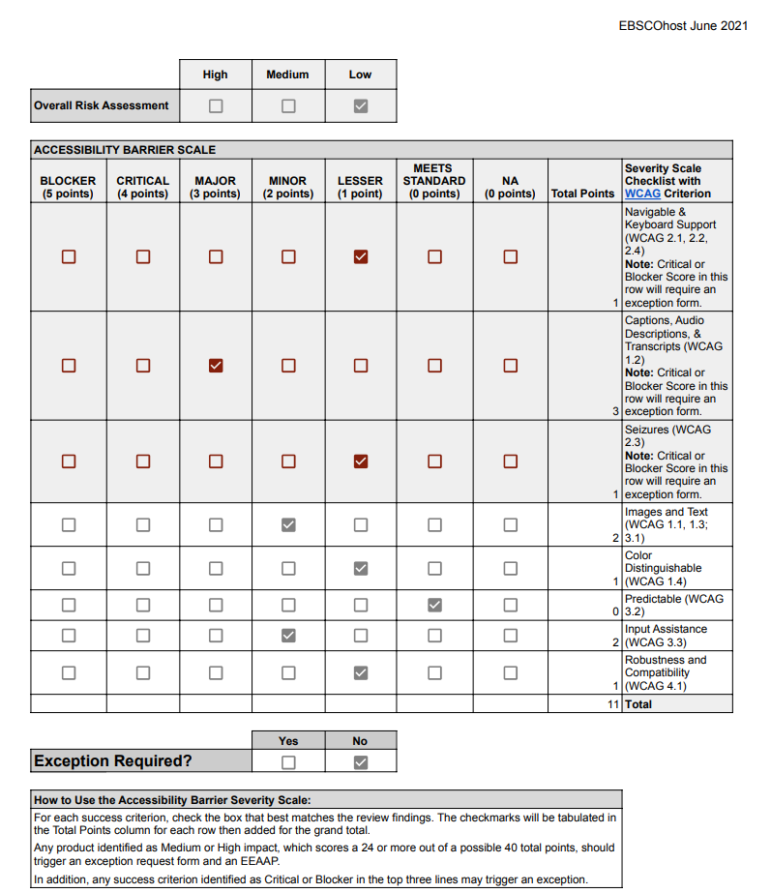
Exception Rubric
Worked with Noah Roth (BCC) to design
Reviewed by SUNY Sys Admin Staff and selected campus EIT officers
Complete in conjunction with VPAT® review
Aligns with standards covered in review
Overall Risk Assessment usually low for library resources – no mandatory use
Some standards more impactful than others – any Critical or Blocker score in top three sections will trigger Exception Form and Equally Effective Alternate Access Plan (EEAAP)
www.suny.edu

Slide 10
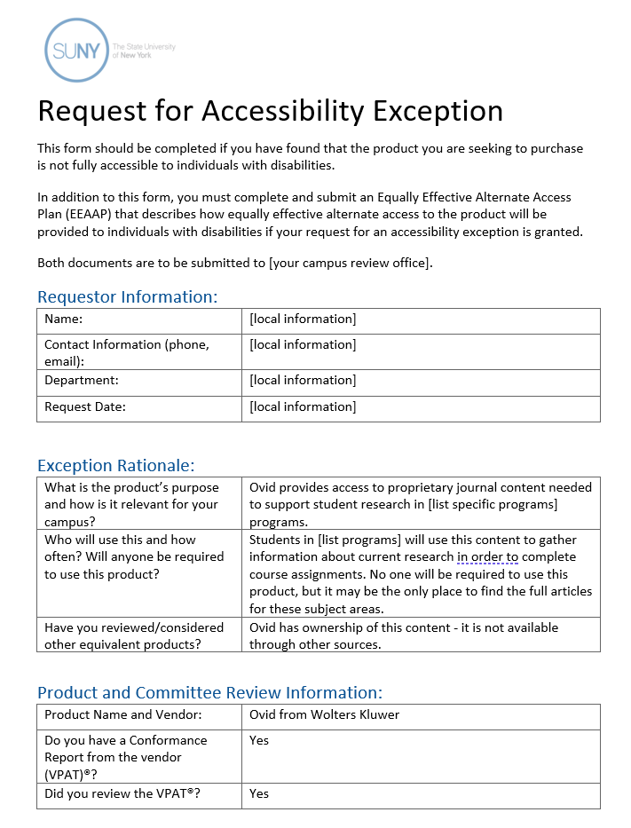
Exception Form
Acknowledges that there are accessibility problems with the product, explains why you want to purchase it anyway
Ovid example in repository: https://slcny.libguides.com/c.php?g=1085439&p=7913988
Posted as Word doc so that you can edit, adjust for your campus
www.suny.edu

Slide 11
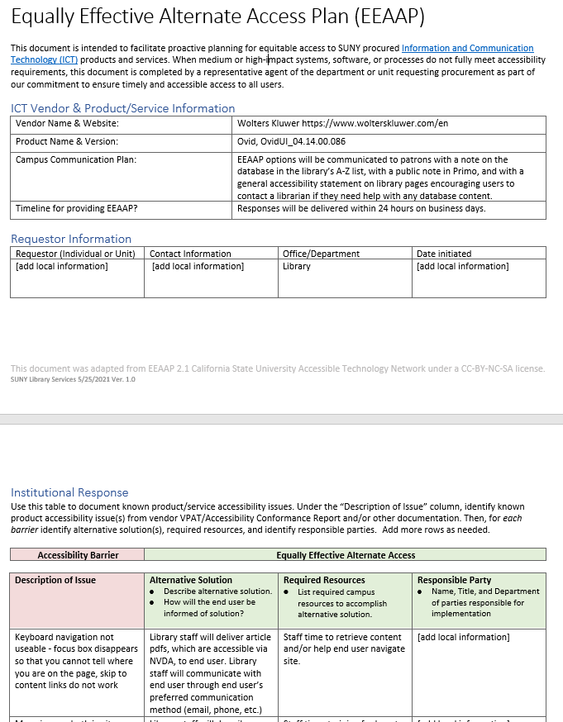
EEAAP
Equally Effective Alternative Access Plan
Explains how you'll help patrons get around the accessibility barriers in the resource, how you'll let them know about their options for help, etc.
May need to collaborate with other offices on campus to produce video transcripts, etc.
www.suny.edu

Slide 12
Vendor Management Regarding Accessibility
SLS reviews accessibility for central agreements as part of the procurement process.
There are no plans for coordinated vendor management of library content where there is no central agreement, or we have a pricing agreement.
Can provide limited coaching to campuses on how to reach out to vendor.
Accessibility Toolkit will have suggested language/templates in this area.
www.suny.edu

Slide 13
Pilot Reciprocal Review Partner Program
Why are we taking this approach?
Not yet widespread integration of Critical Reviewing of ACR at campuses.
System-wide or large group approach isn't yet feasible, or may never be.
Lessons learned from cohort is that if reviewing isn't happening at campus, there's minimal opportunity for a meaningful partnership.
Some campuses may never want to develop this expertise locally.
www.suny.edu

Slide 14
Pilot Reciprocal Review Partner Program
Overview
Campus Commitment:
Dean/Director approval of staff to work directly with SLS on ACR Reviews
Staff must dedicate time to working with SLS to learn processes and attend mentoring meetings.
A minimum of 5 ACR Reviews are required each year.
A minimum of 3 ACR Peer Reviews are required each year.
Participation of staff in at least 1 webinar or training activity provided to SUNY or SUNY libraries.
Guest login(s) for ACR reviews.
www.suny.edu

Slide 15
Pilot Reciprocal Review Partner Program
Benefit to Partner Campus
Support for Review Activities:
Partner campus can ask SLS to review up to 7 products per year.
SLS will peer review up to 5 partner campus reviews annually.
Prioritization input on which products SLS reviews.
Engagement with SLS staff on review process
Staff Development:
SLS staff will mentor/train campus individual on how to conduct ACR reviews, and coaching on best practices.
Prioritization input on what products SLS will review.
1-1 coaching sessions with campus individual on applying best practices to ACR reviewing.
Peer reviewing of ACR Reviews of campus (limits in previous slide).
www.suny.edu

Slide 16
Pilot Reciprocal Review Partner Program
Details:
Limit of 2 campuses for this year
Will analyze to see if we have more capacity in early 2022
Quarterly Reviews of the agreement
It's ok if this doesn't work out; we'll figure out a transition plan
Will review any adjustments needed
Annual Review of program
Will determine if both sides are still interested, and long-term adjustments that may need to happen
www.suny.edu

Slide 17
SUNY Service via IT for Accessibility Reviewing
There are conversations happening in IT management about a shared service structure for Accessibility Reviewing.
Current proposed approach is to use a 3rd party vendor
SLS has provided input on our efforts, and will:
Merge/collaborate when there are common interests
Continue separately where it makes sense for our program.
www.suny.edu

Slide 18
Support Service: SortSite
SLS can run accessibility checking software on your LibGuides or other college webpages
Will provide you with a report of fixable errors, including broken links in text boxes, deprecated style code, missing alt tags, etc.
Will explain how to remediate these problems
www.suny.edu

Slide 19
Questions?
www.suny.edu

