Slide 1

Pediatric Weight Management ECHO®
Session Topic: Family-Based Behavioral Treatment
Presenter: Elissa Jelalian, PhD
Date: February 16, 2023
PLEASE NOTE: Project ECHO case consultations do not create or otherwise establish a provider-patient relationship between any clinician and any patient whose case is being presented in a project ECHO setting

Slide 2
Welcome
This session will be recorded for educational and quality improvement purposes
Please do not provide any protected health information (PHI) during any ECHO session
Introduce Yourself
Microphones
Agenda
Please turn on your video
Please enter your name and organization in the chat box
Please mute your microphone when not speaking
Introduction
Lecture
Case
Close
Discussion

Slide 3
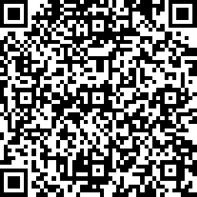
CME Credits
(currently pending for MDs, PAs, Rx, RNs, NPs, PsyD, PhD)
CME Credits – Please request session credits when filling out the evaluation at the end of the meeting.
Evaluation/Credit Request Form: https://www.surveymonkey.com/r/PediWtMgmtCMEEvaluation
The AAFP has reviewed ‘Advancing Community-Oriented Comprehensive Primary Care Through Improved Care Delivery Design and Community Health,’ and deemed it acceptable for AAFP credit. Term of approval is from 09/15/2022 to 09/15/2023. Physicians should claim only the credit commensurate with the extent of their participation in the activity.
NPs and RNs can also receive credit through AAFP’s partnership with the American Nurses Credentialing Center (ANCC) and the American Academy of Nurse Practitioners Certification Board (AANPCB).
Notes:
Linda

Slide 4
Agenda
Time | Topic | Presenter
7:30 – 7:35 AM | Welcome & Introductions | Linda & Liz
7:35 – 8:00 AM | Didactic: | Elissa Jelalian, PhD
8:00 - 8:10 AM | Case Presentation | Colleen Vitale, MD Atlantic Pediatrics
8:10 - 8:25 AM | Discussion | All
8:25 – 8:30 AM | Wrap up; Evaluation; Announcements | Linda
Notes:
Liz Introduce Vania

Slide 5
Today’s Faculty
Dr. Jelalian is a Professor of Psychiatry and Human Behavior and Pediatrics at the Alpert Medical School of Brown University and Associate Director of The Miriam Hospital Weight Control and Diabetes Research Center.
Her research focuses on development and implementation of weight management interventions for children and adolescents, as well as dissemination of evidenced based treatments to community settings. Her current research includes an implementation study to address overweight/obesity in children from under resourced communities and a clinical trial examining integration of emotion regulation training with lifestyle intervention for adolescents with obesity.
Dr. Jelalian is also the Director of the Clinical Psychology Postdoctoral Fellowship Training Program at Brown.

Slide 6
Disclosures
Session presenters have no financial relationships with a commercial entity producing healthcare-related products used on or by patients.
If CME credits are offered, all relevant financial relationships of those on the session planning committee have been disclosed and, if necessary, mitigated.

Slide 7
Learning Objectives
After participating in this session, attendees should be able to:
Understand the role of intensive health behavior and lifestyle interventions in the treatment of youth with higher weight status.
Describe the key components of intensive health behavior and lifestyle interventions.
Recognize primary considerations in determining whether referral to an intensive lifestyle intervention is appropriate.

Slide 8
Intensive Lifestyle Interventions
What’s in a name?
  USPSTF - Comprehensive intensive lifestyle intervention
  AAP Clinical Practice Guideline - Intensive health behavior & lifestyle treatment
  CDC – Pediatric weight management intervention
      Family healthy weight program
  Literature -Family-based behavioral treatment
  Convergence regarding program elements:
  family involvement
  prescription related to dietary intake, physical activity, and sedentary behavior
  behavioral strategies

Slide 9
U.S. Preventive Services Task Force Recommendations – 2010 & 2017
Notes:
Based on the accumulation of evidence related to comorbidities and effectiveness of tx, the Task Force made a recommendation in 2010, which was re-issued in 2017.

Slide 10
Intensive health behavior and lifestyle treatment: IHBLT educates and supports families in nutrition and physical activity changes that improve weight status and comorbidities and promote long term health.
IHBLT is most often effective when it occurs face-to face, engages the whole family, and delivers at least 26 hours of nutrition, physical activity, and behavior change lessons over 3 to 12 months.
IHBLT is foundational to COT (comprehensive obesity treatment) and should continue longitudinally.
It should be provided in conjunction with pharmacotherapy and metabolic and bariatric surgery if these treatments are indicated.….

Slide 11
Evidence-based Interventions
Intensive Health Behavior and Lifestyle Treatment
Pharmacotherapy
Metabolic and Bariatric Surgery
Indications: Youth > 12 years of age with BMI > 95th%
- Metformin
- Glucagon-like peptide-1 receptor Agonists – e.g. liraglutide, semaglutide
Indications: Class 2 obesity: BMI > 35 kg/m² or 120% of the 95th percentile AND significant disease (including physical or psychological
Class 3 obesity: BMI > 40 kg/m² or 140% of the 95th percentile; no comorbidity necessary
Indications: Children from 6-18 years with BMI > 85th% for age and sex
Less evidence for children 2-5 years
Notes:
Semaglutide - decrease hunger by
slowing gastric emptying and by
acting on targets in the central
nervous system. Depending on the
medication, the formulation is either
oral or a daily or weekly
subcutaneous injection

Slide 12
Considerations in Delivery of Intensive Health Behavior and Lifestyle Treatment
Notes:
May be delivered within a specialty program, be embedded within a medical home, and/or involve integration with community organizations for elements such as access to structured physical activity
Current recommendation is to refer to these programs as soon as possible

Slide 13
Components of Intensive Lifestyle Interventions
Targets modest reduction in energy intake combined with changes in energy expenditure
physical activity and sedentary behavior/screen time
Dietary prescription focuses on improving diet quality
Key behavioral strategies include:
  Self-monitoring
  Reinforcement for behavioral goal achievement
  Stimulus control
  Parenting strategies
Notes:
So with that background, let’s turn to what these interventions look like…
Focus on non-scale benefits of changing diet and physical activity

Slide 14
Intensive Lifestyle Interventions
Guidelines for physical activity and sedentary behavior are consistent with recommendations for all youth:
  gradual increase to 60 minutes/daily of PA – combination of aerobic and nonaerobic
  decrease to < 2 hours of screen time/daily
Focus on improving eating and activity behaviors at the level of the family, not singling out a specific child
  Unhealthy eating and physical inactivity are leading contributors to death in the U.S.
  Majority of children and adults in the U.S. do not engage in adequate amounts of physical activity
  Everyone benefits from improving these behaviors, independent of weight status

Slide 15

Improving Diet Quality
Red—Stop and think!
  High in fat (>5g/serving) and sugar
  Less nutrient dense
  Examples: chocolate, fries,
  ice cream, cakes, cookies
Yellow—Caution; slow!
  Nutrient adequate
  Medium energy density
  1-5 g of fat/serving
  Examples: crackers, dried fruit
Green – Go!
  Nutrient rich
  Low Energy Density (LED)
  Examples: fruits, vegetables
Notes:
Attention to diet quality can be through a number of different approaches

Slide 16

Improving Diet Quality
https://www.nhlbi.nih.gov/health/educational/wecan/index.htm
https://www.myplate.gov/

Slide 17
Key Behavioral Strategies
Self-monitoring: dietary intake, physical activity
Positive reinforcement for adherence to dietary and activity prescriptions (non-food rewards)
Positive parenting strategies and contingency management
Goal-setting: for children and caregivers
Enhancing emotional well-being: body acceptance, self-concept, strategies to manage bullying, cognitive strategies to address negative thinking

Slide 18
Role of the Caregiver
Parents/caregivers play a crucial role in:
  Modifying the home environment to make healthy choices available and unhealthy choices less available
  Modeling healthy eating and activity behaviors
  Providing access to opportunities for physical activity
  Setting limits – i.e., willing to say no to additional screen time, energy dense foods, etc.
  Managing and decreasing family conflict
  Supporting child’s self-concept at any size
Caregivers have considerable influence with children < 12 years
Role of caregiver with adolescents is more complex

Slide 19
Attention to Social Determinants of Health
Access to healthy foods
  Assess food security
  Connect to available programs
Opportunities for physical activity
  Safe spaces for outdoor activities
  Options for activities that can easily be done in small indoor settings
  Support participation in activities available through school/community – may need to address stigma related to participation in physical activity

Slide 20
When Intensive Programs Are Not Available
Consider use of reminders embedded within EHR to streamline care during office visits and prompt distribution of relevant materials to families
Training in MI to join with families to encourage progress and collaborate on identifying areas for improvement
Provide resources that families can utilize outside of office visits
Consider collaborations with other organizations – e.g. referral to YMCA or Boys and Girls Club, RI Community Food Bank Healthy Habits program, etc.
Collaborate with a behavioral health specialist to address parenting behaviors, motivation, etc.

Slide 21
Addressing High Weight Status in Pediatric Samples
Cardel et al. 2022. Journal of the Academy of Nutrition and Dietetics.
A
Self-directed dieting among patients with obesity
Increase in disordered eating behaviors
Gateway to eating disorders and low self-worth
Severe avoidance of foods
Severe restriction
Unsustainable behaviors
Excessive intake
B
Supervised evidence-based treatment for obesity
Increase in sustainable healthy behaviors
Sustainable improvements in health outcomes and self-worth
Behavior change strategies
Meal Planning and Regular Eating Schedules
Improving diet quality without restriction
Self-Monitoring
Engaging in movement that brings you joy
Notes:
We want to be attentive to weight stigma and also want to treat people who are interested in receiving tx for high weight status.
Recent publication – made a nice distinction between evidence-based interventions and “dieting”.

Slide 22
Is Participation in Intensive Lifestyle Intervention Appropriate?
Prior to program enrollment - screen children/teens for eating disordered behaviors using a standard questionnaire or interview
Alternative treatments if:
  history of bulimia or anorexia diagnosis
  current or recent engagement in self-induced vomiting or laxative use for the purpose of weight management
  Family member in treatment for eating disorder
Binge eating (i.e. episodes of eating objectively large amount of food with associated loss of control) - several studies with adults suggest that intensive lifestyle may be appropriate

Slide 23
Effects of Participation in Lifestyle Interventions on Psychological Outcomes
Evidence supports that treatment positively influences mental health outcomes in children with overweight/obesity
2020 Meta-analysis of 49 studies (n=10,471) showed that treatment participation was associated with increased self-esteem (p<.001) and improvements in body image (p<.001) post intervention.
2020 Meta-analysis of 29 interventions found that the inclusion of physical activity significantly reduced depression (p < 0.001), increased self-esteem (p < 0.001) and improved body image (p < 0.001).
J.E. King, H. Jebeile, S.P. Garnett, et al. Mental Health and Physical Activity. 2020; Gow, ML, Tee, MSY, Garnett, SP, et al. Pediatric Obesity. 2020.
Notes:
Need to move this slide and the next one!

Slide 24
Effects of Participation in Lifestyle Interventions on Psychological Outcomes
Systematic review with meta-analysis examining the effect of participating in structured weight management intervention that included a dietary component on eating-disorder related outcomes for children and teens:
  Reduction in the prevalence of eating disorder risk and related symptoms immediately following intervention and at follow-up
  (bulimic symptoms, binge eating, eating in response to emotion, drive for thinness, and eating concern)
Systematic review of similar programs documents short-term modest decreases in symptoms of depression and anxiety
  Jebeile et al. Obesity Reviews, 2019. Jebeile et al. JAMA Pediatrics, 2019.
Notes:
Contrary to what has been suggested…there are some data to suggest that participation in these programs leads to a decrease in eating disordered behaviors.

Slide 25
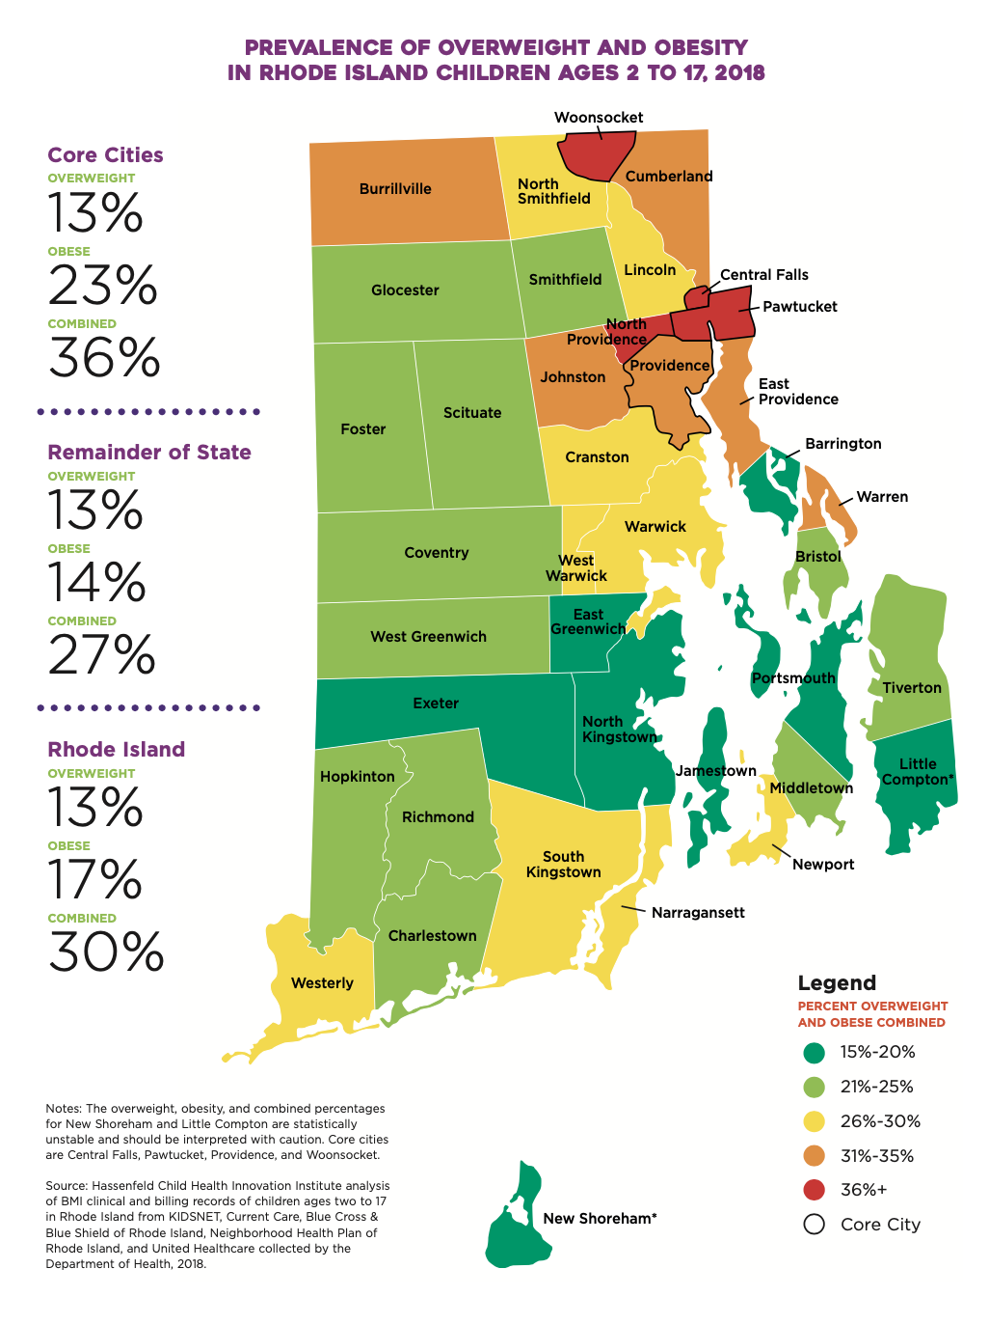
Childhood Obesity Research Demonstration Projects
Core Cities
Central Falls (housing authority)
Providence (PCHC; federally-qualified health center)
Woonsocket (housing authority)
Children 6-12 years and a caregiver
English or Spanish language
Participation in 24 group sessions over 10 months; remote synchronous delivery
Notes:
You will notice that this map – which was from 2018 – looks different from the most recent one of RI that I showed you at the outset …

Slide 26
HealthTRAC
Study Aims – compare two different group-based intensive lifestyle interventions
  Intervention 1: Standard intensive lifestyle intervention – nutrition, physical activity, cognitive-behavioral strategies, self-concept
  Intervention 2: Standard program combined with emotion regulation skills training
  Eligibility: 13-17 years; availability to participate in in-person groups

Slide 27
Resources
https://publications.aap.org/pediatrics/article/doi/10.1542/peds.2022-060640/190443/Clinical-Practice-Guideline-for-the-Evaluation-and?autologincheck=redirected
https://www.jandonline.org/action/showPdf?pii=S2212-2672%2822%2900007-7
https://www.nhlbi.nih.gov/health/educational/wecan/index.htm
https://rifoodbank.org/what-we-do/food-bank-programs/healthy-habits/

Slide 28
Contact information
Elissa_Jelalian@brown.edu

Slide 29
Pediatric Weight Management ECHO®
Case Presentation
Presenter(s): Colleen Vitale MD -Atlantic Pediatrics
Date: February 16, 2023
Contact Info: ccvitale@outlook.com
PLEASE NOTE: Project ECHO case consultations do not create or otherwise establish a provider-patient relationship between any clinician and any patient whose case is being presented in a project ECHO setting
Prepared by Care Transformation Collaborative of RI

Slide 30
Reasons for Selecting this Case
Do Not Include PHI
Why did you choose this case? | 1. The family has always been consistent (for 15 years) with keeping appointments in our office as well getting labs and going to specialists. 2. Mom and children all have expressed motivation while in office. 3. Unfortunately, none of the children have made improvements in their BMIs/health.
What questions do you have for the group? | Are their unique treatments for multigeneration obesity? When parents and adults are all themselves obese, how to best discuss the reality of psychological and physical impacts on teens without offending the teen or parents? Any way to help all of them see someone together?

Slide 31
Basic Patient Information
Do Not Include PHI
Age | Brothers 17 and 22 Sisters 15 and 13
Race/Ethnicity | Hispanic
Current Weight and Height | 13y Fall 2022 ---wt: 244 lb Ht: 5ft 4.5in BMI 41 15y Fall 2022--- wt: 250 lb Ht: 5ft 5in BMI 42 17y Fall 2022----wt: 395 lb Ht: 5ft 11 in BMI 55 22y Fall 2021----wt 251lb Ht: 5ft 9 in BMI 36
How long has the patient had concerning growth trends? | All have been obese since at least 5 years old
How long has this individual/family been in your care? | For more than 17 years
Insurance type (Commercial, Medicaid, Uninsured, Other) | United Medicaid

Slide 32
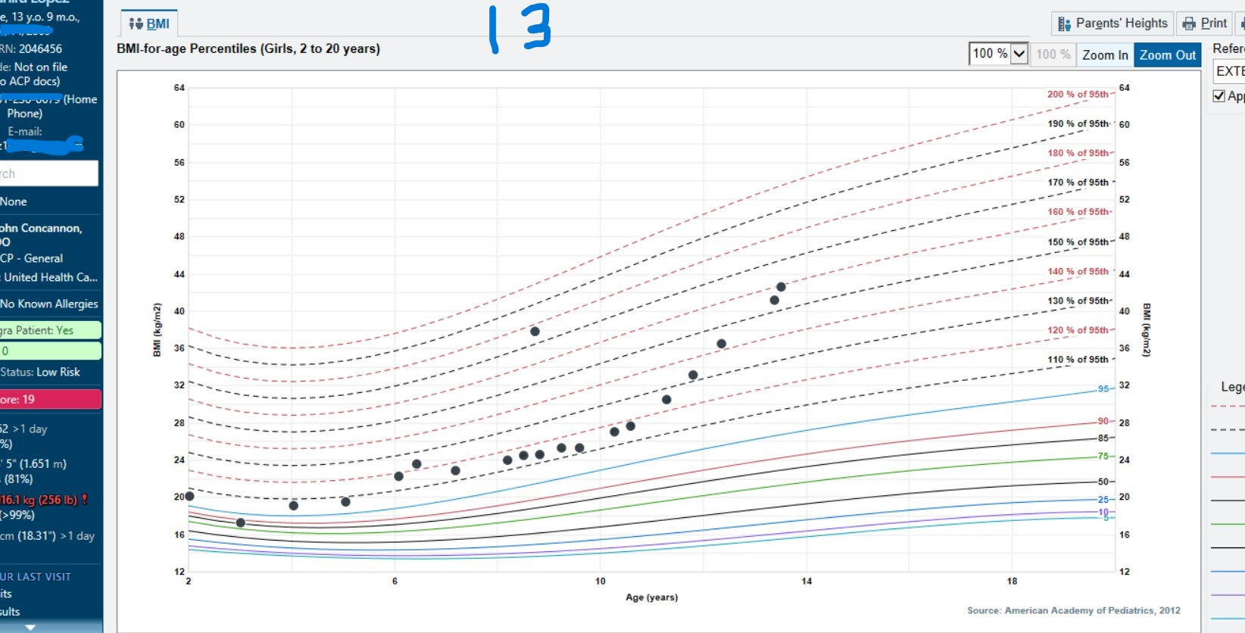
Growth Curve 13 yo 160% of 95%
Do Not Include PHI

Slide 33
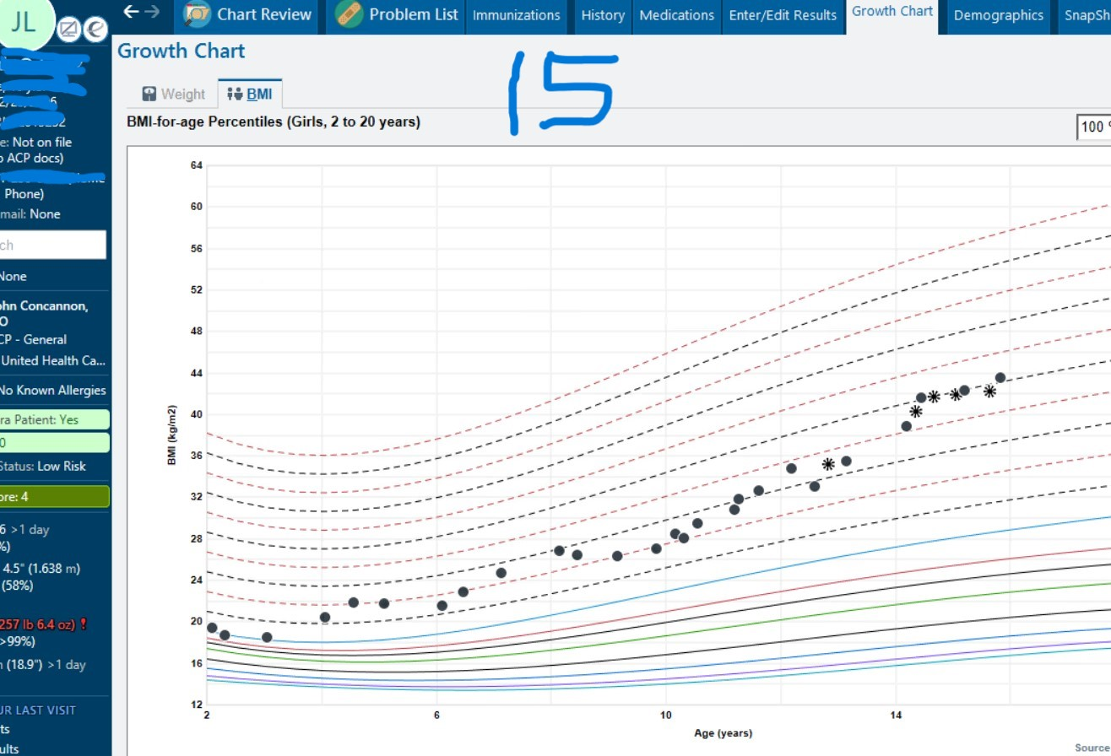
Growth Curve 15y 150% of 95%

Slide 34
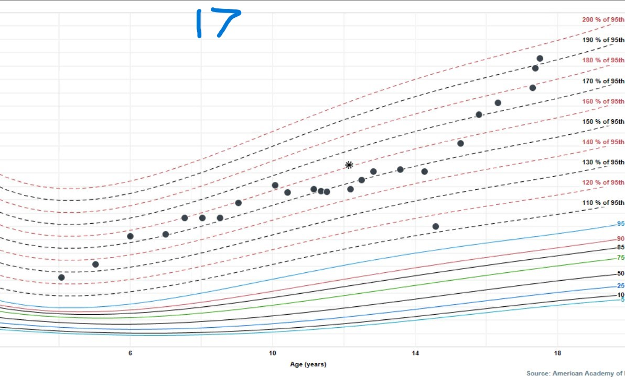
Growth chart 17y 190% of 95%

Slide 35
Does the Patient/Family have a weight management goal? Please describe.
Do Not Include PHI
Family stated they wanted to eat healthier in general
Suggestions from Dr. V include:
  Limit times they snack
  Limit portion size
  Decrease carbs included in routine meals (less rice, less bread)

Slide 36
Relevant Background
Do Not Include PHI
Relevant medical and/or behavioral comorbidities | PCOS in 15 yo daughter, acanthosis nigricans all kids
Relevant medications | No
Relevant lab results | High triglycerides Labs c/w PCOS in middle daughter Pre-Diabetes
Relevant BH Screening results | Sisters screen positive for moderate depression over past 2-3 years Brothers have admitted verbally to lower self esteem but not on screening
Relevant SDOH Screening results | No

Slide 37
Relevant Social History
Do Not Include PHI
Relevant obesity related family history? | Every family member in morbid obesity category Father with diabetes on insulin; grandmother with diabetes (no insulin); mother with prediabetes
Family/patient history of trauma? | Never mentioned.
School related concerns? | Grades for all three in the house have been slowly decreasing as their depression screens have been increasing. State they have friends but do not routinely see peers outside of school.
Other social history concerns? | Grandmother lives in the house and cooks the family dinners and often after school snacks.

Slide 38
Nutrition
Do Not Include PHI
What interventions have been tried? How responsive has the family been to nutrition interventions? | Saw nutritionist two to three times in 2018; Mom stated it was helpful, changed diet for a short time. Mother and children will discuss with Dr. V but nothing is changing.
What barriers have the family identified for improving nutrition? | Grandmother’s food choices are less healthy – she does the cooking Husband not on board with limiting unhealthy food in the house Varied mealtimes, all on different schedules.
Does the patient(s) have any of the following: Excessive hunger Night-time eating or binging Sneaking food Other | Older siblings admit to binge eating when feeling bored. Offered a large snack, often meal size, by grandmother after school.
Other concerns with nutrition/eating (such as cultural considerations)? | Question whether culture plays a role? How?

Slide 39
Physical Activity
Do Not Include PHI
What interventions have been tried? How responsive has the family been to physical activity recommendations? | When in elementary school – all the children played soccer, on school and spring teams. Stopped due to covid; never restarted.
Does the patient engage in regular physical activity? (yes/no) Please describe | Not currently
Is screen time a significant part of the patient’s social time? (yes/no) Please describe | YES – especially after school. Brother has an afterschool job 2 weekdays a week but otherwise they all come straight home after school.
Other concerns with physical activity/exercise (such as physical restrictions, access, environmental safety)? | N0

Slide 40
Were other approaches used for managing this patient?
Do Not Include PHI
Oldest daughter has been to endocrine X 2 years, saw their nutritionist once, keeps follow ups with medical specialist/endocrine, has missed recent nutrition follow ups.
Each patient comes in for 1-2 rechecks with Dr. V per year
Offered therapists, discussed value of an SSRI trial, for 17 yo brother broached the subject of seeing obesity specialist to consider medical weight management, bypass.

Slide 41
Patient /Family Successes and Strengths?
Do Not Include PHI
Close knit family, warm
Consistently attend PCP appts
Consistently get recommended labs
Sisters honest on BH screens

Slide 42

Summary & Clarifying Questions

Slide 43
Reasons for Selecting this Case
Do Not Include PHI
Why did you choose this case? | 1. The family has always been consistent (for 15 years) with keeping appointments in our office as well getting labs and going to specialists. 2. Mom and children all have expressed motivation while in office. 3. Unfortunately, none of the children have made improvements in their BMIs/health.
What questions do you have for the group? | Are their unique treatments for multigeneration obesity? When parents and adults are all themselves obese, how to best discuss the reality of psychological and physical impacts on teens without offending the teen or parents? Any way to help all of them see someone together?

Slide 44
Recommendations from the group
Ask the family who shops for food? Is there room to make some changes with the mom or grandmother?
Is there a field nearby for soccer or other fun activities, can the family go on walks together to get exercise so girls don't have to go alone?
Make sure family is aware of weight management medication, for both brothers and sisters
To start an MI conversation, maybe ask the mom, what matters most to you?
Re SDOH screening - maybe do an updated screener; also consider a more private way for patients to "hand in" the screener, out of view of front desk staff
Behavioral health intervention:
Can the family be connected to BH that is connected to the practice (upstairs)?
Are there BH connections through the schools?
Is there a way to start the therapy conversation around the two daughters, who expressed interest?
Consider a family therapy approach, to better understand/identify what everyone's role is in the family and how best to intervene
Notes:
IBH Clincian involved?

Slide 45
CME Credits
(currently pending for MDs, PAs, Rx, RNs, NPs, PsyD, PhD)
CME Credits – Please request session credits when filling out the evaluation at the end of the meeting.
Evaluation/Credit Request Form: https://www.surveymonkey.com/r/PediWtMgmtCMEEvaluation
The AAFP has reviewed ‘Advancing Community-Oriented Comprehensive Primary Care Through Improved Care Delivery Design and Community Health,’ and deemed it acceptable for AAFP credit. Term of approval is from 09/15/2022 to 09/15/2023. Physicians should claim only the credit commensurate with the extent of their participation in the activity.
NPs and RNs can also receive credit through AAFP’s partnership with the American Nurses Credentialing Center (ANCC) and the American Academy of Nurse Practitioners Certification Board (AANPCB).
Notes:
Linda

Slide 46
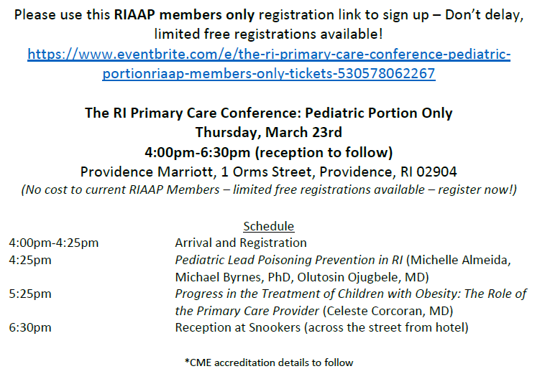
RIAAP Meeting Announcement
Notes:
https://www.eventbrite.com/e/the-ri-primary-care-conference-pediatric-portionriaap-members-only-tickets-530578062267

Slide 47
Announcements
  Next Session: Thursday March 16th, 7:30am-8:30am
  Topic: Empowering Parents
  Presenter: Sarah Hagin, PhD

Slide 48


