Slide 1

George Mason District
Roundtable
December 14, 2023

Slide 2
Agenda
Welcome and Pledge
Questions about Read-ahead
General Announcements
Joint Session –
  Listening Sessions
  Membership Questions
  Marketing Opportunities
Cracker Barrel/Networking (Optional; NLT 9pm)
Next Meeting: January 11, 2024 (7:30pm)

Slide 3

Pledge

Slide 4
Welcome
New to Roundtable?
Please introduce yourself!

Slide 5
Questions/Clarification about Read-ahead?

Slide 6
General Announcements
12/17/23 – Citizenship in the Nation MB, Ft Belvoir, VA
https://scoutingevent.com/082-dec23_citinnation#
12/23/23 - GMU Geology MB Workshop, Fairfax, VA
https://scoutingevent.com/082-geology
01/06/24 – Trainer’s Edge, St. Thomas a’ Becket, Reston, VA
https://scoutingevent.com/082-78053#
Jan-Apr ‘24 – Wilderness First Aid, Camp Snyder, Haymarket, VA https://scoutingevent.com/082-WFASpring2024
02/24/24 – USA Archery Level 1 Instructor, Camp Snyder, Haymarket, VA
https://scoutingevent.com/082-USAArcherLevel1

Slide 7

General Announcement (cont.)
Troop 1539 JSN
Special Guest Speaker:
Phillip Reilly
January 30, 7:00pm
Vienna Community Center
Phil Reilly is an Eagle Scout and a decorated CIA senior Operations Officer who retired after a 29-year career. Mr. Reilly held numerous foreign and domestic assignments including Chief of Station positions in Afghanistan, Europe and in the Far East and served as the CIA’s senior paramilitary officer as Chief of Special Activities Division. Mr. Reilly was the deputy commander of “Operation Jawbreaker”, the first US Govt team to enter Afghanistan two
weeks after the 9/11 attacks, which is highlighted in the first episode of the new Netflix Series “Spy Ops”. He holds numerous awards including the CIA Distinguished Career Intelligence Medal, the Intelligence Star, and the Director of National Intelligence Personal Medallion. He was awarded the National Eagle Scout Association’s Outstanding Eagle Scout Award in 2021.

Slide 8
General Announcements (cont.)

Slide 9
Big Rock
Joint Session –
  District Realignment:
    Listening Session
    Survey to Unit Leadership (411 resp.)
  Membership:
    Membership Questions
    Marketing Opportunities

Slide 10
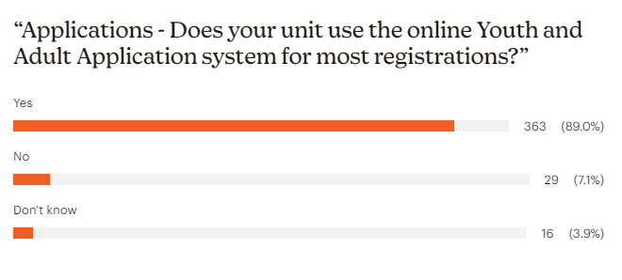

Slide 11
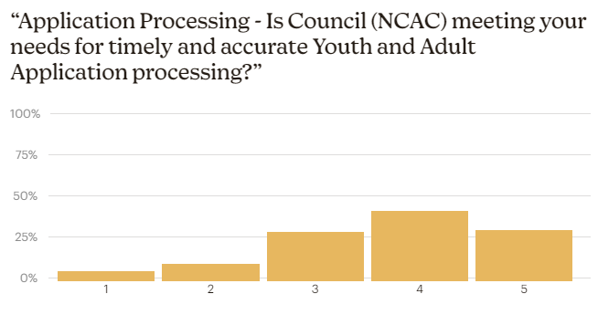

Slide 12
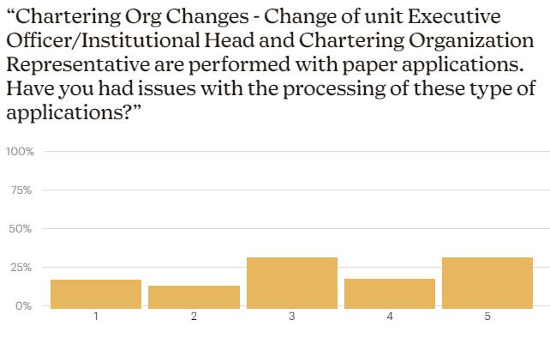

Slide 13
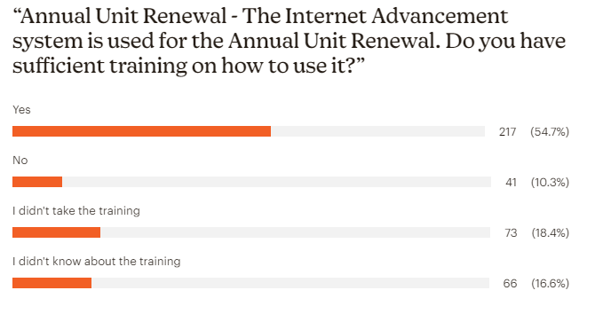

Slide 14
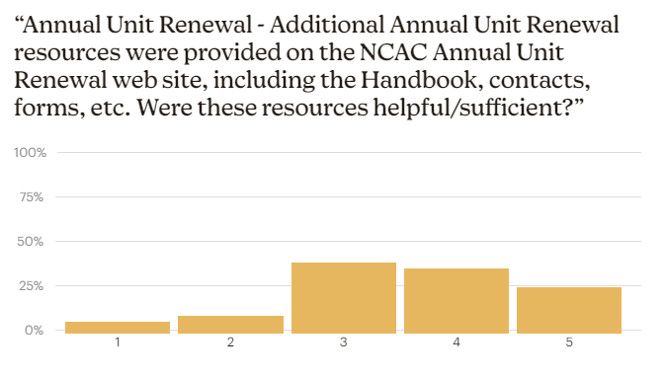

Slide 15
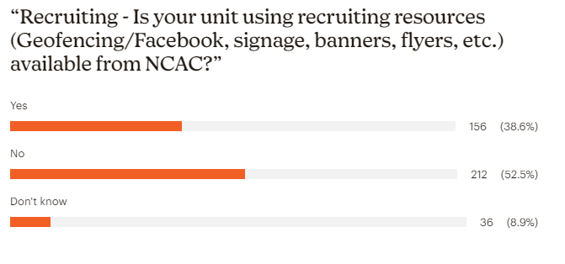

Slide 16
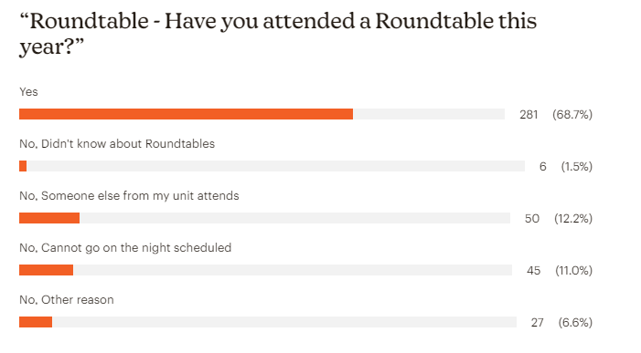

Slide 17
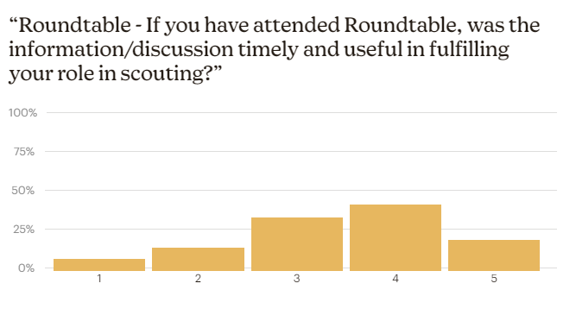

Slide 18
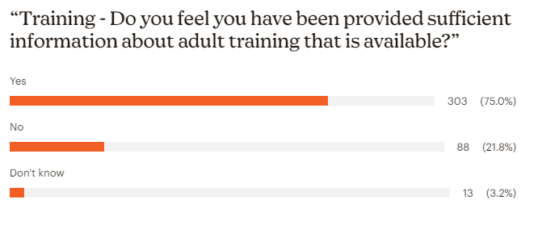

Slide 19
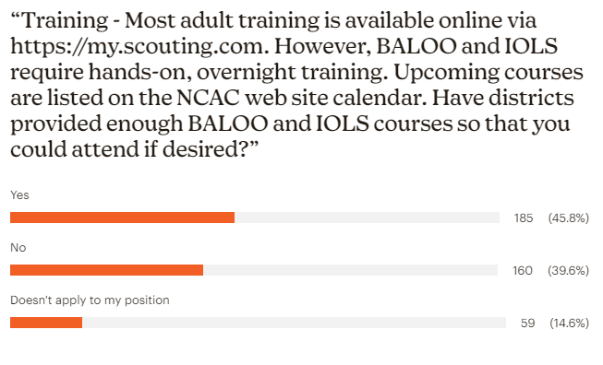

Slide 20
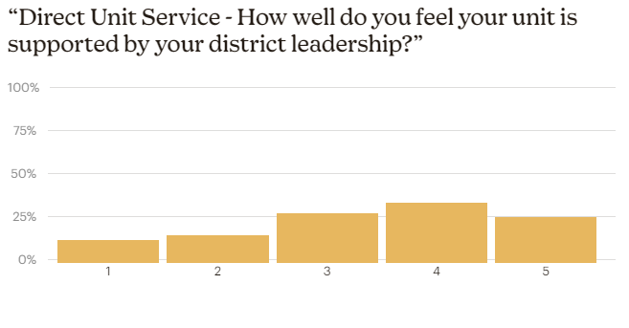

Slide 21
“Advancement/Recognition (Awards Processing) - What could the District and/or NCAC do to improve Award processing?”
(17%) Adequate/doing a great job/much improved
(33%) Make process easier/timely/faster/proof-read
(22%) Track/communicate when done/deliver them to us
( 3%) Keep better tabs on who is eligible
(18%) What Awards are available?/Send info to Unit Key 3
( 2%) National Outdoor Challenge difficult to submit
( 5%) Other – Scoutbook, don’t know, etc.

Slide 22
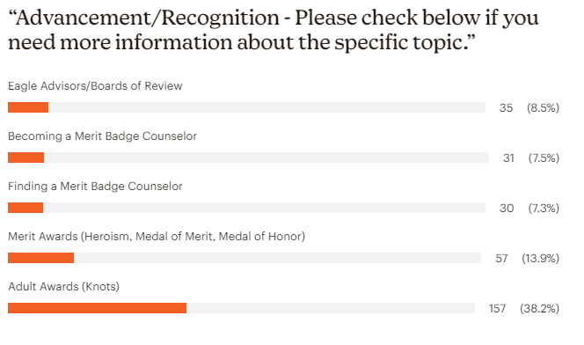

Slide 23
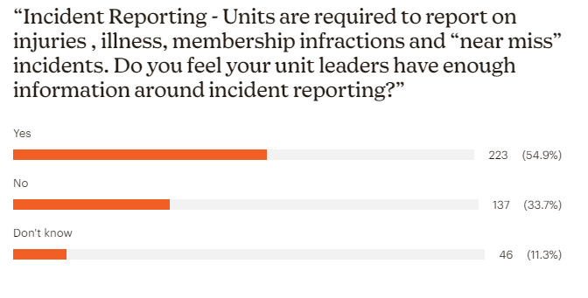

Slide 24
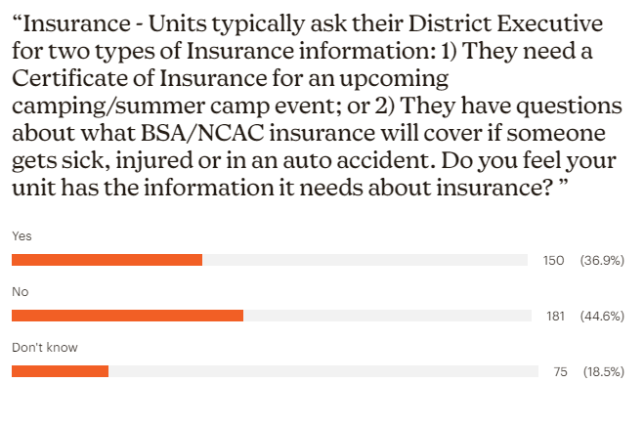

Slide 25
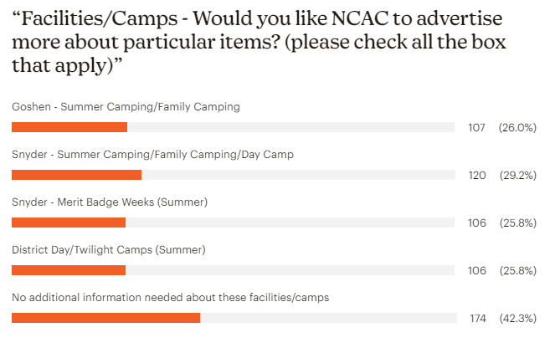

Slide 26
“What information or assistance do you need, from your district or NCAC, that you are not currently getting?”
199 responses
Need a DE
Eliminate paper applications
Why do we have to change Cos
Reduce cost of scouting
Certificate of Insurance – slow, why need, way not posted online
Streamline transfers – from units and other councils
Mentorship for unit leaders
Free events at Camp Snyder
Marketing Campaign

Slide 27
“How could we improve communications with your unit?”
155 responses
Have a DE and District Committee
Send out info earlier
Provide lists of campsites available
Arrange annual meeting of unit leaders
Send information to family’s email, not just unit leaders
Provide a monthly newsletter
Contact me for things other than money
Use Facebook more

Slide 28
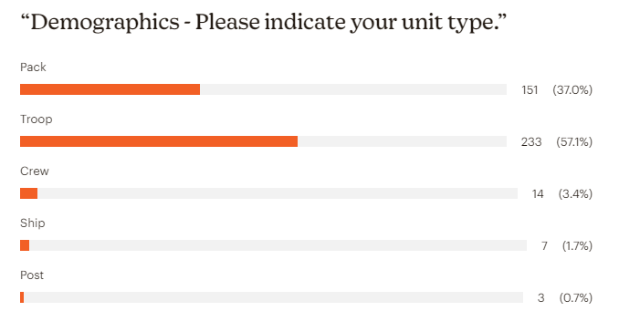

Slide 29
Survey Link:
https://public.3.basecamp.com/p/jCjyqoBNf6BKFWnkSjv8cDp9

Slide 30
Membership Questions/Marketing Opportunities
Do you receive relevant and timely information from council; what council resources or council committee support do you need to grow scouting?
What are some audacious ideas for exponential growth of scouting?
How do we package and demonstrate the scout benefit? Is the benefit leadership, patriotism, preparation for life, or something else?
Who are the influencers within your communities and how do we reach them?
What changes to your district would facilitate exponential growth?

Slide 31

Current 2023 George Mason Calendar
February 03, 2024 – Life to Eagle Seminar, Virtual
February 24, 2024 – University of Scouting, Alexandria, VA
March 09, 2024 – GMD Merit Badge Day, Fairfax, VA
April 13, 2024 – GMD Pinewood Derby, Fairfax, VA
May 27, 2024 – Memorial Day Flags In, Falls Church, VA

Slide 32
STEM
02/03/24 - Akela Chess Classic Cub Scout Tournament, MSSC, Bethesda, MD
02/10/24 - Akela Chess Classic Scouts BSA Tournament, MSSC, Bethesda, MD
03/23/24 – Maryland Science Center Camp-In, Baltimore, MD
Ancient Earth: Birth of the Sky (on PBS) - link
Anytime – DC STEM Trek- Showcases 24 government agencies, private organizations and monuments related to the tenets upon which STEM is based. Two hikes - 10.57 miles, or 4.75 miles

Slide 33
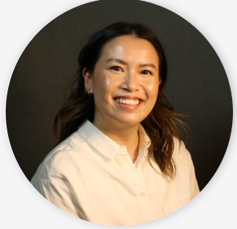
Message from Liz (our District Executive)
"I'm so sorry I wasn't able to make it tonight due to a prior engagement. I hope everyone has happy and safe holidays with your families and friends. Because of everyone here, George Mason is seen as one of the most successful districts of this year. That is because of all of your leadership. Thank you all for your continued support and I look forward to celebrating my first full year of scouting with you all next year!"

Slide 34
Time for Cracker Barrell
Minutes and slides available on the GMD web site (District Resources, Roundtable). Password is “GMDRT”
Next meeting – January 11, 2024, at Thoreau MS

Slide 35
Backup Slides

Slide 36
Council Update
2024 National Dues – Effective 08/01/23 - https://public.3.basecamp.com/p/XoisQJcMr1NncMfshG7xCj9f
2024 Council Dues – Effective 1/1/24 - https://www.ncacbsa.org/participation-fee/https://www.ncacbsa.org/participation-fee/
Unit Charter Renewal - Charter Renewal input at https://advancements.scouting.org/. Only the unit Key 3 and Key 3 delegates can access the software. Use the same Username and Password that you use for https://my.scouting.org and Scoutbook.

Slide 37


Merit Badges
The online Merit Badge Counselor registration works for all Scouters who do not already hold another District position.
New Merit Badge Counselors must complete online merit badge counselor training, in addition to YPT. Be sure the counselor uses his/her legal name – no nicknames.
Merit Badge Counselors, or the unit Dean/Leader, also need to scan and send Margee the Merit Badge application form listing the badges the counselor is applying to teach and providing a justification of his/her qualifications.
Youth Protection Training is the essential first step. Don’t hit “send” on the application without it!
Contact Margee if you have questions at GM.MB.Dean@hotmail.com.
Did you know:
The National Council does not limit the number of merit badges a youth may earn from one counselor, though a unit leader is permitted to do so, as long as the same limit applies to all Scouts in the unit. Ideally, Scouts should work with a variety of adults. (GTA 7.0.0.3)
Partial Merit Badges have no expiration except the Scout’s 18th birthday. (GTA 7.0.3.3)
Due to the BSA policies related to Youth Protection and two-deep leadership, a merit badge counselor must have another adult present during all merit badge counseling sessions. However, the parent or legal guardian of the Scout may serve as the second adult. This parent or legal guardian does not have to be a registered leader.
If the requirements for a merit badge differ between the merit badge pamphlet and the current edition of Scouts BSA Requirements, the requirements in the Scouts BSA Requirements book supersede all others.

Slide 38

2024 GM District Merit Badge Day
March 9th, 2024 at Fairfax Presbyterian Church in Fairfax.
Registration will open on December 15th, 2023
Need Unit Merit Badge Day Coordinator names and contact details by November 30 to John Drisco at gmasonmeritbadgeday@gmail.com
Encourage Scouts to get merit badge books by December 31. Read requirements and start tackling “pre-work” by early January 2024.
Note: The “pre-work” is not the same as a “prerequisite.” The “pre-work” consists of tasks/activities that the Scout is advised to do in advance of the Merit Badge Day. A Scout can still participate in the Merit Badge Day class if he hasn’t completed the pre-work but failure to complete the pre-work may mean the Scout leaves the Merit Badge Day with a partial badge. A prerequisite is something that must be done in order to qualify to take the class. The only prerequisite we are aware of for the George Mason Merit Badge Day is that the Scout must be a registered member of the Boy Scouts in a participating unit.
Feedback to John Drisco at gmasonmeritbadgeday@gmail.com

Slide 39

Training (https://www.ncacbsa.org/george-mason/training/)
Back Country Outdoor Leadership Skills (BCOLS)
03/23/24 & 04/27/24-04/28/24
10/05/24 & 11/02/24-11/03/24
Climbing Level 1 Instructor
April 20-21 at Great Falls Park, 7:30 AM to 5:00 PM. Logistics memo
April 27-28 at Carderock Rec Area, 8:00 AM to 5:00 PM. Logistics memo
June 15-16 at Great Falls Park, 7:30 AM to 5:00 PM. Logistics memo
Sept 7-8 at Great Falls Park, 7:30 AM to 5:00 PM. Logistics memo
Sept 21-22 at Sugarloaf Mountain, 8:15 AM to 5:00 PM. Logistics memo
Mental Health First Aid https://www.fairfaxcounty.gov/hscode/ereg/Registration.aspx?groupID=47
NYLT
24-1: 01/12/24 -01/15/24 & 01/27/24-01/28/24
24.2: 06/16/24-06/21/24
24.3: 06/23/24-06/28/24
24.4: 07/28/24-08/02/24
24.5: 07/28/24-08/02/24
Registration will open in the Fall and will be announced via email and on Facebook
Trainer’s Edge
09/10/24
12/07/24
Wilderness First Aid (N02) https://scoutingevent.com/082-WFASpring2024
01/27/24 0 01/28/24 – Camp Snyder
02/24/24 – 02/25/24 – Camp Snyder
03/23/24 – 03/24/24 – Camp Snyder
04/27/24 – 04/28/24 – Camp Snyder
Wood Badge (A90) https://www.ncacbsa.org/wood-badge/
04/12/24 – 04/14/24 & 05/04/24 – 05/05/24
10/14/24 – 10/15/24 & 10/05/24 – 10/06/24

Slide 40

GM High
Adventure
Important notes for this month
  Wilderness First Aid Training – Holiday sales going on now!
    See PDF’s attached to the notes
  Registration dates for 2025 trips
    NORTHERN TIER & OPIK: Reservations open Jan 18, 2024
    SEA BASE: Reservations open Jan 18, 2024
    SUMMIT: Reservations open Jan 18, 2024
    Philmont: Lottery registration has closed, but treks are still available
  2024 National High Adventure Base Scholarships
    NORTHERN TIER: Submit by Jan 31st, 2024. Go here for the application.
    PHILMONT: Up to $400. Submit by Feb 1st, 2024. Go here for the application.
    SUMMIT: Submit by Mar 31st, 2024. Go here for the application.
    SEA BASE: The deadline has already passed
  Most BSA High Adventure bases still have availability for summer 2024 trips – See the URL below for more information
    https://www.scouting.org/outdooradventures/open4adventure/
NCAC-Organized High Adventure Trips - 2024
  Lenhok’sin – James River Canoeing Trek - July 7-13, 2024
    Crew of 6-12 - $475 per participant
    Registration: https://scoutingevent.com/082-75664
    For more information, e-mail highadventure@ncacbsa.org
  Wind River Range, WY: 06/22 to 06/30/24
    Registration: https://scoutingevent.com/082-77027
    Booking up fast! Space for 4 Scouts - $1,430 per participant
    Mandatory Practice/Training for Everyone
      HAC Philmont Training Sessions
  NCAC-sponsored trips for Philmont, Northern Tier & Sea Base are already full
Dec 2023
Notes:
Sea Base Trip on Jul 29-Aug 3, 2024 - FULL

Slide 41
GM High
Adventure
Training - Open to all NCAC Scouts & adults that are participating in HA trips in the next few years
  Philmont 2024 Sessions: I – passed; II – 01/07/24; IIIa – 03/24/24; IIIb – 04/06/24
  Philmont Advisor Hikes: 8:00am, Sat 3/09 & Sun 3/17/24, 8:00am Catoctin Mt Park, Thurmont, MD
  BCOLS: Spring 2024 (MD): 03/02/24 (classroom), 04/27 & 28 (overnight)
  Northern Tier 2024 Sessions: Sat, 04/06/24 (in-person); Sat, 04/20/24 (virtual)
  Sea Base Session: TBD
  Members of the High Adventure Committee are available to assist units in planning and training for their upcoming high adventure trips – Contact Brian Heath for more information
NCAC High Adventure Committee is Planning for More Big High Adventure Trips
  Backpacking in Wyoming – Summer of 2024
  Climbing Trip to Zion National Park – Planning Underway
  Looking for more ideas and volunteers to plan the trips
National High Adventure Base Quick Links
  Philmont: https://www.philmontscoutranch.org/register/
  Northern Tier: https://www.ntier.org/provisional-scout-connections/
  Sea Base: https://www.bsaseabase.org/scouts/scout-connections/
  Summit: https://www.summitbsa.org/registration/scoutconnections/
Other High Adventure Bases
  Adirondack High Adventure Area: https://public.3.basecamp.com/p/hLgsVbk7Suju6cuDzQQJaEn4
  Maine High Adventure Area: https://www.mainehighadventure.org/
  Montana Outdoor High Adventure Base: https://montanabsa.org/camps/high-adventure/
Other useful links for high adventure information and opportunities
  NCAC High Adventure website - https://www.ncacbsa.org/high-adventure/
  List of units with available slots in their upcoming high adventure trips - https://public.3.basecamp.com/p/xWpkdrKHKAA9pCzwmHMNdbWb
Dec 2023

Slide 42
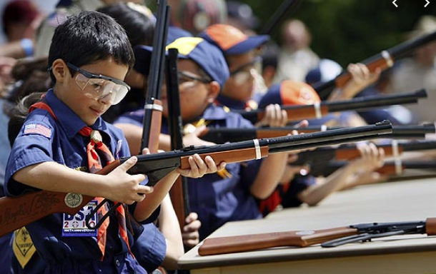
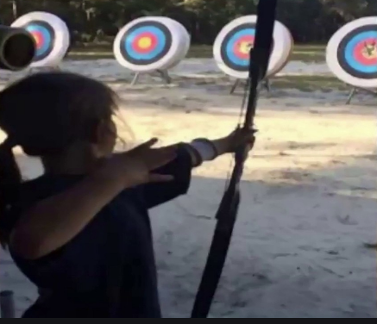
Shooting Sports
Requests for Shooting Events – Lead Time!
  50+ scouts - 6mos
  Less than 50 scouts - 3mos
Shooting on private land:
  Requirements
  Permissions/protocols
Shooting Sports web page
Shooting Sports Instructor Classes:
  Rifle/Shotgun - 02/24/24, 04/27/24, 07/20/24, 08/24/24
  Archery – 02/24/24, 03/18/24

Slide 43
Order of the Arrow
  Mary Neuse has accepted the Scoutmaster position at T1978G. Brian Fleck will be the new Chapter Advisor.
  2023 Dues can be paid online: https://wipit470.org/dues.html
  11/01/23 – Election Season Opens
The Amangamek-Wipit Lodge will be sending a contingent to the one-and-only National Order of the Arrow Conference (NOAC) next summer and we want you to join us! Registration is now open! Follow the directions below to register for the one and only 2024 National Order of the Arrow Conference (NOAC) at the University of Colorado at Boulder. Here are the steps to register for this once-in-a-lifetime opportunity!
Step 1: Click the registration link here!
Step 2: Fill out all information for the registration form.
Step 3: Congrats! You have reserved your spot for the 2024 NOAC! Look out for other emails in regard to both national registration AND further payments you may need to make! Can’t wait to see you there!!
If you have any questions regarding the National Order of the Arrow Conference email noac2024@wipit470.org
  * Registrations open online https://wipit470.org/index.html under “Events”

