Slide 1

COVID 19 Response in SUNY Libraries
May 8,2020
www.suny.edu

Slide 2

OLIS Update
Mark McBride, Library Sr. Strategist
www.suny.edu

Slide 3

Response to Discussion on Listserv
  There is uncertainty on our campuses as we prepare for fall
  Budgets are going to be tight for the foreseeable future
  We can do more together than separate
  Are there areas where the OLIS could offer more support to campuses?
www.suny.edu

Slide 4
We Asked for Volunteers
Seeking 4-6 volunteers for different focus areas; we already have many
Seeking not just library directors
4 week sprints to implement solutions
Meet once a week and continue discussion online
Members of OLIS will facilitate
Each week teams will report progress; seek feedback
May 29 solutions presented to implement; libraries required to implement
www.suny.edu

Slide 5
Follow up discussion
Sara Davenport, Cayuga
Holly Heller-Ross, Plattsburgh
Brian Sullivan, Alfred
Karen Gelles, Farmingdale
Jennifer Whittaker, Canton
Mark McBride, OLIS
www.suny.edu

Slide 6
MAIN TOPIC | FACILITATOR | FOCUS | COLLABORATORS
Virtual Library Services | Susan Perry | Chat, Services, Ask 24/7, Research Appointments. | Ken Fujiuchi, Brian sullivan, Christine Rosa, Fantasia Thorne-Ortiz
Resources Sharing | Tim Jackson/Shannon Pritting | Interlibrary loan, Sharing staff, Regional approaches | Amy Hillick, David Schuster, Kenneth Wierzbowski,
Professional Development | Jennifer Smathers | Working remotely, Redefining ones role, Leadership development. | Jennifer Whittaker, Holly Heller Ross, Dana Laird
Partnerships | Shannon Pritting/Mark McBride | Forming campus partnership.; on campus; partnerships outside of librarianship SUNY-wide partnerships. Global partnerships. | Jill Locascio
Course Reserves | Mike Daly | How to support electronic reserves? Transition from print textbooks | Katie Ghidu, Connie Holberg, Cori Wilhelm, Christine Faraday, Jessica McGivney

Slide 7
MAIN TOPIC | FACILITATOR | FOCUS | COLLABORATORS
Physical spaces | Jennifer Smathers | When we open, how do we open? Front line services (circulation, handling of materials). Making our libraries available to all SUNY students? | Cristina Pope, Karen Gelles, Sara Davenport
Library Instruction/Course Support | Mike Daly | Course support; instructional design help; technology support; digital transformation Can we use a common approach that aligns with Gen Ed? | John Hosford
Shared Collection Management | Esta Tovstiadi | Analyzing collections. Sharing collections in SUNY. Opportunties with existing ebooks. | Curtis Kendrick, Stephanie Hess, .James Galbraith ,Jean Guyon, Brenda Hazard, Charles Lyons, Chair, Buffalo State, Kathy Machin, Heath Martin, Joe Riggie, Matthew Smith, Esta Tovstiadi, Mary Van Ullen, Evviva Weinraub, Alana Nuth
Scholarly Communication | Maureen Zajkowski | Services for OA support. Campus workflows. | Sarah Morehouse, Laura Andrews, Elizabeth Brown,

Slide 8
Our Steps to Problem Solving (4 Weeks)
Be flexible, willing to change, & measure
Evaluate & Iterate
What is the solution
Implement
How can this be solved?
Generate Possible Solutions
What is it we are dealing with?
Gather Information
What are we going to solve?
Define the problem
www.suny.edu

Slide 9
https://bit.ly/4weekvolunteers
www.suny.edu
Notes:
To volunteer email Connie Perrin

Slide 10
SUNY Open Access Repository Update
Maureen Zajkowski, SUNY Shared Repositories
www.suny.edu

Slide 11
SUNY Open Access Repository (SOAR)
Staging platform
  Used for testing: design, functionality, and workflow
  All content is for test purposed only
Production platform is in development
www.suny.edu

Slide 12
SOAR Testing
Creation of landing pages
  Structure of Communities
  Navigation links
Creation and linking to static pages
Record loads
  Manual input
  Batch loads of metadata and content
  Importing metadata from CrossRef and PubMed
  Link authors to their ORCID iDs
www.suny.edu

Slide 13
SOAR Development
Guidelines for
  Content
  Rights and Terms for Use
  Withdrawal of Content
  Preservation
  Accessibility
Workflow development
  Metadata
  Submission
  Training
www.suny.edu

Slide 14
SOAR Shared Services Development
OLIS Baseline Support (No direct costs to campuses)
OLIS Extended Support (Fee-based services)
Campus responsibilities
Atmire responsibilities
www.suny.edu

Slide 15
SOAR Next Steps Through Summer 2020
Complete draft support model and resource needs
Complete documentation and suggested workflows
Prepare basic promotional materials for campuses
Contact campuses regarding the possibility of migrating scholarly and creative works from the SUNY Digital Repository (SDR) to SOAR
  Content most be open and accessible
  Review/updates to metadata as necessary
  [Note: review of SDR based on Community/Collection names indicate that ~2,000 records (out of ~41,000) appear to be scholarly and creative works]
www.suny.edu

Slide 16
SLSS Update
Shannon Pritting, Director of SUNY Library Shared Services
www.suny.edu

Slide 17
Helping Libraries as Part of Baseline Services
In response to what we heard from campuses in virtual site visits, most libraries are doing well with Alma/Primo.
But—they'd like a little help here and there with things they may be struggling with. Or, maybe you want a report or two developed to meet your needs.
SLSS will provide up to 5 hours per year of consulting with campuses if you're struggling with something, with no need for an extended agreement.
Just reach out if you need help. If you can send it to libanswers: info@slcny.libanswers.com, that would be helpful
This is in addition to our integration and other configuration work we have been and continue to do such as:
  OCLC integration
  GOBI/Oasis API integration
  SIS
  Science Direct change
  Shared Reports
www.suny.edu

Slide 18
New Training Opportunities – Acquisitions
Stay tuned...
May 28, 2020 – Webinar (1 hour)
Review and Revisit Alma Acquisitions
June 23, 24, 25, 29 - (8) hour course
CPD fee - $100
Using or upgrading to full acquisitions
www.suny.edu

Slide 19
Shared Collections Update
Esta Tovstiadi, Shared Collections Coordinator
www.suny.edu

Slide 20
Renewal reminder – Chronicle of Higher Ed
Please respond to the Chronicle of Higher Education renewal offer by end of day May 11.
Pricing and terms in the SLSS Collections Portal (password required): https://slcny.libguides.com/c.php?g=1030210&p=7506592
www.suny.edu

Slide 21

Presentations on Making Cuts in Collections
SLSS will be providing a series of 3 workshops starting the week of May 18th on strategies for cutting collections.
Registration and information will be shared soon.
www.suny.edu

Slide 22
Want Some Help in Reviewing What to Cut?
SLSS is offering a service to assist you with identifying cuts in your collections.
Send us a request via libanswers (info@slcny.libanswers.com), and we'll work with you to help make the best decisions on resources that can be cancelled to meet demands for budget cuts.
Will need administrative logins (for usage data), a spreadsheet or other information about resources, target percentage for cuts, and any other relevant information.
We'll do as many of these consults as we can.
Please give us at least 3-4 days advance notice before any deadlines/meetings you have.
www.suny.edu

Slide 23
Resource Sharing Update
Timothy Jackson, SUNY Library Shared Services
www.suny.edu

Slide 24
Alma Article Resource Sharing
Article borrowing implemented at Adirondack, Jamestown, and Ulster on May 7
Thank you to our article lenders!
  Albany, Binghamton, Buffalo, Fredonia, Oswego, Purchase, Stony Brook
  SLSS staff using Empire State College ejournals to help fill requests
  If your library would like to participate in article lending, please let me know
Alma article borrowing could potentially replace ILLiad at low volume libraries
  If your library is thinking about dropping ILLiad and would like to test article borrowing in Alma, please let me know
www.suny.edu

Slide 25
Alma/ILLiad Physical Resource Sharing
Access Services and Resource Sharing Working Group decided to automate lending renewal responses in Alma
  You will need to manually process lending renewal requests received prior to May 5
  Submit ticket to info@slcny.libanswers.com if you see any 12/31/1969 due dates
Lots of questions about returning materials
  SLSS discussing recommendations
  Ask users to hold on to materials for now if you're unsure of what to do
www.suny.edu

Slide 26
SLC Update
Jennifer Smathers, SLC Consortial Engagement Coordinator
www.suny.edu

Slide 27


COVID-19 SLC Board Budget Response
No SLC Membership fee for 2020-2021
SLC Investing in SUNY Libraries Support Services
  $208,000 leveraged to support SLC libraries to extend SLSS Basic Support Services for a year
OLIS to manage remaining funds
  Salary for Jennifer Smathers to 2022
  Anticipated expenditures for the next in-person SLC meeting
www.suny.edu

Slide 28

SLC Spring 2020 Virtual Meeting
June 8-10
No Registration Fee
Open to All SLC
Breakout Rooms
Afternoon Schedule
Virtually Social Events
www.suny.edu
Notes:
Decorative image from https://www.pxfuel.com/en/free-photo-xnwek

Slide 29

VOTE for SLC Board
Each institution can vote once and should select three candidates
Voting ends today at 5 p.m.
Results will be shared the following week
https://forms.gle/8VVHPfrHB8tSKhxSA
How Can You
Get Involved with SLC?
LSP Advisory Committee
Task Forces
www.suny.edu
Notes:
Last Day to Vote Reminder.
Call to Action volunteer in SLC in other ways
Katie Ghidiu sent email on 4/22
From WebForm:
Vote for SLC Board Members, 2020
Each institution should submit this form to select three candidates from the slate of nominations. Responses are due TODAY Friday May 8, 2020 at 5PM. Results will be shared to the Membership shortly after voting closes.
The two candidates with the highest vote totals will fill the three year positions. The third highest vote getter will fill the two year position.

Slide 30
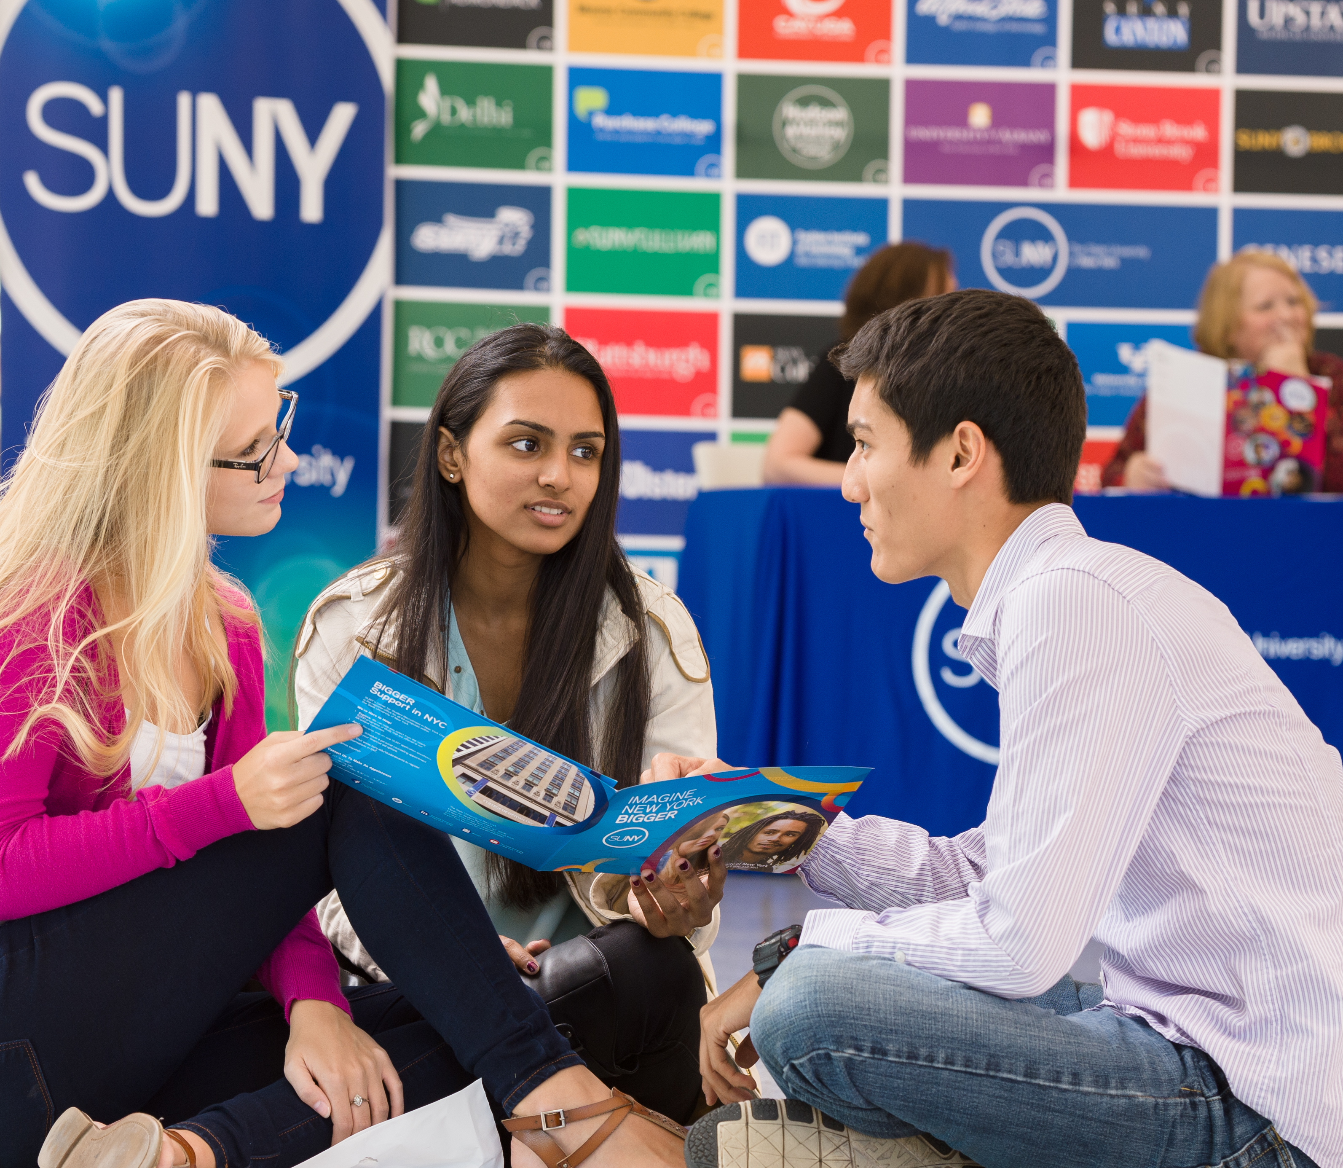

Questions?
How are Things Going at your Campus?
www.suny.edu

