Slide 1

Alternative Access:
Configuring Unmediated Article Purchasing Via Link Resolver
December 18, 2019
Shannon Pritting
Tim Jackson
Michelle Eichelberger
www.suny.edu

Slide 2





Focus will be on Reprints Desk
We’ll focus on how to set up Reprints Desk today, but you could use the same approach for CCC Get it Now as well.
SUNY has negotiated a reduced price for the service fee that Reprints Charges for delivering articles.
www.suny.edu

Slide 3
Use Cases for Link Resolver Based Purchasing
In general, campuses will want to limit the scenarios that a link to purchase articles is provided.
  Provide access to embargoed content if you have the backfile/almost current content via an aggregator.
  Deliver access to specific user groups for limited or extended years for journals that have extremely high subscription cost and usage may be low.
  Subscription options such as tokens don’t have a good business model, and one-off purchasing is better.
  Facilitate short-term access if there is an interruption in a subscription.
www.suny.edu

Slide 4
Reprints Desk Account Options and Configuration
Custom Account option with $1500 annual cost
  Reduces per article price by 50 cents ($3.00 service charge vs. $3.50 SUNY wide prices)
  Adds duplicate request filter
  Includes Open Access (from hybrid journals) filter and refunds if it is discovered that an OA article paid for by APCs is purchased.
Can configure per-article maximum cost that will trigger mediation if the cost of the article is more than that.
  This may not be a major issue as you will be setting up the service for specific titles that you will know the per-article price for.
Can configure what email domains are acceptable to deliver articles.
www.suny.edu

Slide 5
What Journals Can Reprints Provide Access to?
Reprints has agreements with many publishers, and over 30,000 journals.
Can provide current content, including prepubs.
Shannon can provide you with a title list and holdings years.
When you set up RPD account, you’ll be able to search for holdings and costs for titles.
www.suny.edu

Slide 6
What Files are Delivered
Reprints Desk gets pdf directly from the publisher.
PDFs don’t have DRM, so can be saved, printed, and don’t expire.
As long as publisher has OCR and high-res or color images, this will be delivered to your user.
Supplemental material can also be delivered, if appropriate.
www.suny.edu

Slide 7
How to Set Up Reprints Desk as a General Electronic Service
Account:
First, need to set up a Reprints Account: https://info.reprintsdesk.com/customers/academia (Contact Us at bottom of page)
Reprints Desk works by IP authentication, so you'll need to set up an account with them and provide them with both your on-campus IP range(s) and your proxy range
Please send this information to Shannon (preferably via libanswers: info@slcny.libanswers).
Reprints Desk staff will help you configure your Reprints order screen so that it has your logo and any language customization the you prefer
www.suny.edu

Slide 8
How to Set Up Reprints Desk as a General Electronic Service, cont.
Proxy:
You will need to add Reprints Desk to your proxy configuration file
Your proxy stanza should look something like this:
  T Reprints Desk
  U https://www.reprintsdesk.com
  D reprintsdesk.com
  H reprintsdesk.com
www.suny.edu

Slide 9
How to Set Up Reprints Desk as a General Electronic Service, cont
GES:
Go to Config->Institution->Fulfillment->Discovery Interface Display Logic->General Electronic Services and Add Service
Fields:
  Call the service whatever you'd like, and add whatever description you'd like – you may want to note that this service costs money
  Is this a Document Delivery/ILL service? = Yes
  Display location = Getit & How to Getit
  URL Template = [your proxy prefix]https://www.reprintsdesk.com/landing/poe2.aspx?&rft.genre={rft.genre}&rft.title={rft.title}&rft.stitle={rft.stitle}&rft.atitle={rft.atitle}&rft.jtitle={rft.jtitle}&rft.au={rft.au}&rft.date={rft.year}&rft.month={rft.month}&rft.volume={rft.volume}&rft.issue={rft.issue}&rft.number={rft.number}&rft.spage={rft.spage}&rft.epage={rft.epage}&rft.edition={rft.edition}&rft.issn={rft.issn}&rft.eissn={rft.eissn}&rft.aulast={rft.aulast}&rft.aufirst={rft.aufirst}&rft.auinit={rft.auinit}&rft.pub={rft.pub}&rft.pubdate={rft.pubdate}&rft.pubyear={rft.pubyear}&rft.publisher={rft.publisher}&rft.place={rft.place}&rft.doi={rft.doi}&rfe_dat={rft.oclcnum}&rfr_id={rfr_id}
  Enable without login = no
  Item level = no
  Disable Service = your choice as to when you'd like it to display
www.suny.edu

Slide 10
How to Set Up Reprints Desk as a General Electronic Service, cont
GES Service Availability:
Service Availability:
Make sure that default rule at the bottom is Display = false
Use the Service Availability rules to decide when you would like the Reprints Desk link to appear. You could have it appear by genre if you wanted it on all articles. However, if you only want it to appear on selected journals, you can limit that by adding a rule for rft.issn = [your journal ISSN], eg,
If you wanted to get even more granular with this rule, you could add date criteria based on rft.year, something like rft.year >= 2017
You will need to add each title as a separate rule because there's no way to use OR for multiple criteria inside of a rule
You could also use the "contains" parameter with the DOI prefix as a way to select only journals from a specific publisher. For instance, all Elsevier articles have a DOI that starts with 10.1016
www.suny.edu

Slide 11
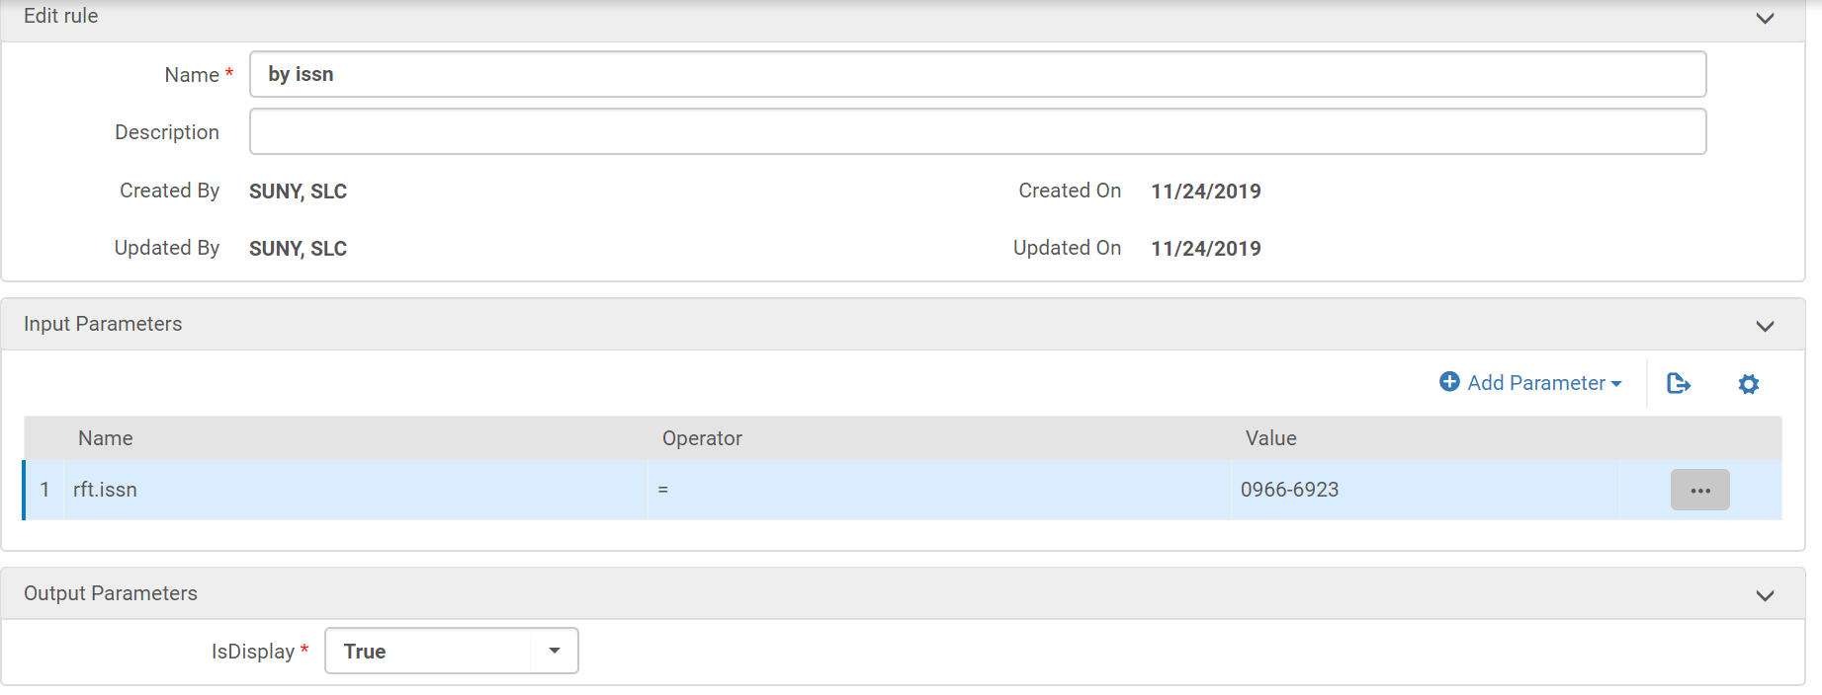
How to Set Up Reprints Desk as a General Electronic Service, cont
GES Service Availability:

Slide 12
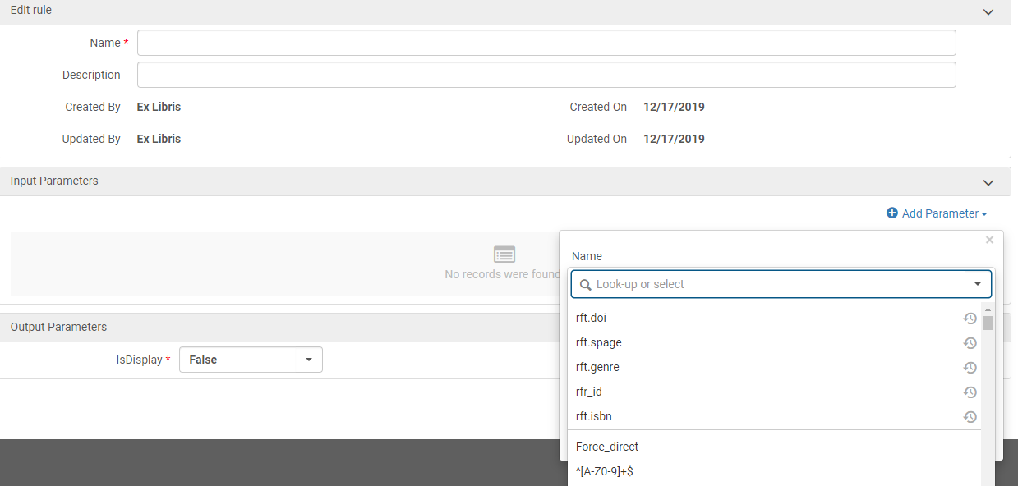
What are Parameters on Service Availability Rules?
Are standard OpenURL attributes.
Most useful fields to use:
  rft.date
  rft.doi
  rft.issn
  rft.jtitle
  rft.volume
www.suny.edu

Slide 13
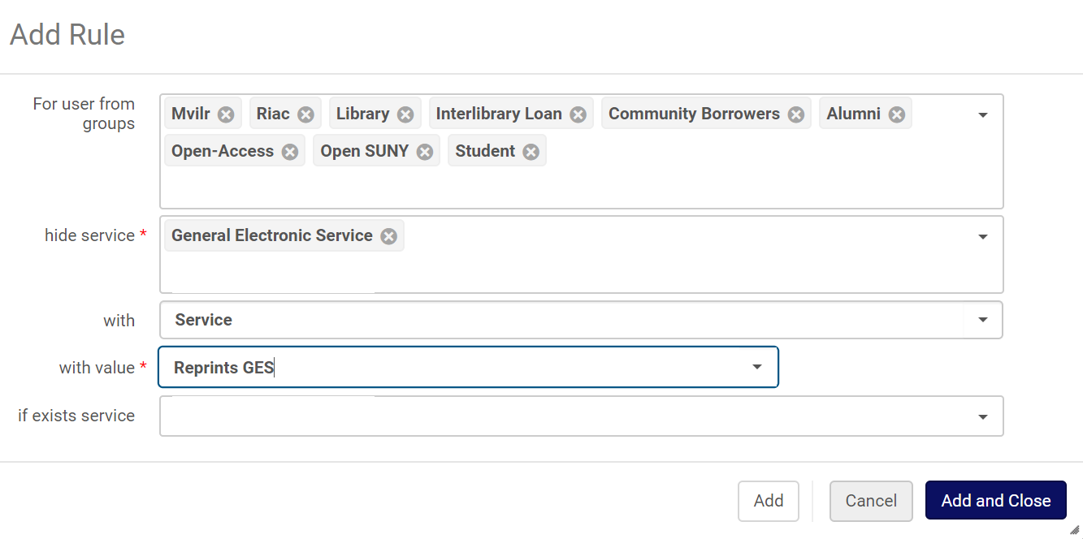
Configuring Display Logic
Display Logic:
Go to Config->Institution->Fulfillment->Discovery Interface Display Logic->Display Logic Rules
Add a rule to hide the Reprints Desk rule for the patron groups who aren't allowed to place orders
May want to hide ILLiad if reprints yes, or you could leave both ILLiad and Reprints, though you might want to put them both behind login to avoid confusion and make them show at same time
www.suny.edu

Slide 14
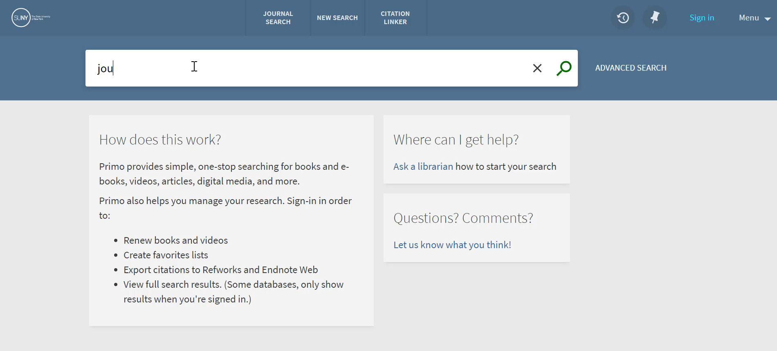
User Experience of Link-Resolver Based Article Purchasing
www.suny.edu

Slide 15
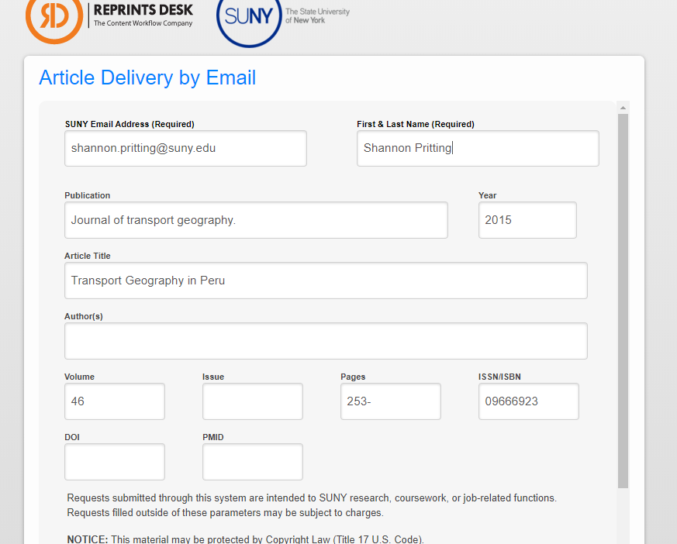

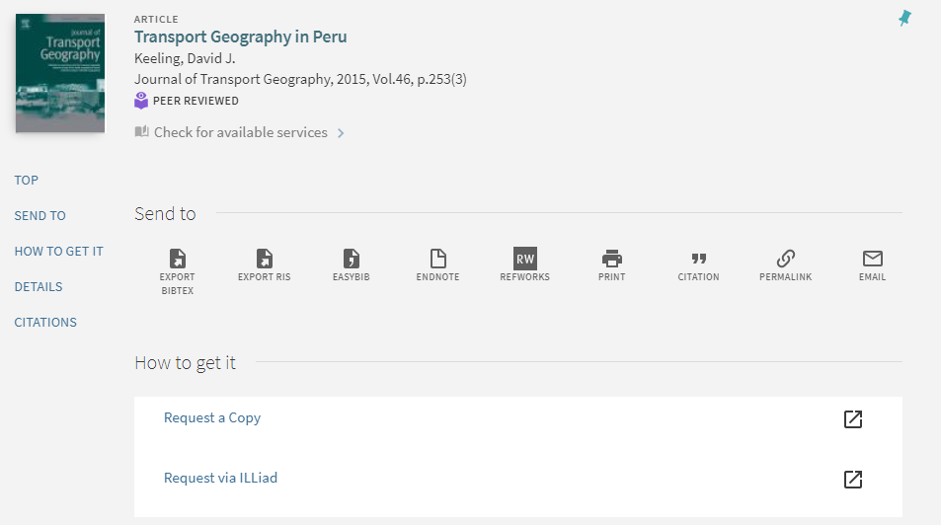

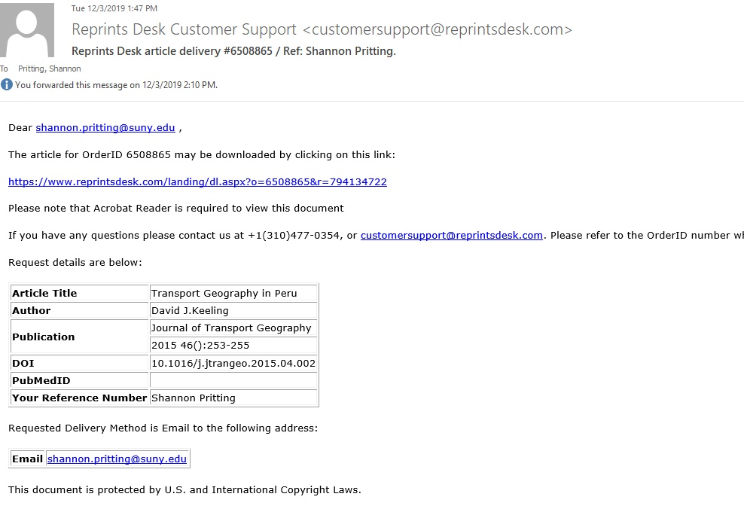


Link Resolver Based Purchasing: 4 Steps and Access in 2-30 Minutes
www.suny.edu

Slide 16

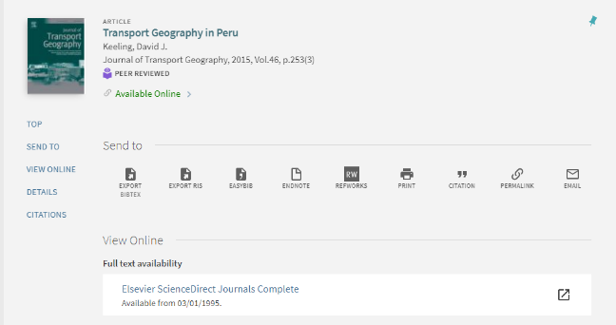
Link Resolver Steps
3
4
1
2
1-30 minutes
You find article you want via search (Google Scholar, Library Discovery, etc)
You’re taken to the tool your library uses to provide you access
A Link in the library’s tool takes you to a request form that will trigger a pdf to be sent to your email
An e-mail arrives in your inbox typically within minutes with a link to the pdf of the article.
www.suny.edu

Slide 17
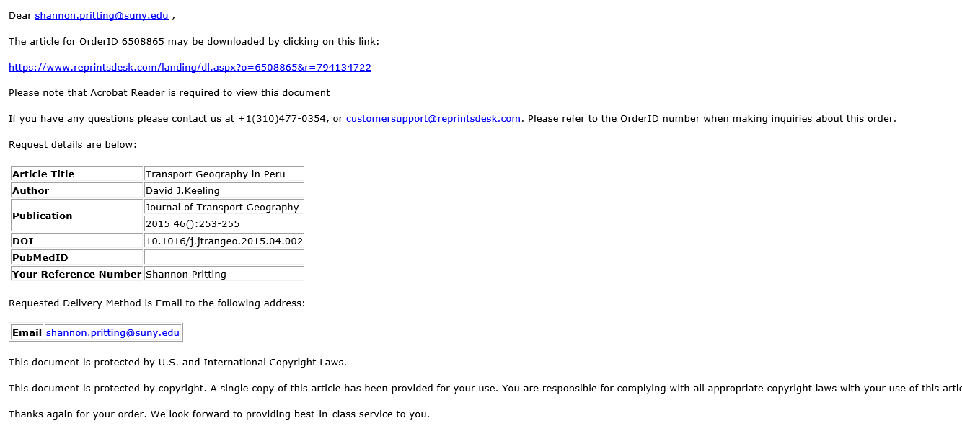
What Email Looks like
www.suny.edu

Slide 18
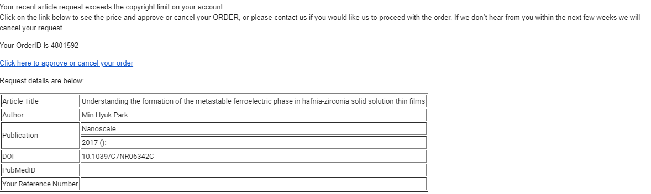
Max Cost Email and Process
www.suny.edu

Slide 19
How SLSS Can Help
If you need to set up a consult to configure this service in your link resolver, or to set up ILL based mediated/unmediated purchasing, send us a request to:
  info@slcny.libanswers.com
Please provide us with times/days you have available to meet, and as much relevant information as you can provide.
www.suny.edu

Slide 20


Questions or Discussion?
www.suny.edu

