Slide 1

ERM/Discovery: Setting up Discovery Import Profiles
February 26, 2020
Michelle Eichelberger
Michelle.Eichelberger@suny.edu

Slide 2
Plan for Today
Learn how to configure discovery import profiles for commonly used external resources like LibGuides and DSpace, and review results from data harvested by the profile.
Develop knowledge of what type of data can be harvested, and what metadata normalization may be needed.
We’re not going to cover setting up import profiles for acquisitions or traditional e-resources like eBook Central or Sciencedirect.
www.suny.edu

Slide 3
Why Set up Import Profile?
Keeps your content up to date – can set harvest schedule
May not have MARC records for content or other formats that are easily loaded into Alma
Helps bring more sources into central discovery and makes it easier for patrons to find
www.suny.edu

Slide 4
What can you import?
https://knowledge.exlibrisgroup.com/Primo/Product_Documentation/020Primo_VE/045Loading_Records_from_External_Sources_into_Primo_VE/Configuring_Import_Profiles_for_Primo_VE
https://developers.exlibrisgroup.com/blog/Adding-Springshare-Libguide-Discovery-to-Primo-VE/
www.suny.edu

Slide 5
Import Challenges
Can take some trial and error to set up
Adding proxy is difficult
Can require normalization rules and linking syntax
Records don’t get imported into Alma – so you won’t be able to find them in an IZ search. Can make troubleshooting challenging
www.suny.edu

Slide 6
Workflow
Thanks to Kristy Lee, Heidi Webb, and Rebecca Nous for excellent FAQs about Discovery Import Profiles:
How do I add Libguides or Libguides A-Z resources to Primo for discovery?
How to harvest SUNY DSpace metadata (OAI) and import into Primo VE?
www.suny.edu

Slide 7
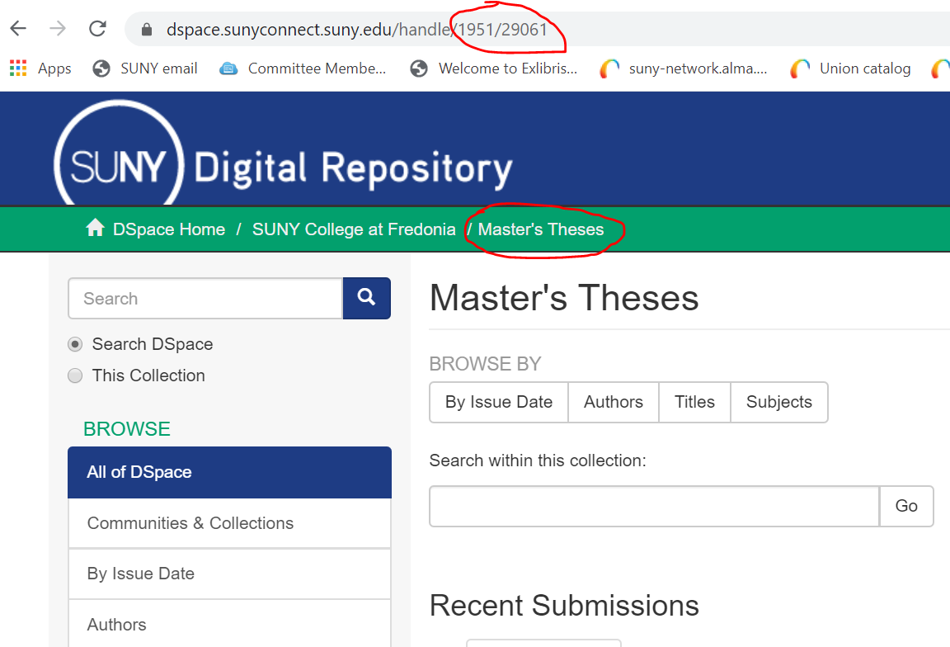
Use Case
SUNY Fredonia Masters Theses:
210 Titles
Dates from 2012 to the present
Hosted in DSpace: https://dspace.sunyconnect.suny.edu/handle/1951/29061
www.suny.edu

Slide 8
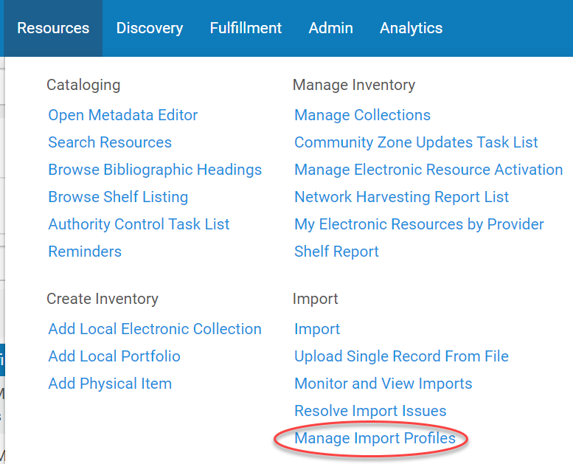
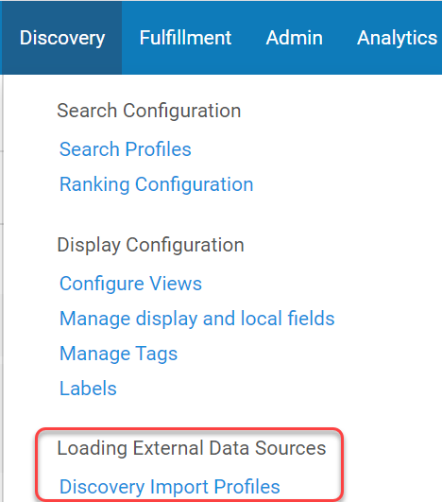
Setting up the Import Profile
Go to Resources->Import->Manage Import Profiles
Or Discovery->Loading External Data Sources->Discovery Import Profiles
www.suny.edu

Slide 9
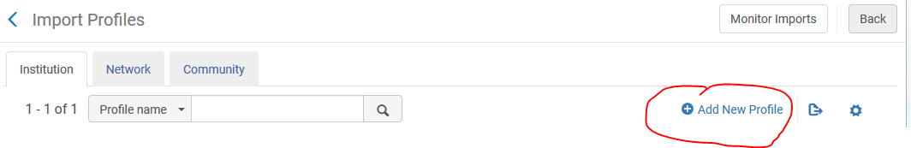
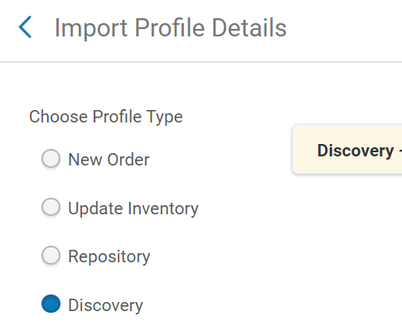
Setting up the Import Profile
Select Add New Profile and choose Discovery as the Profile Type
www.suny.edu

Slide 10
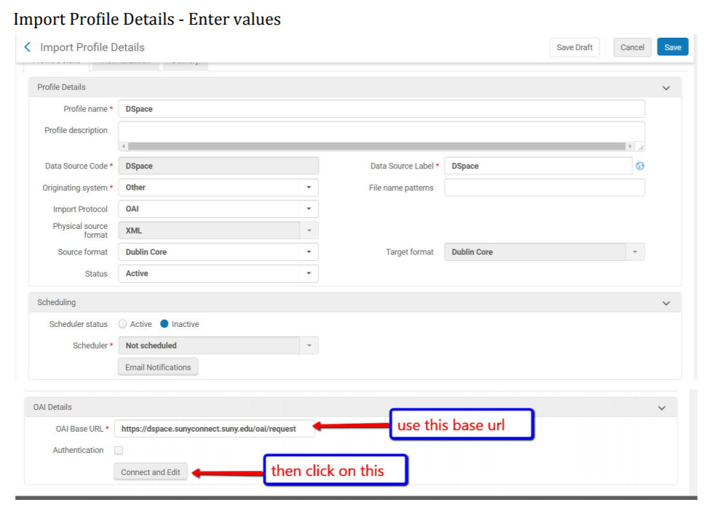
Setting up the Import Profile
You can call the Profile and the Data Source Label whatever you’d like
If you’re importing from SUNY DSpace, the other parameters are:
Data Source Code = DSpace
Originating System = Other (or DSpace)
Import Protocol = OAI
Physical source format: XML
Source Format = Dublin Core
Don’t schedule yet
OAI Details:
https://dspace.sunyconnect.suny.edu/oai/request
www.suny.edu

Slide 11
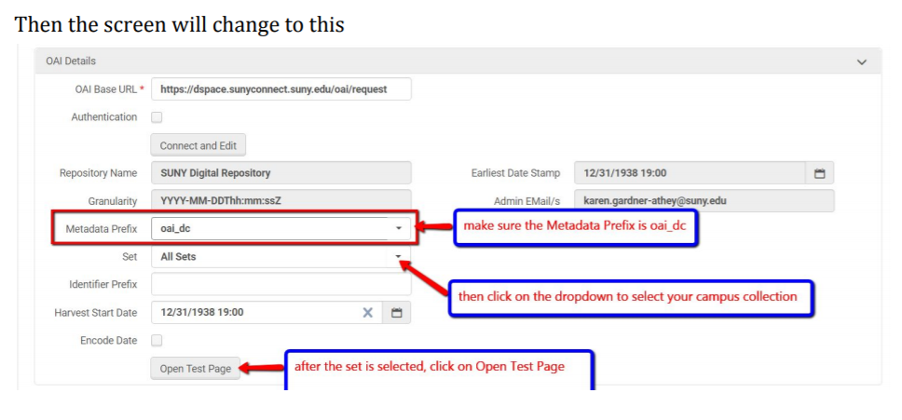
Setting up the Import Profile
We’re looking for the 1951/29061 collection
www.suny.edu

Slide 12
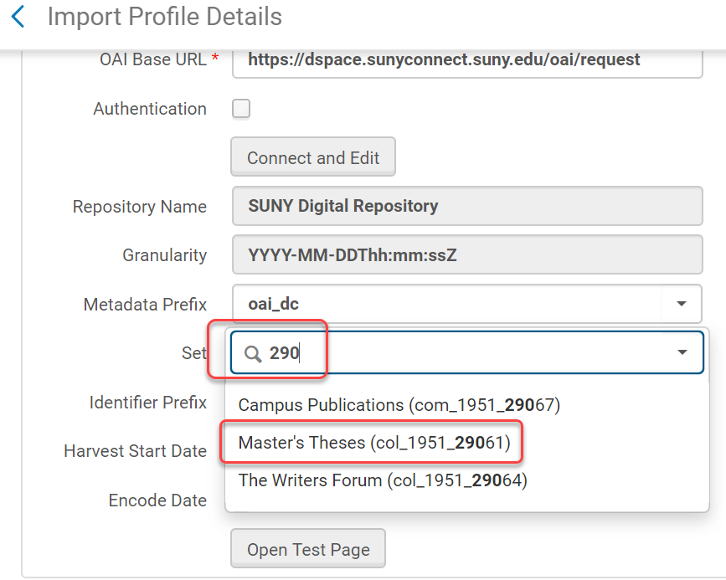
Setting up the Import Profile
We’re looking for the 1951/29061 collection
www.suny.edu

Slide 13
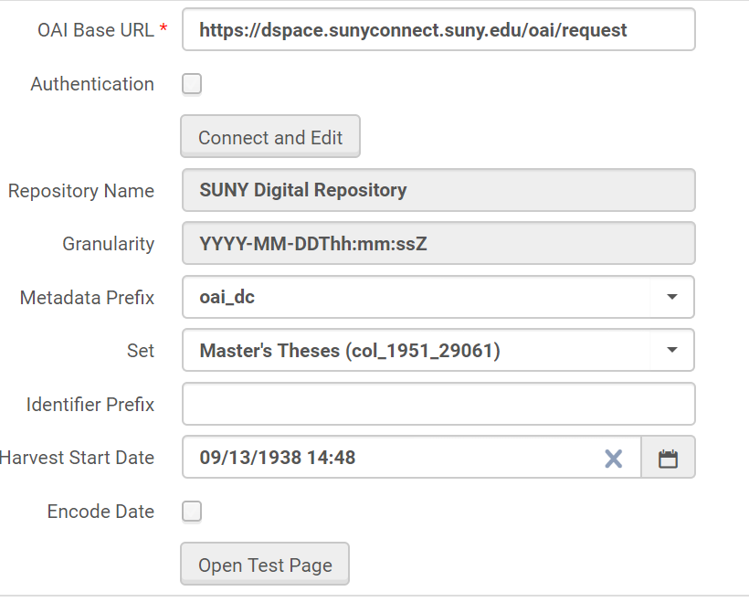
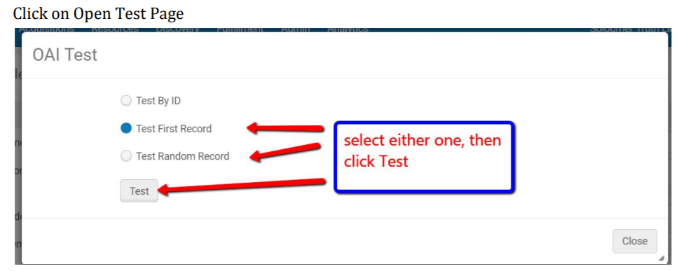
Test Set-up
www.suny.edu

Slide 14
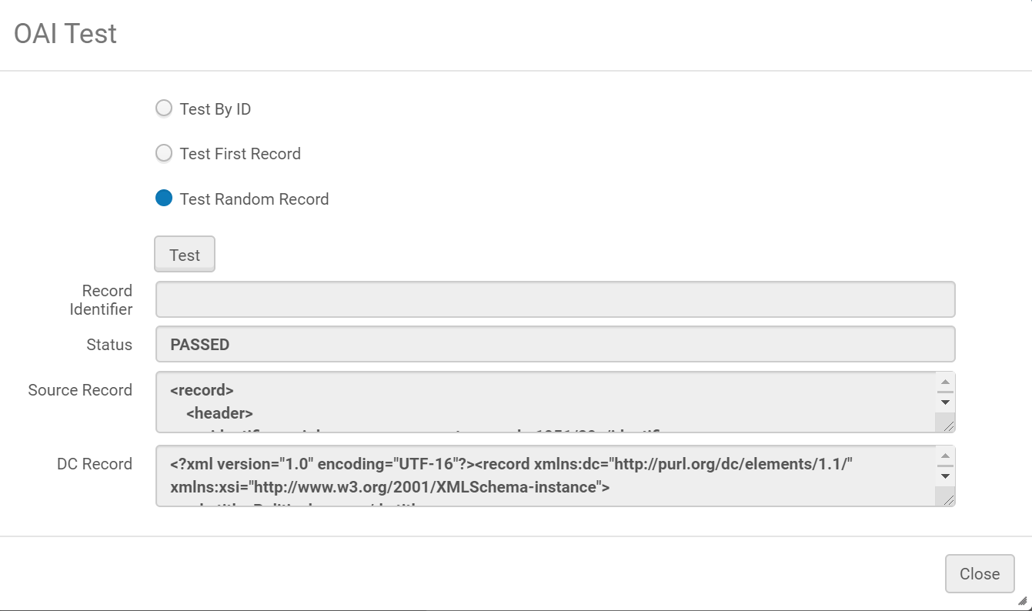
Test Set-up
Want it to say “Passed”
Can expand source record and DC record boxes to look at source code and what it turned into
Note the dc:identifier tags. That’s what we’ll use for linking to the record in Primo VE:
<dc:identifier>http://hdl.handle.net/1951/58375</dc:identifier>
<dc:language>en_US</dc:language>
<dc:format>application/pdf</dc:format>
<dc:identifier xml:lang="eng">oai:dspace.sunyconnect.suny.edu:1951/58375</dc:identifier>
www.suny.edu

Slide 15
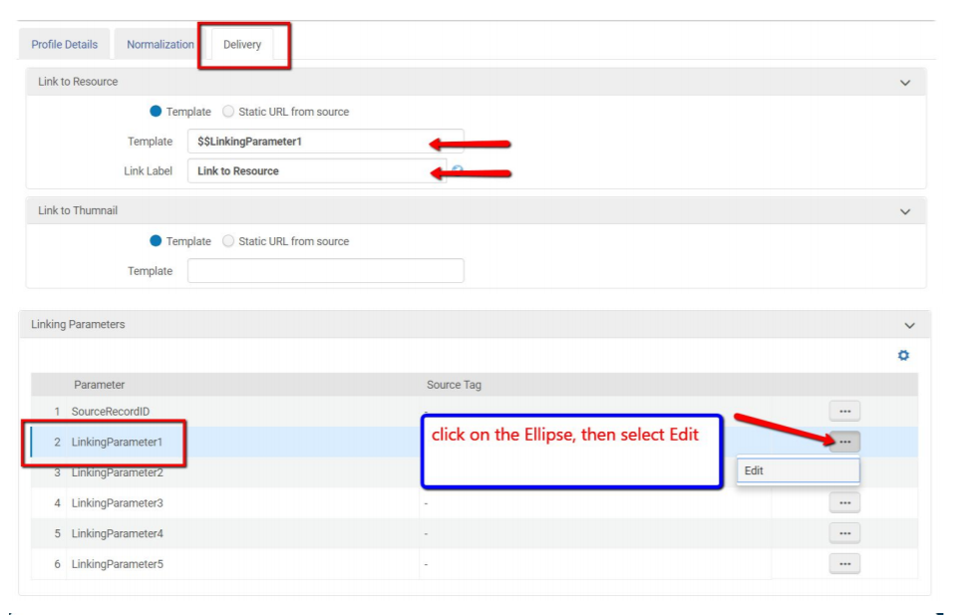
Setting up Linking
Click next twice to skip over the normalization tab. We’ll get back to that later.
The Delivery tab sets up your linking. It tells Primo which field to use to create the link, and how to handle it. Can change linking without re-exporting content. Because our data has more than one dc:identifier, have to use Linking Parameter.
Want Template = $$LinkingParameter1
You’ll add code to that parameter
www.suny.edu

Slide 16
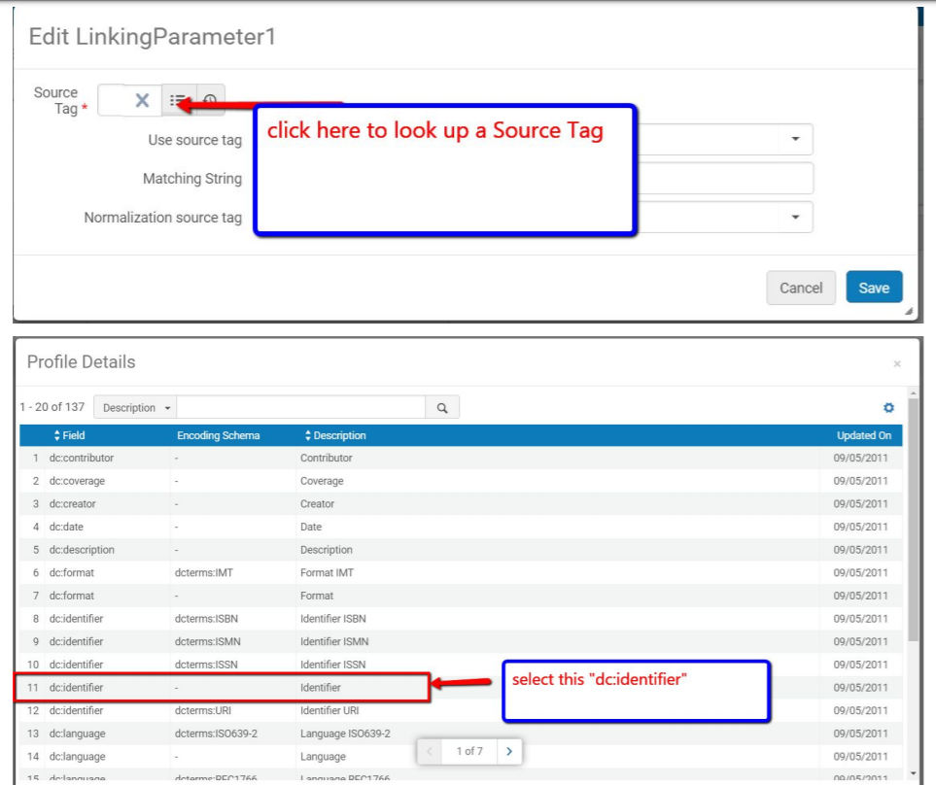
Setting up Linking
Need to pick the tag that you want to use as the source for your link. Click on bullet list to pick your source.
Note that it will look like the source tag field is empty on the look-up even after you’ve picked a field.
Pick the plain dc:identifier field
www.suny.edu

Slide 17
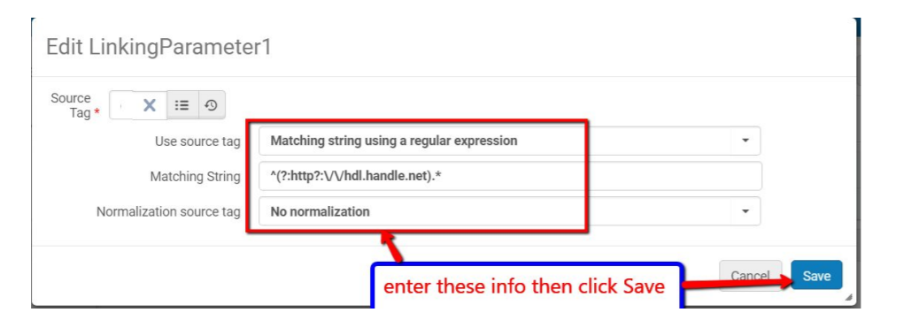
Setting up Linking
Because there’s more than one dc:identifier in the source code, you need to tell it which one to pick. You do that with a matching string. The string that you want to use is
^(?:http?:\/\/hdl.handle.net).*
Make sure you copy this code exactly
www.suny.edu

Slide 18
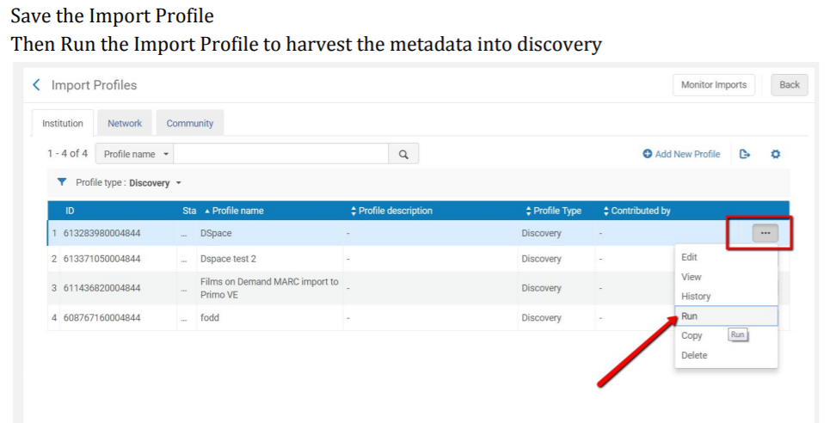
Run the Import Profile
www.suny.edu

Slide 19
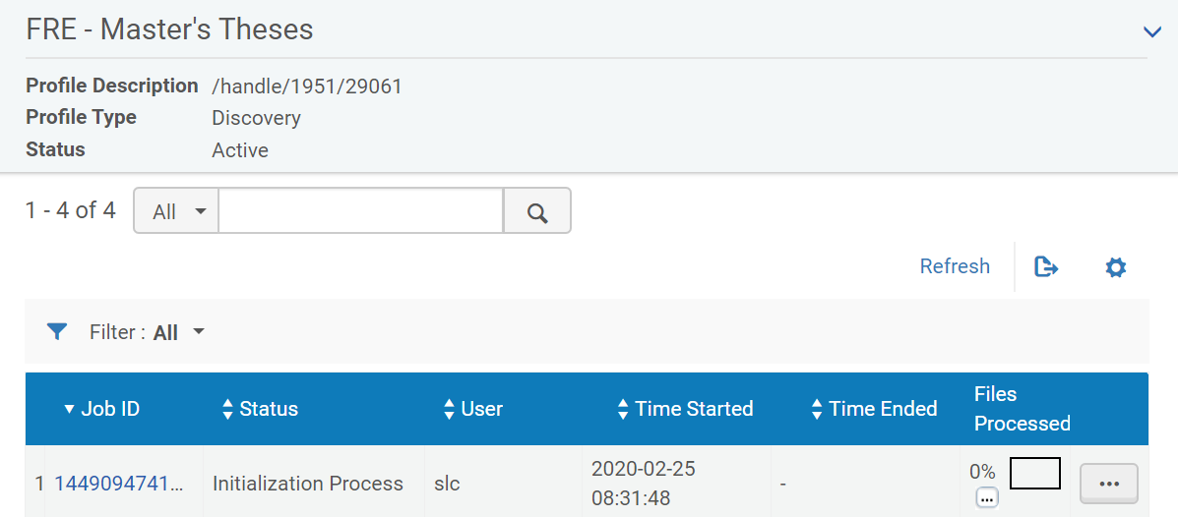
Run the Import Profile
Click Submit to run.
Can Refresh to update progress.
www.suny.edu

Slide 20
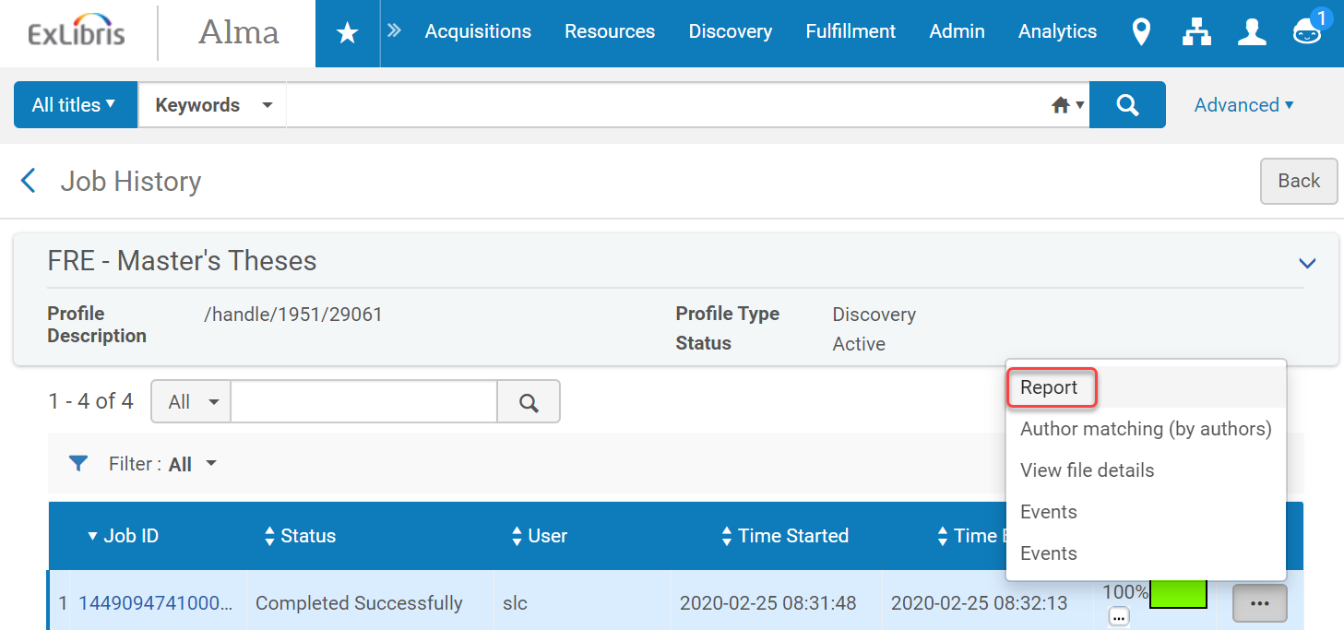
Review the Import Profile
www.suny.edu

Slide 21
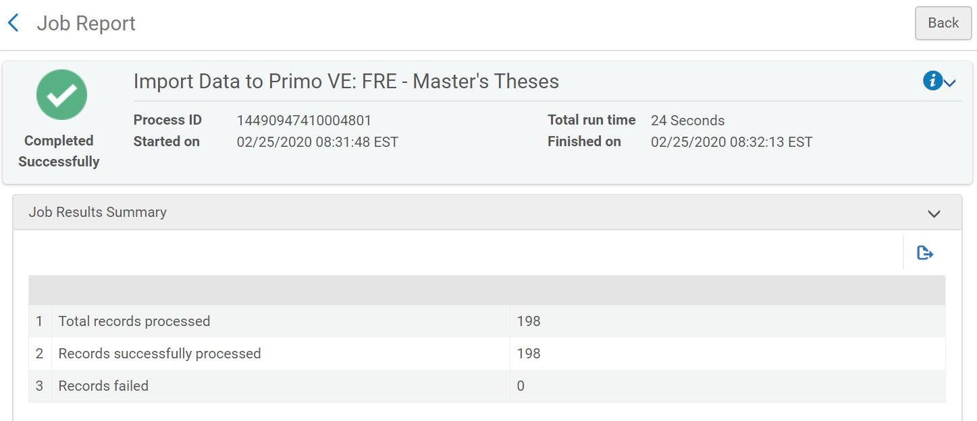
Review the Import Profile
Report tells you how many records were processed – should compare this to the number of records in DSpace or LibGuides or other external source.
In this case, we’re 12 records short – may be a metadata problem in DSpace records
www.suny.edu

Slide 22
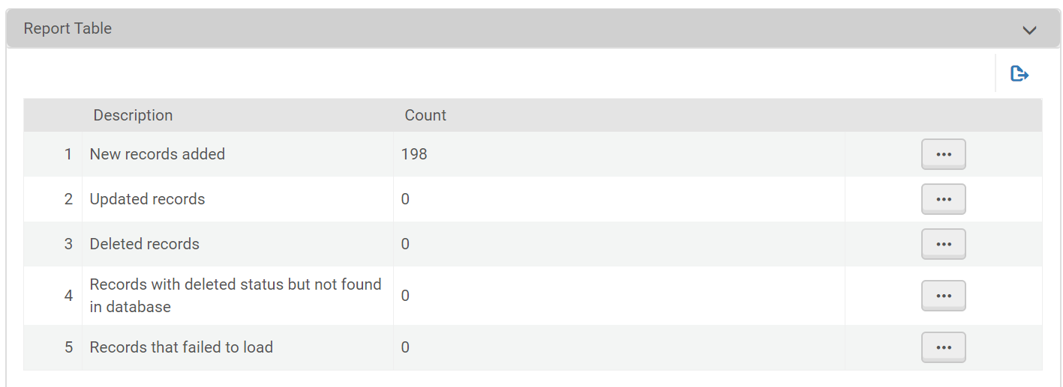
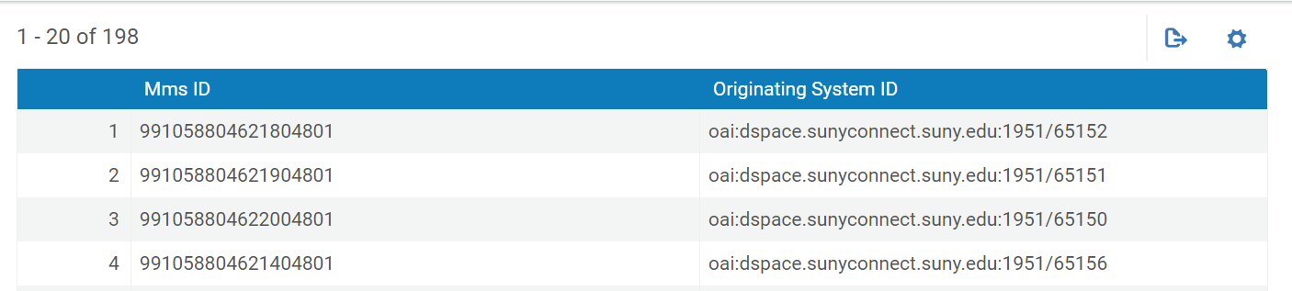
Review the Import Profile
Report table gives you MMS IDs and matching DSpace id, but you can’t look up these MMS IDs in Alma IZ or NZ
www.suny.edu

Slide 23
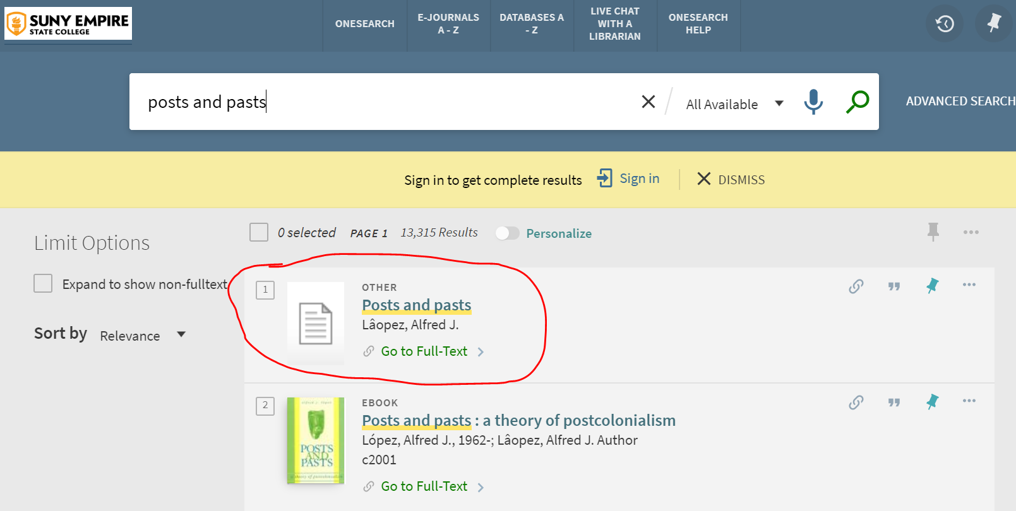
Test in Primo VE
Pick title from test, or from DSpace and look it up in Primo VE. Should be in there right after running job.
Default is to add it to your Everything search.
Note that resource type is Other. Could be Thesis or something else, depending on source info.
www.suny.edu

Slide 24
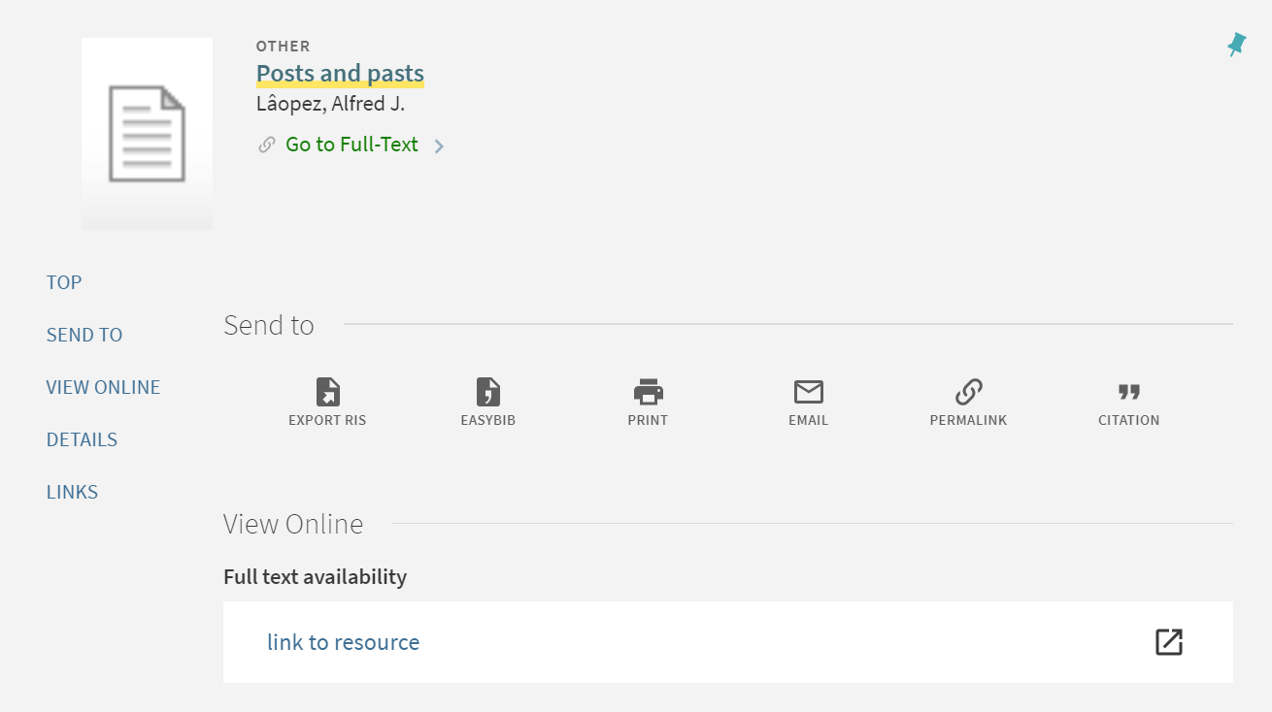
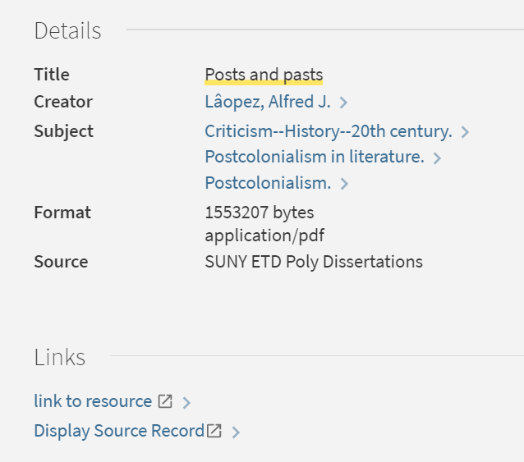
Test in Primo VE
Test the link. Take a look at the source and other bib info to make sure that it looks the way you want it to look. If it doesn’t, you can use normalization rules to make changes.
www.suny.edu

Slide 25
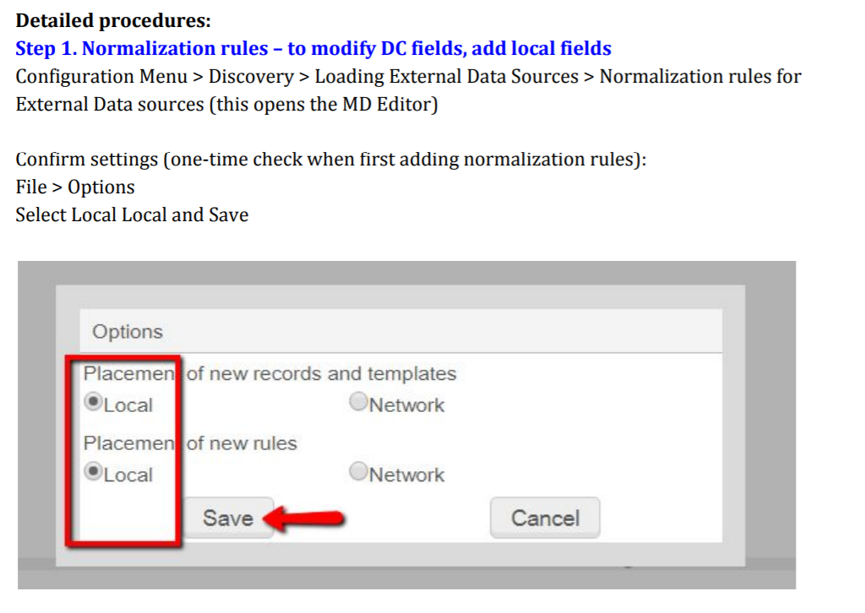
Normalization Rules
If you don’t like the way that your content displays in Primo, you can set up normalization rules to change the display.
To change the resource type for this collection, you’d open your MD Editor, make sure that new norm rules are created in your IZ rather than the NZ, and create a new rule.
www.suny.edu

Slide 26
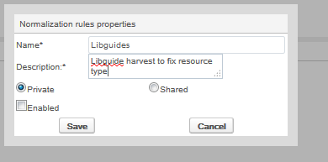
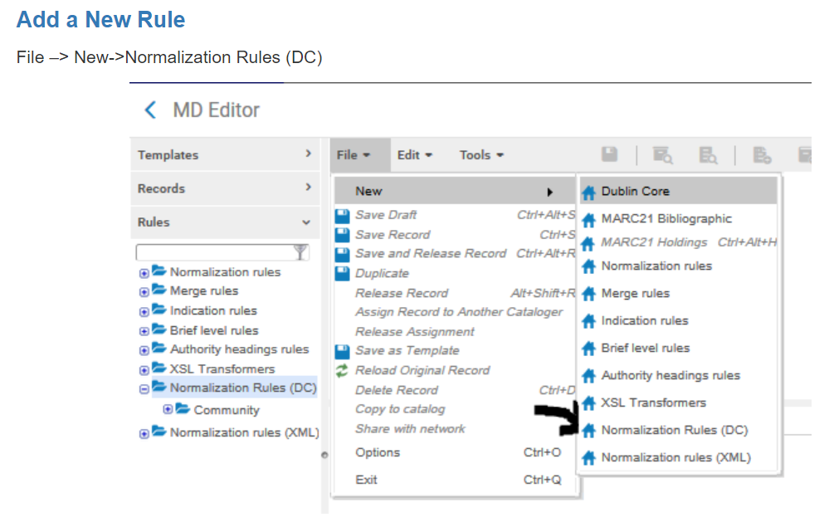
Normalization Rules
Give it a name and a description:
The following is suggested to change the “Other” resource type to “book”
rule "create type"
when
(true)
then
set “Book" in "discovery"."resourceType"
end
Click Save
www.suny.edu

Slide 27
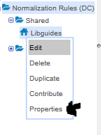
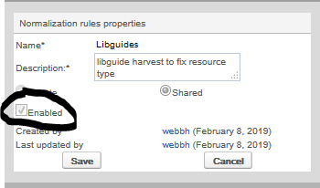
Normalization Rules
Enable your rule by going to rule properties:
www.suny.edu

Slide 28
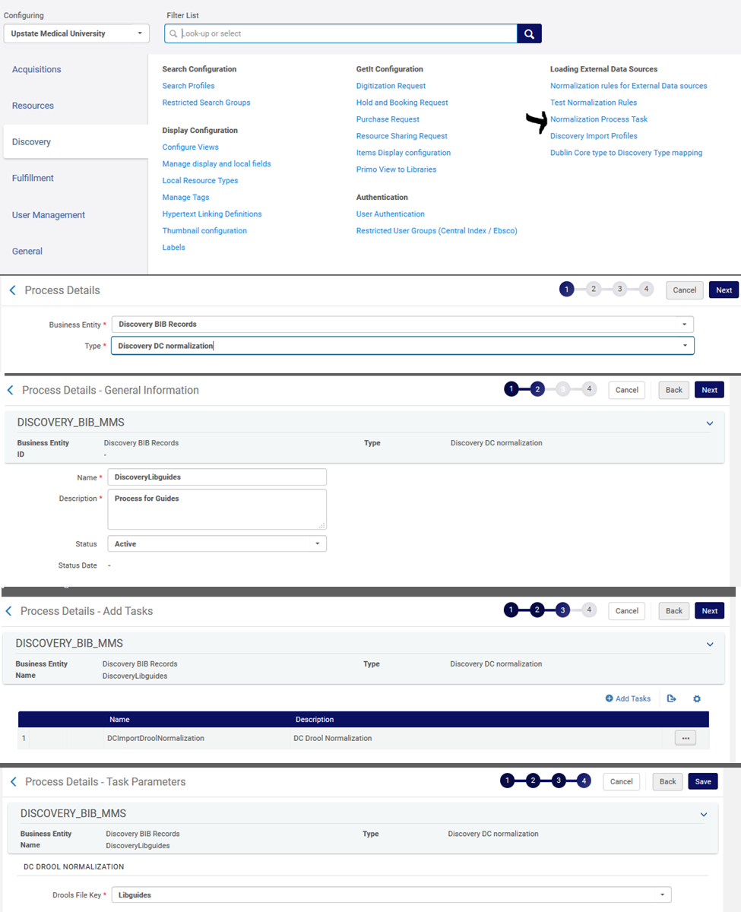
Normalization Process Task
The next step is to set up a Normalization Process Task to work with your Normalization Rule:
www.suny.edu

Slide 29
Normalization Process Task
www.suny.edu

Slide 30
Normalization Process Task
www.suny.edu

Slide 31
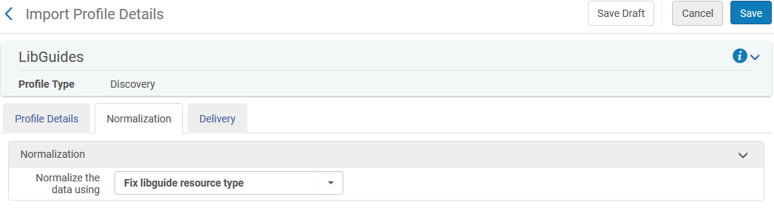
Normalization
Once your task is set up, you can add it to your import profile and rerun your import:
www.suny.edu

Slide 32
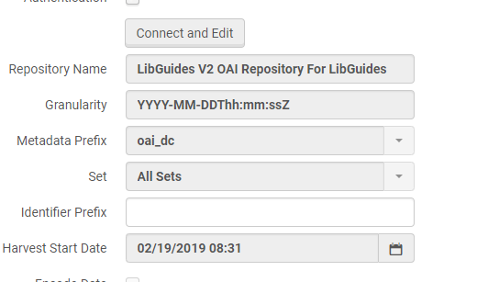
Normalization
If you want to go back and edit/rerun your import profile make sure to reconnect (Connect and Edit button) and update the Harvest Start Date back to the earliest date stamp:
www.suny.edu

Slide 33
Tips and Tricks
You can duplicate import profiles if you want to set up a new one that’s similar to the old one, like a different DSpace collection, just be sure to change status from inactive to active before running.
If your collection will never get any new content, you don’t need to set up a harvest schedule
If the import profile says that it can’t connect, try copying the url, pasting it into Notepad, then copying it and pasting it back into the profile.
If you run into any problems, submit a Salesforce case.
www.suny.edu

Slide 34
Questions?
www.suny.edu

