Slide 1
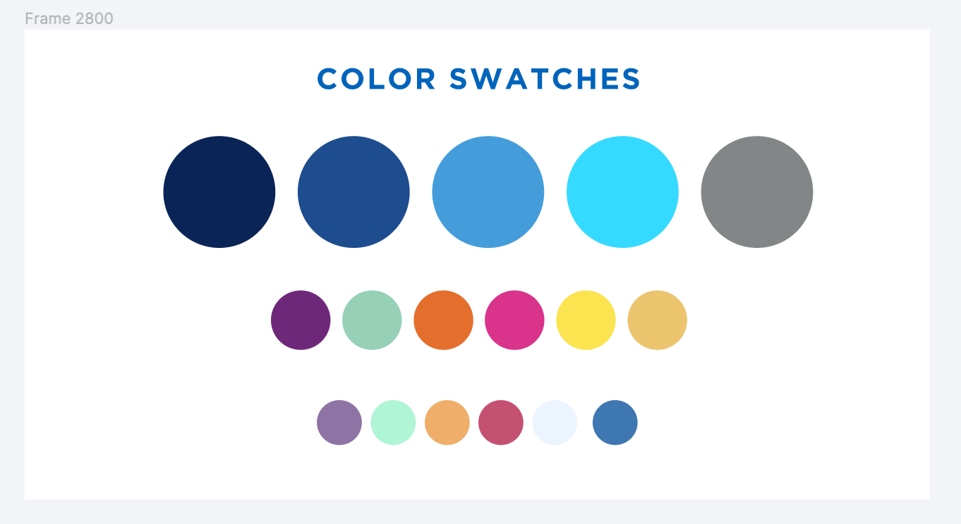
Alma Resource Sharing Analytics
September 25, 2024

Slide 2
Alma Analytics Training
Intro to Alma Analytics session presented by Michelle Eichelberger on September 17
Covers the basics of using Alma Analytics
Recording: https://public.3.basecamp.com/p/fDCS2xcNGzzcF1njQ1qJe94F
Future Analytics training sessions on Physical Collections, Acquisitions, Fulfillment, eResources, and Sharing Reports
Registration information: https://sunyolis.libcal.com/calendar/training
All sessions will be recorded, and recoding links will be posted to Basecamp

Slide 3
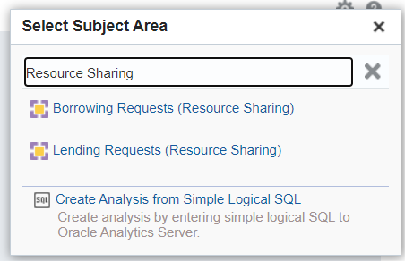
Alma Resource Sharing Analytics
Alma Resource Sharing Analytics divided into two subject areas
Borrowing Requests (Resource Sharing)
Lending Requests (Resource Sharing)
Analytics retains information about resource sharing requests even after requests are deleted from Alma by the Resource Sharing Completed Requests Cleanup job
Analytics does not retain personally identifying user information if you are anonymizing your requests

Slide 4
Alma Resource Sharing Analytics
Analytics considers each partner in a borrowing request’s rota to be a separate request
Always include a “Partner Active Status = Active” filter in your Borrowing Requests reports to avoid requests being counted multiple times
Alma/ILLiad integration will impact your borrowing and lending reports
ILLiad NCIP addons create borrowing and lending requests in Alma
External identifier will be the ILLiad transaction numbers
Can use “External ID begins with 01SUNY” filter to exclude ILLiad requests
Unfilled Alma borrowing requests exported to ILLiad or WorldShare will have an active partner of ILLiad or WorldShare

Slide 5
Alma Resource Sharing Analytics
Will be saving reports created during today’s session to the following shared Analytics folder:
/shared/Community/Reports/Consortia/SUNY/Alma Resource Sharing
Plan to add additional resource sharing reports to shared folder soon
Feel free to submit requests to info@sunyolis.libanswers.org
Shared reports can be copied to your institution’s Analytics folder
Will only return your institution’s data
Please do not make any changes to reports in shared Analytics folders!

Slide 6
Alma Resource Sharing Analytics
Alma Analytics does not provide data in real time
A snapshot of all of your data is taken every night
Data you’re seeing in Analytics is from previous day
Ex Libris documentation
https://knowledge.exlibrisgroup.com/Alma/Product_Documentation/010Alma_Online_Help_(English)/080Analytics/Alma_Analytics_Subject_Areas

