Slide 1
Integrated Behavioral Health (IBH) Quarterly Meeting
Care Transformation Collaborative of Rhode Island
February 9, 2023
7:30 – 9:00 AM

Slide 2
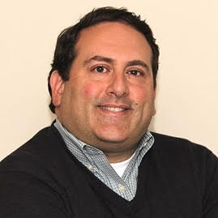
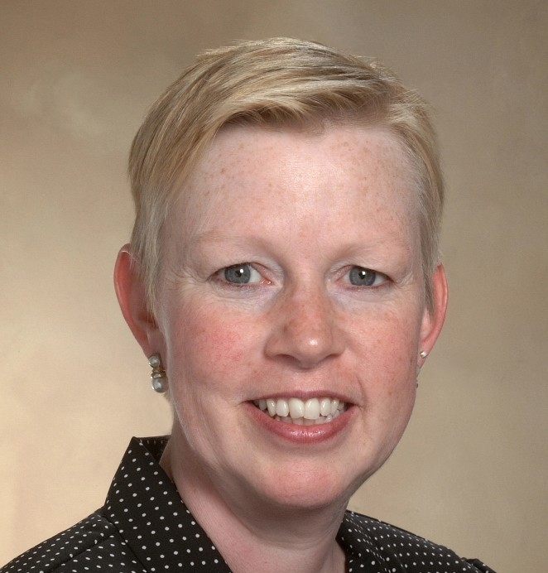
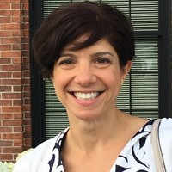
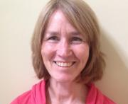
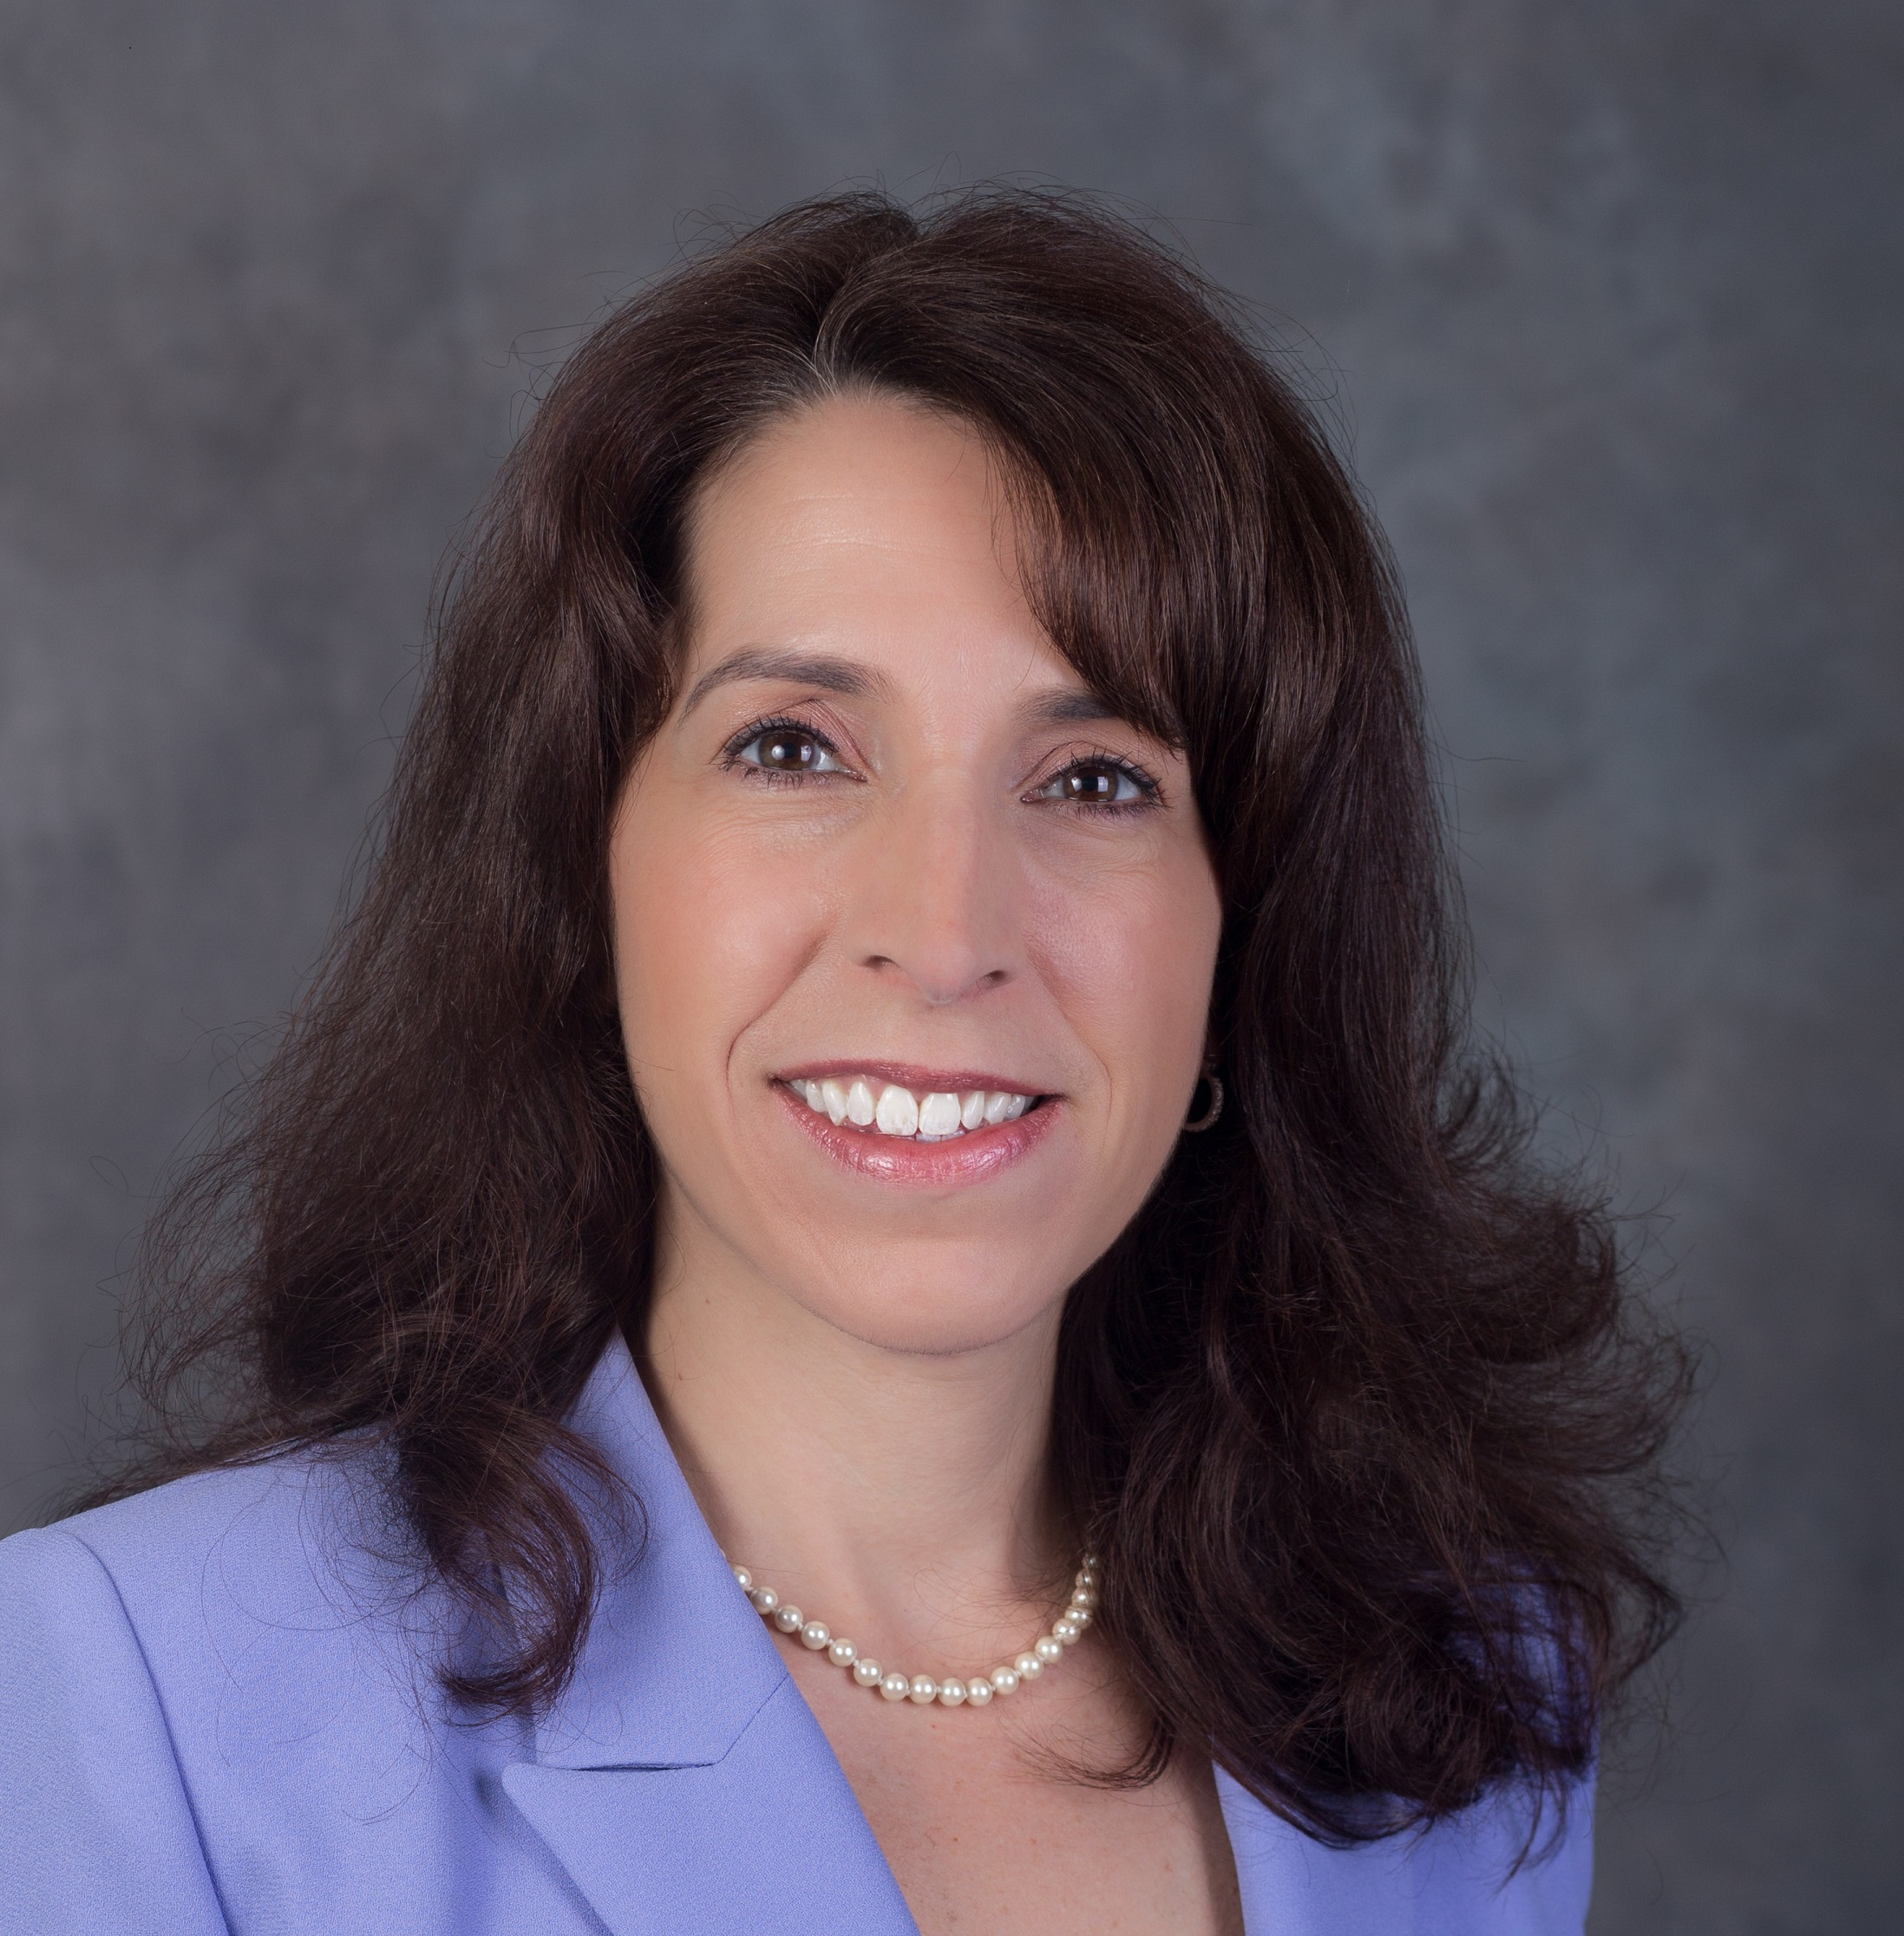
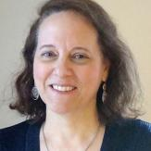
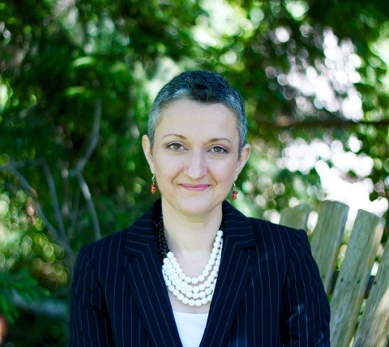
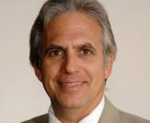
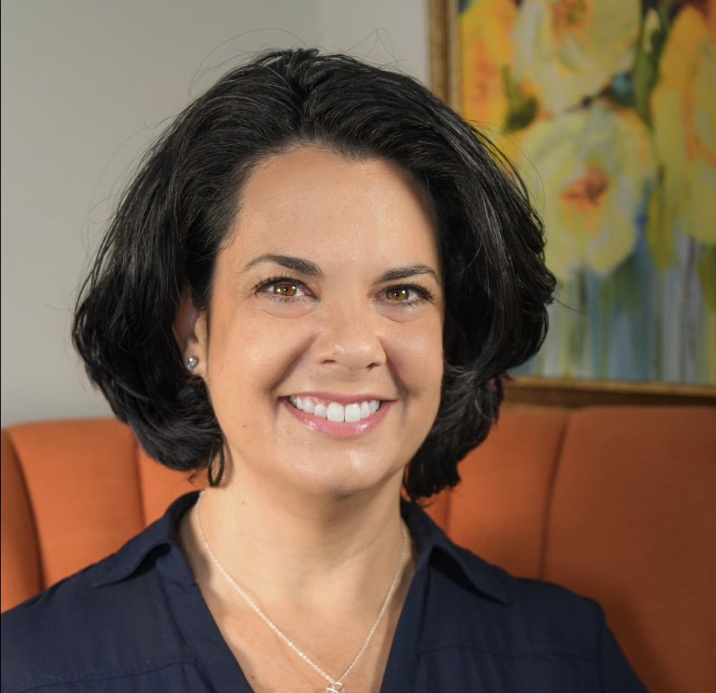
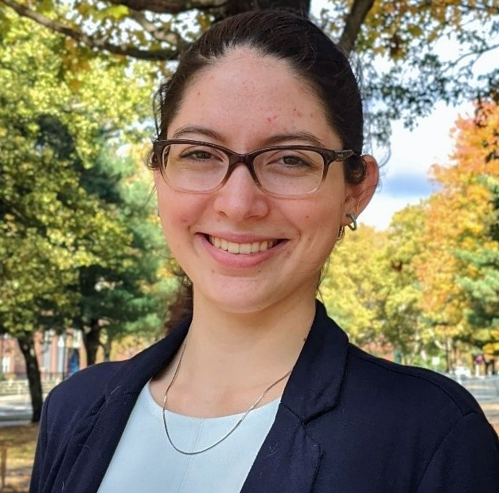
Introductions
John Todaro, PhD
CTC-RI IBH Committee Co-Chair
Clinical Psychologist and Director at Providence Behavioral Health Associates
Patricia Flanagan, MD
Clinical Director
Welcome! Please put your name and organization into the chat
Rena Sheehan, MBA, LICSW
CTC-RI IBH Committee Co-Chair
Managing Director Clinical Integration at Blue Cross Blue Shield
Susanne Campbell, RN, MS, PCMH CCE
Senior Program Administrator
Debra Hurwitz, MBA, BSN, RN
Executive Director
Linda Cabral, MHA
Senior Program Manager
Nelly Burdette, PsyD
Senior Program Director, IBH
Liz Cantor, PhD
Practice Facilitator
Pano Yeracaris, MD, MPH
Chief Clinical Strategist
Kristin David, PsyD
Practice Facilitator
Edyth Dwyer, MPA, MPH
Program Coordinator
Notes:
Add liz and kristin

Slide 3
Today’s Main Goals & Agenda
Objectives:
Share CTC’s IBH-related projects coming in 2023
Solicit feedback from the committee regarding one of these projects - Incentivizing Community BH Providers to enter into IBH arrangements
Agenda:
7:30-7:35– Welcome
2. 7:35-8:00– New 2023 IBH projects
3. 8:00-8:50 - Brainstorming
4. 8:50-9:00—Thank you & Brief Announcements

Slide 4
New 2023 IBH Projects
Thank you to our project sponsors
IBH Clinician Training – Workforce Development
2. Expanding IBH Capacity in Pediatrics
3. Reimagining High-Functioning Team-Based Primary Care
4. Developmental Understanding and Legal Collaboration for Everyone (DULCE)
5. Restrictive Eating Disorders in Children
6. Incentivizing Community BH Providers to enter into IBH arrangements
Notes:
[put in order of launch

Slide 5
IBH Clinician Training – Workforce Development
Project Goal: Provide behavioral health providers with the skills they need to effectively work in IBH
Brief Description: Offers free enrollment for up to 18 BH clinicians in the UMass Center for Integrated Primary Care training, as well as stipends for completing the training and incentives for primary care employers to send their staff. 36 CEUs are available. Will also explore a similar UMichigan training, which has a pediatric focus. 1 hour of IBH consultation available to all who complete the course.
Current opportunity can be found here – applications due 2/13
Key Staff: Kristin Davis and Liz Cantor
Timeline:
Call for Applications: Feb and August 2023
Class Start: March and October 2023

Slide 6
Expanding IBH Capacity in Pediatrics
Project Goal: Expand the capacity of pediatric practices to deliver IBH services by utilizing CHWs/BSWs
Brief Description: Support 4-7 pediatric practices (with or without an IBH clinician) in a 12-month learning collaborative that will offer cross-staff training to maximize the delivery in IBH services within the practice. Practices will receive financial support for a CHW/BSW position (approximately $45K per practice) and monthly practice facilitation.
Key Staff: Linda Cabral and Liz Cantor
Timeline:
Project Planning: January – March 2023
Call for Applications: March 2023
Implementation: May 2023 – April 2024
Notes:
Linda present

Slide 7
Reimagining High-Functioning Team-Based Primary Care
Project Goal: Promote a high functioning team-based care framework to be implemented in a manner that not only takes account for how COVID has impacted healthcare team functioning, but also fosters healthcare worker connectedness and teamwork.
Brief Description: Provide funding for up to 10 practices to participate in a 12-month learning collaborative that supports high-functioning teams inclusive of all healthcare worker categories: support staff/operations, nursing/pharmacy, and providers. Will include three 90-minute training sessions and monthly practice facilitation.
Key Staff: Nelly Burdette and Kristin Davis
Timeline:
Project Planning: February – April 2023
Call for Applications: April 2023
Implementation: June 2023-May 2024
Notes:
Nelly and Kristin

Slide 8
Developmental Understanding and Legal Collaboration for Everyone (DULCE)
Project Goal: Pilot the DULCE approach in additional pediatric practices to implement strengths-based screening for health-related social needs (HRSN) as well as more effective referral and response through the efforts of a Family Specialist and the broader DULCE interdisciplinary team (a medical provider, a mental health representative, a legal partner, an early childhood lead and a project lead).
Brief Description: This project will offer infrastructure payments to practices to hire and/or integrate a Family Specialist into the practice. Additional support is provided to connect Medical Legal partnership and an Early Childhood Lead to help practices support families. An existing core planning team will plan the training and program incentives to be offered.
Key Staff: Susanne Campbell, Kim Nguyen-Leite, Liz Cantor
Timeline:
Project Planning: 2023
Call for Applications: 2023
Implementation: 2023
Notes:
Susanne and Kim

Slide 9
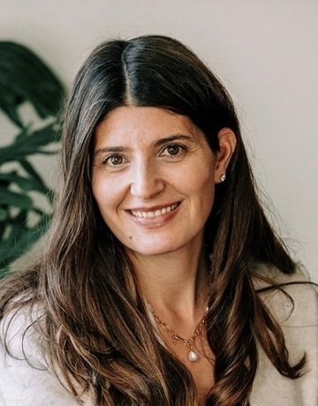
Restrictive Eating Disorders in Children
Project Goal: Provide evidence-based eating disorder treatment training and support to IBH clinicians who can intervene with at-risk patients in the pediatric office.
Brief Description: Using an interactive online case-based ECHO® learning series to connect eating disorder experts with the pediatric community via didactic presentations, case reviews, and ongoing supervision. Up to 5 pediatric practices would participate in this quality improvement initiative that would also include regular practice facilitation.
Key Staff: Christina Tortolani and Liz Cantor
Timeline:
Project Planning: May-June 2023
Call for Applications: July 2023
Implementation: September 2023-August 2024
Introducing
Christina Tortolani, PhD
Associate Professor
Rhode Island College
Notes:
Liz

Slide 10
Incentivizing Community BH Providers to Enter into IBH Arrangements
Project Goal: Develop and pilot a payment and program model for incentivizing BH clinicians not currently working in IBH to connect with primary care (pediatric/family medicine focus)
Brief Description: This project will offer incentives to engage and sustain community BH providers in pediatric/family medicine practices. A core planning team will develop the training and program incentives to be offered. This project will include facilitation/training by IBH practice facilitators to individual clinicians during the ramp up and then to organizations once clinicians are placed.
Key Staff: Nelly Burdette, Kristin Davis, Liz Cantor
Timeline:
Project Planning: January – April 2023
Call for Applications: May 2023
Implementation: June 2023-May 2024
Notes:
Nelly

Slide 11
Announcement:
New Affordability Standards for RI
https://ohic.ri.gov/regulations-and-enforcement-actions/regulations
Notes:
This link allows you to download : https://rules.sos.ri.gov/Promulgations/part/230-20-30-4

Slide 12
Jamboard Exercise:
Incentivizing Community BH Providers to Enter into IBH Arrangements
https://jamboard.google.com/d/1qDnjRe6mSvBJGKol7LzsjcFnY05hLWDM1VkHBaGGlDU/viewer?f=0
Notes:
Work life

Slide 13
Next IBH Quarterly Meeting
May 11, 2023, 7:30-9

