Slide 1
Virtual Office Hours: Provider Enrollment Hot Topics & Reminders
March 8, 2023
Susan Sartain, Provider Relations Representative
Michael Herrera, Provider Relations Supervisor
Serja Goram, Provider Relations Representative
RCC (Relay Conference Captioning)
Participants can access real-time captioning for this webinar here:
https://www.captionedtext.com/client/event.aspx?EventID=5367066&CustomerID=290
Notes:
Chris

Slide 2
AGENDA
01
NC Medicaid Provider Ombudsman
02
Federal PHE Ending May 11, 2023
03
Provider Reverification to be Reinstated at End of PHE
P
04
Provider Reverification – Voluntary Program
Enhanced Security for OA & EFT Change Requests
05
PDM/CVO Journey to Modernization
06
Provider Reverification/Recredentialing
NC Health Choice is Moving to Medicaid
07
Healthy Opportunities Pilots Update

Slide 3
NC Medicaid Provider Ombudsman
Medicaid.ProviderOmbudsman@dhhs.nc.gov
1-866-304-7062
Created for Provider inquiries, concerns, and complaints regarding Medicaid Managed Care. Also responsive to Medicaid Direct concerns.

Slide 4
Common Inquiries Submitted to the Provider Ombudsman
Enrollment
Contracting
Administrative
Claims
Oversight

Slide 5
Federal Public Health Emergency Ending May 11, 2023
EXECUTIVE OFFICE OF THE PRESIDENT
OFFICE OF MANAGEMENT AND BUDGET
WASHINGTON, D.C. 20503
The Federal Public Health Emergency (PHE) is expected to end on May 11, 2023, according to the Statement of Administrative Policy from the Executive Office of the President, published Jan 30, 2023.

Slide 6
Provider Reverification Requirements to be Reinstated at End of PHE
In March 2020, Centers for Medicare and Medicaid Services (CMS) paused provider reverification due to the PHE.
Once the PHE ends on May 11, 2023, reverification is not optional. Providers who receive a notice of reverification are encouraged to promptly respond. Providers who do not complete the process within the designated timeframe will receive a Notice of Suspension in the mail and in their NCTracks Message Center Inbox. The notice informs the provider that they are in suspended status, which will cause all NC Medicaid Direct and NC Medicaid Managed Care claims to pend.
For help with the reverification process, providers can refer to the Provider Re-credentialing/Re-verification webpage in the NCTracks public facing webpage.

Slide 7
Provider Reverification – Voluntary Program
Another option for reverification currently available is the voluntary reverification program, which ends on March 31.
Voluntary reverification:
Allows providers to complete reverification before it becomes a
requirement after May 11.
Providers can take advantage of the $100 NC Application Fee
waiver (expires June 30).
While this is a voluntary program and allows you to get ahead of the reverification process, reverification will be required at the end of the PHE.
No adverse action for not submitting reverification application during voluntary period. However, if the reverification application is submitted, any requested credentialing activities must be completed.
For more information, click here

Slide 8
Federal Enrollment Application Fee Increase for Year 2023
The federal fee for Medicaid enrollment has increased from $631 for calendar year (CY) 2022 to $688 for CY 2023.
You can find a record of federal fees and NC Enrollment fees by year in NCTracks on the Provider Enrollment page. That link is also available in the Access Links slide at the end of this presentation.
The federal fee is required for:
Initial enrollment applications
Re-enrollment applications
Manage change requests (MCR) to add a new site location
Re-verification applications
For more information, click here

Slide 9
Check Your NCTracks Record Regularly
Participating providers are contractually obligated to maintain and update their NCTracks record, which serves as the “source of truth” for managed care entities, within 30 days of any change.
Providers are also encouraged to use the NC Health Choice Provider and Health Plan Lookup Tool to confirm the availability and accuracy of information contained in their NCTracks provider enrollment record.
Outdated information on a provider’s NCTracks record may cause disruption or delays in claims processing.
Providers may correct erroneous demographic and affiliation data on their enrollment record in the secure NCTracks Provider Portal using the NCTracks Managed Change Request (MCR) process.
For more information, please reference NCDHHS Bulletin “Keep NCTracks Records Current to Avoid Claims Processing Issues”

Slide 10
Office Administrator (OA) Change Tips: How to Answer the Continued Access Question in an OA Change Request
When completing an OA change request, users will see the question “Do you want the existing user to continue to have access to this NPI?” with answer choices of “yes” or “no.”
This answer determines future access for NPIs previously associated with the OA.
Selecting “yes” means all other users (previously associated with the NPI) will remain associated with the NPI.
Selecting “no” means most other users will NOT remain associated with the NPI. Regardless of answering “yes” or “”no,” all existing owners and managing relationship (MR) users will remain associated with the NPI.
More information on the OA change process and common questions can be found on the updated FAQ page.

Slide 11
Medicare-only Lite Enrollment Application
A new Medicare-only Lite enrollment has been added in NCTracks to align with CMS requirements.
This update allows Medicare-enrolled providers to complete a simplified enrollment that will allow them to access a remittance advice (RA) for the Medicare crossover claim. It facilitates a provider’s ability to receive a Medicaid RA and claim Medicare bad debt.
No taxonomy, application fee, training, or fingerprinting is required for this application under NC Medicaid.
Enrollment lasts one year, and providers must re-enroll annually.

Slide 12
Recent Changes to Managing Employee and Owner Attestation on NCTracks Applications
Currently, NCTracks compares the managing employees listed on an organization’s initial enrollment application against the managing employees listed in the Medicare Provider Enrollment, Chain and Ownership System (PECOS). If managing employees listed on the application do not match those listed in PECOS, the application is denied.
As of February 26, 2023, NCTracks no longer compares the managing employees listed on initial enrollment applications to the managing employees listed in PECOS, and applications will no longer be denied due to managing employees not matching those listed in PECOS.
Note – This change does not impact Owners. Owners listed on the organization initial enrollment application will still require matching against the Owner listed in PECOS to avoid application denial.

Slide 13
PDM/CVO – Coming Early 2024
Session Law 2017-57 authorized the replacement of current Medicaid Management Information System.
Provider enrollment, credentialing, and data management components of NCTracks will transition to a new Provider Data Management/Credentialing Verification Organization (PDM/CVO) solution.
The new PDM/CVO solution will:
Improve the user experience
Reduce provider administrative burden
Streamline data intake and maintenance throughout provider lifecycle
Align CMS requirements to NCDHHS provider enrollment and credentialing processes
To schedule a presentation for five or more providers, contact Michael Herrera at 919-219-3445 or Michael.Herrera@dhhs.nc.gov
For more info: Visit Medicaid.ncdhhs.gov/pdm-cvo

Slide 14
NC Health Choice is Moving to Medicaid
On April 1, 2023, beneficiaries currently receiving NC Health Choice coverage will move to NC Medicaid.
For more information, visit the NC Health Choice webpage at medicaid.ncdhhs.gov/nc-health-choice-move-medicaid.

Slide 15
Tailored Plan Updates
Tailored Plan Launch has been delayed to 10/1/2023.
For more information, please join the Fireside Chat presentation on March 16, presented by Dr. Shannon Dowler.
To register for the webinar series, click here

Slide 16
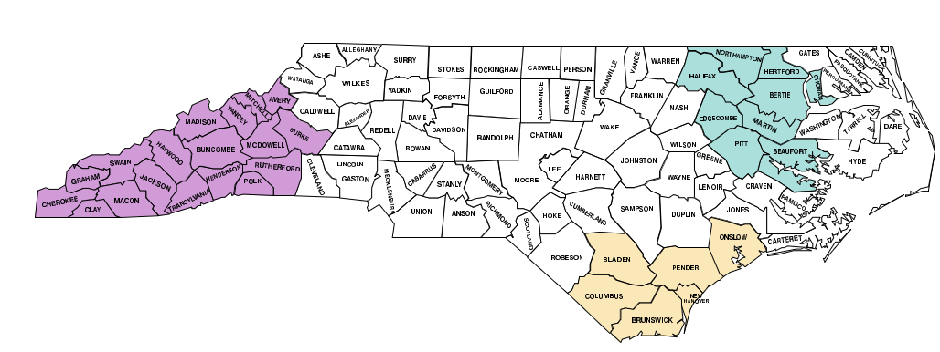
Healthy Opportunities Pilots Update
The Healthy Opportunities Pilot has delivered nearly 30,000 non-medical services to over 3,200 enrollees since March 2022.
Who’s involved?
DHHS, PHPs, CMs, NLs, HSOs, NCCARE360, and you!
Service Domains
Food (Ex. Food/Nutrition Case Management, Healthy Food Boxes/Meals)
Housing (Ex. Housing Navigation, Home Remediation Services, Move-In Support)
Transportation (Ex. Reimbursement for Health-Related Private Transportation)
Toxic Stress (Ex. Evidence-Based Parenting Curriculum and Home Visiting)
Cross-Domain (Ex. Medical Respite)
Eligibility Criteria
Enrolled in Medicaid Managed Care
Live in a Pilot Region
Have at least one qualifying physical/behavioral condition and one qualifying social risk factor
Note: There are no age restrictions for eligibility!
Remember: A whole family can access HOP services through one Medicaid member!
Network Lead: Access East, Inc
Network Lead: Impact Health
Network Lead: Community Care of the Lower Cape Fear
No Wrong Door referral pathway in NCCARE360: Create a "Benefits Eligibility Screening” referral in NCCARE360 to refer a member you think may be eligible for HOP to their health plan. The health plan will assess the member's eligibility and enroll them in HOP, if eligible.
Source: UniteUs Insights Dashboard, Payments Activity Overview, Data as of Jan. 31, 2023. For Additional Information Visit: Healthy Opportunities Pilots | NCDHHS.
​

Slide 17
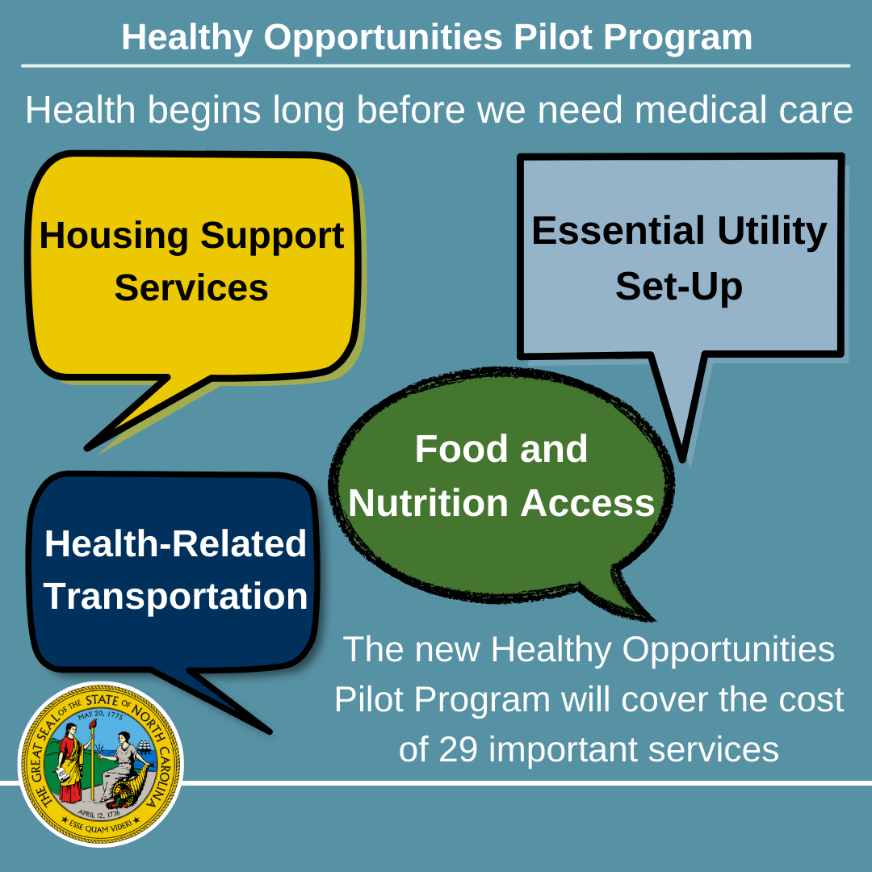
Healthy Opportunities Pilots Update - Continued
Upcoming Engagements
Community Partners Webinar – TBD (March)
How Providers can refer Medicaid Members
Providers play an essential role in helping to identify Medicaid members that can benefit from Pilot services—including identifying physical or behavioral health conditions that may qualify someone for the Pilots. A provider may contact a member's PHP to request the member be assessed for Pilot services. For members without a care manager, providers can help patients call the Member Services line on their health plan Member ID card (see Health Plans’ Member Services numbers below). For more information, please visit the Healthy Opportunities Pilots webpage or the Healthy Opportunities Frequently Asked Questions.
Contact
For more information, call the NC Medicaid Contact Center: 888-245-0179
Health Plans’ Member Services Numbers:
AmeriHealth Caritas: 855-375-8811 (TTY 1-866-209-6421)
Carolina Complete Health: 833-552-3876
Healthy Blue: 844-594-5070 (TTY 711)
United Healthcare: 800-349-1855
WellCare: 866-799-5318
Where to learn more
Visit Healthy Opportunities Pilots at Work webpage for key Pilot metrics and success stories
Like our posts on the DHHS Facebook, Twitter, and Instagram accounts!

Slide 18
Access Links
Provider Ombudsman: Medicaid.ProviderOmbudsman@dhhs.nc.gov 866-304-7062
Provider Reverification webpage: Reverification
Voluntary reverification information: Voluntary Reverification
Provider enrollment: Provider Enrollment
Office Administrator, FAQs: FAQ page
PDM/CVO: NC Medicaid PDM/CVO webpage
Michael Herrera: 919-219-3445 or Michael.Herrera@dhhs.nc.gov
NC Health Choice moves to Medicaid: NC Health Choice
Healthy Opportunities Pilot program: Healthy Opportunities Website Healthy Opportunities FAQ
Fireside Chat - March 16, 2023: Fireside Chat

