Slide 1
Primo Web Configuration Tips & Tricks
September 30, 2021
Michelle Eichelberger
www.suny.edu

Slide 2
Plan for Today
Focus on design choices, not setting up scopes or other Primo VE customization
Anatomy of the Primo web pages
Editing labels
Editing configuration package
Primo Studio
Accessibility checking
www.suny.edu

Slide 3
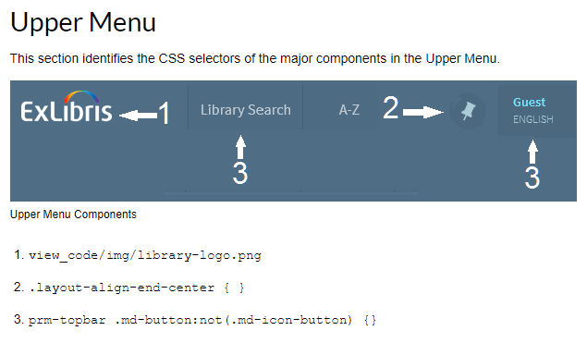
Primo Web Design
Can edit most areas of the pages through either labels or customization package
Ex Libris Primo VE Customization Best Practices
Good overview of ways to edit labels/customization package
Provides underlying code for many components of the pages
www.suny.edu

Slide 4
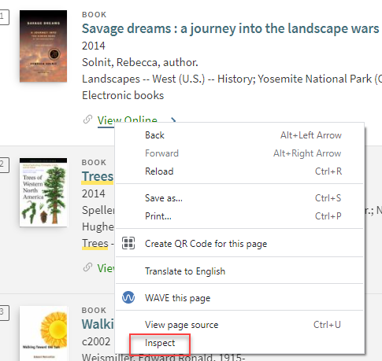
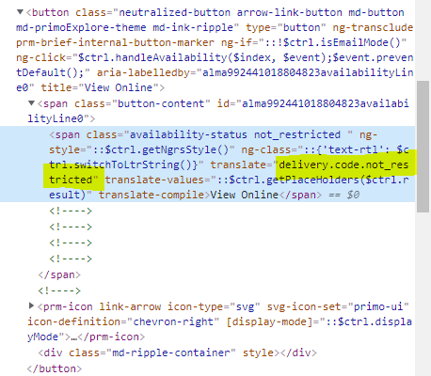
Identifying Source of Content: Labels
Is it a label or part of the customization package css?
Inspect page code: in Chrome, right click on element you want to check, choose Inspect
Translate= gives us the label name
www.suny.edu

Slide 5
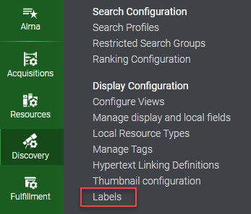
Editing Labels
Config->Discovery->Display Configuration->Labels
Can search by label name or description
www.suny.edu

Slide 6
Editing Labels, cont.
Click three dots to edit table, search page for code
Can change wording in tables and add basic html style code like <span style=“color:#ff0000;”>View Online</span>
If you have multiple Views, changes will be applied to all views
www.suny.edu

Slide 7
Identifying Source of Style: CSS
Is it a label or part of the customization package css?
Inspect page code: may have to play around to figure out where code lives
Can have different code for different views
Test thoroughly: changing one link’s code may change all links
www.suny.edu

Slide 8
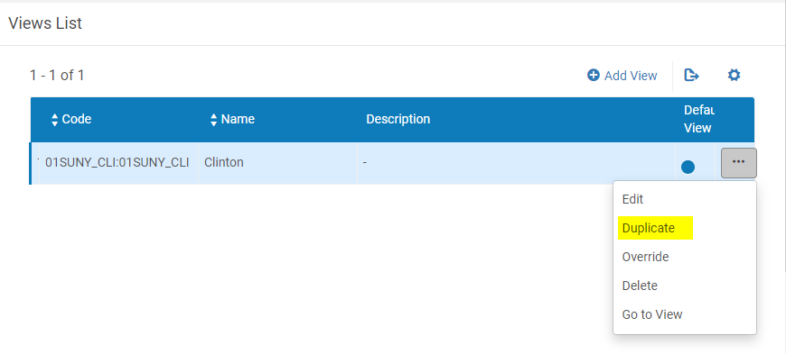
Editing Configuration Package
How do I make changes to Primo VE using the Configuration Package?
Best practices:
Set up a test site by creating a duplicate view
Download original config package and rename to duplicate view name
Make sure that you zip the package at the correct level – will download with extra top level folder
Make sure there are no thumbnail files created
www.suny.edu

Slide 9
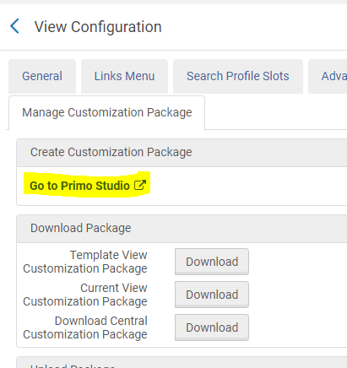
Primo Studio?
Supposed to be able to load current package and edit that, haven’t had much luck
Submit a Salesforce case if you want to use it (and copy me)
www.suny.edu

Slide 10
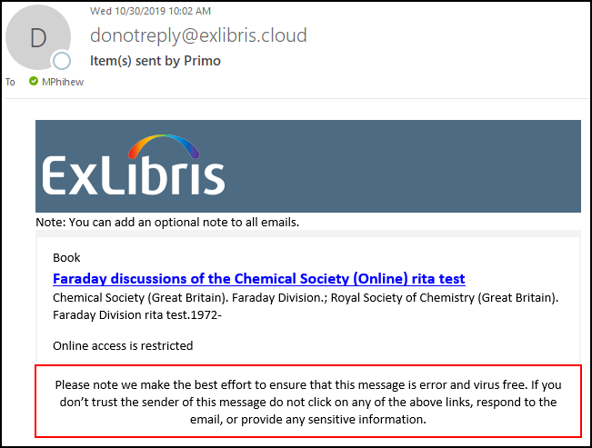
Email Template
Notes:
The email template supports a maximum of 50 records. If a user sends more than 50 records, the system reverts to the classic email template, which was used in previous releases.
For security reasons, all links are removed from your email template.
Send a test to yourself to see how it works
Ex Libris Documentation
Change the default email template sent from Primo VE on the Manage Configuration Package page.
Template is in HTML format and includes:
Logo – Displays the logo from your view's customization package.
Institution note – Displays the text configured with the following code in the Send Email and SMS code table: nui.email.institutionNote. By default, this field has no value and does not display if left empty.
List of records – For each record, the email displays the record's brief display and availability statement.
Disclaimer – Displays the text configured with the following code in the Send Email and SMS code table: nui.email.disclaimer.
www.suny.edu

Slide 11
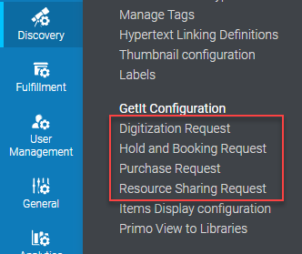
Request Forms
Ex Libris documentation on configuring request forms
Config->Discovery->Getit Configuration
Allows you to choose which fields display, which are mandatory
Use labels to modify field wording and style
www.suny.edu

Slide 12
Resource Sharing Request Form
Best Practices:
Hide the Format field. “Format” in Delivery fields. Also make sure there's no default set. Some users have been manually switching physical requests to digital requests thinking that will allow them to get electronic copies of entire books (it won't).
Hide Specific Chapter or Pages options. “Specific Chapter or Pages” in Resource Sharing Request Fields. This field adds a check box to the form that users can check if they need just a chapter of a book. If they click it, additional fields appear and the requested format switches from Physical to Digital. Tim does want to implement that for anyone interested by the end of this semester, but that will need to happen within the context of a system-wide project.
Hide Need by Dates. “Not Need After” in Delivery fields. Users are providing unrealistic need by dates when they're submitting requests, which can cause the request to be completed automatically. The only way to prevent this from happening is to remove the needed by field from your request forms.
www.suny.edu

Slide 13
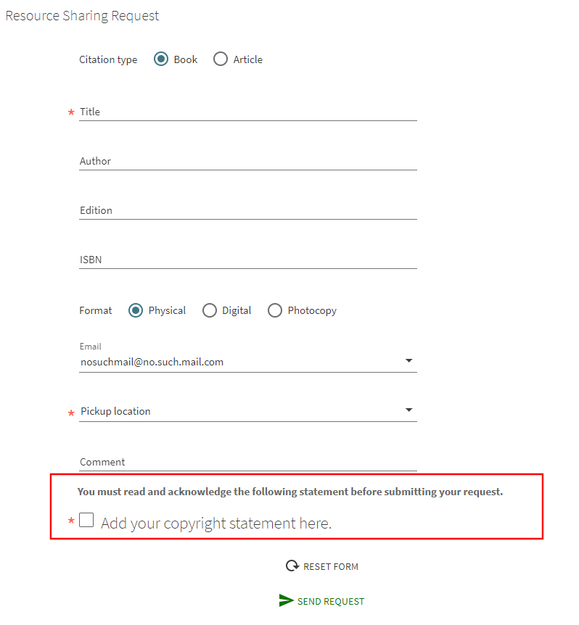
Request Forms: Add Copyright
August 2021 Primo VE Release: can now add copyright statement to request forms
Configure:
Copyright Configuration Files page (Configuration Menu > Fulfillment > Copyright Management > Copyright Declaration) – Configure resourceSharingCopyrights and DigitizationRequestCopyrightDeclaration.html
Enable Copyright field on forms
Check associated labels to make sure they say what you’d like: almaDigitization.copyright.sub_title, almaResourceSharing.copyright.sub_title, and nui.mandatory.copyright
www.suny.edu

Slide 14
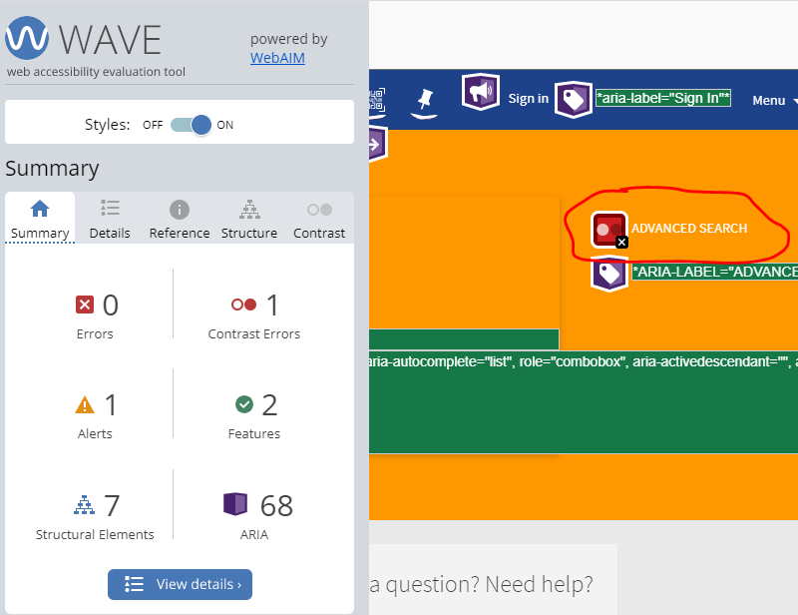
Accessibility
Anything you modify in your Primo VE webpages introduces opportunity to break accessibility.
Default Primo VE accessibility is fairly good: Ex Libris hired Deque to review product and they’ve been making improvements in response to the report.
How to test:
WAVE
Keyboard testing: open the site and tab through it, making sure that you can access everything via the keyboard
Screenreader testing: NVDA, Apple VoiceOver, etc.
www.suny.edu

Slide 15
Demo & Questions?
www.suny.edu

