Slide 1
Dealing with Missing or Poor Quality CZ Records
April 22, 2021
Michelle Eichelberger & Maggie McGee
www.suny.edu

Slide 2
Plan for Today
Review How do I deal with poor bibliographic records in the CZ? FAQ​
Discuss current CZ update issues
Investigate pros and cons of importing and managing your own records
www.suny.edu

Slide 3
Identifying the Problem
Community Zone records are primarily added by vendors, through an ingestion process, and the currency and accuracy of the records are dependent on the vendor load.
Benefits of using a CZ record:
You don't have to create the record through an import profile or portfolio loader – can choose it from a list
You don't have to maintain the record yourself, including keeping the linking up to date
Helps us track SUNY holdings in the NZ, which may become more important as we pursue eBook lending and other shared services
Drawbacks:
Because CZ records are dependent on the vendor load, there may be a lag and you might purchase something that hasn't been added yet.
You might not like the vendor record – it may be too brief, or inaccurate
www.suny.edu

Slide 4
Option 1: Live with it
If a poor record exists:
Accept the poor record with the knowledge that it will probably be enhanced by the vendor (or another Alma user) eventually
Pros: requires no extra work on your part, don't need to maintain the record or link it to the CZ in the future, students may not notice that the record is bad
Cons: if it's REALLY bad, it may not be findable in Primo because of missing subtitles, missing identifiers, etc.
If no record exists:
Give it some time and wait for the record to appear
www.suny.edu

Slide 5
Option 2: Ask Ex Libris to do something about it
You are welcome to report the poor record to data services to see if it can be enhanced, or ask them to contact the vendor for a record for the title.
This is most effective if it's a group of records that are missing or bad. However, it can take a long time for your request to be resolved.
www.suny.edu

Slide 6
Option 3: Activate CZ record but relink to a better bib
The benefit of this approach is that you get the linking from the correct portfolio in the collection in the CZ, but you get a better bib record. Make sure to link to another CZ record, not an NZ record.
Remember that portfolios and bib records are different (Maggie will talk more about this)
www.suny.edu

Slide 7
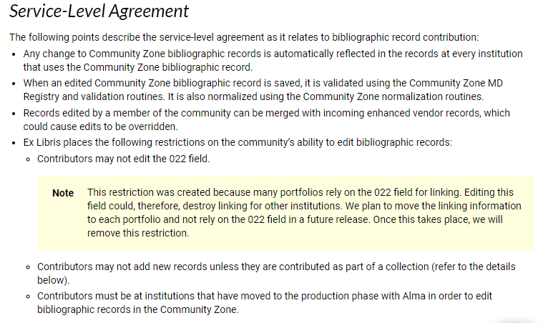
Option 4: Edit the CZ record
Ex Libris Documentation
Should be able to edit anything in the CZ record except the 022, which is the primary match point.
Would add content for anyone using that record (might take a couple weeks to roll out via CZ Updates job).
Ask SLS to force NZ update, which is needed because Primo indexes on NZ record.
www.suny.edu

Slide 8
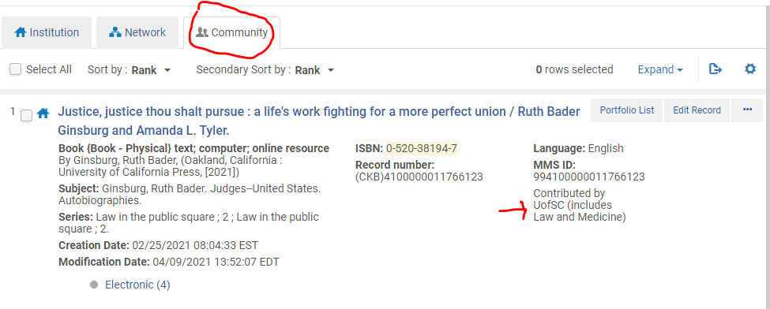
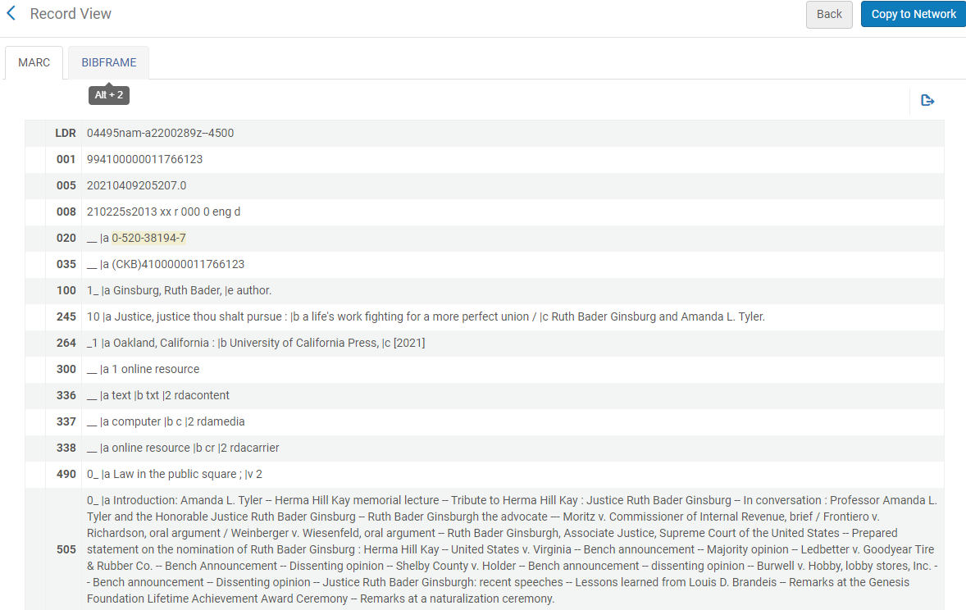
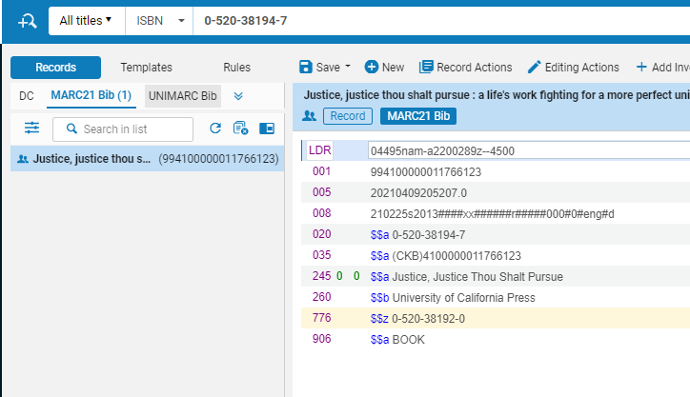
Option 4: Edit the CZ record – Alert!
Editing the CZ is useful, especially if you need to add a 776 field for the EISSN for a portfolio – CDI record may have it but CZ record might not, causing your links to not show.
We were just starting to get comfortable doing this, when it stopped working.
Changes look like they're being applied, and may be applied locally, but aren't modifying the underlying MARC, so won't push out globally. Ticket 00943731.
www.suny.edu

Slide 9
Portfolio vs. Bibliographic Record
A portfolio contains the specific coverage, services, and link information relevant for a particular electronic title:
Portfolio information is found in the full record display in Primo VE under "Availability:"
Electronic Collection Name
Coverage
Linking information
A portfolio is not discoverable without a bib record
A Bibliographic (bib) record contains the descriptive metadata about the item:
Portfolios are created when ordering using an e-resource PO Line type
Primo VE uses the bibliographic record to make the portfolio discoverable
A bib record is discoverable without a portfolio
www.suny.edu

Slide 10
Electronic Title vs. Electronic Portfolio Search
Performing an "Electronic title" repository search in Alma:
Displays the bib record being used for the portfolio
Icon will identify if a local bib or a CZ bib record's descriptive data is being used
Performing an "Electronic portfolio" repository search in Alma:
Displays the portfolio, which provides information related to the portfolio such as the electronic collection, linking, coverage, etc.
Icon will identify if the portfolio is local or linked to the community zone
www.suny.edu

Slide 11
Using a Local Record vs. A Community Zone Record
Local Bib Record:
Local (IZ only) bib records can be used to create portfolios in Alma
Local bib record will have a house icon
Locally created portfolios can be part of a:
Local collection
Linked to a CZ collection later
Example; Portfolios created by New Order APIs
User is responsible for maintaining descriptive metadata
Local portfolios in a local collection will have a house icon
Local portfolios linked to the CZ collection will have a community icon
Community Zone Bib Record:
CZ bib records are used to create portfolios in Alma
CZ portfolios are part of a Community Zone electronic collection
Linking information and descriptive metadata is maintained by the CZ
CZ linked portfolios will have a community icon
www.suny.edu

Slide 12
Using a CZ Bib Record to Create a CZ Linked Portfolio
Using Community Zone bib records to create CZ linked portfolios:
PO Line creates the portfolio
Link is created between the Institution Zone (IZ) portfolio and the CZ portfolio
A Network Zone (NZ) bib record is created and linked to the CZ
Held by institution is added to the NZ bib record
Primo VE uses the NZ bib record for discovery once the portfolio is activated in the IZ
No additional work required by the user
www.suny.edu

Slide 13
Using a Local Bib Record to Create Portfolio
Using a local bib record to create a Portfolio:
Create an electronic bib record in the IZ:
Import Profile
New Order API
OCLC
Using "Add Local Portfolio" to create a brief bib record
Create the portfolio:
PO Line
Add Local Portfolio
Can link the portfolio to an electronic collection (local or CZ)
Electronic bib record and portfolio are both local
Local portfolios can:
Remain local in a local electronic collection
Be linked to a Community Zone electronic collection using "Link to Community"
www.suny.edu

Slide 14
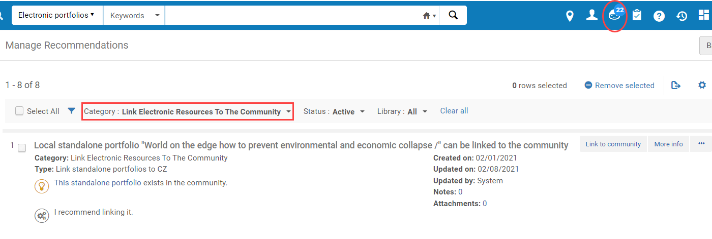
"Link to Community"
"Link to Community" is only available for local (IZ only) portfolios
"Link to Community" can be used to link a local portfolio to a CZ portfolio using:
The Community Zone's descriptive metadata
The local bib record's descriptive metadata
DARA may recommend users link local portfolios to the CZ using "Link to Community"
www.suny.edu

Slide 15
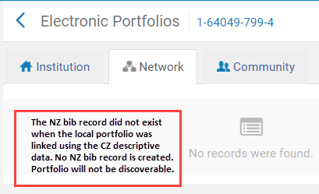
"Link to Community" Using the CZ Descriptive Data
"Link to Community" using the CZ descriptive metadata creates a:
Link between the Institution Zone (IZ) portfolio and the CZ portfolio
Portfolio and bib record will have a community zone icon
Link to the Network Zone (NZ):
Created when the NZ bib records linked to the CZ already exists in the Network Zone and the institution is added to the held by institution
Portfolio will be discoverable in Primo VE
Is not created if there is no existing NZ bib records in the Network zone,
The bib record is not created and the held by institution is not linked
Portfolio will not be discoverable in Primo VE
www.suny.edu

Slide 16
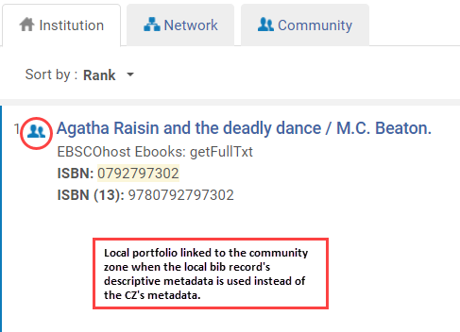
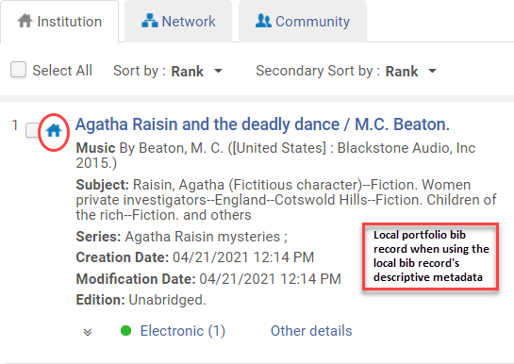
"Link to Community" Using the Local Descriptive Metadata
"Link to Community" using the local bib record's descriptive data:
Link is created between the Institution Zone (IZ) portfolio and the CZ portfolio
The bib record remains local (house icon)
Use an "Electronic titles" search to see if the bib record the portfolio is using is local or linked to the CZ
Primo VE uses the IZ bib record for discovery
www.suny.edu

Slide 17
Impact on Discoverability Using "Link to Community"
A Network Zone bib record linked to the Community Zone must exist for the portfolio to be discoverable in Primo VE when using the CZ descriptive metadata:
The portfolio will not be discoverable if the bib record does not exist in the NZ
"Link to Community" does not impact discoverability when the user chooses to use the local descriptive metadata
Primo VE uses the local bib record
www.suny.edu

