Slide 1

Ex Libris Moses Lake Data Center Migration
May 17, 2021
www.suny.edu

Slide 2
Event Details
May 29-30, 2021:
Ex Libris will be migrating data from their Moses Lake facility to a new data center.
This migration will result in a 24 hour service disruption (9:00pm EST on May 29 to 9:00pm EST on May 30).
For more information, please see Data Center Migration (Moses Lake Data Center, DC 01) FAQ.

Slide 3
SLS Tracking, Management, and Communication
SLS will be monitoring data migration activities and will be communicating updates via Workplace:
  Institutional Leads, LSP and Discovery HQ
SLS will do some initial testing and data review once word is received that migration is complete.
We'll be reviewing Salesforce for any issues you submit related to data migration.
We'll monitor job performance and performance of link resolver and other key public facing services but appreciate any input if it looks like there are problems.
Once Migration timeframe is over, make sure to use high enough case statuses to gain attention. If there are major problems, use System-Component Down

Slide 4

Preparing for Outage
www.suny.edu

Slide 5
Adjusting Your Library Calendar
Alma assigns due dates based in part on your library calendar, so you may want to configure a closed date exception to ensure users are not given due dates during the outage
  Libraries inherit closed dates from the Institution, so this configuration work should be done at the Institution level
  Role needed: General System Administrator
Once you've added a closed date exception to your calendar, you can run the Loans - Due Date Correction After Calendar Change job to adjust due dates that fall within the closed exception
  How due dates change is determined by the Closed Library Due Date Management policy in your Loan TOUs
  Job will send the Loan Status Notice letter every time a due date is adjusted, so you should disable that letter before running the job to avoid spamming users
  Roles needed: Fulfillment Administrator (configuring job), Letter Administrator (disabling email)
FAQ: https://slcny.libanswers.com/faq/286279

Slide 6
Installing and Using the Offline Circulation Utility
Alma's Offline Circulation Utility can be used to record circulation transactions while Alma is offline
  Utility keeps track of user IDs, barcodes, and transaction types (check in vs. check out)
  Generates data file that can be uploaded to Alma once it is back online
  Uploading that file will update item and user records accordingly
  Role needed: None for using utility, Circulation Desk Operator for uploading file once Alma is back online
Do not install multiple instances of the Offline Circulation Utility at the same circulation desk
  If the same item is checked out and then back in at different workstations, having those transactions in two different files could create confusion once those files are uploaded
The circulation desk you're logged in to when you upload the OffCirc.dat file matters
  Items housed in locations attached to other circulation desks will be placed In Transit to those desks
Uploading the OffCirc.dat file to Alma will not trigger any loan or return notices
Be sure to delete the OffCirc.dat file once it's been uploaded to Alma
  If you do not delete that file, the transactions it contains will be uploaded again the next time you use the Offline Circulation Utility
FAQ: https://slcny.libanswers.com/faq/345091

Slide 7
Alma/ILLiad Integration
ILLiad will not be able to communicate with Alma via NCIP while Alma is offline
  Attempts to update Alma via NCIP will produce errors in ILLiad
Best to avoid processing borrowing or lending loan requests in ILLiad while Alma is offline if you're using the borrowing and/or lending NCIP addon
  If you absolutely must do either of those things during the outage, you will need to redo that work once Alma is back online if you'd like Alma to be properly updated
If you are using the Borrowing Renewal Server Addon, you should disable that during the outage
  Renewed requests will build up in Awaiting Renewal OK Processing queue during outage
  Due dates will be updated in Alma once Alma is back online and you reactivate the addon
  FAQ: https://slcny.libanswers.com/faq/263830

Slide 8
Alma and IDS Logic
IDS Project Borrowing and Lending Availability Services help automate ILLiad requests by performing automated z39.50 searches of Alma
Those z39.50 searches will fail while Alma is offline, which could result in borrowing requests for locally held items being sent to other libraries and lending requests being automatically cancelled
To avoid this, you can ask the IDS Project to temporarily deactivate the Borrowing and Lending Availability Services
  Email logic@idsproject.libanswers.com
You may also want to turn off lending in OCLC

Slide 9
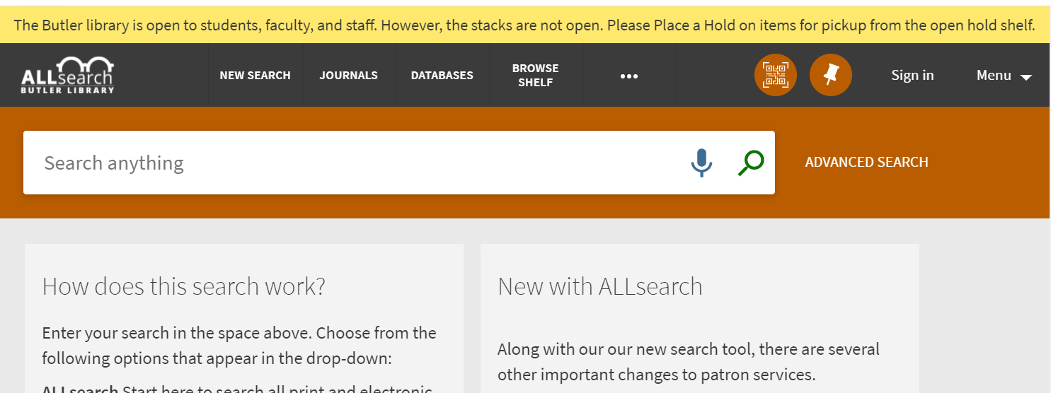
Notify Users in Primo VE
You may want to add a top banner to your Primo VE instance to warn users that the system will be down
Ex Libris Presentation showing how to edit the yellow status bar
SLS FAQ about adding a top notification bar
Ex Libris also suggested adding a footer, but Nancy Babb tested and found that it's too far down the page to be of much use (thanks Nancy!)

Slide 10
Communication Strategy to Campus Offices
Offices to Notify:
  IT helpdesk
  IT office in case scheduled jobs such as SIS loading fails.
  Distance Learning—Primo/Alma may be embedded in LMS

Slide 11
User Experience During Outage
www.suny.edu

Slide 12
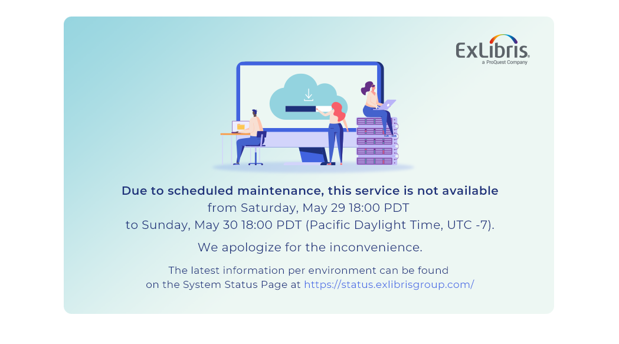
Primo VE & Link Resolver
For most of the outage, users will see a system down message when they try to get to Primo VE from the search widget, direct link, or link resolver
For the last half hour, they'll get a 404 error

Slide 13
Should I make temporary changes with link resolver in e-resources?
A day of downtime for something as important as a link resolver or discovery solution is not something to take lightly.
Removing/modifying your link resolver information in your collections is likely to lead to problems for multiple days after data migration.
Overall, the cost-benefit likely isn't worth making any changes temporarily.
If you're a LibKey library, now would be a good time to try Libkey Link to mitigate issues: https://thirdiron.com/products/libkey-link/

Slide 14
Post-Outage Expectations
www.suny.edu

Slide 15
Jobs, Primo VE speed, etc.
Jobs: when asked, EL told us: "All jobs, will be paused to include jobs that are running while the system is being shut down. Jobs will resume when the system is brought back up to include jobs that scheduled to start during the down time. We don’t see any major issues with backlogs of jobs in the system, there are enough resources to handle the influx of jobs. We will be monitoring jobs and address any issues."
Primo VE: speed has improved since go live due to caching, EL's response to our question about starting back up: "We expect caching to be quick with very little impact on performance."
Submit questions to info@slcny.libanswers.com if you run into any problems

Slide 16


Questions or Discussion?
www.suny.edu

