Slide 1

Implementing Curbside Pickup Services
July 16, 2020
www.suny.edu

Slide 2
Agenda
Implementing Alma’s Request Feature
Processing Requests
Scheduling Pickup Times
Editing Your Hold Notification Email
Self Check Web Applications
How to Get Help
www.suny.edu

Slide 3
Implementing Alma’s Request Feature
Alma’s request feature allows your users to submit requests for items from your collection in Primo
In order to Implement Alma’s Request Feature, you will need to configure:
  Fulfillment Unit On Shelf Request Policy
  Request Terms of Use
  Request Fulfillment Unit Rules
  Display Logic Rules
  Request Link Label (optional)
Roles Needed: Fulfillment Administrator (1-4) and Discovery Administrator (5)
www.suny.edu

Slide 4
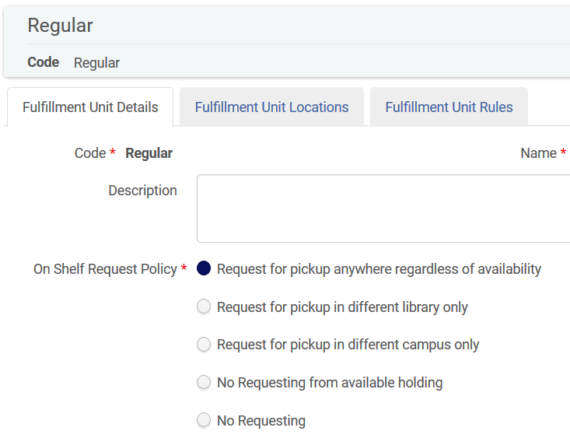
Fulfillment Unit On Shelf Request Policy
On Shelf Request Policy determines:
  whether items can be requested
  where those items can be picked up
Should be set to “Request for pickup anywhere regardless of availability”
Must be configured separately for each Fulfillment Unit
Configured in Fulfillment Unit Details tab
  Configuration | Fulfillment | Physical Fulfillment | Fulfillment Units
https://slcny.libanswers.com/faq/316393
www.suny.edu

Slide 5
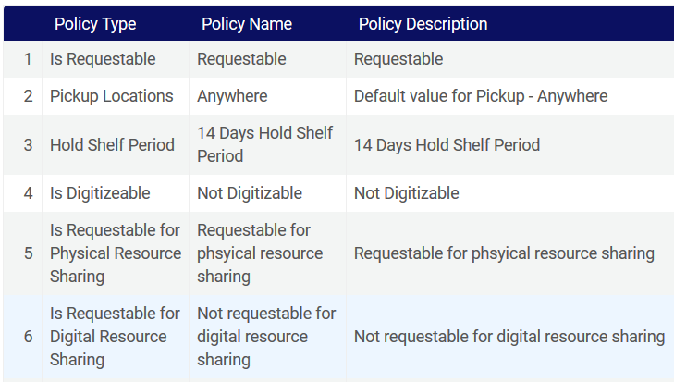
Request Terms of Use (TOUs)
Request TOUs determine:
  whether items can be requested
  where those items can be picked up
Most relevant Fulfillment Policies:
  Is Requestable (Requestable/Not Requestable)
  Pickup Locations (Anywhere/Pickup Only In Owning Library)
Configuration | Fulfillment | Physical Fulfillment
  Advanced Policy Configuration
  Terms of Use and Policies
Fulfillment Policies: https://slcny.libanswers.com/faq/298416
TOUs: https://slcny.libanswers.com/faq/298510
www.suny.edu

Slide 6
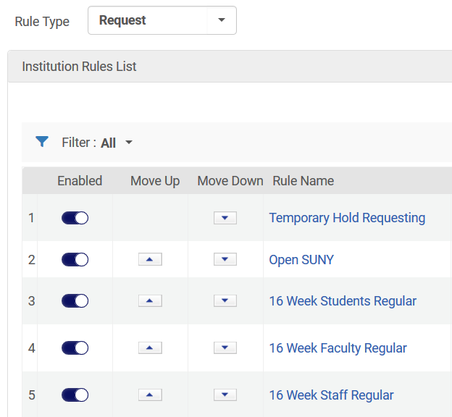
Request Fulfillment Unit Rules
Apply Request TOUs to items within a Fulfillment Unit
Can be applied based on:
  Location
  Material Type
  User Group
Request Fulfillment Unit Rules not applied to a specific User Group will impact resource sharing
  Is Requestable for Physical Resource Sharing
  Is Requestable for Digital Resource Sharing
https://slcny.libanswers.com/faq/301855
www.suny.edu

Slide 7
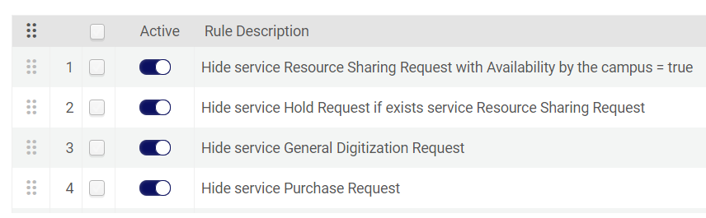
Display Logic Rules
Determine what request options appear in Primo
Check to make sure you’re not hiding the Request link if the item is available
Hide the Request link if the item is unavailable
Configuration | Fulfillment | Discovery Interface Display Logic | Display Logic Rules
https://slcny.libanswers.com/faq/316924
www.suny.edu

Slide 8
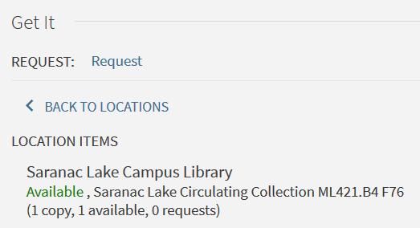
Renaming the Hold Request Link
By default, the hold request link is labeled “Request” in Primo
You may want to change label that so your users have a better understanding of the service you’re providing
Go to Configuration | Discovery | Display Configuration | Labels
Request Options Labels table (#61)
https://slcny.libanswers.com/faq/316435
www.suny.edu

Slide 9
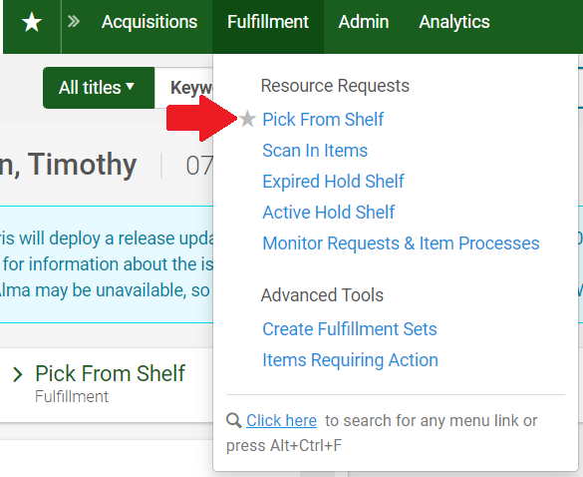
Processing Hold Requests
Processing Hold Requests is very similar to processing Resource Sharing Lending Requests
  Print pull slip from Pick From Shelf list
  Scan In Item
The Ful Hold Shelf Request Slip Letter prints at the circulation desk, and the user is sent the On Hold Shelf Letter
Requests that cannot be filled can be converted into resource sharing requests, marked as missing, or cancelled
https://slcny.libanswers.com/faq/316739
www.suny.edu

Slide 10
Request Configuration & Processing Demo
www.suny.edu

Slide 11
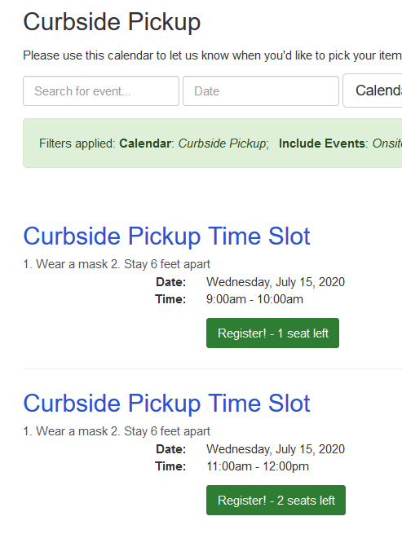
LibCal: Events Calendar Overview
Can create a calendar event for each pickup time slot
  limit number of users who can register
  control when users can register
  send email confirmations and reminders
Configuration is simple but labor intensive
  Creating event templates and repeating events helps!
Simple Interface for Users
www.suny.edu

Slide 12
LibCal: Events Calendar Configuration
Create Registration Form
Create Events Calendar
Edit Confirmation & Reminder Emails
Create Event Template
Create Locations (if necessary)
Use Template to Create Repeating or Single Calendar Events
www.suny.edu

Slide 13
LibCal: Events Calendar Management
Can view users registered for each event
Can send emails to all users registered for an event
Unfortunately, each event must be managed separately
www.suny.edu

Slide 14
Other Scheduling Options
LibCal Seats
  Additional information: https://blog.springshare.com/2020/05/20/using-libcal-to-schedule-curbside-pickup/
  SLSS working with Springshare to schedule a Seats webinar for SUNY in late July
Alma Appointment Scheduler App
  Part of August 2020 release
  SLSS staff will test apps once they are available
  Additional information: https://developers.exlibrisgroup.com/appcenter/
Google Forms
  Free but features are limited
www.suny.edu

Slide 15
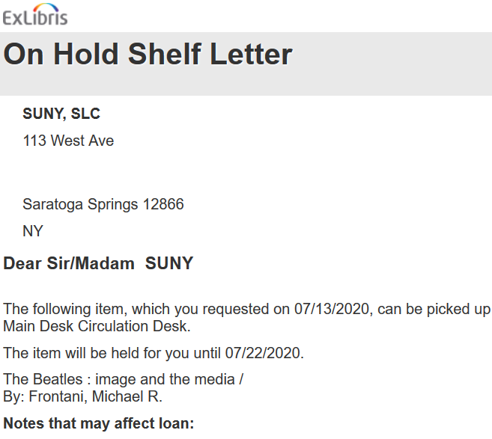
Editing Your Hold Notification Email
When an item is placed on hold, the user is sent the On Hold Shelf Letter
You will want to add curbside pickup instructions and a link to your curbside pickup registration calendar to this letter
Configuration | General | Letters | Letters Configuration
https://slcny.libanswers.com/faq/277717
www.suny.edu

Slide 16
Editing Your Hold Notification Email
<tr><td><b>Please click the following link to schedule a curbside pickup time.</b></td></tr>
<tr><td><b><a href="https://xxx.libcal.com/calendar/curbsidepickup">Schedule a curbside pickup time</a></b></td></tr>
<tr><td><b>When you arrive for your curbside pickup appointment, please call 518-555-5555. Please wear a mask and be prepared to show a photo ID.</b></td></tr>
www.suny.edu

Slide 17
LibCal & Letter Editing Demo
www.suny.edu

Slide 18
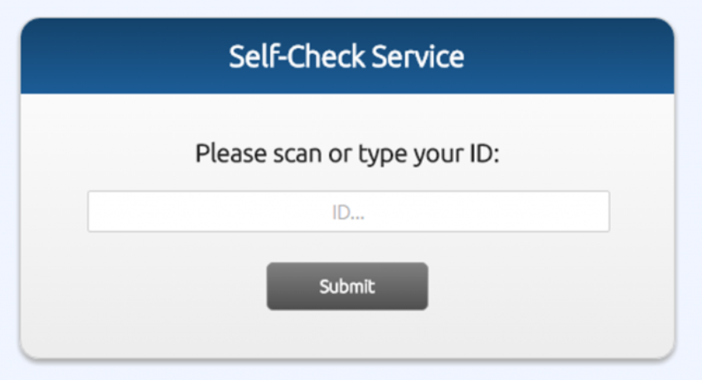
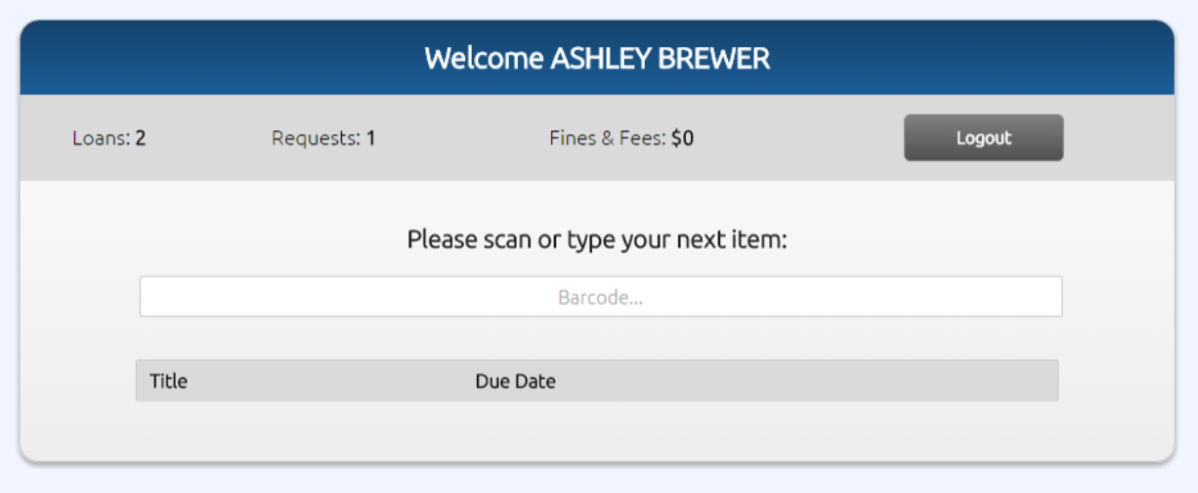
Self Check Web Applications
SLSS has been testing Alma Self Check Web Application
  Additional Information: https://developers.exlibrisgroup.com/blog/self-check-web-based-application/
  Email info@slcny.libanswers.com if you’re interested in implementing this at your library
MeeScan
  Additional Information: https://www.meescan.com/
www.suny.edu

Slide 19
Need Help?
FAQ on Safely Handling Materials
  https://slcny.libanswers.com/faq/313363
SLSS can assist with Alma/Primo configuration
Extended Support Campuses
  Post to your extended support Basecamp
All Other Campuses
  Email info@slcny.libanswers.com
  First hour will not count against your annual 5 hours of SLSS support
FAQ: https://slcny.libanswers.com/faq/316384
www.suny.edu

Slide 20


Questions or Discussion?
www.suny.edu

