Slide 1

SUNY Library Services Update
April 9, 2021
www.suny.edu

Slide 2
SUNY Library Accessibility Cohort
Vendor Repository up to 45 reviews:
https://slcny.libguides.com/vendor_accessibility
Upcoming Accessibility Exception Review Process Overview from SUNY Broome EIT Procurement Committee and EIT Advisory Council members. Thursday, April 15 at 9am. Register here: https://slcny.libcal.com/event/7644424
Working on Procurement Accessibility Toolkit: https://slcny.libguides.com/slss-accessibility/procurement-toolkit

Slide 3


Procurement Update
OCLC
IT Umbrella
Third Iron
CQ Researcher
Springer-Nature
Open Athens

Slide 4
ProQuest ebook ILL pilot
This is a pilot, not a fully-functioning product or service
Workflows in Alma, Primo and eBook Central are all exploratory
Our scope for investigation will not focus on ILLiad, OCLC, or other systems outside of Alma
We plan to collaborate with Cal State System to develop workflows
SLS is investigating the discovery/record management and back-end workflows

Slide 5
SUNY LARS Report
SLS has reached out to Sys. Admin individual in charge of this data gathering.
Will work to investigate how much coordination we can achieve on data gathering.
  Will depend on campus Alma data and cooperation from sys. admin department.
May need some input from campuses and will engage appropriate working group or individuals.

Slide 6
Moses Lake Migration
Some of you received emails a few weeks ago about a potential migration of our Alma/Primo data center.
SLS followed up asking to be notified as plans move forward, especially if the migration moved from “potential” to “planned.”
Received e-mail from ExLibris support today that migration is planned on May 29th.
Meeting with Exlibris on 4/12 to get further information.
Will be sharing details and information to Institutional Leads Workplace Group.

Slide 7
SICAS Banner-Alma Update: Preferred Names
SICAS has developed a beta patch that has some enhancements, most notably, the ability to send the preferred name to Alma.
Getting campuses to test has taken some time, waiting for initial results.
Current version of SICAS application update will only pull from preferred name field located in “SPAIDEN,” (spbpers_pref_first_name).
  Some campuses may not be using this field, and SICAS plans to expand where the preferred name can be pulled from, but not in this version.
SLS is eager to work with campuses on this, and will assist with updating/configuring Alma/Primo VE to accommodate and use preferred names wherever possible. Please reach out if you’re interested.
Training and documentation on these changes will be developed as soon as the patch/version from SICAS can be run successfully at an institution.

Slide 8
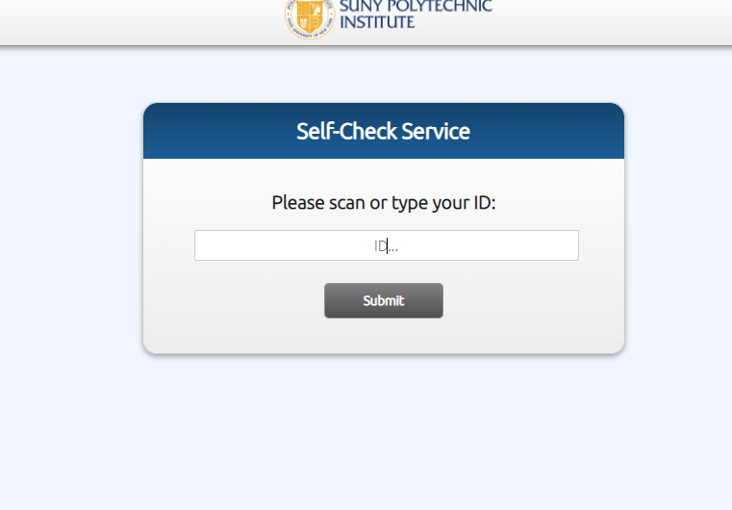
Reminder: Self-Check Web App
Several SUNY libraries have implemented the Self-Check Web App as a limited self-check solution.
If this would be useful to you as your library reopens or changes access, please let us know, and we can set this up for you within a few weeks.

Slide 9

Discovery & E-Resources
Michelle Eichelberger
www.suny.edu

Slide 10
Updates
Direct Linking for NZ-managed and Unpaywall content now working
Keep an eye on CKB Release Notes: https://knowledge.exlibrisgroup.com/Alma/Content_Corner/Release_Notes/2021_Alma_CKB_Release_Notes_January_-_June
  Should also show as changes in your CZ Updates Task List
  Recently removed collections: National Academies Press, Elsevier ScienceDirect Open Access, DTIC is going to be removed, DOAJ no longer tracking coverage dates, etc.

Slide 11
Outstanding Cases
How do embargos work for matching on CDI to decide availability? 00937177
Problems with eBook linking in EBSCO Points of View, Masterfile. 00891959
Unpaywall in Online Service Order – supposed to be fixed in May. 00755746 and 00756319

Slide 12
Training
New IPEDS Dashboard and FAQ:
  FAQ: https://slcny.libanswers.com/faq/339699
  Webinar: https://public.3.basecamp.com/p/sUnEvzZrsb14mxq28oYQzLZB
Advanced SUSHI training coming Wed. April 14, 1pm. Register:
https://slcny.libcal.com/event/7619042
New Ex Libris Primo VE Libguide:
https://exlibris.libguides.com/PrimoVE/Welcome

Slide 13
SUNY Shared Collections
Esta Tovstiadi
www.suny.edu

Slide 14
Expanding System-wide Library Content Agreements
7 IFB awardees moving to contracts
  Oxford miscommunicated the contingencies of their pricing proposal and withdrew, but we hope to develop a system-wide agreement after the IFB
ProQuest, JSTOR and Chronicle of Higher Education on recharge
Indirect Cost Recovery (Direct/Recharge Fee) lowered to 2.69% (estimate provided was 3.33%)
Participation in offers varied:
  CHE: ~40
  JSTOR: ~38
  ProQuest: ~32

Slide 15
eBook Central DDA Pilot
Cohort A (6 campuses):
Total spent: $13,553.67 (41% of total budget)
  Titles purchased: 60 (about 11% of pool; 68 total titles accessed)
Cohort B (14 campuses):
  Total spent: $4,114.77 (25% of total budget)
  Titles purchased: 7 (about 12% of pool; 25 total titles accessed)
New titles added monthly

Slide 16
SUNYConnect
The SUNYConnect EBSCO databases come up for renewal June 30, 2022
In the following months SLS will be working with stakeholders to assess this collection and make recommendations
More information on this project will be forthcoming

Slide 17
Other updates
STAT!Ref renewal coming up (August 1 renewal date)
  Currently a pricing agreement with no central license.
  Investigating most beneficial way to handle this renewal moving forward
Reminder about ATIS portal
  Pricing information
  Contact Sarak K. (Sarah.Kruzinski@suny.edu ) if you need access to this portal
SLS Collections Portal
  https://slcny.libguides.com/collections
  Password-protected; contact info@slcny.libanswers.com if you need the password

Slide 18
Resource Management
Maggie McGee
www.suny.edu

Slide 19
Analytics Training Schedule
The SLS is developing an analytics training schedule to coincide with the needs of SUNY Libraries
Areas of analytics training may include, but not limited to:
  Annual reports
  Renewals
  Clean-up projects
  Course Reserves

Slide 20
Shelf Inventory App Initiative
The SLS has been testing Purdue's Shelf Inventory App in conjunction with Alma's Shelf Report
Training was slated for mid-March, but issues on the sunyconnect server has prevented this from taking place
ITEC is investigating the issue on the sunyconnect server
Training will be announced and rescheduled once the issue has been resolved

Slide 21
Label Printing App Initiative
The SLS is testing Ex Libris' SpineOmatic cloud App and the Orbis Cascade Label Printer Cloud App
The SLS is working directly with Ex Libris on SpineOmatic improvements
A Training session will be scheduled and announced within the next month

Slide 22
Removing Foreign Language & Fast Subject Heading Initiative
MSP-59: Remove 6XX fields with $$2 containing foreign language and fast subject headings from Network Zone records to improve discoverability in Primo VE
The initiative was delayed due to an issue with how the OCLC Network Zone integration profile applying the normalization rule to remove foreign language and fast subject headings
Implementation of the project will begin May 2021 starting with the Network Zone
Implementation for SUNY institutions will begin after the Network Zone implementation has completed
  Institutional and Cataloging Leads will be contacted prior to changes being made to their Alma environment

Slide 23
Upcoming: Brief Level Rules Initiative
OCLC is updating their encoding level (LDR 17) to adhere to MARC21 standards
January 2021 OCLC began converting encoding level K to level 7
The SUNY Metadata Standards & Policies Working Group will amend MSP-42 to adhere to MARC21 standards and move from 10 brief levels to 4 brief levels
SUNY Brief Level Rules changes will be applied to the Network Zone and to Institution Zones
Institutional and Cataloging leads will be contacted prior to SUNY Brief Level Rules being applied to their Institution Zone only records

Slide 24
Physical Title Indexing issues
SUNY institutions are reporting potential indexing issues for physical titles
The SLS is working with Ex Libris to address this and other indexing issues
There are no tools to identify indexing issues in Alma/Primo VE
  Rely on institutions to report the indexing issues
Check physical titles in Primo VE after receiving
  Wait 15-30 minutes to allow for indexing
  View the title in Primo VE:
    Using "Display in discovery"
      Click "Display Source Record" from the full record view
      If "Record ID alma991011901639704801 was not found" displays, the record has not been indexed
    Search Primo VE directly or from the Discovery widget on the Alma landing page
Report indexing issues
  Open a case in Salesforce
  Report the indexing issues to info@slcny.libanswers.com with the case number

Slide 25
Resource Sharing
Timothy Jackson
www.suny.edu

Slide 26
Resource Sharing Statistics – March 2021
Book Fill Rates:
  All SUNYs: 65.3% (n = 1,378)
  Community Colleges: 76.2% (n = 105)
  Comprehensive & Tech Colleges: 68.1% (n = 686)
  University Centers: 60.1% (n = 590)
Higher fill rates likely result of locate process changes and adding Ithaca College to our rotas
Book Turnaround Time: 7.7 days
Article Fill Rate: 91.8%
Article Turnaround Time: 1.7 days

Slide 27
Binghamton Collection Shift
500,000 items in HN-Z call number range being moved to off-site storage
Shift scheduled to start next week, and all items will be inaccessible by late May or early June
Items should be accessible again in early 2022
This shift will have a significant impact on Binghamton's ability to fill lending requests, and it will also increase their borrowing volume
May have noticeable impact on lending volumes at other SUNYs
SLS will monitor request volumes and work with Binghamton on rota adjustments to make sure requests are as evenly distributed as possible
Email info@slcny.libanswers.com if you notice problematic lending volume spike at your library

Slide 28
Alma Resource Sharing With Non-SUNY Libraries
Alma RS with Ithaca College has been expanded to include articles
  Participating libraries: Empire State, Tompkins-Cortland, Cayuga, Jefferson, Westchester
Still working with Nazareth College, Union College, and St. John Fisher on Alma RS
  Physical RS only
  Hope to go live this summer
Empire State College now lending articles to Tunxis Community College (CSCU)
  Plan to expand Alma article RS between SUNY and CSCU
Testing Alma RS between SUNY and WRLC
  Physical RS only
  SUNY Participants: Albany, Buffalo, Stony Brook
  WRLC Participants: American University, George Washington University, and Marymount University
  Hope to go live later this spring and eventually expand to include more participants
Discussing an Alma RS pilot project with Cal State system and Brandeis University

Slide 29
Lost Resource Sharing Items
Approximately 560 items are currently meet the criteria for being declared lost
  Lost criteria: 120+ days overdue or 30+ days in transit
Number of lost items was more than 700 last month
Next steps:
  SLS will send lists of in transit items that need shelf checks to campuses
  SLS will send list of in transit items still missing to ELD
Configuring Overdue and Lost Loan Profiles for RS loans:
  https://slcny.libwizard.com/f/OverdueRS
SLS will work with ASRS, LSP Advisory Board, and SLC Board on specifics of lost Alma RS billing policy
Please refrain from billing for lost Alma RS items for the time being

Slide 30
Automated Fulfillment Network Project
Moving forward with modified project scope
  Implement return anywhere for all SUNY libraries
  Implement hold request pickup at other SUNYs for interested libraries
  RS request pickup at other SUNYs will not be implemented
AFN meeting #4 scheduled for 2:00pm on Monday, April 12
  https://slcny.libcal.com/event/7649013
SLS staff will begin work on implementing return anywhere this week
  Configuring Institutions Relations table in each SUNY Institution Zone (approx. 3,500 table entries)
  We will contact each library after this work has been done
  Plan to be finished by early May
  Thanks Susan and Yvonne!

Slide 31


Questions or Discussion?
www.suny.edu

