Slide 1
Unpaywall & CZ Update Tasks List
Why knowing about both things can make your Primo life better
Michelle Eichelberger Discovery and E-Resources Program Manager
Michelle.Eichelberger@suny.edu

Slide 2
Unpaywall

Slide 3
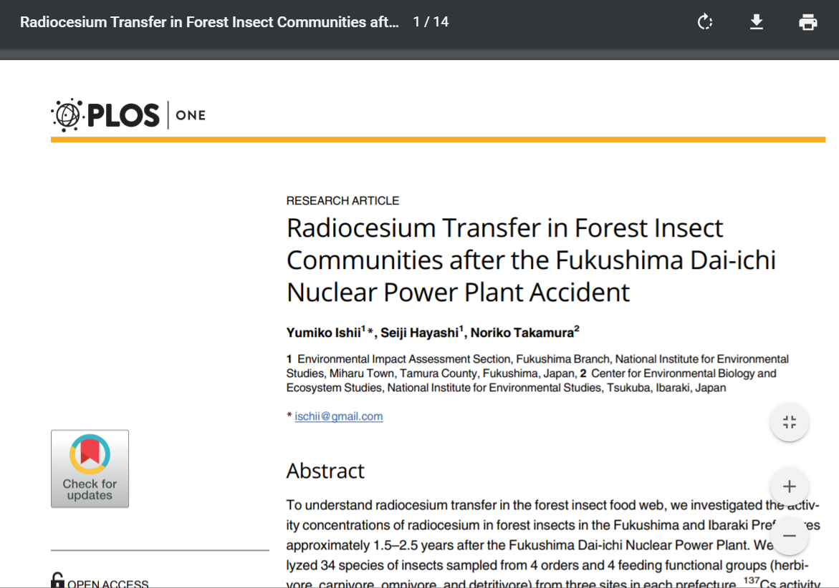
Unpaywall
https://unpaywall.org/
"We harvest Open Access content from over 50,000 publishers and repositories, and make it easy to find, track, and use."
Now part of Alma/Primo as of November 2019 release, Alma Link Resolver for Unpaywall
Good Basecamp discussion about it, thanks to Nancy Babb & Brenden McCarthy for posts
Why should you care? If you activate it, it will improve or fix your Open Access linking, leading to less patron frustration.

Slide 4
Activating Unpaywall: Ex Libris Release Notes
New for November! A new link resolver service for Unpaywall Open Access articles is available. To enable the service, set the enable_open_access_services_from_unpaywall_api customer parameter to true (see enable_open_access_services_from_unpaywall_api in Configuring Other Settings (Fulfillment).
Where the open access information is placed can be configured in the Online Services Order configuration (Configuration Menu > Fulfillment > Discovery Interface Display Logic > Online Services Order). See the section Configuring the Order of Online Services for more information. The default placement of the open access information is at the end.
Open access rules can be configured to specify what appears or is hidden based on open access. See Configuring Display Logic Rules for more information.
Direct linking for open access can also be configured. See Configuring Direct Linking for more information.

Slide 5
Activating Unpaywall: Mapping Table
Fulfillment > General > Other Settings
Scroll down to enable_open_access_services_from_unpaywall_api
Click three dots to edit, change false to true and save

Slide 6
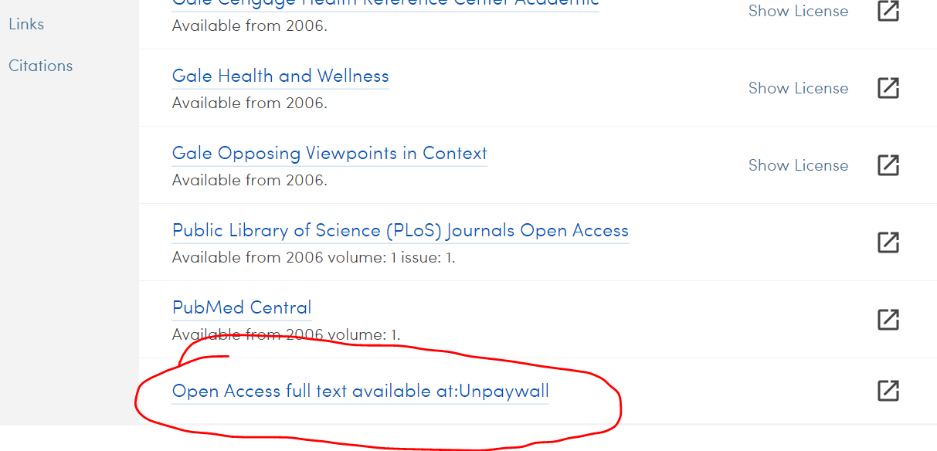
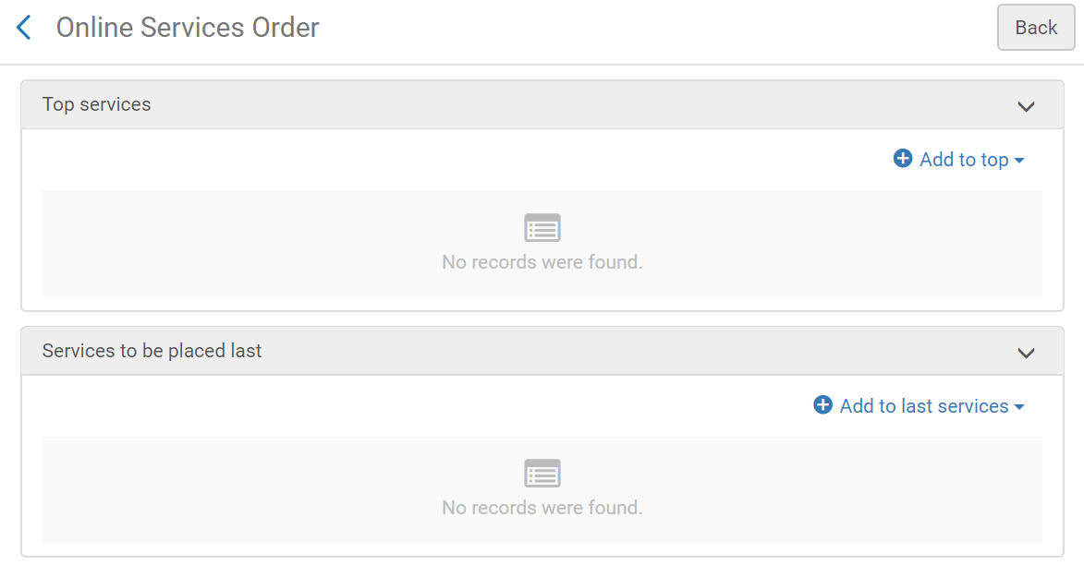
Activating Unpaywall: Order of Services
Defaults to display at the end of the list of services but you can push it higher in the list by using Online Services Order configuration (Configuration Menu > Fulfillment > Discovery Interface Display Logic > Online Services Order)

Slide 7
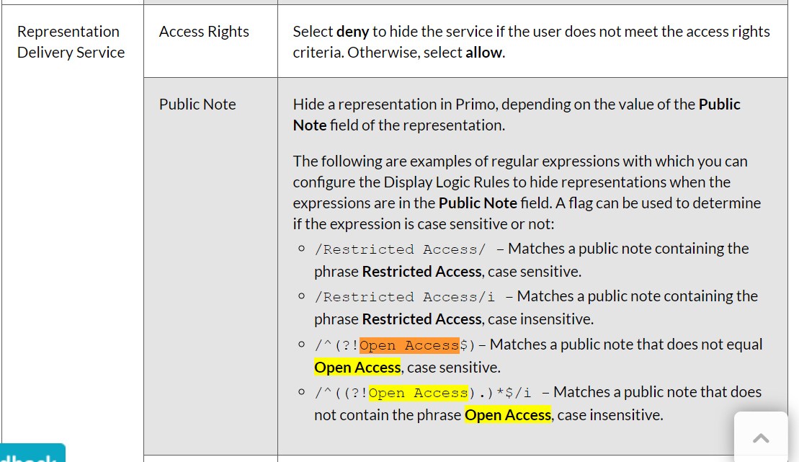
Activating Unpaywall: Display Logic
Can also use Display Logic to hide or display Open Access content (Configuration Menu > Fulfillment > Discovery Interface Display Logic > Display Logic Rules)
May be way to hide if you have licensed content available

Slide 8
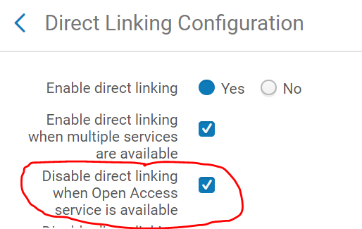
Activating Unpaywall: Direct Linking
Can adjust your direct linking to not link directly if first link is Open Access, can do this to avoid bad OA links (Configuration Menu > Fulfillment > Discovery Interface Display Logic >Direct Linking)
Note that this direct linking option will only show if you changed your mapping table Enable Open Access (slide 5) to true

Slide 9
Community Zone Updates Task List

Slide 10
CZ Updates Task List
Why should you care?
The Alma Community Zone (CZ) Updates Tasks job keeps your title coverage, linking, record info, etc., up to date = good
The CZ Updates Task job gets rid of outdated titles that the vendor no longer owns
Good if it's an "automatically activate new titles" aggregator package
Bad if it's a selective package – can't automatically activate the title replacement, if there is one
Selective packages: The system is smart enough to know your activated titles, and will make changes to them including deactivating them. But, it's not smart enough to know which titles you might want to activate to replace the deactivated titles. E.g. GVRL, STAT!Ref, etc.
The only way you'll know if a title or collection has been deactivated is if you keep an eye on the CZ Updates Task List, or if someone complains

Slide 11
CZ Updates Task List: How to Monitor
Make sure that you've got the Repository Manager role
Look in the Alma header under Resources->Manage Inventory.
Don't have to check the list daily, weekly or monthly would be good. You can set a calendar reminder.
Filter by the most important types of actions: Electronic collection deleted, portfolio deleted, and electronic service deleted.
When you see something that has been deleted, you will need to take action to reactivate it in a new collection, service, or portfolio.
Ex Libris documentation

Slide 12
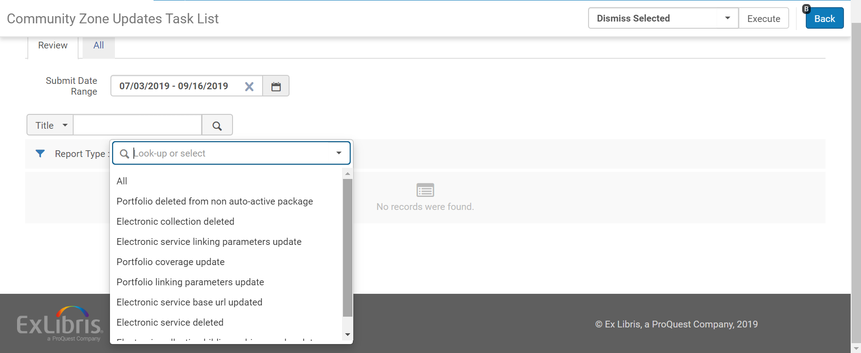
CZ Updates Task List: How to Monitor

Slide 13
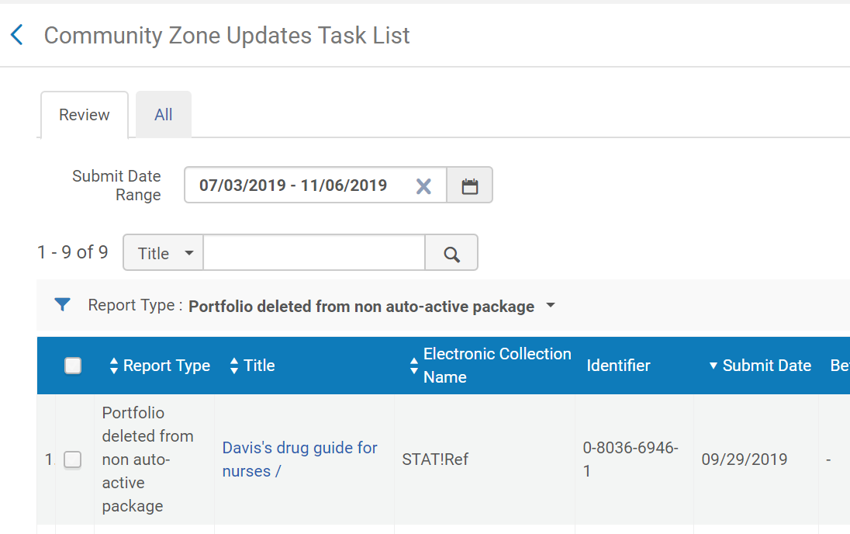
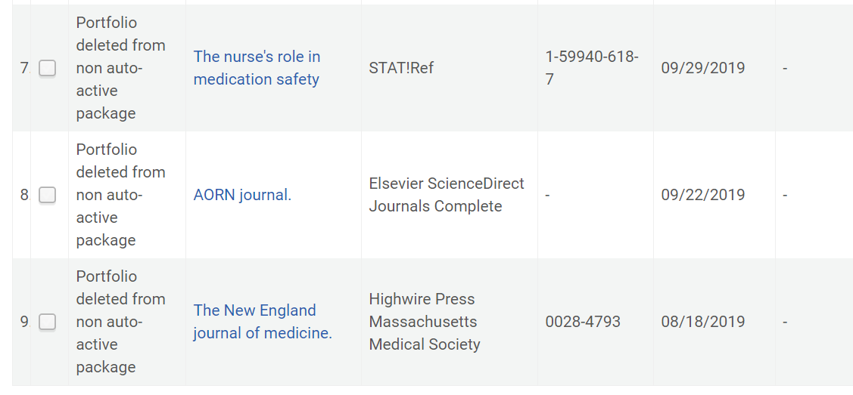
SUNY Examples

