Slide 1
Luxembourg’s Future Skills Initiative
& sector-level studies

Slide 2
Future Skills Initiative
ADEM supports the anticipation and development of future skills, with the aim of employment preservation.
Upskilling and reskilling of jobseekers
Supporting companies in upskilling and reskilling of employees
Analysis & studies of evolution in sectors, jobs and skills
via:

Slide 3





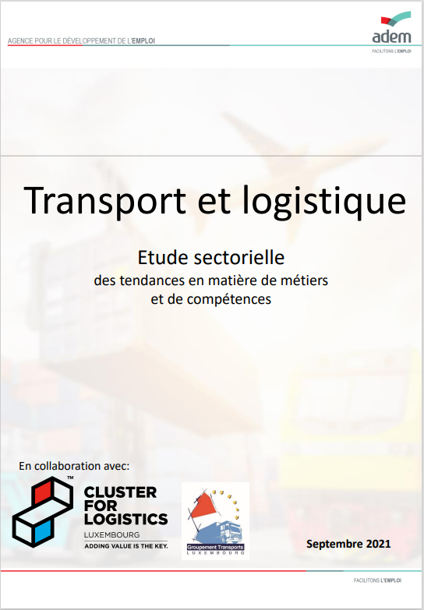

Analysis & studies of evolution in sectors, jobs and skills
Sectoral studies
Analysis of trends in occupations (growth, decline, emergence, shortage) and skills (demand & evolution)
7 sectors covered so far
In collaboration with employer federations
Using various approaches: statistical analysis, qualitative exchanges, text mining of vacancies
https://adem.public.lu/en/employeurs/futureskills/etudes-sectorielles.html

Slide 4

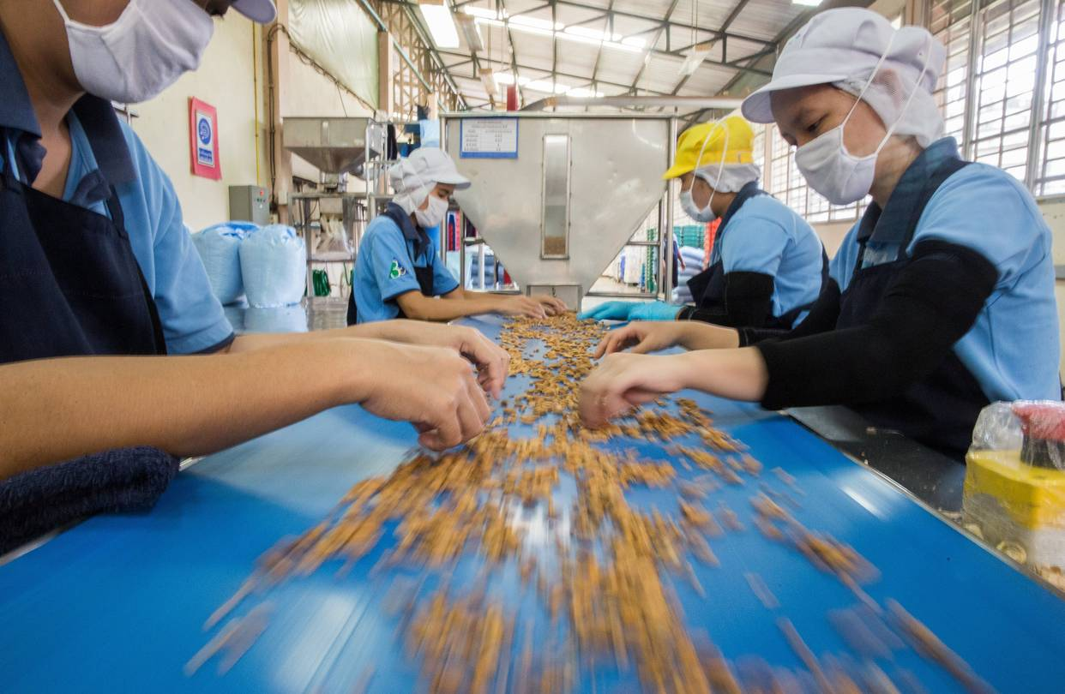

Analysis & studies of evolution in sectors, jobs and skills
ANALYSIS OF OCCUPATIONS - CONCLUSIONS
Growing occupations
Declining occupations
Emerging occupations
Shortage occupations
Surplus occupations
Very diverse occupations (very qualified & less qualified),
due to sector growth (construction, asset management…) or due to specific trends (IT, project management, financial regulation, home delivery)
Less cases than for growing occupations, due to automation & digitalization (administrative operations, simple client service transactions, routine manual work…)
Linked to technological trends (e.g. cloud architects, cybersecurity), environmental trends (e.g. reuse of materials, disassembly, HSE, sustainable finance…) and societal trends (e.g. baristas)
Highly qualified occupations (IT developers, lawyers…) and craft/trade occupations (butchers, electricians …)
Less qualified occupations and administrative occupations – there may still be a skills shortage!

Slide 5
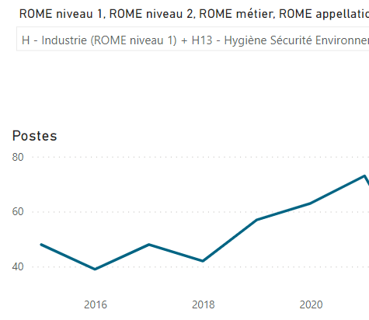
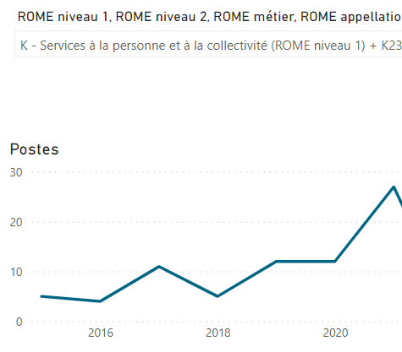
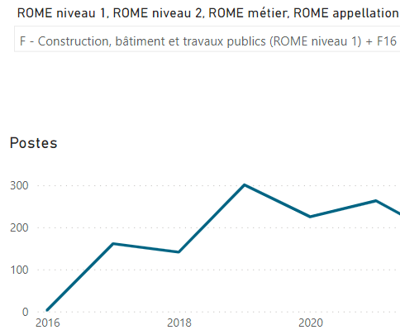
H13 – HSE experts
K2304 – industrial product revalorization
F1603 – thermic installation incl. solar/pv pannels
http://emdwh-pbi-p/bireports/powerbi/ADEM/R79383%20-%20Analyse%20des%20offres?RS:EMBED=TRUE

Slide 6
Analysis & studies of evolution in sectors, jobs and skills
ANALYSIS OF SKILLS - CONCLUSIONS

Slide 7
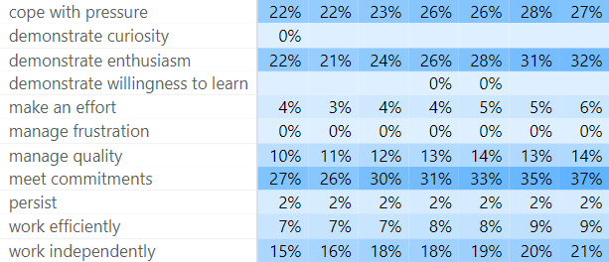
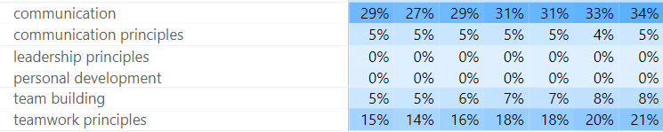
Analysis & studies of evolution in sectors, jobs and skills
ANALYSIS OF SKILLS - CONCLUSIONS
Use a computer
Using digital tools for collaboration and productivity
Managing and analysing digital data
Database and network design and administration
Software and applications development and analysis
Adapt to change
Cope with pressure
Demonstrate enthusiasm
Assume responsibility
Work independently
Think creatively
Solving problems
Communication
Working in teams
Listening an asking questions
Project management
Manage time
Perform planning
Manage quality
Complying with legal and organisational guidelines
Digital skills
Skills with strongest growth
→ transversal skills
Personal skills
Social skills
Management skills
Compliance skills
Notes:
Future: link skills to newly developed green label by escp

Slide 8
Analysis & studies of evolution in sectors, jobs and skills
USE OF THE SECTORAL STUDIES
Adapting training strategy and offer
Guidance of jobseekers
Input for upskilling/reskilling pathways (for modular training programme, for workforce planning programme)
National skills strategy & Talent attraction strategy

Slide 9
Questions?
Inès Baer
Head of data, statistics and lbour market studies
ines.baer@adem.etat.lu
T: +352 247-61691

