Slide 1
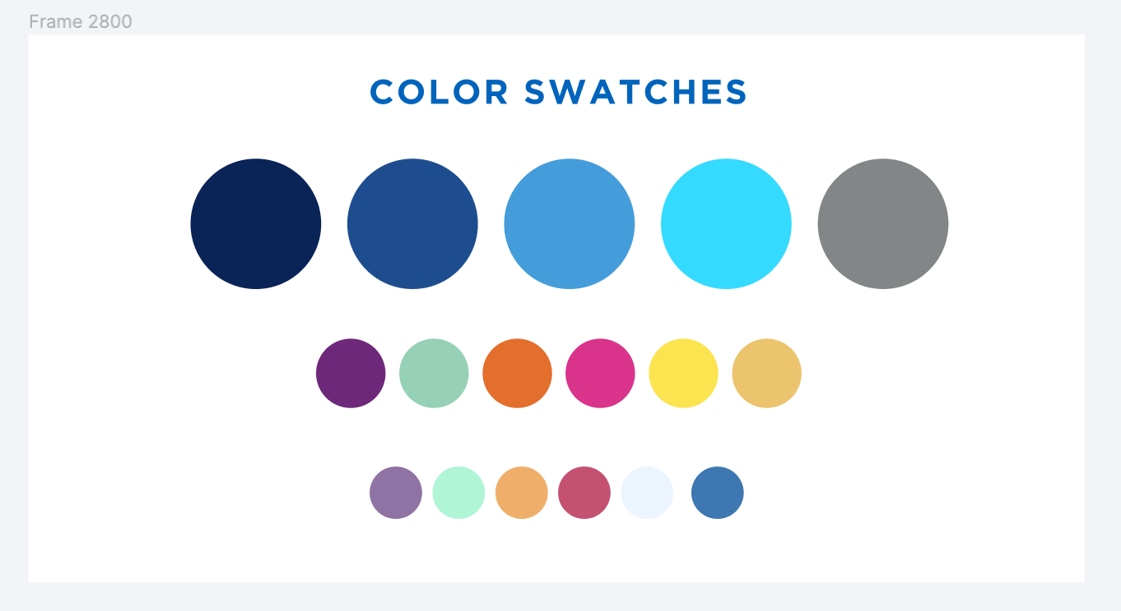
New Alma Borrowing and Lending Request List Interface
October 19, 2022

Slide 2
Agenda
Timeline of changes to borrowing and lending request list interface
How to opt in and out of new interface
Major differences between old and new interface
Known issues with new interface
Demo of new interface

Slide 3
New Alma Borrowing and Lending Request List Interface Timeline
August 2022: Ex Libris included a new interface for the borrowing and lending resource sharing request list interfaces in the Alma update
You currently need to opt in to use the new interface
November 2022: The new interface will become the default interface for all users once the November Alma update is released
You’ll be able to opt out of the new interface until February 2023
February 2023: The old interface will no longer be available once the February 2023 Alma update is released
All SLS resource sharing FAQs will be updated by February 2023

Slide 4
New Alma Borrowing and Lending Request List Interface
Tasks widget on the main Alma page has not been changed
General layout of borrowing and lending requests lists hasn’t changed significantly
Facets still on left and requests still on right
New borrowing and lending request list interface is designed to be less clicky
Clicking on a request will open a new window within same browser page, so need to navigate between pages greatly reduced
Modeled after Rapido’s borrowing and lending request list interface

Slide 5
Opting In to the New Interface
Opt-In Process:
Click person icon
Click “Feature Rollout Configuration”
Slide “Turn on new layout” button to right
You can opt back out using this same process
Opting in and out of the new interface will not impact other Alma users at your institution
FAQ: https://slcny.libanswers.com/faq/377271

Slide 6
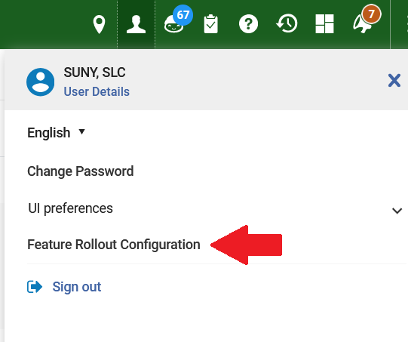
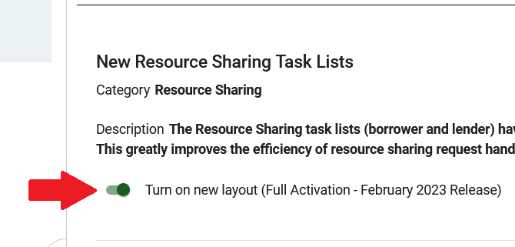
Opting In to the New Interface

Slide 7
Major Differences Between Old and New Interfaces
Request search function added to interface
Activity Status dropdown has been removed
Activity Status now included in Facets
Facet set to “Active” by default when you go to borrowing or lending request list
Removing “Active” facet causes all requests still in Alma to appear in request list
You had to actively search for specific requests in old interface
Requests that have been cleaned up by the Resource Sharing Completed Request Cleanup Job will not appear
Information about cleaned up requests still in Analytics

Slide 8
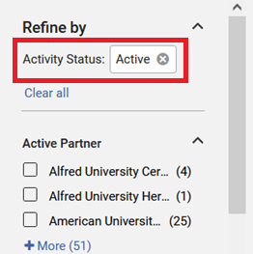
Major Differences Between Old and New Interfaces
OLD
NEW

Slide 9
Major Differences Between Old and New Interfaces
Assigned to Me, Unassigned, and Assigned to Others tabs have been removed
Assignee is now a facet
Assignee is at bottom of facet list, so it is easy to miss
Request assignment functionality has not changed
If you would like to turn off automatic request assignment features, go to Configuration | Fulfillment | General | Other Settings and change the following settings to “true”
rs_disable_borrowing_auto_assign
rs_disable_lending_auto_assign

Slide 10
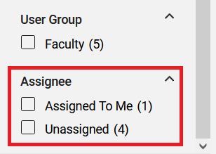
Major Differences Between Old and New Interfaces
OLD
NEW

Slide 11
Major Differences Between Old and New Interfaces
You can now view and edit requests without navigating away from the request list
Clicking on a request will display additional information to the right
General request info (External ID, partner, etc.), citation information, notes/alerts
Citation information can be edited from this view
You can still use the Edit function to see additional information (request history, rota) and edit non-citation information (requester, pickup location)
The Edit function now opens a new window on the right rather than opening an entirely new page

Slide 12
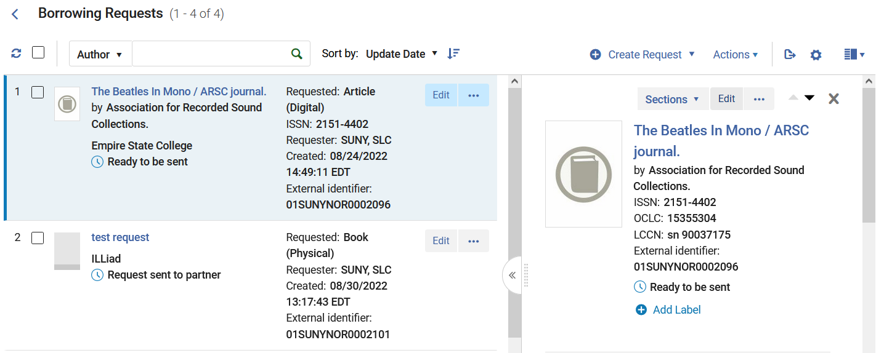
Major Differences Between Old and New Interfaces

Slide 13
Major Differences Between Old and New Interfaces
Custom request label feature added to new request list interface
Labels must be a single word
You can add multiple labels to a request
Labels are a facet
Could potentially be used like ILLiad’s custom queue feature
Manage Labels function in Action menu does not work reliably
Much easier to add labels once you open a request
Unable to remove labels from label list once they’ve been created
Submitted case to Ex Libris (case # 06534721)
FAQ: https://slcny.libanswers.com/faq/378331

Slide 14
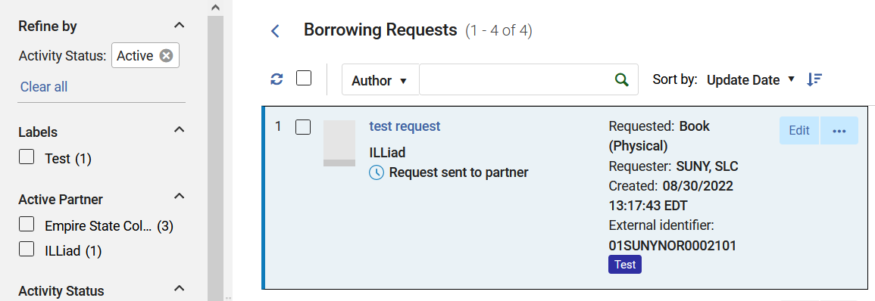
Major Differences Between Old and New Interfaces

Slide 15
Other Differences Between Old and New Interfaces
Refresh function has been moved and switched from a link to a button
Select All function no longer has a label (it’s just a checkbox)
Remove Request and Change Status are now in the Action dropdown
Manage Fulfillment Options function has been renamed
Print Items: Create Move Request & Create Digitization Request
Digital Items: Download Electronic Resource
Alma now adding alerts to requests to lending requests when move requests are created and completed
Alerts are pointless and can be ignored
Submitted case to see these alerts can be suppressed (case # 06532597)

Slide 16
Known Issues with New Interfaces
Date facets (Creation Date, Update Date, Due Date) do not work
Submitted case to Ex Libris (case #06532268)
Reports of new search function not returning correct results
Problem seems to be intermittent
Trying to document problem so we can submit a case
Article titles much more difficult to copy
Have to open the request before you can copy article title
Suggest using the Download Electronic Resource function

Slide 17
Known Issues with New Interfaces
If you notice a problem with the new interface, please submit a ticket to info@slcny.libanswers.com
Please provide specific examples of problem
Document problem as thoroughly as possible
SLS will submit a case on SUNY’s behalf

